Slide 1
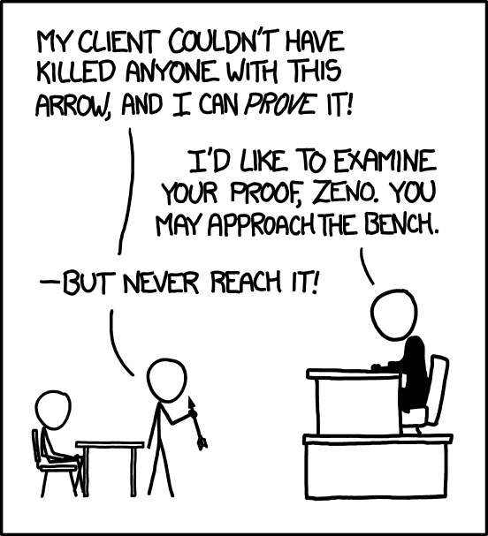
Propositional Logic
Mathematical Foundations
CS51 – Spring 2026
https://xkcd.com/1153/
https://www.explainxkcd.com/wiki/index.php/1153:_Proof
Notes:
Today open’s a new chapter in our class, that of mathematical foundations of computer science.

Slide 2
Abstraction
Critical technique for managing complexity. We will simplify and generalize information by hiding details when they are not important. This allows us to cultivate a higher level of understanding without being overwhelmed with insignificant details.
High level of abstraction
Applications
Algorithms and data structures
Programming languages
Software
Operating system
Architecture
Integrated circuits
Hardware
Low level of abstraction
Physical components, e.g., transistors
Notes:
Throughout this class, we have talked about the important concept of abstraction which allows us to handle the complexity of modern computer systems. Abstraction looked like a tower, where each layer depends on the previous one. So far, we have focused on the lower half of that tower, mostly on the physical side of computer systems, but we have also seen how they are related to a mathematical side of computer science through their affinity with Boolean Algebra. Today, we will start a new chapter in the course that will allow us to not blindly trust that something works, be it the layers in the tower of abstraction or the functions in the programs we have built, but prove that it will work as intended.

Slide 3
Proofs
Proofs are mathematical techniques that will allow us to demonstrate the truth of a claim, starting with certain assumptions and using logical reasoning to reach the conclusion while leaving no doubt to us or the reader of our proof.
  For example, the claim might have to do about the correctness or efficiency of an algorithm or circuit we designed to solve a problem.
Proofs have both practical implications as they reduce bugs and theoretical implications as they give us insights into structural aspects of problems we try to tackle.
Proofs demonstrate that a statement is true for all possible cases. This contrasts “good-enough” experimental approaches where we just try a few cases.
Notes:
Proofs are mathematical techniques that will allow us to demonstrate the truth of a claim, starting with certain assumptions and using logical reasoning to reach the conclusion while leaving no doubt to us or the reader of our proof. For example, the claim might have to do about the correctness or efficiency of an algorithm we designed to solve a problem. Proofs have both practical implications as they reduce bugs and theoretical implications as they give us insights into structural aspects of problems we try to tackle.
Proofs demonstrate that a statement is true for all possible cases. This contrasts “good-enough” experimental approaches where we can try a few cases and call it a day.

Slide 4
Logic
We are familiar with the concept of truth and falsity, both through Boolean algebra and working with circuits.
A lot of what we have been learning falls under Logic, the study of truth and falsity, of theorems, and proofs.
Logic is the foundation of all computer science. It’s behind the programs we write and behind the gates we connect to build circuits.
Many types of logic. We will focus on propositional logic.
Notes:
So far, we have been working a lot with the concept of truth and falsity, be it through Boolean algebra or circuits. A lot of what we have been learning so far falls under Logic, the study of truth and falsity, of theorems and proofs. Logic is the foundation of all computer science. It’s behind the if statements or the while loops we write or any program really. It’s behind the gates and wires that act as physical manifestation of logical operations we apply on signals that represent information. There are different types of formal logic (we care about the form of the arguments rather than the content). We will focus on propositional logic but if you continue in more advanced CS classes you will encounter more of them, such a predicate logic.

Slide 5
Propositions
A proposition is a statement that is true or not. For example,
  “CS51 has an enrolment of 47 students.”
  “Pomona College is the founding college of the Claremont Colleges Consortium.”
For a particular proposition p, the truth value of p is its truth or falsity. The truth values for those statements are false and true, respectively.
Propositional logic is the study of propositions, including how to formulate statements as propositions, how to evaluate whether a proposition is true or false, and how to manipulate propositions.
Notes:
A proposition is a statement that is true or not. For example, the statements “CS51 has an enrolment of 47 students” and “Pomona College is the founding college of the Claremont Colleges Consortium” are both propositions. For a particular proposition p, the truth value of p is its truth or falsity. The truth values for those statements are false and true, respectively. Propositional logic is the study of propositions, including how to formulate statements as propositions, how to evaluate whether a proposition is true or false, and how to manipulate propositions.

Slide 6
Atomic propositions
An atomic proposition is a proposition that is conceptually indivisible. It is also known as a Boolean variable. For example:
  “Pomona College’s mascot is Cecil the Sagehen.”
Practice Time: Can you come up with an example of an atomic proposition?
Notes:
An atomic proposition is a proposition that is conceptually indivisible. It is also known as a Boolean variable. We cannot break it further. For example, "Pomona College’s mascot is Cecil the Sagehen."
Can you come up with your own examples for atomic propositions?

Slide 7
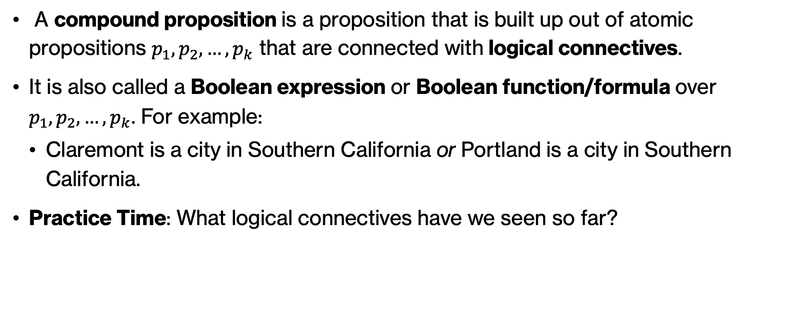
Compound propositions
A compound proposition is a proposition that is built up out of atomic propositions $p_{1}, p_{2}, …, p_{k}$ that are connected with logical connectives.
It is also called a Boolean expression or Boolean function/formula over $p_{1}, p_{2}, …, p_{k}$. For example:
  Claremont is a city in Southern California or Portland is a city in Southern California.
Practice Time: What logical connectives have we seen so far?
Notes:
A compound proposition is a proposition that is built up out of k atomic propositions p1, p2, …, pk that are connected with logical connectives. It is also called a Boolean expression or Boolean function/formula over p1, p2, …, pk. For example: "Claremont is a city in Southern California or Portland is a city in Southern California." The two atomic propositions are p1="Claremont is a city in Southern California", p2=Portland is a city in Southern California" and are connected with an the logical connective or. What logical connectives have we seen so far?

Slide 8

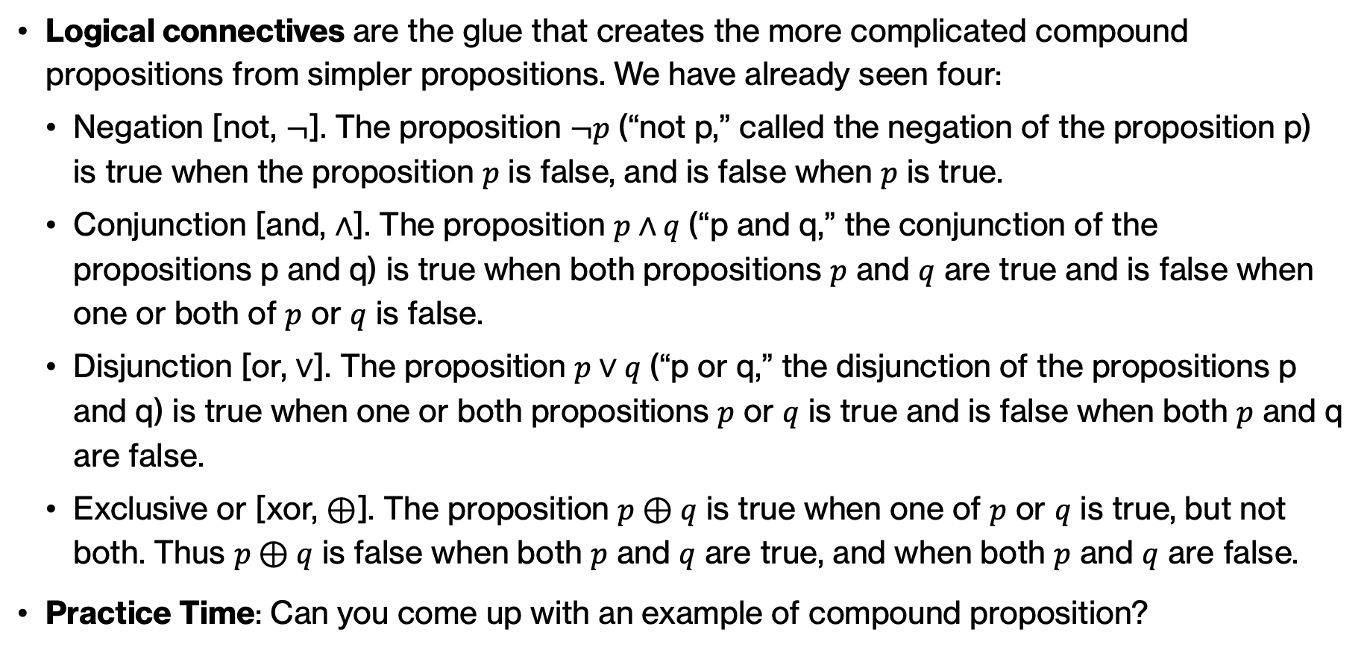
Logical connectives we have seen: $¬,∧,\text{∨}\text{,}\text{⊕}$
Logical connectives are the glue that creates the more complicated compound propositions from simpler propositions. We have already seen four:
  Negation [not, $¬$]. The proposition $¬p$ (“not p,” called the negation of the proposition p) is true when the proposition $p$ is false, and is false when $p$ is true.
  Conjunction [and, $∧$]. The proposition $p∧q$(“p and q,” the conjunction of the propositions p and q) is true when both propositions $p$ and $q$ are true and is false when one or both of $p$ or $q$ is false.
  Disjunction [or, ∨]. The proposition $p∨q$(“p or q,” the disjunction of the propositions p and q) is true when one or both propositions $p$ or $q$ is true and is false when both $p$ and q are false.
  Exclusive or [xor, ⊕]. The proposition $p⊕q$ is true when one of $p$ or $q$ is true, but not both. Thus $p⊕q$ is false when both $p$ and $q$ are true, and when both $p$ and $q$ are false.
Practice Time: Can you come up with an example of compound proposition?
Notes:
Logical connectives are the glue that creates the more complicated compound propositions from simpler propositions. We have already seen quite a few:
i) Negation [not, ¬]. The proposition ¬p (“not p,” called the negation of the proposition p) is true when the proposition p is false, and is false when p is true.
ii) Conjunction [and, ∧]. The proposition p ∧ q (“p and q,” the conjunction of the propositions p and q) is true when both of the propositions p and q are true, and is false when one or both of p or q is false. Be careful to not confuse it with the bitwise xor operation in Python.
iii) Disjunction [or, ∨]. The proposition p ∨ q (“p or q,” the disjunction of the propositions p and q) is true when one or both of the propositions p or q is true, and is false when both p and q are false.
iv) Exclusive or [xor, ⊕]. The proposition p ⊕ q is true when one of p or q is true, but not both. Thus p ⊕ q is false when both p and q are true, and when both p and q are false.
Unfortunately, the word “or” in English can mean either inclusive or exclusive or, depending on the context in which it’s being used. When you see the word “or,” you’ll have to think carefully about which meaning is intended.
Can you come up with your own examples for compound propositions?

Slide 9
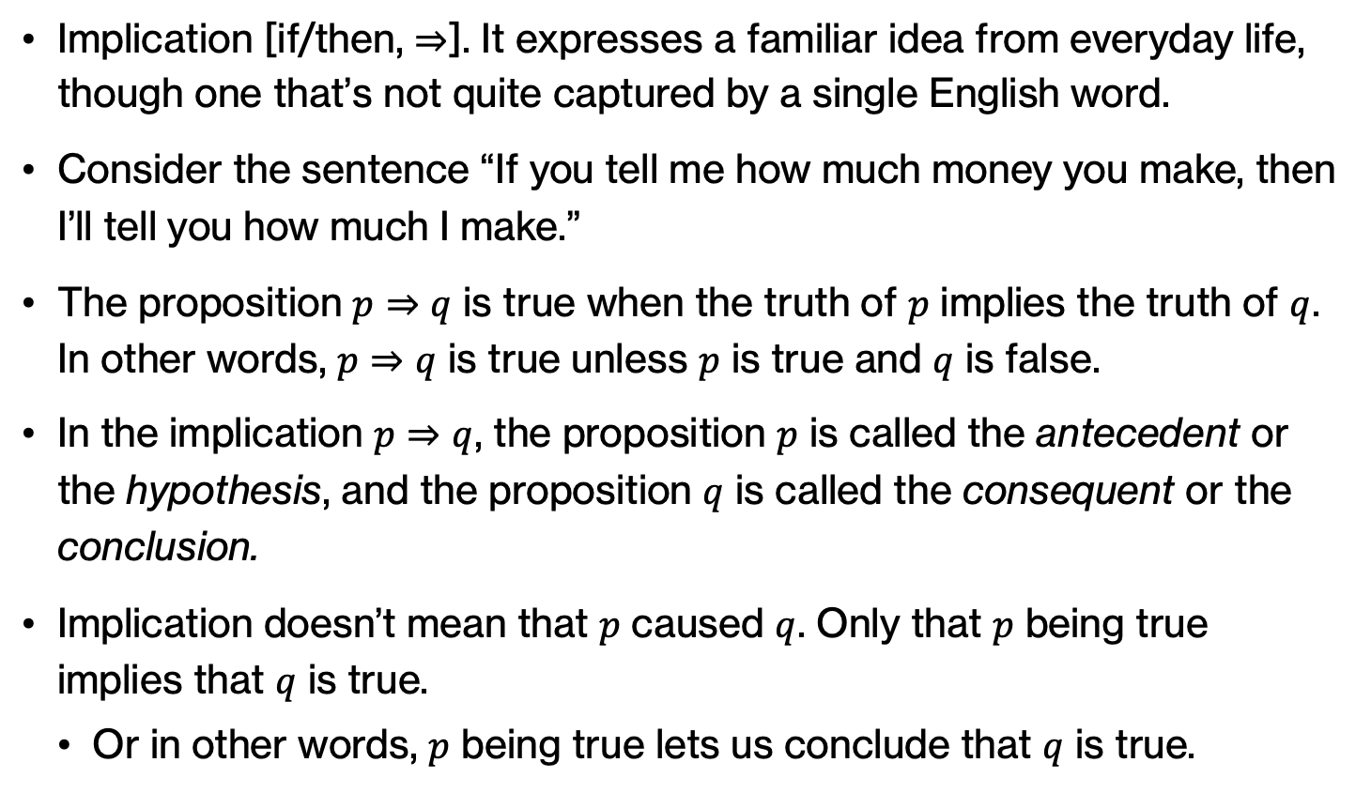
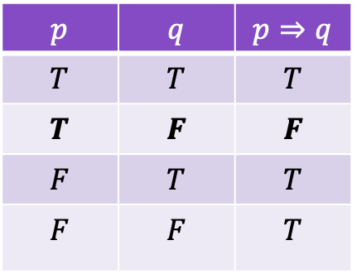
New logical connective: ⇒
Implication [if/then, ⇒]. It expresses a familiar idea from everyday life, though one that’s not quite captured by a single English word.
Consider the sentence “If you tell me how much money you make, then I’ll tell you how much I make.”
The proposition $p⇒q$ is true when the truth of $p$ implies the truth of $q$. In other words, $p⇒q$ is true unless $p$ is true and $q$ is false.
In the implication $p⇒q$, the proposition $p$ is called the antecedent or the hypothesis, and the proposition $q$ is called the consequent or the conclusion.
Implication doesn’t mean that $p$ caused $q$. Only that $p$ being true implies that $q$ is true.
  Or in other words, $p$ being true lets us conclude that $q$ is true.
$$p$$ | $$q$$ | $$p⇒q$$
$$T$$ | $$T$$ | $$T$$
$$T$$ | $$F$$ | $$F$$
$$F$$ | $$T$$ | $$T$$
$$F$$ | $$F$$ | $$T$$
Notes:
There are more logical connectives used in propositional logic that we have not seen so far. The first one is implication.
Implication [if/then, ⇒]: It expresses a familiar idea from everyday life, though one that’s not quite captured by a single English word. Consider the sentence “If you tell me how much money you make, then I’ll tell you how much I make.” It’s easiest to think of this sentence as a promise: I’ve promised that I’ll tell you my financial situation, as long as you tell me yours. I haven’t promised anything about what I’ll do if you don’t tell me your salary—I can abstain from revealing anything about myself, or I might spontaneously tell you my salary anyway, but the point is that I haven’t guaranteed anything. (But you’d justifiably call me a liar if you told me what you make, and I failed to disclose my salary in return.) This kind of promise is expressed as an implication in propositional logic.
The proposition p ⇒ q is true when the truth of p implies the truth of q. In other words, p ⇒ q is true unless p is true and q is false.
In the implication p ⇒ q, the proposition p is called the antecedent or the hypothesis, and the proposition q is called the consequent or the conclusion. A confusing aspect is that implication doesn’t mean that p caused q. Only that p being true implies that q is true. Or in other words, p being true lets us conclude that q is true

Slide 10
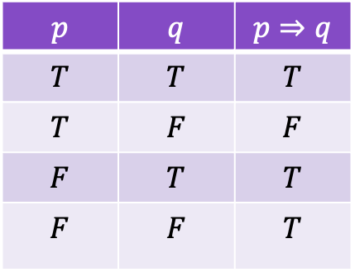
Practice Time: truth values of implications
  What will the following propositions evaluate to?
    1 + 1 = 2 implies that 2 + 3 = 5.
    2 + 3 = 4 implies that 2 + 2 = 4.
    2 + 2 = 4 implies that 2 + 1 = 5.
    2 + 3 = 4 implies that 2 + 3 = 6.
$$p$$ | $$q$$ | $$p⇒q$$
$$T$$ | $$T$$ | $$T$$
$$T$$ | $$F$$ | $$F$$
$$F$$ | $$T$$ | $$T$$
$$F$$ | $$F$$ | $$T$$
Notes:
Let's practice, what will the following propositions evaluate to? Here's the implication truth table for your convenience.

Slide 11
Answer: truth values of implications
  What will the following propositions evaluate to?
    1 + 1 = 2 implies that 2 + 3 = 5. (“True implies True” is true.)
    2 + 3 = 4 implies that 2 + 2 = 4. (“False implies True” is true.)
    2 + 2 = 4 implies that 2 + 1 = 5. (“True implies False” is false.)
      This is false because 2 + 2 = 4 is true, but 2 + 1 = 5 is false.
    2 + 3 = 4 implies that 2 + 3 = 6. (“False implies False” is true.)
$$p$$ | $$q$$ | $$p⇒q$$
$$T$$ | $$T$$ | $$T$$
$$T$$ | $$F$$ | $$F$$
$$F$$ | $$T$$ | $$T$$
$$F$$ | $$F$$ | $$T$$
Notes:
Here are some examples of implications and their truth value:
The following propositions are all true:
1 + 1 = 2 implies that 2 + 3 = 5. (“True implies True” is true.)
2 + 3 = 4 implies that 2 + 2 = 4. (“False implies True” is true.)
2 + 3 = 4 implies that 2 + 3 = 6. (“False implies False” is true.)
But the following proposition is false:
2 + 2 = 4 implies that 2 + 1 = 5. (“True implies False” is false.)
This last proposition is false because 2 + 2 = 4 is true, but 2 + 1 = 5 is false.

Slide 12

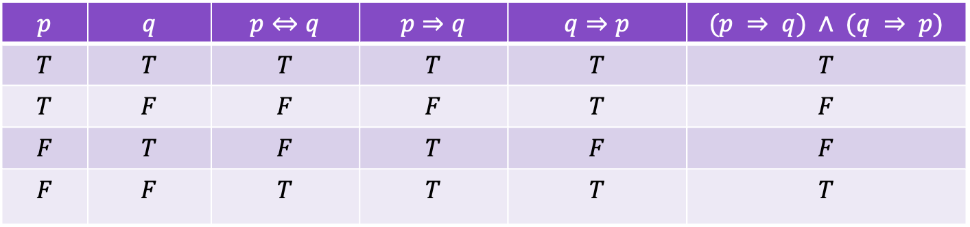
New logical connective: ⇔
If and only if [⇔]: The proposition $p⇔q$ (“$p$ if and only if $q$”) is true when the propositions $p$ or $q$ have the same truth value (both $p$ and $q$ are true, or both p and q are false), and false otherwise.
The reason that ⇔ is read as “if and only if” is that $p⇔q$ means the same thing as the compound proposition $(p ⇒ q) ∧ (q ⇒ p)$.
$$p$$ | $$q$$ | $p⇔q$ | $$p⇒q$$ | $$q⇒p$$ | $$(p ⇒ q) ∧ (q ⇒ p)$$
$$T$$ | $$T$$ | $$T$$ | $$T$$ | $$T$$ | $$T$$
$$T$$ | $$F$$ | $$F$$ | $$F$$ | $$T$$ | $$F$$
$$F$$ | $$T$$ | $$F$$ | $$T$$ | $$F$$ | $$F$$
$$F$$ | $$F$$ | $$T$$ | $$T$$ | $$T$$ | $$T$$
Notes:
The final logic connect we will see is if and only if [⇔]: The proposition p ⇔ q (“p if and only if q”) is true when the propositions p or q have the same truth value (both p and q are true, or both p and q are false), and false otherwise. The reason that ⇔ is read as “if and only if” is that p ⇔ q means the same thing as the compound proposition (p ⇒ q) ∧ (q ⇒ p).
Unfortunately, just like with “or,” the word “if” is ambiguous in English. Sometimes “if” is used to express an implication, and sometimes it’s used to express an if-and-only-if definition. When you see the word “if” in a sentence, you’ll need to think carefully about whether it means ⇒ or ⇔.

Slide 13
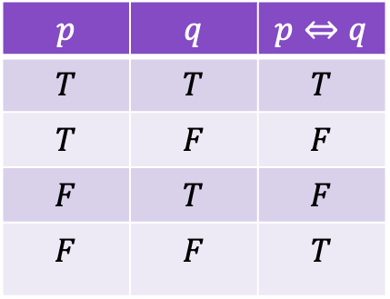
Practice Time: truth values of if and only if
  What will the following propositions evaluate to?
    1 + 1 = 2 if and only if 2 + 3 = 5.
    2 + 3 = 4 if and only if 2 + 2 = 4.
    2 + 2 = 4 if and only if 2 + 1 = 5.
    2 + 3 = 4 if and only if 2 + 3 = 6.
$$p$$ | $$q$$ | $p⇔q$
$$T$$ | $$T$$ | $$T$$
$$T$$ | $$F$$ | $$F$$
$$F$$ | $$T$$ | $$F$$
$$F$$ | $$F$$ | $$T$$
Notes:
Let's practice, what will the following propositions evaluate to? Here's the if and only if truth table for your convenience.

Slide 14
Answer: truth values of if and only if
  What will the following propositions evaluate to?
    1 + 1 = 2 if and only if 2 + 3 = 5. ("True if and only if True" is true)
    2 + 3 = 4 if and only if 2 + 2 = 4. ("False if and only if True" is false)
    2 + 2 = 4 if and only if 2 + 1 = 5. ("True if and only if False" is false)
    2 + 3 = 4 if and only if 2 + 3 = 6. ("False if and only if False" is true)
$$p$$ | $$q$$ | $p⇔q$
$$T$$ | $$T$$ | $$T$$
$$T$$ | $$F$$ | $$F$$
$$F$$ | $$T$$ | $$F$$
$$F$$ | $$F$$ | $$T$$
Notes:
Did you get these?

Slide 15
Precedence of logical connectives
The precedence of our logical connectives is:
  negation (¬) has the highest precedence;
  then there is a three-way tie among ∧, ∨, and ⊕;
  then there’s ⇒;
  then finally ⇔ has the lowest precedence.
Notes:
The precedence (which one is more important and applied first in a Boolean expression) of our logical connectives: negation (¬) has the highest precedence; then there is a three-way tie among ∧, ∨, and ⊕; then there’s ⇒; then finally ⇔ has the lowest precedence.

Slide 16
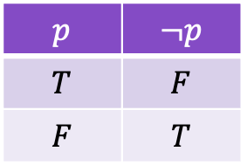
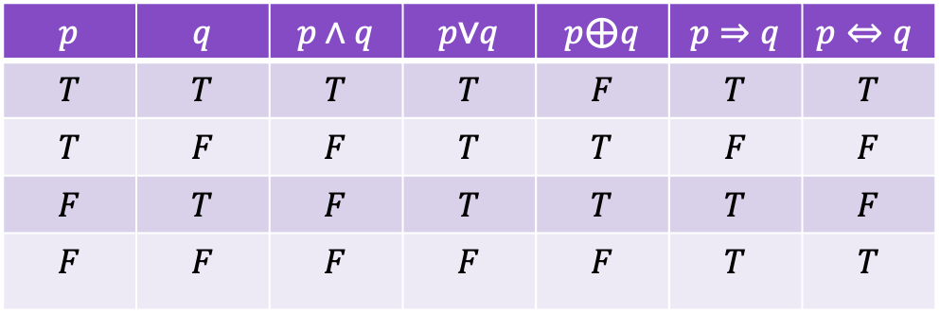
Truth tables for basic logical connectives
$$p$$ | $$¬p$$
$$T$$ | $$F$$
$$F$$ | $$T$$
$$p$$ | $$q$$ | $$p∧q$$ | $$p\text{∨}q$$ | $$p\text{⊕}q$$ | $$p⇒q$$ | $p⇔q$
$$T$$ | $$T$$ | $$T$$ | $$T$$ | $$F$$ | $$T$$ | $$T$$
$$T$$ | $$F$$ | $$F$$ | $$T$$ | $$T$$ | $$F$$ | $$F$$
$$F$$ | $$T$$ | $$F$$ | $$T$$ | $$T$$ | $$T$$ | $$F$$
$$F$$ | $$F$$ | $$F$$ | $$F$$ | $$F$$ | $$T$$ | $$T$$
Notes:
To summarize, here are the truth tables for the logical connectives we have seen.

Slide 17

Practice Time: Compound propositions
We can now build truth tables for more complex propositions. For example, what is the truth table for $p∧q⇒¬q$ ?
Notes:
For more complicated propositions, we can fill in a truth table by repeatedly applying the basic truth tables and following the precedence of logical connectives. What is the truth table for this complex proposition?

Slide 18
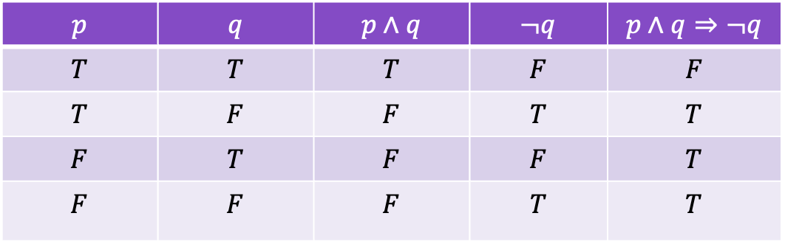

Practice Time: Complex propositions
We can now build truth tables for more complex propositions. For example, what is the truth table for $p∧q⇒¬q$ ?
The given proposition is true precisely when at least one of p and q is false.
$$p$$ | $$q$$ | $$p∧q$$ | $$¬q$$ | $$p∧q⇒¬q$$
$$T$$ | $$T$$ | $$T$$ | $$F$$ | $$F$$
$$T$$ | $$F$$ | $$F$$ | $$T$$ | $$T$$
$$F$$ | $$T$$ | $$F$$ | $$F$$ | $$T$$
$$F$$ | $$F$$ | $$F$$ | $$T$$ | $$T$$
Notes:
We can find the truth table for p ∧ q ⇒ ¬q which leads to the conclusion that the given proposition is true precisely when at least one of p and q is false.

Slide 19
Practice time
Cecil Sagehen, who is 47 years old, was asked at the doctor's office: "If you are over 55 years old, do you have an advance care directive?"
What should Cecil answer?
Hint: translate this English statement to propositional logic
Notes:
Here's a situation where propositional logic can be useful. Let's assume that Cecil Sagehen, who is 47 y.o., goes to the doctor and is asked " "If you are over 55 years old, do you have an advance care directive?" What should Cecil answer?

Slide 20
Answer
p = "over 55 years old"
q = "have an advance care directive"
p ⇒ q is true whenever p is false, and p=“over 55 years old” is false. (That is, False ⇒ anything is true.)
Thus, Ceil should answer “yes”
Notes:
Cecil should say yes. The question is framed as a p implies q proposition. Since p is false, then it doesn't matter whether Cecil has an advance care directive. The statement is true. Sometimes the hardest part is knowing how to translate English to the right propositions.

Slide 21

Practice time: More compound propositions
What are the truth tables for the following compound propositions?
  $[p∧(p⇒q)]⇒q$
  $[¬q∧(p⇒q)]⇒¬p$
Notes:
Let's practice some more with building truth tables. Can you work the following compound propositions?

Slide 22
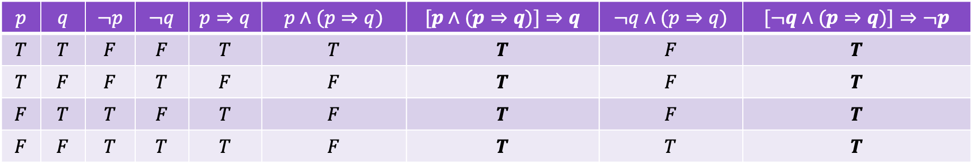
Answer: More compound propositions
$$p$$ | $$q$$ | $$¬p$$ | $$¬q$$ | $$p⇒q$$ | $$p∧(p⇒q)$$ | $$[p∧(p⇒q)]⇒q$$ | $$¬q∧(p⇒q)$$ | $$[¬q∧(p⇒q)]⇒¬p$$
$$T$$ | $$T$$ | $$F$$ | $$F$$ | $$T$$ | $$T$$ | $$T$$ | $$F$$ | $$T$$
$$T$$ | $$F$$ | $$F$$ | $$T$$ | $$F$$ | $$F$$ | $$T$$ | $$F$$ | $$T$$
$$F$$ | $$T$$ | $$T$$ | $$F$$ | $$T$$ | $$F$$ | $$T$$ | $$F$$ | $$T$$
$$F$$ | $$F$$ | $$T$$ | $$T$$ | $$T$$ | $$F$$ | $$T$$ | $$T$$ | $$T$$
Notes:
Do you notice that they all evaluate to True?

Slide 23
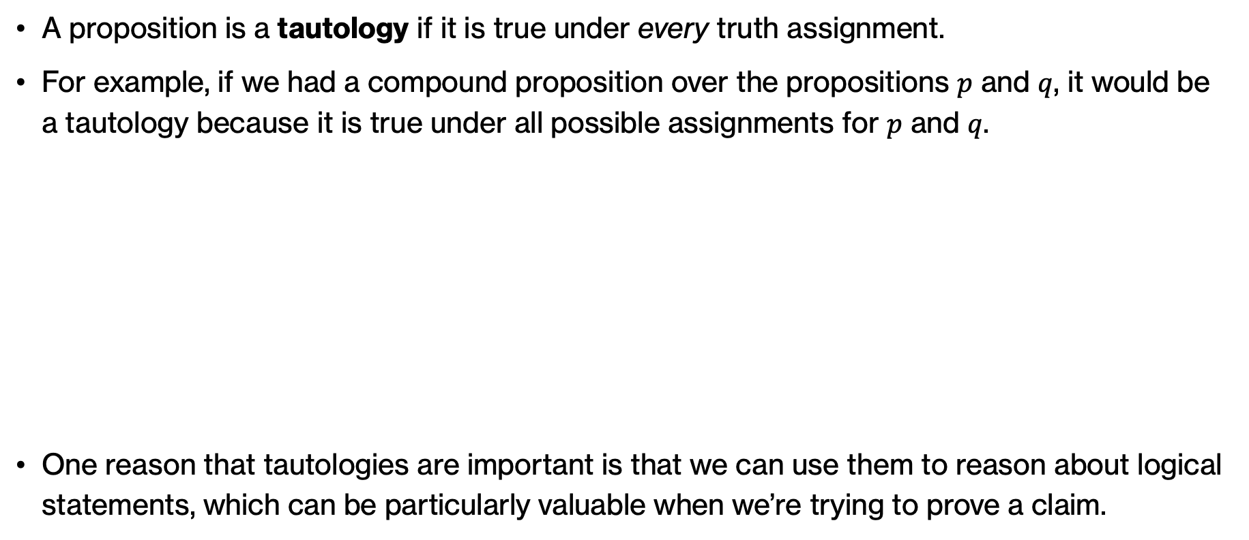
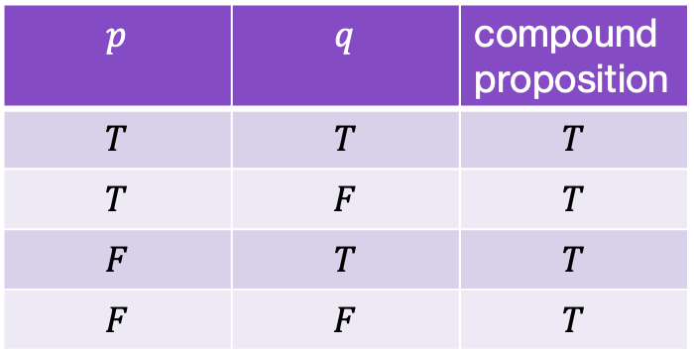
Tautologies
A proposition is a tautology if it is true under every truth assignment.
For example, if we had a compound proposition over the propositions $p$ and $q$, it would be a tautology because it is true under all possible assignments for $p$ and $q$.
One reason that tautologies are important is that we can use them to reason about logical statements, which can be particularly valuable when we’re trying to prove a claim.
$$p$$ | $$q$$ | compound proposition
$$T$$ | $$T$$ | $$T$$
$$T$$ | $$F$$ | $$T$$
$$F$$ | $$T$$ | $$T$$
$$F$$ | $$F$$ | $$T$$
Notes:
The Boolean expressions we just saw are called tautologies. A proposition is a tautology if it is true under every truth assignment. One reason that tautologies are important is that we can use them to reason about logical statements, which can be particularly valuable when we’re trying to prove a claim.

Slide 24
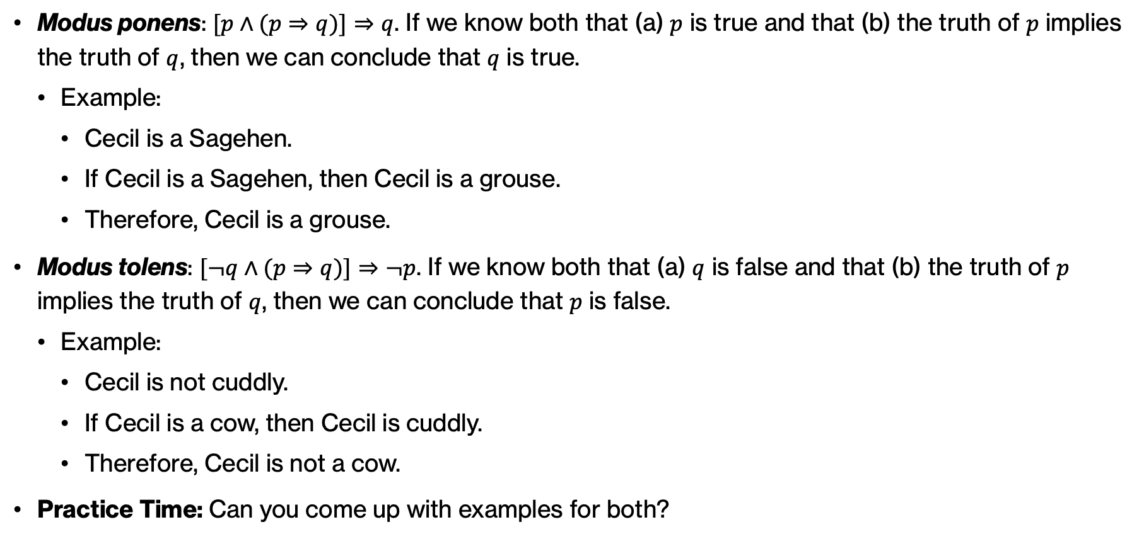
Revisiting practice time – Rules of inference
Modus ponens: $[p∧(p⇒q)]⇒q$. If we know both that (a) $p$ is true and that (b) the truth of $p$ implies the truth of $q$, then we can conclude that $q$ is true.
  Example:
    Cecil is a Sagehen.
    If Cecil is a Sagehen, then Cecil is a grouse.
    Therefore, Cecil is a grouse.
Modus tolens: $[¬q∧(p⇒q)]⇒¬p$. If we know both that (a) $q$ is false and that (b) the truth of $p$ implies the truth of $q$, then we can conclude that $p$ is false.
  Example:
    Cecil is not cuddly.
    If Cecil is a cow, then Cecil is cuddly.
    Therefore, Cecil is not a cow.
Practice Time: Can you come up with examples for both?
Notes:
The exercise we just did showed both compound propositions were tautologies. These three tautologies are so important in Propositional Logic they have their own special names. The first is called modus ponens and the second modus tolens and they are part of rules of inference that can be used to derive conclusions.

Slide 25

Practice time
What is the truth tables for the following compound proposition?
$(p⇔q)∧(p⊕q)$
Notes:
Let's continue with practicing with this compound proposition.

Slide 26
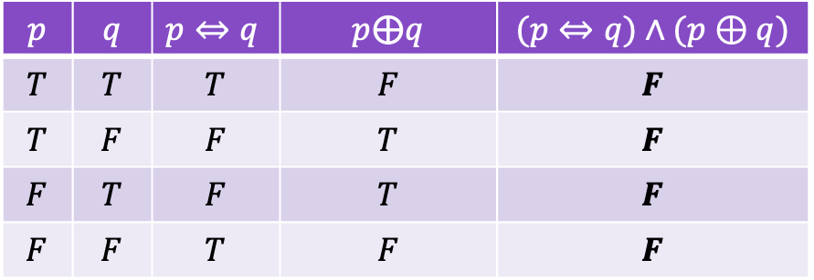
Answer
What is the truth tables for the following compound proposition?
$(p⇔q)∧(p⊕q)$
$$p$$ | $$q$$ | $p⇔q$ | $$p\text{⊕}q$$ | $$(p⇔q)∧(p⊕q)$$
$$T$$ | $$T$$ | $$T$$ | $$F$$ | $$F$$
$$T$$ | $$F$$ | $$F$$ | $$T$$ | $$F$$
$$F$$ | $$T$$ | $$F$$ | $$T$$ | $$F$$
$$F$$ | $$F$$ | $$T$$ | $$F$$ | $$F$$
Notes:
Did you notice that every row evaluates to False?

Slide 27


Satisfiable propositions
A proposition is satisfiable if it is true under at least one truth assignment.
A proposition is unsatisfiable if it is not satisfiable.
That means, the proposition $(p⇔q)∧(p⊕q)$is unsatisfiable.
$$p$$ | $$q$$ | $p⇔q$ | $$p\text{⊕}q$$ | $$(p⇔q)∧(p⊕q)$$
$$T$$ | $$T$$ | $$T$$ | $$F$$ | $$F$$
$$T$$ | $$F$$ | $$F$$ | $$T$$ | $$F$$
$$F$$ | $$T$$ | $$F$$ | $$T$$ | $$F$$
$$F$$ | $$F$$ | $$T$$ | $$F$$ | $$F$$
Notes:
This brings us to two definitions.
A proposition is satisfiable if it is true under at least one truth assignment.
A proposition is unsatisfiable if it is not satisfiable. That is, it is false under every single truth assignment
That means, the proposition $(p⇔q)∧(p⊕q)$we just saw is unsatisfiable as there is no truth assignment.

Slide 28

Practice time: Satisfiable or not?
Is the proposition $p∨q⇒¬p∧¬q$ satisfiable?
Notes:
Can you show using truth tables whether the proposition p ∨ q ⇒ ¬p ∧ ¬q is satisfiable?

Slide 29

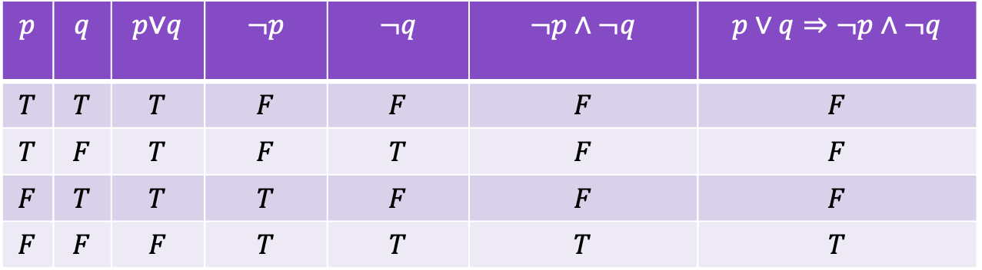
Practice time: Satisfiable or not?
Is the proposition $p∨q⇒¬p∧¬q$ satisfiable?
  Yes, it is.
$$p$$ | $$q$$ | $$p\text{∨}q$$ | $$¬p$$ | $$¬q$$ | $$¬p∧¬q$$ | $$p∨q⇒¬p∧¬q$$
$$T$$ | $$T$$ | $$T$$ | $$F$$ | $$F$$ | $$F$$ | $$F$$
$$T$$ | $$F$$ | $$T$$ | $$F$$ | $$T$$ | $$F$$ | $$F$$
$$F$$ | $$T$$ | $$T$$ | $$T$$ | $$F$$ | $$F$$ | $$F$$
$$F$$ | $$F$$ | $$F$$ | $$T$$ | $$T$$ | $$T$$ | $$T$$
Notes:
Yes it is satisfiable. We constructed its truth table and we see that we have one truth assignment (p=F, q=F) where the proposition is true.

Slide 30
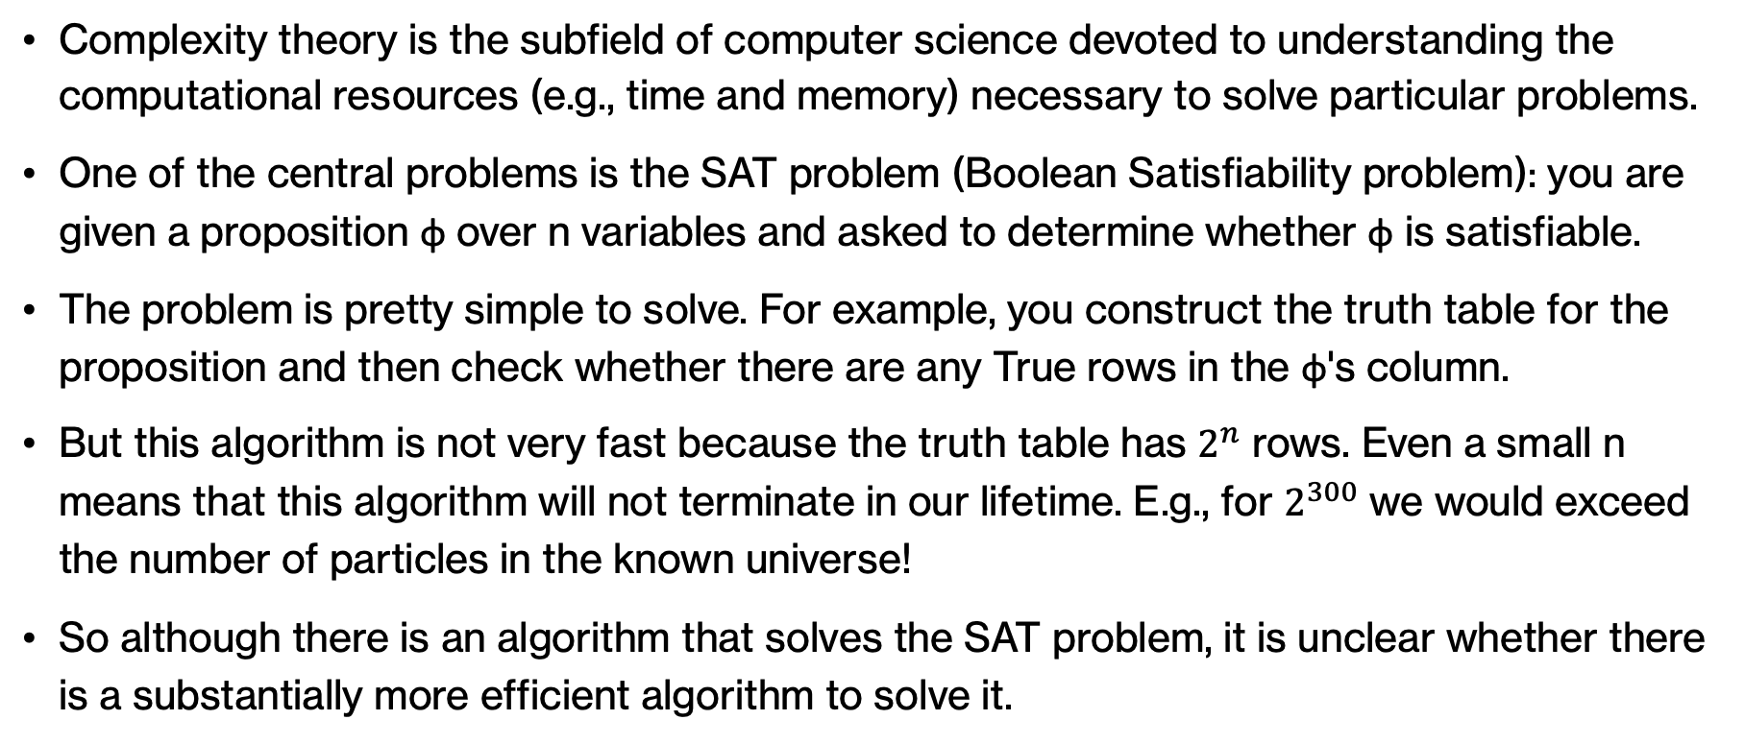
Complexity theory
Complexity theory is the subfield of computer science devoted to understanding the computational resources (e.g., time and memory) necessary to solve particular problems.
One of the central problems is the SAT problem (Boolean Satisfiability problem): you are given a proposition φ over n variables and asked to determine whether φ is satisfiable.
The problem is pretty simple to solve. For example, you construct the truth table for the proposition and then check whether there are any True rows in the φ's column.
But this algorithm is not very fast because the truth table has $2^{n}$ rows. Even a small n means that this algorithm will not terminate in our lifetime. E.g., for $2^{300}$ we would exceed the number of particles in the known universe!
So although there is an algorithm that solves the SAT problem, it is unclear whether there is a substantially more efficient algorithm to solve it.
Notes:
Satisfiability plays a prominent role in the field of complexity theory. Complexity theory is the subfield of computer science devoted to understanding the computational resources (primarily time and memory) necessary to solve particular problems. One of the central problems is the SAT problem (Boolean Satisfiability problem): you are given a proposition φ over n variables and asked to determine whether φ is satisfiable. The problem could be easily solved with what we know so far. We can construct the truth table for the proposition and then check whether for all possible truth assignments for the n variables there are any True rows in the φ's column.
But this algorithm is not very fast because the truth table has $2^{n}$ rows. Even a small n means that this algorithm will not terminate in our lifetime. E.g., for $2^{300}$ we would exceed the number of particles in the known universe!
So although there is an algorithm that solves the SAT problem, it is unclear whether there is a substantially more efficient algorithm to solve it.

Slide 31
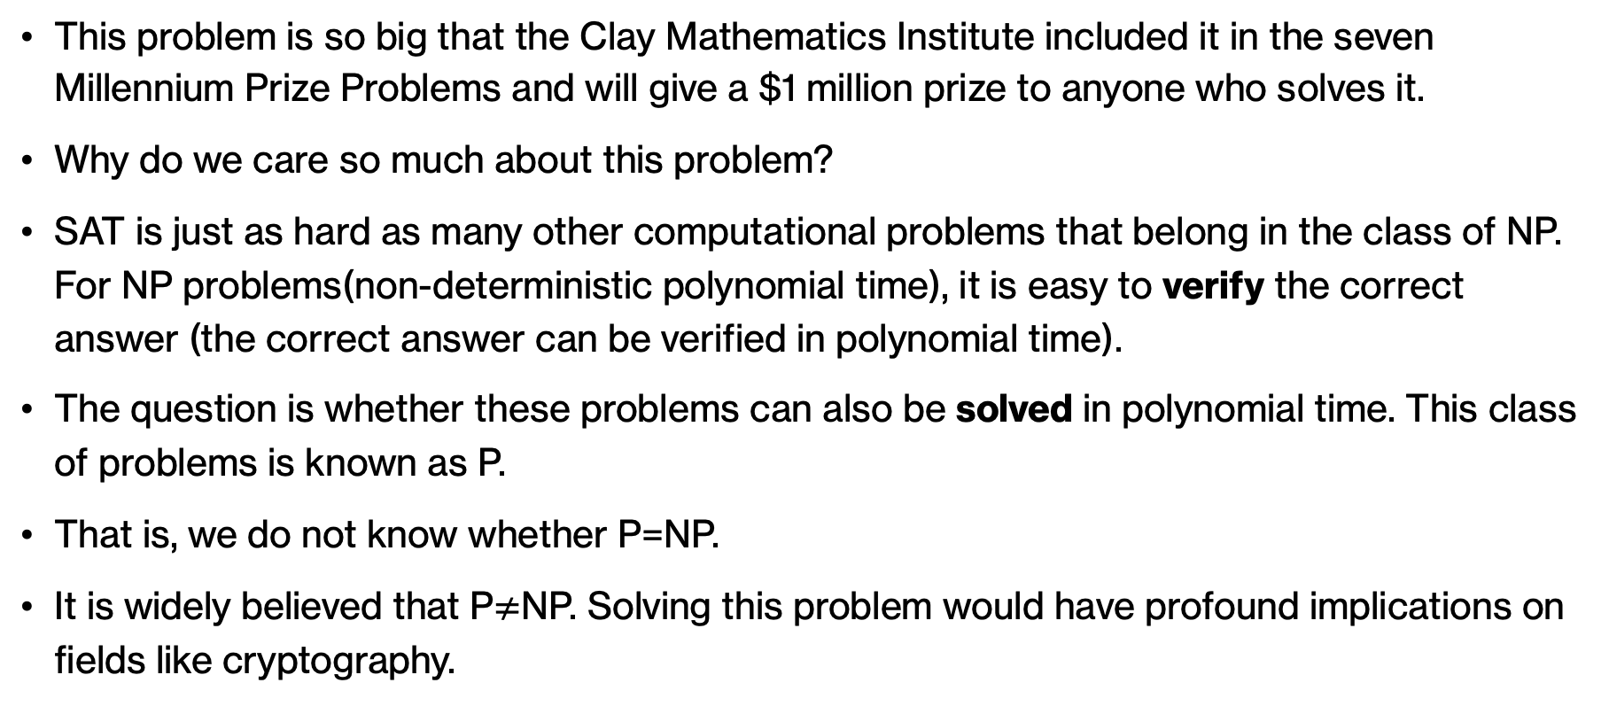
Satisfiability and a million dollars prize
This problem is so big that the Clay Mathematics Institute included it in the seven Millennium Prize Problems and will give a $1 million prize to anyone who solves it.
Why do we care so much about this problem?
SAT is just as hard as many other computational problems that belong in the class of NP. For NP problems(non-deterministic polynomial time), it is easy to verify the correct answer (the correct answer can be verified in polynomial time).
The question is whether these problems can also be solved in polynomial time. This class of problems is known as P.
That is, we do not know whether P=NP.
It is widely believed that P$≠$NP. Solving this problem would have profound implications on fields like cryptography.
Notes:
The SAT problem is so big that the Clay Mathematics Institute included it in the seven Millennium Prize Problems and will give a $1 million prize to anyone who solves it. But why do we care so much about this problem?
SAT is just as hard as many other computational problems that belong in the class of NP. For NP problems(non-deterministic polynomial time), it is easy to verify the correct answer (the correct answer can be verified in polynomial time) e.g., for SAT, if you give me the truth assignment under which φ is satisfiable, I just have to go and plug in these truth assignments to φ and confirm that indeed I got back a True.
The question is whether these problems can also be solved in polynomial time. This class of problems that can be solved in polynomial time is known as P.
It is widely believed that P$≠$NP. Solving this problem would have profound implications on fields like cryptography.

Slide 32
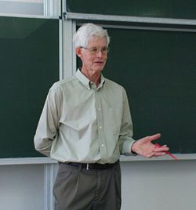

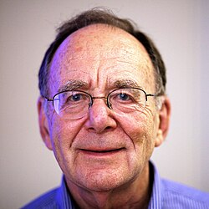
Complexity theory pioneers
Cook-Levin Theorem: If you can solve SAT efficiently, then you can solve any problem in NP efficiently.
Karp also contributed to theory of NP-completeness and along with Lipton showed a relationship between SAT and circuits that have a polynomial number of logic gates
Stephen Cook
Leonid Levin
Richard Karp
Notes:
The bulk of these major problems in theoretical computer science was formulated in late 70s and 80s although it is still an active research area. Complexity theory pioneers like Stephen Cook and Leonid Levin gave us the famous Cook-Levin Theorem that roughly says if you can solve SAT efficiently, then you can solve any problem in NP efficiently. Richard Karp, another seminal figure in theoretical computer science, also worked in N—completeness and along with Richard Lipton examined the relationship of SAT with circuits that can have polynomial number of gates. Cook and Karp hold Turing awards.
If you enjoyed this small introduction to complexity theory, make sure you continue with upper division classes like CS140 (Algorithms) and CS101 (Theory and Programming Languages).

Slide 33
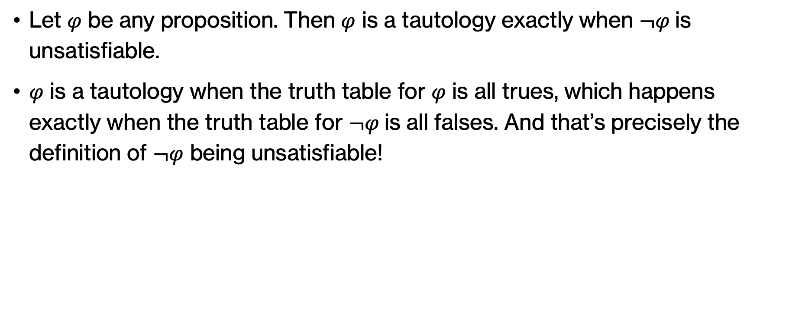
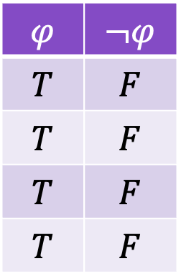
Tautology and satisfiability
Let $φ$ be any proposition. Then $φ$ is a tautology exactly when $¬φ$is unsatisfiable.
$φ$ is a tautology when the truth table for $φ$ is all trues, which happens exactly when the truth table for $¬φ$is all falses. And that’s precisely the definition of $¬φ$ being unsatisfiable!
$$φ$$ | $$¬φ$$
$$T$$ | $$F$$
$$T$$ | $$F$$
$$T$$ | $$F$$
$$T$$ | $$F$$
Notes:
It may be helpful to think about the general relationship between tautology and satisfiability. Let φ be any proposition. (We occasionally denote generic propositions by lowercase Greek letters, particularly φ [“phi”] or ψ [“psi”].) Then φ is a tautology exactly when ¬φ is unsatisfiable: φ is a tautology when the truth table for φ is all “T”s, which happens exactly when the truth table for ¬φ is all “F”s. And that’s precisely the definition of ¬φ being unsatisfiable!

Slide 34

Practice Time
What are the truth tables for the following compound propositions?
$¬\left(p∧q\right)$
$(p∧q)⇒¬q$
Notes:
More practice time. Can you fill in the assignments for the truth tables for these two propositions?

Slide 35
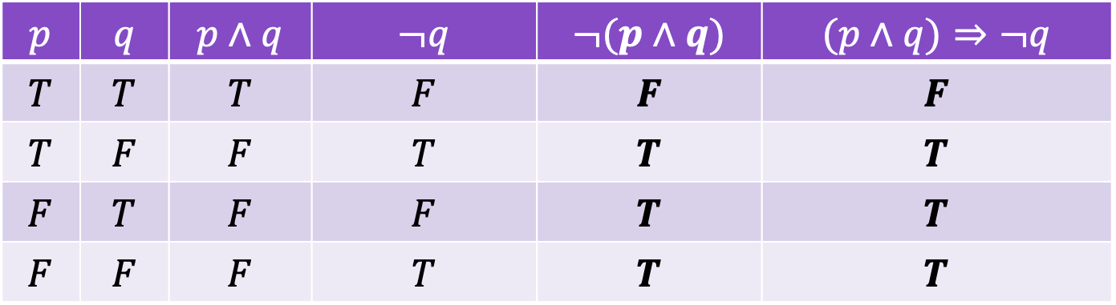
Practice Time
What are the truth tables for the following compound propositions?
$¬\left(p∧q\right)$
$(p∧q)⇒¬q$
$$p$$ | $$q$$ | $$p∧q$$ | $$¬q$$ | $$¬(p∧q)$$ | $$(p∧q)⇒¬q$$
$$T$$ | $$T$$ | $$T$$ | $$F$$ | $$F$$ | $$F$$
$$T$$ | $$F$$ | $$F$$ | $$T$$ | $$T$$ | $$T$$
$$F$$ | $$T$$ | $$F$$ | $$F$$ | $$T$$ | $$T$$
$$F$$ | $$F$$ | $$F$$ | $$T$$ | $$T$$ | $$T$$
Notes:
You should have gotten this. Do you notice that they both resulted to identical truth tables.

Slide 36

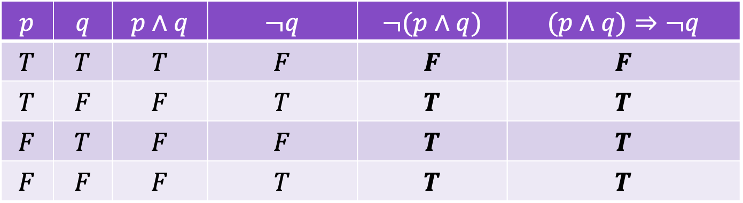
Logical equivalence
Two propositions $φ$ and $ψ$ are logically equivalent, written $φ ≡ ψ$, if they have exactly identical truth tables (in other words, their truth values are the same under every truth assignment).
$$p$$ | $$q$$ | $$p∧q$$ | $$¬q$$ | $$¬(p∧q)$$ | $$(p∧q)⇒¬q$$
$$T$$ | $$T$$ | $$T$$ | $$F$$ | $$F$$ | $$F$$
$$T$$ | $$F$$ | $$F$$ | $$T$$ | $$T$$ | $$T$$
$$F$$ | $$T$$ | $$F$$ | $$F$$ | $$T$$ | $$T$$
$$F$$ | $$F$$ | $$F$$ | $$T$$ | $$T$$ | $$T$$
Notes:
Two propositions φ and ψ are logically equivalent, written φ ≡ ψ, if they have exactly identical truth tables (in other words, their truth values are the same under every truth assignment).

Slide 37

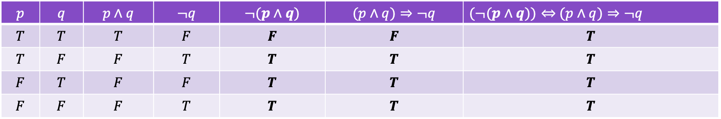
Logical equivalence and tautologies
To state it differently: $φ$ and $ψ$ are logically equivalent whenever $φ ⇔ ψ$is a tautology.
For example, $¬(p∧q)$and $(p∧q)⇒¬q$are logically equivalent:
$$p$$ | $$q$$ | $$p∧q$$ | $$¬q$$ | $$¬(p∧q)$$ | $$(p∧q)⇒¬q$$ | $(¬(p∧q))⇔$ $(p∧q)⇒¬q$
$$T$$ | $$T$$ | $$T$$ | $$F$$ | $$F$$ | $$F$$ | $$T$$
$$T$$ | $$F$$ | $$F$$ | $$T$$ | $$T$$ | $$T$$ | $$T$$
$$F$$ | $$T$$ | $$F$$ | $$F$$ | $$T$$ | $$T$$ | $$T$$
$$F$$ | $$F$$ | $$F$$ | $$T$$ | $$T$$ | $$T$$ | $$T$$
Notes:
To state it differently: two propositions φ and ψ are logically equivalent whenever φ ⇔ ψ is a tautology.
$¬(p∧q)$and $(p∧q)⇒¬q$are logically equivalent as it can be seen in the truth table

Slide 38

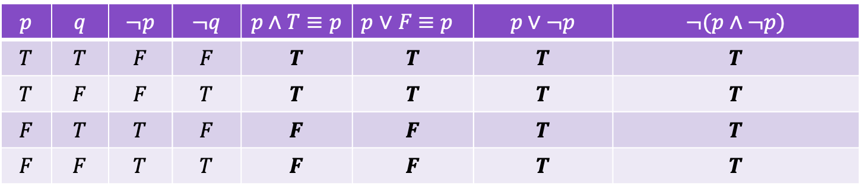
Important laws of logic
Law of identity. $p∧T≡p$and $p∨F≡p$: for any proposition $p$, $p$ is identical to itself.
Law of the excluded middle. $p∨¬p:$for any proposition $p$, either $p$ is true or $p$ is false; there is nothing “in-between” true and false. This is a tautology.
Law of non-contradiction.$¬(p∧¬p):$for any proposition $p$, $p$ and its contradiction/negation, $¬ p,$ cannot both be simultaneously true. This is a tautology.
$$p$$ | $$q$$ | $$¬p$$ | $$¬q$$ | $$p∧T≡p$$ | 𝑝 ∨ 𝐹 ≡ 𝑝 | $$p \text{∨} ¬p$$ | $$¬(p∧¬p)$$
$$T$$ | $$T$$ | $$F$$ | $$F$$ | $$T$$ | $$T$$ | $$T$$ | $$T$$
$$T$$ | $$F$$ | $$F$$ | $$T$$ | $$T$$ | $$T$$ | $$T$$ | $$T$$
$$F$$ | $$T$$ | $$T$$ | $$F$$ | $$F$$ | $$F$$ | $$T$$ | $$T$$
$$F$$ | $$F$$ | $$T$$ | $$T$$ | $$F$$ | $$F$$ | $$T$$ | $$T$$
Notes:
The exercise we just did showed both compound propositions were tautologies. These three tautologies are so important in Propositional Logic they have their own special names. The first is called modus ponens and the second modus tolens and they are part of rules of inference that can be used to derive conclusions.

Slide 39
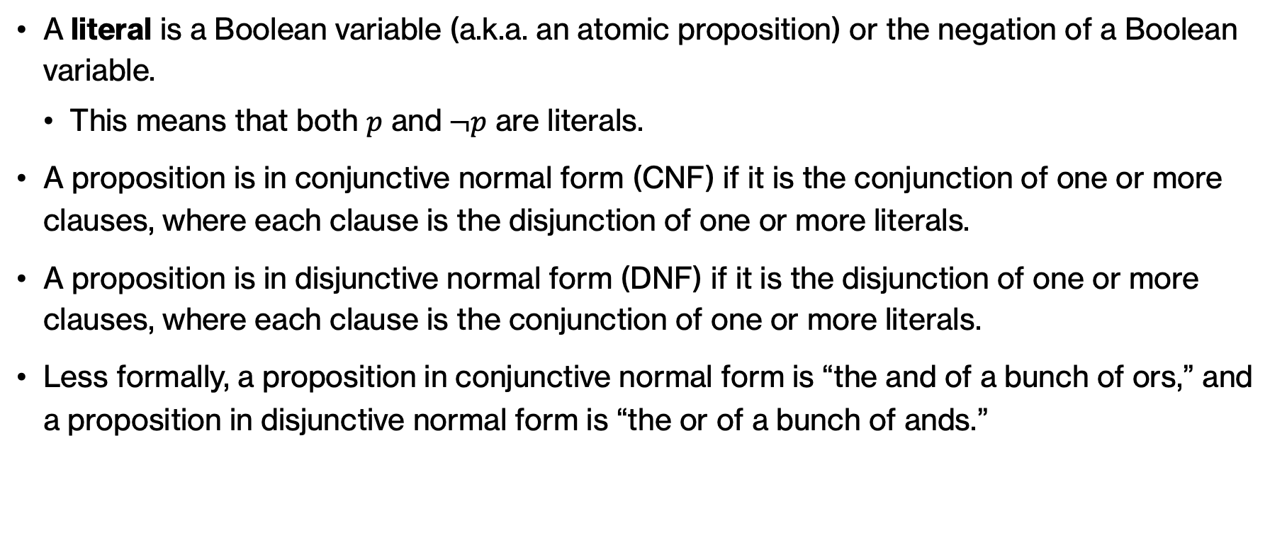
Literals, CNFs, and DNFs
A literal is a Boolean variable (a.k.a. an atomic proposition) or the negation of a Boolean variable.
  This means that both $p$ and$¬p$ are literals.
A proposition is in conjunctive normal form (CNF) if it is the conjunction of one or more clauses, where each clause is the disjunction of one or more literals.
A proposition is in disjunctive normal form (DNF) if it is the disjunction of one or more clauses, where each clause is the conjunction of one or more literals.
Less formally, a proposition in conjunctive normal form is “the and of a bunch of ors,” and a proposition in disjunctive normal form is “the or of a bunch of ands.”
Notes:
A literal is a Boolean variable (a.k.a. an atomic proposition) or the negation of a Boolean variable.
This means that both $p$ and$¬p$ are literals.
A proposition is in conjunctive normal form (CNF) if it is the conjunction of one or more clauses, where each clause is the disjunction of one or more literals.
A proposition is in disjunctive normal form (DNF) if it is the disjunction of one or more clauses, where each clause is the conjunction of one or more literals.
Less formally, a proposition in conjunctive normal form is “the and of a bunch of ors,” and a proposition in disjunctive normal form is “the or of a bunch of ands.”

Slide 40

A somewhat familiar theorem
Theorem: For any proposition $φ$, there is a proposition $ψ_{dnf}$over the same Boolean variables and in disjunctive normal form such that $φ ≡ ψ_{dnf}$.
Notes:
We have already worked with CNFs so it shouldn’t come as a surprise if you see this theorem. We just formalize things now using propositional logic.
Theorem: For any proposition $φ$, there is a proposition $ψ_{dnf}$over the same Boolean variables and in disjunctive normal form such that $φ ≡ ψ_{dnf}$.
Theorem 2: All propositions are expressible in CNF. For any proposition φ, there is a proposition $φ_{cnf}$ over the same Boolean variables and in conjunctive normal form such that $φ ≡ φ_{cnf}.$

Slide 41



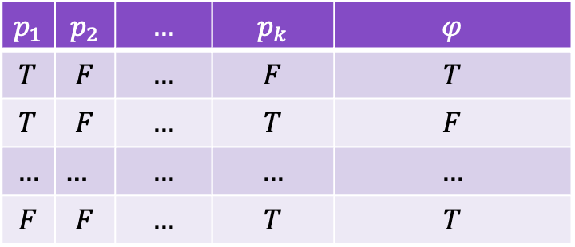
Proof of Theorem
Let $φ$ be an arbitrary proposition, say over the Boolean variables$p_{1},…, p_{k}$.
Build the truth table for $φ$, and let $S_{φ}=\left\{f_{1}, f_{2}, . . . , f_{m}\right\}$denote the set of $m$ truth assignments for $p_{1},…, p_{k}$under which $φ$ is true.
$$p_{1}$$ | $$p_{2}$$ | $$…$$ | $$p_{k}$$ | $$φ$$
$$T$$ | $$F$$ | $$…$$ | $$F$$ | $$T$$
$$T$$ | $$F$$ | $$…$$ | $$T$$ | $$F$$
$$…$$ | … | $$…$$ | $$…$$ | $$…$$
$$F$$ | $$F$$ | $$…$$ | $$T$$ | $$T$$
$$f_{1}$$
$$S_{φ}=\left\{f_{1}, . . . , f_{m}\right\}$$
…
$$f_{m}$$
Notes:
Let $φ$ be an arbitrary proposition, say over the Boolean variables$p_{1},…, p_{k}$. We start by building the truth table for $φ$, and let $S_{φ}=\left\{f_{1}, f_{2}, . . . , f_{m}\right\}$denote the set of $m$ truth assignments for $p_{1},…, p_{k}$under which $φ$ is true (that is, we isolate the rows that φ is true, as we have already done in the past.)
For example, in this truth table, we see that we have k variables and rows 1, potentially some intermediates, and the last row. That gives us the set of m truth assignments.

Slide 42
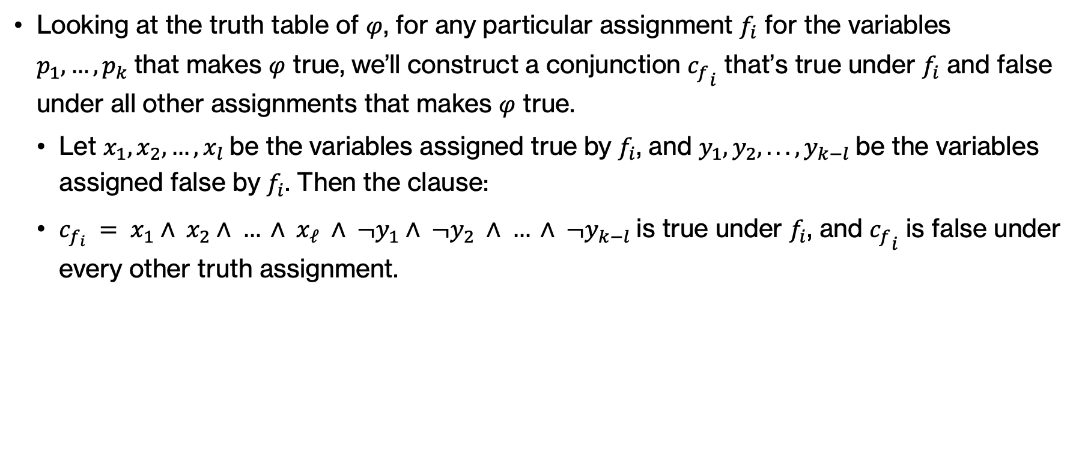
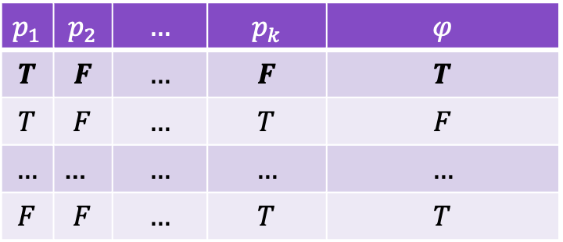
Proof of Theorem
Looking at the truth table of $φ$, for any particular assignment $f_{i}$ for the variables $p_{1},…, p_{k}$that makes $φ$ true, we’ll construct a conjunction ${c_{f}}_{i}$ that’s true under $f_{i}$ and false under all other assignments that makes $φ$ true.
  Let $x_{1}, x_{2}, …, x_{l}$be the variables assigned true by $f_{i}$, and $y_{1}, y_{2}, . . . , y_{k−l}$be the variables assigned false by $f_{i}$. Then the clause:
  $c_{f_{i}} = x_{1}∧ x_{2}∧ … ∧ x_{ℓ} ∧ ¬y_{1}∧ ¬y_{2} ∧ … ∧ ¬y_{k−l}$is true under $f_{i}$, and ${c_{f}}_{i}$ is false under every other truth assignment.
$$p_{1}$$ | $$p_{2}$$ | $$…$$ | $$p_{k}$$ | $$φ$$
$$T$$ | $$F$$ | $$…$$ | $$F$$ | $$T$$
$$T$$ | $$F$$ | $$…$$ | $$T$$ | $$F$$
$$…$$ | … | $$…$$ | $$…$$ | $$…$$
$$F$$ | $$F$$ | $$…$$ | $$T$$ | $$T$$
$c_{f_{1}}=p_{1}∧$ $¬ p_{2}∧…∧¬p_{k}$
Notes:
Looking at the truth table of $φ$, for any particular assignment $f_{i}$ for the variables $p_{1},…, p_{k}$that makes $φ$ true, we’ll construct a conjunction ${c_{f}}_{i}$ that’s true under $f_{i}$ and false under all other assignments that makes $φ$ true.
Let $x_{1}, x_{2}, …, x_{l}$be the variables assigned true by $f_{i}$, and $y_{1}, y_{2}, . . . , y_{k−l}$be the variables assigned false by $f_{i}$. Then the clause:
$c_{f_{i}} = x_{1}∧ x_{2}∧ … ∧ x_{ℓ} ∧ ¬y_{1}∧ ¬y_{2} ∧ … ∧ ¬y_{k−l}$is true under $f_{i}$, and ${c_{f}}_{i}$ is false under every other truth assignment.
For example, c_f_1 would be the conjunction of p1 and not p2 … and not pk. We would repeat this process for all m assignments that result to φ being true,

Slide 43

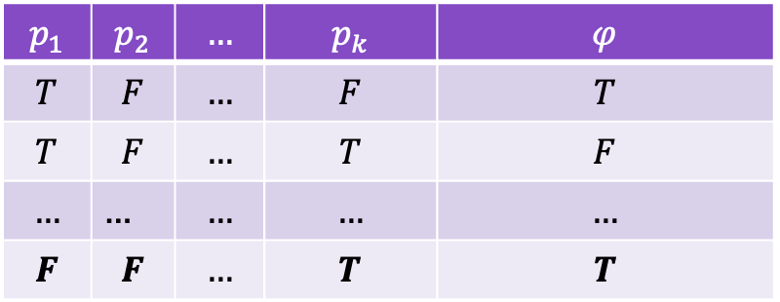
Proof of Theorem
We will repeat this process for all truth assignments that make $φ$ true, e.g.,
$$p_{1}$$ | $$p_{2}$$ | $$…$$ | $$p_{k}$$ | $$φ$$
$$T$$ | $$F$$ | $$…$$ | $$F$$ | $$T$$
$$T$$ | $$F$$ | $$…$$ | $$T$$ | $$F$$
$$…$$ | … | $$…$$ | $$…$$ | $$…$$
$$F$$ | $$F$$ | $$…$$ | $$T$$ | $$T$$
$c_{f_{m}}=¬p_{1}∧$ $¬ p_{2}∧…∧p_{k}$
Notes:
We will repeat this process for all truth assignments that make $φ$ true, e.g., here we will do it for the last row.

Slide 44

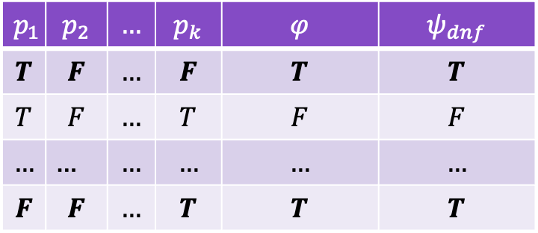
Proof of Theorem
We can now construct a DNF proposition $ψ_{dnf}$ that is logically equivalent to $φ$ by “or”ing together the clause $c_{f_{i}}$ for each truth assignment $f_{i}, i=1,…,m$, $m≥1$ that makes $φ$ true.
Define $ψ_{dnf} = c_{f_{1}}∨ c_{f_{2}}∨ … ∨ c_{f_{m}}$(*)
$$p_{1}$$ | $$p_{2}$$ | $$…$$ | $$p_{k}$$ | $$φ$$ | $$ψ_{dnf}$$
$$T$$ | $$F$$ | $$…$$ | $$F$$ | $$T$$ | $$T$$
$$T$$ | $$F$$ | $$…$$ | $$T$$ | $$F$$ | $$F$$
$$…$$ | … | $$…$$ | $$…$$ | $$…$$ | $$…$$
$$F$$ | $$F$$ | $$…$$ | $$T$$ | $$T$$ | $$T$$
$$ψ_{dnf} = c_{f_{1}}∨… ∨ c_{f_{m}}$$
Notes:
Putting all them together, can now construct a DNF proposition $ψ_{dnf}$ that is logically equivalent to $φ$ by “or”ing together the clause $c_{f_{i}}$ for each truth assignment $f_{i}, i=1,…,m$, $m≥1$ that makes $φ$ true.
Define $ψ_{dnf} = c_{f_{1}}∨ c_{f_{2}}∨ … ∨ c_{f_{m}}$(*)

Slide 45
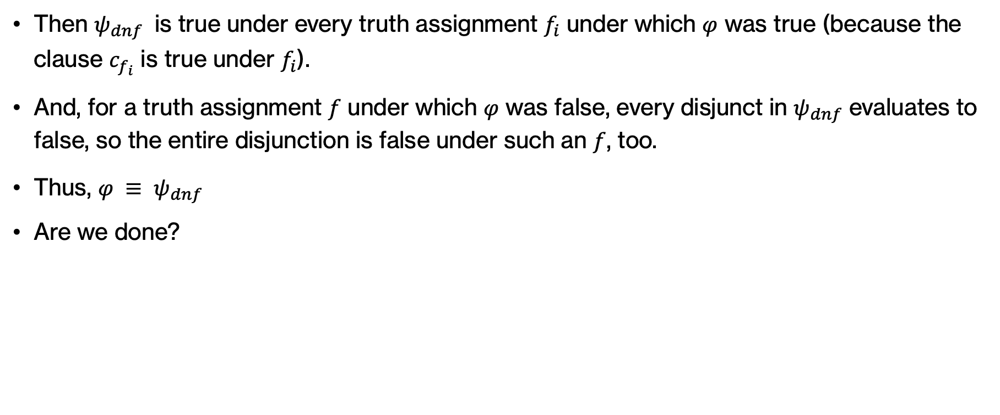

Proof of Theorem
Then $ψ_{dnf}$ is true under every truth assignment $f_{i}$ under which $φ$ was true (because the clause $c_{f_{i}}$ is true under $f_{i}$).
And, for a truth assignment $f$ under which $φ$ was false, every disjunct in $ψ_{dnf}$ evaluates to false, so the entire disjunction is false under such an $f$, too.
Thus, $φ ≡ ψ_{dnf}$
Are we done?
$$p_{1}$$ | $$p_{2}$$ | $$…$$ | $$p_{k}$$ | $$φ$$ | $$ψ_{dnf}$$
$$T$$ | $$F$$ | $$…$$ | $$F$$ | $$T$$ | $$T$$
$$T$$ | $$F$$ | $$…$$ | $$T$$ | $$F$$ | $$F$$
$$…$$ | … | $$…$$ | $$…$$ | $$…$$ | $$…$$
$$F$$ | $$F$$ | $$…$$ | $$T$$ | $$T$$ | $$T$$
$$ψ_{dnf} = c_{f_{1}}∨… ∨ c_{f_{m}}$$
Notes:
Then $ψ_{dnf}$ is true under every truth assignment $f_{i}$ under which $φ$ was true (because the clause $c_{f_{i}}$ is true under $f_{i}$).
And, for a truth assignment $f$ under which $φ$ was false, every disjunct in $ψ_{dnf}$ evaluates to false, so the entire disjunction is false under such an $f$, too.
Thus, $φ ≡ ψ_{dnf}$
Are we done?

Slide 46


$ψ_{dnf} = c_{f_{1}}∨ c_{f_{2}}∨ … ∨ c_{f_{m}}$(*)
Proof of Theorem
There’s one thing we have to be careful about: what happens if $S_{φ}$ is an empty set, that is if $φ$ is unsatisfiable?
The construction in (∗) doesn’t work, but it’s easy to handle this case separately: we simply choose an unsatisfiable DNF proposition like the opposite of the law of non-contradiction, i.e. $p∧¬p$ as $ψ_{dnf}$.
$$p_{1}$$ | $$p_{2}$$ | $$…$$ | $$p_{k}$$ | $$φ$$ | $$ψ_{dnf}$$
$$T$$ | $$F$$ | $$…$$ | $$F$$ | $$F$$ | $$F$$
$$T$$ | $$F$$ | $$…$$ | $$T$$ | $$F$$ | $$F$$
$$…$$ | … | $$…$$ | $$…$$ | $$…$$ | $$…$$
$$F$$ | $$F$$ | $$…$$ | $$T$$ | $$F$$ | $$F$$
Notes:
There’s one thing we have to be careful about: what happens if $S_{φ}$ is an empty set, that is if $φ$ is unsatisfiable?
The construction in (∗) doesn’t work, but it’s easy to handle this case separately: we simply choose an unsatisfiable DNF proposition like $p∧¬p$ as $ψ_{dnf}$.

Slide 47

Proofs in computer science
The type of proof we saw is known as proof by cases, with two cases corresponding to $φ$ being satisfiable and $φ$ being unsatisfiable being proven separately.
There are many types of proofs used in computer science.
  Together, we will see loop invariant proofs and proofs by induction but if you continue with more advanced computer science courses you will encounter even more.
There’s genuine creativity in producing proofs along with key strategies that one can learn.
Notes:
The type of proof we saw for is known as proof by cases, with two cases corresponding to $φ$ being satisfiable and $φ$ being unsatisfiable being proven separately.
There are many types of proofs used in computer science. Together, we will see loop invariant proofs and proofs by induction but if you continue with more advanced computer science courses, like CS54, CS140, and theory electives, you will encounter even more.
it’s worth emphasizing again that there’s genuine creativity required in proving these theorems. By learning more proof techniques and through practice, you can get better at having the kinds of creative ideas that lead to proofs—but that doesn’t mean that these results should have been “obvious” to you in advance.

