Slide 1
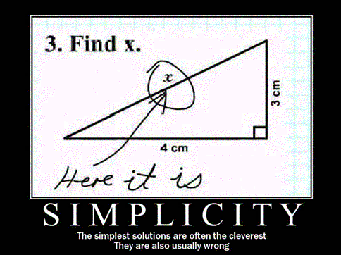
Text Simplification
David Kauchak CS159 – Fall 2024

Slide 2
https://xkcd.com/547/

Slide 3
Admin
Final project
Paper draft due Wednesday (get it done early!)
Presentations on Tuesday after break
4 minute presentations with 1 minute for questions
No class next week
Grading

Slide 4
Course feedback forms

Slide 5
Text simplification
Any intelligent fool can make things bigger, more complex, and more violent. It takes a touch of genius and a lot of courage to move in the opposite direction.
E. F. Schumacher
Goal:
Reduce the reading complexity of a sentence by incorporating more accessible vocabulary and sentence structure while maintaining the content.

Slide 6
Text simplification: real examples
Alfonso Perez Munoz, usually referred to as Alfonso, is a former Spanish footballer, in the striker position.
Alfonso Perez is a former Spanish football player.
What types of transformations are happening?

Slide 7
Text simplification: real examples
Alfonso Perez Munoz, usually referred to as Alfonso, is a former Spanish footballer, in the striker position.
Alfonso Perez is a former Spanish football player.
Deletion

Slide 8
Text simplification: real examples
Alfonso Perez Munoz, usually referred to as Alfonso, is a former Spanish footballer, in the striker position.
Alfonso Perez is a former Spanish football player.
Rewording

Slide 9
Text simplification: real examples
Endemic types or species are especially likely to develop on islands because of their geographical isolation.
Endemic types are most likely to develop on islands because they are isolated.
What types of transformations are happening?

Slide 10
Text simplification: real examples
Endemic types or species are especially likely to develop on islands because of their geographical isolation.
Endemic types are most likely to develop on islands because they are isolated.
Deletion

Slide 11
Text simplification: real examples
Endemic types or species are especially likely to develop on islands because of their geographical isolation.
Endemic types are most likely to develop on islands because they are isolated.
Rewording

Slide 12
Text simplification: real examples
The reverse process, producing electrical energy from mechanical energy, is accomplished by a generator or dynamo.
A dynamo or an electric generator does the reverse: it changes mechanical movement into electric energy.
What types of transformations are happening?

Slide 13
Text simplification: real examples
The reverse process, producing electrical energy from mechanical energy, is accomplished by a generator or dynamo.
A dynamo or an electric generator does the reverse: it changes mechanical movement into electric energy.

Slide 14
Text simplification: real examples
The reverse process, producing electrical energy from mechanical energy, is accomplished by a generator or dynamo.
A dynamo or an electric generator does the reverse: it changes mechanical movement into electric energy.
Deletion and rewording
Insertion and reordering
Notes:
Text simplification can be challenging
-- text to text application
-- full range of text manipulation operations
-- a range of

Slide 15
Goals today
Introduce the text simplification problem
Understand why it’s important
Examine what makes text difficult/simple
Overview of approaches to text simplification

Slide 16
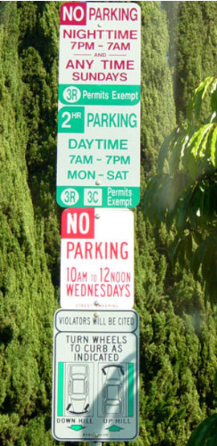
Why text simplification?
DO NOT PARK HERE
Notes:
- life is complicated

Slide 17
Why text simplification?
A lot of text data is available
Problem: much of this content is written above many people’s reading level
Notes:
on average, half of the people read at a below average reading level ☺
numbers:
tens of billions of web pages
English Wikipedia has ~4.5 million articles
half a billion tweets/day
billions of e-mails/day

Slide 18
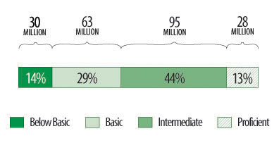
Adult literacy
Below Basic: no more than the most simple and concrete literacy skills
Basic: can perform simple and everyday literacy activities
Intermediate: can perform moderately challenging literacy activities
Proficient: can perform complex and challenging literacy activities
http://nces.ed.gov/naal/kf_demographics.asp
Notes:
National Center for Education Statistics: National Assessment of Adult Literacy

Slide 19
Why text simplification?
Broader availability of standard text resources
language learners
people with aphasia or other cognitive disabilities
children
Broader availability of domain-specific text resources
health and medical documents
90M Americans (at least a third!) do not have sufficient health literacy to understand currently provided materials
Cost of low health literacy is estimated to be hundreds of billions
academic papers
legal documents
Notes:
~14% of Americans speak a language besides English as their native language (http://nces.ed.gov/pubs93/93275.pdf)

Slide 20
Why text simplification?
Make life easier for computers!
I find forest colored chicken ovum and smoked pork thigh to be dietarily disturbing.
I do not like green eggs and ham.
Notes:
what doesn’t the person like?

Slide 21
What makes text difficult/simple?
?

Slide 22
What makes text difficult/simple?
Lots of previous research going back decades!
Some ideas:
vocabulary
sentence structure/grammatical components
passive vs. active tense
use of relative clauses
compound nouns
nominalization (turning verbs into nouns)
…
organization/flow
Notes:
Nominalization example:
I will investigate how nominalization affects text difficulty.
I will do an investigation of how nominalization affects text difficulty.

Slide 23
Quantifying text difficulty
vocabulary
sentence structure/grammatical components
passive vs. active tense
use of relative clauses
compound nouns
nominalization (turning verbs into nouns)
…
organization/flow
How do we measure/quantify these things, particularly with minimal human intervention?
Notes:
- if we want to look at semi-automated or automated approaches we need to be able to automatically (or semi-automatically) detect and correct these things

Slide 24
Quantifying word difficulty
Hypothesis:
The more often a person sees a word, the more familiar they are with it, and therefore the simpler it is
Proxy for “how often you see a word”:
Frequency on the web!

Slide 25
Validating frequency hypothesis
Google unigrams: ~13M
randomly pick 25 words from each bin
sort based on frequency
275 words
Does the frequency of these words relate to people’s knowledge/familiarity with these words?
11 bins based on frequency:
1%, 10%, 20%, …, 100%

Slide 26
Validating frequency hypothesis
Google unigrams: ~13M
Annotate with definition
randomly pick 25 words from each bin
275 words
11 bins based on frequency:
1%, 10%, 20%, …, 100%

Slide 27
Validating frequency hypothesis
marmorean:
crimson-and-grey songbird that inhabits town walls and mountain cliffs of southern Eurasia and northern Africa
of or relating to or characteristic of marble
the most common protein in muscle
a woman policeman

Slide 28
Validating frequency hypothesis
marmorean:
crimson-and-grey songbird that inhabits town walls and mountain cliffs of southern Eurasia and northern Africa
of or relating to or characteristic of marble
the most common protein in muscle
a woman policeman
random definitions from other words in data set

Slide 29
Study participants
50 participants per word =
1,250 annotations/frequency bin
13,750 total annotations!

Slide 30
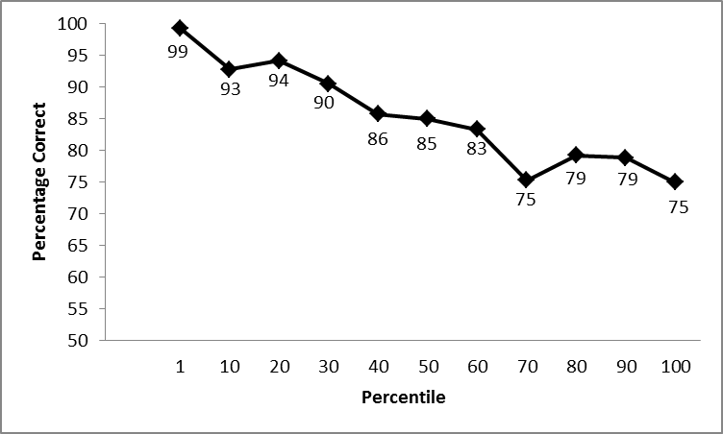
Frequency correlates with understanding!
more frequent
Frequency percentile
What does this tell us about simplifying text?
Notes:
mechanical turk
50 users per word, averaged per bin (50 users * 25 words = 1250 per bin and 13,750 annotations!!!)

Slide 31
Frequency correlates with understanding!
more frequent
Frequency percentile
Avoid less frequent words. Use more frequent words.
Notes:
mechanical turk
50 users per word, averaged per bin

Slide 32
Quantifying text difficulty
vocabulary
sentence structure/grammatical components
passive vs. active tense
use of relative clauses
compound nouns
nominalization (turning verbs into nouns)
…
organization/flow
Still many, many aspects of language to explore…
Notes:
- if we want to look at semi-automated or automated approaches we need to be able to automatically (or semi-automatically) detect and correct these things

Slide 33
Goals today
Introduce the text simplification problem
Understand why it’s important
Examine what makes text difficult/simple
Overview of approaches to text simplification

Slide 34
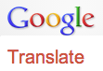
Spectrum of solutions
Focus on these types of approaches today
writer assist tools/resources
readability formulas
simple word lists
flag difficult text sections
simplification thesauruses
rule-based with human verification
…
Simplify
manual
semi-automated
fully automated

Slide 35
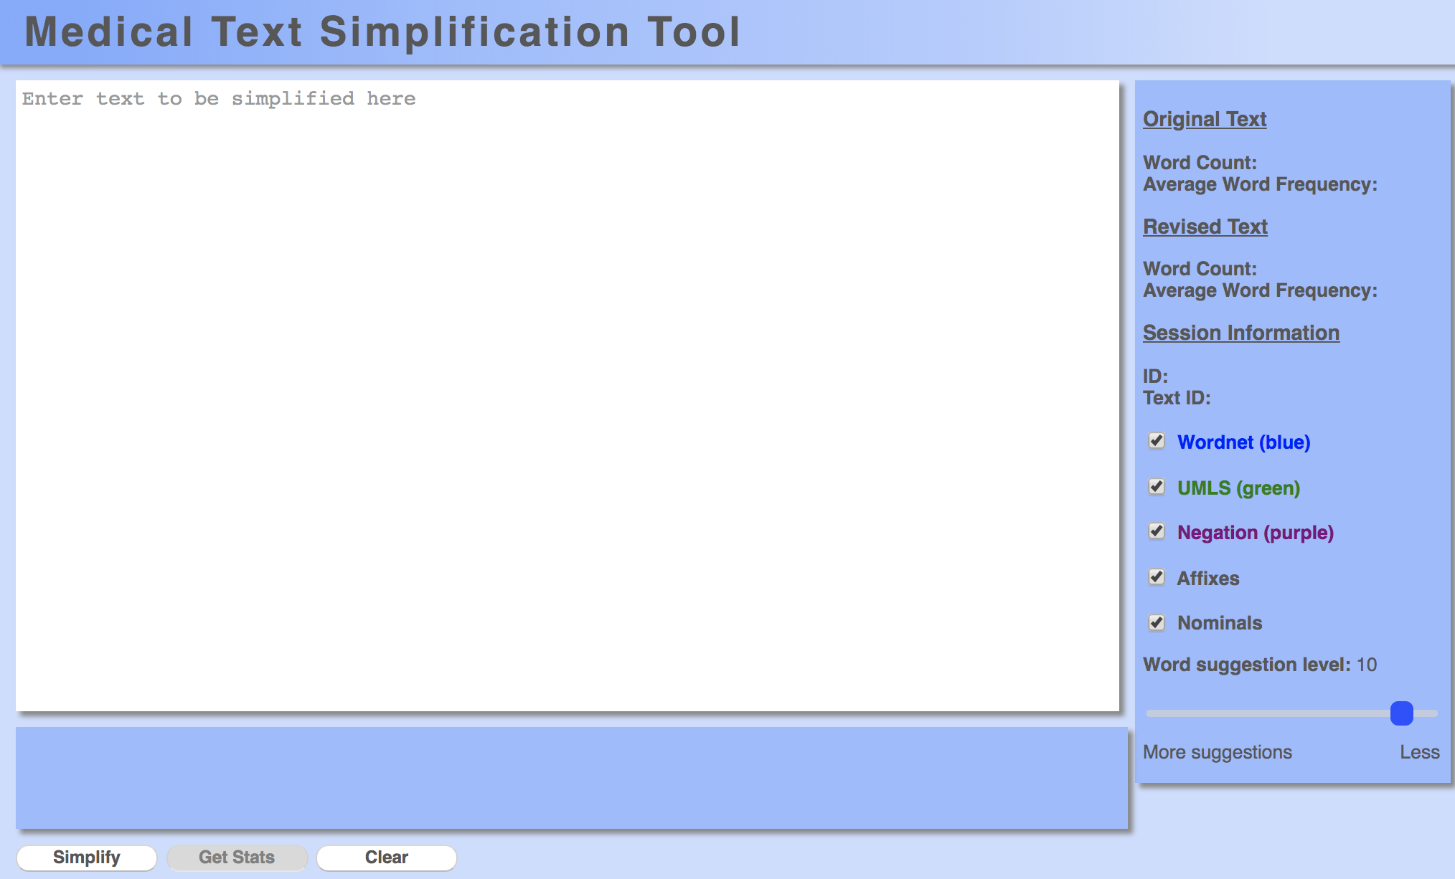
Writer assist tool
Notes:
- Web-based tool

Slide 36
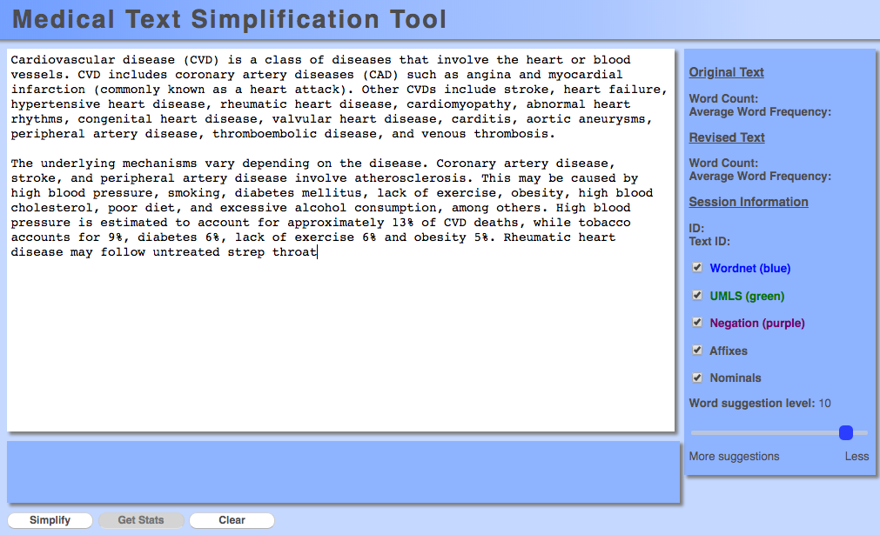
Writer assist tool

Slide 37
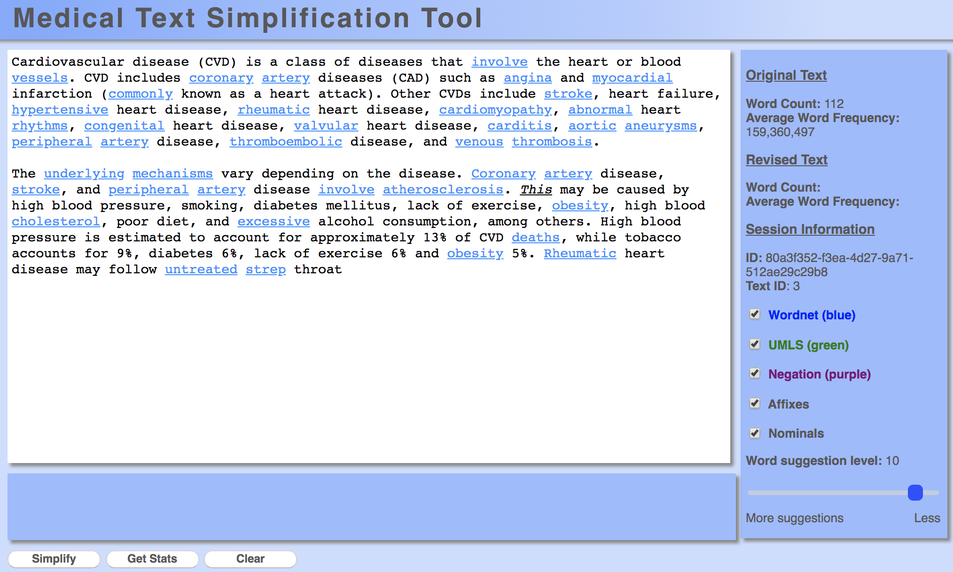
Writer assist tool

Slide 38
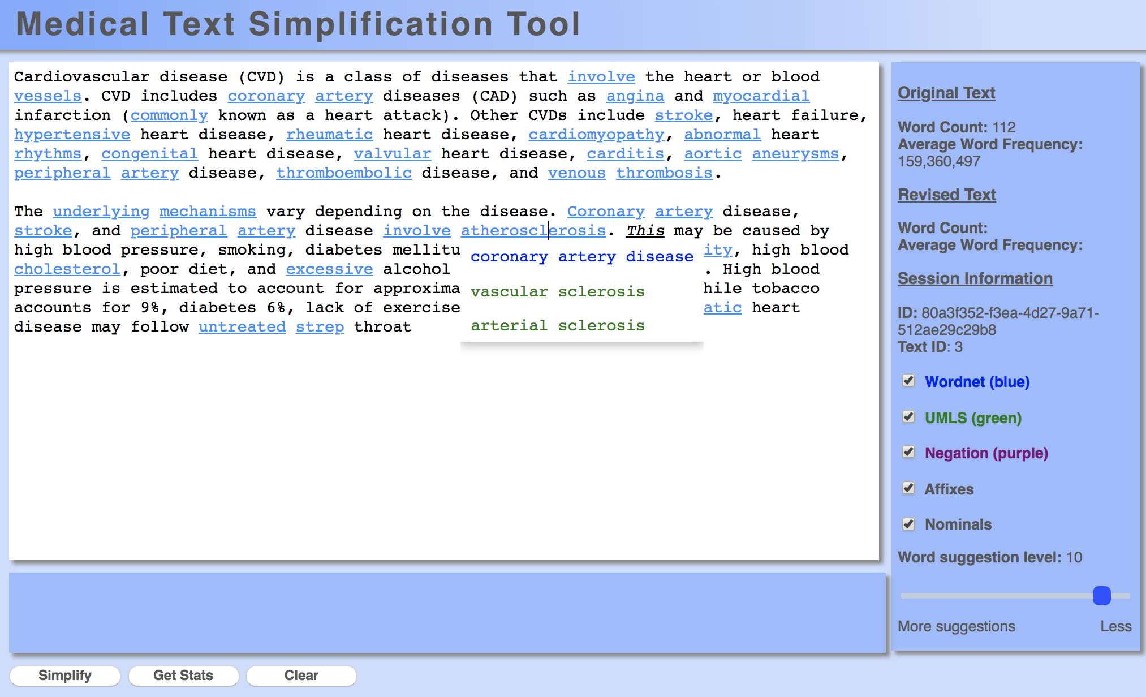
Writer assist tool

Slide 39
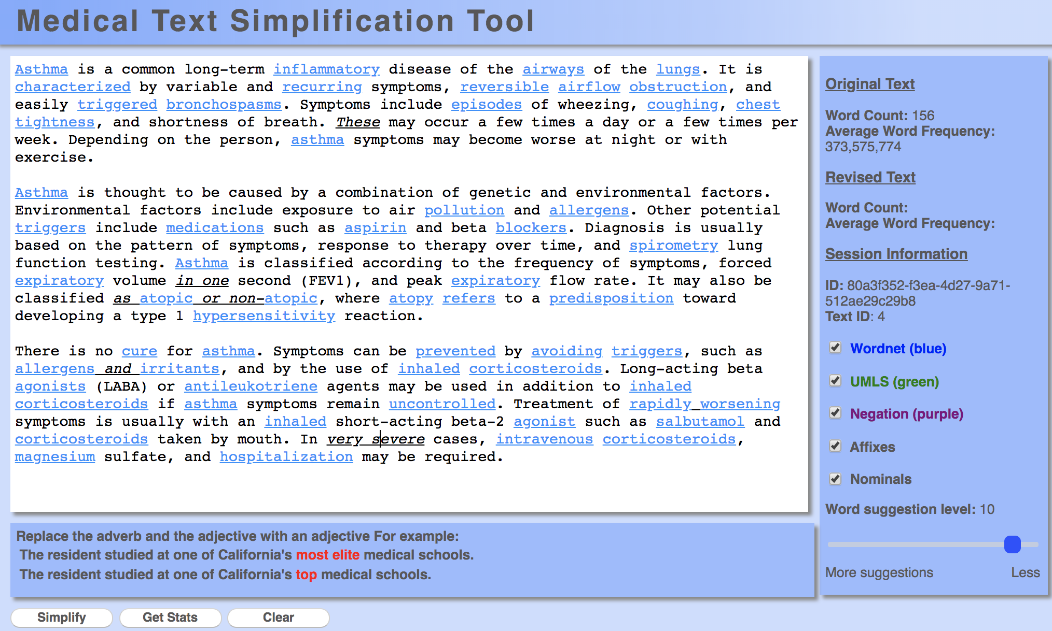
Writer assist tool

Slide 40
How do we identify difficult words?
Notes:
Historically, this has been done either by a person or using a pre-defined word list.
Every simplification component utilized in the tool has been experimentally validated with multiple types of studies, including corpus analyses and user studies.

Slide 41
A semi-automated approach
I disdain green chicken ovum and ham.
identify difficult words
I disdain green chicken ovum and ham.
Based on word frequency!
(low-frequency words)

Slide 42
A semi-automated approach
I disdain green chicken ovum and ham.
dislike
hate
scorn
…
egg cell
seed
egg
…
generate candidate word simplifications from text resources (e.g. thesauruses, dictionaries, etc.)
Human annotator
Notes:
This is still a huge savings over a fully manual approach:
only have to focus on the words/phrases that are flagged
given hints of possible words, ideally ranked by likelihood of replacement
Why we call it a “semi-automated” approach

Slide 43
A semi-automated approach
I disdain green chicken ovum and ham.
dislike
hate
scorn
…
egg cell
seed
egg
…
I do not like green eggs and ham.

Slide 44
Evaluation/experimentation
I disdain green chicken ovum and ham.
I do not like green eggs and hame
How do we tell if our system is useful?

Slide 45
An experiment
original document
simplified document
Examine if people’s learning and understanding improve with the simplified article

Slide 46
An experiment
Page 1:
Page 2:
Page 3:
original
simple
Q1
Q2
Q3
…
Q1
Q2
Q3
…
or
Q4, Q5, Q6, …
answer some questions related to the article topic
read one version of the article and answer some different questions with the text
answer the same questions again!
Notes:
pre/post questions check to see how much the user learned
questions with text check to see how well user understands text

Slide 47
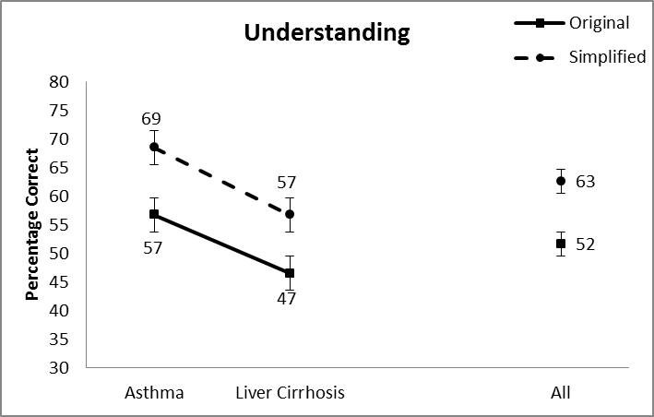
Results with the text: understanding (questions Q3, Q4, Q5, …)
Notes:
mechanical turk
100 random participants
two articles

Slide 48
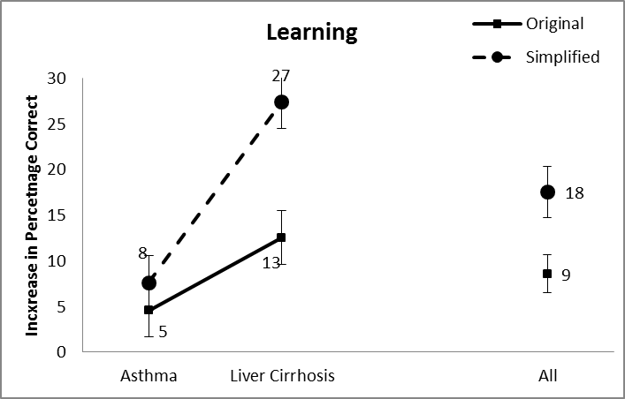
Results without the text: learning (questions Q1, Q2, Q3,…)

Slide 49
Spectrum of solutions
readability formulas
simple word lists
flag difficult text sections
simplification thesauruses
rule-based with human check
…
Simplify
manual
semi-automated
fully automated

Slide 50
Data-driven approach
unsimplified
simplified
Alfonso Perez Munoz, usually referred to as Alfonso, is a former Spanish footballer, in the striker position.
Alfonso Perez is a former Spanish football player.
learning
The reverse process, producing electrical energy from mechanical, energy, is accomplished by a generator or dynamo.
A dynamo or an electric generator does the reverse: it changes mechanical movement into electric energy.
I find forest colored chicken ovum and pork rump to be dietarily disturbing.
I do not like green eggs and ham.
…
Given training data (paired sentences)
learn a simplification model
Notes:
not the only way to pose the problem
-- could not require any data (for example, based on hand-written rules)
-- could also utilize monolingual text

Slide 51
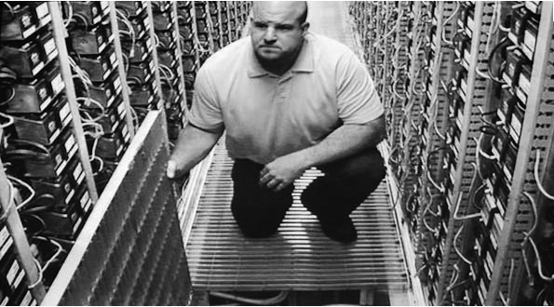
Collecting simplification data
I took a speed reading course and read War and Peace in twenty minutes. It involves Russia. – Woody Allen

Slide 52
Wikipedia for text simplification
“We use Simple English words and grammar here. The Simple English Wikipedia is for everyone! That includes children and adults who are learning English.”
Notes:
- 67K articles

Slide 53
Wikipedia for text simplification
“Simple does not mean little. Writing in Simple English means that simple words are used. It does not mean readers want simple information. Articles do not have to be short to be simple; expand articles, include a lot of information, but use basic vocabulary.”
Notes:
- 67K articles

Slide 54
Wikipedia for text simplification
4.4M articles
97K articles
unsimplified
simplified
Alfonso Perez Munoz, usually referred to as Alfonso, is a former Spanish footballer, in the striker position.
Alfonso Perez is a former Spanish football player.
The reverse process, producing electrical energy from mechanical, energy, is accomplished by a generator or dynamo.
A dynamo or an electric generator does the reverse: it changes mechanical movement into electric energy.
I find forest colored chicken ovum and pork rump to be dietarily disturbing.
I do not like green eggs and ham.

Slide 55
From aligned documents to aligned sentences

Slide 56
From aligned documents to aligned sentences

Slide 57
Wikipedia for text simplification
4.4M articles
97K articles
unsimplified
simplified
167K aligned sentence pairs
Alfonso Perez Munoz, usually referred to as Alfonso, is a former Spanish footballer, in the striker position.
Alfonso Perez is a former Spanish football player.
The reverse process, producing electrical energy from mechanical, energy, is accomplished by a generator or dynamo.
A dynamo or an electric generator does the reverse: it changes mechanical movement into electric energy.
I find forest colored chicken ovum and pork rump to be dietarily disturbing.
I do not like green eggs and ham.

Slide 58
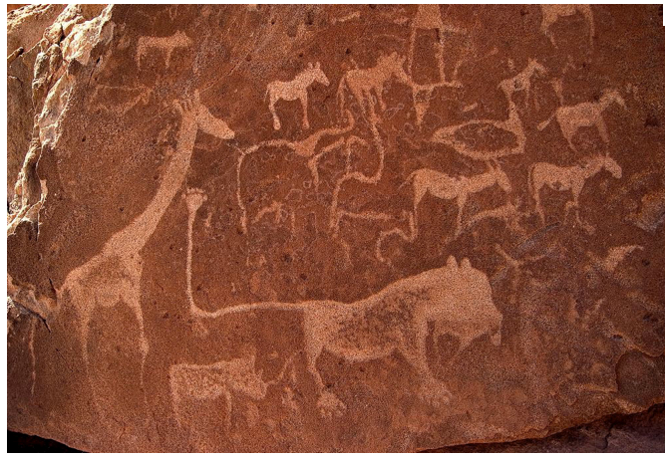
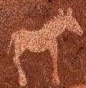
Simplification approaches

Slide 59
Simplification approaches
Many different data-driven approaches
Lexical (change a word at a time)
Phrasal (change phrases)
Syntactic (use grammatical structure)
Neural networks/LLMs

Slide 60
Lexical simplification
The ACL was established in 1962.
The ACL was started in 1962.
Simplification is accomplished by changing one word (or phrase) at a time.

Slide 61
Lexical simplification
The ACL was established in 1962.
The ACL was started in 1962.
How can we learn to do this from our data?

Slide 62
Preprocessing
The first school was established in 1857
The first school was started in 1857
The district was established in 1993 by merging …
The district was made in 1993 by joining …
Automatically word-align sentences
Notes:
Starting with 200K aligned sentence pairs

Slide 63
Extract candidate simplifications
The first school was established in 1857
The first school was started in 1857
The district was established in 1993 by merging …
The district was made in 1993 by joining …
extract aligned candidate word pairs:
different words
same part of speech
not in a list of common words (stoplist)

Slide 64
Simplification rules learned
word
candidate simplifications
abolish remove, replace, stop
established began, made, settled, started
merging becoming, joining
…
Learned simplification rules for 14,478 words
On average 2.25 candidate simplifications

Slide 65
Not all rules apply in all contexts
The ACL was established in 1962.
The ACL was began in 1962.
The ACL was made in 1962.
The ACL was settled in 1962.
The ACL was started in 1962.

Slide 66
Data for learning context

Slide 67
Collected data for 500 words
# of people that suggested simplification
(out of 50)
simplification
obtained 17
gathered 9
gotten 8
grabbed 4
acquired 2
made 2
…
procured
Notes:
Did this for 500 words and 50 people per word

Slide 68
Learning to apply rules
500 examples
Food is procured with its suckers and then crushed using its tough “beak” of chitin.
1.
Food is obtained with its suckers and then crushed using its tough “beak” of chitin.
2.
Food is gathered with its suckers and then crushed using its tough “beak” of chitin.
3.
Food is gotten with its suckers and then crushed using its tough “beak” of chitin.
4.
Food is grabbed with its suckers and then crushed using its tough “beak” of chitin.
…

Slide 69
Learning a ranker
1.
Food is obtained with its suckers and then crushed using its tough “beak” of chitin.
2.
Food is gathered with its suckers and then crushed using its tough “beak” of chitin.
3.
Food is gotten with its suckers and then crushed using its tough “beak” of chitin.
4.
Food is grabbed with its suckers and then crushed using its tough “beak” of chitin.
ranking examples
rerank candidates in the context of the sentence
machine learning
…

Slide 70
Applying the ranker
The ACL was began in 1962.
The ACL was made in 1962.
The ACL was settled in 1962.
The ACL was started in 1962.
rerank candidates in the context of the sentence
The ACL was started in 1962.
The ACL was made in 1962.
The ACL was began in 1962.
The ACL was settled in 1962.

Slide 71
Results
Previous approach:
Coverage: 85% (of the words that could be changed)
Accuracy: 54% (of the suggestions are correct)
Our approach:
Coverage: 86%
Accuracy: 76%
Notes:
A slight bump in coverage
Significantly higher quality suggestions

Slide 72
Phrase-based sentence simplification
I disdain green ham with green eggs
Notes:
this is the approach for phrase-based machine translation
the actual approach is a bit more involved, but this is the high-level idea
phrase-based approaches are roughly state of the art. Used by google’s translation approach.

Slide 73
Phrase-based sentence simplification
I disdain
green ham
with
green eggs
Unsimplified sentence is probabilistically broken into phrases
“phrase” is a sequence of words
Notes:
this is the approach for phrase-based machine translation
the actual approach is a bit more involved, but this is the high-level idea
phrase-based approaches are roughly state of the art. Used by google’s translation approach.

Slide 74
Phrase-based sentence simplification
I disdain
green ham
with
green eggs
I do not like
ham
and
green eggs
Each phrase is probabilistically simplified
Notes:
this is the approach for phrase-based machine translation
the actual approach is a bit more involved, but this is the high-level idea
phrase-based approaches are roughly state of the art. Used by google’s translation approach.

Slide 75
Phrase-based sentence simplification
I disdain
green ham
with
green eggs
I do not like
green eggs
and
ham
Phrases are probabilistically reordered
Notes:
this is the approach for phrase-based machine translation
the actual approach is a bit more involved, but this is the high-level idea
phrase-based approaches are roughly state of the art. Used by google’s translation approach.

Slide 76
Learned phrase examples
original | simple | probability
ham | ham | 0.7
ham | pork | 0.2
ham | meat | 0.1
…
like to eat a variety | like to eat a variety | 0.5
like to eat a variety | like to eat lots | 0.3
like to eat a variety | like to eat many | 0.2
Learn these aligned phrases and probabilities from the aligned sentences

Slide 77
Phrase-based sentence simplification
I disdain green ham with green eggs
I do not like green eggs and ham
I do not like ham and green eggs
I do not like green eggs and green ham
I do not like green eggs with ham
I do not like eggs with ham
…
Model is probabilistic and considers many, many variations!

Slide 78
Phrase-based sentence simplification
Problem: does not account for phrasal deletion
I disdain the food
green ham
with
green eggs
I do not like
green eggs
and
ham
Notes:
reasons are mostly historical
-- this doesn’t happen much in language translation
-- makes the model more complicated
-- and can make translation more complicated

Slide 79
Phrase-based sentence simplification
Problem: does not account for phrasal deletion
I disdain
the food green ham
with
green eggs
I do not like
green eggs
and
ham
Notes:
reasons are mostly historical
-- this doesn’t happen much in language translation
-- makes the model more complicated
-- and can make translation more complicated

Slide 80
Phrase-based sentence simplification
We add phrasal deletion
I disdain
the food
green ham
with
green eggs
I do not like
green eggs
and
ham
Each phrase is probabilistically simplified
Phrases can also be probabilistically deleted

Slide 81
Deleted phrases
0.5% of learned phrases are deletions
Phrase-table entry | probability of deletion
, the of the or however , the city of generally approximately , however , , etc | 0.057 0.033 0.0015 0.0014 0.00095 0.00034 0.00033 0.00025 0.00022 0.00013

Slide 82
Qualitatively: Phrase-based
Critical reception for The Wild has been negative.
Reviews for The Wild has been negative.
rewording

Slide 83
Qualitatively: Phrase-based
Bauska is a town in Bauska county, in the Zemgale region of southern Latvia.
Bauska is a town in Bauska county, in the region of Zemgale.
rewording/reordering, deletion

Slide 84
Qualitatively: Phrase-based
Nicolas Anelka is a French footballer who currently plays as a striker for Chelsea in the English premier league.
Nicolas Anelka is a French football player. He plays for Chelsea.
rewording, deletion, sentence splitting

Slide 85
Qualitatively: Phrase-based
Each edge of a tesseract is of the same length.
Same edge of the same length.

Slide 86
Qualitatively: Previous approach
He often recuperated at Menton, near Nice, France, where he eventually died on 1892 January 31.
He died.
Notes:
T3 in general tended to be overly aggressive with deletion
averaged 13 words per sentence, as compared to 21 words for the human simplifications

Slide 87
Quantitatively
Compared to three previous systems:
Pros:
phrase-based approach tends to be more similar to human simplifications than other approaches
deletion improves the quality
model is fairly easy to understand
Cons:
tends to only make minor changes to the sentences
some disfluencies due to long distance dependencies

Slide 88
A syntax-based approach
Our life is frittered away by detail.
Simplify, simplify.
- H.D. Thoreau
Our life is frittered away.
- Lab Machine 227-31

Slide 89
Future thoughts/challenges
How do people do it?
What is simple?
different domains may have different notion
How do domain constraints affect approaches
medical and legal
deletion is frowned upon
insertions are much more common (e.g. definitions)
can our algorithms vary the simplicity?
Text-to-image models
LLMs (hallucinations?)

Slide 90
Current version of the tool

Slide 91
Four of these are true
I was pulled over by a helicopter
I speak three languages fluently
I had a “strip-off” with my CEO at an all-hands meeting
I know how to scuba dive
I play Pokemon GO

Slide 92
Four of these are true
I lived in Vermont for three years
I won a disc golf tournament
I’m a dual citizen
I’ve been to Albania 5 times
I brew my own beer

Slide 93
Four of these are true
I cut my own hair
I wrote the prototype of Google Scholar
I mountain unicycle
I was born in Antarctica
I have over 100 bottles of alcohol at home

