Slide 1
Final project
David Kauchak CS159 Fall 2024

Slide 2
Admin
Quiz 3
Assignment 7

Slide 3
Final project
Your project should relate to something involving NLP
Your project must include a solid experimental evaluation
Your project must have an ethical component
Your project should be in a group of 2-4. If you’d like to do it solo, please come talk to me.

Slide 4
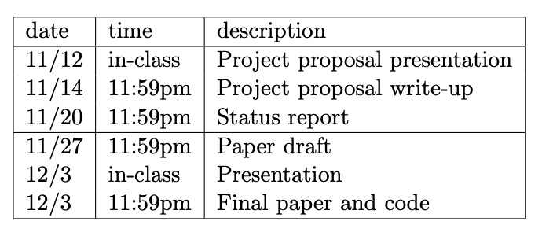
Final project
Read the final project handout ASAP!
Start forming groups and thinking about what you want to do

Slide 5
Final project ideas
pick a text classification task
evaluate different machine learning methods
implement a machine learning method
analyze different feature categories
n-gram language modeling
implement and compare other smoothing techniques
implement alternative models
parsing
lexicalized PCFG (with smoothing)
n-best list generation
parse output reranking
implement another parsing approach and compare
parsing non-traditional domains (e.g. twitter)
EM
try and implement IBM model 2
word-level translation models

Slide 6
Final project application areas
spelling correction
part of speech tagger
text chunker
dialogue generation
pronoun resolution
compare word similarity measures (more than the ones we looked at)
word sense disambiguation
machine translation
information retrieval/search
information extraction
question answering
summarization
speech recognition

Slide 7
Final project application areas
Ethical analysis of: Word2Vec, GPT-X, ChatGPT
Utilize LLM (large language model), e.g., GPT
poety
lyrics
code generation
prompt engineering/effect
…
Limited resource NLP (e.g., limited memory or computation)
BART/BERT

