Slide 1
Advanced Classification techniques
David Kauchak CS 159 – Fall 2024

Slide 2
Admin
Assignment 7 out (last one!!)
Thursday:
30 minute class discussing final project details
Take Quiz 3 sometime during the day
Grading

Slide 3
Schedule for the rest of the semester

Slide 4
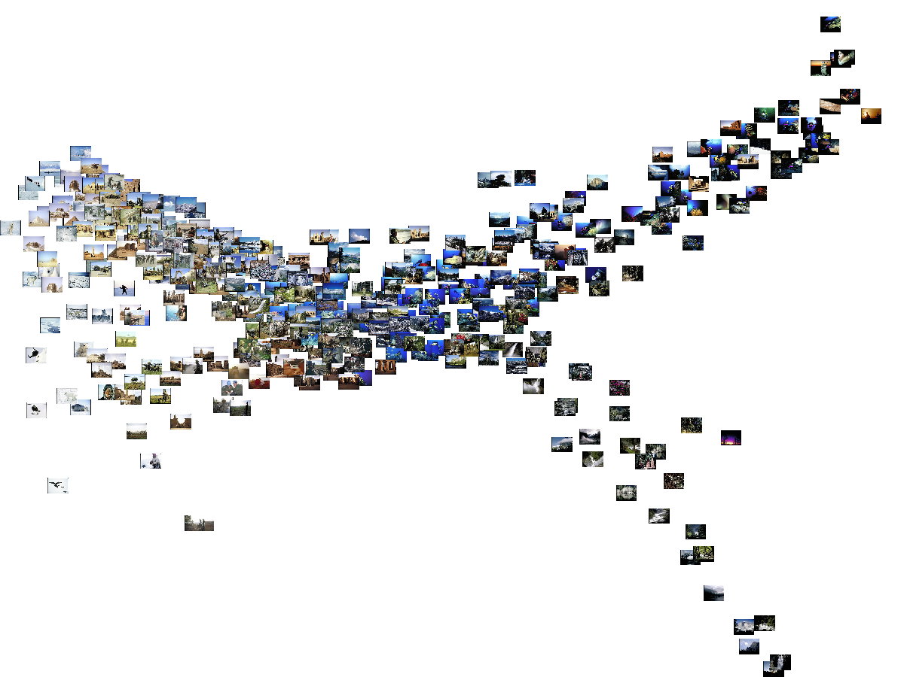
Machine Learning: A Geometric View

Slide 5
Apples vs. Bananas
Weight | Color | Label
4 | Red | Apple
5 | Yellow | Apple
6 | Yellow | Banana
3 | Red | Apple
7 | Yellow | Banana
8 | Yellow | Banana
6 | Yellow | Apple
Can we visualize this data?

Slide 6
Apples vs. Bananas
Turn features into numerical values
Weight | Color | Label
4 | 0 | Apple
5 | 1 | Apple
6 | 1 | Banana
3 | 0 | Apple
7 | 1 | Banana
8 | 1 | Banana
6 | 1 | Apple
1
A
B
B
B
A
Color
0
A
A
0
Weight
10
We can view examples as points in an n-dimensional space where n is the number of features called the feature space

Slide 7
Examples in a feature space
feature₂
label 1
label 2
label 3
feature₁

Slide 8
Test example: what class?
feature₂
label 1
label 2
label 3
feature₁

Slide 9
Test example: what class?
feature₂
label 1
label 2
closest to red
label 3
feature₁

Slide 10
Another classification algorithm?
To classify an example d:
Label d with the label of the closest example to d in the training set

Slide 11
What about this example?
feature₂
label 1
label 2
label 3
feature₁

Slide 12
What about this example?
feature₂
label 1
label 2
closest to red, but…
label 3
feature₁

Slide 13
What about this example?
feature₂
label 1
Most of the next closest are blue
label 2
label 3
feature₁

Slide 14
k-Nearest Neighbor (k-NN)
To classify an example d:
Find k nearest neighbors of d
Choose as the label the majority label within the k nearest neighbors

Slide 15
k-Nearest Neighbor (k-NN)
To classify an example d:
Find k nearest neighbors of d
Choose as the label the majority label within the k nearest neighbors
How do we measure “nearest”?

Slide 16
Decision boundaries
The decision boundaries are places in the features space where the classification of a point/example changes
label 1
label 2
label 3
Where are the decision boundaries for k-NN?

Slide 17
k-NN decision boundaries
label 1
label 2
label 3
k-NN gives locally defined decision boundaries between classes

Slide 18
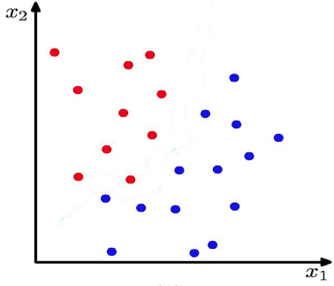
k-Nearest Neighbour (k-NN) Classifier
K = 1
What is the decision boundary for k-NN for this one?

Slide 19
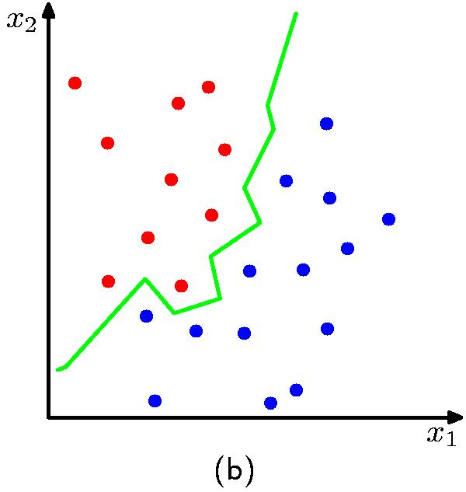
k-Nearest Neighbour (k-NN) Classifier
K = 1

Slide 20
Machine learning models
Some machine learning approaches make strong assumptions about the data
If the assumptions are true this can often lead to better performance
If the assumptions aren’t true, they can fail miserably
Other approaches don’t make many assumptions about the data
This can allow us to learn from more varied data
But, they are more prone to overfitting (biasing too much to the training data)
and generally require more training data

Slide 21
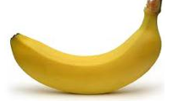
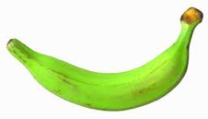
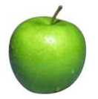
data generating distribution
Training data
Test set
data generating distribution

Slide 22
What is the data generating distribution?

Slide 23
What is the data generating distribution?

Slide 24
What is the data generating distribution?

Slide 25
What is the data generating distribution?

Slide 26
What is the data generating distribution?

Slide 27
What is the data generating distribution?

Slide 28
Actual model

Slide 29
Model assumptions
If you don’t have strong assumptions about the model, it can take you a longer to learn
Assume now that our model of the blue class is two circles

Slide 30
What is the data generating distribution?

Slide 31
What is the data generating distribution?

Slide 32
What is the data generating distribution?

Slide 33
What is the data generating distribution?

Slide 34
What is the data generating distribution?

Slide 35
Actual model

Slide 36
What is the data generating distribution?
Knowing the model beforehand can drastically improve the learning and the number of examples required

Slide 37
What is the data generating distribution?

Slide 38
Make sure your assumption is correct, though!

Slide 39
Machine learning models
What were the model assumptions (if any) that k-NN and NB made about the data?
Are there training data sets that could never be learned correctly by these algorithms?

Slide 40
k-NN model
K = 1

Slide 41
Linear models
A strong assumption is linear separability:
in 2 dimensions, you can separate labels/classes by a line
in higher dimensions, need hyperplanes
A linear model is a model that assumes the data is linearly separable

Slide 42
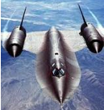
Hyperplanes
A hyperplane is line/plane in a high dimensional space
What defines a line?
What defines a hyperplane?

Slide 43
Defining a line
Any pair of values (w₁,w₂) defines a line through the origin:
f₂
f₁

Slide 44
Defining a line
Any pair of values (w₁,w₂) defines a line through the origin:
f₂
f₁
What does this line look like?

Slide 45
Defining a line
Any pair of values (w₁,w₂) defines a line through the origin:
f₂
-2
-1
0
1
2
1
0.5
0
-0.5
-1
f₁

Slide 46
Defining a line
Any pair of values (w₁,w₂) defines a line through the origin:
f₂
-2
-1
0
1
2
1
0.5
0
-0.5
-1
f₁

Slide 47
Defining a line
Any pair of values (w₁,w₂) defines a line through the origin:
f₂
(1,2)
w=(1,2)
f₁
We can also view it as the line perpendicular to the weight vector

Slide 48
Classifying with a line
Mathematically, how can we classify points based on a line?
f₂
BLUE
(1,1)
f₁
RED
(1,-1)
w=(1,2)

Slide 49
Classifying with a line
Mathematically, how can we classify points based on a line?
f₂
BLUE
(1,1):
(1,1)
(1,-1):
f₁
RED
(1,-1)
w=(1,2)
The sign indicates which side of the line

Slide 50
Defining a line
Any pair of values (w₁,w₂) defines a line through the origin:
f₂
f₁
How do we move the line off of the origin?

Slide 51
Defining a line
Any pair of values (w₁,w₂) defines a line through the origin:
f₂
-2
-1
0
1
2
f₁

Slide 52
Defining a line
Any pair of values (w₁,w₂) defines a line through the origin:
f₂
Now intersects at -1
-2
-1
0
1
2
0.5
0
-0.5
-1
-1.5
f₁

Slide 53
Linear models
A linear model in n-dimensional space (i.e. n features) is define by n+1 weights:
In two dimensions, a line:
In three dimensions, a plane:
In n-dimensions, a hyperplane
(where b = -a)

Slide 54
Classifying with a linear model
We can classify with a linear model by checking the sign:
Positive example
f₁, f₂, …, f_{m}
classifier
Negative example

Slide 55
An aside: dot product
$$b+ \sum_{j=1}^{m}{w_{j}f_{j}=b+w∙f}$$
$w=w_{1},w_{2},$ $w_{f},$…, $w_{m},$
f$=f_{1},f_{2},$ $f_{f},$…, $f_{m},$

Slide 56
Learning a linear model
Geometrically, we know what a linear model represents
Given a linear model (i.e. a set of weights and b) we can classify examples
learn
Training
Data
How do we learn a linear model?
(data with labels)

Slide 57
Which hyperplane would you choose?

Slide 58
Large margin classifiers
margin
margin
Choose the line where the distance to the nearest point(s) is as large as possible

Slide 59
Large margin classifiers
margin
margin
The margin of a classifier is the distance to the closest points of either class
Large margin classifiers attempt to maximize this

Slide 60
Large margin classifier setup
Select the hyperplane with the largest margin where the points are classified correctly!
Setup as a constrained optimization problem:
subject to:
what does this say?
y_{i}: label for example i, either 1 (positive) or -1 (negative)
x_{i}: our feature vector for example i
Notes:
That each example is classified correctly!

Slide 61
Measuring the margin
How do we calculate the margin?

Slide 62
Support vectors
For any separating hyperplane, there exist some set of “closest points”
These are called the support vectors
Notes:
- they are vectors (i.e. points) and they support/define the line

Slide 63
Measuring the margin
The margin is the distance to the support vectors, i.e. the “closest points”, on either side of the hyperplane

Slide 64
Support vector machine problem
Posed as a quadratic optimization problem
Maximize/minimize a quadratic function
Subject to a set of linear constraints
Many, many variants of solving this problem
One of the most successful classification approaches

Slide 65
Support vector machines
One of the most successful (if not the most successful) classification approaches:
decision tree
Support vector machine (SVM)
k nearest neighbor
Naïve Bayes

Slide 66
NN decision boundary
x₁
w₁
x₂
w₂
output
…
w_{m}
x_{m}
What does the decision boundary of a perceptron look like?
Line (linear set of weights)

Slide 67
NN decision boundary
What does the decision boundary of a 2-layer network look like?
Is it linear?
What types of things can and can’t it model?

Slide 68
XOR
1
Input x₁
1
-1
Output = x₁ xor x₂
b=-0.5
-1
1
1
b=-0.5
Input x₂
x₁ | x₂ | x₁ xor x₂
0 | 0 | 0
0 | 1 | 1
1 | 0 | 1
1 | 1 | 0
b=-0.5

Slide 69
What does the decision boundary look like?
1
Input x₁
1
-1
Output = x₁ xor x₂
b=-0.5
-1
1
1
b=-0.5
Input x₂
x₁ | x₂ | x₁ xor x₂
0 | 0 | 0
0 | 1 | 1
1 | 0 | 1
1 | 1 | 0
b=-0.5

Slide 70
What does the decision boundary look like?
1
Input x₁
1
-1
Output = x₁ xor x₂
b=-0.5
-1
1
1
b=-0.5
Input x₂
x₁ | x₂ | x₁ xor x₂
0 | 0 | 0
0 | 1 | 1
1 | 0 | 1
1 | 1 | 0
b=-0.5
What does this perceptron’s decision boundary look like?

Slide 71
NN decision boundary
Input x₁
-1
x₂
(-1,1)
1
Input x₂
x₁
b=-0.5
(without the bias)

Slide 72
NN decision boundary
Input x₁
-1
x₂
1
Input x₂
x₁
b=-0.5

Slide 73
What does the decision boundary look like?
1
Input x₁
1
-1
Output = x₁ xor x₂
b=-0.5
-1
1
1
b=-0.5
Input x₂
x₁ | x₂ | x₁ xor x₂
0 | 0 | 0
0 | 1 | 1
1 | 0 | 1
1 | 1 | 0
b=-0.5
What does this perceptron’s decision boundary look like?

Slide 74
NN decision boundary
1
Input x₁
x₂
b=-0.5
-1
Input x₂
x₁
(1,-1)
(without the bias)

Slide 75
NN decision boundary
1
Input x₁
x₂
b=-0.5
-1
Input x₂
x₁

Slide 76
What does the decision boundary look like?
1
Input x₁
1
-1
Output = x₁ xor x₂
b=-0.5
-1
1
1
b=-0.5
Input x₂
x₁ | x₂ | x₁ xor x₂
0 | 0 | 0
0 | 1 | 1
1 | 0 | 1
1 | 1 | 0
b=-0.5
What operation does this perceptron perform on the result?

Slide 77
Fill in the truth table
1
1
b=-0.5
out1 | out2
0 | 0 | ?
0 | 1 | ?
1 | 0 | ?
1 | 1 | ?

Slide 78
OR
1
1
b=-0.5
out1 | out2
0 | 0 | 0
0 | 1 | 1
1 | 0 | 1
1 | 1 | 1

Slide 79
What does the decision boundary look like?
1
Input x₁
1
-1
Output = x₁ xor x₂
b=-0.5
-1
1
1
b=-0.5
Input x₂
x₁ | x₂ | x₁ xor x₂
0 | 0 | 0
0 | 1 | 1
1 | 0 | 1
1 | 1 | 0
b=-0.5

Slide 80
1
Input x₁
1
-1
Output = x₁ xor x₂
x₂
b=-0.5
-1
1
1
b=-0.5
Input x₂
x₁
b=-0.5
If either predicts positive, example is positive

Slide 81
1
Input x₁
1
-1
Output = x₁ xor x₂
x₂
b=-0.5
-1
1
1
b=-0.5
Input x₂
x₁
b=-0.5
x₁ | x₂ | x₁ xor x₂
0 | 0 | 0
0 | 1 | 1
1 | 0 | 1
1 | 1 | 0

Slide 82
What does the decision boundary look like?
Input x₁
Output = x₁ xor x₂
Input x₂
linear splits of the feature space
combination of these linear spaces

Slide 83
What does the decision boundary look like?
Input x₁
Output = x₁ xor x₂
Input x₂
combination of these linear spaces
linear splits of the feature space

Slide 84
Three hidden nodes

Slide 85
NN decision boundaries
Put simply: two-layer networks can approximate any function

Slide 86
Compiling Java programs

Slide 87
Soft Margin Classification
subject to:
What about this problem?

Slide 88
Soft Margin Classification
subject to:
We’d like to learn something like this, but our constraints won’t allow it ☹

Slide 89
Slack variables
subject to:
$maxwb$ margin(w,b) + C $\sum_{i}{−ξi}$
slack variables (one for each example)
subject to:
$yi\left(w∙xi+b\right)≥−ξ$_{i} $∀i$
$ξ$_{i} $≥$ 0
What effect does this have?

Slide 90
Slack variables
$maxwb$ margin(w,b) + C $\sum_{i}{ξi}$
subject to:
$yi\left(w∙xi+b\right)≥−ξ$_{i} $∀i$
$ξ$_{i} $≥$ 0
slack penalties

Slide 91
Slack variables
trade-off between margin maximization and penalization
margin
penalized by how far from “correct”
$maxwb$ margin(w,b) + C $\sum_{i}{ξi}$
subject to:
allowed to make a mistake
$yi\left(w∙xi+b\right)≥−ξ$_{i} $∀i$
$ξ$_{i} $≥$ 0

Slide 92
Soft margin SVM
$maxwb$ margin(w,b) + C $\sum_{i}{ξi}$
subject to:
$yi\left(w∙xi+b\right)≥−ξ$_{i} $∀i$
$ξ$_{i} $≥$ 0
Still a quadratic optimization problem!

Slide 93
Other successful classifiers in NLP
Perceptron algorithm
Linear classifier
Trains “online”
Fast and easy to implement
Often used for tuning parameters (not necessarily for classifying)
Logistic regression classifier (aka Maximum entropy classifier)
Probabilistic classifier
Doesn’t have the NB constraints
Performs very well
More computationally intensive to train than NB

