Slide 1
Neural networks Applied
David Kauchak
CS159 – Fall 2024

Slide 2
Admin
Assignment 5a due tonight
Assignment 5b due next Wednesday
Grading update
Schedule for the rest of the semester mostly up to date

Slide 3
A Single Neuron/Perceptron
Input x₁
Each input contributes:
x_{i} * w_{i}
Weight w₁
Weight w₂
Input x₂
Output y
threshold function
Input x₃
Weight w₃
Weight w₄
Input x₄

Slide 4
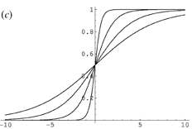
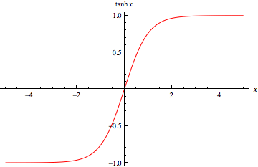
Activation functions
hard threshold:
sigmoid
tanh x
$$g\left(in\right)= \left\{\begin{matrix}1 & if in≥T \\ 0 & otherwise\end{matrix}\right.$$
Notes:
Allow us to model more than just 0/1 outputs
Differentiable! (this will come into play in a minute)

Slide 5
Many other activation functions
Rectified Linear Unit
Softmax (for probabilities)

Slide 6
Neural network
inputs
Individual perceptrons/neurons
Notes:
- often we view a slice of them

Slide 7
Neural network
some inputs are provided/entered
inputs
Notes:
- often we view a slice of them

Slide 8
Neural network
inputs
each perceptron computes and calculates an answer
Notes:
- often we view a slice of them

Slide 9
Neural network
inputs
those answers become inputs for the next level
Notes:
- often we view a slice of them

Slide 10
Neural network
inputs
finally get the answer after all levels compute
Notes:
- often we view a slice of them

Slide 11
XOR
x₁ | x₂ | x₁ xor x₂
0 | 0 | 0
0 | 1 | 1
1 | 0 | 1
1 | 1 | 0
Input x₁
W₁ = ?
T = ?
Output y
Input x₂
W₂ = ?
Notes:
What about for an OR gate?
What weights and thresholds would serve to create an OR gate?

Slide 12
Learning in multilayer networks
Challenge: for multilayer networks, we don’t know what the expected output/error is for the internal nodes!
how do we learn these weights?
w
w
w
w
w
w
w
w
w
expected output?
w
w
w
perceptron/ linear model
neural network

Slide 13
Backpropagation: intuition
Gradient descent method for learning weights by optimizing a loss function
calculate output of all nodes
calculate the weights for the output layer based on the error
“backpropagate” errors through hidden layers

Slide 14
Backpropagation: intuition
We can calculate the actual error here

Slide 15
Backpropagation: intuition
Key idea: propagate the error back to this layer

Slide 16
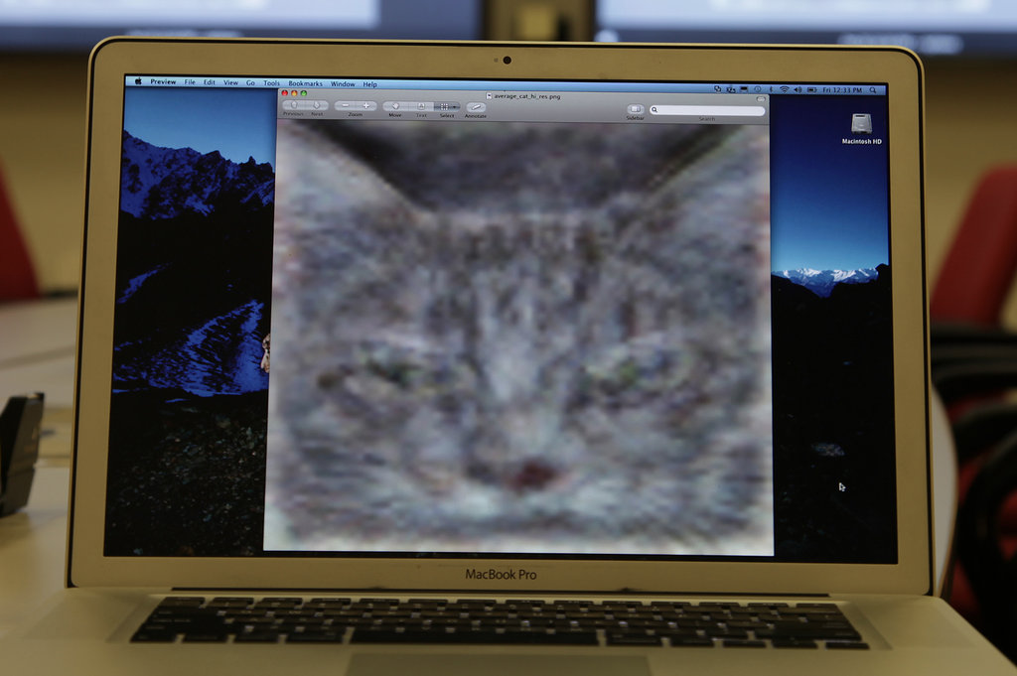
Trained a NN with 1B connections on 10M snapshots from youtube on 16,000 processors

Slide 17
http://www.nytimes.com/2012/06/26/technology/in-a-big-network-of-computers-evidence-of-machine-learning.html

Slide 18
Deep learning
Deep learning is a branch of machine learning based on a set of algorithms that attempt to model high level abstractions in data by using a deep graph with multiple processing layers, composed of multiple linear and non-linear transformations.
Deep learning is part of a broader family of machine learning methods based on learning representations of data.

Slide 19
Deep learning
Key: learning better features that abstract from the “raw” data
Using learned feature representations based on large amounts of data, generally unsupervised
Using classifiers with multiple layers of learning

Slide 20
Deep learning
More abstract representation
Train multiple layers of features/abstractions from data.
Try to discover representation that makes decisions easy.
Low-level
Features
Mid-level
Features
High-level
Features
Classifier
“Cat”?
Deep Learning: train layers of features so that classifier works well.
Slide adapted from: Adam Coates

Slide 21
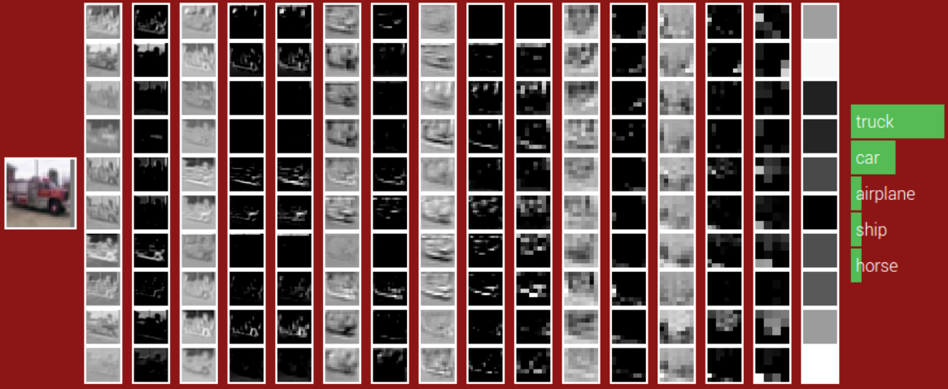
POOL
POOL
POOL
ReLU
ReLU
ReLU
ReLU
ReLU
ReLU
CONV
CONV
CONV
CONV
CONV
CONV
Fully-connected
32x32
Weights:
280
910
910
910
910
910
1600
Size:
16x16
8x8
4x4

Slide 22
Deep learning for neural networks
Traditional NN models: 1-2 hidden layers
Deep learning NN models: 3+ hidden layers
…

Slide 23
Challenges
What makes “deep learning” hard for NNs?
w₅
w₄
w₆
…
~w * error
Modified errors tend to get diluted as they get combined with many layers of weight corrections

Slide 24
Deep learning
Growing field
Driven by:
Increase in data availability
Increase in computational power
Parallelizability of many of the algorithms
Involves more than just neural networks (though, they’re a very popular model)

Slide 25
word2vec
How many people have heard of it?
What is it?

Slide 26
Word representations generalized
Project words into a multi-dimensional “meaning” space
word
[x₁, x₂, …, x_{d}]
What is our projection for assignment 5?

Slide 27
Word representations generalized
Project words into a multi-dimensional “meaning” space
word
[w₁, w₂, …, w_{d}]
Each dimension is the co-occurrence of word with w_{i}

Slide 28
Word representations
Project words into a multi-dimensional “meaning” space
word
[x₁, x₂, …, x_{d}]
red
[r₁, r₂, …, r_{d}]
[y₁, y₂, …, y_{d}]
crimson
[c₁, c₂, …, c_{d}]
[r₁, r₂, …, r_{d}]
[c₁, c₂, …, c_{d}]
yellow
[y₁, y₂, …, y_{d}]

Slide 29
Word representations
Project words into a multi-dimensional “meaning” space
word
[x₁, x₂, …, x_{d}]
The idea of word representations is not new:
Co-occurrence matrices
Latent Semantic Analysis (LSA)
New idea: learn word representation using a task-driven approach

Slide 30
A prediction problem
I like to eat bananas with cream cheese
Given a context of words
Predict what words are likely to occur in that context

Slide 31
A prediction problem
Given text, can generate lots of examples:
I like to eat bananas with cream cheese
input
prediction
___ like to eat
I ___ to eat bananas
I like ___ eat bananas with
I like to ___ bananas with cream
…
I
like
to
eat
…

Slide 32
A prediction problem
Use data like this to learn a distribution:
words before
words after

Slide 33
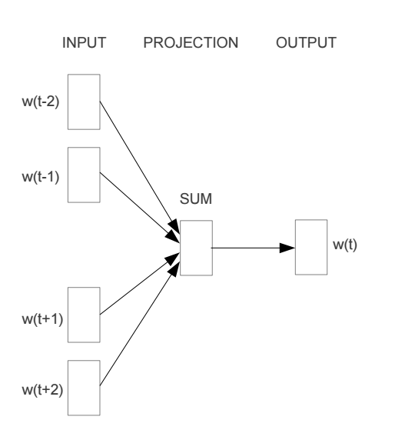
Train a neural network on this problem
https://arxiv.org/pdf/1301.3781v3.pdf

Slide 34
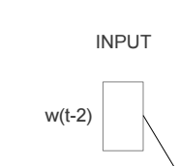
Encoding words
How can we input a “word” into a network?

Slide 35
“One-hot” encoding
For a vocabulary of V words, have V input nodes
All inputs are 0 except for the one corresponding to the word
a
apple
…
V nodes
banana
…
zebra

Slide 36
“One-hot” encoding
For a vocabulary of V words, have V input nodes
All inputs are 0 except the for the one corresponding to the word
0
a
0
apple
banana
…
1
banana
…
0
zebra

Slide 37
“One-hot” encoding
For a vocabulary of V words, have V input nodes
All inputs are 0 except the for the one corresponding to the word
0
a
1
apple
apple
…
0
banana
…
0
zebra

Slide 38
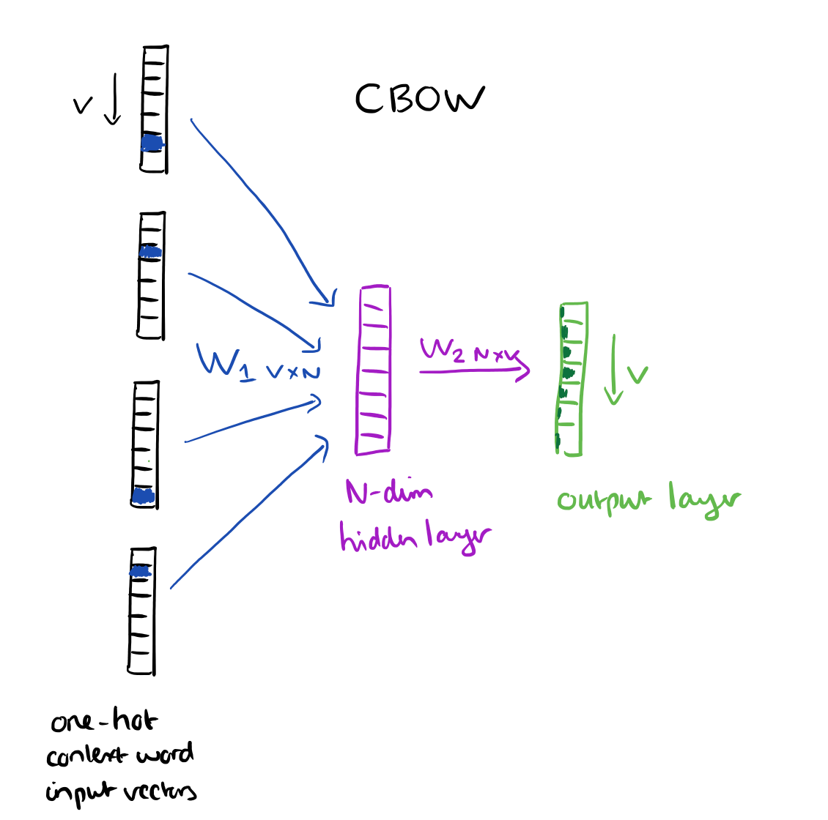
N = 100 to 1000
https://blog.acolyer.org/2016/04/21/the-amazing-power-of-word-vectors/

Slide 39
Another view
…
…
…
N hidden nodes
V input nodes
V output nodes

Slide 40
Training: backpropagation
___ like to eat
I ___ to eat bananas
I like ___ eat bananas with
I like to ___ bananas with cream
…
I
like
to
eat
…
…
…
…
N hidden nodes
V input nodes
V output nodes

Slide 41
Training: backpropagation
eat
I like to ___ bananas with cream
0
0
…
1
0
…
1
0
…
1
0
…
0
0
…
1
0
…
eat
I
…
like
…
…
to
N hidden nodes
V input nodes
V output nodes
Notes:
We want to predict 1 for the correct (positive) word and 0 for all other words

Slide 42
Word representation
VxN weights
The weights for each word provide an N dimensional mapping of the word
Words that predict similarly should have similar weights
…
…
…
Why does this work?
N hidden nodes
V input nodes
V output nodes

Slide 43
Results
vector(word1) – vector(word2) = vector(word3) - X
word1 is to word2 as word3 is to X

Slide 44
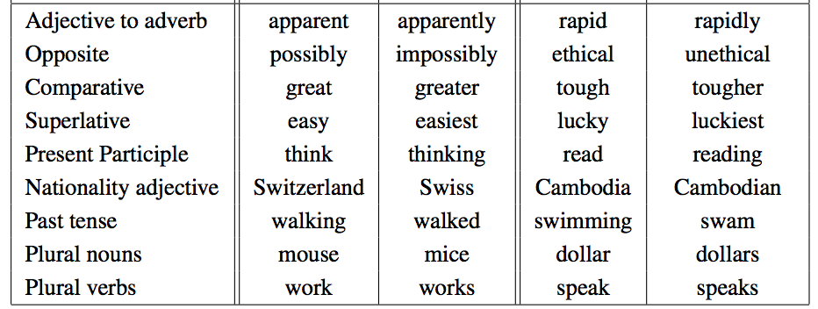
Results
vector(word1) – vector(word2) = vector(word3) - X
word1 is to word2 as word3 is to X

Slide 45
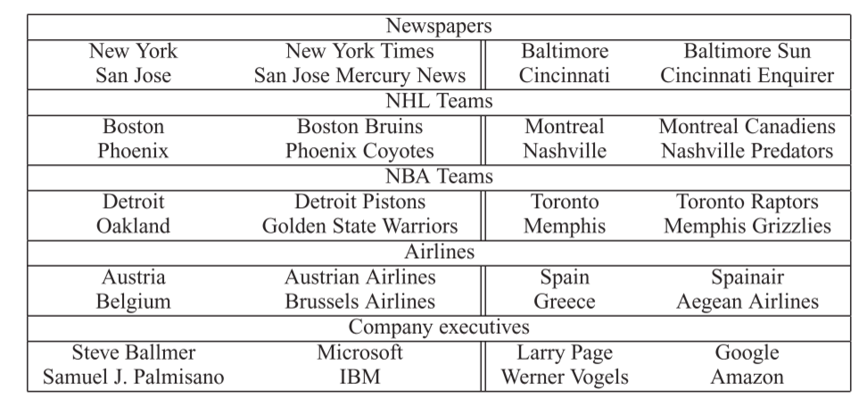
Results
vector(word1) – vector(word2) = vector(word3) - X
word1 is to word2 as word3 is to X

Slide 46
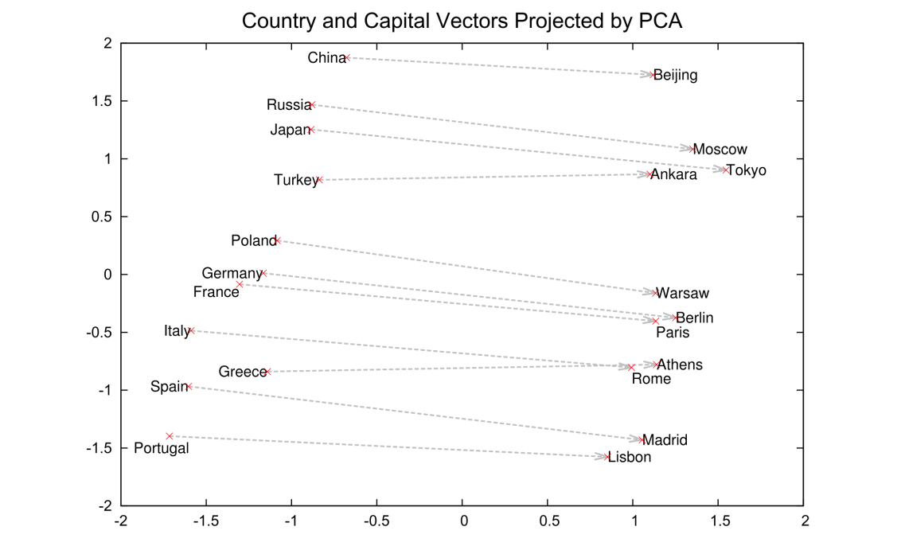
Results
2-Dimensional projection of the N-dimensional space

Slide 47
Visualized
https://projector.tensorflow.org/

Slide 48
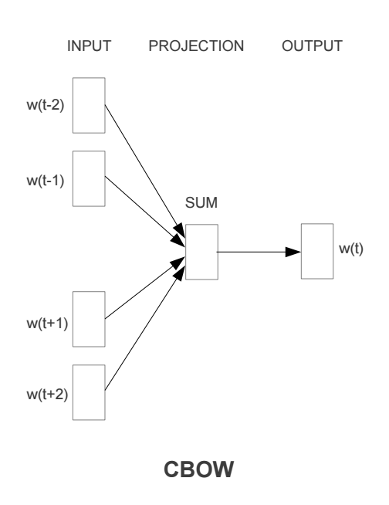
Continuous Bag Of Words

Slide 49
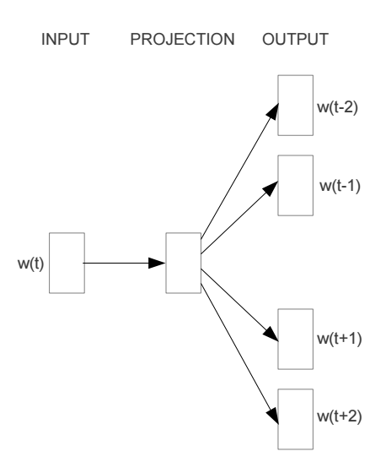
Other models: skip-gram

Slide 50
word2vec
A model for learning word representations from large amounts of data
Has become a popular pre-processing step for learning a more robust feature representation
Models like word2vec have also been incorporated into other learning approaches (e.g. translation tasks)

Slide 51
word2vec resources
https://blog.acolyer.org/2016/04/21/the-amazing-power-of-word-vectors/
https://code.google.com/archive/p/word2vec/
https://deeplearning4j.org/word2vec
https://arxiv.org/pdf/1301.3781v3.pdf

Slide 52
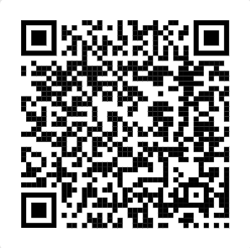
Playing with word2vec
http://vectors.nlpl.eu/explore/embeddings/en/

Slide 53
10 minutes
https://www.youtube.com/watch?v=zl99IZvW7rE

