Slide 1
Machine Translation Concluded
David Kauchak
CS159 – Fall 2020
Some slides adapted from
Philipp Koehn
Kevin Knight
Dan Klein
School of Informatics
University of Edinburgh
USC/Information Sciences Institute
USC/Computer Science Department
Computer Science Department
UC Berkeley

Slide 2
Admin
Assignment 5b
Assignment 6 available
Quiz 3: 11/10

Slide 3
Language translation
¡Hola!

Slide 4
Word models: IBM Model 1
NULL
Mary did not slap the green witch
p(verde | green)
Maria no dió una botefada a la bruja verde
Each foreign word is aligned to exactly one English word
This is the ONLY thing we model!

Slide 5
Training without alignments
Initially assume a p(f|e) are equally probable
Repeat:
Enumerate all possible alignments
Calculate how probable the alignments are under the current model (i.e. p(f|e))
Recalculate p(f|e) using counts from all alignments, weighted by how probable they are
(Note: theoretical algorithm)

Slide 6
EM alignment
E-step
Enumerate all possible alignments
Calculate how probable the alignments are under the current model (i.e. p(f|e))
M-step
Recalculate p(f|e) using counts from all alignments, weighted by how probable they are
(Note: theoretical algorithm)

Slide 7
green house
green house
the house
the house
casa verde
casa verde
la casa
la casa
green house
green house
the house
the house
casa verde
casa verde
la casa
la casa
p( casa | green) | 1/2
p( verde | green) | 1/2
p( la | green ) | 0
p( casa | house) | 1/2
p( verde | house) | 1/4
p( la | house ) | 1/4
p( casa | the) | 1/2
p( verde | the) | 0
p( la | the ) | 1/2
E-step: Given p(F|E), calculate p(A,F|E)

Slide 8
green house
green house
the house
the house
1/8
1/4
1/4
1/8
casa verde
casa verde
la casa
la casa
green house
green house
the house
the house
1/4
1/8
1/4
1/8
casa verde
casa verde
la casa
la casa
p( casa | green) | 1/2
p( verde | green) | 1/2
p( la | green ) | 0
p( casa | house) | 1/2
p( verde | house) | 1/4
p( la | house ) | 1/4
p( casa | the) | 1/2
p( verde | the) | 0
p( la | the ) | 1/2
E-step: Given p(F|E), calculate p(A,F|E)
Calculate unnormalized counts

Slide 9
green house
green house
the house
the house
1/8
1/4
1/4
1/8
casa verde
casa verde
la casa
la casa
green house
green house
the house
the house
1/4
1/8
1/4
1/8
casa verde
casa verde
la casa
la casa
sum = (3/4)
sum = (3/4)
p( casa | green) | 1/2
p( verde | green) | 1/2
p( la | green ) | 0
p( casa | house) | 1/2
p( verde | house) | 1/4
p( la | house ) | 1/4
p( casa | the) | 1/2
p( verde | the) | 0
p( la | the ) | 1/2
$$p\left(ai | E,F\right)=\frac{p(F,ai|E)}{\sum_{j=1}^{4}{p(F,aj|E)}}$$
E-step: Given p(F|E), calculate p(A,F|E)
Normalize by the sum

Slide 10
green house
green house
the house
the house
1/6
1/3
1/3
1/6
casa verde
casa verde
la casa
la casa
green house
green house
the house
the house
1/3
1/6
1/3
1/6
casa verde
casa verde
la casa
la casa
sum = (3/4)
sum = (3/4)
p( casa | green) | 1/2
p( verde | green) | 1/2
p( la | green ) | 0
p( casa | house) | 1/2
p( verde | house) | 1/4
p( la | house ) | 1/4
p( casa | the) | 1/2
p( verde | the) | 0
p( la | the ) | 1/2
$$p\left(ai | E,F\right)=\frac{p(F,ai|E)}{\sum_{j=1}^{4}{p(F,aj|E)}}$$
E-step: Given p(F|E), calculate p(A,F|E)
Normalize by the sum

Slide 11
green house
green house
the house
the house
1/6
1/3
1/3
1/6
casa verde
casa verde
la casa
la casa
green house
green house
the house
the house
1/3
1/6
1/3
1/6
casa verde
casa verde
la casa
la casa
M-step: calculate unnormalized counts for p(f|e) given the alignments
p( casa | green)
p( verde | green)
p( la | green )
p( casa | house)
p( verde | house)
( la | house )
p( casa | the)
p( verde | the)
p( la | the )
c(casa,green) = 1/6+1/3 = 3/6
c(verde,green) = 1/3+1/3 = 4/6
c(la, green) = 0
c(casa,house) = 1/3+1/6+
1/3+1/6 = 6/6
c(verde,house) = 1/6+1/6 = 2/6
c(la,house) = 1/6+1/6 = 2/6
c(casa,the) = 1/6+1/3 = 3/6
c(verde,the) = 0
c(la,the) = 1/3+1/3 = 4/6

Slide 12
green house
green house
the house
the house
1/6
1/3
1/3
1/6
casa verde
casa verde
la casa
la casa
green house
green house
the house
the house
1/3
1/6
1/3
1/6
casa verde
casa verde
la casa
la casa
M-step: normalize
p( casa | green) | 3/7
p( verde | green) | 4/7
p( la | green ) | 0
p( casa | house) | 3/5
p( verde | house) | 1/5
p( la | house ) | 1/5
p( casa | the) | 3/7
p( verde | the) | 0
p( la | the ) | 4/7
c(casa,green) = 1/6+1/3 = 3/6
c(verde,green) = 1/3+1/3 = 4/6
c(la, green) = 0
c(casa,house) = 1/3+1/6+
1/3+1/6 = 6/6
c(verde,house) = 1/6+1/6 = 2/6
c(la,house) = 1/6+1/6 = 2/6
c(casa,the) = 1/6+1/3 = 3/6
c(verde,the) = 0
c(la,the) = 1/3+1/3 = 4/6
Then, calculate the probabilities by normalizing the counts

Slide 13
Implementation details
For |E| English words and |F| foreign words, how many alignments are there?
Repeat:
E-step
Enumerate all possible alignments
Calculate how probable the alignments are under the current model (i.e. p(f|e))
M-step
Recalculate p(f|e) using counts from all alignments, weighted by how probable they are

Slide 14
Implementation details
Each foreign word can be aligned to any of the English words (or NULL)
(|E|+1)^{|F|}
Repeat:
E-step
Enumerate all possible alignments
Calculate how probable the alignments are under the current model (i.e. p(f|e))
M-step
Recalculate p(f|e) using counts from all alignments, weighted by how probable they are
Notes:
This is exponential ☹

Slide 15
Thought experiment
The old man is happy. He has fished many times.
El viejo está feliz porque ha pescado muchos veces.
His wife talks to him.
The sharks await.
Su mujer habla con él.
Los tiburones esperan.
p(el | the) = 0.5
p(Los | the) = 0.5
Notes:
really, count(e aligned-to anything)

Slide 16
If we had the alignments
Input: corpus of English/Foreign sentence pairs along with alignment
for (E, F) in corpus:
for aligned words (e, f) in pair (E,F):
count(e,f) += 1
count(e) += 1
for all (e,f) in count:
p(f|e) = count(e,f) / count(e)

Slide 17
If we had the alignments
Input: corpus of English/Foreign sentence pairs along with alignment
for (E, F) in corpus:
for e in E:
for f in F:
if f aligned-to e:
count(e,f) += 1
count(e) += 1
for all (e,f) in count:
p(f|e) = count(e,f) / count(e)

Slide 18
If we had the alignments
Input: corpus of English/Foreign sentence pairs along with alignment
for (E, F) in corpus:
for aligned words (e, f) in pair (E,F):
count(e,f) += 1
count(e) += 1
for all (e,f) in count:
p(f|e) = count(e,f) / count(e)
for (E, F) in corpus
for e in E:
for f in F:
if f aligned-to e:
count(e,f) += 1
count(e) += 1
Are these equivalent?

Slide 19
Thought experiment #2
The old man is happy. He has fished many times.
80 annotators
El viejo está feliz porque ha pescado muchos veces.
The old man is happy. He has fished many times.
20 annotators
El viejo está feliz porque ha pescado muchos veces.
Use partial counts:
count(viejo | man) 0.8
count(viejo | old) 0.2

Slide 20
Without the alignments
if f aligned-to e:
count(e,f) += 1
count(e) += 1
$p\left(f→e\right)$: probability that f is aligned to e in this pair
count(e,f) += $p\left(f→e\right)$
count(e) += $p\left(f→e\right)$
Key: use expected counts (i.e., how likely based on the current model), rather than actual counts

Slide 21
Without alignments
$p\left(f→e\right)$: probability that f is aligned to e in this pair
a b c
y z
What is $p\left(y→a\right)$?
Put another way, of all things that y could align to in this sentence, how likely is it to be a?

Slide 22
Without alignments
$p\left(f→e\right)$: probability that f is aligned to e in this pair
a b c
y z
Of all things that y could align to, how likely is it to be a:
p(y | a)
Does that do it?
No! p(y | a) is how likely y is to align to a over the whole data set.

Slide 23
Without alignments
$p\left(f→e\right)$: probability that f is aligned to e in this pair
a b c
y z
Of all things that y could align to, how likely is it to be a:
p(y | a)
p(y | a) + p(y | b) + p(y | c)

Slide 24
Without the alignments
Input: corpus of English/Foreign sentence pairs along with alignment
for (E, F) in corpus:
for e in E:
for f in F:
$p\left(f→e\right)=p\left(f\right|e)/\sum_{e in E}{p(f|e)}$
count(e,f) += $p\left(f→e\right)$
count(e) += $p\left(f→e\right)$
for all (e,f) in count:
p(f|e) = count(e,f) / count(e)

Slide 25
EM: without the alignments
Input: corpus of English/Foreign sentence pairs along with alignment
for some number of iterations:
for (E, F) in corpus:
for e in E:
for f in F:
$p\left(f→e\right)=p\left(f\right|e)/\sum_{e in E}{p(f|e)}$ count(e,f) += $p\left(f→e\right)$
count(e) += $p\left(f→e\right)$
for all (e,f) in count:
p(f|e) = count(e,f) / count(e)

Slide 26
EM: without the alignments
Input: corpus of English/Foreign sentence pairs along with alignment
for some number of iterations:
for (E, F) in corpus:
for e in E:
for f in F:
$p\left(f→e\right)=p\left(f\right|e)/\sum_{e in E}{p(f|e)}$ count(e,f) += $p\left(f→e\right)$
count(e) += $p\left(f→e\right)$
for all (e,f) in count:
p(f|e) = count(e,f) / count(e)

Slide 27
EM: without the alignments
Input: corpus of English/Foreign sentence pairs along with alignment
for some number of iterations:
for (E, F) in corpus:
for e in E:
for f in F:
$p\left(f→e\right)=p\left(f\right|e)/\sum_{e in E}{p(f|e)}$ count(e,f) += $p\left(f→e\right)$
count(e) += $p\left(f→e\right)$
for all (e,f) in count:
p(f|e) = count(e,f) / count(e)
Where are the E and M steps?

Slide 28
EM: without the alignments
Input: corpus of English/Foreign sentence pairs along with alignment
for some number of iterations:
for (E, F) in corpus:
for e in E:
for f in F:
$p\left(f→e\right)=p\left(f\right|e)/\sum_{e in E}{p(f|e)}$ count(e,f) += $p\left(f→e\right)$
count(e) += $p\left(f→e\right)$
for all (e,f) in count:
p(f|e) = count(e,f) / count(e)
Calculate how probable the alignments are under the current model (i.e. p(f|e))

Slide 29
EM: without the alignments
Input: corpus of English/Foreign sentence pairs along with alignment
for some number of iterations:
for (E, F) in corpus:
for e in E:
for f in F:
$p\left(f→e\right)=p\left(f\right|e)/\sum_{e in E}{p(f|e)}$ count(e,f) += $p\left(f→e\right)$
count(e) += $p\left(f→e\right)$
for all (e,f) in count:
p(f|e) = count(e,f) / count(e)
Recalculate p(f|e) using counts from all alignments, weighted by how probable they are

Slide 30
NULL
Sometimes foreign words don’t have a direct correspondence to an English word
Adding a NULL word allows for p(f | NULL), i.e. words that appear, but are not associated explicitly with an English word
Implementation: add “NULL” (or some unique string representing NULL) to each of the English sentences, often at the beginning of the sentence
p( casa | NULL) | 1/3
p( verde | NULL) | 1/3
p( la | NULL ) | 1/3

Slide 31
Benefits of word-level model
Rarely used in practice for modern MT system
Mary did not slap the green witch
Maria no dió una botefada a la bruja verde
Two key side effects of training a word-level model:
Word-level alignment
p(f | e): translation dictionary
How do I get this?

Slide 32
Word alignment
100 iterations
green house
p( casa | green) | 0.005
p( verde | green) | 0.995
p( la | green ) | 0
casa verde
How should these be aligned?
p( casa | house) | ~1.0
p( verde | house) | ~0.0
p( la | house ) | ~0.0
the house
la casa
p( casa | the) | 0.005
p( verde | the) | 0
p( la | the ) | 0.995

Slide 33
Word alignment
100 iterations
green house
p( casa | green) | 0.005
p( verde | green) | 0.995
p( la | green ) | 0
casa verde
Why?
p( casa | house) | ~1.0
p( verde | house) | ~0.0
p( la | house ) | ~0.0
the house
la casa
p( casa | the) | 0.005
p( verde | the) | 0
p( la | the ) | 0.995

Slide 34
Word-level alignment
Which for IBM model 1 is:
Given a model (i.e. trained p(f|e)), how do we find this?
Align each foreign word (f in F) to the English word (e in E) with highest p(f|e)

Slide 35
Word-alignment Evaluation
The old man is happy. He has fished many times.
El viejo está feliz porque ha pescado muchos veces.
How good of an alignment is this?
How can we quantify this?

Slide 36
Word-alignment Evaluation
System:
The old man is happy. He has fished many times.
El viejo está feliz porque ha pescado muchos veces.
Human
The old man is happy. He has fished many times.
El viejo está feliz porque ha pescado muchos veces.
How can we quantify this?

Slide 37
Word-alignment Evaluation
System:
The old man is happy. He has fished many times.
El viejo está feliz porque ha pescado muchos veces.
Human
The old man is happy. He has fished many times.
El viejo está feliz porque ha pescado muchos veces.
Precision and recall!

Slide 38
Word-alignment Evaluation
System:
The old man is happy. He has fished many times.
El viejo está feliz porque ha pescado muchos veces.
Human
The old man is happy. He has fished many times.
El viejo está feliz porque ha pescado muchos veces.
6
6
Precision:
Recall:
7
10

Slide 39
Problems for Statistical MT
Preprocessing
Language modeling
Translation modeling
Decoding
Parameter optimization
Evaluation

Slide 40
What kind of Translation Model?
Mary did not slap the green witch
Word-level models
Phrasal models
Syntactic models
Semantic models
Maria no dió una botefada a la bruja verde

Slide 41
Phrasal translation model
The models define probabilities over inputs
Morgen
fliege
ich
nach Kanada
zur Konferenz
1. Sentence is divided into phrases

Slide 42
Phrasal translation model
The models define probabilities over inputs
Morgen
fliege
ich
nach Kanada
zur Konferenz
Tomorrow
will fly
I
In Canada
to the conference
Sentence is divided into phrases
Phrases are translated (avoids a lot of weirdness from word-level model)

Slide 43
Phrasal translation model
The models define probabilities over inputs
Morgen
fliege
ich
nach Kanada
zur Konferenz
Tomorrow
I
will fly
to the conference
In Canada
Sentence is divided into phrases
Phrase are translated (avoids a lot of weirdness from word-level model)
Phrases are reordered

Slide 44
Phrase table
natuerlich
Translation | Probability
of course | 0.5
naturally | 0.3
of course , | 0.15
, of course , | 0.05

Slide 45
Phrase table
den Vorschlag
Translation | Probability
the proposal | 0.6227
‘s proposal | 0.1068
a proposal | 0.0341
the idea | 0.0250
this proposal | 0.0227
proposal | 0.0205
of the proposal | 0.0159
the proposals | 0.0159
the suggestions | 0.0114
…

Slide 46
Phrasal translation model
The models define probabilities over inputs
Morgen
fliege
ich
nach Kanada
zur Konferenz
Tomorrow
I
will fly
to the conference
In Canada
Advantages?

Slide 47
Advantages of Phrase-Based
Many-to-many mappings can handle non-compositional phrases
Easy to understand
Local context is very useful for disambiguating
“Interest rate” → …
“Interest in” → …
The more data, the longer the learned phrases
Sometimes whole sentences!

Slide 48
Syntax-based models
S
Benefits?
VP
NP
VP
PP
NP
NP
NP
NP
NP
DT
CD
NNS
VBP
NNS
VBG
IN
NNP
CC
NNP
PUNC
These
7
people
include
astronauts
coming
from
France
and
Russia
.

Slide 49
Syntax-based models
Benefits
Can use syntax to motivate word/phrase movement
Could ensure grammaticality
Two main types:
p(foreign string | English parse tree)
p(foreign parse tree | English parse tree)
Notes:
More data and better parsers for English.
Problem was often formulated as translating to English; it’s important that the output language be syntactically correct.

Slide 50
Tree to string rule
S
ADVP
,
x0:NP
x1:VP
->
x0:NP “*” x1:VP
RB
“,”
“therefore”

Slide 51
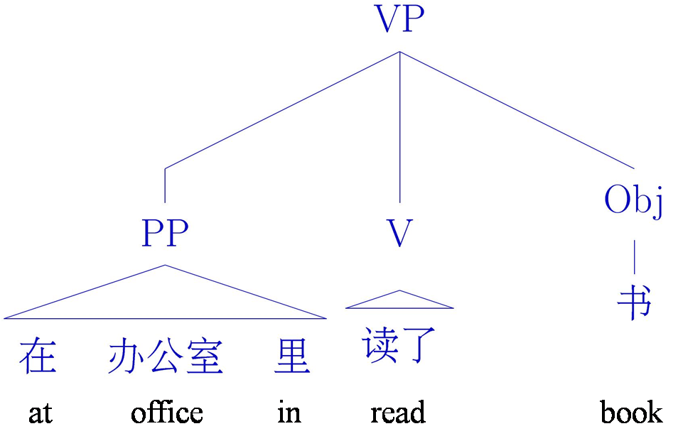
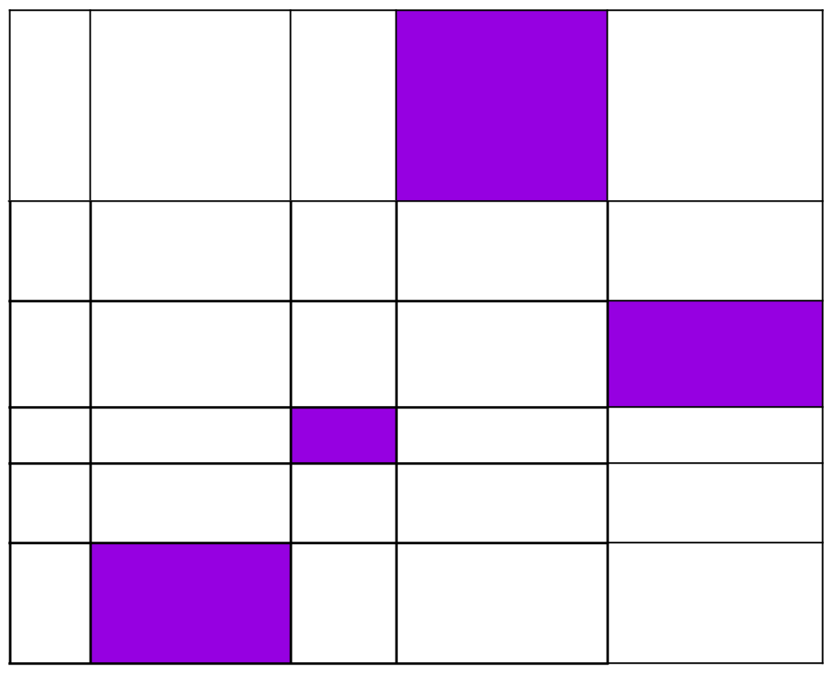
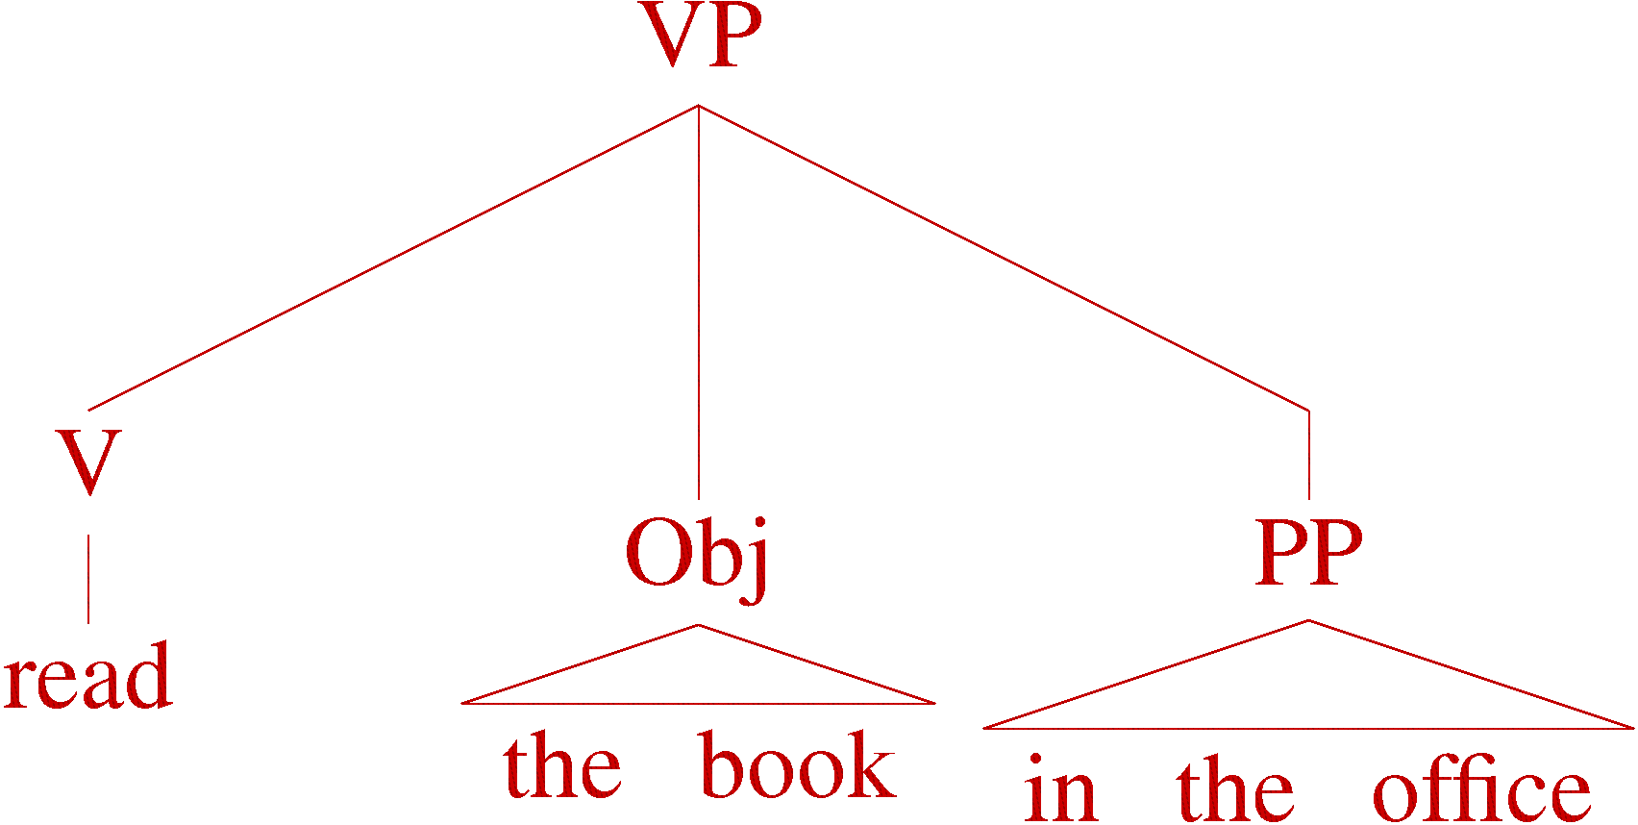
Tree to tree example

Slide 52
Problems for Statistical MT
Preprocessing
Language modeling
Translation modeling
Decoding
Parameter optimization
Evaluation

Slide 53
MT Evaluation
How do we do it?
What data might be useful?

Slide 54
MT Evaluation
Source only
Manual:
SSER (subjective sentence error rate)
Correct/Incorrect
Error categorization
Extrinsic:
Objective usage testing
Automatic:
WER (word error rate)
BLEU (Bilingual Evaluation Understudy)
NIST

Slide 55
Automatic Evaluation
Common NLP/machine learning/AI approach
Training sentence pairs
All sentence pairs
Testing sentence pairs
Notes:
“train” a model on the training sentences (that is learn the probabilities)
then evaluate on the test sentences (which the model has never seen before)

Slide 56
Automatic Evaluation
Reference (human) translation: The U.S. island of Guam is maintaining a high state of alert after the Guam airport and its offices both received an e-mail from someone calling himself the Saudi Arabian Osama bin Laden and threatening a biological/chemical attack against public places such as the airport .
Machine translation: The American [?] international airport and its the office all receives one calls self the sand Arab rich business [?] and so on electronic mail , which sends out ; The threat will be able after public place and so on the airport to start the biochemistry attack , [?] highly alerts after the maintenance.
Machine translation 2:
United States Office of the Guam International Airport and were received by a man claiming to be Saudi Arabian businessman Osama bin Laden, sent emails, threats to airports and other public places will launch a biological or chemical attack, remain on high alert in Guam.
Ideas?

Slide 57
BLEU Evaluation Metric
(Papineni et al, ACL-2002)
Reference (human) translation: The U.S. island of Guam is maintaining a high state of alert after the Guam airport and its offices both received an e-mail from someone calling himself the Saudi Arabian Osama bin Laden and threatening a biological/chemical attack against public places such as the airport .
Basic idea:
Combination of n-gram precisions of varying size
What percentage of machine n-grams can be found in the reference translation?
Machine translation: The American [?] international airport and its the office all receives one calls self the sand Arab rich business [?] and so on electronic mail , which sends out ; The threat will be able after public place and so on the airport to start the biochemistry attack , [?] highly alerts after the maintenance.

Slide 58
Multiple Reference Translations
Reference translation 1: The U.S. island of Guam is maintaining a high state of alert after the Guam airport and its offices both received an e-mail from someone calling himself the Saudi Arabian Osama bin Laden and threatening a biological/chemical attack against public places such as the airport .
Reference translation 1: The U.S. island of Guam is maintaining a high state of alert after the Guam airport and its offices both received an e-mail from someone calling himself the Saudi Arabian Osama bin Laden and threatening a biological/chemical attack against public places such as the airport .
Reference translation 2: Guam International Airport and its offices are maintaining a high state of alert after receiving an e-mail that was from a person claiming to be the wealthy Saudi Arabian businessman Bin Laden and that threatened to launch a biological and chemical attack on the airport and other public places .
Reference translation 2: Guam International Airport and its offices are maintaining a high state of alert after receiving an e-mail that was from a person claiming to be the wealthy Saudi Arabian businessman Bin Laden and that threatened to launch a biological and chemical attack on the airport and other public places .
Machine translation: The American [?] international airport and its the office all receives one calls self the sand Arab rich business [?] and so on electronic mail , which sends out ; The threat will be able after public place and so on the airport to start the biochemistry attack , [?] highly alerts after the maintenance.
Machine translation: The American [?] international airport and its the office all receives one calls self the sand Arab rich business [?] and so on electronic mail , which sends out ; The threat will be able after public place and so on the airport to start the biochemistry attack , [?] highly alerts after the maintenance.
Reference translation 3: The US International Airport of Guam and its office has received an email from a self-claimed Arabian millionaire named Laden , which threatens to launch a biochemical attack on such public places as airport . Guam authority has been on alert .
Reference translation 3: The US International Airport of Guam and its office has received an email from a self-claimed Arabian millionaire named Laden , which threatens to launch a biochemical attack on such public places as airport . Guam authority has been on alert .
Reference translation 4: US Guam International Airport and its office received an email from Mr. Bin Laden and other rich businessman from Saudi Arabia . They said there would be biochemistry air raid to Guam Airport and other public places . Guam needs to be in high precaution about this matter .
Reference translation 4: US Guam International Airport and its office received an email from Mr. Bin Laden and other rich businessman from Saudi Arabia . They said there would be biochemistry air raid to Guam Airport and other public places . Guam needs to be in high precaution about this matter .

Slide 59
N-gram precision example
Candidate 1: It is a guide to action which ensures that the military always obey the commands of the party.
Reference 1: It is a guide to action that ensures that the military will forever heed Party commands.
Reference 2: It is the guiding principle which guarantees the military forces always being under the command of the Party.
Reference 3: It is the practical guide for the army always to heed directions of the party.
What percentage of machine n-grams can be found in the reference translations? Do unigrams, bigrams and trigrams.

Slide 60
N-gram precision example
Candidate 1: It is a guide to action which ensures that the military
always obey the commands of the party.
Reference 1: It is a guide to action that ensures that the military will forever heed Party commands.
Reference 2: It is the guiding principle which guarantees the military forces always being under the command of the Party.
Reference 3: It is the practical guide for the army always to heed directions of the party.
Unigrams: 17/18

Slide 61
N-gram precision example
Candidate 1: It is a guide to action which ensures that the military
always obey the commands of the party.
Reference 1: It is a guide to action that ensures that the military will forever heed Party commands.
Reference 2: It is the guiding principle which guarantees the military forces always being under the command of the Party.
Reference 3: It is the practical guide for the army always to heed directions of the party.
Unigrams: 17/18
Bigrams: 10/17

Slide 62
N-gram precision example
Candidate 1: It is a guide to action which ensures that the military
always obey the commands of the party.
Reference 1: It is a guide to action that ensures that the military will forever heed Party commands.
Reference 2: It is the guiding principle which guarantees the military forces always being under the command of the Party.
Reference 3: It is the practical guide for the army always to heed directions of the party.
Unigrams: 17/18
Bigrams: 10/17
Trigrams: 7/16

Slide 63
N-gram precision example 2
Candidate 2: It is to ensure the army forever hearing the directions guide that party commands.
Reference 1: It is a guide to action that ensures that the military will forever heed Party commands.
Reference 2: It is the guiding principle which guarantees the military forces always being under the command of the Party.
Reference 3: It is the practical guide for the army always to heed directions of the party.

Slide 64
N-gram precision example 2
Candidate 2: It is to ensure the army forever hearing the directions guide that party commands.
Reference 1: It is a guide to action that ensures that the military will forever heed Party commands.
Reference 2: It is the guiding principle which guarantees the military forces always being under the command of the Party.
Reference 3: It is the practical guide for the army always to heed directions of the party.
Unigrams: 12/14

Slide 65
N-gram precision example 2
Candidate 2: It is to ensure the army forever hearing the directions
guide that party commands.
Reference 1: It is a guide to action that ensures that the military will forever heed Party commands.
Reference 2: It is the guiding principle which guarantees the military forces always being under the command of the Party.
Reference 3: It is the practical guide for the army always to heed directions of the party.
Unigrams: 12/14
Bigrams: 4/13

Slide 66
N-gram precision example 2
Candidate 2: It is to ensure the army forever hearing the directions
guide that party commands.
Reference 1: It is a guide to action that ensures that the military will forever heed Party commands.
Reference 2: It is the guiding principle which guarantees the military forces always being under the command of the Party.
Reference 3: It is the practical guide for the army always to heed directions of the party.
Unigrams: 12/14
Bigrams: 4/13
Trigrams: 1/12

Slide 67
N-gram precision
Candidate 1: It is a guide to action which ensures that the military always obey the commands of the party.
Unigrams: 17/18
Bigrams: 10/17
Trigrams: 7/16
Candidate 2: It is to ensure the army forever hearing the directions guide that party commands.
Unigrams: 12/14
Bigrams: 4/13
Trigrams: 1/12
Any problems/concerns?

Slide 68
N-gram precision example
Candidate 3: the
Candidate 4: It is a
Reference 1: It is a guide to action that ensures that the military will forever heed Party commands.
Reference 2: It is the guiding principle which guarantees the military forces always being under the command of the Party.
Reference 3: It is the practical guide for the army always to heed directions of the party.
What percentage of machine n-grams can be found in the reference translations? Do unigrams, bigrams and trigrams.

Slide 69
BLEU Evaluation Metric
(Papineni et al, ACL-2002)
Reference (human) translation: The U.S. island of Guam is maintaining a high state of alert after the Guam airport and its offices both received an e-mail from someone calling himself the Saudi Arabian Osama bin Laden and threatening a biological/chemical attack against public places such as the airport .
N-gram precision (score is between 0 & 1)
What percentage of machine n-grams can be found in the reference translation?
Not allowed to use same portion of reference translation twice (can’t cheat by typing out “the the the the the”)
Brevity penalty
Can’t just type out single word “the” (precision 1.0!)
*** Amazingly hard to “game” the system (i.e., find a way to change machine output so that BLEU goes up, but quality doesn’t)
Machine translation: The American [?] international airport and its the office all receives one calls self the sand Arab rich business [?] and so on electronic mail , which sends out ; The threat will be able after public place and so on the airport to start the biochemistry attack , [?] highly alerts after the maintenance.

Slide 70
BLEU Tends to Predict Human Judgments
(variant of BLEU)
slide from G. Doddington (NIST)

Slide 71
BLEU: Problems?
Doesn’t care if an incorrectly translated word is a name or a preposition
gave it to Albright (reference)
gave it at Albright (translation #1)
gave it to altar (translation #2)
What happens when a program reaches human level performance in BLEU but the translations are still bad?
maybe sooner than you think …

