Slide 1
Word Similarity
David Kauchak CS159 Fall 2020

Slide 2
Admin
Assignment 4
Quiz #2 Thursday
1 hour (shouldn’t need that long)
Will post link on piazza
Will be available 12:15-1:15pm on class zoom
Open book and notes
Class starts at 1:15pm
Assignment 5 out soon

Slide 3
Quiz #2
Topics
Linguistics 101
Parsing
Grammars, CFGs, PCFGs
Top-down vs. bottom-up
CKY algorithm
Grammar learning
Evaluation
Improved models
Text similarity
Will also be covered on Quiz #3, though

Slide 4
Text Similarity
A common question in NLP is how similar are texts
sim(
,
) = ?
score:
rank:
?

Slide 5
Bag of words representation
For now, let’s ignore word order:
Obama said banana repeatedly last week on tv, “banana, banana, banana”
“Bag of words representation”: multi-dimensional vector, one dimension per word in our vocabulary
(4, 1, 1, 0, 0, 1, 0, 0, …)
obama
said
california
across
tv
wrong
banana
capital
Frequency of word occurrence

Slide 6
Vector based word
A
a₁: When 1
a₂: the 2
a₃: defendant 1
a₄: and 1
a₅: courthouse 0
…
Multi-dimensional vectors, one dimension per word in our vocabulary
B
b₁: When 1
b₂: the 2
b₃: defendant 1
b₄: and 0
b₅: courthouse 1
…

Slide 7
Normalized distance measures
Cosine
L2
L1
a’ and b’ are length normalized versions of the vectors

Slide 8
Our problems
Which of these have we addressed?
word order
length
synonym
spelling mistakes
word importance
word frequency

Slide 9
Word overlap problems
Treats all words the same
A: When the defendant and his lawyer walked into the court, some of the victim supporters turned their backs to him.
B: When the defendant walked into the courthouse with his attorney, the crowd truned their backs on him.
Ideas?

Slide 10
Word importance
Include a weight for each word/feature
A
a₁: When 1
a₂: the 2
a₃: defendant 1
a₄: and 1
a₅: courthouse 0
…
w₁
w₂
w₃
w₄
w₅
…
B
b₁: When 1
b₂: the 2
b₃: defendant 1
b₄: and 0
b₅: courthouse 1
…
w₁
w₂
w₃
w₄
w₅
…

Slide 11
Distance + weights
We can incorporate the weights into the distances
Think of it as either (both work out the same):
preprocessing the vectors by multiplying each dimension by the weight
incorporating it directly into the similarity measure

Slide 12
Idea: use corpus statistics
the
defendant
What would be a quantitative measure of word importance?

Slide 13
Document frequency
document frequency (DF) is one measure of word importance
Terms that occur in many documents are weighted less, since overlapping with these terms is very likely
In the extreme case, take a word like the that occurs in almost EVERY document
Terms that occur in only a few documents are weighted more

Slide 14
Document vs. overall frequency
The overall frequency of a word is the number of occurrences in a dataset, counting multiple occurrences
Example:
Word | Overall frequency | Document frequency
insurance | 10440 | 3997
try | 10422 | 8760
Which word is a more informative (and should get a higher weight)?

Slide 15
Document frequency
Word | Collection frequency | Document frequency
insurance | 10440 | 3997
try | 10422 | 8760
Document frequency is often related to word importance, but we want an actual weight. Problems?

Slide 16
From document frequency to weight
Word | Collection frequency | Document frequency
insurance | 10440 | 3997
try | 10422 | 8760
weight and document frequency are inversely related
higher document frequency should have lower weight and vice versa
document frequency is unbounded
document frequency will change depending on the size of the data set (i.e. the number of documents)

Slide 17
Inverse document frequency
# of documents in dataset
document frequency of w
IDF is inversely correlated with DF
higher DF results in lower IDF
N incorporates a dataset dependent normalizer
log dampens the overall weight

Slide 18
IDF example, suppose N=1 million
term | df_{t} | idf_{t}
calpurnia | 1
animal | 100
sunday | 1,000
fly | 10,000
under | 100,000
the | 1,000,000
What are the IDFs assuming log base 10?

Slide 19
IDF example, suppose N=1 million
term | df_{t} | idf_{t}
calpurnia | 1 | 6
animal | 100 | 4
sunday | 1,000 | 3
fly | 10,000 | 2
under | 100,000 | 1
the | 1,000,000 | 0
There is one idf value/weight for each word

Slide 20
IDF example, suppose N=1 million
term | df_{t} | idf_{t}
calpurnia | 1
animal | 100
sunday | 1,000
fly | 10,000
under | 100,000
the | 1,000,000
What if we didn’t use the log to dampen the weighting?

Slide 21
IDF example, suppose N=1 million
term | df_{t} | idf_{t}
calpurnia | 1 | 1,000,000
animal | 100 | 10,000
sunday | 1,000 | 1,000
fly | 10,000 | 100
under | 100,000 | 10
the | 1,000,000 | 1
What if we didn’t use the log to dampen the weighting?

Slide 22
TF-IDF
One of the most common weighting schemes
TF = term frequency
IDF = inverse document frequency
TF
IDF (word importance weight )
We can then use this with any of our similarity measures!

Slide 23
Stoplists: extreme weighting
Some words like ‘a’ and ‘the’ will occur in almost every document
IDF will be 0 for any word that occurs in all documents
For words that occur in almost all of the documents, they will be nearly 0
A stoplist is a list of words that should not be considered (in this case, similarity calculations)
Sometimes this is the n most frequent words
Often, it’s a list of a few hundred words manually created

Slide 24
Stoplist
I
a
aboard
about
above
across
after
afterwards
against
agin
ago
agreed-upon
ah
alas
albeit
all
all-over
almost
along
alongside
altho
although
amid
amidst
among
amongst
an
and
another
any
anyone
anything
around
as
aside
astride
at
atop
avec
away
back
be
because
before
beforehand
behind
behynde
below
beneath
beside
besides
between
bewteen
beyond
bi
both
but
by
ca.
de
des
despite
do
down
due
durin
during
each
eh
either
en
every
ever
everyone
everything
except
far
fer
for
from
go
goddamn
goody
gosh
half
have
he
hell
her
herself
hey
him
himself
his
ho
how
If most of these end up with low weights anyway, why use a stoplist?

Slide 25
Stoplists
Two main benefits
More fine grained control: some words may not be frequent, but may not have any content value (alas, teh, gosh)
Often does contain many frequent words, which can drastically reduce our storage and computation
Any downsides to using a stoplist?
For some applications, some stop words may be important

Slide 26
Our problems
Which of these have we addressed?
word order
length
synonym
spelling mistakes
word importance
word frequency
A model of word similarity!

Slide 27
Word overlap problems
A: When the defendant and his lawyer walked into the court, some of the victim supporters turned their backs to him.
B: When the defendant walked into the courthouse with his attorney, the crowd truned their backs on him.

Slide 28
Word similarity
How similar are two words?
score:
sim(w₁, w₂) = ?
w₁
w₂
w₃
applications?
w
rank:
?
list: w₁ and w₂ are synonyms

Slide 29
Word similarity applications
General text similarity
Thesaurus generation
Automatic evaluation
Text-to-text
paraphrasing
summarization
machine translation
information retrieval (search)

Slide 30
Word similarity
How similar are two words?
score:
sim(w₁, w₂) = ?
w₁
w₂
w₃
ideas? useful resources?
w
rank:
?
list: w₁ and w₂ are synonyms

Slide 31
Word similarity
Four categories of approaches (maybe more)
Character-based
turned vs. truned
cognates (night, nacht, nicht, natt, nat, noc, noch)
Semantic web-based (e.g. WordNet)
Dictionary-based
Distributional similarity-based
similar words occur in similar contexts

Slide 32
Character-based similarity
sim(turned, truned) = ?
How might we do this using only the words (i.e. no outside resources?

Slide 33
Edit distance (Levenshtein distance)
The edit distance between w₁ and w₂ is the minimum number of operations to transform w₁ into w₂
Operations:
insertion
deletion
substitution
EDIT(turned, truned) = ?
EDIT(computer, commuter) = ?
EDIT(banana, apple) = ?
EDIT(wombat, worcester) = ?

Slide 34
Edit distance
EDIT(turned, truned) = 2
delete u
insert u
EDIT(computer, commuter) = 1
replace p with m
EDIT(banana, apple) = 5
delete b
replace n with p
replace a with p
replace n with l
replace a with e
EDIT(wombat, worcester) = 6

Slide 35
Better edit distance
Are all operations equally likely?
No
Improvement: give different weights to different operations
replacing a for e is more likely than z for y
Ideas for weightings?
Learn from actual data (known typos, known similar words)
Intuitions: phonetics
Intuitions: keyboard configuration

Slide 36
Vector character-based word similarity
sim(turned, truned) = ?
Any way to leverage our vector-based similarity approaches from last time?

Slide 37
Vector character-based word similarity
sim(turned, truned) = ?
Generate a feature vector based on the characters
(or could also use the set based measures at the character level)
a: 0
b: 0
c: 0
d: 1
e: 1
f: 0
g: 0
…
a: 0
b: 0
c: 0
d: 1
e: 1
f: 0
g: 0
…
problems?

Slide 38
Vector character-based word similarity
sim(restful, fluster) = ?
Character level loses a lot of information
a: 0
b: 0
c: 0
d: 1
e: 1
f: 0
g: 0
…
a: 0
b: 0
c: 0
d: 1
e: 1
f: 0
g: 0
…
ideas?

Slide 39
Vector character-based word similarity
sim(restful, fluster) = ?
Use character bigrams or even trigrams
aa: 0
ab: 0
ac: 0
…
es: 1
…
fu: 1
…
re: 1
…
aa: 0
ab: 0
ac: 0
…
er: 1
…
fl: 1
…
lu: 1
…

Slide 40
Word similarity
Four general categories
Character-based
turned vs. truned
cognates (night, nacht, nicht, natt, nat, noc, noch)
Semantic web-based (e.g. WordNet)
Dictionary-based
Distributional similarity-based
similar words occur in similar contexts

Slide 41
Word similarity
Four general categories
Character-based
turned vs. truned
cognates (night, nacht, nicht, natt, nat, noc, noch)
Semantic web-based (e.g. WordNet)
Dictionary-based
Distributional similarity-based
similar words occur in similar contexts

Slide 42
Dictionary-based similarity
Word
Dictionary blurb
a large, nocturnal, burrowing mammal, Orycteropus afer, ofcentral and southern Africa, feeding on ants and termites andhaving a long, extensile tongue, strong claws, and long ears.
aardvark
One of a breed of small hounds having long ears, short legs, and a usually black, tan, and white coat.
beagle
Any carnivore of the family Canidae, having prominent canine teeth and, in the wild state, a long and slender muzzle, a deep-chested muscular body, a bushy tail, and large, erect ears. Compare canid.
dog

Slide 43
Dictionary-based similarity
Utilize our text similarity measures
sim(dog, beagle) =
sim( ,
One of a breed of small hounds having long ears, short legs, and a usually black, tan, and white coat.
Any carnivore of the family Canidae, having prominent canine teeth and, in the wild state, a long and slender muzzle, a deep-chested muscular body, a bushy tail, and large, erect ears. Compare canid.
)

Slide 44
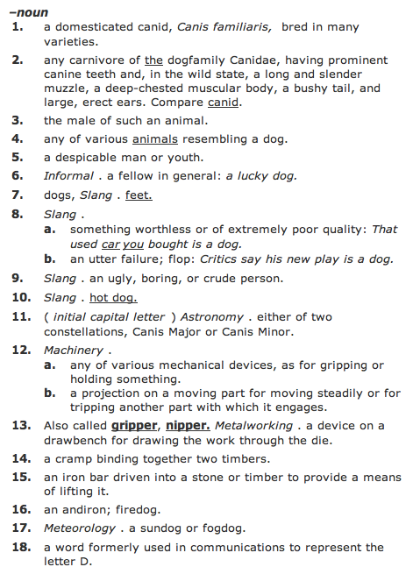
Dictionary-based similarity
What about words that have multiple senses/parts of speech?

Slide 45
Dictionary-based similarity
part of speech tagging
word sense disambiguation
most frequent sense
average similarity between all senses
max similarity between all senses
sum of similarity between all senses

Slide 46
Dictionary + WordNet
WordNet also includes a “gloss” similar to a dictionary definition
Other variants include the overlap of the word senses as well as those word senses that are related (e.g. hypernym, hyponym, etc.)
incorporates some of the path information as well
Banerjee and Pedersen, 2003

Slide 47
Word similarity
Four general categories
Character-based
turned vs. truned
cognates (night, nacht, nicht, natt, nat, noc, noch)
Semantic web-based (e.g. WordNet)
Dictionary-based
Distributional similarity-based
similar words occur in similar contexts

Slide 48
Corpus-based approaches
Word
ANY blurb with the word
aardvark
Ideas?
beagle
dog

Slide 49
Corpus-based
The Beagle is a breed of small to medium-sized dog. A member of the Hound Group, it is similar in appearance to the Foxhound but smaller, with shorter leg
Beagles are intelligent, and are popular as pets because of their size, even temper, and lack of inherited health problems.
Dogs of similar size and purpose to the modern Beagle can be traced in Ancient Greece[2] back to around the 5th century BC.
From medieval times, beagle was used as a generic description for the smaller hounds, though these dogs differed considerably from the modern breed.
In the 1840s, a standard Beagle type was beginning to develop: the distinction between the North Country Beagle and Southern

Slide 50
Corpus-based: feature extraction
The Beagle is a breed of small to medium-sized dog. A member of the Hound Group, it is similar in appearance to the Foxhound but smaller, with shorter leg
We’d like to utilize our vector-based approach
How could we we create a vector from these occurrences?
collect word counts from all documents with the word in it
collect word counts from all sentences with the word in it
collect all word counts from all words within X words of the word
collect all words counts from words in specific relationship: subject-object, etc.

Slide 51
Word-context co-occurrence vectors
The Beagle is a breed of small to medium-sized dog. A member of the Hound Group, it is similar in appearance to the Foxhound but smaller, with shorter leg
Beagles are intelligent, and are popular as pets because of their size, even temper, and lack of inherited health problems.
Dogs of similar size and purpose to the modern Beagle can be traced in Ancient Greece[2] back to around the 5th century BC.
From medieval times, beagle was used as a generic description for the smaller hounds, though these dogs differed considerably from the modern breed.
In the 1840s, a standard Beagle type was beginning to develop: the distinction between the North Country Beagle and Southern

Slide 52
Word-context co-occurrence vectors
The Beagle is a breed
Beagles are intelligent, and
to the modern Beagle can be traced
From medieval times, beagle was used as
1840s, a standard Beagle type was beginning
the: 2
is: 1
a: 2
breed: 1
are: 1
intelligent: 1
and: 1
to: 1
modern: 1
…
Often do some preprocessing like lowercasing and removing stop words

Slide 53
Corpus-based similarity
sim(dog, beagle) =
sim(context_vector(dog), context_vector(beagle))
the: 5
is: 1
a: 4
breeds: 2
are: 1
intelligent: 5
…
the: 2
is: 1
a: 2
breed: 1
are: 1
intelligent: 1
and: 1
to: 1
modern: 1
…

Slide 54
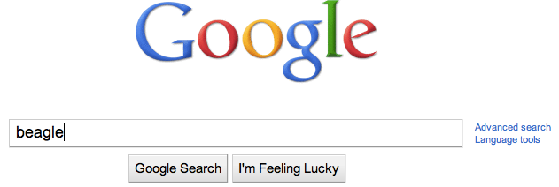
Web-based similarity
Ideas?
Notes:
yahoo and some others allow you API access to their search engine

Slide 55
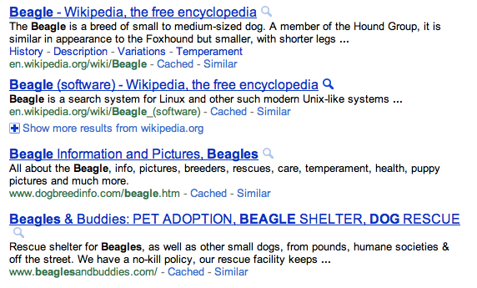
Web-based similarity
beagle
Notes:
yahoo and some others allow you API access to their search engine

Slide 56
Web-based similarity
Concatenate the snippets for the top N results
Concatenate the web page text for the top N results

Slide 57
Another feature weighting
TF- IDF weighting takes into account the general importance of a feature
For distributional similarity, we have the feature (f_{i}), but we also have the word itself (w) that we can use for information
sim(context_vector(dog), context_vector(beagle))
the: 5
is: 1
a: 4
breeds: 2
are: 1
intelligent: 5
…
the: 2
is: 1
a: 2
breed: 1
are: 1
intelligent: 1
and: 1
to: 1
modern: 1
…

Slide 58
Another feature weighting
Feature weighting ideas given this additional information?
sim(context_vector(dog), context_vector(beagle))
the: 5
is: 1
a: 4
breeds: 2
are: 1
intelligent: 5
…
the: 2
is: 1
a: 2
breed: 1
are: 1
intelligent: 1
and: 1
to: 1
modern: 1
…

Slide 59
Another feature weighting
count how likely feature f_{i} and word w are to occur together
incorporates co-occurrence
but also incorporates how often w and f_{i} occur in other instances
sim(context_vector(dog), context_vector(beagle))
Does IDF capture this?
Not really. IDF only accounts for f_{i} regardless of w

Slide 60
Mutual information
A bit more probability ☺
When will this be high and when will this be low?

Slide 61
Mutual information
A bit more probability ☺
if x and y are independent (i.e. one occurring doesn’t impact the other occurring) then:

Slide 62
Mutual information
A bit more probability ☺
if x and y are independent (i.e. one occurring doesn’t impact the other occurring) then:
What does this do to the sum?

Slide 63
Mutual information
A bit more probability ☺
if they are dependent then:

Slide 64
Mutual information
What is this asking?
When is this high?
How much more likely are we to see y given x has a particular value!

Slide 65
Point-wise mutual information
Mutual information
How related are two variables (i.e. over all possible values/events)
Point-wise mutual information
How related are two particular events/values

Slide 66
PMI weighting
Mutual information is often used for feature selection in many problem areas
PMI weighting weights co-occurrences based on their correlation (i.e. high PMI)
context_vector(beagle)
the: 2
is: 1
a: 2
breed: 1
are: 1
intelligent: 1
and: 1
to: 1
modern: 1
…
How do we calculate these?

