Slide 1
Binary search trees
David Kauchak
CS 140 – Fall 2024

Slide 2
Admin
Assignment 3 out
  Partner assignment
  Can work with anyone
  Coding + paper (two separate submissions)
  Follow naming conventions
  command-line arguments

Slide 3
Group/mentor schedule
Group sessions optional this week
  Mentors will be available to answer questions
Group sessions this week:
  Thu 6-7pm (Sae)
  Fri 9:30-10:30am (Taylor)
  Fri 5-6pm (Stanley)
  No group session for Catherine or Elshiekh
Mentor hours changes this week:
  No mentor hours on Friday for Catherine
  Extra hours: Sunday, 9-11am (Catherine)

Slide 4
Midterm 1
Available on Thursday morning
Must take by end of day Friday
Download from Gradescope
  1 hour and 15 minutes for exam
  30 additional minutes to scan and upload
Sample midterm (and solutions) available

Slide 5
Stock market problem

Slide 6
Binary Search Trees

Slide 7
Binary Search Trees
BST – A binary tree where a parent’s value is greater than all values in the left subtree and less than or equal to all the values in the right subtree
and the left and right children are also binary search trees
Why not?
Ambiguous about where elements that are equal would reside

Slide 8
Example
12
8
14
5
9
20
Can be implemented with references or an array

Slide 9
What else can we conclude?
12
The smallest element is the left-most element
The largest element is the right-most element
8
14
5
9
20

Slide 10
Another example: the solo tree
12

Slide 11
Another example: the twig
12
8
5
1

Slide 12
Operations
Search(T,k) – Does value k exist in tree T
Insert(T,k) – Insert value k into tree T
Delete(T,x) – Delete node x from tree T
Minimum(T) – What is the smallest value in the tree?
Maximum(T) – What is the largest value in the tree?
Successor(T,x) – What is the next element in sorted order after x
Predecessor(T,x) – What is the previous element in sorted order of x
Median(T) – return the median of the values in tree T

Slide 13
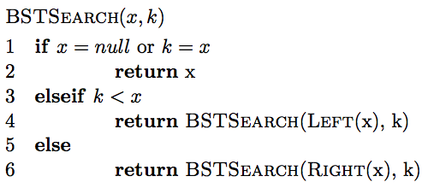
Search
How do we find an element?

Slide 14
Finding an element
Search(T, 9)
12
8
14
5
9
20

Slide 15
Finding an element
Search(T, 9)
12
8
14
5
9
20

Slide 16
Finding an element
Search(T, 9)
12
8
14
5
9
20
9 > 12?

Slide 17
Finding an element
Search(T, 9)
12
8
14
5
9
20

Slide 18
Finding an element
Search(T, 9)
12
8
14
5
9
20

Slide 19
Finding an element
Search(T, 9)
12
8
14
5
9
20

Slide 20
Finding an element
Search(T, 13)
12
8
14
5
9
20

Slide 21
Finding an element
Search(T, 13)
12
8
14
5
9
20

Slide 22
Finding an element
Search(T, 13)
12
8
14
5
9
?
20

Slide 23
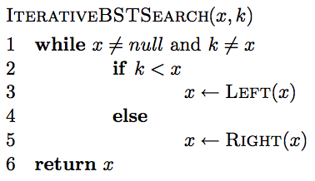
Iterative search

Slide 24
Is BSTSearch correct?

Slide 25
Running time of BSTSearch
Worst case?
  θ(height of the tree)
Average case?
  O(height of the tree)
Best case?
  O(1)

Slide 26
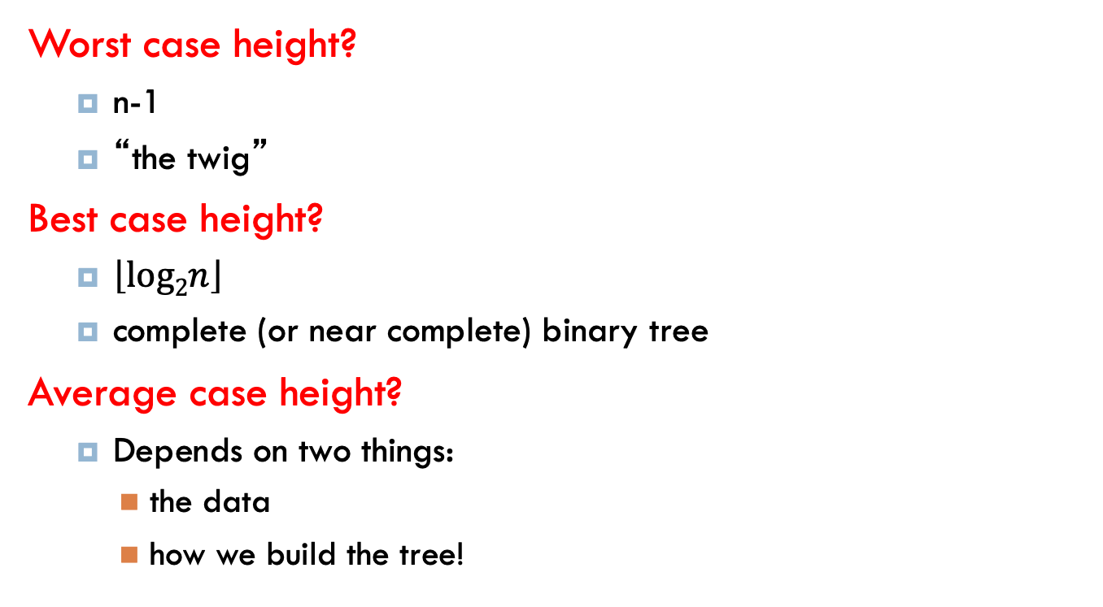
Height of the tree
Worst case height?
  n-1
  “the twig”
Best case height?
  $\left\lfloor log2n\right\rfloor$
  complete (or near complete) binary tree
Average case height?
  Depends on two things:
    the data
    how we build the tree!

Slide 27
Insertion
Search and then insert when you find a “null” spot in the tree

Slide 28
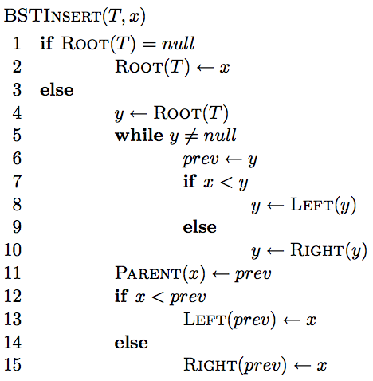
Insertion

Slide 29
Insertion
Similar to search

Slide 30
Insertion
Similar to search
Find the correct location in the tree

Slide 31
Insertion
keeps track of the previous node we visited so when we fall off the tree, we know

Slide 32
Insertion
add node onto the bottom of the tree

Slide 33
Correctness?
maintain BST property

Slide 34
Correctness
What happens if it is a duplicate?

Slide 35
Inserting duplicates
Insert(T, 14)
12
8
14
5
9
20

Slide 36
Inserting duplicates
Insert(T, 14)
12
8
14
5
9
20
14

Slide 37
Running time
Search and then insert when you find a “null” spot in the tree
O(height of the tree)

Slide 38
Running time
Search and then insert when you find a “null” spot in the tree
O(height of the tree)
Why not Θ(height of the tree)?

Slide 39
Running time
Insert(T, 15)
12
8
5
1

Slide 40
Height of the tree
Worst case: “the twig” – When will this happen?
Search and then insert when you find a “null” spot in the tree
Notes:
sorted or inversely sorted data (and there are other cases as well)

Slide 41
Height of the tree
Best case: “complete” – When will this happen?
Search and then insert when you find a “null” spot in the tree

Slide 42
Height of the tree
Average case for random data?
Search and then insert when you find a “null” spot in the tree
Randomly inserting data into a BST generates a tree on average that is O(log n)

Slide 43
Visiting all nodes
In sorted order
12
8
14
5
9
20

Slide 44
Visiting all nodes
In sorted order
5
12
8
14
5
9
20

Slide 45
Visiting all nodes
In sorted order
5, 8
12
8
14
5
9
20

Slide 46
Visiting all nodes
In sorted order
5, 8, 9
12
8
14
5
9
20

Slide 47
Visiting all nodes
In sorted order
5, 8, 9, 12
12
8
14
5
9
20

Slide 48
Visiting all nodes
What’s happening?
5, 8, 9, 12
12
8
14
5
9
20

Slide 49
Visiting all nodes
In sorted order
5, 8, 9, 12, 14
12
8
14
5
9
20

Slide 50
Visiting all nodes
In sorted order
5, 8, 9, 12, 14, 20
12
8
14
5
9
20

Slide 51
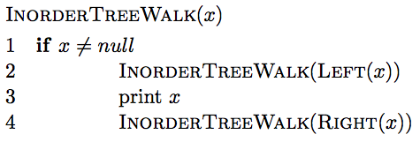
Visiting all nodes in order

Slide 52
Visiting all nodes in order
any operation

Slide 53
Is it correct?
Does it print out all of the nodes in sorted order?

Slide 54
Running time?
Recurrence relation:
  j nodes in the left subtree
  n – j – 1 in the right subtree
Or
  How much work is done for each call?
  How many calls?
  Θ(n)

Slide 55
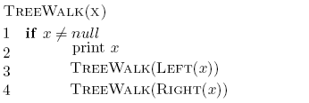
What about?

Slide 56
Preorder traversal
12, 8, 5, 9, 14, 20
Tree copying: insert in to new tree in preorder
prefix notation: (2+3)*4 -> * + 2 3 4
How is this useful?
12
8
14
5
9
20

Slide 57
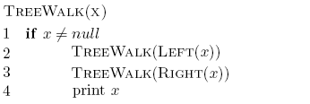
What about?

Slide 58
Postorder traversal
5, 9, 8, 20, 14, 12
postfix notation: (2+3)*4 -> 4 3 2 + *
?
How is this useful?
12
8
14
5
9
20

Slide 59
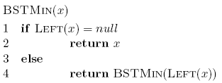

Min/Max
12
8
14
5
9
20

Slide 60
Running time of min/max?
O(height of the tree)

Slide 61
Successor and predecessor
Predecessor(12)?
9
12
8
14
5
9
13
20

Slide 62
Successor and predecessor
Predecessor in general?
largest node of all those smaller than this node
rightmost element of the left subtree
12
8
14
5
9
13
20

Slide 63
Successor
Successor(12)?
13
12
8
14
5
9
13
20

Slide 64
Successor
Successor in general?
smallest node of all those larger than this node
leftmost element of the right subtree
12
8
14
5
9
13
20

Slide 65
Successor
What if the node doesn’t have a right subtree?
smallest node of all those larger than this node
leftmost element of the right subtree
12
8
14
5
9
13
20

Slide 66
Successor
What if the node doesn’t have a right subtree?
node is the largest
the successor is the node that has x as a predecessor
12
8
14
5
9
13
20

Slide 67
Successor
successor is the node that has x as a predecessor
12
8
14
5
9
13
20

Slide 68
Successor
successor is the node that has x as a predecessor
12
8
14
5
9
13
20

Slide 69
Successor
successor is the node that has x as a predecessor
12
8
14
5
9
13
20

Slide 70
Successor
keep going up until we’re no longer a right child
successor is the node that has x as a predecessor
12
8
14
5
9
13
20

Slide 71
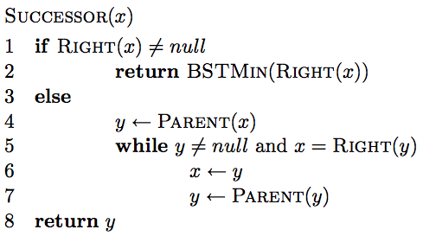
Successor

Slide 72
Successor
if we have a right subtree, return the smallest of the right subtree

Slide 73
Successor
find the node that x is the predecessor of
keep going up until we’re no longer a right child

Slide 74
Successor running time
O(height of the tree)

Slide 75
Deletion
12
8
14
5
9
13
20
Three cases!

Slide 76
Deletion: case 1
No children
Just delete the node
12
8
14
5
9
13
20
17

Slide 77
Deletion: case 1
No children
Just delete the node
12
8
14
5
13
20
17

Slide 78
Deletion: case 2
One child
Splice out the node
12
8
14
5
13
20
17

Slide 79
Deletion: case 2
One child
Splice out the node
12
5
14
13
20
17

Slide 80
Deletion: case 3
Two children
Replace x with it’s successor
12
5
14
13
20
17

Slide 81
Deletion: case 3
Two children
Replace x with it’s successor
12
5
17
13
20

Slide 82
Deletion: case 3
Two children
Will we always have a successor?
Why successor?
  Larger than the left subtree
  Less than or equal to right subtree

Slide 83
Height of the tree
Most of the operations take time
O(height of the tree)
We said trees built from random data have height O(log n), which is asymptotically tight
Two problems:
  We can’t always ensure random data
  What happens when we delete nodes and insert others after building a tree?

Slide 84
Balanced trees
Make sure that the trees remain balanced!
  Red-black trees
  AVL trees
  2-3-4 trees
  …
B-trees

Slide 85
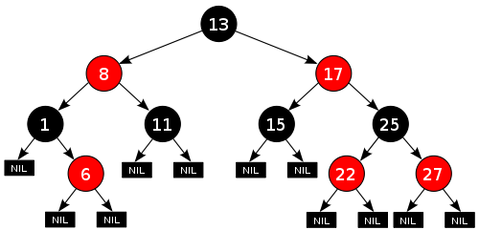
Red-black trees: BST (plus some)
every node is either red or black
root is black
leaves (NIL) are black
if a node is red, both children are black
for every node, all paths from the node to descendant leaves contain the same number of black nodes.
https://en.wikipedia.org/wiki/Red–black_tree

Slide 86
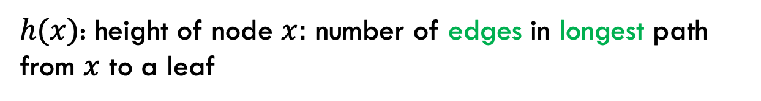
Red-black trees: BST (plus some)
every node is either red or black
root is black
leaves (NIL) are black
if a node is red, both children are black
for every node, all paths from the node to descendant leaves contain the same number of black nodes.
$h(x)$: height of node $x:$ number of edges in longest path from $x$ to a leaf

Slide 87

Red-black trees: BST (plus some)
$h(x)$: height of node $x:$ number of edges in longest path from $x$ to a leaf
What is the height of the root node?

Slide 88
Red-black trees: BST (plus some)
$h(x)$: height of node $x:$ number of edges in longest path from $x$ to a leaf
4

Slide 89
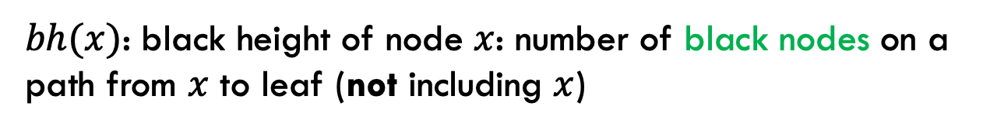
Red-black trees: BST (plus some)
every node is either red or black
root is black
leaves (NIL) are black
if a node is red, both children are black
for every node, all paths from the node to descendant leaves contain the same number of black nodes.
$bh(x)$: black height of node $x$: number of black nodes on a path from $x$ to leaf (not including $x$)
Why don’t we say ”path with the most…”?

Slide 90
Red-black trees: BST (plus some)
every node is either red or black
root is black
leaves (NIL) are black
if a node is red, both children are black
for every node, all paths from the node to descendant leaves contain the same number of black nodes.
$bh(x)$: black height of node $x$: number of black nodes on a path from $x$ to leaf (not including $x$)
Why don’t we say ”path with the most…”?

Slide 91
Red-black trees: BST (plus some)
$bh(x)$: black height of node $x$: number of black nodes on a path from $x$ to leaf (not including $x$)
What is the black height of the root node?

Slide 92
Red-black trees: BST (plus some)
$bh(x)$: black height of node $x$: number of black nodes on a path from $x$ to leaf (not including $x$)
2

Slide 93
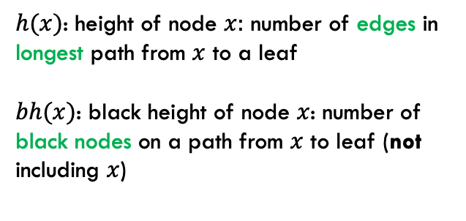
Bounding the height
every node is either red or black
root is black
leaves (NIL) are black
if a node is red, both children are black
for every node, all paths from the node to descendant leaves contain the same number of black nodes.
$h(x)$: height of node $x:$ number of edges in longest path from $x$ to a leaf
$bh(x)$: black height of node $x$: number of black nodes on a path from $x$ to leaf (not including $x$)
Claim 1: For every node $x$, $bh\left(x\right)≥h(x)/2$
Proof?

Slide 94
Bounding the height
every node is either red or black
root is black
leaves (NIL) are black
if a node is red, both children are black
for every node, all paths from the node to descendant leaves contain the same number of black nodes.
$h(x)$: height of node $x:$ number of edges in longest path from $x$ to a leaf
$bh(x)$: black height of node $x$: number of black nodes on a path from $x$ to leaf (not including $x$)
Claim 1: For every node $x$, $bh\left(x\right)≥h(x)/2$
Worst case: nodes alternate red/black
root is black
leaf is black
In terms of h(x): How many black nodes are there on this path?

Slide 95
Bounding the height
every node is either red or black
root is black
leaves (NIL) are black
if a node is red, both children are black
for every node, all paths from the node to descendant leaves contain the same number of black nodes.
$h(x)$: height of node $x:$ number of edges in longest path from $x$ to a leaf
$bh(x)$: black height of node $x$: number of black nodes on a path from $x$ to leaf (not including $x$)
Claim 1: For every node $x$, $bh\left(x\right)≥h(x)/2$
Worst case: nodes alternate red/black
root is black
leaf is black
…

Slide 96

Bounding the height
every node is either red or black
root is black
leaves (NIL) are black
if a node is red, both children are black
for every node, all paths from the node to descendant leaves contain the same number of black nodes.
$h(x)$: height of node $x:$ number of edges in longest path from $x$ to a leaf
$bh(x)$: black height of node $x$: number of black nodes on a path from $x$ to leaf (not including $x$)
Claim 1: For every node $x$, $bh\left(x\right)≥h(x)/2$
Worst case: nodes alternate red/black
root is black
leaf is black
…
$$bh\left(x\right)=h(x)/2$$
(Note that bh does not include the root)

Slide 97

Bounding the height
every node is either red or black
root is black
leaves (NIL) are black
if a node is red, both children are black
for every node, all paths from the node to descendant leaves contain the same number of black nodes.
$h(x)$: height of node $x:$ number of edges in longest path from $x$ to a leaf
$bh(x)$: black height of node $x$: number of black nodes on a path from $x$ to leaf (not including $x$)
Claim 1: For every node $x$, $bh\left(x\right)≥h(x)/2$
Worst case: nodes alternate red/black
root is black
leaf is black
…
$$bh\left(x\right)≥h(x)/2$$
We can remove red nodes, but that would decrease h(x)

Slide 98

Bounding the height
Claim 2: The subtree rooted at any node $x$ contains at least $2^{bh(x)}−1$ internal (non-leaf) nodes
Proof?

Slide 99
Structural induction
Want to prove something about a recursive structure (e.g., a tree)

Slide 100

Structural induction
$$x$$
Proof by induction:
IH: Assume the property holds for sub-structures (i.e., subtrees)
Show that it holds for the entire tree

Slide 101
Structural induction
$$x$$
Base case is often the smallest structure possible (e.g., a leaf)

Slide 102
Bounding the height
Claim 2: The subtree rooted at any node $x$ contains at least $2^{bh(x)}−1$ internal (non-leaf) nodes
Base case:

Slide 103
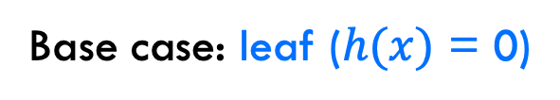
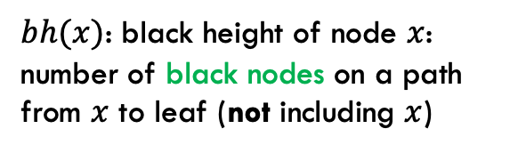


Bounding the height
Claim 2: The subtree rooted at any node $x$ contains at least $2^{bh(x)}−1$ internal (non-leaf) nodes
Base case: leaf ($h(x)$ = 0)
$$bh\left(x\right)= 0$$
$bh(x)$: black height of node $x$: number of black nodes on a path from $x$ to leaf (not including $x$)
$$2^{0}−1=0$$

Slide 104

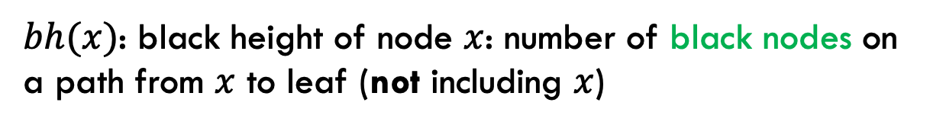

Bounding the height
Claim 2: The subtree rooted at any node $x$ contains at least $2^{bh(x)}−1$ internal (non-leaf) nodes
Inductive case: $h(x)$ > 0
IH: Assume $2^{bh(y)}−1$ for all y that are subtrees of x
What is $bh(child(x))$ wrt $bh(x)$?
$bh(x)$: black height of node $x$: number of black nodes on a path from $x$ to leaf (not including $x$)

Slide 105
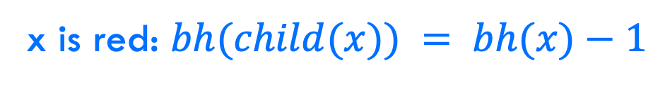

Bounding the height
Claim 2: The subtree rooted at any node $x$ contains at least $2^{bh(x)}−1$ internal (non-leaf) nodes
Inductive case: $h(x)$ > 0
IH: Assume $2^{bh(y)}−1$ for all y that are subtrees of x
x is red: $bh(child(x)) = bh(x)−1$
$bh(x)$: black height of node $x$: number of black nodes on a path from $x$ to leaf (not including $x$)

Slide 106



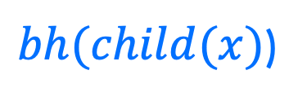
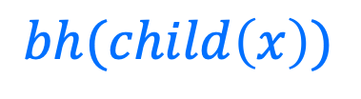
Bounding the height
x is red: $bh\left(child\left(x\right)\right)= ?$
$$x$$
$$bh(child\left(x\right))$$
$bh(child(x)$)
$bh(x)$: black height of node $x$: number of black nodes on a path from $x$ to leaf (not including $x$)

Slide 107
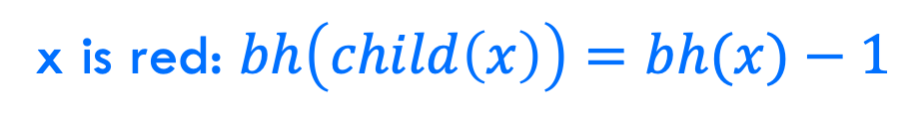
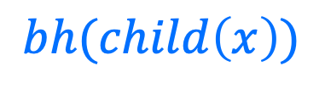
Bounding the height
x is red: $bh\left(child\left(x\right)\right)=bh(x)−1$
$$x$$
$$bh(child\left(x\right))$$
$$bh(child\left(x\right))$$
$bh(x)$: black height of node $x$: number of black nodes on a path from $x$ to leaf (not including $x$)

Slide 108

Bounding the height
x is black: $bh\left(child\left(x\right)\right)= ?$
$$x$$
$$bh(child\left(x\right))$$
$$bh(child\left(x\right))$$
$bh(x)$: black height of node $x$: number of black nodes on a path from $x$ to leaf (not including $x$)

Slide 109




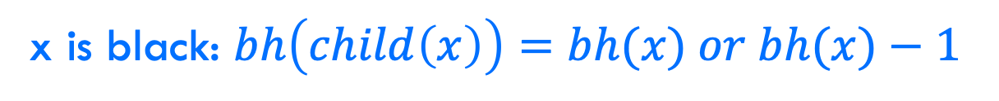

Bounding the height
x is black: $bh\left(child\left(x\right)\right)=bh(x) or bh(x)−1$
$$x$$
$$x$$
$$bh(child\left(x\right))$$
$$bh(child\left(x\right))$$
$$bh(child\left(x\right))$$
$bh(x)$: black height of node $x$: number of black nodes on a path from $x$ to leaf (not including $x$)

Slide 110
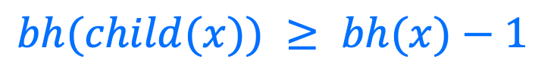
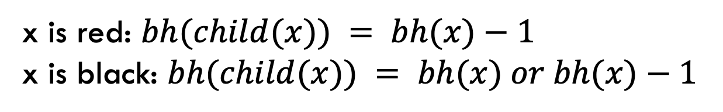
Bounding the height
Claim 2: The subtree rooted at any node $x$ contains at least $2^{bh(x)}−1$ internal (non-leaf) nodes
Inductive case: $h(x)$ > 0
IH: Assume $2^{bh(y)}−1$ for all y that are subtrees of x
x is red: $bh(child(x)) = bh(x)−1$
x is black: $bh(child(x)) = bh(x) or bh(x)−1$
$bh(child(x)) ≥ bh(x)−1$

Slide 111


Bounding the height
Claim 2: The subtree rooted at any node $x$ contains at least $2^{bh(x)}−1$ internal (non-leaf) nodes
Inductive case: $h(x)$ > 0
IH: Assume $2^{bh(y)}−1$ for all y that are subtrees of x
$bh(child(x)) ≥ bh(x)−1$
$$x$$
How many (internal nodes are in this tree (at least)?

Slide 112



Bounding the height
Claim 2: The subtree rooted at any node $x$ contains at least $2^{bh(x)}−1$ internal (non-leaf) nodes
Inductive case: $h(x)$ > 0
IH: Assume $2^{bh(y)}−1$ for all y that are subtrees of x
$bh(child(x)) ≥ bh(x)−1$
$$x$$
$$1$$
$$2^{bh\left(x\right)−1}−1$$
$$2^{bh\left(x\right)−1}−1$$

Slide 113

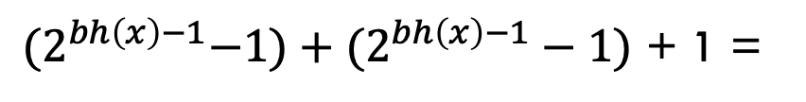
Bounding the height
Claim 2: The subtree rooted at any node $x$ contains at least $2^{bh(x)}−1$ internal (non-leaf) nodes
Inductive case: $h(x)$ > 0
IH: Assume $2^{bh(y)}−1$ for all y that are subtrees of x
$bh(child(x)) ≥ bh(x)−1$
${(2}^{bh\left(x\right)−1}−1)+(2^{bh\left(x\right)−1}−1)$ + 1 =
$$2^{bh\left(x\right)}−1$$

Slide 114
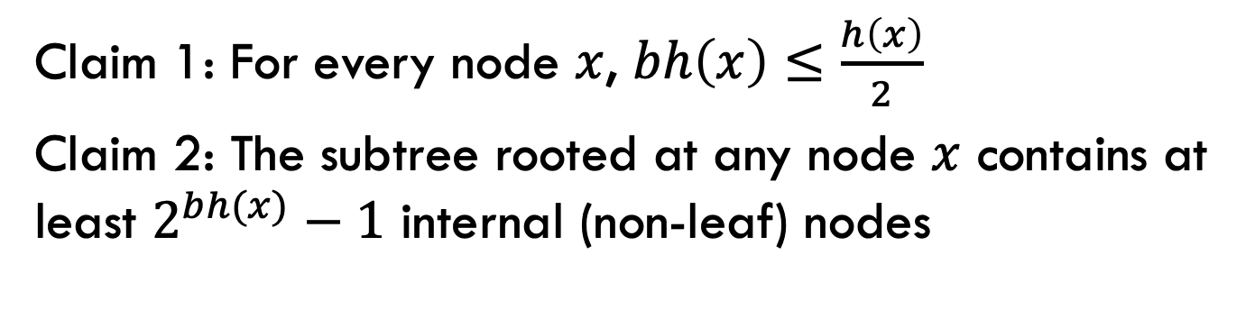
Bounding the height (almost there!)
Claim 1: For every node $x$, $bh\left(x\right)≤\frac{h\left(x\right)}{2}$
Claim 2: The subtree rooted at any node $x$ contains at least $2^{bh(x)}−1$ internal (non-leaf) nodes
How does this help us?

Slide 115

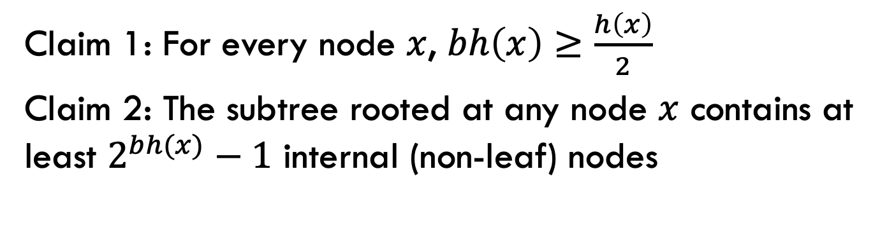



Bounding the height
Claim 1: For every node $x$, $bh\left(x\right)≥\frac{h\left(x\right)}{2}$
Claim 2: The subtree rooted at any node $x$ contains at least $2^{bh(x)}−1$ internal (non-leaf) nodes
${n ≥2}^{bh(x)}−1$
Claim 2
Claim 1
${n ≥2}^{h(x)/2}−1$
math
$${n+1 ≥2}^{h(x)/2}$$
math
$$h\left(x\right) ≤2log⁡(n+1)$$
What does this mean?

Slide 116
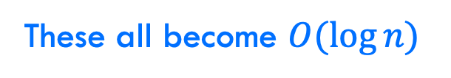
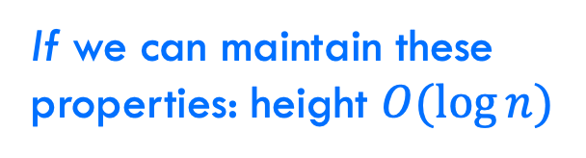
Bounding the height
every node is either red or black
root is black
leaves (NIL) are black
if a node is red, both children are black
for every node, all paths from the node to descendant leaves contain the same number of black nodes.
If we can maintain these properties: height $O(log⁡n)$
Search
Insert
Delete
Maximum
These all become $O(\log{n})$

Slide 117
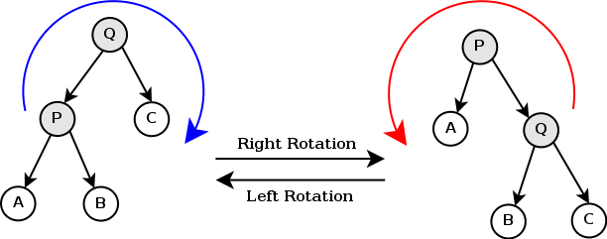
Can it be done?
Can we maintain the red-black tree properties without making insertion and deletion more expensive?
https://en.wikipedia.org/wiki/Tree_rotation#/media/File:Tree_rotation.png

Slide 118
A quick example
https://www.youtube.com/watch?v=vDHFF4wjWYU

Slide 119
Number guessing game
I’m thinking of a number between 1 and n
You are trying to guess the answer
For each guess, I’ll tell you “correct”, “higher” or “lower”
Describe an algorithm that minimizes the number of guesses

