Slide 1
More Recurrences
David Kauchak
cs140
Fall 2024

Slide 2
Administrative
Group sessions
Assignment 1

Slide 3
Recurrence
A function that is defined with respect to itself on smaller inputs

Slide 4
The challenge
Recurrences are often easy to define because they mimic the structure of the program
But… they do not directly express the computational cost, i.e. n, n², …
We want to remove self-recurrence and find a more understandable form for the function

Slide 5
Three approaches
Substitution method: when you have a good guess of the solution, prove that it’s correct
Recursion-tree method: If you don’t have a good guess, the recursion tree can help. Then solve with substitution method.
Master method: Provides solutions for recurrences of the form:

Slide 6
Substitution method
Guess the form of the solution
Then prove it’s correct by induction
Guesses?

Slide 7
Guess the solution?
  At each iteration, does a linear amount of work (i.e. iterate over the data) and reduces the size by one at each step
  O(n²)
Assume T(k) = O(k²) for all k < n
  again, this implies that T(n-1) ≤ c(n-1)²
Show that T(n) = O(n²), i.e. T(n) ≤ c’n²

Slide 8
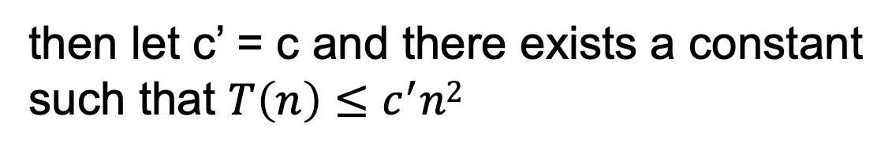
from our inductive hypothesis
residual
if
then let c’ = c and there exists a constant
such that $T\left(n\right)≤c^{′}n2$

Slide 9
from our inductive hypothesis
residual
which holds for any c ≥1 for n ≥1

Slide 10
Guess the solution?
  Recurses into 2 sub-problems that are half the size and performs some operation on all the elements
  O(n log n)
What if we guess wrong, e.g. O(n²)?
Assume T(k) = O(k²) for all k < n
  again, this implies that T(n/2) ≤ c(n/2)²
Show that T(n) = O(n²)

Slide 11
from our inductive hypothesis
residual
if
overkill?

Slide 12
What if we guess wrong, e.g. O(n)?
Assume T(k) = O(k) for all k < n
  again, this implies that T(n/2) ≤ c(n/2)
Show that T(n) = O(n)
factor of n so we can just roll it in?

Slide 13
What if we guess wrong, e.g. O(n)?
Assume T(k) = O(k) for all k < n
  again, this implies that T(n/2) ≤ c(n/2)
Show that T(n) = O(n)
Must prove the exact form!
cn+n ≤ c’n ??
factor of n so we can just roll it in?

Slide 14
Prove T(n) = O(n log₂ n)
Assume T(k) = O(k log₂ k) for all k < n
  again, this implies that T(k) = ck log₂k
Show that T(n) = O(n log₂ n)
residual
if cn ≥ n, c > 1

Slide 15
Recursion Tree
Guessing the answer can be difficult
The recursion tree approach
  Draw out the cost of the tree at each level of recursion
  Sum up the cost of the levels of the tree
    Find the cost of each level with respect to the depth
    Figure out the depth of the tree
    Figure out (or bound) the number of leaves
  Verify your answer using the substitution method

Slide 16
cost
cn²
cn²
T(n/4 )
T(n/4 )
T(n/4 )

Slide 17
cost
cn²
cn²
3/16cn²

Slide 18
cost
cn²
cn²
3/16cn²
(3/16)²cn²
What is the cost at each level?

Slide 19
What is the depth of the tree?
At each level, the size of the data is divided by 4

Slide 20
cn²
How many leaves are there?

Slide 21
How many leaves?
How many leaves are there in a complete ternary tree of depth d?

Slide 22
Total cost
let x = 3/16
?

Slide 23
Total cost
Assignment 0!

Slide 24
Recursion tree
If you went through the exact calculation (like we just did), you can be done!
Often, this isn’t feasible (or desirable)
Instead, use the recursion tree to get a good guess

Slide 25
Verify solution using substitution
Assume T(k) = O(k²) for all k < n
Show that T(n) = O(n²)
Given that T(n/4) = O((n/4)²), then
T(n/4) ≤ c(n/4)²

Slide 26
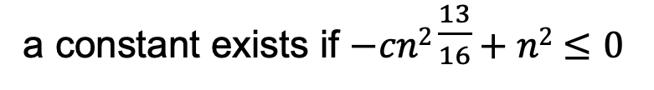
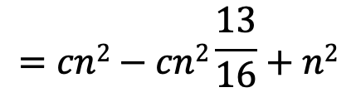
To prove that Show that T(n) = O(n²) we need to identify the appropriate constants:
i.e. some constant c such that T(n) ≤ cn²
$$=cn2−cn2\frac{13}{16}+n2$$
residual
a constant exists if $−cn2\frac{13}{16}+n2≤0$

Slide 27
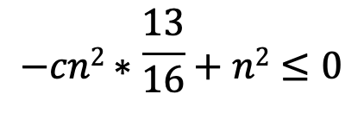
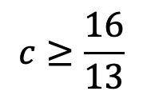
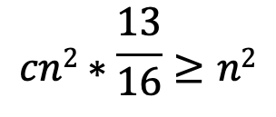
To prove that Show that T(n) = O(n²) we need to identify the appropriate constants:
i.e. some constant c such that T(n) ≤ cn²
$$−cn2∗\frac{13}{16}+n2≤0$$
$$cn2∗\frac{13}{16}≥n2$$
$$c≥\frac{16}{13}$$

Slide 28
Master Method
Provides solutions to the recurrences of the form:

Slide 29
a =
b =
f(n) =
16
4
n
Case 1:
Θ(n²)

Slide 30
a =
b =
f(n) =
1
2
2^{n}
Case 3?

Slide 31
Let c = 1/2
T(n) = Θ(2^{n})

Slide 32
a =
b =
f(n) =
2
2
n
Case 2:
Θ(n log n)

Slide 33
a =
b =
f(n) =
16
4
n!
Case 3?

Slide 34
Let c = 1/2
T(n) = Θ(n!)
therefore,

Slide 35
a =
b =
f(n) =
2
logn
Case 1:
Θ( )

Slide 36
a =
b =
f(n) =
4
2
n
Case 1:
Θ(n²)

Slide 37
Recurrences

Slide 38
Why does the master method work?
a
a
a
a

Slide 39
What is the depth of the tree?
At each level, the size of the data is divided by b

Slide 40
How many leaves?
How many leaves are there in a complete
a-ary tree of depth d?

Slide 41
Total cost
Case 1: cost is dominated by the cost of the leaves

Slide 42
Total cost
Case 2: cost is evenly distributed across tree
As we saw with mergesort, log n levels to the tree and at each level f(n) work

Slide 43
Total cost
Case 3: cost is dominated by the cost of the root
a

Slide 44
Other forms of the master method

Slide 45
Changing variables
Guesses?
We can do a variable change: let m = log₂ n
(or n = 2^{m})
Now, let S(m)=T(2^{m})

Slide 46
Changing variables
Guess?
substituting m=log n

