Slide 1
Big O
David Kauchak
cs140
Fall 2024

Slide 2
Administrative
Assignment 0 out and due on Sunday
Mentor hours up soon!
No group sessions this week

Slide 3
Proofs
What is a proof?
  A deductive argument showing a statement is true based on previous knowledge (axioms)
Why are they important/useful?
  Allows us to be sure that something is true
  In algs: allow us to prove properties of algorithms

Slide 4
An example
Prove the sum of two odd integers is even

Slide 5
An example
Prove the sum of two odd integers is even
Odd number: n = 2k + 1 for some integer k
Even number: n = 2k for some integer k

Slide 6
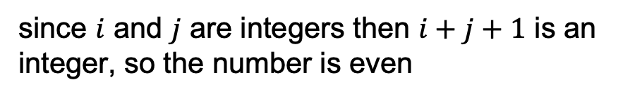




An example
Prove the sum of two odd integers is even
Odd number: n = 2k + 1 for some integer k
Even number: n = 2k for some integer k
Let $a$ and $b$ be odd numbers
By definition: $a = 2i+1$and $b = 2j+1$ where $i$ and $j$ are integers
$$a+b = 2i+1+2j+1$$
$$= 2i+2j+2$$
$$= 2(i+j+1)$$
since $i$ and $j$ are integers then $i+j+1$ is an integer, so the number is even

Slide 7
Proof techniques?
example/counterexample
enumeration
by cases
by inference (aka direct proof)
trivially
contrapositive
contradiction
induction (strong and weak)

Slide 8
Proof by induction (weak)
Proving something about a sequence of events by:
first: proving that some starting case is true and
then: proving that if a given event in the sequence were true then the next event would be true

Slide 9
Proof by induction (weak)
Base case: prove some starting case is true
Inductive case: Assume some event is true and prove the next event is true
  Inductive hypothesis: Assume the event is true at some point (usually k or k-1)
  Inductive step to prove: What you’re trying to prove assuming the inductive hypothesis is true (the next step)
  Proof of inductive step

Slide 10
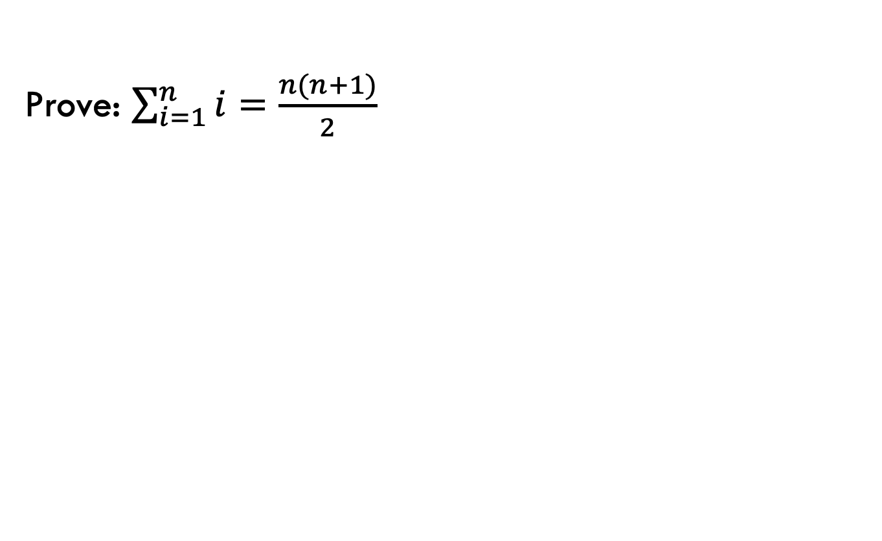
Proof by induction example
Prove: $\sum_{i=1}^{n}{i=\frac{n(n+1)}{2}}$
Base case: prove some starting case is true
Inductive case: Assume some event is true and prove the next event is true
  Inductive hypothesis: Assume the event is true at some point (usually k or k-1)
  Inductive step to prove: What you’re trying to prove assuming the inductive hypothesis is true (the next step)
  Proof of inductive step

Slide 11
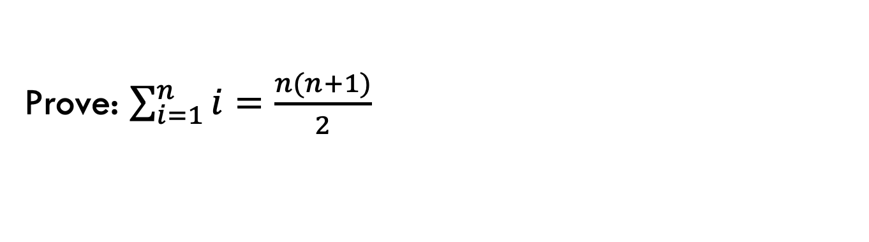
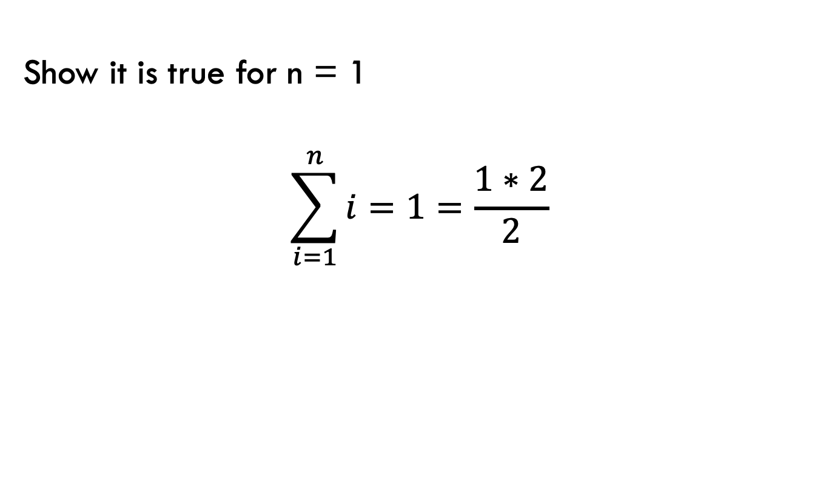
Base case
Prove: $\sum_{i=1}^{n}{i=\frac{n(n+1)}{2}}$
Show it is true for n = 1
$$\sum_{i=1}^{n}{i}=1=\frac{1∗2}{2}$$

Slide 12
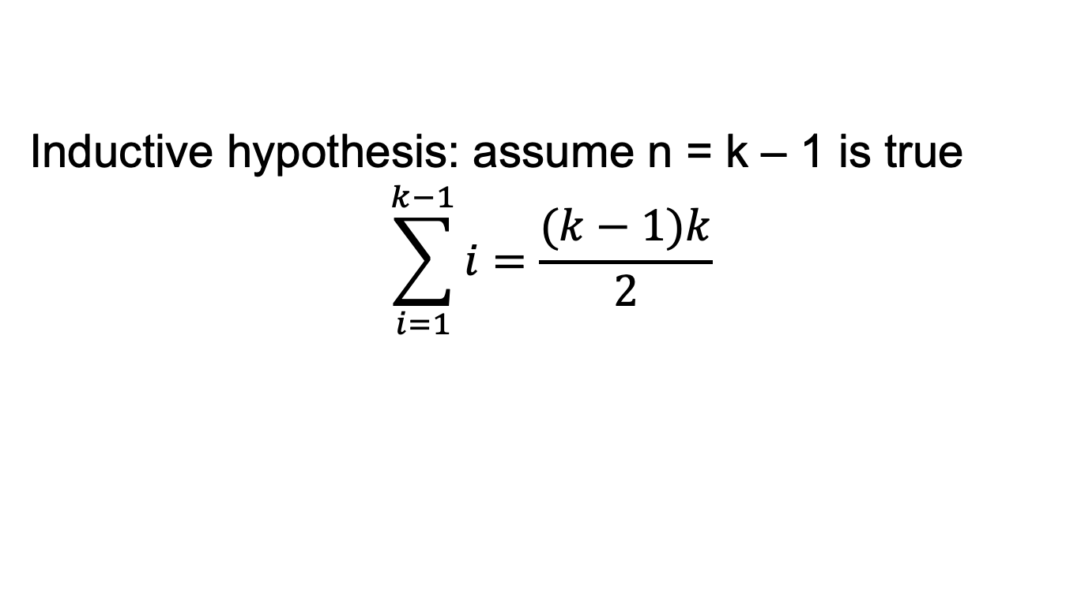
Inductive case
Prove: $\sum_{i=1}^{n}{i=\frac{n(n+1)}{2}}$
Inductive hypothesis: assume n = k – 1 is true
$$\sum_{i=1}^{k−1}{i}=\frac{(k−1)k}{2}$$

Slide 13
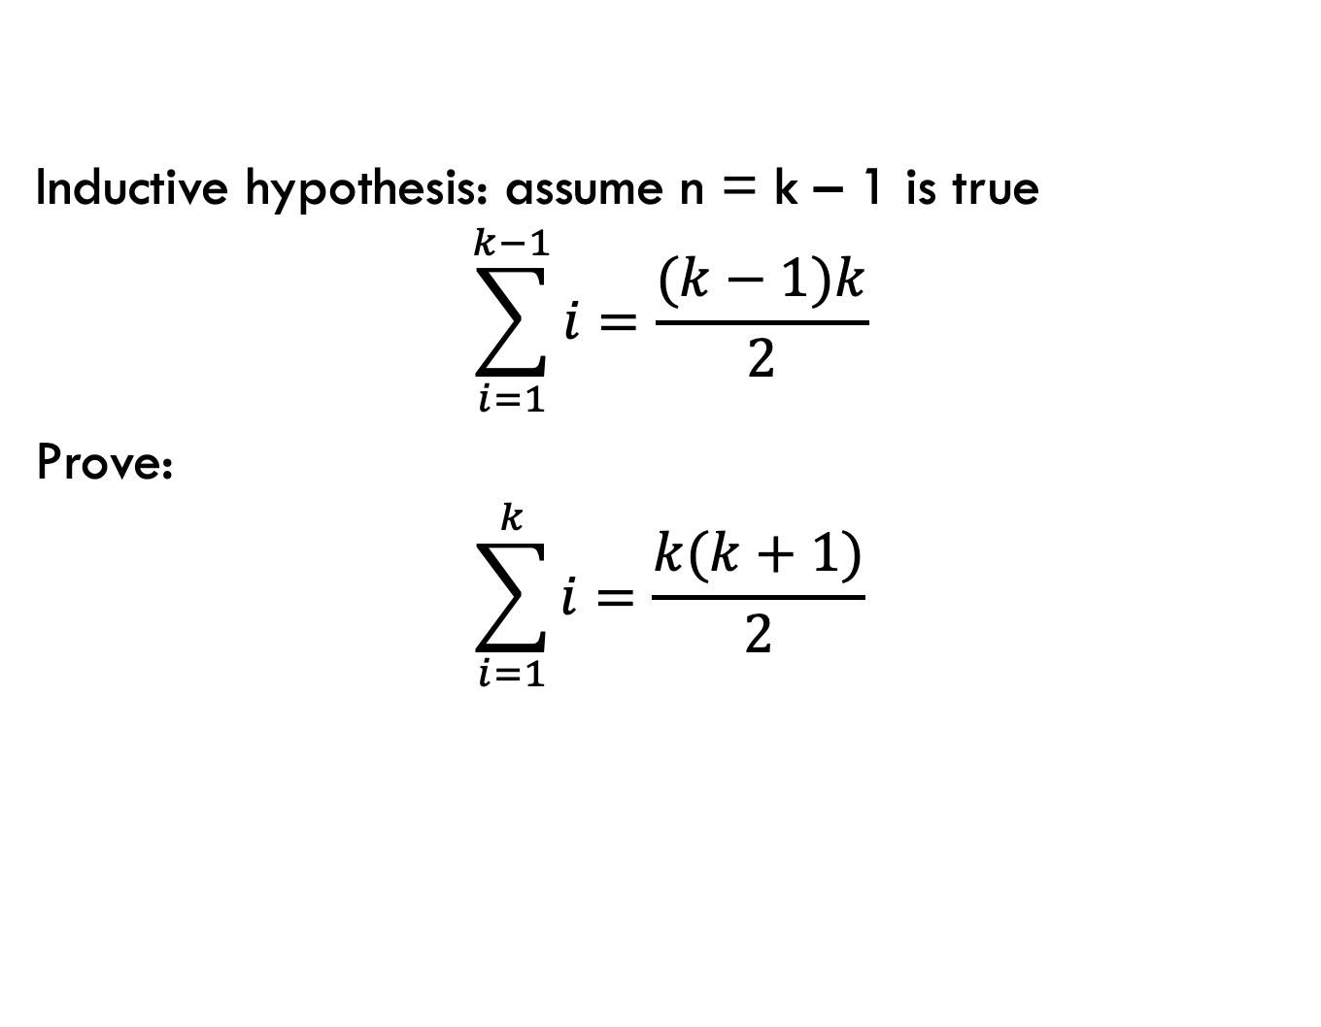
Inductive case
Prove: $\sum_{i=1}^{n}{i=\frac{n(n+1)}{2}}$
Inductive hypothesis: assume n = k – 1 is true
$$\sum_{i=1}^{k−1}{i}=\frac{(k−1)k}{2}$$
Prove:
$$\sum_{i=1}^{k}{i}=\frac{k(k+1)}{2}$$

Slide 14
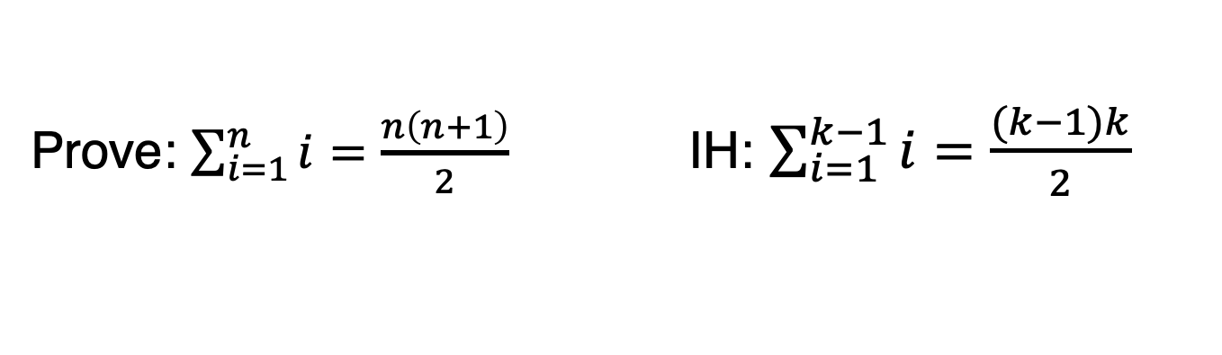
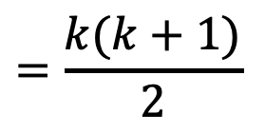
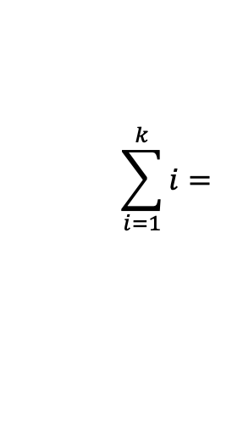
Inductive case: proof
Prove: $\sum_{i=1}^{n}{i=\frac{n\left(n+1\right)}{2}}$ IH: $\sum_{i=1}^{k−1}{i}=\frac{(k−1)k}{2}$
$$\sum_{i=1}^{k}{i}=$$
$$=\frac{k(k+1)}{2}$$

Slide 15


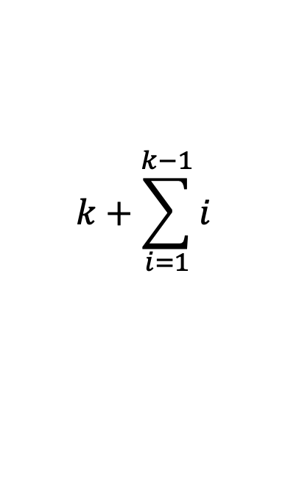
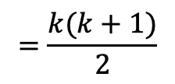


Inductive case: proof
Prove: $\sum_{i=1}^{n}{i=\frac{n\left(n+1\right)}{2}}$ IH: $\sum_{i=1}^{k−1}{i}=\frac{(k−1)k}{2}$
$$\sum_{i=1}^{k}{i}=$$
$$k+\sum_{i=1}^{k−1}{i}$$
by definition of sum
$=k+$ $\frac{(k−1)∗k}{2}$
by IH
$=\frac{2k}{2}+$ $\frac{(k−1)∗k}{2}$
$=$ $\frac{2k+ (k−1)∗k}{2}$
Why does induction work as a proof?
$=$ $\frac{k2+k}{2}$
$$=\frac{k(k+1)}{2}$$

Slide 16
Layout of a proof by induction
State what you’re trying to prove
We show that XXX using proof by induction
Prove base case
State the inductive hypothesis
Inductive proof
  State what you want to show (may include a variable change, e.g., k in instead of n)
  Show a step-by-step derivation from the left-hand side resulting in the right-hand side. Give justifications for steps that are non-trivial

Slide 17
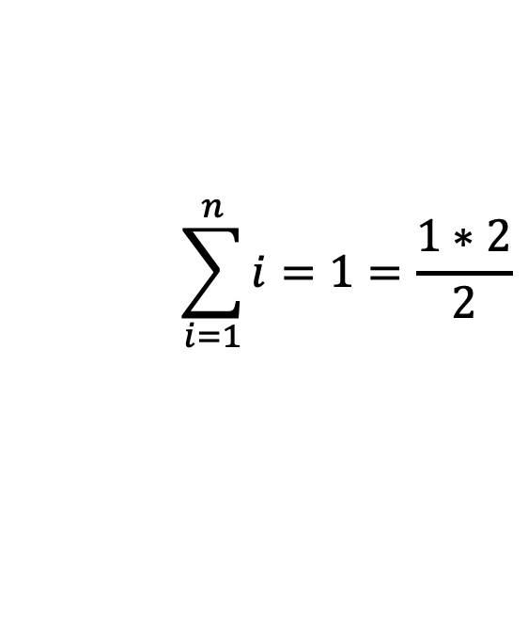
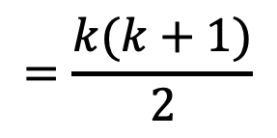
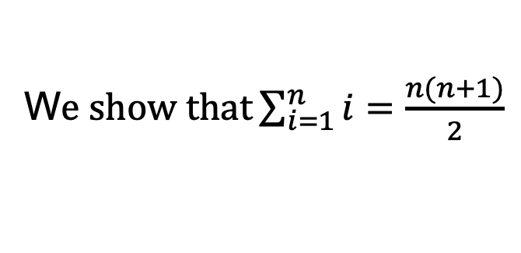
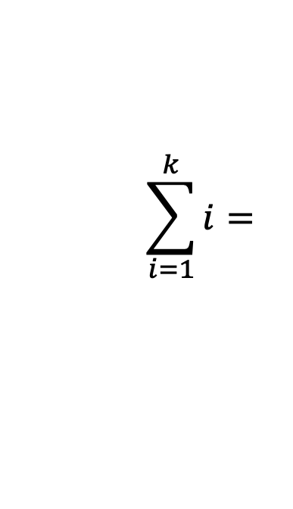
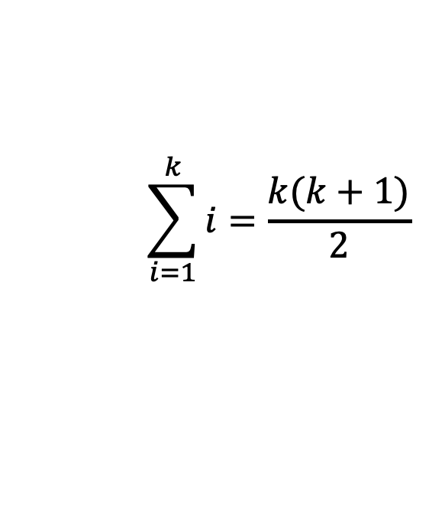
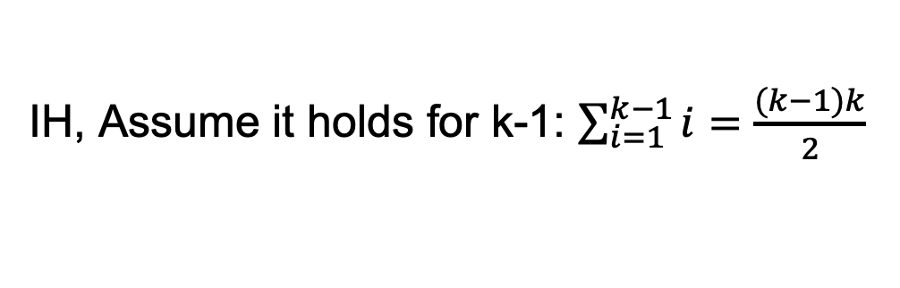
1.
W$e show that\sum_{i=1}^{n}{i=\frac{n(n+1)}{2}}$
using proof by induction
2.
Base case: n = 1
$$\sum_{i=1}^{n}{i}=1=\frac{1∗2}{2}$$
3.
IH, Assume it holds for k-1: $\sum_{i=1}^{k−1}{i}=\frac{(k−1)k}{2}$
$$\sum_{i=1}^{k}{i}=\frac{k(k+1)}{2}$$
4.
Inductive step: want to show
$$\sum_{i=1}^{k}{i}=$$
…
$$=\frac{k(k+1)}{2}$$

Slide 18
Inductive proofs
Weak vs. strong?

Slide 19
Inductive proofs
Weak: inductive hypothesis only assumes it holds for some step (e.g., kth step)
Strong: inductive hypothesis assumes it holds for all steps from the base case up to k

Slide 20

Sorting
Input: An array of numbers A
Output: The number in sorted order, i.e.,

Slide 21
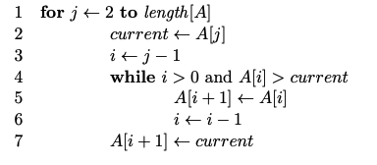
Sorting
What sorting algorithm?

Slide 22
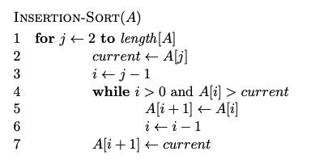
Sorting

Slide 23
Does it terminate?
Is it correct?
How long does it take to run?
Memory usage?

Slide 24
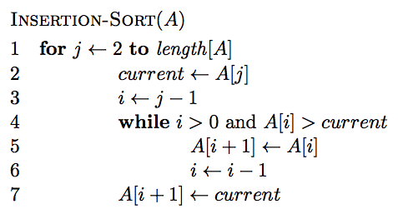
Insertion-sort
Does it terminate?

Slide 25
Insertion-sort
Is it correct? Can you prove it?

Slide 26
Loop invariant
Loop invariant: A statement about a loop that is true before the loop begins and after each iteration of the loop.
Upon termination of the loop, the invariant should help you show something useful about the algorithm.
Loop invariant?

Slide 27
Loop invariant
Loop invariant: A statement about a loop that is true before the loop begins and after each iteration of the loop.
At the start of each iteration of the for loop of lines 1-7 the subarray A[1..j − 1] is the sorted version of the original elements of A[1..j − 1]
Proof?

Slide 28
Loop invariant
At the start of each iteration of the for loop of lines 1-7 the subarray A[1..j − 1] is the sorted version of the original elements of A[1..j − 1]
Proof by induction
- Base case: invariant is true before loop
- Inductive case: it is true after each iteration

Slide 29
Insertion-sort
How long will it take to run?

Slide 30
Asymptotic notation
How do you answer the question: “what is the running time of algorithm x?”
We want to talk about the computational cost of an algorithm that focuses on the essential parts and ignores irrelevant details
You’ve seen some of this already:

Slide 31
Asymptotic notation
How do you answer the question: “what is the running time of algorithm x?”
We want to talk about the computational cost of an algorithm that focuses on the essential parts and ignores irrelevant details
You’ve seen some of this already:
  linear
  n log n
  n²

Slide 32
Asymptotic notation
Precisely calculating the actual steps is tedious and not generally useful
Different operations take different amounts of time. Even from run to run, things such as caching, etc. cause variations
We want to identify categories of algorithmic runtimes

Slide 33
For example…
f₁(n) takes n² steps
f₂(n) takes 2n + 100 steps
f₃(n) takes 3n+1 steps
Which algorithm is better (wrt run-time)?
Is the difference between f₂ and f₃ important/significant?

Slide 34
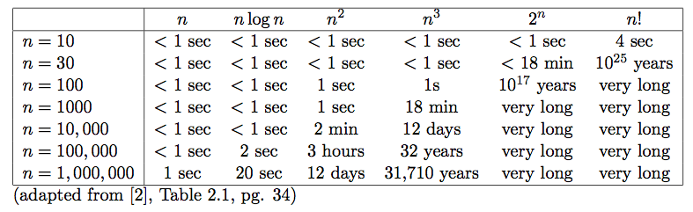
Runtime examples

Slide 35
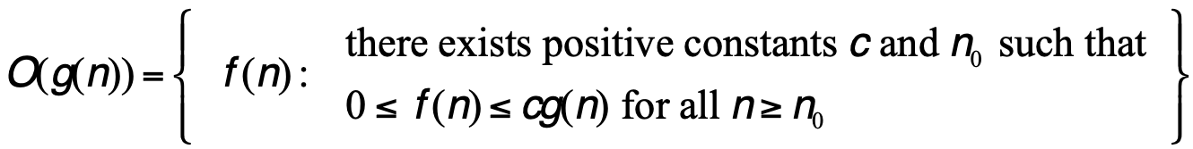
Big O: Upper bound
O(g(n)) is the set of functions:

Slide 36
Big O: Upper bound
O(g(n)) is the set of functions:
We can bound the function f(n) above by some constant factor times g(n)

Slide 37
Big O: Upper bound
O(g(n)) is the set of functions:
We can bound the function f(n) above by some constant times g(n)
As n increases, starting at some point

Slide 38
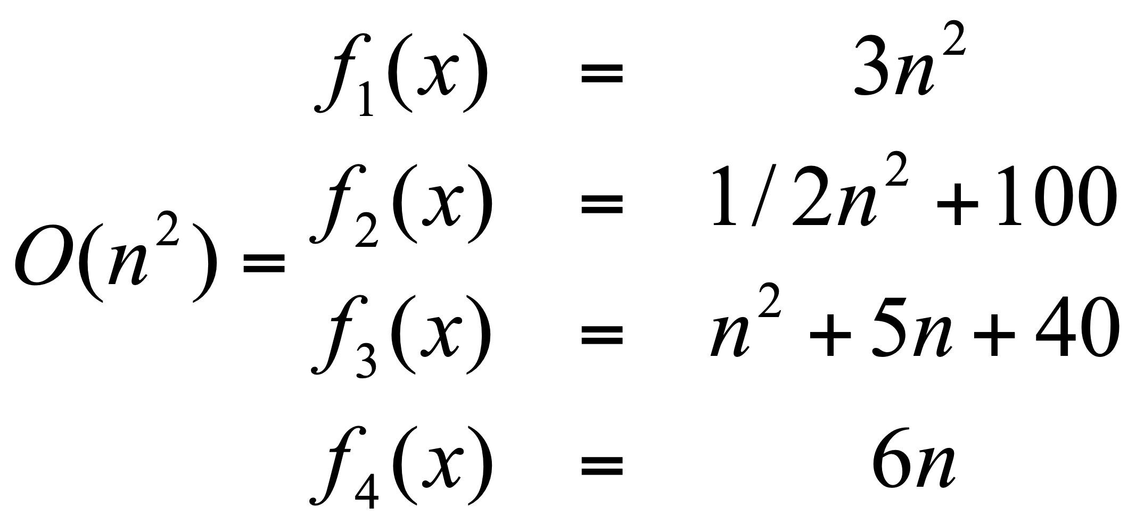
Big O: Upper bound
O(g(n)) is the set of functions:

Slide 39
Big O: Upper bound
O(g(n)) is the set of functions:
Generally, we’re most interested in big O notation since it is an upper bound on the running time

Slide 40
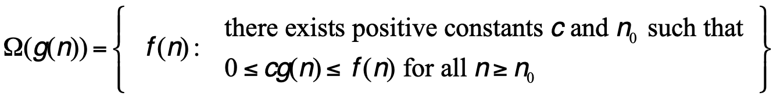
Omega: Lower bound
Ω(g(n)) is the set of functions:

Slide 41
Omega: Lower bound
Ω(g(n)) is the set of functions:
We can bound the function f(n) below by some constant factor times g(n)

Slide 42
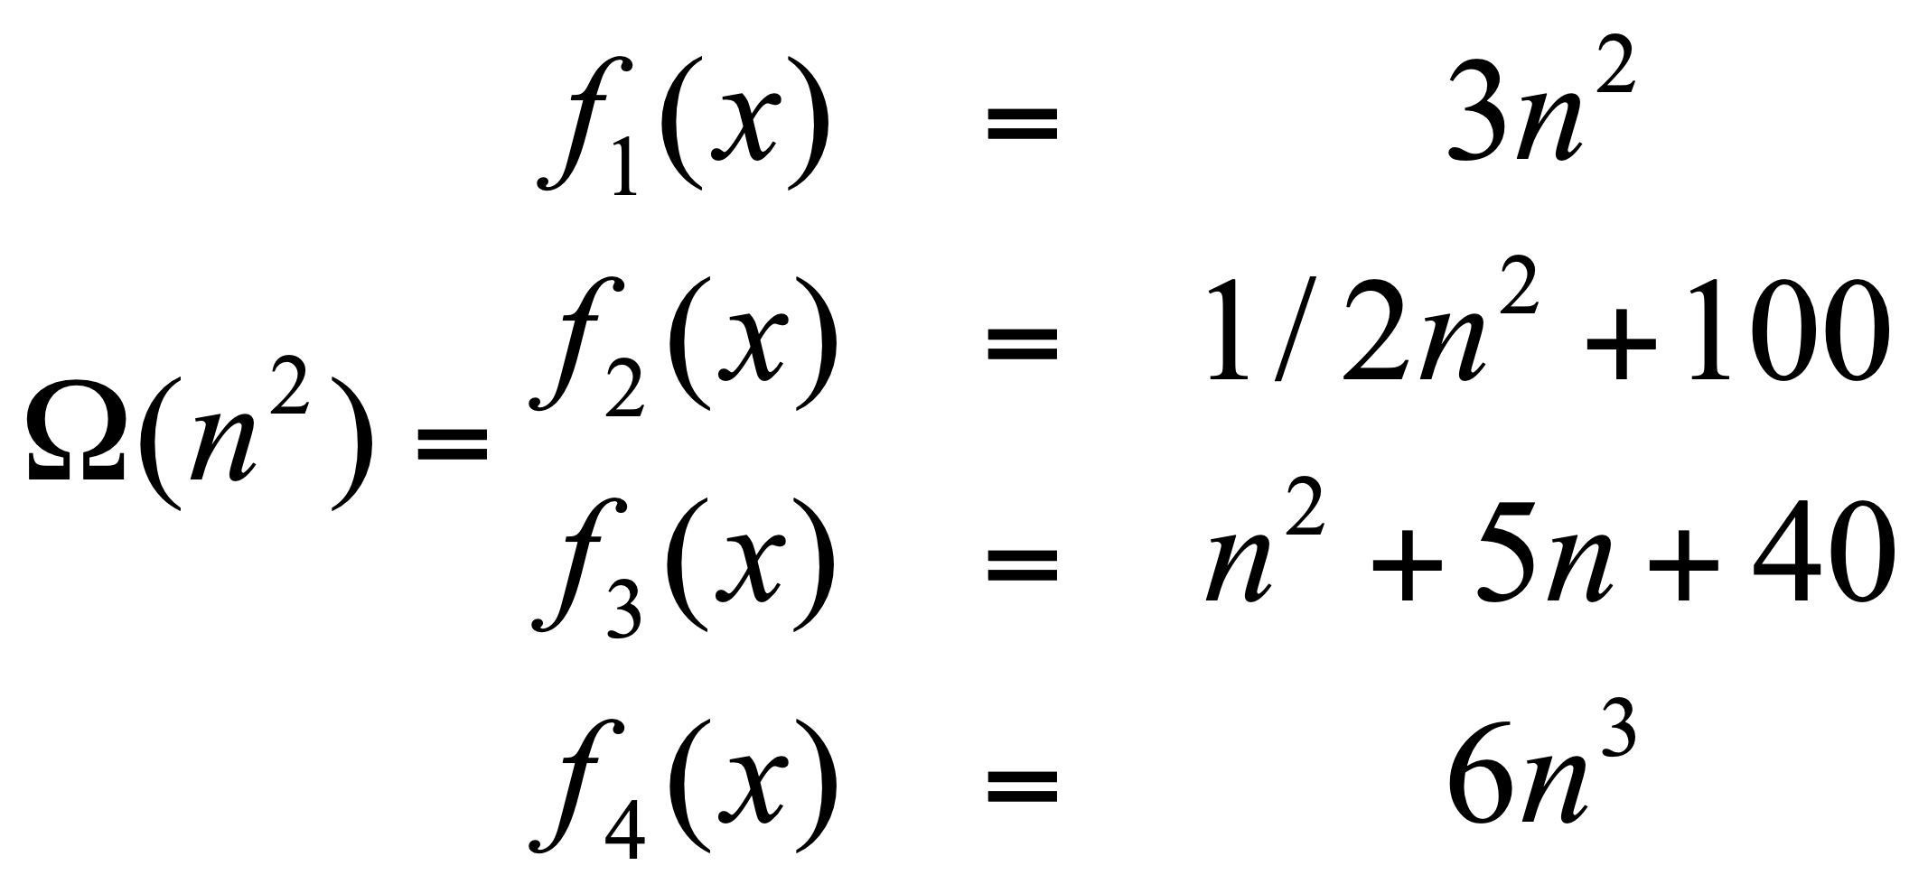
Omega: Lower bound
Ω(g(n)) is the set of functions:

Slide 43
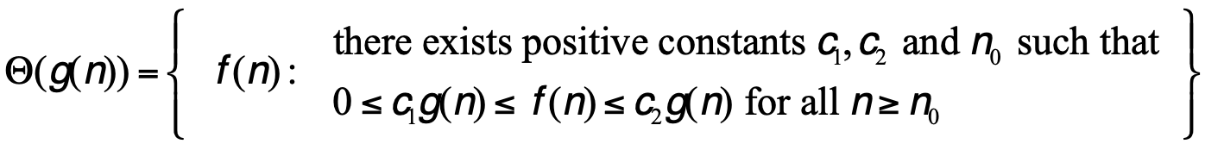
Theta: Upper and lower bound
Θ(g(n)) is the set of functions:

Slide 44
Theta: Upper and lower bound
Θ(g(n)) is the set of functions:
We can bound the function f(n) above and below by some constant factor of g(n) (though different constants)

Slide 45
Theta: Upper and lower bound
Θ(g(n)) is the set of functions:
Note: A function is θ bounded iff it is O bounded and Ω bounded

Slide 46
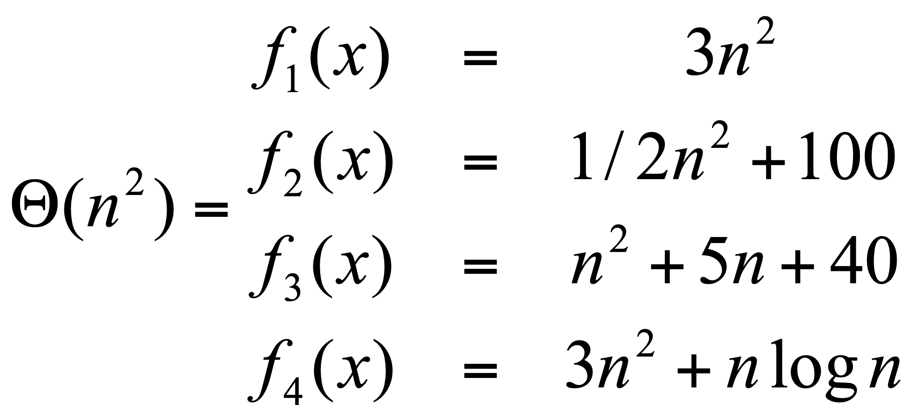

Theta: Upper and lower bound
$Θ(g(n))$ is the set of functions:

Slide 47
Visually
f(n)

Slide 48
Visually: upper bound
f(n)
n₀

Slide 49
Visually: lower bound
f(n)
n₀

Slide 50
worst-case vs. best-case vs. overall
worst-case: what is the worst the running time of the algorithm can be?
best-case: what is the best the running time of the algorithm can be?
overall: given some data, what is the running time of the algorithm? (Sometimes can think about this as any data or random data)
Don’t confuse this with O, Ω and Θ. The cases above are situations, asymptotic notation is about bounding particular situations

Slide 51
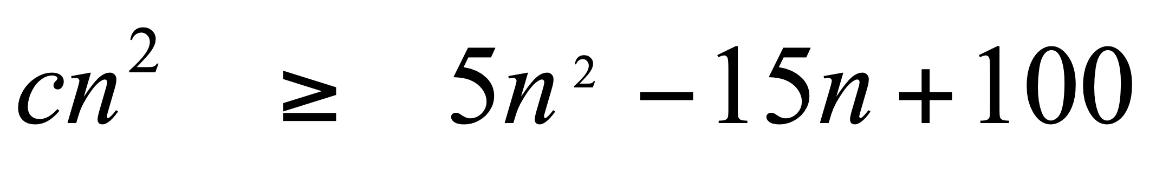
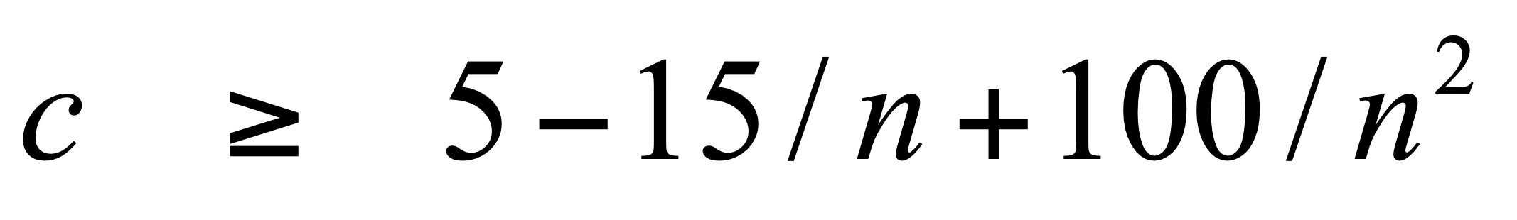
Proving bounds: find constants that satisfy inequalities
Show that 5n² – 15n + 100 is Θ(n²)
Step 1: Prove O(n²) – Find constants c and n₀ such that
5n² – 15n + 100 ≤ cn² for all n > n₀
Let n₀ =1 and c = 5 + 100 = 105.
100/n² only gets smaller as n increases and we ignore -15/n since it only varies between -15 and 0

Slide 52
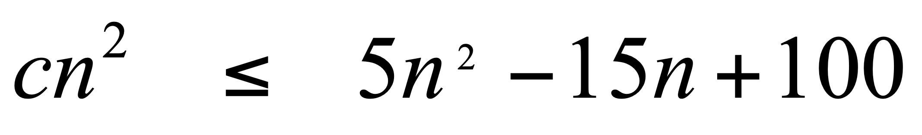
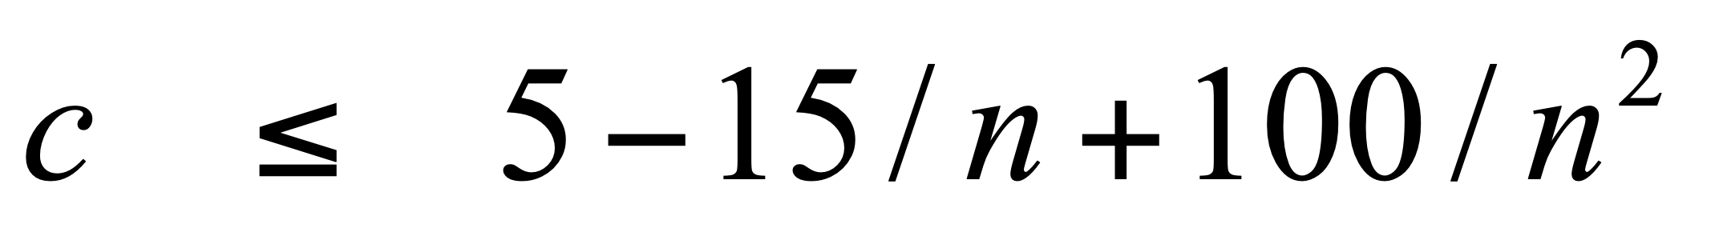
Proving bounds
Step 2: Prove Ω(n²) – Find constants c and n₀ such that 5n² – 15n + 100 ≥ cn² for all n > n₀
Let n₀ =4 and c = 5 – 15/4 = 1.25 (or anything less than 1.25). -15/n is always increasing and we ignore 100/n² since it is always between 0 and 100.

Slide 53
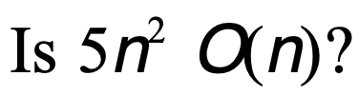
Bounds
No
How would we prove it?

Slide 54
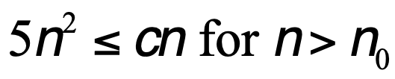

Disproving bounds
Assume it’s true.
That means there exists some c and n₀ such that
contradiction!

Slide 55
Some rules of thumb
Multiplicative constants can be omitted
  14n² becomes n²
  7 log n become log n
Lower order functions can be omitted
  n + 5 becomes n
  n² + n becomes n²
nª dominates n^{b} if a > b
  n² dominates n, so n²+n becomes n²
  n^{1.5} dominates n^{1.4}

Slide 56
Some rules of thumb
a^{n} dominates b^{n} if a > b
  3^{n} dominates 2^{n}
Any exponential dominates any polynomial
  3^{n} dominates n⁵
  2^{n} dominates n^{c}
Any polynomial dominates any logorithm
  n dominates log n or log log n
  n² dominates n log n
  n^{1/2} dominates log n
Do not omit lower order terms of different variables (n² + m) does not become n²

Slide 57
Big O
n² + n log n + 50
2^{n} -15n² + n³ log n
n^{log n} + n² + 15n³
n⁵ + n! + n^{n}

Slide 58
Insertion-sort
How long will it take to run?

Slide 59
Insertion-sort
How long will it take to run?
Best case? Worst case? Overall?
Use theta when you can, O otherwise.

Slide 60
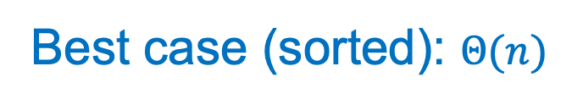
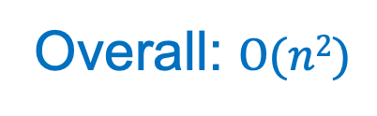
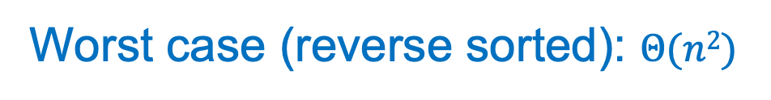
Insertion-sort
Best case (sorted): $Θ(n)$
Worst case (reverse sorted): $Θ(n2)$
Overall: $O(n2)$

Slide 61
Some examples
O(1) – constant. Fixed amount of work, regardless of the input size
  add two 32 bit numbers
  determine if a number is even or odd
  sum the first 20 elements of an array
  delete an element from a doubly linked list
O(log n) – logarithmic. At each iteration, discards some portion of the input (i.e. half)
  binary search

Slide 62
Some examples
O(n) – linear. Do a constant amount of work on each element of the input
  find an item in a linked list
  determine the largest element in an array
O(n log n) log-linear. Divide and conquer algorithms with a linear amount of work to recombine
  Sort a list of number with MergeSort
  FFT

Slide 63
Some examples
O(n²) – quadratic. Double nested loops that iterate over the data
  Insertion sort
O(2^{n}) – exponential
  Enumerate all possible subsets
  Traveling salesman using dynamic programming
O(n!)
  Enumerate all permutations
  determinant of a matrix with expansion by minors

