Slide 1
Spooky shortest paths
David Kauchak
CS 140 –Fall 2024

Slide 2


Slide 3
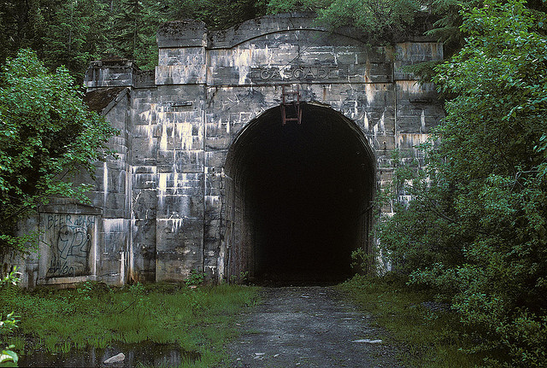

Slide 4
Admin
Assignment 8
Group 8

Slide 5
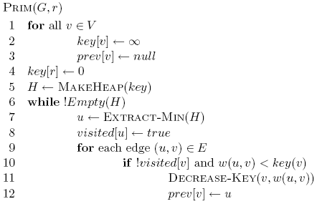
Prim’s

Slide 6
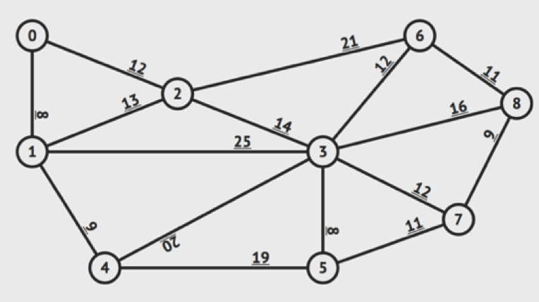
MST Practice

Slide 7
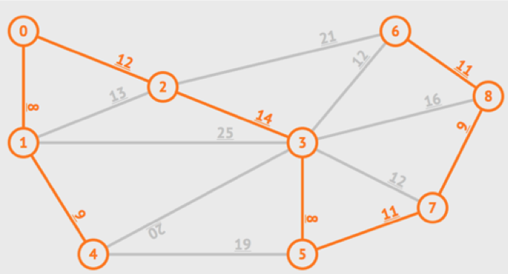
Solution
Sum = 8 + 8 + 9 + 9 + 11 + 11 + 12 + 14 = 82

Slide 8
Shortest paths
What is the shortest path from a to d?
B
D
A
C
E

Slide 9
Shortest paths
How can we find this?
B
D
A
C
E

Slide 10
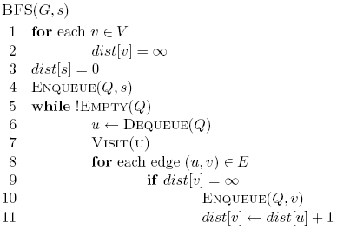
Shortest paths
BFS
B
D
A
C
E

Slide 11
Shortest paths
What is the shortest path from a to d?
2
B
D
3
3
A
1
2
1
C
E
4

Slide 12
Shortest paths
What is the shortest path from a to d?
2
B
D
3
3
A
1
2
1
C
E
4

Slide 13
Shortest path algorithms?

Slide 14
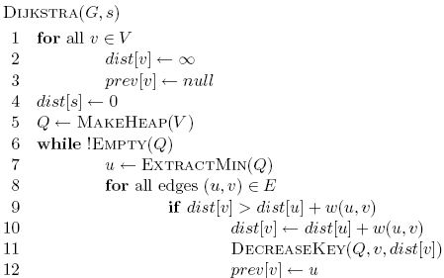
Dijkstra’s algorithm
What is dist?
What is prev?
How does it work?
What is the run-time?
How do we get the shortest path?

Slide 15
Dijkstra’s algorithm

Slide 16
Dijkstra’s algorithm
prev keeps track of
the shortest path

Slide 17
Dijkstra’s algorithm

Slide 18
Dijkstra’s algorithm

Slide 19
Dijkstra’s algorithm

Slide 20
3
B
D
3
1
A
1
2
1
C
E
4

Slide 21
∞
∞
3
B
D
3
∞
1
A
1
2
∞
1
C
E
∞
4

Slide 22
Heap
A 0
B ∞
C ∞
D ∞
E ∞
∞
∞
3
B
D
3
0
1
A
1
2
∞
1
C
E
∞
4

Slide 23
Heap
B ∞
C ∞
D ∞
E ∞
∞
∞
3
B
D
3
0
1
A
1
2
∞
1
C
E
∞
4

Slide 24
Heap
B ∞
C ∞
D ∞
E ∞
∞
∞
3
B
D
3
0
1
A
1
2
∞
1
C
E
∞
4

Slide 25
Heap
C 1
B ∞
D ∞
E ∞
∞
∞
3
B
D
3
0
1
A
1
2
1
1
C
E
∞
4

Slide 26
Heap
C 1
B ∞
D ∞
E ∞
∞
∞
3
B
D
3
0
1
A
1
2
1
1
C
E
∞
4

Slide 27
Heap
C 1
B 3
D ∞
E ∞
3
∞
3
B
D
3
0
1
A
1
2
1
1
C
E
∞
4

Slide 28
Heap
C 1
B 3
D ∞
E ∞
3
∞
3
B
D
3
0
1
A
1
2
1
1
C
E
∞
4

Slide 29
Heap
B 3
D ∞
E ∞
3
∞
3
B
D
3
0
1
A
1
2
1
1
C
E
∞
4

Slide 30
Heap
B 3
D ∞
E ∞
3
∞
3
B
D
3
0
1
A
1
2
1
1
C
E
∞
4

Slide 31
Heap
B 3
D ∞
E ∞
3
∞
3
B
D
3
0
1
A
1
2
1
1
C
E
∞
4

Slide 32
Heap
B 2
D ∞
E ∞
2
∞
3
B
D
3
0
1
A
1
2
1
1
C
E
∞
4

Slide 33
Heap
B 2
D ∞
E ∞
2
∞
3
B
D
3
0
1
A
1
2
1
1
C
E
∞
4

Slide 34
Heap
B 2
E 5
D ∞
2
∞
3
B
D
3
0
1
A
1
2
1
1
C
E
5
4

Slide 35
Heap
E 3
D 5
2
5
3
B
D
3
0
1
A
1
2
1
1
C
E
3
4

Slide 36
Heap
D 5
2
5
3
B
D
3
0
1
A
1
2
1
1
C
E
3
4

Slide 37
Heap
2
5
3
B
D
3
0
1
A
1
2
1
1
C
E
3
4

Slide 38
Heap
2
5
3
Prev
B
D
3
A: null
B: C
C: A
D: B
E: B
0
1
A
1
2
1
1
C
E
3
4

Slide 39
Heap
How do we get the actual paths?
2
5
3
Prev
B
D
3
A: null
B: C
C: A
D: B
E: B
0
1
A
1
2
1
1
C
E
3
4

Slide 40
Heap
2
5
3
Prev
B
D
A: null
B: C
C: A
D: B
E: B
0
1
A
1
1
1
C
E
3

Slide 41
Is Dijkstra’s algorithm correct?
Invariant: For every vertex removed from the heap, dist[v] is the actual shortest distance from s to v
proof?

Slide 42
Is Dijkstra’s algorithm correct?
Invariant: For every vertex removed from the heap, dist[v] is the actual shortest distance from s to v
  The only time a vertex gets visited is when the distance from s to that vertex is smaller than the distance to any remaining vertex
  Therefore, there cannot be any other path that hasn’t been visited already that would result in a shorter path

Slide 43
Running time?

Slide 44
Running time?
Θ(|V|)
1 call to MakeHeap
|V| calls to Extract-Min
|E| calls to Decrease-Key

Slide 45
Running time?
Depends on the heap implementation
1 MakeHeap
|V| ExtractMin
|E| DecreaseKey
Total
Array
O(|V|)
O(|V|²)
O(|E|)
O(|V|²)
Bin heap
O(|V|)
O(|V| log |V|)
O(|E| log |V|)
O((|V|+|E|) log |V|)
O(|E| log |V|)

Slide 46
Running time?
Depends on the heap implementation
1 MakeHeap
|V| ExtractMin
|E| DecreaseKey
Total
Array
O(|V|)
O(|V|²)
O(|E|)
O(|V|²)
Bin heap
O(|V|)
O(|V| log |V|)
O(|E| log |V|)
O((|V|+|E|) log |V|)
O(|E| log |V|)
Is this an improvement?
If |E| < |V|² / log |V|

Slide 47
Running time?
Depends on the heap implementation
1 MakeHeap
|V| ExtractMin
|E| DecreaseKey
Total
Array
O(|V|)
O(|V|²)
O(|E|)
O(|V|²)
Bin heap
O(|V|)
O(|V| log |V|)
O(|E| log |V|)
O((|V|+|E|) log |V|)
O(|E| log |V|)
Fib heap
O(|V|)
O(|V| log |V|)
O(|E|)
O(|V| log |V| + |E|)

Slide 48
Dijkstra’s vs Prim’s

Slide 49
What about Dijkstra’s on…?
1
1
B
D
A
5
10
-10
C
E

Slide 50
What about Dijkstra’s on…?
Dijkstra’s algorithm only works for positive edge weights
1
1
B
D
A
5
10
C
E

Slide 51
Is Dijkstra’s algorithm correct?
Invariant: For every vertex removed from the heap, dist[v] is the actual shortest distance from s to v
  The only time a vertex gets visited is when the distance from s to that vertex is smaller than the distance to any remaining vertex
  Therefore, there cannot be any other path that hasn’t been visited already that would result in a shorter path
We relied on having positive edge weights for correctness!

Slide 52
Bounding the distance
Another invariant: For each vertex v, dist[v] is an upper bound on the actual shortest distance
Is this a valid invariant?

Slide 53
Bounding the distance
Another invariant: For each vertex v, dist[v] is an upper bound on the actual shortest distance
  start off at ∞
  only update the value if we find a shorter distance
An update procedure: for an edge (u,v)

Slide 54
Can we ever go wrong applying this update rule?
  We can apply this rule as many times as we want and will never underestimate dist[v]
When will dist[v] be right?
  If u is along the shortest path to v and dist[u] is correct

Slide 55
dist[v] will be right if u is along the shortest path to v and dist[u] is correct
Consider the shortest path from s to v
s
p₁
p₂
p₃
p_{k}
v

Slide 56
dist[v] will be right if u is along the shortest path to v and dist[u] is correct
What happens if we update all of the vertices with the above update?
s
p₁
p₂
p₃
p_{k}
v

Slide 57
dist[v] will be right if u is along the shortest path to v and dist[u] is correct
What happens if we update all of the vertices with the above update?
s
p₁
p₂
p₃
p_{k}
v
correct

Slide 58
dist[v] will be right if u is along the shortest path to v and dist[u] is correct
What happens if we update all of the vertices with the above update?
s
p₁
p₂
p₃
p_{k}
v
correct
correct

Slide 59
dist[v] will be right if u is along the shortest path to v and dist[u] is correct
Does the order that we update the vertices matter?
s
p₁
p₂
p₃
p_{k}
v
correct
correct
Notes:
yes! If we did it in the order of the correct path, we’d be done.

Slide 60
dist[v] will be right if u is along the shortest path to v and dist[u] is correct
How many times do we have to do this for vertex p_{i} to have the correct shortest path from s?
  i times
s
p₁
p₂
p₃
p_{k}
v

Slide 61
dist[v] will be right if u is along the shortest path to v and dist[u] is correct
How many times do we have to do this for vertex p_{i} to have the correct shortest path from s?
  i times
s
p₁
p₂
p₃
p_{k}
v
correct
correct

Slide 62
dist[v] will be right if u is along the shortest path to v and dist[u] is correct
How many times do we have to do this for vertex p_{i} to have the correct shortest path from s?
  i times
s
p₁
p₂
p₃
p_{k}
v
correct
correct
correct

Slide 63
dist[v] will be right if u is along the shortest path to v and dist[u] is correct
How many times do we have to do this for vertex p_{i} to have the correct shortest path from s?
  i times
s
p₁
p₂
p₃
p_{k}
v
correct
correct
correct
correct

Slide 64
dist[v] will be right if u is along the shortest path to v and dist[u] is correct
How many times do we have to do this for vertex p_{i} to have the correct shortest path from s?
  i times
s
p₁
p₂
p₃
p_{k}
v
…
correct
correct
correct
correct

Slide 65
dist[v] will be right if u is along the shortest path to v and dist[u] is correct
What is the longest (vertex-wise) the shortest path from s to any node v can be?
  |V| - 1 edges/vertices
s
p₁
p₂
p₃
p_{k}
v
…
correct
correct
correct
correct

Slide 66
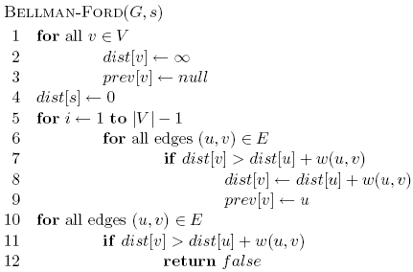
Bellman-Ford algorithm

Slide 67
Bellman-Ford algorithm
Initialize all the distances
do it |V| -1 times
iterate over all edges/vertices and apply update rule

Slide 68
Bellman-Ford algorithm
check for negative cycles

Slide 69
Negative cycles
What is the shortest path from a to e?
1
1
B
D
A
5
10
-10
C
E
3

Slide 70
Bellman-Ford algorithm

Slide 71
Bellman-Ford algorithm
10
How many edges is the shortest path from s to:
S
A
8
1
G
-4
B
A:
2
1
1
-2
B:
F
C
-1
3
E
D
D:
-1

Slide 72
Bellman-Ford algorithm
10
How many edges is the shortest path from s to:
S
A
8
1
G
-4
B
A:
3
2
1
1
-2
C
F
-1
3
E
D
-1

Slide 73
Bellman-Ford algorithm
10
How many edges is the shortest path from s to:
S
A
8
1
G
-4
B
A:
3
2
1
1
-2
B:
F
C
-1
3
E
D
-1

Slide 74
Bellman-Ford algorithm
10
How many edges is the shortest path from s to:
S
A
8
1
G
-4
B
A:
3
2
1
1
-2
B:
5
F
C
-1
3
E
D
-1

Slide 75
Bellman-Ford algorithm
10
How many edges is the shortest path from s to:
S
A
8
1
G
-4
B
A:
3
2
1
1
-2
B:
5
F
C
-1
3
E
D
D:
-1

Slide 76
Bellman-Ford algorithm
10
How many edges is the shortest path from s to:
S
A
8
1
G
-4
B
A:
3
2
1
1
-2
B:
5
F
C
-1
3
E
D
D:
7
-1

Slide 77
Bellman-Ford algorithm
0
∞
10
S
A
Iteration: 0
8
1
∞
∞
G
-4
B
2
1
1
-2
C
∞
F
∞
-1
3
E
D
-1
∞
∞

Slide 78
Bellman-Ford algorithm
0
10
10
S
A
Iteration: 1
8
1
∞
8
G
-4
B
2
1
1
-2
C
∞
F
∞
-1
3
E
D
-1
∞
∞

Slide 79
Bellman-Ford algorithm
0
10
10
S
A
Iteration: 2
8
1
∞
8
G
-4
B
2
1
1
-2
C
∞
F
9
-1
3
E
D
-1
12
∞

Slide 80
Bellman-Ford algorithm
0
5
10
S
A
Iteration: 3
8
1
10
8
G
-4
B
A has the correct distance and path
2
1
1
-2
C
∞
F
9
-1
3
E
D
-1
8
∞

Slide 81
Bellman-Ford algorithm
0
5
10
S
A
Iteration: 4
8
1
6
8
G
-4
B
2
1
1
-2
C
11
F
9
-1
3
E
D
-1
7
∞

Slide 82
Bellman-Ford algorithm
0
5
10
S
A
Iteration: 5
8
1
5
8
G
-4
B
B has the correct distance and path
2
1
1
-2
C
7
F
9
-1
3
E
D
-1
7
14

Slide 83
Bellman-Ford algorithm
0
5
10
S
A
Iteration: 6
8
1
5
8
G
-4
B
2
1
1
-2
C
6
F
9
-1
3
E
D
-1
7
10

Slide 84
Bellman-Ford algorithm
0
5
10
S
A
Iteration: 7
8
1
5
8
G
-4
B
D (and all other nodes) have the correct distance and path
2
1
1
-2
C
6
F
9
-1
3
E
D
-1
7
9

Slide 85
Correctness of Bellman-Ford
Loop invariant: After iteration i, all vertices with shortest paths from s of length i edges or less have correct distances

Slide 86
Runtime of Bellman-Ford
O(|V| |E|)

Slide 87
Runtime of Bellman-Ford
Can you modify the algorithm to run faster (in some circumstances)?

Slide 88
Shortest Paths
2
B
D
-1
1
3
-3
A
2
4
C
E
5
What is the shortest path from A to E?

Slide 89
Shortest Paths
2
B
D
-1
1
3
-3
A
2
4
C
E
5
-2

Slide 90
Shortest Paths
2
B
D
-1
1
3
-3
A
2
4
C
E
5
What algorithm would we use to calculate this?

Slide 91
Shortest Paths
2
B
D
-1
1
3
-3
A
2
4
C
E
5
Bellman-Ford (since the graph has negative edges)
O(VE)

Slide 92
Shortest Paths
2
B
D
-1
1
3
-3
A
2
4
C
E
5
Bellman-Ford (since the graph has negative edges)
O(VE)
Called a single-source shortest path algorithm. Why?

Slide 93
Shortest Paths
2
B
D
-1
1
3
-3
A
2
4
C
E
5
Bellman-Ford (since the graph has negative edges)
O(VE)
Calculate all paths from a single vertex.

Slide 94
Shortest Paths
2
B
D
-1
1
3
-3
A
2
4
C
E
5
What is the shortest path from A to C?
If we already calculated A to E using Bellman-Ford do we need to do any work?

Slide 95
Shortest Paths
2
B
D
-1
1
3
-3
A
2
4
C
E
5
No new calculations!
Bellman-Ford calculates all shortest paths starting at A.

Slide 96
Shortest Paths
2
B
D
-1
1
3
-3
A
2
4
C
E
5
What is the shortest path from D to C?
If we already calculated A to E using Bellman-Ford do we need to do any work?

Slide 97
Shortest Paths
2
B
D
-1
1
3
-3
A
2
4
C
E
5
Different source.
Have to run Bellman-Ford again!

Slide 98
All pairs shortest paths
All pairs shortest paths: calculate the shortest paths between all vertices
2
B
D
-1
1
3
-3
A
2
4
C
E
5

Slide 99
All pairs shortest paths
All pairs shortest paths: calculate the shortest paths between all vertices
Easy solution?

Slide 100
All pairs shortest paths
All pairs shortest paths: calculate the shortest paths between all vertices
Run Bellman-Ford from each vertex!
Running time (in terms of E and V)?

Slide 101
All pairs shortest paths
All pairs shortest paths: calculate the shortest paths between all vertices
Run Bellman-Ford from each vertex!
O(V²E)
Bellman-Ford: O(VE)
V calls, one for each vertex

Slide 102
DAGs?

Slide 103
Handout

Slide 104
Kruskals
Add smallest edge that connects two sets not already connected
Prims
Starting at 0, grow MST by adding lowest weight edge out of current MST

Slide 105
Bellman-Ford algorithm
0
∞
10
S
A
8
1
∞
∞
G
-4
B
2
1
1
-2
C
∞
F
∞
-1
3
E
D
-1
∞
∞

