Slide 1
Dynamic programming: Even More fun!
David Kauchak CS 140 – Fall 2024

Slide 2
Admin
Assignment 5
Out later today
Due Sunday (extra credit for submitting by Friday)
Schedule changes this week soon
Will post final schedule
No group session for Elshiekh

Slide 3
Longest increasing subsequence
Given a sequence of numbers X = x₁, x₂, …, x_{n} find the longest increasing subsequence
(i₁, i₂, …, i_{m}), i.e., a subsequence where numbers in the sequence increase.
5 2 8 6 3 6 9 7

Slide 4
Longest increasing subsequence
Given a sequence of numbers X = x₁, x₂, …, x_{n} find the longest increasing subsequence
(i₁, i₂, …, i_{m}), i.e., a subsequence where numbers in the sequence increase.
5 2 8 6 3 6 9 7

Slide 5
1a: optimal substructure
Prove: optimal solutions to the problem incorporate optimal solutions to related subproblems
5 2 8 6 3 6 9 7
$$\{i1, i2, …, im\}$$
What would a solution to a subproblem look like?

Slide 6
1a: optimal substructure
Prove: optimal solutions to the problem incorporate optimal solutions to related subproblems
5 2 8 6 3 6 9 7
$$\{i1, i2, …, im\}$$
$\{i2, …, im\}$ for the sequence
starting at index i₂

Slide 7
1a: optimal substructure
Prove: optimal solutions to the problem incorporate optimal solutions to related subproblems
Proof by contradiction:
Assume: $\left\{i1, i2, i3, …, im\right\}$is a solution to $x1…xn$ but
$\left\{i2, i3, …, im\right\}$ is not a solution to $x_{i2}…xn$
Then some solution to $x_{i2}…xm$ exists, $\left\{i′2, i′3, …, i^{′}k\right\}$ where k$> m$.
We could create a solution $\left\{i1,i′2, i′3, …, i^{′}k\right\}$ to the original problem that is a better solution ... contradiction

Slide 8
Recursive solution
5 2 8 6 3 6 9 7
Is 5 part off the LIS?

Slide 9
Recursive solution
5 2 8 6 3 6 9 7
Two options: Either 5 is in the LIS or it’s not

Slide 10
Recursive solution
5 2 8 6 3 6 9 7
include 5
5 + LIS(8 6 3 6 9 7)

Slide 11
Recursive solution
5 2 8 6 3 6 9 7
include 5
5 + LIS(8 6 3 6 9 7)
What is this function exactly?
longest increasing sequence of the numbers
longest increasing sequence of the numbers starting with 8

Slide 12
Recursive solution
5 2 8 6 3 6 9 7
include 5
5 + LIS(8 6 3 6 9 7)
What is this function exactly?
longest increasing sequence of the numbers
This would allow for the option of sequences starting with 3 which are NOT valid!

Slide 13
Recursive solution
5 2 8 6 3 6 9 7
include 5
5 + LIS’(8 6 3 6 9 7)
longest increasing sequence of the numbers starting with 8
Do we need to consider anything else for subsequences starting at 5?

Slide 14
Recursive solution
5 2 8 6 3 6 9 7
include 5
5 + LIS’(8 6 3 6 9 7)
5 + LIS’(6 3 6 9 7)
5 + LIS’(6 9 7)
5 + LIS’(9 7)
5 + LIS’(7)

Slide 15
Recursive solution
5 2 8 6 3 6 9 7
don’t include 5
LIS(2 8 6 3 6 9 7)
Anything else?
Technically, this is fine, but now we have LIS and LIS’ to worry about.
Can we rewrite LIS in terms of LIS’?

Slide 16
Recursive solution
Longest increasing sequence for X is the longest increasing sequence starting at any element
And what is LIS’ defined as (recursively)?

Slide 17
Recursive solution
Longest increasing sequence for X is the longest increasing sequence starting at any element
$$LIS^{′}\left(i\right)= 1+\max_{j: i<j≤n and x_{j}>x_{i}}{LIS′(j)}$$
Longest increasing sequence starting at i

Slide 18
DP solution (bottom-up)
$$LIS^{′}\left(i\right)= 1+\max_{j: i<j≤n and x_{j}>x_{i}}{LIS′(j)}$$
LIS’:
5 2 8 6 3 6 9 7

Slide 19
DP solution (bottom-up)
$$LIS^{′}\left(i\right)= 1+\max_{j: i<j≤n and x_{j}>x_{i}}{LIS′(j)}$$
LIS’: 1
5 2 8 6 3 6 9 7

Slide 20
DP solution (bottom-up)
$$LIS^{′}\left(i\right)= 1+\max_{j: i<j≤n and x_{j}>x_{i}}{LIS′(j)}$$
LIS’: 1
5 2 8 6 3 6 9 7

Slide 21
DP solution (bottom-up)
$$LIS^{′}\left(i\right)= 1+\max_{j: i<j≤n and x_{j}>x_{i}}{LIS′(j)}$$
LIS’: 1 1
5 2 8 6 3 6 9 7

Slide 22
DP solution (bottom-up)
$$LIS^{′}\left(i\right)= 1+\max_{j: i<j≤n and x_{j}>x_{i}}{LIS′(j)}$$
LIS’: 1 1
5 2 8 6 3 6 9 7

Slide 23
DP solution (bottom-up)
$$LIS^{′}\left(i\right)= 1+\max_{j: i<j≤n and x_{j}>x_{i}}{LIS′(j)}$$
LIS’: 2 1 1
5 2 8 6 3 6 9 7

Slide 24
DP solution (bottom-up)
$$LIS^{′}\left(i\right)= 1+\max_{j: i<j≤n and x_{j}>x_{i}}{LIS′(j)}$$
LIS’: 3 2 1 1
5 2 8 6 3 6 9 7

Slide 25
DP solution (bottom-up)
$$LIS^{′}\left(i\right)= 1+\max_{j: i<j≤n and x_{j}>x_{i}}{LIS′(j)}$$
LIS’: 2 3 2 1 1
5 2 8 6 3 6 9 7

Slide 26
DP solution (bottom-up)
$$LIS^{′}\left(i\right)= 1+\max_{j: i<j≤n and x_{j}>x_{i}}{LIS′(j)}$$
LIS’: 2 2 3 2 1 1
5 2 8 6 3 6 9 7

Slide 27
DP solution (bottom-up)
$$LIS^{′}\left(i\right)= 1+\max_{j: i<j≤n and x_{j}>x_{i}}{LIS′(j)}$$
LIS’: 4 2 2 3 2 1 1
5 2 8 6 3 6 9 7

Slide 28
DP solution (bottom-up)
$$LIS^{′}\left(i\right)= 1+\max_{j: i<j≤n and x_{j}>x_{i}}{LIS′(j)}$$
LIS’: 3 4 2 2 3 2 1 1
5 2 8 6 3 6 9 7

Slide 29
DP solution (bottom-up)
$$LIS^{′}\left(i\right)= 1+\max_{j: i<j≤n and x_{j}>x_{i}}{LIS′(j)}$$
LIS’: 3 4 2 2 3 2 1 1
5 2 8 6 3 6 9 7

Slide 30
DP solution (bottom-up)
$$LIS^{′}\left(i\right)= 1+\max_{j: i<j≤n and x_{j}>x_{i}}{LIS′(j)}$$
What does the table for storing answers look like?

Slide 31
DP solution (bottom-up)
$$LIS^{′}\left(i\right)= 1+\max_{j: i<j≤n and x_{j}>x_{i}}{LIS′(j)}$$
1-D array: only one thing changes for recursive calls

Slide 32
DP solution (bottom-up)
$$LIS^{′}\left(i\right)= 1+\max_{j: i<j≤n and x_{j}>x_{i}}{LIS′(j)}$$
What are the “smallest” possible subproblems?
To calculate LIS’(n), what are all the subproblems we need to calculate? This is the “table”.
How should we fill in the table?
Where will the answer be?

Slide 33
DP solution (bottom-up)
$$LIS^{′}\left(i\right)= 1+\max_{j:i<j≤n and xj>xi}{LIS′(j)}$$
What are the “smallest” possible subproblems?
LIS’(n) and that is well-defined for this problem
To calculate LIS’(i), what are all the subproblems we need to calculate? This is the “table”.
LIS’(1) … LIS’(n)
How should we fill in the table?
n → 1
Where will the answer be?
max(LIS’(1)…LIS’(n))

Slide 34
DP solution (bottom-up)

Slide 35
DP solution (bottom-up)
start from the end (bottom)

Slide 36
DP solution (bottom-up)
$$LIS^{′}\left(i\right)= 1+\max_{j:i<j≤n and xj>xi}{LIS′(j)}$$

Slide 37
DP solution (bottom-up)

Slide 38
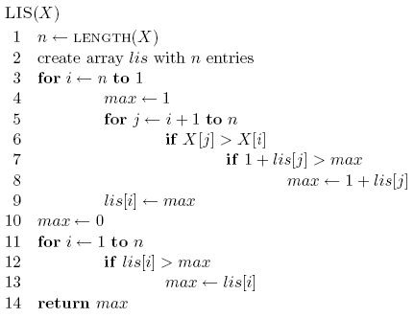
Analysis
Space requirements?
Running time?

Slide 39
Analysis
Space requirements: Θ(n)
Running time: Θ(n²)

Slide 40
Another solution
Can we use LCS to solve this problem?
5 2 8 6 3 6 9 7
LCS
2 3 5 6 6 7 8 9

Slide 41
Another solution
Can we use LCS to solve this problem?
5 2 8 6 3 6 9 7
LCS
2 3 5 6 6 7 8 9

Slide 42
Edit distance (aka Levenshtein distance)
Edit distance between two strings is the minimum number of insertions, deletions and substitutions required to transform string s₁ into string s₂
Insertion:
ABACED
ABACCED
DABACCED
Insert ‘C’
Insert ‘D’

Slide 43
Edit distance (aka Levenshtein distance)
Edit distance between two strings is the minimum number of insertions, deletions and substitutions required to transform string s₁ into string s₂
Deletion:
ABACED

Slide 44
Edit distance (aka Levenshtein distance)
Edit distance between two strings is the minimum number of insertions, deletions and substitutions required to transform string s₁ into string s₂
Deletion:
ABACED
BACED
Delete ‘A’

Slide 45
Edit distance (aka Levenshtein distance)
Edit distance between two strings is the minimum number of insertions, deletions and substitutions required to transform string s₁ into string s₂
Deletion:
ABACED
BACED
BACE
Delete ‘A’
Delete ‘D’

Slide 46
Edit distance (aka Levenshtein distance)
Edit distance between two strings is the minimum number of insertions, deletions and substitutions required to transform string s₁ into string s₂
Substitution:
ABACED
ABADED
ABADES
Sub ‘D’ for ‘C’
Sub ‘S’ for ‘D’

Slide 47
Edit distance examples
Edit(Kitten, Mitten) =
1
Operations:
Sub ‘M’ for ‘K’
Mitten

Slide 48
Edit distance examples
Edit(Happy, Hilly) =
3
Operations:
Sub ‘a’ for ‘i’
Hippy
Sub ‘l’ for ‘p’
Hilpy
Sub ‘l’ for ‘p’
Hilly

Slide 49
Edit distance examples
Edit(Banana, Car) =
5
Operations:
Delete ‘B’
anana
Delete ‘a’
nana
Delete ‘n’
naa
Sub ‘C’ for ‘n’
Caa
Sub ‘a’ for ‘r’
Car

Slide 50
Edit distance examples
Edit(Simple, Apple) =
3
Operations:
Delete ‘S’
imple
Sub ‘A’ for ‘i’
Ample
Sub ‘m’ for ‘p’
Apple

Slide 51
Edit distance
Why might this be useful?

Slide 52
Is edit distance symmetric?
that is, is Edit(s₁, s₂) = Edit(s₂, s₁)?
Why?
sub ‘i’ for ‘j’ → sub ‘j’ for ‘i’
delete ‘i’ → insert ‘i’
insert ‘i’ → delete ‘i’
Edit(Simple, Apple) =? Edit(Apple, Simple)

Slide 53
Calculating edit distance
X = A B C B D A B
Y = B D C A B A
Ideas? How can we break this into subproblems?

Slide 54
Calculating edit distance
X = A B C B D A ?
Y = B D C A B ?
After all of the operations, X needs to equal Y
Start with the last two characters

Slide 55
Calculating edit distance
X = A B C B D A ?
Y = B D C A B ?
Operations:
Insert
Delete
Substitute
Assume they’re different
How can we make them the same?

Slide 56
Insert
X = A B C B D A ?
Y = B D C A B ?
How can we use insert to transform X into Y?

Slide 57
Insert
X = A B C B D A ? ?
Y = B D C A B ?
insert the last character of Y to the end of X

Slide 58
Insert
X = A B C B D A ? ?
Y = B D C A B ?
How does this make the problem smaller?

Slide 59
Insert
X = A B C B D A ? ?
Edit
Y = B D C A B ?

Slide 60
Delete
X = A B C B D A ?
Y = B D C A B ?
How can we use delete to transform X into Y?

Slide 61
Delete
X = A B C B D A
Edit
Y = B D C A B ?

Slide 62
Substition
X = A B C B D A ?
Y = B D C A B ?
How can we use substitution to transform X into Y?

Slide 63
Substition
X = A B C B D A ?
Edit
Y = B D C A B ?

Slide 64
Anything else?
X = A B C B D A ?
Y = B D C A B ?

Slide 65
Equal
X = A B C B D A ?
Y = B D C A B ?
What if the last characters are equal?

Slide 66
Equal
X = A B C B D A ?
Edit
Y = B D C A B ?

Slide 67
1b: recursive solution - combining results
Insert:
Delete:
$$Xn≠Ym$$
Substitute:
$$Xn=Ym$$
Equal:
How do we decide between these?

Slide 68
1b: recursive solution - combining results
1: if they’re different
0: if they’re the same

Slide 69
2: DP solution (bottom-up)
What does the table for storing answers look like?

Slide 70
2: DP solution (bottom-up)
$$Edit(X_{1…i},Y_{1…j})$$
d$\left[i,j\right]$: edit distance between $X_{1…i}$ and $Y_{1…j}$

Slide 71
2: DP solution (bottom-up)
What are the “smallest” possible subproblems?
To calculate $d(n,m)$, what are all the subproblems we need to calculate? This is the “table”.
How should we fill in the table?
Where will the answer be?

Slide 72
2: DP solution (bottom-up)
What are the “smallest” possible subproblems?
Edit(X, “”) = len(X) and Edit(“”, Y) = len(Y)
To calculate $d(n,m)$, what are all the subproblems we need to calculate? This is the “table”.
i < n and j < m
How should we fill in the table?
i = 1…, j = 1…
Where will the answer be?
d[n,m]

Slide 73
2: DP solution (bottom-up)

Slide 74
3: analysis
Space requirements?
Running time?

Slide 75
3: analysis
Space requirements: Θ(nm)
Running time: Θ(nm)

Slide 76
Edit distance variants
Only include insertions and deletions
What does this do to substitutions?
Include swaps, i.e. swapping two adjacent characters counts as one edit
Weight insertion, deletion and substitution differently
Weight specific character insertion, deletion and substitutions differently
Length normalize the edit distance

Slide 77
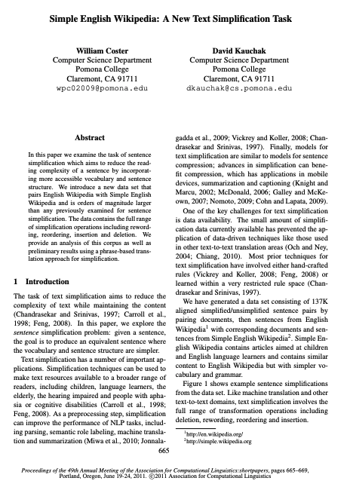
DP in practice

Slide 78
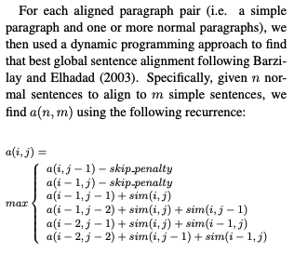

Slide 79
Skiers and Skis
Skis: 1 5 5 7 9 12 12 13
Skiers: 6 7 7 10 12
What is the optimal matching?

Slide 80
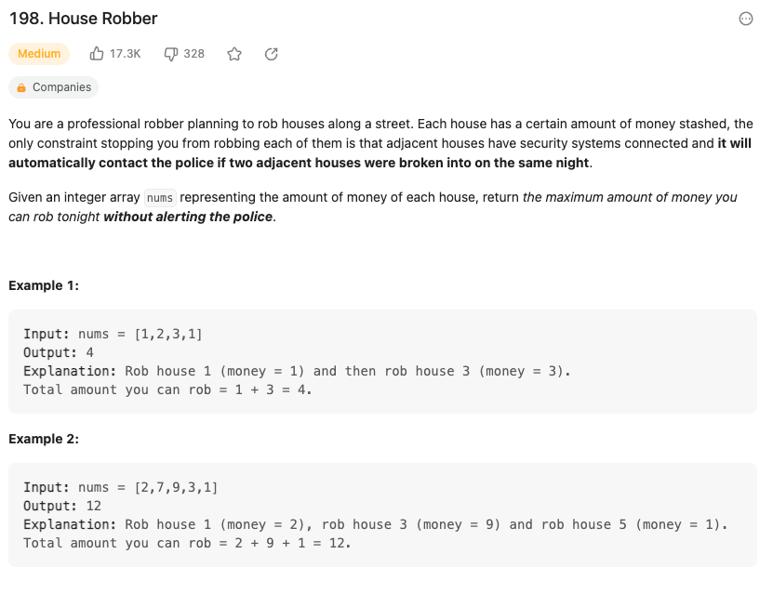
https://leetcode.com/problems/house-robber/

Slide 81
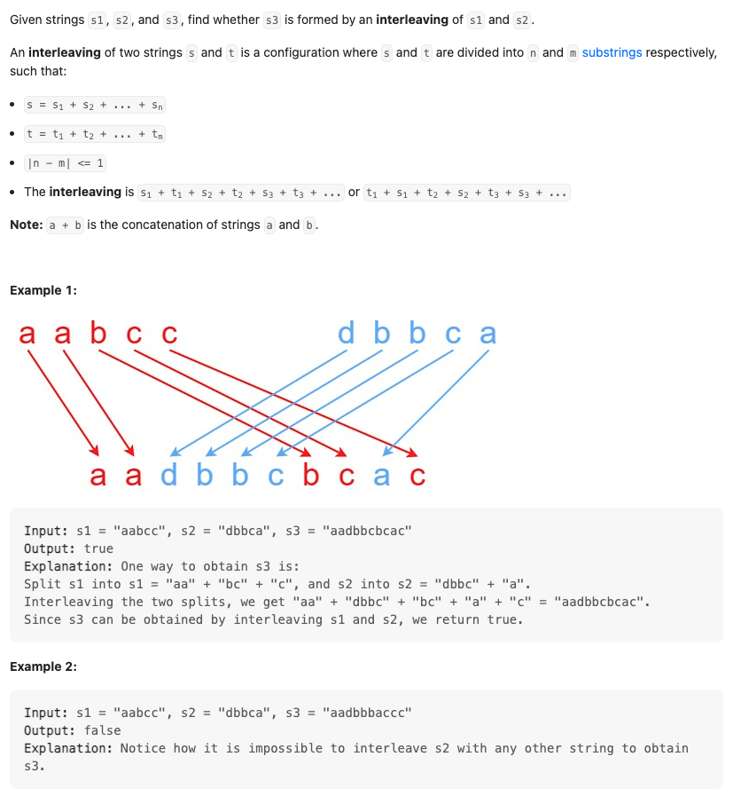
https://leetcode.com/problems/interleaving-string/description/

Slide 82
Memoization?

