Slide 1
Dynamic programming:
More fun!
David Kauchak
CS 140 – Fall 2024

Slide 2
Admin
Assignment 4
Group 4
Assignment 5

Slide 3
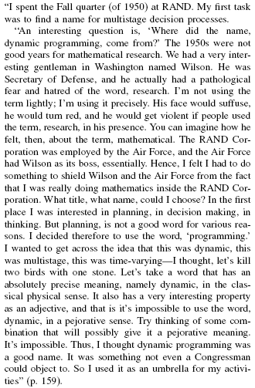
Where did “dynamic programming” come from?
Richard Bellman On the Birth of Dynamic Programming
Stuart Dreyfus
http://www.eng.tau.ac.il/~ami/cd/or50/1526-5463-2002-50-01-0048.pdf

Slide 4
Dynamic programming
Method for solving problems where optimal solutions can be defined in terms of optimal solutions to subproblems
AND
the subproblems are overlapping

Slide 5
Dynamic programming: steps
1) recursive definition: use this to recursively define the value of an optimal solution
2) DP solution: describe the dynamic programming table:
  size, initial values, order in which it’s filled in, location of solution
3) Analysis: analyze space requirements, running time

Slide 6
LCS problem
Given two sequences X and Y, a common subsequence is a subsequence that occurs in both X and Y
Given two sequences X = x₁, x₂, …, x_{n} and
Y = y₁, y₂, …, y_{n}
What is the longest common subsequence?

Slide 7
recursive solution
X = A B C B D A B
Y = B D C A B A
(for now, let’s just worry about counting the length of the LCS)

Slide 8
2: DP solution
LCS(X_{1…j}, Y_{1…k})

Slide 9
j
0 1 2 3 4 5 6
y_{j} B D C A B A
i
0 x_{i}
1 A
2 B
3 C
4 B
5 D
6 A
7 B
0 0 0 0 0 0 0
0 0 0 0 ?
0
0
0
0
0
0
LCS(A, BDCA)

Slide 10
j
0 1 2 3 4 5 6
y_{j} B D C A B A
i
0 x_{i}
1 A
2 B
3 C
4 B
5 D
6 A
7 B
0 0 0 0 0 0 0
0 0 0 0 1
0
0
0
0
0
0
LCS(A, BDCA)

Slide 11
j
0 1 2 3 4 5 6
y_{j} B D C A B A
i
0 x_{i}
1 A
2 B
3 C
4 B
5 D
6 A
7 B
0 0 0 0 0 0 0
0 0 0 0 1 1 1
0 1 1 1 1 2 2
0 1 1 2 2 2 2
0 1 1 2 2 ?
0
0
0
LCS(ABCB, BDCAB)

Slide 12
j
0 1 2 3 4 5 6
y_{j} B D C A B A
i
0 x_{i}
1 A
2 B
3 C
4 B
5 D
6 A
7 B
0 0 0 0 0 0 0
0 0 0 0 1 1 1
0 1 1 1 1 2 2
0 1 1 2 2 2 2
0 1 1 2 2 3
0
0
0
LCS(ABCB, BDCAB)

Slide 13
j
0 1 2 3 4 5 6
y_{j} B D C A B A
i
0 x_{i}
1 A
2 B
3 C
4 B
5 D
6 A
7 B
0 0 0 0 0 0 0
0 0 0 0 1 1 1
0 1 1 1 1 2 2
0 1 1 2 2 2 2
0 1 1 2 2 3 3
0 1 2 2 2 3 3
0 1 2 2 3 3 4
0 1 2 2 3 4 4
Where’s the final answer?

Slide 14
j
0 1 2 3 4 5 6
y_{j} B D C A B A
i
Space requirements: Θ(nm)
Running time: Θ(nm)
0 x_{i}
1 A
2 B
3 C
4 B
5 D
6 A
7 B
0 0 0 0 0 0 0
0 0 0 0 1 1 1
0 1 1 1 1 2 2
0 1 1 2 2 2 2
0 1 1 2 2 3 3
0 1 2 2 2 3 3
0 1 2 2 3 3 4
0 1 2 2 3 4 4

Slide 15
Keeping track of the solution
Our LCS algorithm only calculated the length of the LCS between X and Y
What if we wanted to know the actual sequence?

Slide 16
j
0 1 2 3 4 5 6
y_{j} B D C A B A
i
0 x_{i}
1 A
2 B
3 C
4 B
5 D
6 A
7 B
0 0 0 0 0 0 0
0 0 0 0 1 1 1
0 1 1 1 1 2 2
0 1 1 2 2 2 2
0 1 1 2 2 ?
0
0
0
LCS(ABCB, BDCAB)

Slide 17
j
0 1 2 3 4 5 6
y_{j} B D C A B A
i
0 x_{i}
1 A
2 B
3 C
4 B
5 D
6 A
7 B
0 0 0 0 0 0 0
0 0 0 0 1 1 1
0 1 1 1 1 2 2
0 1 1 2 2 2 2
0 1 1 2 2 3
0
0
0
LCS(ABCB, BDCAB)

Slide 18
j
0 1 2 3 4 5 6
y_{j} B D C A B A
i
0 x_{i}
1 A
2 B
3 C
4 B
5 D
6 A
7 B
0 0 0 0 0 0 0
0 0 0 0 1 1 1
0 1 1 1 1 2 2
0 1 1 2 2 2 2
0 1 1 2 2 3 ?
0
0
0
LCS(ABCB, BDCABA)

Slide 19
j
0 1 2 3 4 5 6
y_{j} B D C A B A
i
0 x_{i}
1 A
2 B
3 C
4 B
5 D
6 A
7 B
0 0 0 0 0 0 0
0 0 0 0 1 1 1
0 1 1 1 1 2 2
0 1 1 2 2 2 2
0 1 1 2 2 3 3
0
0
0
LCS(ABCB, BDCABA)

Slide 20
j
0 1 2 3 4 5 6
y_{j} B D C A B A
i
0 x_{i}
1 A
2 B
3 C
4 B
5 D
6 A
7 B
0 0 0 0 0 0 0
0 0 0 0 1 1 1
0 1 1 1 1 2 2
0 1 1 2 2 2 2
0 1 1 2 2 3 3
0 1 2 2 2 3 3
0 1 2 2 3 3 4
0 1 2 2 3 4 4
How do we generate the solution from this?

Slide 21
j
0 1 2 3 4 5 6
y_{j} B D C A B A
i
0 x_{i}
1 A
2 B
3 C
4 B
5 D
6 A
7 B
0 0 0 0 0 0 0
0 0 0 0 1 1 1
0 1 1 1 1 2 2
0 1 1 2 2 2 2
0 1 1 2 2 3 3
0 1 2 2 2 3 3
0 1 2 2 3 3 4
0 1 2 2 3 4 4
We can follow the arrows to generate the solution
BCBA

Slide 22
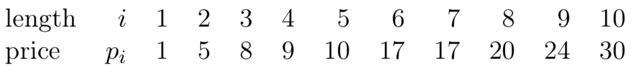
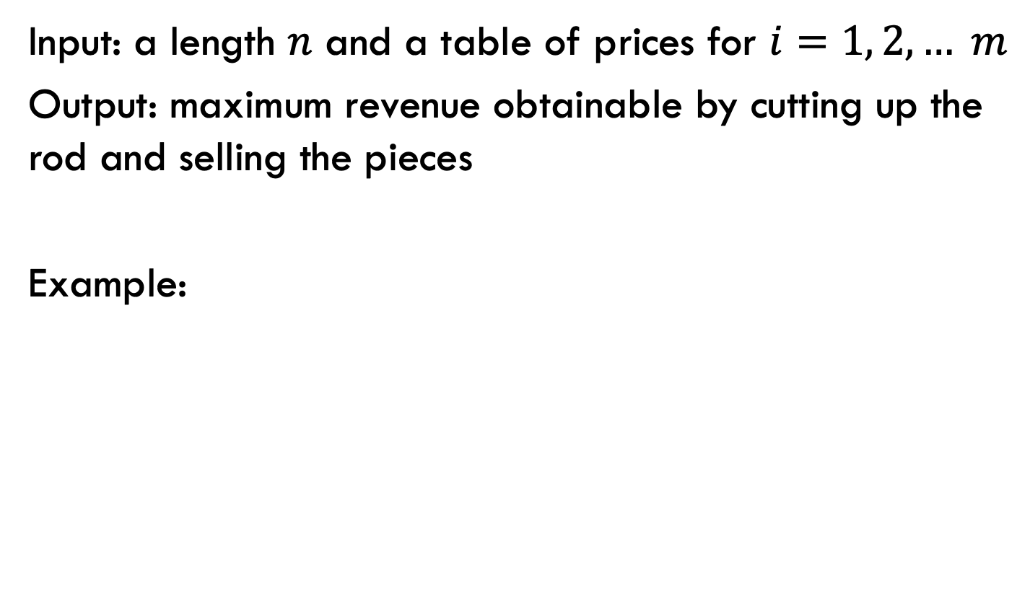
Rod splitting
Input: a length $n$ and a table of prices for $i=1, 2, … m$
Output: maximum revenue obtainable by cutting up the rod and selling the pieces
Example:
3
28

Slide 23
Rod splitting
Input: a length $n$ and a table of prices for $i=1, 2, … m$
Output: maximum revenue obtainable by cutting up the rod and selling the pieces
Example:
3
28
What is the best way if you have 13 units of rod?
Notes:
10 + 3

Slide 24
Rod splitting
Input: a length $n$ and a table of prices for $i=1, 2, … m$
Output: maximum revenue obtainable by cutting up the rod and selling the pieces
Example:
3
28
What is the best way if you have 12 units of rod?
Notes:
6 + 6 + 2

Slide 25
1a: optimal substructure
Prove: optimal solutions to the problem incorporate optimal solutions to related subproblems
3
28
What would a solution look like?

Slide 26
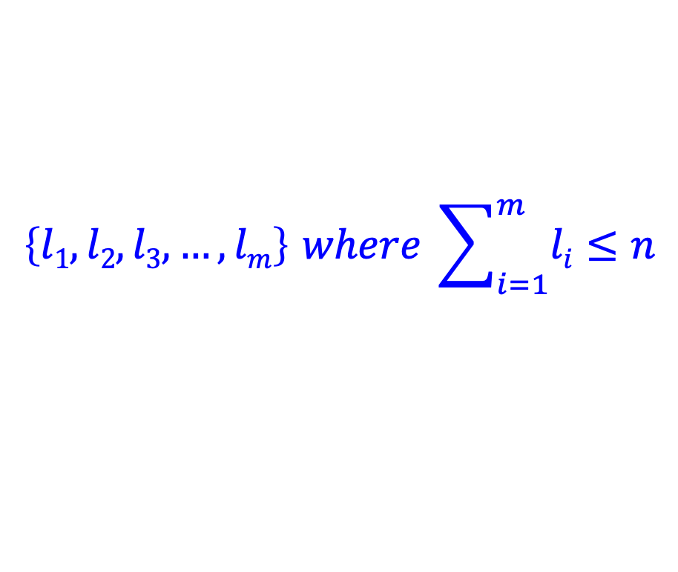
1a: optimal substructure
Prove: optimal solutions to the problem incorporate optimal solutions to related subproblems
3
28
$$\left\{l1, l2, l3, …, lm\right\} where \sum_{i=1}^{m}{li}≤n$$
What would a subproblem solution look like?

Slide 27
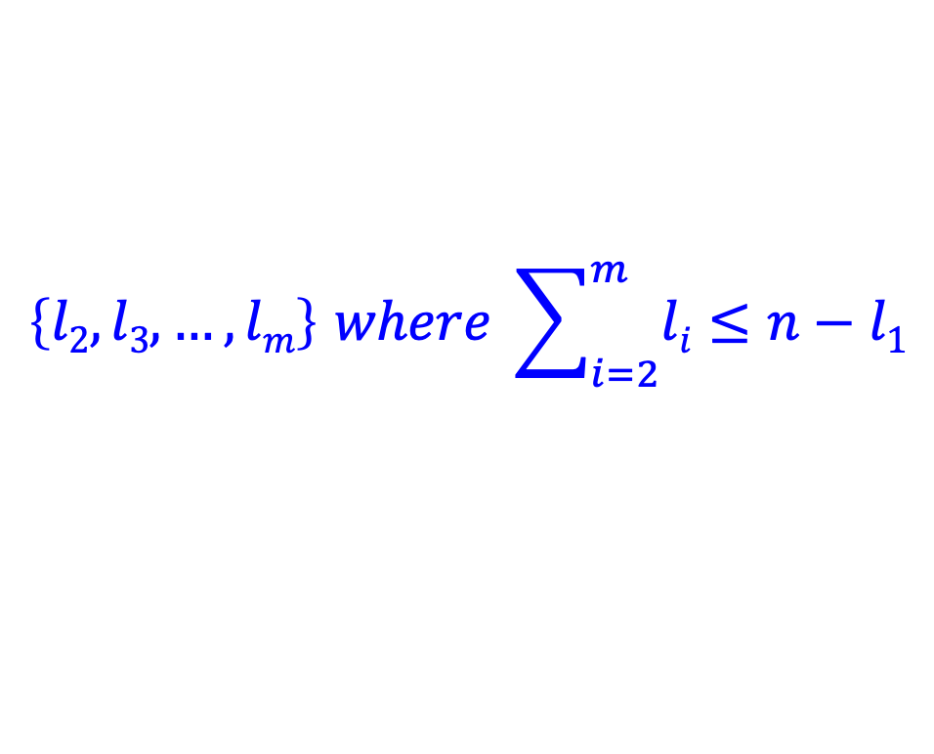
1a: optimal substructure
Prove: optimal solutions to the problem incorporate optimal solutions to related subproblems
3
28
$$\left\{l1, l2, l3, …, lm\right\} where \sum_{i=1}^{m}{li}≤n$$
$$\left\{l2, l3, …, lm\right\} where \sum_{i=2}^{m}{li}≤n−l1$$

Slide 28
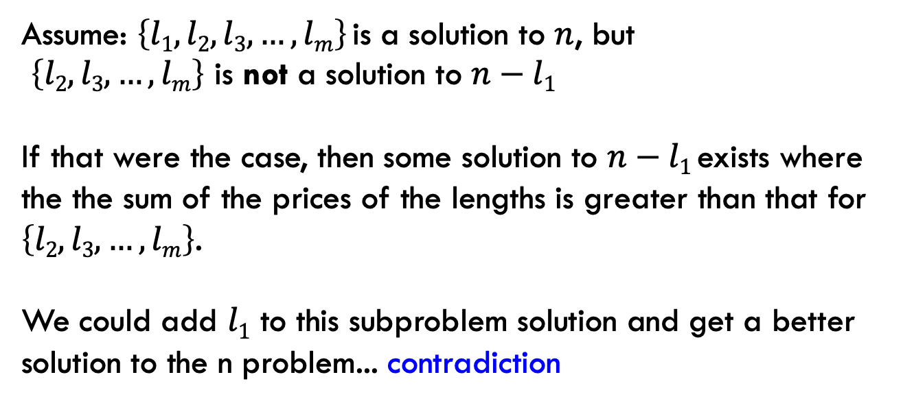
1a: optimal substructure
Prove: optimal solutions to the problem incorporate optimal solutions to related subproblems
Proof by contradiction:
Assume: $\left\{l1, l2, l3, …, lm\right\}$is a solution to $n$, but
$\left\{l2, l3, …, lm\right\}$ is not a solution to $n−l1$
If that were the case, then some solution to $n−l1$exists where the the sum of the prices of the lengths is greater than that for $\left\{l2, l3, …, lm\right\}$.
We could add $l1$ to this subproblem solution and get a better solution to the n problem... contradiction

Slide 29
recursive solution
3
28
n
What should be the first cut?
What are the options?

Slide 30
recursive solution
3
28
n
cut 1
price 1
How much is left?

Slide 31
recursive solution
3
28
n
cut 1
price 1
n-1

Slide 32
recursive solution
3
28
n
cut 2
price 3
n-2

Slide 33
recursive solution
3
28
n
Which one should we choose?
…
Pretend like we have a solver (R) that gives us the answer to suproblems.
What would R take as input and return?

Slide 34
recursive solution
3
28
n
R(x) → price for best set of cuts of length x
(could structure it with the actual cuts, but focusing on just the price is easier for now)
…

Slide 35
recursive solution
3
28
n
cut 1
price 1
n-1
What’s the best we can do with this cut?

Slide 36
recursive solution
3
28
n
cut 1
price 1
n-1
1 + R(n-1)

Slide 37
recursive solution
3
28
n
cut 2
price 3
n-2
What’s the best we can do with this cut?

Slide 38
recursive solution
3
28
n
cut 2
price 3
n-2
3 + R(n-2)

Slide 39
recursive solution
3
28
n
What should be the first cut?

Slide 40
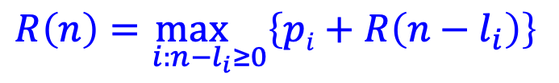
recursive solution
3
28
n
$$R\left(n\right)=\max_{i:n−l_{i}≥0}\left\{pi+R\left(n−l_{i}\right)\right\}$$

Slide 41
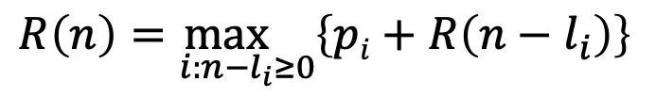
DP solution (from the bottom-up)
$$R\left(n\right)=\max_{i:n−l_{i}≥0}\left\{pi+R\left(n−l_{i}\right)\right\}$$
What are the smallest possible subproblems?
To calculate R(n), what are all the subproblems we need to calculate? This is the “table”.
How should we fill in the table?
Where will the answer be?

Slide 42
DP solution (from the bottom-up)
$$R\left(n\right)=\max_{i:n−l_{i}≥0}\left\{pi+R\left(n−l_{i}\right)\right\}$$
What are the smallest possible subproblems?
R(0) = 0, R(-i) not possible

Slide 43
DP solution (from the bottom-up)
$$R\left(n\right)=\max_{i:n−l_{i}≥0}\left\{pi+R\left(n−l_{i}\right)\right\}$$
To calculate R(n), what are all the subproblems we need to calculate? This is the “table”.
R(0)…R(n)
Note: This is filling in a table for all possible integer lengths from 1 to n.

Slide 44
DP solution (from the bottom-up)
$$R\left(n\right)=\max_{i:n−l_{i}≥0}\left\{pi+R\left(n−l_{i}\right)\right\}$$
How should we fill in the table?
R(0) → R(n)
The dependencies are on smaller values

Slide 45
DP solution (from the bottom-up)
$$R\left(n\right)=\max_{i:n−l_{i}≥0}\left\{pi+R\left(n−l_{i}\right)\right\}$$
Where will the answer be?
R(n)

Slide 46

Rod splitting example
length: 1 3 5 6 8
price: 1 6 9 13 16
$$R\left(n\right)=\max_{i:n−l_{i}≥0}\left\{pi+R\left(n−l_{i}\right)\right\}$$
R 0 1 2 3 4 5 6 7 8 9 10 11 12

Slide 47
Rod splitting example
length: 1 3 5 6 8
price: 1 6 9 13 16
0 1 2
R 0 1 2 3 4 5 6 7 8 9 10 11 12
Choice: 1 1

Slide 48
Rod splitting example
length: 1 3 5 6 8
price: 1 6 9 13 16
3: 6 + R[0] = 6
1: 1 + R[2] = 3
0 1 2 6
R 0 1 2 3 4 5 6 7 8 9 10 11 12
Choice: 1 1 3

Slide 49
Rod splitting example
length: 1 3 5 6 8
price: 1 6 9 13 16
3: 6 + R[1] = 7
1: 1 + R[3] = 7
0 1 2 6 7
R 0 1 2 3 4 5 6 7 8 9 10 11 12
Choice: 1 1 3 3

Slide 50
Rod splitting example
length: 1 3 5 6 8
price: 1 6 9 13 16
5: 9 + R[0] = 9
3: 6 + R[2] = 8
1: 1 + R[4] = 8
0 1 2 6 7 9
R 0 1 2 3 4 5 6 7 8 9 10 11 12
Choice: 1 1 3 3 5

Slide 51
Rod splitting example
length: 1 3 5 6 8
price: 1 6 9 13 16
6: 13 + R[0] = 13
5: 9 + R[1] = 10
3: 6 + R[3] = 12
1: 1 + R[5] = 10
0 1 2 6 7 9 13
R 0 1 2 3 4 5 6 7 8 9 10 11 12
Choice: 1 1 3 3 5 6

Slide 52
Rod splitting example
length: 1 3 5 6 8
price: 1 6 9 13 16
6: 13 + R[1] = 14
5: 9 + R[2] = 11
3: 6 + R[4] = 13
1: 1 + R[6] = 14
0 1 2 6 7 9 13 14
R 0 1 2 3 4 5 6 7 8 9 10 11 12
Choice: 1 1 3 3 5 6 6

Slide 53
Rod splitting example
length: 1 3 5 6 8
price: 1 6 9 13 16
8: 16 + R[0] = 16
6: 13 + R[2] = 15
5: 9 + R[3] = 15
3: 6 + R[5] = 15
1: 1 + R[7] = 15
0 1 2 6 7 9 13 14 16
R 0 1 2 3 4 5 6 7 8 9 10 11 12
Choice: 1 1 3 3 5 6 6 8

Slide 54
Rod splitting example
length: 1 3 5 6 8
price: 1 6 9 13 16
8: 16 + R[1] = 17
6: 13 + R[3] = 19
5: 9 + R[4] = 16
3: 6 + R[6] = 19
1: 1 + R[8] = 17
0 1 2 6 7 9 13 14 16 19
R 0 1 2 3 4 5 6 7 8 9 10 11 12
Choice: 1 1 3 3 5 6 6 8 6

Slide 55
Rod splitting example
length: 1 3 5 6 8
price: 1 6 9 13 16
8: 16 + R[2] = 18
6: 13 + R[4] = 20
5: 9 + R[5] = 18
3: 6 + R[7] = 20
1: 1 + R[9] = 20
0 1 2 6 7 9 13 14 16 19 20
R 0 1 2 3 4 5 6 7 8 9 10 11 12
Choice: 1 1 3 3 5 6 6 8 6 6

Slide 56
Rod splitting example
length: 1 3 5 6 8
price: 1 6 9 13 16
8: 16 + R[3] = 22
6: 13 + R[5] = 22
5: 9 + R[6] = 22
3: 6 + R[8] = 22
1: 1 + R[10] = 21
0 1 2 6 7 9 13 14 16 19 20 22
R 0 1 2 3 4 5 6 7 8 9 10 11 12
Choice: 1 1 3 3 5 6 6 8 6 6 8

Slide 57
Rod splitting example
length: 1 3 5 6 8
price: 1 6 9 13 16
8: 16 + R[4] = 23
6: 13 + R[6] = 26
5: 9 + R[7] = 23
3: 6 + R[9] = 25
1: 1 + R[11] = 23
0 1 2 6 7 9 13 14 16 19 20 22 26
R 0 1 2 3 4 5 6 7 8 9 10 11 12
Choice: 1 1 3 3 5 6 6 8 6 6 8 6

Slide 58
Rod splitting example
length: 1 3 5 6 8
price: 1 6 9 13 16
What cuts do we make?
0 1 2 6 7 9 13 14 16 19 20 22 26
R 0 1 2 3 4 5 6 7 8 9 10 11 12
Choice: 1 1 3 3 5 6 6 8 6 6 8 6

Slide 59
Rod splitting example
length: 1 3 5 6 8
price: 1 6 9 13 16
What cuts do we make?
0 1 2 6 7 9 13 14 16 19 20 22 26
R 0 1 2 3 4 5 6 7 8 9 10 11 12
Choice: 1 1 3 3 5 6 6 8 6 6 8 6
6 + R[6]

Slide 60
Rod splitting example
length: 1 3 5 6 8
price: 1 6 9 13 16
What cuts do we make?
0 1 2 6 7 9 13 14 16 19 20 22 26
R 0 1 2 3 4 5 6 7 8 9 10 11 12
Choice: 1 1 3 3 5 6 6 8 6 6 8 6
6 + R[0]
6 +

Slide 61
Rod splitting example
length: 1 3 5 6 8
price: 1 6 9 13 16
What cuts do we make?
0 1 2 6 7 9 13 14 16 19 20 22 26
R 0 1 2 3 4 5 6 7 8 9 10 11 12
Choice: 1 1 3 3 5 6 6 8 6 6 8 6

Slide 62
Rod splitting example
length: 1 3 5 6 8
price: 1 6 9 13 16
What cuts do we make?
0 1 2 6 7 9 13 14 16 19 20 22 26
R 0 1 2 3 4 5 6 7 8 9 10 11 12
Choice: 1 1 3 3 5 6 6 8 6 6 8 6
8 + R[3]

Slide 63
Rod splitting example
length: 1 3 5 6 8
price: 1 6 9 13 16
What cuts do we make?
0 1 2 6 7 9 13 14 16 19 20 22 26
R 0 1 2 3 4 5 6 7 8 9 10 11 12
Choice: 1 1 3 3 5 6 6 8 6 6 8 6
3 + R[0]
8 +

Slide 64
Rod splitting example
length: 1 3 5 6 8
price: 1 6 9 13 16
What cuts do we make?
0 1 2 6 7 9 13 14 16 19 20 22 26
R 0 1 2 3 4 5 6 7 8 9 10 11 12
Choice: 1 1 3 3 5 6 6 8 6 6 8 6

Slide 65
Rod splitting example
length: 1 3 5 6 8
price: 1 6 9 13 16
What cuts do we make?
0 1 2 6 7 9 13 14 16 19 20 22 26
R 0 1 2 3 4 5 6 7 8 9 10 11 12
Choice: 1 1 3 3 5 6 6 8 6 6 8 6
6 + R[4]

Slide 66
Rod splitting example
length: 1 3 5 6 8
price: 1 6 9 13 16
What cuts do we make?
0 1 2 6 7 9 13 14 16 19 20 22 26
R 0 1 2 3 4 5 6 7 8 9 10 11 12
Choice: 1 1 3 3 5 6 6 8 6 6 8 6
3 + R[1]
6 +

Slide 67
Rod splitting example
length: 1 3 5 6 8
price: 1 6 9 13 16
What cuts do we make?
0 1 2 6 7 9 13 14 16 19 20 22 26
R 0 1 2 3 4 5 6 7 8 9 10 11 12
Choice: 1 1 3 3 5 6 6 8 6 6 8 6
1 + R[0]
3 +
6 +

Slide 68
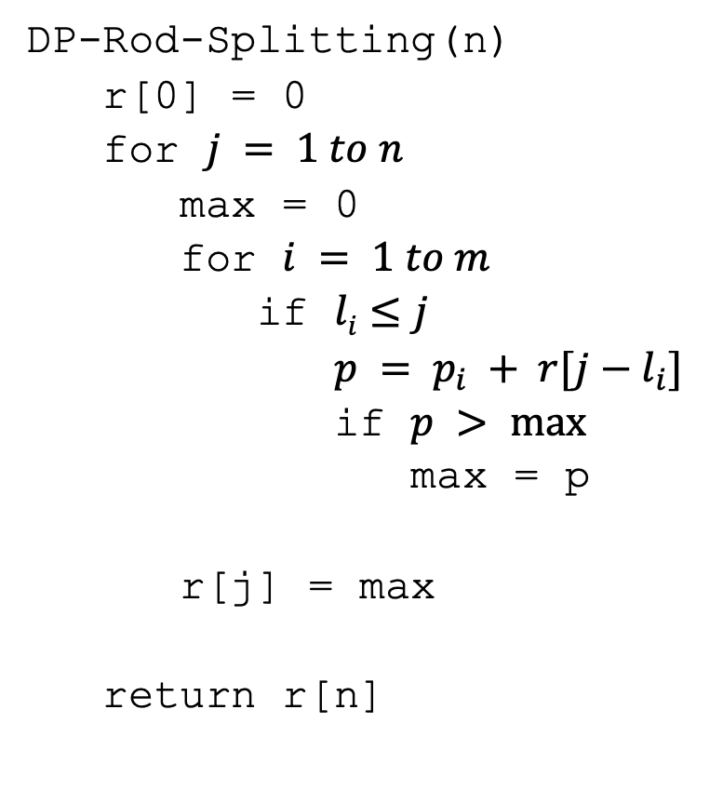
DP solution
DP-Rod-Splitting(n)
r[0] = 0
for $j = 1 to n$
max = 0
for $i = 1 to m$
if $li≤j$
$p = p_{i} + r[j−l_{i}]$
if $p > max⁡$
max = p
r[j] = max
return r[n]

Slide 69
DP solution
DP-Rod-Splitting(n)
r[0] = 0
for $j = 1 to n$
max = 0
for $i = 1 to m$
if $li≤j$
$p = p_{i} + r[j−l_{i}]$
if $p > max⁡$
max = p
r[j] = max
return r[n]
Space requirements?
Running time?

Slide 70
DP solution
DP-Rod-Splitting(n)
r[0] = 0
for $j = 1 to n$
max = 0
for $i = 1 to m$
if $li≤j$
$p = p_{i} + r[j−l_{i}]$
if $p > max⁡$
max = p
r[j] = max
return r[n]
Space requirements: Θ(n)
Running time: Θ(nm)

Slide 71
DP solution
DP-Rod-Splitting(n)
r[0] = 0
for $j = 1 to n$
max = 0
for $i = 1 to m$
if $li≤j$
$p = p_{i} + r[j−l_{i}]$
if $p > max⁡$
max = p
r[j] = max
return r[n]
What if you want to know the cuts?

Slide 72
0-1 Knapsack problem
0-1 Knapsack – A thief robbing a store finds m items worth
v₁, v₂, .., v_{m} dollars and weight
w₁, w₂, …, w_{m} pounds, where v_{i} and w_{i} are integers. The thief can carry at most W pounds in the knapsack. Which items should the thief take if they want to maximize value?
Repetition is allowed, that is you can take multiple copies of any item

Slide 73
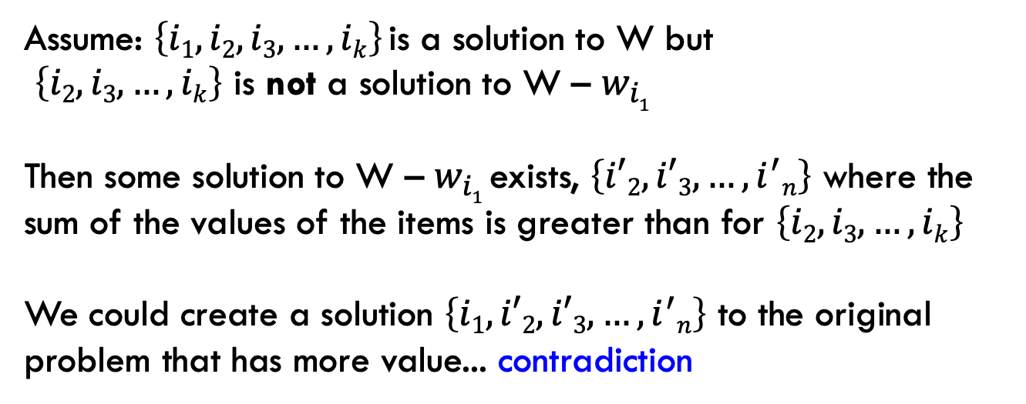
1a: optimal substructure
Prove: optimal solutions to the problem incorporate optimal solutions to related subproblems
Proof by contradiction:
Assume: $\left\{i1, i2,i3, …, ik\right\}$is a solution to W but
$\left\{i2, i3, …, ik\right\}$ is not a solution to W – $w_{i1}$
Then some solution to W – $w_{i1}$exists, $\left\{i′2, i′3, …, i^{′}n\right\}$ where the sum of the values of the items is greater than for $\left\{i2, i3, …, ik\right\}$
We could create a solution $\left\{i1,i′2, i′3, …, i^{′}n\right\}$ to the original problem that has more value... contradiction

Slide 74
1b: recursive solution

Slide 75
2: DP solution (from the bottom-up)
What are the smallest possible subproblems?
K(0) = 0
To calculate K(w), what are all the subproblems we need to calculate? This is the “table”. K(0) … K(W)
How should we fill in the table? K(1) → K(W)
Where will the answer be? K(W)

Slide 76
3: Analysis
What are the smallest possible subproblems? K(0) = 0
To calculate K(w), what are all the subproblems we need to calculate? This is the “table”. K(0) … K(W)
How should we fill in the table? K(0) → K(W)
Where will the answer be? K(W)
Space requirements: Θ(W)
Running time: Θ(Wm)

Slide 77
Memoization
Sometimes it can be a challenge to write the function in a bottom-up fashion
Memoization:
  Write the recursive function top-down
  Alter the function to check if we’ve already calculated the value
  If so, use the pre-calculate value
  If not, do the recursive call(s)

Slide 78
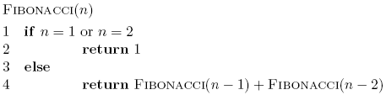
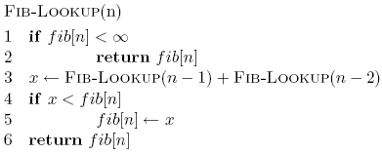
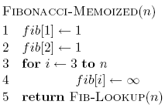
Memoized fibonacci

Slide 79
Memoized fibonacci
Use ∞ to denote uncalculated

Slide 80
Memoized fibonacci
What else could we use besides an array?
Use ∞ to denote uncalculated

Slide 81
Memoized fibonacci
Check if we already calculated the value

Slide 82
Memoized fibonacci
calculate the value

Slide 83
Memoized fibonacci
store the value

Slide 84
Memoization
Pros
  Can be more intuitive to code/understand
  Can be memory savings if you don’t need answers to all subproblems
Cons
  Depending on implementation, larger overhead because of recursion (though often the functions are tail recursive)

