Slide 1
Order Statistics
David Kauchak
cs140
Fall 2024

Slide 2
Administrative
Group assignment
Assignment 2
Midterm 1
Assignment 3
  Available early next week
  Due on Sunday 9/29 (two weeks)

Slide 3
Administrative
  Midterm 1
    Take-home midterm
      Download from Gradescope
      1 hour and 15 minutes to take
      Upload answers to Gradescope (in any reasonable format)
    Available Thursday (9/19) morning
    Must submit by Friday (9/20) 11:59pm
    If you want to take it during the normal class time, I’ll be in the classroom
    Can use 2 pages of notes (and nothing else)
    Cover material up through order statistics (today)
    Post sample problems soon

Slide 4
Midterm 1 topics
Math foundations
log properties
properties of exponentials
Proofs by induction (weak, strong)
Big-O (theta and omega)
Proving and disproving
Categories and function ordering

Slide 5
Midterm 1 topics
Recurrences
Generating (i.e., given a function/algorithm, write the recurrence)
Solving: recurrence tree, substitution, master method
Sorting
Insertion sort, Selection sort, Mergesort, Quicksort
Runtimes
Order statistics
median/selection
run-time
Divide and conquer algorithms

Slide 6
Medians
The median of a set of numbers is the number such that half of the numbers are larger and half smaller
How might we calculate the median of a set?
Sort the numbers, then pick the n/2 element
A = [50, 12, 1, 97, 30]
A = [1, 12, 30, 50, 97]
runtime?

Slide 7
Medians
The median of a set of numbers is the number such that half of the numbers are larger and half smaller
How might we calculate the median of a set?
Sort the numbers, then pick the n/2 element
A = [50, 12, 1, 97, 30]
A = [1, 12, 30, 50, 97]
Θ(n log n)

Slide 8
Selection
More general problem:
find the k-th smallest element in an array
  i.e. element where exactly k-1 things are smaller than it
  aka the “selection” problem
  can use this to find the median if we want
Can we solve this in a similar way?
  Yes, sort the data and take the kth element
  Θ(n log n)

Slide 9
Can we do better?
Are we doing more work than we need to?
To get the k-th element (or the median) by sorting, we’re finding all the k-th elements at once
We just want the one!
Often when you find yourself doing more work than you need to, there is a faster way (though not always)

Slide 10

selection problem
Our tools
  divide and conquer
  sorting algorithms
  other functions
    merge
    partition
    binary search

Slide 11
Partition
Partition takes Θ(n) time and performs a similar operation
given an element A[q], Partition can be seen as dividing the array into two sets:
  ≤ A[q]
  > A[q]
Ideas?

Slide 12
An example
We’re looking for the 5th smallest
5 2 34 9 17 2 1 34 18 5 3 2 1 6 5
If we called partition, what would be the in three sets?
≤ 5:
> 5:

Slide 13
An example
We’re looking for the 5th smallest
5 2 34 9 17 2 1 34 18 5 3 2 1 6 5
≤ 5: 2 5 2 5 1 5 3 2 1
Does this help us?
> 5: 34 9 17 34 18 6

Slide 14
An example
We’re looking for the 5th smallest
5 2 34 9 17 2 1 34 18 5 3 2 1 6 5
We know the 5th smallest has to be in this set
≤ 5: 2 5 2 5 1 5 3 2 1
> 5: 34 9 17 34 18 6

Slide 15
Selection(A, k, p, r)
q ← Partition(A,p,r)
if k = q
Return A[q]
else if k < q
Return Selection(A, k, p, q-1)
else // k > q
Return Selection(A, k, q+1, r)
A: array of data
k: find the kth smallest
p,r: current span we’re exploring (initially 1, len(A))

Slide 16
Selection: divide and conquer
Call partition
  see if we’re at the answer
  if not, decied which of the two sets contains the answer we’re looking for
  recurse
Like binary search on unsorted data
Selection(A, k, p, r)
q ← Partition(A,p,r)
relq = q-p+1
if k = relq
Return A[q]
else if k < relq
Return Selection(A, k, p, q-1)
else // k > relq
Return Selection(A, k-relq, q+1, r)
?

Slide 17
relq
Partition returns the absolute index, we want an index relative to the current p (window start)
relq = q – p + 1
q
p
r

Slide 18
relq
Partition returns the absolute index, we want an index relative to the current p (window start)
relq = q – p + 1
q
p
r
q – p + 1

Slide 19
relq
Partition returns the absolute index, we want an index relative to the current p (window start)
relq = q – p + 1
q=7
p=5
r=9
What is relq?

Slide 20
relq
Partition returns the absolute index, we want an index relative to the current p (window start)
relq = q – p + 1
q=7
p=5
r=9
7-5+1=3

Slide 21
Selection: divide and conquer
Call partition
  decide which of the three sets contains the answer we’re looking for
  recurse
Like binary search on unsorted data
Selection(A, k, p, r)
q ← Partition(A,p,r)
relq = q-p+1
if k = relq
Return A[q]
else if k < relq
Return Selection(A, k, p, q-1)
else // k > relq
Return Selection(A, k-relq, q+1, r)
Partition returns the absolute index, we want an index relative to the current p (window start)

Slide 22
Selection: divide and conquer
Call partition
  decide which of the three sets contains the answer we’re looking for
  recurse
Like binary search on unsorted data
Selection(A, k, p, r)
q ← Partition(A,p,r)
relq = q-p+1
if k = relq
Return A[q]
else if k < relq
Return Selection(A, k, p, q-1)
else // k > relq
Return Selection(A, k-relq, q+1, r)
As we recurse, we may update the k that we’re looking for because we update the lower end

Slide 23
Selection(A, 3, 1, 8)
1 2 3 4 5 6 7 8
5 7 1 4 8 3 2 6
Selection(A, k, p, r)
q ← Partition(A,p,r)
if k = q
Return A[q]
else if k < q
Selection(A, k, p, q-1)
else // k > q
Selection(A, k, q+1, r)

Slide 24
Selection(A, 3, 1, 8)
1 2 3 4 5 6 7 8
5 1 4 3 2 6 8 7
Selection(A, k, p, r)
q ← Partition(A,p,r)
if k = q
Return A[q]
else if k < q
Selection(A, k, p, q-1)
else // k > q
Selection(A, k, q+1, r)

Slide 25
Selection(A, 3, 1, 8)
1 2 3 4 5 6 7 8
5 1 4 3 2 6 8 7
Selection(A, k, p, r)
q ← Partition(A,p,r)
if k = q
Return A[q]
else if k < q
Selection(A, k, p, q-1)
else // k > q
Selection(A, k, q+1, r)

Slide 26
Selection(A, 3, 1, 5)
1 2 3 4 5 6 7 8
5 1 4 3 2 6 8 7
At each call, discard part of the array
Selection(A, k, p, r)
q ← Partition(A,p,r)
if k = q
Return A[q]
else if k < q
Selection(A, k, p, q-1)
else // k > q
Selection(A, k, q+1, r)

Slide 27
Selection(A, 3, 1, 5)
1 2 3 4 5 6 7 8
1 2 4 3 5 6 8 7
Selection(A, k, p, r)
q ← Partition(A,p,r)
if k = q
Return A[q]
else if k < q
Selection(A, k, p, q-1)
else // k > q
Selection(A, k, q+1, r)

Slide 28
Selection(A, 3, 3, 5)
1 2 3 4 5 6 7 8
1 2 4 3 5 6 8 7
Selection(A, k, p, r)
q ← Partition(A,p,r)
if k = q
Return A[q]
else if k < q
Selection(A, k, p, q-1)
else // k > q
Selection(A, k, q+1, r)

Slide 29
Selection(A, 3, 3, 5)
1 2 3 4 5 6 7 8
1 2 4 3 5 6 8 7
Selection(A, k, p, r)
q ← Partition(A,p,r)
if k = q
Return A[q]
else if k < q
Selection(A, k, p, q-1)
else // k > q
Selection(A, k, q+1, r)

Slide 30
Selection(A, 3, 3, 5)
1 2 3 4 5 6 7 8
1 2 4 3 5 6 8 7
Selection(A, k, p, r)
q ← Partition(A,p,r)
if k = q
Return A[q]
else if k < q
Selection(A, k, p, q-1)
else // k > q
Selection(A, k, q+1, r)

Slide 31
Selection(A, 3, 3, 4)
1 2 3 4 5 6 7 8
1 2 4 3 5 6 8 7
Selection(A, k, p, r)
q ← Partition(A,p,r)
if k = q
Return A[q]
else if k < q
Selection(A, k, p, q-1)
else // k > q
Selection(A, k, q+1, r)

Slide 32
Selection(A, 3, 3, 4)
1 2 3 4 5 6 7 8
1 2 4 3 5 6 8 7
Selection(A, k, p, r)
q ← Partition(A,p,r)
if k = q
Return A[q]
else if k < q
Selection(A, k, p, q-1)
else // k > q
Selection(A, k, q+1, r)

Slide 33
Selection(A, 3, 3, 4)
1 2 3 4 5 6 7 8
1 2 3 4 5 6 8 7
Selection(A, k, p, r)
q ← Partition(A,p,r)
if k = q
Return A[q]
else if k < q
Selection(A, k, p, q-1)
else // k > q
Selection(A, k, q+1, r)

Slide 34
Selection(A, 3, 3, 4)
1 2 3 4 5 6 7 8
1 2 3 4 5 6 8 7
Selection(A, k, p, r)
q ← Partition(A,p,r)
if k = q
Return A[q]
else if k < q
Selection(A, k, p, q-1)
else // k > q
Selection(A, k, q+1, r)

Slide 35
Running time of Selection?
Best case?
We get lucky and the element at the end of the list is the kth smallest element!
One call to partition: θ(n)

Slide 36
Running time of Selection?
Worst case?
Each call to Partition only reduces our search by 1
Recurrence?
θ(n²)

Slide 37
Running time of Selection?
Worst case?
Each call to Partition only reduces our search by 1
When does this happen?
  sorted
  reverse sorted
  others…

Slide 38
How can randomness help us?
RSelection(A, k, p, r)
q ← RPartition(A,p,r)
if k = q
Return A[q]
else if k < q
Return Selection(A, k, p, q-1)
else // k > q
Return Selection(A, k, q+1, r)

Slide 39
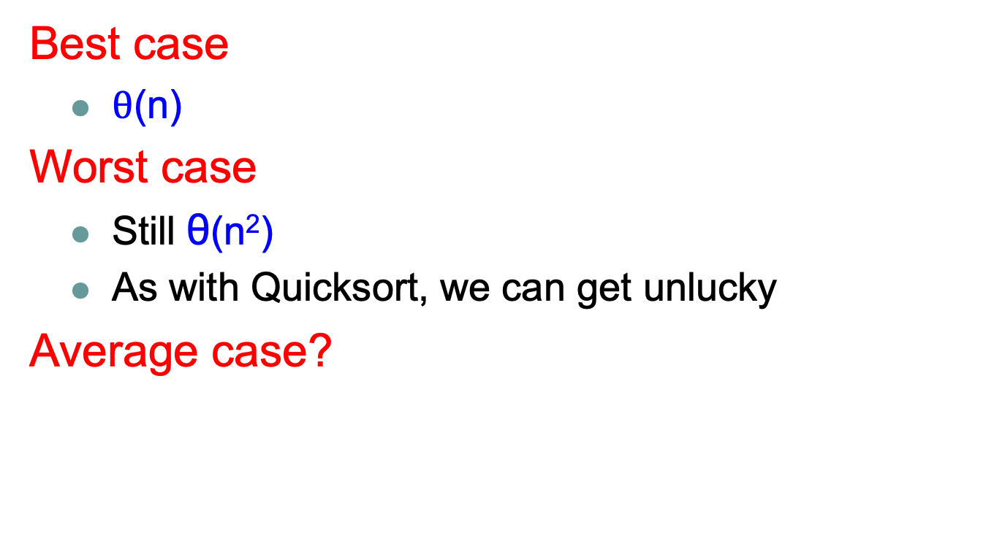
Running time of RSelection?
Best case
  $θ$(n)
Worst case
  Still θ(n²)
  As with Quicksort, we can get unlucky
Average case?

Slide 40
Average case
Depends on how much data we throw away at each step

Slide 41
Average case
We’ll call a partition “good” if the pivot falls within within the 25th and 75th percentile
  a “good” partition throws away at least a quarter of the data
  Or, each of the partitions contains at least 25% of the data
What is the probability of a “good” partition?
Half of the elements lie within this range and half outside, so 50% chance

Slide 42
Average case
Recall, that like Quicksort, we can absorb the cost of a constant number of “bad” partitions

Slide 43
Average case
On average, how many times will Partition need to be called before we get a good partition?
Let E be the number of times
Recurrence:
half the time we get a good partition on the first try and half of the time, we have to try again

Slide 44


Mathematicians and beer
An infinite number of mathematicians walk into a bar. The first one orders a beer. The second orders half a beer. The third, a quarter of a beer. The bartender says "You're all idiots", and pours two beers.

Slide 45
Average case
Another look. Let p be the probability of success
Let X be the number of calls required

Slide 46
Average case
If on average we can get a “good” partition ever other time, what is the recurrence?
  recall the pivot of a “good” partition falls in the 25th and 75th percentile

Slide 47
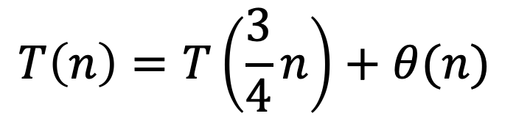
Average case
If on average we can get a “good” partition ever other time, what is the recurrence?
  recall the pivot of a “good” partition falls in the 25th and 75th percentile
$$T\left(n\right)=T\left(\frac{3}{4}n\right)+θ(n)$$
We throw away at least ¼ of the data
roll in the cost of the “bad” partitions

Slide 48
Which is?

Slide 49
a =
b =
f(n) =
1
4/3
n
Case 3: Θ(n)
Average case running time!

Slide 50
Selection
Worst case: Θ(n²)
Best case: Θ(n)
Average case: Θ(n)

Slide 51
An aside…
Notice a trend?
Θ(n)
Θ(n)

Slide 52
a =
b =
f(n) =
1
1/p
f(n)
0
Case 3: Θ(f(n))

Slide 53
Divide and conquer strategy
Split data in half and recurse on two halves
Assume it works! How do we get the answer to the entire problem?
  Often have to do a bit of extra work
  Be careful about solutions that could span/combine the two halves

Slide 54
Data structures
What is a data structure?
Way of storing data that facilitates particular operations

Slide 55
Data structures
What are some of the data structures that you’ve seen?

Slide 56
Data structures review
List
Ordered Set
Priority Queue
Unordered Set
What operations do they support?
What are they good at?
How can we implement them? (Are there variations?)
What are the runtimes for the operations? (Do variations matter?)

Slide 57
Lists
get/set at index
append (add at the end of the list)
remove
add/insert

Slide 58
Ordered Set
insert
remove
contains
next/prev (successor/predecessor)

Slide 59
Priority Queue
insert
remove
min/max

Slide 60
Unordered Set
insert
remove
contains

