Slide 1
review
David Kauchak CS 140 – Spring 2023

Slide 2
Admin
No class Wednesday (office hours)

Slide 3
Admin
Final
posted on Gradescope
due Wednesday (4/10) at 11:59pm (seniors: 4/4 at noon)
time-limited (3 hours – with some flexibility to scan, etc.)
You may use:
the book
your notes
the class notes
the assignments
ONLY these things
Do NOT discuss it with anyone until after Wednesday at 11:59pm

Slide 4
Test taking advice
Read the questions carefully!
Don’t spend too much time on any problem
if you get stuck, move on and come back
When you finish answering a question, reread the question and make sure that you answered everything the question asked
Think about how you might be able to reuse an existing algorithm/approach
Show your work (I can’t give you partial credit if I can’t figure out what went wrong)
Don’t rely on the book/notes for conceptual things
Do rely on the notes for a run-time you may not remember, etc.

Slide 5
High-level approaches
Algorithm tools
Divide and conquer
assume that we have a solver, but that can only solve sub-problems
define the current problem with respect to smaller problems
Key: sub-problems should be non-overlapping
Dynamic programming
Same as above
Key difference: sub-problems are overlapping
Once you have this recursive relationship:
figure out the data structure to store sub-problem solutions
work from bottom up (or memoize)

Slide 6
High-level approaches
Algorithm tools cont.
Greedy
Same idea: most greedy problems can be solve using dynamic programming (but generally slower)
Key difference: Can decide between overlapping sub-problems without having to calculate them (i.e. we can make a local decision)
Flow
Min-capacity cut
Bottleneck edge
Matching problems
Numerical maximization/minimization problems
Linear programming (very light coverage)

Slide 7
Data structures
A data structure
Stores data
Supports access to/questions about data efficiently
the different bias towards different actions
No single best data structure
Fast access/lookup?
If keys are sequential: array
If keys are non-sequential or non-numerical: hashtable
Guaranteed run-time/ordered: balanced binary search tree

Slide 8
Data structures
Min/max?
heap
binomial heaps
Fast insert/delete at positions?
linked list
Others
stacks/queues
extensible data structures
balanced BSTs
disjoint sets

Slide 9
Graphs
Graph types
directed/undirected
weighted/unweighted
trees, DAGs
cyclic
connected
Algorithms
connectedness
contains a cycle
traversal
dfs
bfs

Slide 10
Graphs
Graph algorithms cont.
minimum spanning trees (Prim’s, Kruskal’s)
shortest paths
single source (BFS, Dijskstra’s, Bellman-Ford)
all pairs (Johnson’s, Floyd-Warshall)
topological sort
flow

Slide 11
Other topics…
Analysis tools
recurrences (master method, recurrence trees)
big-O
amortized analysis
NP-completeness
proving NP-completeness
reductions

Slide 12
Proofs: general
Be clear and concise
Make sure you state assumptions and justify each step
Make sure when you’re done you’ve shown what you need to show

Slide 13
Proof by induction
State what you’re trying to prove We show that XXX using proof by induction
Prove base case
State the inductive hypothesis
Inductive proof
State what you want to show (may include a variable change, e.g., k in instead of n)
Show a step by step derivation from the left hand side resulting in the right hand side. Give justifications for steps that are non-trivial

Slide 14
Prof by induction: structural
State what you’re trying to prove We show that XXX using proof by induction
Prove base case
State the inductive hypothesis
Inductive proof
State what you want to show (may include a variable change, e.g., k in instead of n)
Show a step by step derivation from the left hand side resulting in the right hand side. Give justifications for steps that are non-trivial

Slide 15
Other (important) places we saw proofs
Recurrences (substitution method)
Big O (needed find constants c n₀)
Greedy algorithm correctness (proof by contradiction or stays ahead—induction —)
Proof of algorithm correctness (MSTs, Flow)
NP-completeness (proving correctness of reductions)

Slide 16
Recurrences
Three ways to solve:
Substitution
Recurrence tree (may still have to use substitution to verify)
Master method

Slide 17
Recurrences

Slide 18
Dynamic programming
Method for solving problems where optimal solutions can be defined in terms of optimal solutions to subproblems
AND
the subproblems are overlapping
Local decisions result in different subproblems. Not obvious how to make the first choice.

Slide 19
DP advice
Write the recursive definition
What is the input/output to the problem?
What would a solution look like? What are the options for picking the first component of a solution?
Assume you have a solver for subproblems. How can you combine the first decision with answer to subproblem.
Define DP structure: what are subproblems indexed by?
State how to fill in the table (including base cases and where the answer is)

Slide 20
All-pairs shortest paths
V * Bellman-Ford: O(V²E)
Floyd-Warshall: θ(V³)
Johnson’s: O(V² log V + V E)

Slide 21
Floyd-Warshll: Recursive relationship
$dijk$ = shortest path from vertex $i$ to vertex $j$
using only vertices $\{1, 2, …, k\}$
Two options:
Vertex k+1 doesn’t give us a shorter path
Vertex k+1 does give us a shorter path
$${dij}^{k+1}={{min⁡(dijk,d}_{i(k+1)}}^{k}+{d_{\left(k+1\right)j}}^{k})$$
Pick whichever is shorter

Slide 22
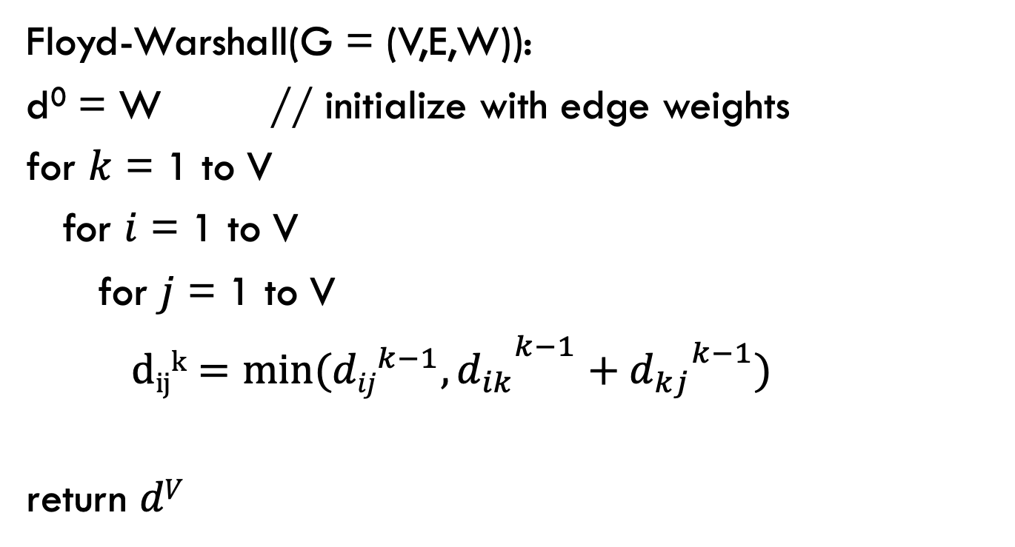
Floyd-Warshall
Calculate $dijk$ for increasing k, i.e. k = 1 to V
Floyd-Warshall(G = (V,E,W)):
d⁰ = W // initialize with edge weights
for $k$ = 1 to V
for $i$ = 1 to V
for $j$ = 1 to V
${{ dijk=min⁡({dij}^{k−1},d}_{ik}}^{k−1}+{d_{kj}}^{k−1})$
return $dV$

Slide 23
Johnson’s algorithm
Create G’ with one extra node s with 0 weight edges to all nodes
run Bellman-Ford(G’,s)
if no negative-weight cycle
reweight edges in G with h(v)=shortest path from s to v
run Dijkstra’s from every vertex
reweight shortest paths based on G

Slide 24
Flow graph/networks
Flow network
directed, weighted graph (V, E)
positive edge weights indicating the “capacity” (generally, assume integers)
contains a single source s ∈ V with no incoming edges
contains a single sink/target t ∈ V with no outgoing edges
every vertex is on a path from s to t
A
20
10
S
30
T
10
B
20

Slide 25
Max flow problem
Given a flow network: what is the maximum flow we can send from s to t that meet the flow constraints?
A
20
10
S
30
T
10
B
20

Slide 26
Network flow properties
If one of these is true then all are true (i.e. each implies the the others):
f is a maximum flow
G_{f} (residual graph) has no paths from s to t
|f| = minimum capacity cut

Slide 27
Application: bipartite graph matching
Bipartite graph – a graph where every vertex can be partitioned into two sets X and Y such that all edges connect a vertex u ∈ X and a vertex v ∈ Y
A
E
B
F
C
G
D

Slide 28
Application: bipartite graph matching
Bipartite matching problem: find the largest matching in a bipartite graph
A
E
B
F
C
G
D

Slide 29
Application: bipartite graph matching
Setup as a flow problem:
all edge weights are 1
A
E
B
S
F
T
C
G
D

Slide 30
Matching generalized
each thing on this side match at most q times
capacity 1 edge
c₁
each thing on this side can match at most s times
q
p₁
c₂
s
q
S
s
q
p₂
T
c₃
s
q
p₃
c₄

Slide 31
NP-Complete
A problem is NP-Complete if
It is in NP (verifiable in polynomial time)
It is NP-Hard (there exists a polynomial-time reduction from all known NP-Hard problems)
- (We can show this by showing a reduction from just one NP-Hard problem)

Slide 32
NP-Complete reduction proofs
x
f
f(x)
P₁ instance
P₂ instance
Allow us to solve P₁ problems if we have a solver for P₂
answer
yes
x
f
f(x)
Problem P₂
yes
no
no
Problem P₁

Slide 33
How many slides this semester?
Notes:
2085

Slide 34
Four of these are true
I cute my own hair
I wrote the prototype of Google Scholar
I mountain unicycle
I’m an only child
I have over 100 bottles of alcohol at home

