Slide 1
Big O
David Kauchak
cs140
Fall 2022

Slide 2
Administrative
Assignment 1
Peer learning groups
Mentor hours
Slack channel

Slide 3
Inductive proofs
Weak vs. strong?

Slide 4
Inductive proofs
Weak: inductive hypothesis only assumes it holds for some step (e.g., kth step)
Strong: inductive hypothesis assumes it holds for all steps from the base case up to k

Slide 5
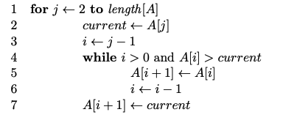
Sorting
What sorting algorithm?

Slide 6
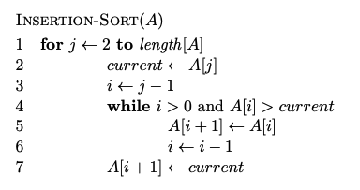
Sorting

Slide 7
Does it terminate?
Is it correct?
How long does it take to run?
Memory usage?

Slide 8
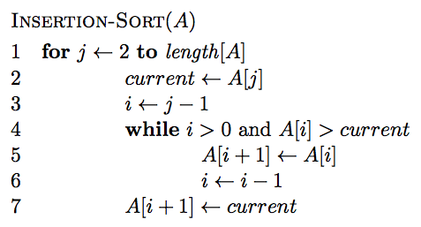
Insertion-sort
Does it terminate?

Slide 9
Insertion-sort
Is it correct? Can you prove it?

Slide 10
Loop invariant
Loop invariant: A statement about a loop that is true before the loop begins and after each iteration of the loop.
Upon termination of the loop, the invariant should help you show something useful about the algorithm.
Loop invariant?

Slide 11
Loop invariant
Loop invariant: A statement about a loop that is true before the loop begins and after each iteration of the loop.
At the start of each iteration of the for loop of lines 1-7 the subarray A[1..j − 1] is the sorted version of the original elements of A[1..j − 1]
Proof?

Slide 12
Loop invariant
At the start of each iteration of the for loop of lines 1-7 the subarray A[1..j − 1] is the sorted version of the original elements of A[1..j − 1]
Proof by induction - Base case: invariant is true before loop
- Inductive case: it is true after each iteration

Slide 13
Insertion-sort
How long will it take to run?

Slide 14
Asymptotic notation
How do you answer the question: “what is the running time of algorithm x?”
Talk about the computational cost of an algorithm that focuses on the essential parts and ignores irrelevant details
You’ve seen some of this already:
linear
n log n
n²

Slide 15
Asymptotic notation
Precisely calculating the actual steps is tedious and not generally useful
Different operations take different amounts of time. Even from run to run, things such as caching, etc. cause variations
We want to identify categories of algorithmic runtimes

Slide 16
For example…
f₁(n) takes n² steps
f₂(n) takes 2n + 100 steps
f₃(n) takes 3n+1 steps
Which algorithm is better?
Is the difference between f₂ and f₃ important/significant?

Slide 17
Runtime examples

Slide 18
Big O: Upper bound
O(g(n)) is the set of functions:

Slide 19
Big O: Upper bound
O(g(n)) is the set of functions:
We can bound the function f(n) above by some constant factor of g(n)

Slide 20
Big O: Upper bound
O(g(n)) is the set of functions:
We can bound the function f(n) above by some constant multiplied by g(n)
For some increasing range

Slide 21
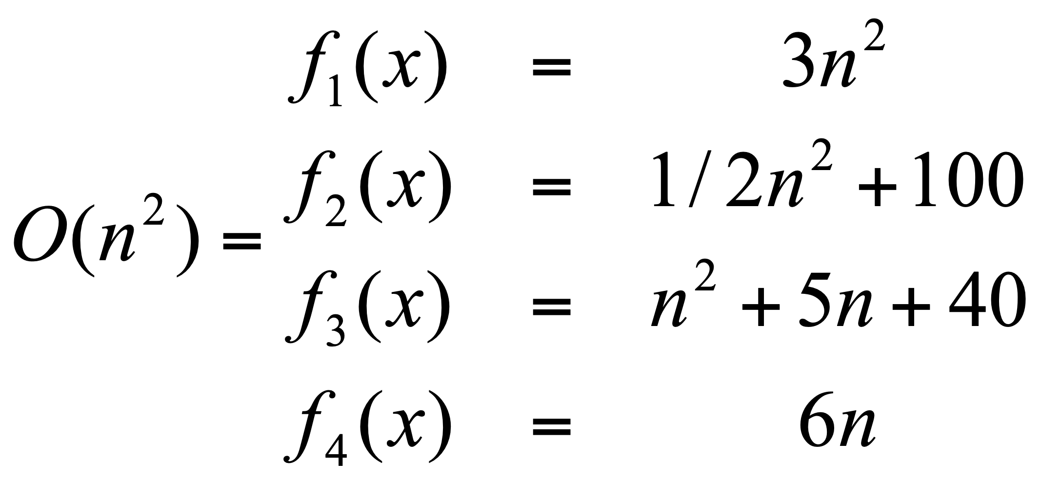
Big O: Upper bound
O(g(n)) is the set of functions:

Slide 22
Big O: Upper bound
O(g(n)) is the set of functions:
Generally, we’re most interested in big O notation since it is an upper bound on the running time

Slide 23
Omega: Lower bound
Ω(g(n)) is the set of functions:

Slide 24
Omega: Lower bound
Ω(g(n)) is the set of functions:
We can bound the function f(n) below by some constant factor of g(n)

Slide 25
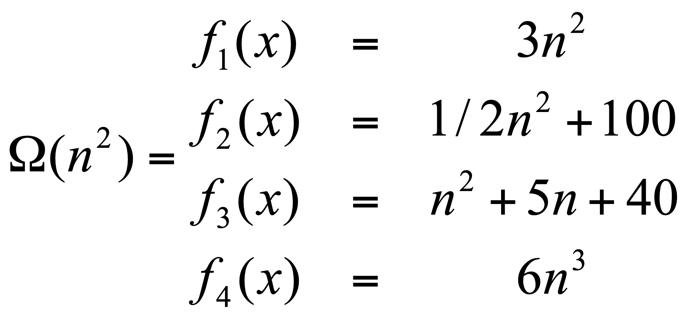
Omega: Lower bound
Ω(g(n)) is the set of functions:

Slide 26
Theta: Upper and lower bound
Θ(g(n)) is the set of functions:

Slide 27
Theta: Upper and lower bound
Θ(g(n)) is the set of functions:
We can bound the function f(n) above and below by some constant factor of g(n) (though different constants)

Slide 28
Theta: Upper and lower bound
Θ(g(n)) is the set of functions:
Note: A function is theta bounded iff it is big O bounded and Omega bounded

Slide 29
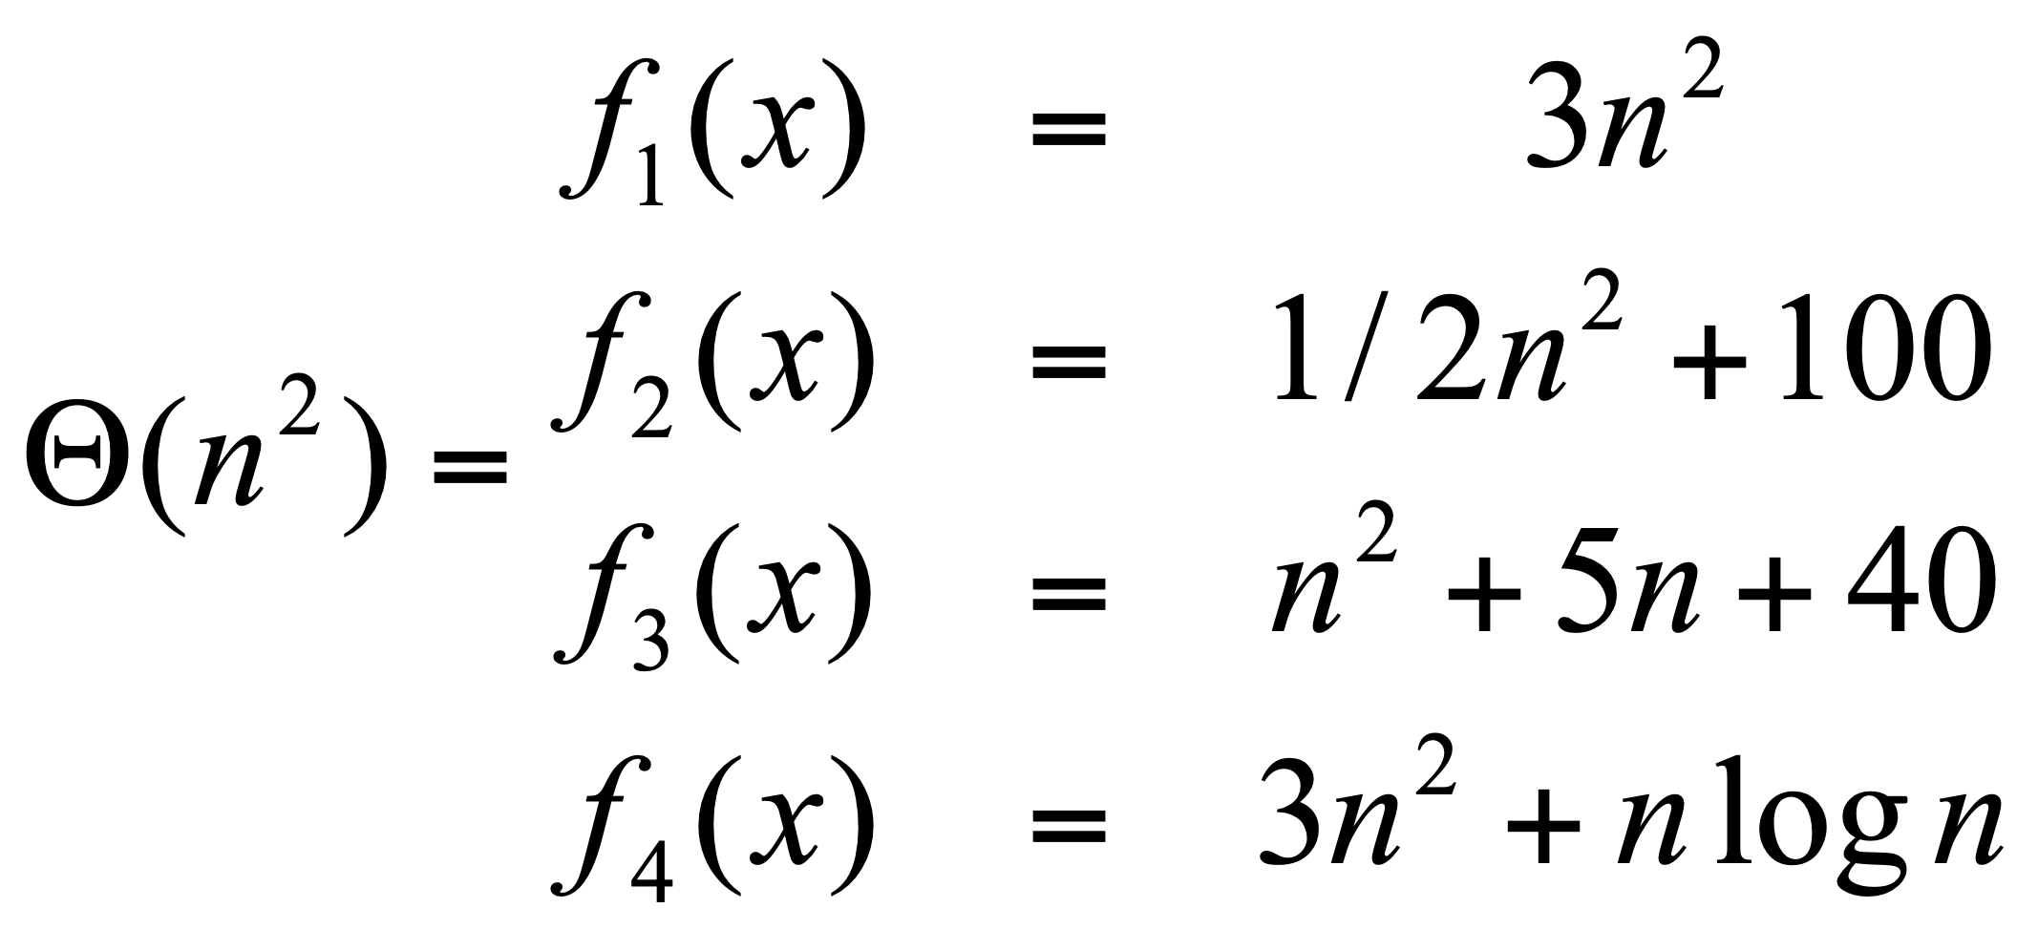
Theta: Upper and lower bound
Θ(g(n)) is the set of functions:

Slide 30
Visually
f(n)

Slide 31
Visually: upper bound
f(n)
n₀

Slide 32
Visually: lower bound
f(n)
n₀

Slide 33
worst-case vs. best-case vs. average-case
worst-case: what is the worst the running time of the algorithm can be?
best-case: what is the best the running time of the algorithm can be?
average-case: given random data, what is the running time of the algorithm?
Don’t confuse this with O, Ω and Θ. The cases above are situations, asymptotic notation is about bounding particular situations

Slide 34
Proving bounds: find constants that satisfy inequalities
Show that 5n² – 15n + 100 is Θ(n²)
Step 1: Prove O(n²) – Find constants c and n₀ such that 5n² – 15n + 100 ≤ cn² for all n > n₀
Let n₀ =1 and c = 5 + 100 = 105.
100/n² only get smaller as n increases and we ignore -15/n since it only varies between -15 and 0

Slide 35
Proving bounds
Step 2: Prove Ω(n²) – Find constants c and n₀ such that 5n² – 15n + 100 ≥ cn² for all n > n₀
Let n₀ =4 and c = 5 – 15/4 = 1.25 (or anything less than 1.25). 15/n is always decreasing and we ignore 100/n² since it is always between 0 and 100.

Slide 36
Bounds
No
How would we prove it?

Slide 37
Disproving bounds
Assume it’s true.
That means there exists some c and n₀ such that
contradiction!

Slide 38
Some rules of thumb
Multiplicative constants can be omitted
14n² becomes n²
7 log n become log n
Lower order functions can be omitted
n + 5 becomes n
n² + n becomes n²
nª dominates n^{b} if a > b
n² dominates n, so n²+n becomes n²
n^{1.5} dominates n^{1.4}

Slide 39
Some rules of thumb
a^{n} dominates b^{n} if a > b
3^{n} dominates 2^{n}
Any exponential dominates any polynomial
3^{n} dominates n⁵
2^{n} dominates n^{c}
Any polynomial dominates any logorithm
n dominates log n or log log n
n² dominates n log n
n^{1/2} dominates log n
Do not omit lower order terms of different variables (n² + m) does not become n²

Slide 40
Big O
n² + n log n + 50
2^{n} -15n² + n³ log n
n^{log n} + n² + 15n³
n⁵ + n! + n^{n}

Slide 41
Some examples
O(1) – constant. Fixed amount of work, regardless of the input size
add two 32 bit numbers
determine if a number is even or odd
sum the first 20 elements of an array
delete an element from a doubly linked list
O(log n) – logarithmic. At each iteration, discards some portion of the input (i.e. half)
binary search

Slide 42
Some examples
O(n) – linear. Do a constant amount of work on each element of the input
find an item in a linked list
determine the largest element in an array
O(n log n) log-linear. Divide and conquer algorithms with a linear amount of work to recombine
Sort a list of number with MergeSort
FFT

Slide 43
Some examples
O(n²) – quadratic. Double nested loops that iterate over the data
Insertion sort
O(2^{n}) – exponential
Enumerate all possible subsets
Traveling salesman using dynamic programming
O(n!)
Enumerate all permutations
determinant of a matrix with expansion by minors

