Slide 1
All pairs shortest paths
David Kauchak
CS 140 – Fall 2022

Slide 2
Admin
Assignment 8 (how did it go?)
Assignment 9 (out later today)
Checkpoint 3: next Thursday!

Slide 3
Shortest Paths
2
B
D
-1
1
3
-3
A
2
4
C
E
5

Slide 4
Shortest Paths
2
B
D
-1
1
3
-3
A
2
4
C
E
5
What is the shortest path from A to E?

Slide 5
Shortest Paths
2
B
D
-1
1
3
-3
A
2
4
C
E
5
-2

Slide 6
Shortest Paths
2
B
D
-1
1
3
-3
A
2
4
C
E
5
What algorithm would we use to calculate this?

Slide 7
Shortest Paths
2
B
D
-1
1
3
-3
A
2
4
C
E
5
Bellman-Ford (since the graph has negative edges)
O(VE)

Slide 8
Shortest Paths
2
B
D
-1
1
3
-3
A
2
4
C
E
5
Bellman-Ford (since the graph has negative edges)
O(VE)
Called a single-source shortest path algorithm. Why?

Slide 9
Shortest Paths
2
B
D
-1
1
3
-3
A
2
4
C
E
5
Bellman-Ford (since the graph has negative edges)
O(VE)
Calculate all paths from a single vertex.

Slide 10
Shortest Paths
2
B
D
-1
1
3
-3
A
2
4
C
E
5
What is the shortest path from A to C?
If we already calculated A to E using Bellman-Ford do we need to do any work?

Slide 11
Shortest Paths
2
B
D
-1
1
3
-3
A
2
4
C
E
5
No new calculations!
Bellman-Ford calculates all shortest paths starting at A.

Slide 12
Shortest Paths
2
B
D
-1
1
3
-3
A
2
4
C
E
5
What is the shortest path from D to C?
If we already calculated A to E using Bellman-Ford do we need to do any work?

Slide 13
Shortest Paths
2
B
D
-1
1
3
-3
A
2
4
C
E
5
Different source.
Have to run Bellman-Ford again!

Slide 14
All pairs shortest paths
All pairs shortest paths: calculate the shortest paths between all vertices
2
B
D
-1
1
3
-3
A
2
4
C
E
5

Slide 15
All pairs shortest paths
All pairs shortest paths: calculate the shortest paths between all vertices
Easy solution?

Slide 16
All pairs shortest paths
All pairs shortest paths: calculate the shortest paths between all vertices
Run Bellman-Ford from each vertex!
Running time (in terms of E and V)?

Slide 17
All pairs shortest paths
All pairs shortest paths: calculate the shortest paths between all vertices
Run Bellman-Ford from each vertex!
O(V²E)
Bellman-Ford: O(VE)
V calls, one for each vertex

Slide 18
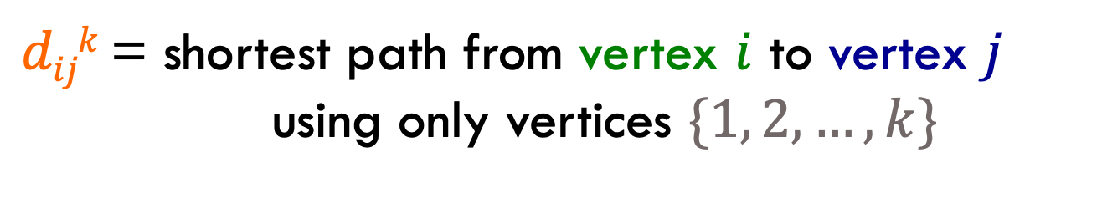
Floyd-Warshall: key idea
Label all vertices with a number from 1 to V
$dijk$ = shortest path from vertex $i$ to vertex $j$
using only vertices $\{1, 2, …, k\}$

Slide 19
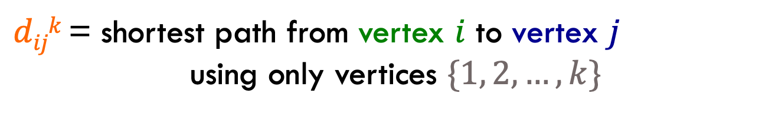
Floyd-Warshall: key idea
$dijk$ = shortest path from vertex $i$ to vertex $j$
using only vertices $\{1, 2, …, k\}$
2
3
4
-1
1
3
-3
1
2
4
2
5
5
What is d₁₅²?
What is d₄₁⁴?
What is d₁₅³?

Slide 20
Floyd-Warshall: key idea
$dijk$ = shortest path from vertex $i$ to vertex $j$
using only vertices $\{1, 2, …, k\}$
2
3
4
-1
1
3
-3
1
2
4
2
5
5
What is d₁₅²?

Slide 21
Floyd-Warshall: key idea
$dijk$ = shortest path from vertex $i$ to vertex $j$
using only vertices $\{1, 2, …, k\}$
2
3
4
-1
1
3
-3
1
2
4
2
5
5
d₁₅² = 9. Can only use 2.

Slide 22
Floyd-Warshall: key idea
$dijk$ = shortest path from vertex $i$ to vertex $j$
using only vertices $\{1, 2, …, k\}$
2
3
4
-1
1
3
-3
1
2
4
2
5
5
What is d₁₅³?

Slide 23
Floyd-Warshall: key idea
$dijk$ = shortest path from vertex $i$ to vertex $j$
using only vertices $\{1, 2, …, k\}$
2
3
4
-1
1
3
-3
1
2
4
2
5
5
d₁₅³ = 1. Can’t use vertex 4.

Slide 24
Floyd-Warshall: key idea
$dijk$ = shortest path from vertex $i$ to vertex $j$
using only vertices $\{1, 2, …, k\}$
2
3
4
-1
1
3
-3
1
2
4
2
5
5
What is d₄₁⁴?

Slide 25
Floyd-Warshall: key idea
$dijk$ = shortest path from vertex $i$ to vertex $j$
using only vertices $\{1, 2, …, k\}$
2
3
4
-1
1
3
-3
1
2
4
2
5
5
d₄₁⁴ = ∞. No possible path.

Slide 26
Floyd-Warshall: key idea
$dijk$ = shortest path from vertex $i$ to vertex $j$
using only vertices $\{1, 2, …, k\}$
2
3
4
-1
1
3
-3
1
2
4
2
5
5
What is d₃₃⁵?

Slide 27
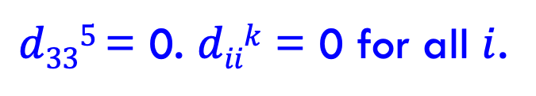
Floyd-Warshall: key idea
$dijk$ = shortest path from vertex $i$ to vertex $j$
using only vertices $\{1, 2, …, k\}$
2
3
4
-1
1
3
-3
1
2
4
2
5
5
$d335$ = 0. $diik$ = 0 for all $i$.

Slide 28

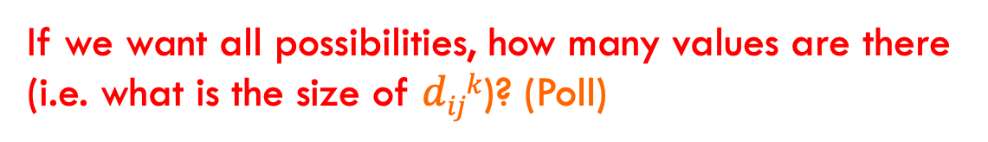
Floyd-Warshall: key idea
Label all vertices with a number from 1 to V
$dijk$ = shortest path from vertex $i$ to vertex $j$
using only vertices $\{1, 2, …, k\}$
If we want all possibilities, how many values are there (i.e. what is the size of $dijk$)? (Poll)

Slide 29
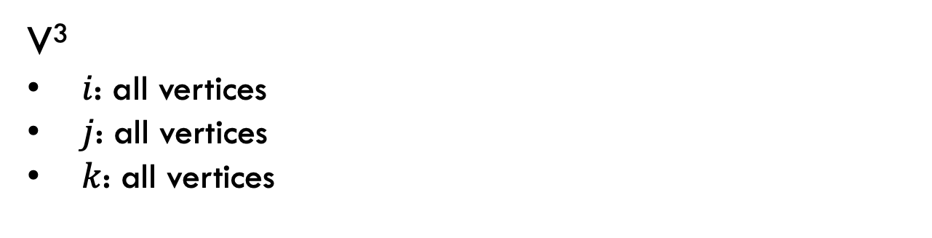
Floyd-Warshall: key idea
Label all vertices with a number from 1 to V
$dijk$ = shortest path from vertex $i$ to vertex $j$
using only vertices $\{1, 2, …, k\}$
V³
$i$: all vertices
$j$: all vertices
$k$: all vertices

Slide 30
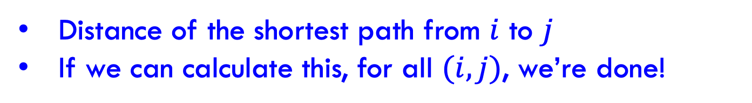

Floyd-Warshall: key idea
Label all vertices with a number from 1 to V
$dijk$ = shortest path from vertex $i$ to vertex $j$
using only vertices $\{1, 2, …, k\}$
What is $dijV$?
Distance of the shortest path from $i$ to $j$
If we can calculate this, for all $(i,j)$, we’re done!

Slide 31
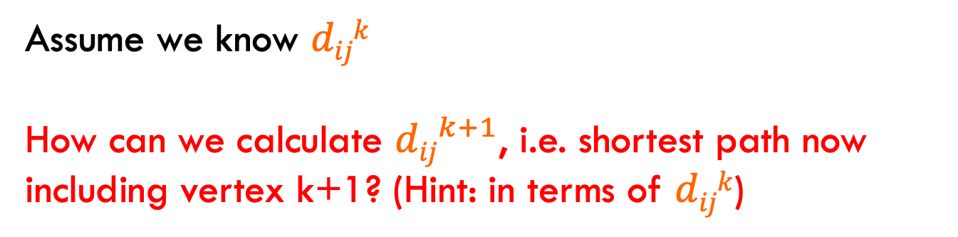
Recursive relationship
$dijk$ = shortest path from vertex $i$ to vertex $j$
using only vertices $\{1, 2, …, k\}$
Assume we know $dijk$
How can we calculate ${dij}^{k+1}$, i.e. shortest path now including vertex k+1? (Hint: in terms of $dijk$)
Two options:
Vertex k+1 doesn’t give us a shorter path
Vertex k+1 does give us a shorter path

Slide 32
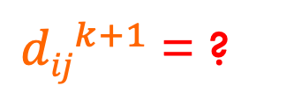
Recursive relationship
$dijk$ = shortest path from vertex $i$ to vertex $j$
using only vertices $\{1, 2, …, k\}$
Two options:
Vertex k+1 doesn’t give us a shorter path
Vertex k+1 does give us a shorter path
${dij}^{k+1}$= ?

Slide 33
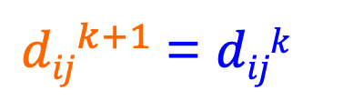
Recursive relationship
$dijk$ = shortest path from vertex $i$ to vertex $j$
using only vertices $\{1, 2, …, k\}$
Two options:
Vertex k+1 doesn’t give us a shorter path
Vertex k+1 does give us a shorter path
${dij}^{k+1}$= $dijk$

Slide 34
Recursive relationship
$dijk$ = shortest path from vertex $i$ to vertex $j$
using only vertices $\{1, 2, …, k\}$
Two options:
Vertex k+1 doesn’t give us a shorter path
Vertex k+1 does give us a shorter path
${dij}^{k+1}$= ?

Slide 35
Recursive relationship
$dijk$ = shortest path from vertex $i$ to vertex $j$
using only vertices $\{1, 2, …, k\}$
Two options:
Vertex k+1 doesn’t give us a shorter path
Vertex k+1 does give us a shorter path
${dij}^{k+1}$= ?
i
k+1
J
some vertices {1…k}
some vertices {1…k}
What is the cost of this path?

Slide 36
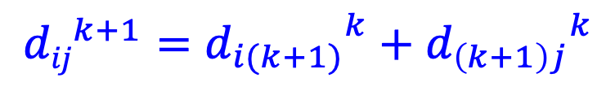
Recursive relationship
$dijk$ = shortest path from vertex $i$ to vertex $j$
using only vertices $\{1, 2, …, k\}$
Two options:
Vertex k+1 doesn’t give us a shorter path
Vertex k+1 does give us a shorter path
$${dij}^{k+1}={d_{i(k+1)}}^{k}+{d_{\left(k+1\right)j}}^{k}$$
i
k+1
J
some vertices {1…k}
some vertices {1…k}
d_{i(k+1)}^{k}
d_{(k+1)j}^{k}
+

Slide 37
Recursive relationship
$dijk$ = shortest path from vertex $i$ to vertex $j$
using only vertices $\{1, 2, …, k\}$
Two options:
Vertex k+1 doesn’t give us a shorter path
Vertex k+1 does give us a shorter path
${dij}^{k+1}$= ?
How do we combine these two options?

Slide 38
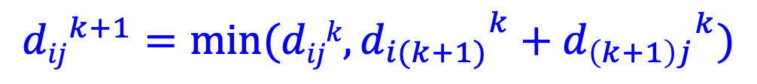
Recursive relationship
$dijk$ = shortest path from vertex $i$ to vertex $j$
using only vertices $\{1, 2, …, k\}$
Two options:
Vertex k+1 doesn’t give us a shorter path
Vertex k+1 does give us a shorter path
$${dij}^{k+1}={{min⁡(dijk,d}_{i(k+1)}}^{k}+{d_{\left(k+1\right)j}}^{k})$$
Pick whichever is shorter

Slide 39
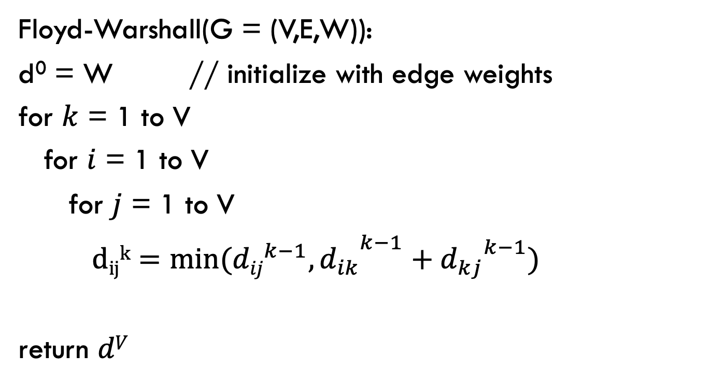
Floyd-Warshall
Calculate $dijk$ for increasing k, i.e. k = 1 to V
Floyd-Warshall(G = (V,E,W)):
d⁰ = W // initialize with edge weights
for $k$ = 1 to V
for $i$ = 1 to V
for $j$ = 1 to V
${{ dijk=min⁡({dij}^{k−1},d}_{ik}}^{k−1}+{d_{kj}}^{k−1})$
return $dV$

Slide 40
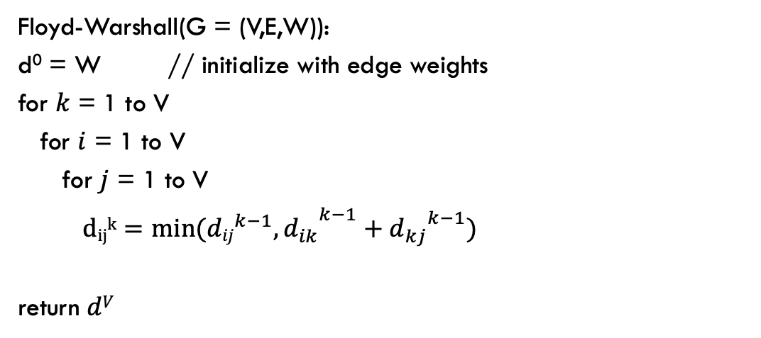
Floyd-Warshall(G = (V,E,W)):
d⁰ = W // initialize with edge weights
for $k$ = 1 to V
for $i$ = 1 to V
for $j$ = 1 to V
${{ dijk=min⁡({dij}^{k−1},d}_{ik}}^{k−1}+{d_{kj}}^{k−1})$
return $dV$
2
3
4
-1
1
3
-3
1
2
4
2
5
5
k = 0
k = 1
1 2 3 4 5
1 2 3 4 5
1
1
2
2
3
3
4
4
5
5
adjacency matrix
no change

Slide 41
Floyd-Warshall(G = (V,E,W)):
d⁰ = W // initialize with edge weights
for $k$ = 1 to V
for $i$ = 1 to V
for $j$ = 1 to V
${{ dijk=min⁡({dij}^{k−1},d}_{ik}}^{k−1}+{d_{kj}}^{k−1})$
return $dV$
2
3
4
-1
1
3
-3
1
2
4
2
5
5
k = 1
k = 2
1 2 3 4 5
1 2 3 4 5
1
1
2
2
3
3
4
4
5
5

Slide 42
Floyd-Warshall(G = (V,E,W)):
d⁰ = W // initialize with edge weights
for $k$ = 1 to V
for $i$ = 1 to V
for $j$ = 1 to V
${{ dijk=min⁡({dij}^{k−1},d}_{ik}}^{k−1}+{d_{kj}}^{k−1})$
return $dV$
2
3
4
-1
1
3
-3
1
2
4
2
5
5
k = 1
k = 2
1 2 3 4 5
1 2 3 4 5
1
1
2
2
3
3
4
4
5
5
minimum

Slide 43
Floyd-Warshall(G = (V,E,W)):
d⁰ = W // initialize with edge weights
for $k$ = 1 to V
for $i$ = 1 to V
for $j$ = 1 to V
${{ dijk=min⁡({dij}^{k−1},d}_{ik}}^{k−1}+{d_{kj}}^{k−1})$
return $dV$
2
3
4
-1
1
3
-3
1
2
4
2
5
5
k = 2
k = 3
1 2 3 4 5
1 2 3 4 5
1
1
2
2
3
3
4
4
5
5

Slide 44
Floyd-Warshall(G = (V,E,W)):
d⁰ = W // initialize with edge weights
for $k$ = 1 to V
for $i$ = 1 to V
for $j$ = 1 to V
${{ dijk=min⁡({dij}^{k−1},d}_{ik}}^{k−1}+{d_{kj}}^{k−1})$
return $dV$
2
3
4
-1
1
3
-3
1
2
4
2
5
5
k = 2
k = 3
1 2 3 4 5
1 2 3 4 5
1
1
2
2
3
3
4
4
5
5
minimum
Found a shorter path!

Slide 45
Floyd-Warshall(G = (V,E,W)):
d⁰ = W // initialize with edge weights
for $k$ = 1 to V
for $i$ = 1 to V
for $j$ = 1 to V
${{ dijk=min⁡({dij}^{k−1},d}_{ik}}^{k−1}+{d_{kj}}^{k−1})$
return $dV$
2
3
4
-1
1
3
-3
1
2
4
2
5
5
k = 2
k = 3
1 2 3 4 5
1 2 3 4 5
1
1
2
2
3
3
4
4
5
5

Slide 46
Floyd-Warshall(G = (V,E,W)):
d⁰ = W // initialize with edge weights
for $k$ = 1 to V
for $i$ = 1 to V
for $j$ = 1 to V
${{ dijk=min⁡({dij}^{k−1},d}_{ik}}^{k−1}+{d_{kj}}^{k−1})$
return $dV$
2
3
4
-1
1
3
-3
1
2
4
2
5
5
k = 2
k = 3
1 2 3 4 5
1 2 3 4 5
1
1
2
2
3
3
4
4
5
5

Slide 47
Floyd-Warshall(G = (V,E,W)):
d⁰ = W // initialize with edge weights
for $k$ = 1 to V
for $i$ = 1 to V
for $j$ = 1 to V
${{ dijk=min⁡({dij}^{k−1},d}_{ik}}^{k−1}+{d_{kj}}^{k−1})$
return $dV$
2
3
4
-1
1
3
-3
1
2
4
2
5
5
k = 2
k = 3
1 2 3 4 5
1 2 3 4 5
1
1
2
2
3
3
4
4
5
5
minimum

Slide 48
Floyd-Warshall(G = (V,E,W)):
d⁰ = W // initialize with edge weights
for $k$ = 1 to V
for $i$ = 1 to V
for $j$ = 1 to V
${{ dijk=min⁡({dij}^{k−1},d}_{ik}}^{k−1}+{d_{kj}}^{k−1})$
return $dV$
2
3
4
-1
1
3
-3
1
2
4
2
5
5
k = 2
k = 3
1 2 3 4 5
1 2 3 4 5
1
1
2
2
3
3
4
4
5
5

Slide 49
Floyd-Warshall(G = (V,E,W)):
d⁰ = W // initialize with edge weights
for $k$ = 1 to V
for $i$ = 1 to V
for $j$ = 1 to V
${{ dijk=min⁡({dij}^{k−1},d}_{ik}}^{k−1}+{d_{kj}}^{k−1})$
return $dV$
2
3
4
-1
1
3
-3
1
2
4
2
5
5
k = 2
k = 3
1 2 3 4 5
1 2 3 4 5
1
1
2
2
3
3
4
4
5
5

Slide 50
Floyd-Warshall(G = (V,E,W)):
d⁰ = W // initialize with edge weights
for $k$ = 1 to V
for $i$ = 1 to V
for $j$ = 1 to V
${{ dijk=min⁡({dij}^{k−1},d}_{ik}}^{k−1}+{d_{kj}}^{k−1})$
return $dV$
2
3
4
-1
1
3
-3
1
2
4
2
5
5
k = 2
k = 3
1 2 3 4 5
1 2 3 4 5
1
1
2
2
3
3
4
4
5
5
minimum
Found a shorter path!

Slide 51
Floyd-Warshall(G = (V,E,W)):
d⁰ = W // initialize with edge weights
for $k$ = 1 to V
for $i$ = 1 to V
for $j$ = 1 to V
${{ dijk=min⁡({dij}^{k−1},d}_{ik}}^{k−1}+{d_{kj}}^{k−1})$
return $dV$
2
3
4
-1
1
3
-3
1
2
4
2
5
5
k = 2
k = 3
1 2 3 4 5
1 2 3 4 5
1
1
2
2
3
3
4
4
5
5

Slide 52
Floyd-Warshall(G = (V,E,W)):
d⁰ = W // initialize with edge weights
for $k$ = 1 to V
for $i$ = 1 to V
for $j$ = 1 to V
${{ dijk=min⁡({dij}^{k−1},d}_{ik}}^{k−1}+{d_{kj}}^{k−1})$
return $dV$
2
3
4
-1
1
3
-3
1
2
4
2
5
5
k = 3
k = 4
1 2 3 4 5
1 2 3 4 5
1
1
2
2
3
3
4
4
5
5

Slide 53
Floyd-Warshall(G = (V,E,W)):
d⁰ = W // initialize with edge weights
for $k$ = 1 to V
for $i$ = 1 to V
for $j$ = 1 to V
${{ dijk=min⁡({dij}^{k−1},d}_{ik}}^{k−1}+{d_{kj}}^{k−1})$
return $dV$
2
3
4
-1
1
3
-3
1
2
4
2
5
5
k = 3
k = 4
1 2 3 4 5
1 2 3 4 5
1
1
2
2
3
3
4
4
5
5
minimum
Found a shorter path!

Slide 54
Floyd-Warshall(G = (V,E,W)):
d⁰ = W // initialize with edge weights
for $k$ = 1 to V
for $i$ = 1 to V
for $j$ = 1 to V
${{ dijk=min⁡({dij}^{k−1},d}_{ik}}^{k−1}+{d_{kj}}^{k−1})$
return $dV$
2
3
4
-1
1
3
-3
1
2
4
2
5
5
k = 3
k = 4
1 2 3 4 5
1 2 3 4 5
1
1
2
2
3
3
4
4
5
5

Slide 55
Floyd-Warshall(G = (V,E,W)):
d⁰ = W // initialize with edge weights
for $k$ = 1 to V
for $i$ = 1 to V
for $j$ = 1 to V
${{ dijk=min⁡({dij}^{k−1},d}_{ik}}^{k−1}+{d_{kj}}^{k−1})$
return $dV$
2
3
4
-1
1
3
-3
1
2
4
2
5
5
k = 3
k = 4
1 2 3 4 5
1 2 3 4 5
1
1
2
2
3
3
4
4
5
5

Slide 56
Floyd-Warshall(G = (V,E,W)):
d⁰ = W // initialize with edge weights
for $k$ = 1 to V
for $i$ = 1 to V
for $j$ = 1 to V
${{ dijk=min⁡({dij}^{k−1},d}_{ik}}^{k−1}+{d_{kj}}^{k−1})$
return $dV$
2
3
4
-1
1
3
-3
1
2
4
2
5
5
k = 3
k = 4
1 2 3 4 5
1 2 3 4 5
1
1
2
2
3
3
4
4
5
5
minimum
Found a shorter path!

Slide 57
Floyd-Warshall(G = (V,E,W)):
d⁰ = W // initialize with edge weights
for $k$ = 1 to V
for $i$ = 1 to V
for $j$ = 1 to V
${{ dijk=min⁡({dij}^{k−1},d}_{ik}}^{k−1}+{d_{kj}}^{k−1})$
return $dV$
2
3
4
-1
1
3
-3
1
2
4
2
5
5
k = 3
k = 4
1 2 3 4 5
1 2 3 4 5
1
1
2
2
3
3
4
4
5
5

Slide 58
Floyd-Warshall(G = (V,E,W)):
d⁰ = W // initialize with edge weights
for $k$ = 1 to V
for $i$ = 1 to V
for $j$ = 1 to V
${{ dijk=min⁡({dij}^{k−1},d}_{ik}}^{k−1}+{d_{kj}}^{k−1})$
return $dV$
2
3
4
-1
1
3
-3
1
2
4
2
5
5
k = 4
k = 5
1 2 3 4 5
1 2 3 4 5
1
1
2
2
3
3
4
4
5
5
Done!

Slide 59
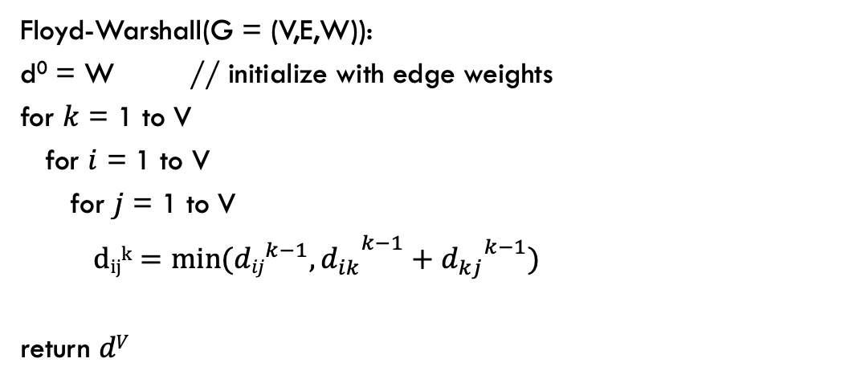
Floyd-Warshall analysis
Is it correct?
Floyd-Warshall(G = (V,E,W)):
d⁰ = W // initialize with edge weights
for $k$ = 1 to V
for $i$ = 1 to V
for $j$ = 1 to V
${{ dijk=min⁡({dij}^{k−1},d}_{ik}}^{k−1}+{d_{kj}}^{k−1})$
return $dV$

Slide 60
Floyd-Warshall analysis
Is it correct?
Any assumptions?
Floyd-Warshall(G = (V,E,W)):
d⁰ = W // initialize with edge weights
for $k$ = 1 to V
for $i$ = 1 to V
for $j$ = 1 to V
${{ dijk=min⁡({dij}^{k−1},d}_{ik}}^{k−1}+{d_{kj}}^{k−1})$
return $dV$

Slide 61
Floyd-Warshall analysis
Is it correct?
Assuming the graph has no negative cycles!
What happens if there is a negative cycle?
Floyd-Warshall(G = (V,E,W)):
d⁰ = W // initialize with edge weights
for $k$ = 1 to V
for $i$ = 1 to V
for $j$ = 1 to V
${{ dijk=min⁡({dij}^{k−1},d}_{ik}}^{k−1}+{d_{kj}}^{k−1})$
return $dV$

Slide 62
Floyd-Warshall analysis
If the graph has a negative weight cycle, at the end, at least one of the diagonal entries will be a negative number, i.e., we there’s a way to get back to a vertex using all of the vertices that results in a negative weight
1 2 3 4 5
1
2
3
4
5

Slide 63
Floyd-Warshall analysis
Run-time?
Floyd-Warshall(G = (V,E,W)):
d⁰ = W // initialize with edge weights
for $k$ = 1 to V
for $i$ = 1 to V
for $j$ = 1 to V
${{ dijk=min⁡({dij}^{k−1},d}_{ik}}^{k−1}+{d_{kj}}^{k−1})$
return $dV$

Slide 64
Floyd-Warshall analysis
Run-time: θ(V³)
Floyd-Warshall(G = (V,E,W)):
d⁰ = W // initialize with edge weights
for $k$ = 1 to V
for $i$ = 1 to V
for $j$ = 1 to V
${{ dijk=min⁡({dij}^{k−1},d}_{ik}}^{k−1}+{d_{kj}}^{k−1})$
return $dV$

Slide 65
Floyd-Warshall analysis
Space usage?
Floyd-Warshall(G = (V,E,W)):
d⁰ = W // initialize with edge weights
for $k$ = 1 to V
for $i$ = 1 to V
for $j$ = 1 to V
${{ dijk=min⁡({dij}^{k−1},d}_{ik}}^{k−1}+{d_{kj}}^{k−1})$
return $dV$

Slide 66

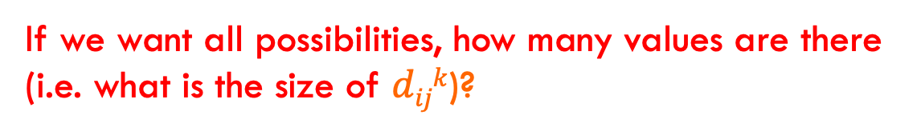
Floyd-Warshall: key idea
Label all vertices with a number from 1 to V
$dijk$ = shortest path from vertex $i$ to vertex $j$
using only vertices $\{1, 2, …, k\}$
If we want all possibilities, how many values are there (i.e. what is the size of $dijk$)?

Slide 67
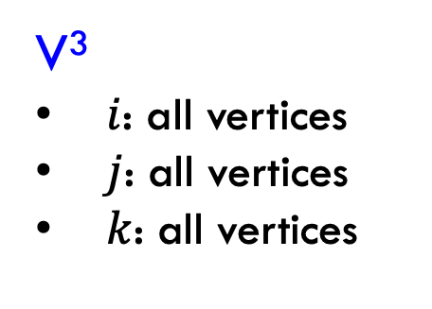
Floyd-Warshall: key idea
Label all vertices with a number from 1 to V
$dijk$ = shortest path from vertex $i$ to vertex $j$
using only vertices $\{1, 2, …, k\}$
V³
$i$: all vertices
$j$: all vertices
$k$: all vertices
Can we do better?

Slide 68
Floyd-Warshall analysis
Space usage: θ(V²)
Only need the current value and the previous
Floyd-Warshall(G = (V,E,W)):
d⁰ = W // initialize with edge weights
for $k$ = 1 to V
for $i$ = 1 to V
for $j$ = 1 to V
${{ dijk=min⁡({dij}^{k−1},d}_{ik}}^{k−1}+{d_{kj}}^{k−1})$
return $dV$

Slide 69
All pairs shortest paths
V * Bellman-Ford: O(V²E)
Floyd-Warshall: θ(V³)

Slide 70
All pairs shortest paths
All pairs shortest paths for positive weight graphs: calculate the shortest paths between all points
Easy solution?

Slide 71
All pairs shortest paths
All pairs shortest paths for positive weight graphs: calculate the shortest paths between all points
Run Dijsktras from each vertex!
Running time (in terms of E and V)?

Slide 72
All pairs shortest paths
All pairs shortest paths for positive weight graphs: calculate the shortest paths between all points
Run Dijsktras from each vertex!
O(V² log V + V E)
V calls do Dijkstras
Dijkstras: O(V log V + E)

Slide 73
All pairs shortest paths
V * Bellman-Ford: O(V²E)
Floyd-Warshall: θ(V³)
V * Dijkstras: O(V² log V + V E)
Is this any better?

Slide 74
All pairs shortest paths
V * Bellman-Ford: O(V²E)
Floyd-Warshall: θ(V³)
V * Dijkstras: O(V² log V + V E)
If the graph is sparse!

Slide 75
All pairs shortest paths
All pairs shortest paths for positive weight graphs: calculate the shortest paths between all points
Run Dijsktras from each vertex!
Challenge: Dijkstras assumes positive weights

Slide 76
Johnson’s: key idea
Reweight the graph to make all edges positive such that shortest paths are preserved
0
2
B
D
B
D
1
-1
0
1
1
0
3
-3
A
3
A
2
4
C
E
4
C
E
8
5

Slide 77
Lemma
let h be any function mapping a vertex to a real value
If we change the graph weights as:
The shortest paths are preserved
Notes:
CLRS has proof

Slide 78
Lemma: proof
Let s, v₁, v₂, …, v_{k}, t be a path from s to t
The weight in the reweighted graph is:
…

Slide 79
Lemma: proof
Claim: the weight change preserves shortest paths, i.e. if a path was the shortest from s to t in the original graph it will still be the shortest path from s to t in the new graph.
Justification?

Slide 80
Lemma: proof
Claim: the weight change preserves shortest paths, i.e. if a path was the shortest from s to t in the original graph it will still be the shortest path from s to t in the new graph.
h(s) – h(t) is a constant and will be the same for all paths from s to t, so the absolute ordering of all paths from s to t will not change.

Slide 81
Lemma
let h be any function mapping a vertex to a real value
If we change the graph weights as:
The shortest paths are preserved
Big question: how do we pick h?
Notes:
CLRS has proof

Slide 82
Selecting h
Need to pick h such that the resulting graph has all weights as positive
0
2
B
D
B
D
1
-1
0
1
1
0
3
-3
A
3
A
2
4
C
E
4
C
E
8
5

Slide 83
Johnson’s algorithm
Create G’ with one extra node s with 0 weight edges to all nodes
run Bellman-Ford(G’,s)
if no negative-weight cycle
  reweight edges in G with h(v)=shortest path from s to v
  run Dijkstra’s from every vertex
  reweight shortest paths based on G

Slide 84
Create G’
run Bellman-Ford(G’,s)
if no negative-weight cycle
  reweight edges in G with h(v)=shortest path from s to v
  run Dijkstra’s from every vertex
  reweight shortest paths based on G
S
0
0
0
0
2
B
D
0
2
-1
B
D
-1
1
3
-3
1
A
2
3
-3
A
2
4
C
E
4
C
E
5
5

Slide 85
Create G’
run Bellman-Ford(G’,s)
if no negative-weight cycle
  reweight edges in G with h(v)=shortest path from s to v
  run Dijkstra’s from every vertex
  reweight shortest paths based on G
S
0
0
S➔A: ?
S➔B:
S➔C:
S➔D:
S➔E:
0
0
0
2
B
D
-1
1
3
-3
A
2
4
C
E
5

Slide 86
Create G’
run Bellman-Ford(G’,s)
if no negative-weight cycle
  reweight edges in G with h(v)=shortest path from s to v
  run Dijkstra’s from every vertex
  reweight shortest paths based on G
S
0
0
S➔A: 0
S➔B:
S➔C:
S➔D:
S➔E:
0
0
0
2
B
D
-1
1
3
-3
A
2
4
C
E
5

Slide 87
Create G’
run Bellman-Ford(G’,s)
if no negative-weight cycle
  reweight edges in G with h(v)=shortest path from s to v
  run Dijkstra’s from every vertex
  reweight shortest paths based on G
S
0
0
S➔A: 0
S➔B: ?
S➔C:
S➔D:
S➔E:
0
0
0
2
B
D
-1
1
3
-3
A
2
4
C
E
5

Slide 88
Create G’
run Bellman-Ford(G’,s)
if no negative-weight cycle
  reweight edges in G with h(v)=shortest path from s to v
  run Dijkstra’s from every vertex
  reweight shortest paths based on G
S
0
0
S➔A: 0
S➔B: -2
S➔C:
S➔D:
S➔E:
0
0
0
2
B
D
-1
1
3
-3
A
2
4
C
E
5

Slide 89
Create G’
run Bellman-Ford(G’,s)
if no negative-weight cycle
  reweight edges in G with h(v)=shortest path from s to v
  run Dijkstra’s from every vertex
  reweight shortest paths based on G
S
0
0
S➔A: 0
S➔B: -2
S➔C: 0
S➔D: 0
S➔E: -3
0
0
0
2
B
D
-1
1
3
-3
A
2
4
C
E
5

Slide 90
S➔A: 0
S➔B: -2
S➔C: 0
S➔D: 0
S➔E: -3
-2
0
2
B
D
-1
0
1
3
-3
A
2
4
C
E
5
-3
0

Slide 91
Create G’
run Bellman-Ford(G’,s)
if no negative-weight cycle
  reweight edges in G with h(v)=shortest path from s to v
  run Dijkstra’s from every vertex
  reweight shortest paths based on G
-2
0
2
B
D
B
D
-1
?
0
1
3
-3
A
A
2
4
C
E
C
E
5
-3
0

Slide 92
Create G’
run Bellman-Ford(G’,s)
if no negative-weight cycle
  reweight edges in G with h(v)=shortest path from s to v
  run Dijkstra’s from every vertex
  reweight shortest paths based on G
-1 + 0 - -2
-2
0
2
B
D
B
D
-1
1
0
1
3
-3
A
A
2
4
C
E
C
E
5
-3
0

Slide 93
Create G’
run Bellman-Ford(G’,s)
if no negative-weight cycle
  reweight edges in G with h(v)=shortest path from s to v
  run Dijkstra’s from every vertex
  reweight shortest paths based on G
-2
0
2
?
B
D
B
D
-1
1
0
1
3
-3
A
A
2
4
C
E
C
E
5
-3
0

Slide 94
Create G’
run Bellman-Ford(G’,s)
if no negative-weight cycle
  reweight edges in G with h(v)=shortest path from s to v
  run Dijkstra’s from every vertex
  reweight shortest paths based on G
2 + -2 - 0
-2
0
2
0
B
D
B
D
-1
1
0
1
3
-3
A
A
2
4
C
E
C
E
5
-3
0

Slide 95
Create G’
run Bellman-Ford(G’,s)
if no negative-weight cycle
  reweight edges in G with h(v)=shortest path from s to v
  run Dijkstra’s from every vertex
  reweight shortest paths based on G
-2
0
2
0
B
D
B
D
-1
1
0
1
3
-3
A
A
2
?
4
C
E
C
E
5
-3
0

Slide 96
Create G’
run Bellman-Ford(G’,s)
if no negative-weight cycle
  reweight edges in G with h(v)=shortest path from s to v
  run Dijkstra’s from every vertex
  reweight shortest paths based on G
4 + 0 - 0
-2
0
2
0
B
D
B
D
-1
1
0
1
3
-3
A
A
2
4
4
C
E
C
E
5
-3
0

Slide 97
Create G’
run Bellman-Ford(G’,s)
if no negative-weight cycle
  reweight edges in G with h(v)=shortest path from s to v
  run Dijkstra’s from every vertex
  reweight shortest paths based on G
-2
0
2
0
B
D
B
D
-1
1
0
1
3
-3
A
A
2
4
4
C
?
E
C
E
5
-3
0

Slide 98
Create G’
run Bellman-Ford(G’,s)
if no negative-weight cycle
  reweight edges in G with h(v)=shortest path from s to v
  run Dijkstra’s from every vertex
  reweight shortest paths based on G
5 + 0 - -3
-2
0
2
0
B
D
B
D
-1
1
0
1
3
-3
A
A
2
4
4
C
8
E
C
E
5
-3
0

Slide 99
Create G’
run Bellman-Ford(G’,s)
if no negative-weight cycle
  reweight edges in G with h(v)=shortest path from s to v
  run Dijkstra’s from every vertex
  reweight shortest paths based on G
-2
0
2
0
B
D
B
D
-1
1
0
1
0
3
-3
1
0
A
2
A
3
4
C
E
4
C
E
5
-3
8
0

Slide 100
Create G’
run Bellman-Ford(G’,s)
if no negative-weight cycle
  reweight edges in G with h(v)=shortest path from s to v
  run Dijkstra’s from every vertex
  reweight shortest paths based on G
0
B
D
1
0
1
0
A
3
4
C
E
8

Slide 101
Create G’
run Bellman-Ford(G’,s)
if no negative-weight cycle
  reweight edges in G with h(v)=shortest path from s to v
  run Dijkstra’s from every vertex
  reweight shortest paths based on G
0
B
D
1
1
0
A
C
E

Slide 102
Create G’
run Bellman-Ford(G’,s)
if no negative-weight cycle
  reweight edges in G with h(v)=shortest path from s to v
  run Dijkstra’s from every vertex
  reweight shortest paths based on G
-2
0
2
2
B
D
B
D
-1
-1
0
1
3
-3
-3
A
2
A
3
4
C
E
C
E
5
-3
0

Slide 103
A➔B: -1
A➔C: 2
A➔D: 1
A➔E: -2
-2
0
2
2
B
D
B
D
-1
-1
0
1
3
-3
-3
A
2
A
3
4
C
E
C
E
5
-3
0

Slide 104
Selecting h
Need to pick h such that the resulting graph has all weights as positive
Create G’ with one extra node s with 0 weight edges to all nodes
run Bellman-Ford(G’,s)
if no negative-weight cycle
  reweight edges in G with h(v)=shortest path from s to v
  run Dijkstra’s from every vertex
  reweight shortest paths based on G
Why does this work (i.e. how do we guarantee that reweighted graph has only positive edges)?

Slide 105
Reweighted graph is positive
Take two nodes u and v
h(u) shortest distance from s to u
h(v) shortest distance from s to v
Claim:
Why?

Slide 106
Reweighted graph is positive
Take two nodes u and v
h(u) shortest distance from s to u
h(v) shortest distance from s to v
Claim:
If this weren’t true, we could have made a shorter path s to v using u
… but this is in contradiction with how we defined h(v)

Slide 107
Reweighted graph is positive
Take two nodes u and v
h(u) shortest distance from s to u
h(v) shortest distance from s to v
What is this?

Slide 108
Reweighted graph is positive
Take two nodes u and v
h(u) shortest distance from s to u
h(v) shortest distance from s to v
All edge weights in reweighted graph are non-negative

Slide 109
Johnson’s algorithm
Create G’
run Bellman-Ford(G’,s)
if no negative-weight cycle
  reweight edges in G
  run Dijkstra’s from every vertex
  reweight shortest paths based on G
Run-time?

Slide 110
Johnson’s algorithm
Create G’
run Bellman-Ford(G’,s)
if no negative-weight cycle
  reweight edges in G
  run Dijkstra’s from every vertex
  reweight shortest paths based on G
θ(V)
O(V²)
θ(E)
O(V²logV+VE)
θ(E)
Run-time?

Slide 111
All pairs shortest paths
V * Bellman-Ford: O(V²E)
Floyd-Warshall: θ(V³)
Johnson’s: O(V² log V + V E)

