Slide 1
Dynamic programming: Even More fun!
David Kauchak CS 140 – Fall 2022

Slide 2
Admin
Assignment 6

Slide 3
Mentor hours this week
Thursday: 6-8pm (Aidan)
Friday: 1-3pm (Emily)
Saturday: 9:30-11:30am (Millie)
Sunday: 7-9pm (Carl), 8-10pm (Alan)

Slide 4
LC meetings
Thursday:
8-9pm (Emily—Edmunds upstairs, Carl—Edmunds upstairs)
Friday:
9-10am (Millie—Edmunds downstairs)
2-3pm (Jiahao—Edmunds downstairs, Aidan)
3-4pm(Jiahao—Edmunds downstairs)
4-5pm (Millie)

Slide 5
Longest increasing subsequence
Given a sequence of numbers X = x₁, x₂, …, x_{n} find the longest increasing subsequence
(i₁, i₂, …, i_{m}), that is a subsequence where numbers in the sequence increase.
5 2 8 6 3 6 9 7

Slide 6
Longest increasing subsequence
Given a sequence of numbers X = x₁, x₂, …, x_{n} find the longest increasing subsequence
(i₁, i₂, …, i_{m}), that is a subsequence where numbers in the sequence increase.
5 2 8 6 3 6 9 7

Slide 7
1a: optimal substructure
Prove: optimal solutions to the problem incorporate optimal solutions to related subproblems
5 2 8 6 3 6 9 7
$$\{i1, i2, …, im\}$$
What would a solution to a subproblem look like?

Slide 8
1a: optimal substructure
Prove: optimal solutions to the problem incorporate optimal solutions to related subproblems
5 2 8 6 3 6 9 7
$$\{i1, i2, …, im\}$$
$\{i2, …, im\}$ for the sequence
starting at index i₂

Slide 9
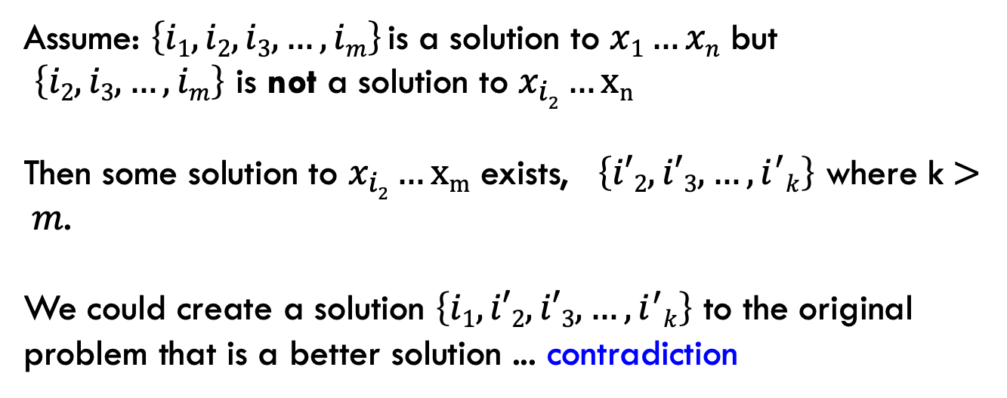
1a: optimal substructure
Prove: optimal solutions to the problem incorporate optimal solutions to related subproblems
Proof by contradiction:
Assume: $\left\{i1, i2, i3, …, im\right\}$is a solution to $x1…xn$ but
$\left\{i2, i3, …, im\right\}$ is not a solution to $x_{i2}…xn$
Then some solution to $x_{i2}…xm$ exists, $\left\{i′2, i′3, …, i^{′}k\right\}$ where k$> m$.
We could create a solution $\left\{i1,i′2, i′3, …, i^{′}k\right\}$ to the original problem that is a better solution ... contradiction

Slide 10
1b: recursive solution
5 2 8 6 3 6 9 7
Is 5 part off the LIS?

Slide 11
1b: recursive solution
5 2 8 6 3 6 9 7
Two options: Either 5 is in the LIS or it’s not

Slide 12
1b: recursive solution
5 2 8 6 3 6 9 7
include 5
5 + LIS(8 6 3 6 9 7)

Slide 13
1b: recursive solution
5 2 8 6 3 6 9 7
include 5
5 + LIS(8 6 3 6 9 7)
What is this function exactly?
longest increasing sequence of the numbers
longest increasing sequence of the numbers starting with 8

Slide 14
1b: recursive solution
5 2 8 6 3 6 9 7
include 5
5 + LIS(8 6 3 6 9 7)
What is this function exactly?
longest increasing sequence of the numbers
This would allow for the option of sequences starting with 3 which are NOT valid!

Slide 15
1b: recursive solution
5 2 8 6 3 6 9 7
include 5
5 + LIS’(8 6 3 6 9 7)
longest increasing sequence of the numbers starting with 8
Do we need to consider anything else for subsequences starting at 5?

Slide 16
1b: recursive solution
5 2 8 6 3 6 9 7
include 5
5 + LIS’(8 6 3 6 9 7)
5 + LIS’(6 3 6 9 7)
5 + LIS’(6 9 7)
5 + LIS’(9 7)
5 + LIS’(7)

Slide 17
1b: recursive solution
5 2 8 6 3 6 9 7
don’t include 5
LIS(2 8 6 3 6 9 7)
Anything else?
Technically, this is fine, but now we have LIS and LIS’ to worry about.
Can we rewrite LIS in terms of LIS’?

Slide 18
1b: recursive solution
Longest increasing sequence for X is the longest increasing sequence starting at any element
And what is LIS’ defined as (recursively)?

Slide 19
1b: recursive solution
Longest increasing sequence for X is the longest increasing sequence starting at any element
$$LIS^{′}\left(i\right)= 1+\max_{j:i<j≤n and xj>xi}{LIS′(j)}$$
Longest increasing sequence starting at i

Slide 20
2: DP solution (bottom-up)
$$LIS^{′}\left(i\right)= 1+\max_{j:i<j≤n and xj>xi}{LIS′(j)}$$
LIS’:
5 2 8 6 3 6 9 7

Slide 21
2: DP solution (bottom-up)
$$LIS^{′}\left(i\right)= 1+\max_{j:i<j≤n and xj>xi}{LIS′(j)}$$
LIS’: 1
5 2 8 6 3 6 9 7

Slide 22
2: DP solution (bottom-up)
$$LIS^{′}\left(i\right)= 1+\max_{j:i<j≤n and xj>xi}{LIS′(j)}$$
LIS’: 1
5 2 8 6 3 6 9 7

Slide 23
2: DP solution (bottom-up)
$$LIS^{′}\left(i\right)= 1+\max_{j:i<j≤n and xj>xi}{LIS′(j)}$$
LIS’: 1 1
5 2 8 6 3 6 9 7

Slide 24
2: DP solution (bottom-up)
$$LIS^{′}\left(i\right)= 1+\max_{j:i<j≤n and xj>xi}{LIS′(j)}$$
LIS’: 1 1
5 2 8 6 3 6 9 7

Slide 25
2: DP solution (bottom-up)
$$LIS^{′}\left(i\right)= 1+\max_{j:i<j≤n and xj>xi}{LIS′(j)}$$
LIS’: 2 1 1
5 2 8 6 3 6 9 7

Slide 26
2: DP solution (bottom-up)
$$LIS^{′}\left(i\right)= 1+\max_{j:i<j≤n and xj>xi}{LIS′(j)}$$
LIS’: 3 2 1 1
5 2 8 6 3 6 9 7

Slide 27
2: DP solution (bottom-up)
$$LIS^{′}\left(i\right)= 1+\max_{j:i<j≤n and xj>xi}{LIS′(j)}$$
LIS’: 2 3 2 1 1
5 2 8 6 3 6 9 7

Slide 28
2: DP solution (bottom-up)
$$LIS^{′}\left(i\right)= 1+\max_{j:i<j≤n and xj>xi}{LIS′(j)}$$
LIS’: 2 2 3 2 1 1
5 2 8 6 3 6 9 7

Slide 29
2: DP solution (bottom-up)
$$LIS^{′}\left(i\right)= 1+\max_{j:i<j≤n and xj>xi}{LIS′(j)}$$
LIS’: 4 2 2 3 2 1 1
5 2 8 6 3 6 9 7

Slide 30
2: DP solution (bottom-up)
$$LIS^{′}\left(i\right)= 1+\max_{j:i<j≤n and xj>xi}{LIS′(j)}$$
LIS’: 3 4 2 2 3 2 1 1
5 2 8 6 3 6 9 7

Slide 31
2: DP solution (bottom-up)
$$LIS^{′}\left(i\right)= 1+\max_{j:i<j≤n and xj>xi}{LIS′(j)}$$
LIS’: 3 4 2 2 3 2 1 1
5 2 8 6 3 6 9 7

Slide 32
2: DP solution (bottom-up)
$$LIS^{′}\left(i\right)= 1+\max_{j:i<j≤n and xj>xi}{LIS′(j)}$$
What does the data structure for storing answers look like?

Slide 33
2: DP solution (bottom-up)
$$LIS^{′}\left(i\right)= 1+\max_{j:i<j≤n and xj>xi}{LIS′(j)}$$
1-D array: only one thing changes for recursive calls

Slide 34
2: DP solution (bottom-up)
$$LIS^{′}\left(i\right)= 1+\max_{j:i<j≤n and xj>xi}{LIS′(j)}$$
What are the “smallest” possible subproblems?
To calculate LIS’(n), what are all the subproblems we need to calculate? This is the “table”.
How should we fill in the table?
Where will the answer be?

Slide 35
2: DP solution (bottom-up)
$$LIS^{′}\left(i\right)= 1+\max_{j:i<j≤n and xj>xi}{LIS′(j)}$$
What are the “smallest” possible subproblems?
LIS’(n) and that is well-defined for this problem
To calculate LIS’(i), what are all the subproblems we need to calculate? This is the “table”.
LIS’(1) … LIS’(n)
How should we fill in the table?
n → 1
Where will the answer be?
max(LIS’(1)…LIS’(n))

Slide 36
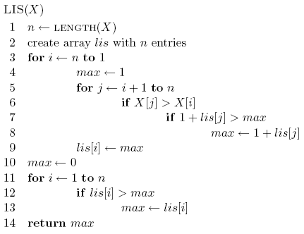
2: DP solution (bottom-up)

Slide 37
2: DP solution (bottom-up)
start from the end (bottom)

Slide 38
2: DP solution (bottom-up)
$$LIS^{′}\left(i\right)= 1+\max_{j:i<j≤n and xj>xi}{LIS′(j)}$$

Slide 39
2: DP solution (bottom-up)

Slide 40
3: Analysis
Space requirements?
Running time?

Slide 41
3: Analysis
Space requirements: Θ(n)
Running time: Θ(n²)

Slide 42
Another solution
Can we use LCS to solve this problem?
5 2 8 6 3 6 9 7
LCS
2 3 5 6 6 7 8 9

Slide 43
Another solution
Can we use LCS to solve this problem?
5 2 8 6 3 6 9 7
LCS
2 3 5 6 6 7 8 9

Slide 44
Edit distance (aka Levenshtein distance)
Edit distance between two strings is the minimum number of insertions, deletions and substitutions required to transform string s₁ into string s₂
Insertion:
ABACED
ABACCED
DABACCED
Insert ‘C’
Insert ‘D’

Slide 45
Edit distance (aka Levenshtein distance)
Edit distance between two strings is the minimum number of insertions, deletions and substitutions required to transform string s₁ into string s₂
Deletion:
ABACED

Slide 46
Edit distance (aka Levenshtein distance)
Edit distance between two strings is the minimum number of insertions, deletions and substitutions required to transform string s₁ into string s₂
Deletion:
ABACED
BACED
Delete ‘A’

Slide 47
Edit distance (aka Levenshtein distance)
Edit distance between two strings is the minimum number of insertions, deletions and substitutions required to transform string s₁ into string s₂
Deletion:
ABACED
BACED
BACE
Delete ‘A’
Delete ‘D’

Slide 48
Edit distance (aka Levenshtein distance)
Edit distance between two strings is the minimum number of insertions, deletions and substitutions required to transform string s₁ into string s₂
Substitution:
ABACED
ABADED
ABADES
Sub ‘D’ for ‘C’
Sub ‘S’ for ‘D’

Slide 49
Edit distance examples
Edit(Kitten, Mitten) =
1
Operations:
Sub ‘M’ for ‘K’
Mitten

Slide 50
Edit distance examples
Edit(Happy, Hilly) =
3
Operations:
Sub ‘a’ for ‘i’
Hippy
Sub ‘l’ for ‘p’
Hilpy
Sub ‘l’ for ‘p’
Hilly

Slide 51
Edit distance examples
Edit(Banana, Car) =
5
Operations:
Delete ‘B’
anana
Delete ‘a’
nana
Delete ‘n’
naa
Sub ‘C’ for ‘n’
Caa
Sub ‘a’ for ‘r’
Car

Slide 52
Edit distance examples
Edit(Simple, Apple) =
3
Operations:
Delete ‘S’
imple
Sub ‘A’ for ‘i’
Ample
Sub ‘m’ for ‘p’
Apple

Slide 53
Edit distance
Why might this be useful?

Slide 54
Is edit distance symmetric?
that is, is Edit(s₁, s₂) = Edit(s₂, s₁)?
Why?
sub ‘i’ for ‘j’ → sub ‘j’ for ‘i’
delete ‘i’ → insert ‘i’
insert ‘i’ → delete ‘i’
Edit(Simple, Apple) =? Edit(Apple, Simple)

Slide 55
Calculating edit distance
X = A B C B D A B
Y = B D C A B A
Ideas? How can we break this into subproblems?

Slide 56
Calculating edit distance
X = A B C B D A ?
Y = B D C A B ?
After all of the operations, X needs to equal Y
Start with the last two characters

Slide 57
Calculating edit distance
X = A B C B D A ?
Y = B D C A B ?
Operations:
Insert
Delete
Substitute
Assume they’re different
How can we make them the same?

Slide 58
Insert
X = A B C B D A ?
Y = B D C A B ?
How can we use insert to transform X into Y?

Slide 59
Insert
X = A B C B D A ? ?
Y = B D C A B ?
insert the last character of Y to the end of X

Slide 60
Insert
X = A B C B D A ? ?
Y = B D C A B ?
How does this make the problem smaller?

Slide 61
Insert
X = A B C B D A ? ?
Edit
Y = B D C A B ?

Slide 62
Delete
X = A B C B D A ?
Y = B D C A B ?
How can we use delete to transform X into Y?

Slide 63
Delete
X = A B C B D A ?
Edit
Y = B D C A B ?

Slide 64
Substition
X = A B C B D A ?
Y = B D C A B ?
How can we use substitution to transform X into Y?

Slide 65
Substition
X = A B C B D A ?
Edit
Y = B D C A B ?

Slide 66
Anything else?
X = A B C B D A ?
Y = B D C A B ?

Slide 67
Equal
X = A B C B D A ?
Y = B D C A B ?
What if the last characters are equal?

Slide 68
Equal
X = A B C B D A ?
Edit
Y = B D C A B ?

Slide 69
1b: recursive solution - combining results
Insert:
Delete:
$$Xn≠Ym$$
Substitute:
$$Xn=Ym$$
Equal:
How do we decide between these?

Slide 70
1b: recursive solution - combining results
1: if they’re different
0: if they’re the same

Slide 71
2: DP solution (bottom-up)
What does the data structure for storing answers look like?

Slide 72
2: DP solution (bottom-up)
$$Edit(X_{1…i},Y_{1…j})$$
d$\left[i,j\right]$: edit distance between $X_{1…i}$ and $Y_{1…j}$

Slide 73
2: DP solution (bottom-up)
What are the “smallest” possible subproblems?
To calculate $d(n,m)$, what are all the subproblems we need to calculate? This is the “table”.
How should we fill in the table?
Where will the answer be?

Slide 74
2: DP solution (bottom-up)
What are the “smallest” possible subproblems?
Edit(X, “”) = len(X) and Edit(“”, Y) = len(Y)
To calculate $d(n,m)$, what are all the subproblems we need to calculate? This is the “table”.
i < n and j < m
How should we fill in the table?
i = 1…, j = 1…
Where will the answer be?
d[n,m]

Slide 75
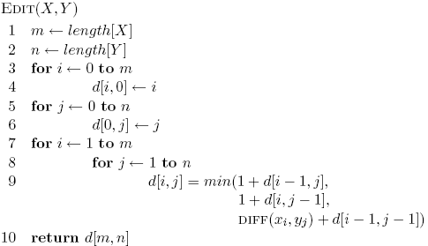
2: DP solution (bottom-up)

Slide 76
3: analysis
Space requirements?
Running time?

Slide 77
3: analysis
Space requirements: Θ(nm)
Running time: Θ(nm)

Slide 78
Edit distance variants
Only include insertions and deletions
What does this do to substitutions?
Include swaps, i.e. swapping two adjacent characters counts as one edit
Weight insertion, deletion and substitution differently
Weight specific character insertion, deletion and substitutions differently
Length normalize the edit distance

Slide 79
Skiers and Skis
Skis: 1 5 5 7 9 12 12 13
Skiers: 6 7 7 10 12
What is the optimal matching?

