Slide 1
algorithms
David Kauchak CS 140 – Fall 2022

Slide 2
Introductions
Dr. | Prof | Professor
Dave | Kauchak
Pronouns: he/him/his

Slide 3
Algorithms
“For me, great algorithms are the poetry of computation. Just like verse, they can be terse, allusive, dense and even mysterious. But once unlocked, they cast a brilliant new light on some aspect of computing.” – Francis Sullivan
What is an algorithm?

Slide 4
Example algorithms
sort a list of numbers
find a route from one place to another (cars, packet routing, phone routing, ...)
find the longest common substring between two strings
add two numbers
microchip wiring/design (VLSI)
solve sudoku
cryptography
compression (file, audio, video)
spell checking
pagerank
classify a web page

Slide 5
To the course webpage…

Slide 7
Pseudocode
A way to discuss how an algorithm works that is language agnostic and without being encumbered with actual implementation details.
Should give enough detail for a person to undersand, analyze and implement the algorithm.

Slide 8
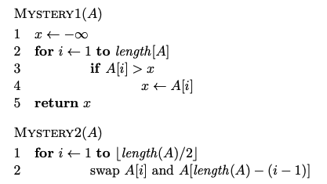
Pseudocode examples

Slide 9
Pseudocode convections
array indices start at 1 not 0
we may use notation such as ∞, which, when translated to
code, would be something like Integer.MAX VALUE
use shortcuts for simple function (e.g. swap) to make pseudocode simpler
we’ll often use ← instead of = to avoid ambiguity
indentation specifies scope

Slide 10
Proofs
What is a proof?
A deductive argument showing a statement is true based on previous knowledge (axioms)
Why are they important/useful?
Allows us to be sure that something is true
In algs: allow us to prove properties of algorithms

Slide 11
An example
Prove the sum of two odd integers is even

Slide 12
Proof techniques?
example/counterexample
enumeration
by cases
by inference (aka direct proof)
trivially
contrapositive
contradiction
induction (strong and weak)

Slide 13
Proof by induction (weak)
Proving something about a sequence of events by:
first: proving that some starting case is true and
then: proving that if a given event in the sequence were true then the next event would be true

Slide 14
Proof by induction (weak)
Base case: prove some starting case is true
Inductive case: Assume some event is true and prove the next event is true
Inductive hypothesis: Assume the event is true (usually k or k-1)
Inductive step to prove: What you’re trying to prove assuming the inductive hypothesis is true
Proof of inductive step

Slide 15
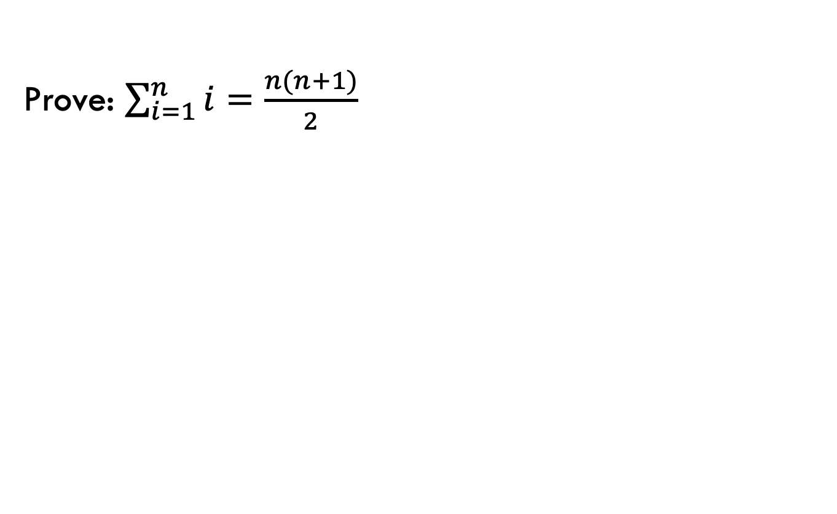
Proof by induction example
Prove: $\sum_{i=1}^{n}{i=\frac{n(n+1)}{2}}$
Base case: prove some starting case is true
Inductive case: Assume some event is true and prove the next event is true
Inductive hypothesis: Assume the event is true (usually k or k-1)
Inductive step to prove: What you’re trying to prove assuming the inductive hypothesis is true
Proof of inductive step

Slide 16
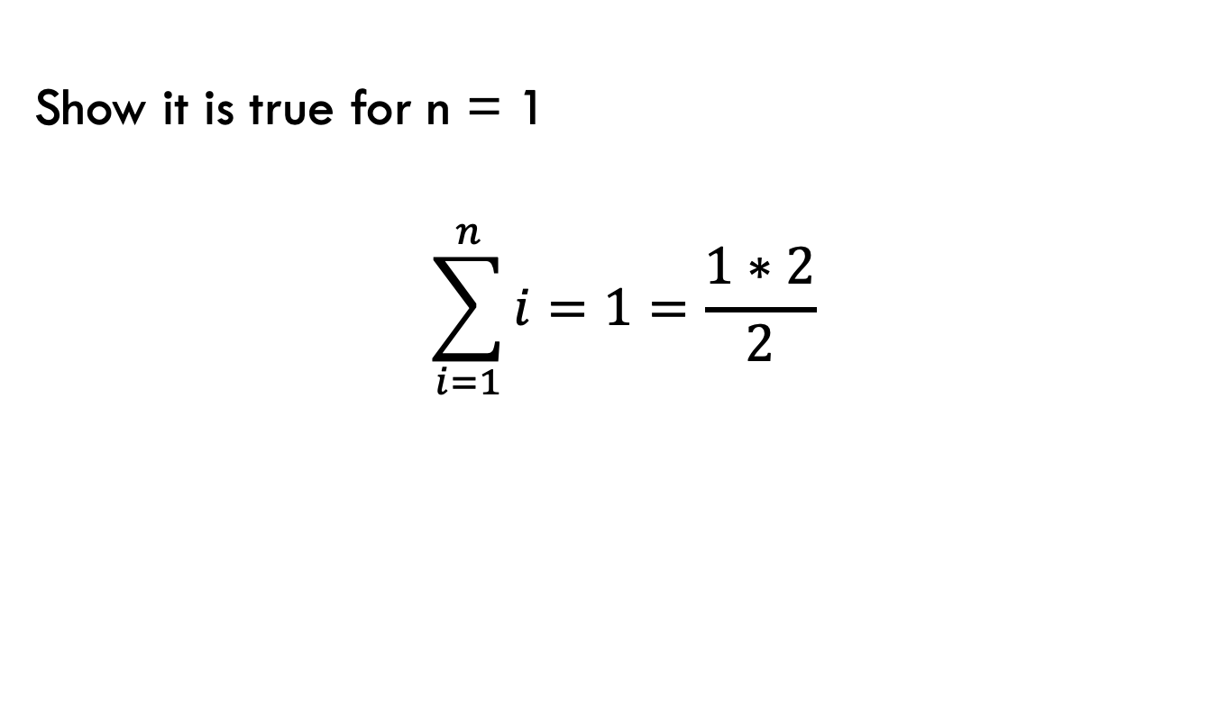
Base case
Prove: $\sum_{i=1}^{n}{i=\frac{n(n+1)}{2}}$
Show it is true for n = 1
$$\sum_{i=1}^{n}{i}=1=\frac{1∗2}{2}$$

Slide 17
Inductive case
Prove: $\sum_{i=1}^{n}{i=\frac{n(n+1)}{2}}$
Inductive hypothesis: assume n = k – 1 is true
$$\sum_{i=1}^{k−1}{i}=\frac{(k−1)∗k}{2}$$

Slide 18
Inductive case
Prove: $\sum_{i=1}^{n}{i=\frac{n(n+1)}{2}}$
Inductive hypothesis: assume n = k – 1 is true
$$\sum_{i=1}^{k−1}{i}=\frac{(k−1)k}{2}$$
Prove:
$$\sum_{i=1}^{k}{i}=\frac{k(k+1)}{2}$$

Slide 19
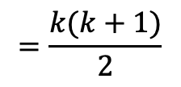
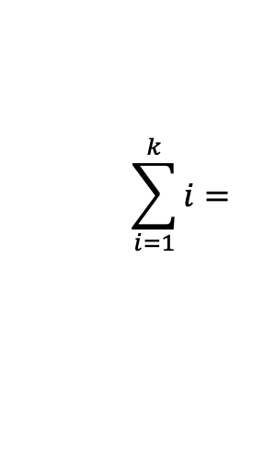
Inductive case: proof
Prove: $\sum_{i=1}^{n}{i=\frac{n\left(n+1\right)}{2}}$ IH: $\sum_{i=1}^{k−1}{i}=\frac{(k−1)k}{2}$
$$\sum_{i=1}^{k}{i}=$$
$$=\frac{k(k+1)}{2}$$

Slide 20
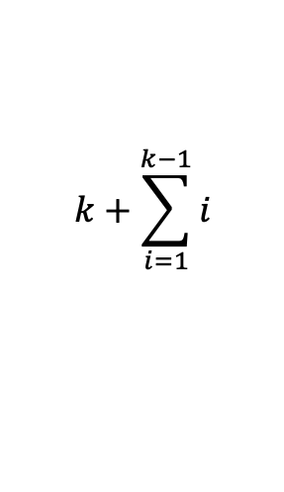
Inductive case: proof
Prove: $\sum_{i=1}^{n}{i=\frac{n\left(n+1\right)}{2}}$ IH: $\sum_{i=1}^{k−1}{i}=\frac{(k−1)k}{2}$
$$\sum_{i=1}^{k}{i}=$$
$$k+\sum_{i=1}^{k−1}{i}$$
by definition of sum
$=k+$ $\frac{(k−1)∗k}{2}$
by IH
$=\frac{2k}{2}+$ $\frac{(k−1)∗k}{2}$
$=$ $\frac{2k+ (k−1)∗k}{2}$
Why does this work?
$=$ $\frac{k2+k}{2}$
$$=\frac{k(k+1)}{2}$$

Slide 21
Sorting
Input: An array of numbers A
Output: The number in sorted order, i.e.,

Slide 22
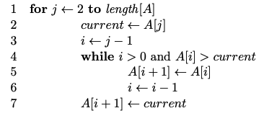
Sorting
What sorting algorithm?

Slide 23
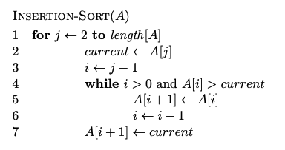
Sorting

Slide 24
Does it terminate?
Is it correct?
How long does it take to run?
Memory usage?

