Slide 1
shortest paths
David Kauchak
CS 140 – Spring 2023

Slide 2
Admin
Assignment 9
No office hours Friday

Slide 3
Minimum spanning trees
What is the lowest weight set of edges that connects all vertices of an undirected graph with positive weights
Input: An undirected, positive weight graph, G=(V,E)
Output: A tree T=(V,E’) where E’ ⊆ E that minimizes

Slide 4
MST example
1
A
C
E
3
4
4
4
2
5
B
D
F
4
6
1
A
C
E
4
4
2
5
B
D
F

Slide 5
Minimum cut property
Given a partition S, let edge e be the minimum cost edge that crosses the partition. Every minimum spanning tree contains edge e.
1
A
C
E
3
4
4
4
2
5
B
D
F
4
6

Slide 6
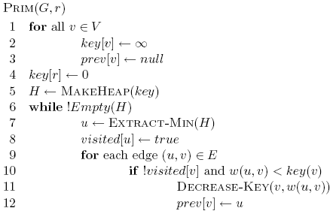
Prim’s algorithm
Start at some root node and build out the MST by adding the lowest weighted edge out of the MST constructed so far

Slide 7
Correctness of Prim’s?
Can we use the min-cut property?
  Given a partion S, let edge e be the minimum cost edge that crosses the partition. Every minimum spanning tree contains edge e.
Let S be the set of vertices visited so far
The only time we add a new edge is if it’s the lowest weight edge from S to V-S

Slide 8
Prim’s
1
A
C
E
3
5
4
4
4
3
MST
1
5
4
B
D
F
2
6
A
C
E
B
D
F
4
3
0

Slide 9
Running time of Prim’s

Slide 10
Running time of Prim’s
Θ(|V|)
1 call to MakeHeap
|V| calls to Extract-Min
|E| calls to Decrease-Key

Slide 11
Running time of Prim’s
1 MakeHeap
|V| ExtractMin
|E| DecreaseKey
Total
Array
θ(|V|)
O(|V|²)
O(|E|)
O(|V|²)
Bin heap
θ(|V|)
O(|V| log |V|)
O(|E| log |V|)
O((|V|+|E|) log |V|)
O(|E| log |V|)
Fib heap
θ(|V|)
O(|V| log |V|)
O(|E|)
O(|V| log |V| + |E|)
Kruskal’s: O(|E| log |E| )

Slide 12
Running time of Prim’s
When should we use Kruskal’s or Prim’s?
1 MakeHeap
|V| ExtractMin
|E| DecreaseKey
Total
Array
θ(|V|)
O(|V|²)
O(|E|)
O(|V|²)
Bin heap
θ(|V|)
O(|V| log |V|)
O(|E| log |V|)
O((|V|+|E|) log |V|)
O(|E| log |V|)
Fib heap
θ(|V|)
O(|V| log |V|)
O(|E|)
O(|V| log |V| + |E|)
Kruskal’s: O(|E| log |E| )

Slide 13
Shortest paths
What is the shortest path from a to d?
B
D
A
C
E

Slide 14
Shortest paths
How can we find this?
B
D
A
C
E

Slide 15
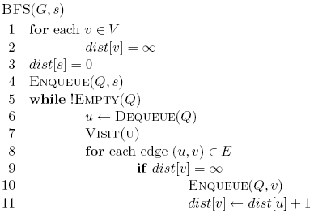
Shortest paths
BFS
B
D
A
C
E

Slide 16
Shortest paths
What is the shortest path from a to d?
2
B
D
3
3
A
1
2
1
C
E
4

Slide 17
Shortest paths
What is the shortest path from a to d?
2
B
D
3
3
A
1
2
1
C
E
4

Slide 18
Shortest path algorithms?

Slide 19
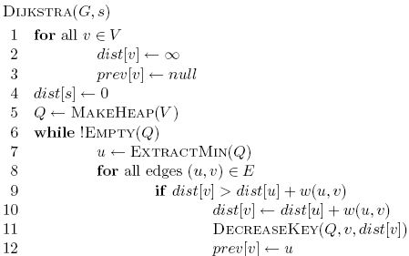
Dijkstra’s algorithm
What is dist?
What is prev?
How does it work?
What is the run-time?
How do we get the shortest path?

Slide 20
Dijkstra’s algorithm

Slide 21
Dijkstra’s algorithm
prev keeps track of
the shortest path

Slide 22
Dijkstra’s algorithm

Slide 23
Dijkstra’s algorithm

Slide 24
Dijkstra’s algorithm

Slide 25
3
B
D
3
1
A
1
2
1
C
E
4

Slide 26
∞
∞
3
B
D
3
∞
1
A
1
2
∞
1
C
E
∞
4

Slide 27
Heap
A 0
B ∞
C ∞
D ∞
E ∞
∞
∞
3
B
D
3
0
1
A
1
2
∞
1
C
E
∞
4

Slide 28
Heap
B ∞
C ∞
D ∞
E ∞
∞
∞
3
B
D
3
0
1
A
1
2
∞
1
C
E
∞
4

Slide 29
Heap
B ∞
C ∞
D ∞
E ∞
∞
∞
3
B
D
3
0
1
A
1
2
∞
1
C
E
∞
4

Slide 30
Heap
C 1
B ∞
D ∞
E ∞
∞
∞
3
B
D
3
0
1
A
1
2
1
1
C
E
∞
4

Slide 31
Heap
C 1
B ∞
D ∞
E ∞
∞
∞
3
B
D
3
0
1
A
1
2
1
1
C
E
∞
4

Slide 32
Heap
C 1
B 3
D ∞
E ∞
3
∞
3
B
D
3
0
1
A
1
2
1
1
C
E
∞
4

Slide 33
Heap
C 1
B 3
D ∞
E ∞
3
∞
3
B
D
3
0
1
A
1
2
1
1
C
E
∞
4

Slide 34
Heap
B 3
D ∞
E ∞
3
∞
3
B
D
3
0
1
A
1
2
1
1
C
E
∞
4

Slide 35
Heap
B 3
D ∞
E ∞
3
∞
3
B
D
3
0
1
A
1
2
1
1
C
E
∞
4

Slide 36
Heap
B 3
D ∞
E ∞
3
∞
3
B
D
3
0
1
A
1
2
1
1
C
E
∞
4

Slide 37
Heap
B 2
D ∞
E ∞
2
∞
3
B
D
3
0
1
A
1
2
1
1
C
E
∞
4

Slide 38
Heap
B 2
D ∞
E ∞
2
∞
3
B
D
3
0
1
A
1
2
1
1
C
E
∞
4

Slide 39
Heap
B 2
E 5
D ∞
2
∞
3
B
D
3
0
1
A
1
2
1
1
C
E
5
4

Slide 40
Heap
E 3
D 5
2
5
3
B
D
3
0
1
A
1
2
1
1
C
E
3
4

Slide 41
Heap
D 5
2
5
3
B
D
3
0
1
A
1
2
1
1
C
E
3
4

Slide 42
Heap
2
5
3
B
D
3
0
1
A
1
2
1
1
C
E
3
4

Slide 43
Heap
2
5
3
Prev
B
D
0
1
A
1
1
1
C
E
3

Slide 44
Heap
2
5
3
Prev
B
D
0
1
How do we get the actual paths?
A
1
1
1
C
E
3

Slide 45
Is Dijkstra’s algorithm correct?
Invariant: For every vertex removed from the heap, dist[v] is the actual shortest distance from s to v
proof?

Slide 46
Is Dijkstra’s algorithm correct?
Invariant: For every vertex removed from the heap, dist[v] is the actual shortest distance from s to v
  The only time a vertex gets visited is when the distance from s to that vertex is smaller than the distance to any remaining vertex
  Therefore, there cannot be any other path that hasn’t been visited already that would result in a shorter path

Slide 47
Running time?

Slide 48
Running time?
1 call to MakeHeap

Slide 49
Running time?
|V| iterations

Slide 50
Running time?
|V| calls

Slide 51
Running time?
O(|E|) calls

Slide 52
Running time?
Depends on the heap implementation
1 MakeHeap
|V| ExtractMin
|E| DecreaseKey
Total
Array
O(|V|)
O(|V|²)
O(|E|)
O(|V|²)
Bin heap
O(|V|)
O(|V| log |V|)
O(|E| log |V|)
O((|V|+|E|) log |V|)
O(|E| log |V|)

Slide 53
Running time?
Depends on the heap implementation
1 MakeHeap
|V| ExtractMin
|E| DecreaseKey
Total
Array
O(|V|)
O(|V|²)
O(|E|)
O(|V|²)
Bin heap
O(|V|)
O(|V| log |V|)
O(|E| log |V|)
O((|V|+|E|) log |V|)
O(|E| log |V|)
Is this an improvement?
If |E| < |V|² / log |V|

Slide 54
Running time?
Depends on the heap implementation
1 MakeHeap
|V| ExtractMin
|E| DecreaseKey
Total
Array
O(|V|)
O(|V|²)
O(|E|)
O(|V|²)
Bin heap
O(|V|)
O(|V| log |V|)
O(|E| log |V|)
O((|V|+|E|) log |V|)
O(|E| log |V|)
Fib heap
O(|V|)
O(|V| log |V|)
O(|E|)
O(|V| log |V| + |E|)

Slide 55
Dijkstra’s vs Prim’s

Slide 56
What about Dijkstra’s on…?
1
1
B
D
A
5
10
-10
C
E

Slide 57
What about Dijkstra’s on…?
Dijkstra’s algorithm only works for positive edge weights
1
1
B
D
A
5
10
C
E

Slide 58
Is Dijkstra’s algorithm correct?
Invariant: For every vertex removed from the heap, dist[v] is the actual shortest distance from s to v
  The only time a vertex gets visited is when the distance from s to that vertex is smaller than the distance to any remaining vertex
  Therefore, there cannot be any other path that hasn’t been visited already that would result in a shorter path
We relied on having positive edge weights for correctness!

Slide 59
Bounding the distance
Another invariant: For each vertex v, dist[v] is an upper bound on the actual shortest distance
Is this a valid invariant?

Slide 60
Bounding the distance
Another invariant: For each vertex v, dist[v] is an upper bound on the actual shortest distance
  start off at ∞
  only update the value if we find a shorter distance
An update procedure

Slide 61
Can we ever go wrong applying this update rule?
  We can apply this rule as many times as we want and will never underestimate dist[v]
When will dist[v] be right?
  If u is along the shortest path to v and dist[u] is correct

Slide 62
dist[v] will be right if u is along the shortest path to v and dist[u] is correct
Consider the shortest path from s to v
s
p₁
p₂
p₃
p_{k}
v

Slide 63
dist[v] will be right if u is along the shortest path to v and dist[u] is correct
What happens if we update all of the vertices with the above update?
s
p₁
p₂
p₃
p_{k}
v

Slide 64
dist[v] will be right if u is along the shortest path to v and dist[u] is correct
What happens if we update all of the vertices with the above update?
s
p₁
p₂
p₃
p_{k}
v
correct

Slide 65
dist[v] will be right if u is along the shortest path to v and dist[u] is correct
What happens if we update all of the vertices with the above update?
s
p₁
p₂
p₃
p_{k}
v
correct
correct

Slide 66
dist[v] will be right if u is along the shortest path to v and dist[u] is correct
Does the order that we update the vertices matter?
s
p₁
p₂
p₃
p_{k}
v
correct
correct
Notes:
yes! If we did it in the order of the correct path, we’d be done.

Slide 67
dist[v] will be right if u is along the shortest path to v and dist[u] is correct
How many times do we have to do this for vertex p_{i} to have the correct shortest path from s?
  i times
s
p₁
p₂
p₃
p_{k}
v

Slide 68
dist[v] will be right if u is along the shortest path to v and dist[u] is correct
How many times do we have to do this for vertex p_{i} to have the correct shortest path from s?
  i times
s
p₁
p₂
p₃
p_{k}
v
correct
correct

Slide 69
dist[v] will be right if u is along the shortest path to v and dist[u] is correct
How many times do we have to do this for vertex p_{i} to have the correct shortest path from s?
  i times
s
p₁
p₂
p₃
p_{k}
v
correct
correct
correct

Slide 70
dist[v] will be right if u is along the shortest path to v and dist[u] is correct
How many times do we have to do this for vertex p_{i} to have the correct shortest path from s?
  i times
s
p₁
p₂
p₃
p_{k}
v
correct
correct
correct
correct

Slide 71
dist[v] will be right if u is along the shortest path to v and dist[u] is correct
How many times do we have to do this for vertex p_{i} to have the correct shortest path from s?
  i times
s
p₁
p₂
p₃
p_{k}
v
…
correct
correct
correct
correct

Slide 72
dist[v] will be right if u is along the shortest path to v and dist[u] is correct
What is the longest (vertex-wise) the path from s to any node v can be?
  |V| - 1 edges/vertices
s
p₁
p₂
p₃
p_{k}
v
…
correct
correct
correct
correct

Slide 73
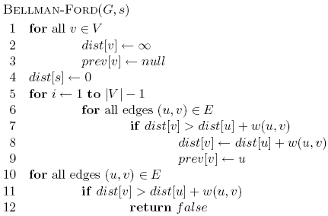
Bellman-Ford algorithm

Slide 74
Bellman-Ford algorithm
Initialize all the distances
do it |V| -1 times
iterate over all edges/vertices and apply update rule

Slide 75
Bellman-Ford algorithm
check for negative cycles

Slide 76
Negative cycles
What is the shortest path from a to e?
1
1
B
D
A
5
10
-10
C
E
3

Slide 77
Bellman-Ford algorithm

Slide 78
Bellman-Ford algorithm
10
How many edges is the shortest path from s to:
S
A
8
1
G
-4
B
A:
2
1
1
-2
B:
F
C
-1
3
E
D
D:
-1

Slide 79
Bellman-Ford algorithm
10
How many edges is the shortest path from s to:
S
A
8
1
G
-4
B
A:
3
2
1
1
-2
C
F
-1
3
E
D
-1

Slide 80
Bellman-Ford algorithm
10
How many edges is the shortest path from s to:
S
A
8
1
G
-4
B
A:
3
2
1
1
-2
B:
F
C
-1
3
E
D
-1

Slide 81
Bellman-Ford algorithm
10
How many edges is the shortest path from s to:
S
A
8
1
G
-4
B
A:
3
2
1
1
-2
B:
5
F
C
-1
3
E
D
-1

Slide 82
Bellman-Ford algorithm
10
How many edges is the shortest path from s to:
S
A
8
1
G
-4
B
A:
3
2
1
1
-2
B:
5
F
C
-1
3
E
D
D:
-1

Slide 83
Bellman-Ford algorithm
10
How many edges is the shortest path from s to:
S
A
8
1
G
-4
B
A:
3
2
1
1
-2
B:
5
F
C
-1
3
E
D
D:
7
-1

Slide 84
Bellman-Ford algorithm
0
∞
10
S
A
Iteration: 0
8
1
∞
∞
G
-4
B
2
1
1
-2
C
∞
F
∞
-1
3
E
D
-1
∞
∞

Slide 85
Bellman-Ford algorithm
0
10
10
S
A
Iteration: 1
8
1
∞
8
G
-4
B
2
1
1
-2
C
∞
F
∞
-1
3
E
D
-1
∞
∞

Slide 86
Bellman-Ford algorithm
0
10
10
S
A
Iteration: 2
8
1
∞
8
G
-4
B
2
1
1
-2
C
∞
F
9
-1
3
E
D
-1
12
∞

Slide 87
Bellman-Ford algorithm
0
5
10
S
A
Iteration: 3
8
1
10
8
G
-4
B
A has the correct distance and path
2
1
1
-2
C
∞
F
9
-1
3
E
D
-1
8
∞

Slide 88
Bellman-Ford algorithm
0
5
10
S
A
Iteration: 4
8
1
6
8
G
-4
B
2
1
1
-2
C
11
F
9
-1
3
E
D
-1
7
∞

Slide 89
Bellman-Ford algorithm
0
5
10
S
A
Iteration: 5
8
1
5
8
G
-4
B
B has the correct distance and path
2
1
1
-2
C
7
F
9
-1
3
E
D
-1
7
14

Slide 90
Bellman-Ford algorithm
0
5
10
S
A
Iteration: 6
8
1
5
8
G
-4
B
2
1
1
-2
C
6
F
9
-1
3
E
D
-1
7
10

Slide 91
Bellman-Ford algorithm
0
5
10
S
A
Iteration: 7
8
1
5
8
G
-4
B
D (and all other nodes) have the correct distance and path
2
1
1
-2
C
6
F
9
-1
3
E
D
-1
7
9

Slide 92
Correctness of Bellman-Ford
Loop invariant: After iteration i, all vertices with shortest paths from s of length i edges or less have correct distances

Slide 93
Runtime of Bellman-Ford
O(|V| |E|)

Slide 94
Runtime of Bellman-Ford
Can you modify the algorithm to run faster (in some circumstances)?

Slide 95
Shortest Paths
2
B
D
-1
1
3
-3
A
2
4
C
E
5
What is the shortest path from A to E?

Slide 96
Shortest Paths
2
B
D
-1
1
3
-3
A
2
4
C
E
5
-2

Slide 97
Shortest Paths
2
B
D
-1
1
3
-3
A
2
4
C
E
5
What algorithm would we use to calculate this?

Slide 98
Shortest Paths
2
B
D
-1
1
3
-3
A
2
4
C
E
5
Bellman-Ford (since the graph has negative edges)
O(VE)

Slide 99
Shortest Paths
2
B
D
-1
1
3
-3
A
2
4
C
E
5
Bellman-Ford (since the graph has negative edges)
O(VE)
Called a single-source shortest path algorithm. Why?

Slide 100
Shortest Paths
2
B
D
-1
1
3
-3
A
2
4
C
E
5
Bellman-Ford (since the graph has negative edges)
O(VE)
Calculate all paths from a single vertex.

Slide 101
Shortest Paths
2
B
D
-1
1
3
-3
A
2
4
C
E
5
What is the shortest path from A to C?
If we already calculated A to E using Bellman-Ford do we need to do any work?

Slide 102
Shortest Paths
2
B
D
-1
1
3
-3
A
2
4
C
E
5
No new calculations!
Bellman-Ford calculates all shortest paths starting at A.

Slide 103
Shortest Paths
2
B
D
-1
1
3
-3
A
2
4
C
E
5
What is the shortest path from D to C?
If we already calculated A to E using Bellman-Ford do we need to do any work?

Slide 104
Shortest Paths
2
B
D
-1
1
3
-3
A
2
4
C
E
5
Different source.
Have to run Bellman-Ford again!

Slide 105
All pairs shortest paths
All pairs shortest paths: calculate the shortest paths between all vertices
2
B
D
-1
1
3
-3
A
2
4
C
E
5

Slide 106
All pairs shortest paths
All pairs shortest paths: calculate the shortest paths between all vertices
Easy solution?

Slide 107
All pairs shortest paths
All pairs shortest paths: calculate the shortest paths between all vertices
Run Bellman-Ford from each vertex!
Running time (in terms of E and V)?

Slide 108
All pairs shortest paths
All pairs shortest paths: calculate the shortest paths between all vertices
Run Bellman-Ford from each vertex!
O(V²E)
Bellman-Ford: O(VE)
V calls, one for each vertex

Slide 109
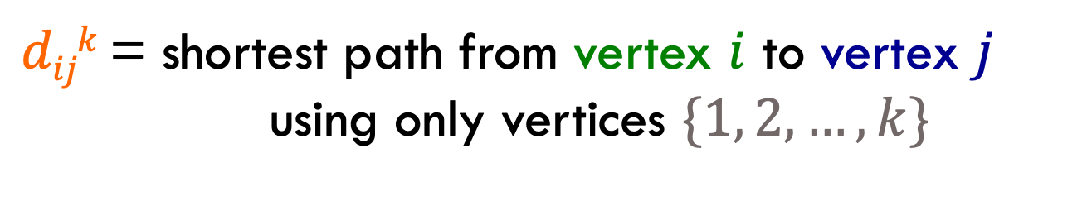
Floyd-Warshall: key idea
Label all vertices with a number from 1 to V
$dijk$ = shortest path from vertex $i$ to vertex $j$
using only vertices $\{1, 2, …, k\}$

Slide 110
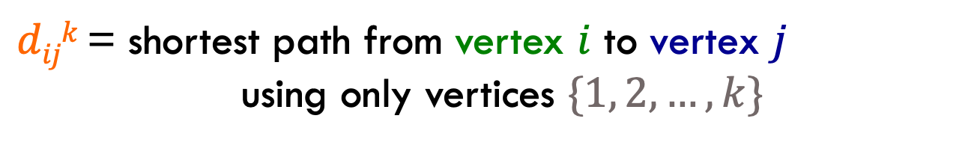
Floyd-Warshall: key idea
$dijk$ = shortest path from vertex $i$ to vertex $j$
using only vertices $\{1, 2, …, k\}$
2
3
4
-1
1
3
-3
1
2
4
2
5
5
What is d₁₅²?
What is d₄₁⁴?
What is d₁₅³?

Slide 111
Floyd-Warshall: key idea
$dijk$ = shortest path from vertex $i$ to vertex $j$
using only vertices $\{1, 2, …, k\}$
2
3
4
-1
1
3
-3
1
2
4
2
5
5
What is d₁₅²?

Slide 112
Floyd-Warshall: key idea
$dijk$ = shortest path from vertex $i$ to vertex $j$
using only vertices $\{1, 2, …, k\}$
2
3
4
-1
1
3
-3
1
2
4
2
5
5
d₁₅² = 9. Can only use 2.

Slide 113
Floyd-Warshall: key idea
$dijk$ = shortest path from vertex $i$ to vertex $j$
using only vertices $\{1, 2, …, k\}$
2
3
4
-1
1
3
-3
1
2
4
2
5
5
What is d₁₅³?

Slide 114
Floyd-Warshall: key idea
$dijk$ = shortest path from vertex $i$ to vertex $j$
using only vertices $\{1, 2, …, k\}$
2
3
4
-1
1
3
-3
1
2
4
2
5
5
d₁₅³ = 1. Can’t use vertex 4.

Slide 115
Floyd-Warshall: key idea
$dijk$ = shortest path from vertex $i$ to vertex $j$
using only vertices $\{1, 2, …, k\}$
2
3
4
-1
1
3
-3
1
2
4
2
5
5
What is d₄₁⁴?

Slide 116
Floyd-Warshall: key idea
$dijk$ = shortest path from vertex $i$ to vertex $j$
using only vertices $\{1, 2, …, k\}$
2
3
4
-1
1
3
-3
1
2
4
2
5
5
d₄₁⁴ = ∞. No possible path.

Slide 117
Floyd-Warshall: key idea
$dijk$ = shortest path from vertex $i$ to vertex $j$
using only vertices $\{1, 2, …, k\}$
2
3
4
-1
1
3
-3
1
2
4
2
5
5
What is d₃₃⁵?

Slide 118
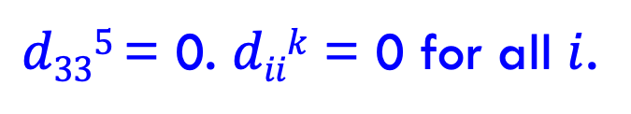
Floyd-Warshall: key idea
$dijk$ = shortest path from vertex $i$ to vertex $j$
using only vertices $\{1, 2, …, k\}$
2
3
4
-1
1
3
-3
1
2
4
2
5
5
$d335$ = 0. $diik$ = 0 for all $i$.

Slide 119


Floyd-Warshall: key idea
Label all vertices with a number from 1 to V
$dijk$ = shortest path from vertex $i$ to vertex $j$
using only vertices $\{1, 2, …, k\}$
If we want all possibilities, how many values are there (i.e. what is the size of $dijk$)?

Slide 120
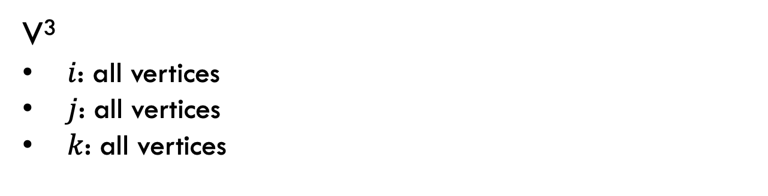
Floyd-Warshall: key idea
Label all vertices with a number from 1 to V
$dijk$ = shortest path from vertex $i$ to vertex $j$
using only vertices $\{1, 2, …, k\}$
V³
$i$: all vertices
$j$: all vertices
$k$: all vertices

Slide 121
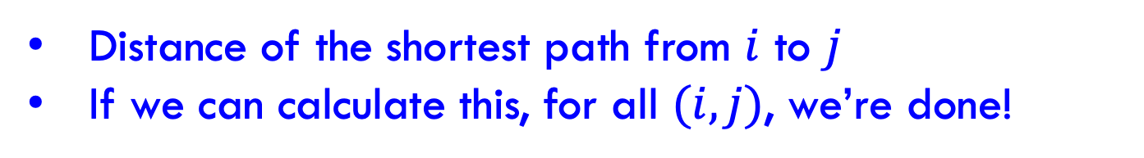

Floyd-Warshall: key idea
Label all vertices with a number from 1 to V
$dijk$ = shortest path from vertex $i$ to vertex $j$
using only vertices $\{1, 2, …, k\}$
What is $dijV$?
Distance of the shortest path from $i$ to $j$
If we can calculate this, for all $(i,j)$, we’re done!

Slide 122

Recursive relationship
$dijk$ = shortest path from vertex $i$ to vertex $j$
using only vertices $\{1, 2, …, k\}$
Assume we know $dijk$
How can we calculate ${dij}^{k+1}$, i.e. shortest path now including vertex k+1? (Hint: in terms of $dijk$)
Two options:
Vertex k+1 doesn’t give us a shorter path
Vertex k+1 does give us a shorter path

Slide 123
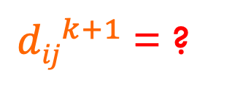
Recursive relationship
$dijk$ = shortest path from vertex $i$ to vertex $j$
using only vertices $\{1, 2, …, k\}$
Two options:
Vertex k+1 doesn’t give us a shorter path
Vertex k+1 does give us a shorter path
${dij}^{k+1}$= ?

Slide 124
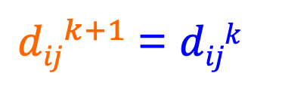
Recursive relationship
$dijk$ = shortest path from vertex $i$ to vertex $j$
using only vertices $\{1, 2, …, k\}$
Two options:
Vertex k+1 doesn’t give us a shorter path
Vertex k+1 does give us a shorter path
${dij}^{k+1}$= $dijk$

Slide 125
Recursive relationship
$dijk$ = shortest path from vertex $i$ to vertex $j$
using only vertices $\{1, 2, …, k\}$
Two options:
Vertex k+1 doesn’t give us a shorter path
Vertex k+1 does give us a shorter path
${dij}^{k+1}$= ?

Slide 126
Recursive relationship
$dijk$ = shortest path from vertex $i$ to vertex $j$
using only vertices $\{1, 2, …, k\}$
Two options:
Vertex k+1 doesn’t give us a shorter path
Vertex k+1 does give us a shorter path
${dij}^{k+1}$= ?
i
k+1
J
some vertices {1…k}
some vertices {1…k}
What is the cost of this path?

Slide 127
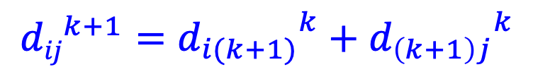
Recursive relationship
$dijk$ = shortest path from vertex $i$ to vertex $j$
using only vertices $\{1, 2, …, k\}$
Two options:
Vertex k+1 doesn’t give us a shorter path
Vertex k+1 does give us a shorter path
$${dij}^{k+1}={d_{i(k+1)}}^{k}+{d_{\left(k+1\right)j}}^{k}$$
i
k+1
J
some vertices {1…k}
some vertices {1…k}
d_{i(k+1)}^{k}
d_{(k+1)j}^{k}
+

Slide 128
Recursive relationship
$dijk$ = shortest path from vertex $i$ to vertex $j$
using only vertices $\{1, 2, …, k\}$
Two options:
Vertex k+1 doesn’t give us a shorter path
Vertex k+1 does give us a shorter path
${dij}^{k+1}$= ?
How do we combine these two options?

Slide 129
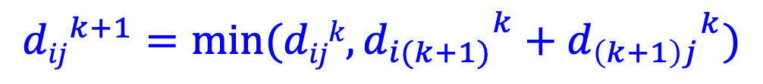
Recursive relationship
$dijk$ = shortest path from vertex $i$ to vertex $j$
using only vertices $\{1, 2, …, k\}$
Two options:
Vertex k+1 doesn’t give us a shorter path
Vertex k+1 does give us a shorter path
$${dij}^{k+1}={{min⁡(dijk,d}_{i(k+1)}}^{k}+{d_{\left(k+1\right)j}}^{k})$$
Pick whichever is shorter

Slide 130
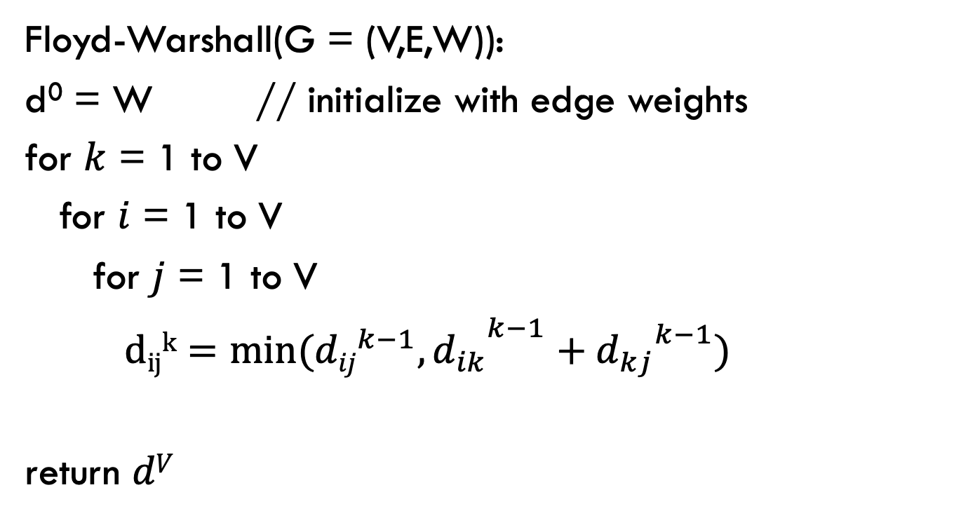
Floyd-Warshall
Calculate $dijk$ for increasing k, i.e. k = 1 to V
Floyd-Warshall(G = (V,E,W)):
d⁰ = W // initialize with edge weights
for $k$ = 1 to V
for $i$ = 1 to V
for $j$ = 1 to V
${{ dijk=min⁡({dij}^{k−1},d}_{ik}}^{k−1}+{d_{kj}}^{k−1})$
return $dV$

Slide 131
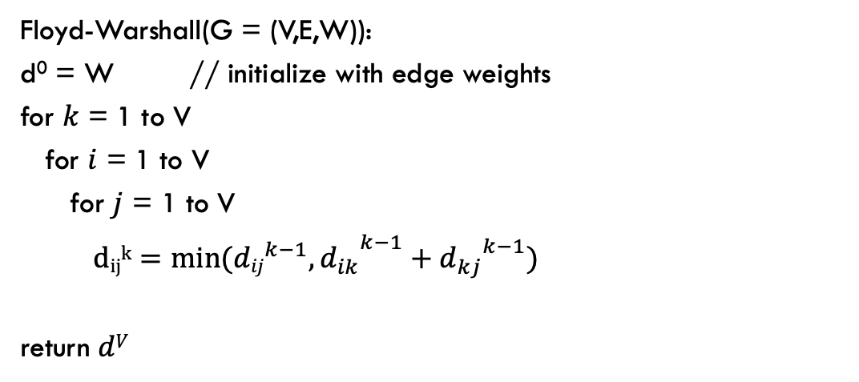
Floyd-Warshall(G = (V,E,W)):
d⁰ = W // initialize with edge weights
for $k$ = 1 to V
for $i$ = 1 to V
for $j$ = 1 to V
${{ dijk=min⁡({dij}^{k−1},d}_{ik}}^{k−1}+{d_{kj}}^{k−1})$
return $dV$
2
3
4
-1
1
3
-3
1
2
4
2
5
5
k = 0
k = 1
1 2 3 4 5
1 2 3 4 5
1
1
2
2
3
3
4
4
5
5
adjacency matrix
no change

Slide 132
Floyd-Warshall(G = (V,E,W)):
d⁰ = W // initialize with edge weights
for $k$ = 1 to V
for $i$ = 1 to V
for $j$ = 1 to V
${{ dijk=min⁡({dij}^{k−1},d}_{ik}}^{k−1}+{d_{kj}}^{k−1})$
return $dV$
2
3
4
-1
1
3
-3
1
2
4
2
5
5
k = 1
k = 2
1 2 3 4 5
1 2 3 4 5
1
1
2
2
3
3
4
4
5
5

Slide 133
Floyd-Warshall(G = (V,E,W)):
d⁰ = W // initialize with edge weights
for $k$ = 1 to V
for $i$ = 1 to V
for $j$ = 1 to V
${{ dijk=min⁡({dij}^{k−1},d}_{ik}}^{k−1}+{d_{kj}}^{k−1})$
return $dV$
2
3
4
-1
1
3
-3
1
2
4
2
5
5
k = 1
k = 2
1 2 3 4 5
1 2 3 4 5
1
1
2
2
3
3
4
4
5
5
minimum

Slide 134
Floyd-Warshall(G = (V,E,W)):
d⁰ = W // initialize with edge weights
for $k$ = 1 to V
for $i$ = 1 to V
for $j$ = 1 to V
${{ dijk=min⁡({dij}^{k−1},d}_{ik}}^{k−1}+{d_{kj}}^{k−1})$
return $dV$
2
3
4
-1
1
3
-3
1
2
4
2
5
5
k = 2
k = 3
1 2 3 4 5
1 2 3 4 5
1
1
2
2
3
3
4
4
5
5

Slide 135
Floyd-Warshall(G = (V,E,W)):
d⁰ = W // initialize with edge weights
for $k$ = 1 to V
for $i$ = 1 to V
for $j$ = 1 to V
${{ dijk=min⁡({dij}^{k−1},d}_{ik}}^{k−1}+{d_{kj}}^{k−1})$
return $dV$
2
3
4
-1
1
3
-3
1
2
4
2
5
5
k = 2
k = 3
1 2 3 4 5
1 2 3 4 5
1
1
2
2
3
3
4
4
5
5
minimum
Found a shorter path!

Slide 136
Floyd-Warshall(G = (V,E,W)):
d⁰ = W // initialize with edge weights
for $k$ = 1 to V
for $i$ = 1 to V
for $j$ = 1 to V
${{ dijk=min⁡({dij}^{k−1},d}_{ik}}^{k−1}+{d_{kj}}^{k−1})$
return $dV$
2
3
4
-1
1
3
-3
1
2
4
2
5
5
k = 2
k = 3
1 2 3 4 5
1 2 3 4 5
1
1
2
2
3
3
4
4
5
5

Slide 137
Floyd-Warshall(G = (V,E,W)):
d⁰ = W // initialize with edge weights
for $k$ = 1 to V
for $i$ = 1 to V
for $j$ = 1 to V
${{ dijk=min⁡({dij}^{k−1},d}_{ik}}^{k−1}+{d_{kj}}^{k−1})$
return $dV$
2
3
4
-1
1
3
-3
1
2
4
2
5
5
k = 2
k = 3
1 2 3 4 5
1 2 3 4 5
1
1
2
2
3
3
4
4
5
5

Slide 138
Floyd-Warshall(G = (V,E,W)):
d⁰ = W // initialize with edge weights
for $k$ = 1 to V
for $i$ = 1 to V
for $j$ = 1 to V
${{ dijk=min⁡({dij}^{k−1},d}_{ik}}^{k−1}+{d_{kj}}^{k−1})$
return $dV$
2
3
4
-1
1
3
-3
1
2
4
2
5
5
k = 2
k = 3
1 2 3 4 5
1 2 3 4 5
1
1
2
2
3
3
4
4
5
5
minimum

Slide 139
Floyd-Warshall(G = (V,E,W)):
d⁰ = W // initialize with edge weights
for $k$ = 1 to V
for $i$ = 1 to V
for $j$ = 1 to V
${{ dijk=min⁡({dij}^{k−1},d}_{ik}}^{k−1}+{d_{kj}}^{k−1})$
return $dV$
2
3
4
-1
1
3
-3
1
2
4
2
5
5
k = 2
k = 3
1 2 3 4 5
1 2 3 4 5
1
1
2
2
3
3
4
4
5
5

Slide 140
Floyd-Warshall(G = (V,E,W)):
d⁰ = W // initialize with edge weights
for $k$ = 1 to V
for $i$ = 1 to V
for $j$ = 1 to V
${{ dijk=min⁡({dij}^{k−1},d}_{ik}}^{k−1}+{d_{kj}}^{k−1})$
return $dV$
2
3
4
-1
1
3
-3
1
2
4
2
5
5
k = 2
k = 3
1 2 3 4 5
1 2 3 4 5
1
1
2
2
3
3
4
4
5
5

Slide 141
Floyd-Warshall(G = (V,E,W)):
d⁰ = W // initialize with edge weights
for $k$ = 1 to V
for $i$ = 1 to V
for $j$ = 1 to V
${{ dijk=min⁡({dij}^{k−1},d}_{ik}}^{k−1}+{d_{kj}}^{k−1})$
return $dV$
2
3
4
-1
1
3
-3
1
2
4
2
5
5
k = 2
k = 3
1 2 3 4 5
1 2 3 4 5
1
1
2
2
3
3
4
4
5
5
minimum
Found a shorter path!

Slide 142
Floyd-Warshall(G = (V,E,W)):
d⁰ = W // initialize with edge weights
for $k$ = 1 to V
for $i$ = 1 to V
for $j$ = 1 to V
${{ dijk=min⁡({dij}^{k−1},d}_{ik}}^{k−1}+{d_{kj}}^{k−1})$
return $dV$
2
3
4
-1
1
3
-3
1
2
4
2
5
5
k = 2
k = 3
1 2 3 4 5
1 2 3 4 5
1
1
2
2
3
3
4
4
5
5

Slide 143
Floyd-Warshall(G = (V,E,W)):
d⁰ = W // initialize with edge weights
for $k$ = 1 to V
for $i$ = 1 to V
for $j$ = 1 to V
${{ dijk=min⁡({dij}^{k−1},d}_{ik}}^{k−1}+{d_{kj}}^{k−1})$
return $dV$
2
3
4
-1
1
3
-3
1
2
4
2
5
5
k = 3
k = 4
1 2 3 4 5
1 2 3 4 5
1
1
2
2
3
3
4
4
5
5

Slide 144
Floyd-Warshall(G = (V,E,W)):
d⁰ = W // initialize with edge weights
for $k$ = 1 to V
for $i$ = 1 to V
for $j$ = 1 to V
${{ dijk=min⁡({dij}^{k−1},d}_{ik}}^{k−1}+{d_{kj}}^{k−1})$
return $dV$
2
3
4
-1
1
3
-3
1
2
4
2
5
5
k = 3
k = 4
1 2 3 4 5
1 2 3 4 5
1
1
2
2
3
3
4
4
5
5
minimum
Found a shorter path!

Slide 145
Floyd-Warshall(G = (V,E,W)):
d⁰ = W // initialize with edge weights
for $k$ = 1 to V
for $i$ = 1 to V
for $j$ = 1 to V
${{ dijk=min⁡({dij}^{k−1},d}_{ik}}^{k−1}+{d_{kj}}^{k−1})$
return $dV$
2
3
4
-1
1
3
-3
1
2
4
2
5
5
k = 3
k = 4
1 2 3 4 5
1 2 3 4 5
1
1
2
2
3
3
4
4
5
5

Slide 146
Floyd-Warshall(G = (V,E,W)):
d⁰ = W // initialize with edge weights
for $k$ = 1 to V
for $i$ = 1 to V
for $j$ = 1 to V
${{ dijk=min⁡({dij}^{k−1},d}_{ik}}^{k−1}+{d_{kj}}^{k−1})$
return $dV$
2
3
4
-1
1
3
-3
1
2
4
2
5
5
k = 3
k = 4
1 2 3 4 5
1 2 3 4 5
1
1
2
2
3
3
4
4
5
5

Slide 147
Floyd-Warshall(G = (V,E,W)):
d⁰ = W // initialize with edge weights
for $k$ = 1 to V
for $i$ = 1 to V
for $j$ = 1 to V
${{ dijk=min⁡({dij}^{k−1},d}_{ik}}^{k−1}+{d_{kj}}^{k−1})$
return $dV$
2
3
4
-1
1
3
-3
1
2
4
2
5
5
k = 3
k = 4
1 2 3 4 5
1 2 3 4 5
1
1
2
2
3
3
4
4
5
5
minimum
Found a shorter path!

Slide 148
Floyd-Warshall(G = (V,E,W)):
d⁰ = W // initialize with edge weights
for $k$ = 1 to V
for $i$ = 1 to V
for $j$ = 1 to V
${{ dijk=min⁡({dij}^{k−1},d}_{ik}}^{k−1}+{d_{kj}}^{k−1})$
return $dV$
2
3
4
-1
1
3
-3
1
2
4
2
5
5
k = 3
k = 4
1 2 3 4 5
1 2 3 4 5
1
1
2
2
3
3
4
4
5
5

Slide 149
Floyd-Warshall(G = (V,E,W)):
d⁰ = W // initialize with edge weights
for $k$ = 1 to V
for $i$ = 1 to V
for $j$ = 1 to V
${{ dijk=min⁡({dij}^{k−1},d}_{ik}}^{k−1}+{d_{kj}}^{k−1})$
return $dV$
2
3
4
-1
1
3
-3
1
2
4
2
5
5
k = 4
k = 5
1 2 3 4 5
1 2 3 4 5
1
1
2
2
3
3
4
4
5
5
Done!

Slide 150
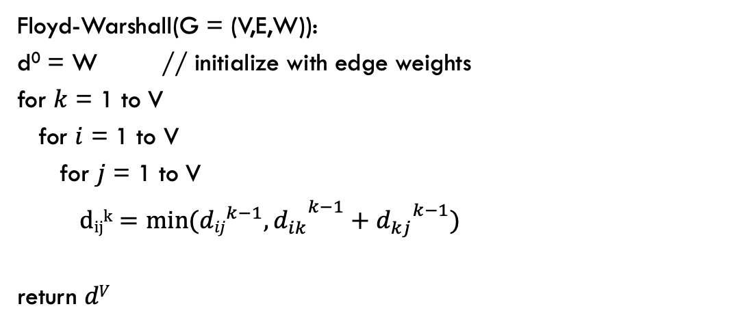
Floyd-Warshall analysis
Is it correct?
Floyd-Warshall(G = (V,E,W)):
d⁰ = W // initialize with edge weights
for $k$ = 1 to V
for $i$ = 1 to V
for $j$ = 1 to V
${{ dijk=min⁡({dij}^{k−1},d}_{ik}}^{k−1}+{d_{kj}}^{k−1})$
return $dV$

Slide 151
Floyd-Warshall analysis
Is it correct?
Any assumptions?
Floyd-Warshall(G = (V,E,W)):
d⁰ = W // initialize with edge weights
for $k$ = 1 to V
for $i$ = 1 to V
for $j$ = 1 to V
${{ dijk=min⁡({dij}^{k−1},d}_{ik}}^{k−1}+{d_{kj}}^{k−1})$
return $dV$

Slide 152
Floyd-Warshall analysis
Is it correct?
Assuming the graph has no negative cycles!
What happens if there is a negative cycle?
Floyd-Warshall(G = (V,E,W)):
d⁰ = W // initialize with edge weights
for $k$ = 1 to V
for $i$ = 1 to V
for $j$ = 1 to V
${{ dijk=min⁡({dij}^{k−1},d}_{ik}}^{k−1}+{d_{kj}}^{k−1})$
return $dV$

Slide 153
Floyd-Warshall analysis
If the graph has a negative weight cycle, at the end, at least one of the diagonal entries will be a negative number, i.e., we there’s a way to get back to a vertex using all of the vertices that results in a negative weight
1 2 3 4 5
1
2
3
4
5

Slide 154
Floyd-Warshall analysis
Run-time?
Floyd-Warshall(G = (V,E,W)):
d⁰ = W // initialize with edge weights
for $k$ = 1 to V
for $i$ = 1 to V
for $j$ = 1 to V
${{ dijk=min⁡({dij}^{k−1},d}_{ik}}^{k−1}+{d_{kj}}^{k−1})$
return $dV$

Slide 155
Floyd-Warshall analysis
Run-time: θ(V³)
Floyd-Warshall(G = (V,E,W)):
d⁰ = W // initialize with edge weights
for $k$ = 1 to V
for $i$ = 1 to V
for $j$ = 1 to V
${{ dijk=min⁡({dij}^{k−1},d}_{ik}}^{k−1}+{d_{kj}}^{k−1})$
return $dV$

Slide 156
Floyd-Warshall analysis
What type of algorithm is Floyd-Warshall?
Floyd-Warshall(G = (V,E,W)):
d⁰ = W // initialize with edge weights
for $k$ = 1 to V
for $i$ = 1 to V
for $j$ = 1 to V
${{ dijk=min⁡({dij}^{k−1},d}_{ik}}^{k−1}+{d_{kj}}^{k−1})$
return $dV$

Slide 157
Floyd-Warshall analysis
Dynamic programming!!
Build up solutions to larger problems using solutions to smaller problems. Use a table to store the values.
Floyd-Warshall(G = (V,E,W)):
d⁰ = W // initialize with edge weights
for $k$ = 1 to V
for $i$ = 1 to V
for $j$ = 1 to V
${{ dijk=min⁡({dij}^{k−1},d}_{ik}}^{k−1}+{d_{kj}}^{k−1})$
return $dV$

Slide 158
Floyd-Warshall analysis
Space usage?
Floyd-Warshall(G = (V,E,W)):
d⁰ = W // initialize with edge weights
for $k$ = 1 to V
for $i$ = 1 to V
for $j$ = 1 to V
${{ dijk=min⁡({dij}^{k−1},d}_{ik}}^{k−1}+{d_{kj}}^{k−1})$
return $dV$

Slide 159


Floyd-Warshall: key idea
Label all vertices with a number from 1 to V
$dijk$ = shortest path from vertex $i$ to vertex $j$
using only vertices $\{1, 2, …, k\}$
If we want all possibilities, how many values are there (i.e. what is the size of $dijk$)?

Slide 160
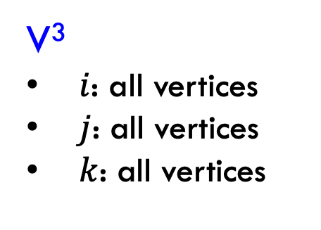
Floyd-Warshall: key idea
Label all vertices with a number from 1 to V
$dijk$ = shortest path from vertex $i$ to vertex $j$
using only vertices $\{1, 2, …, k\}$
V³
$i$: all vertices
$j$: all vertices
$k$: all vertices
Can we do better?

Slide 161
Floyd-Warshall analysis
Space usage: θ(V²)
Only need the current value and the previous
Floyd-Warshall(G = (V,E,W)):
d⁰ = W // initialize with edge weights
for $k$ = 1 to V
for $i$ = 1 to V
for $j$ = 1 to V
${{ dijk=min⁡({dij}^{k−1},d}_{ik}}^{k−1}+{d_{kj}}^{k−1})$
return $dV$

Slide 162
All pairs shortest paths
V * Bellman-Ford: O(V²E)
Floyd-Warshall: θ(V³)

Slide 163
All pairs shortest paths
All pairs shortest paths for positive weight graphs: calculate the shortest paths between all points
Easy solution?

Slide 164
All pairs shortest paths
All pairs shortest paths for positive weight graphs: calculate the shortest paths between all points
Run Dijsktras from each vertex!
Running time (in terms of E and V)?

Slide 165
All pairs shortest paths
All pairs shortest paths for positive weight graphs: calculate the shortest paths between all points
Run Dijsktras from each vertex!
O(V² log V + V E)
V calls do Dijkstras
Dijkstras: O(V log V + E)

Slide 166
All pairs shortest paths
V * Bellman-Ford: O(V²E)
Floyd-Warshall: θ(V³)
V * Dijkstras: O(V² log V + V E)
Is this any better?

Slide 167
All pairs shortest paths
V * Bellman-Ford: O(V²E)
Floyd-Warshall: θ(V³)
V * Dijkstras: O(V² log V + V E)
If the graph is sparse!

Slide 168
All pairs shortest paths
All pairs shortest paths for positive weight graphs: calculate the shortest paths between all points
Run Dijsktras from each vertex!
Challenge: Dijkstras assumes positive weights

Slide 169
Johnson’s: key idea
Reweight the graph to make all edges positive such that shortest paths are preserved
0
2
B
D
B
D
1
-1
0
1
1
0
3
-3
A
3
A
2
4
C
E
4
C
E
8
5

Slide 170
Lemma
let h be any function mapping a vertex to a real value
If we change the graph weights as:
The shortest paths are preserved
Notes:
CLRS has proof

Slide 171
Lemma: proof
Let s, v₁, v₂, …, v_{k}, t be a path from s to t
The weight in the reweighted graph is:
…

Slide 172
Lemma: proof
Claim: the weight change preserves shortest paths, i.e. if a path was the shortest from s to t in the original graph it will still be the shortest path from s to t in the new graph.
Justification?

Slide 173
Lemma: proof
Claim: the weight change preserves shortest paths, i.e. if a path was the shortest from s to t in the original graph it will still be the shortest path from s to t in the new graph.
h(s) – h(t) is a constant and will be the same for all paths from s to t, so the absolute ordering of all paths from s to t will not change.

Slide 174
Lemma
let h be any function mapping a vertex to a real value
If we change the graph weights as:
The shortest paths are preserved
Big question: how do we pick h?
Notes:
CLRS has proof

Slide 175
Selecting h
Need to pick h such that the resulting graph has all weights as positive
0
2
B
D
B
D
1
-1
0
1
1
0
3
-3
A
3
A
2
4
C
E
4
C
E
8
5

Slide 176
Johnson’s algorithm
Create G’ with one extra node s with 0 weight edges to all nodes
run Bellman-Ford(G’,s)
if no negative-weight cycle
  reweight edges in G with h(v)=shortest path from s to v
  run Dijkstra’s from every vertex
  reweight shortest paths based on G

Slide 177
Create G’
run Bellman-Ford(G’,s)
if no negative-weight cycle
  reweight edges in G with h(v)=shortest path from s to v
  run Dijkstra’s from every vertex
  reweight shortest paths based on G
S
0
0
0
0
2
B
D
0
2
-1
B
D
-1
1
3
-3
1
A
2
3
-3
A
2
4
C
E
4
C
E
5
5

Slide 178
Create G’
run Bellman-Ford(G’,s)
if no negative-weight cycle
  reweight edges in G with h(v)=shortest path from s to v
  run Dijkstra’s from every vertex
  reweight shortest paths based on G
S
0
0
S➔A: ?
S➔B:
S➔C:
S➔D:
S➔E:
0
0
0
2
B
D
-1
1
3
-3
A
2
4
C
E
5

Slide 179
Create G’
run Bellman-Ford(G’,s)
if no negative-weight cycle
  reweight edges in G with h(v)=shortest path from s to v
  run Dijkstra’s from every vertex
  reweight shortest paths based on G
S
0
0
S➔A: 0
S➔B:
S➔C:
S➔D:
S➔E:
0
0
0
2
B
D
-1
1
3
-3
A
2
4
C
E
5

Slide 180
Create G’
run Bellman-Ford(G’,s)
if no negative-weight cycle
  reweight edges in G with h(v)=shortest path from s to v
  run Dijkstra’s from every vertex
  reweight shortest paths based on G
S
0
0
S➔A: 0
S➔B: ?
S➔C:
S➔D:
S➔E:
0
0
0
2
B
D
-1
1
3
-3
A
2
4
C
E
5

Slide 181
Create G’
run Bellman-Ford(G’,s)
if no negative-weight cycle
  reweight edges in G with h(v)=shortest path from s to v
  run Dijkstra’s from every vertex
  reweight shortest paths based on G
S
0
0
S➔A: 0
S➔B: -2
S➔C:
S➔D:
S➔E:
0
0
0
2
B
D
-1
1
3
-3
A
2
4
C
E
5

Slide 182
Create G’
run Bellman-Ford(G’,s)
if no negative-weight cycle
  reweight edges in G with h(v)=shortest path from s to v
  run Dijkstra’s from every vertex
  reweight shortest paths based on G
S
0
0
S➔A: 0
S➔B: -2
S➔C: 0
S➔D: 0
S➔E: -3
0
0
0
2
B
D
-1
1
3
-3
A
2
4
C
E
5

Slide 183
S➔A: 0
S➔B: -2
S➔C: 0
S➔D: 0
S➔E: -3
-2
0
2
B
D
-1
0
1
3
-3
A
2
4
C
E
5
-3
0

Slide 184
Create G’
run Bellman-Ford(G’,s)
if no negative-weight cycle
  reweight edges in G with h(v)=shortest path from s to v
  run Dijkstra’s from every vertex
  reweight shortest paths based on G
-2
0
2
B
D
B
D
-1
?
0
1
3
-3
A
A
2
4
C
E
C
E
5
-3
0

Slide 185
Create G’
run Bellman-Ford(G’,s)
if no negative-weight cycle
  reweight edges in G with h(v)=shortest path from s to v
  run Dijkstra’s from every vertex
  reweight shortest paths based on G
-1 + 0 - -2
-2
0
2
B
D
B
D
-1
1
0
1
3
-3
A
A
2
4
C
E
C
E
5
-3
0

Slide 186
Create G’
run Bellman-Ford(G’,s)
if no negative-weight cycle
  reweight edges in G with h(v)=shortest path from s to v
  run Dijkstra’s from every vertex
  reweight shortest paths based on G
-2
0
2
?
B
D
B
D
-1
1
0
1
3
-3
A
A
2
4
C
E
C
E
5
-3
0

Slide 187
Create G’
run Bellman-Ford(G’,s)
if no negative-weight cycle
  reweight edges in G with h(v)=shortest path from s to v
  run Dijkstra’s from every vertex
  reweight shortest paths based on G
2 + -2 - 0
-2
0
2
0
B
D
B
D
-1
1
0
1
3
-3
A
A
2
4
C
E
C
E
5
-3
0

Slide 188
Create G’
run Bellman-Ford(G’,s)
if no negative-weight cycle
  reweight edges in G with h(v)=shortest path from s to v
  run Dijkstra’s from every vertex
  reweight shortest paths based on G
-2
0
2
0
B
D
B
D
-1
1
0
1
3
-3
A
A
2
?
4
C
E
C
E
5
-3
0

Slide 189
Create G’
run Bellman-Ford(G’,s)
if no negative-weight cycle
  reweight edges in G with h(v)=shortest path from s to v
  run Dijkstra’s from every vertex
  reweight shortest paths based on G
4 + 0 - 0
-2
0
2
0
B
D
B
D
-1
1
0
1
3
-3
A
A
2
4
4
C
E
C
E
5
-3
0

Slide 190
Create G’
run Bellman-Ford(G’,s)
if no negative-weight cycle
  reweight edges in G with h(v)=shortest path from s to v
  run Dijkstra’s from every vertex
  reweight shortest paths based on G
-2
0
2
0
B
D
B
D
-1
1
0
1
3
-3
A
A
2
4
4
C
?
E
C
E
5
-3
0

Slide 191
Create G’
run Bellman-Ford(G’,s)
if no negative-weight cycle
  reweight edges in G with h(v)=shortest path from s to v
  run Dijkstra’s from every vertex
  reweight shortest paths based on G
5 + 0 - -3
-2
0
2
0
B
D
B
D
-1
1
0
1
3
-3
A
A
2
4
4
C
8
E
C
E
5
-3
0

Slide 192
Create G’
run Bellman-Ford(G’,s)
if no negative-weight cycle
  reweight edges in G with h(v)=shortest path from s to v
  run Dijkstra’s from every vertex
  reweight shortest paths based on G
-2
0
2
0
B
D
B
D
-1
1
0
1
0
3
-3
1
0
A
2
A
3
4
C
E
4
C
E
5
-3
8
0

Slide 193
Create G’
run Bellman-Ford(G’,s)
if no negative-weight cycle
  reweight edges in G with h(v)=shortest path from s to v
  run Dijkstra’s from every vertex
  reweight shortest paths based on G
0
B
D
1
0
1
0
A
3
4
C
E
8

Slide 194
Create G’
run Bellman-Ford(G’,s)
if no negative-weight cycle
  reweight edges in G with h(v)=shortest path from s to v
  run Dijkstra’s from every vertex
  reweight shortest paths based on G
0
B
D
1
1
0
A
C
E

Slide 195
Create G’
run Bellman-Ford(G’,s)
if no negative-weight cycle
  reweight edges in G with h(v)=shortest path from s to v
  run Dijkstra’s from every vertex
  reweight shortest paths based on G
-2
0
2
2
B
D
B
D
-1
-1
0
1
3
-3
-3
A
2
A
3
4
C
E
C
E
5
-3
0

Slide 196
A➔B: -1
A➔C: 2
A➔D: 1
A➔E: -2
-2
0
2
2
B
D
B
D
-1
-1
0
1
3
-3
-3
A
2
A
3
4
C
E
C
E
5
-3
0

Slide 197
Selecting h
Need to pick h such that the resulting graph has all weights as positive
Create G’ with one extra node s with 0 weight edges to all nodes
run Bellman-Ford(G’,s)
if no negative-weight cycle
  reweight edges in G with h(v)=shortest path from s to v
  run Dijkstra’s from every vertex
  reweight shortest paths based on G
Why does this work (i.e. how do we guarantee that reweighted graph has only positive edges)?

Slide 198
Reweighted graph is positive
Take two nodes u and v
h(u) shortest distance from s to u
h(v) shortest distance from s to v
Claim:
Why?

Slide 199
Reweighted graph is positive
Take two nodes u and v
h(u) shortest distance from s to u
h(v) shortest distance from s to v
Claim:
If this weren’t true, we could have made a shorter path s to v using u
… but this is in contradiction with how we defined h(v)

Slide 200
Reweighted graph is positive
Take two nodes u and v
h(u) shortest distance from s to u
h(v) shortest distance from s to v
What is this?

Slide 201
Reweighted graph is positive
Take two nodes u and v
h(u) shortest distance from s to u
h(v) shortest distance from s to v
All edge weights in reweighted graph are non-negative

Slide 202
Johnson’s algorithm
Create G’
run Bellman-Ford(G’,s)
if no negative-weight cycle
  reweight edges in G
  run Dijkstra’s from every vertex
  reweight shortest paths based on G
Run-time?

Slide 203
Johnson’s algorithm
Create G’
run Bellman-Ford(G’,s)
if no negative-weight cycle
  reweight edges in G
  run Dijkstra’s from every vertex
  reweight shortest paths based on G
θ(V)
O(V²)
θ(E)
O(V²logV+VE)
θ(E)
Run-time?

Slide 204
All pairs shortest paths
V * Bellman-Ford: O(V²E)
Floyd-Warshall: θ(V³)
Johnson’s: O(V² log V + V E)

