Slide 1
Dynamic programming:
More fun!
David Kauchak
CS 140 – Fall 2022

Slide 2
Admin
Assignment 7

Slide 3
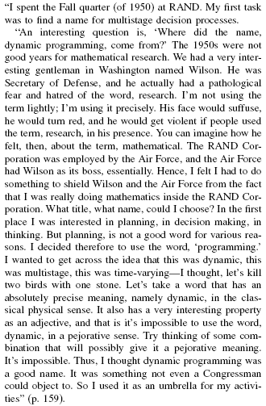
Where did “dynamic programming” come from?
Richard Bellman On the Birth of Dynamic Programming
Stuart Dreyfus
http://www.eng.tau.ac.il/~ami/cd/or50/1526-5463-2002-50-01-0048.pdf

Slide 4
Dynamic programming
Method for solving problems where optimal solutions can be defined in terms of optimal solutions to subproblems
AND
the subproblems are overlapping

Slide 5
Dynamic programming: steps
1a) optimal substructure: optimal solutions to the problem incorporate optimal solutions to related subproblems
  convince yourself that there is optimal substructure
1b) recursive definition: use this to recursively define the value of an optimal solution
2) DP solution: describe the dynamic programming table:
  size, initial values, order in which it’s filled in, location of solution
3) Analysis: analyze space requirements, running time

Slide 6
LCS problem
Given two sequences X and Y, a common subsequence is a subsequence that occurs in both X and Y
Given two sequences X = x₁, x₂, …, x_{n} and
Y = y₁, y₂, …, y_{n}
What is the longest common subsequence?

Slide 7
Keeping track of the solution
Our LCS algorithm only calculated the length of the LCS between X and Y
What if we wanted to know the actual sequence?

Slide 8
1b: recursive solution
X = A B C B D A B
Y = B D C A B A
Assume you have a solver for smaller problems

Slide 9
1b: recursive solution
X = A B C B D A ?
Y = B D C A B ?
Is the last character part of the LCS?

Slide 10
1b: recursive solution
X = A B C B D A ?
Y = B D C A B ?
Two cases: either the characters are the same or they’re different

Slide 11
1b: recursive solution
X = A B C B D A A
LCS
The characters are part of the LCS
Y = B D C A B A
What is the recursive relationship?
If they’re the same

Slide 12
1b: recursive solution
X = A B C B D A B
LCS
Y = B D C A B A
If they’re different

Slide 13
1b: recursive solution
X = A B C B D A B
LCS
Y = B D C A B A
If they’re different

Slide 14
1b: recursive solution
X = A B C B D A B
Y = B D C A B A
?
X = A B C B D A B
Y = B D C A B A
If they’re different

Slide 15
1b: recursive solution
X = A B C B D A B
Y = B D C A B A
(for now, let’s just worry about counting the length of the LCS)

Slide 16
2: DP solution
What types of subproblem solutions do we need to store?
LCS(X_{1…j}, Y_{1…k})
two different indices

Slide 17
2: DP solution
What types of subproblem solutions do we need to store?
LCS(X_{1…j}, Y_{1…k})

Slide 18
j
0 1 2 3 4 5 6
y_{j} B D C A B A
i
0 x_{i}
1 A
2 B
3 C
4 B
5 D
6 A
7 B
For Fibonacci and tree counting, we had to initialize some entries in the array. Any here?

Slide 19
j
0 1 2 3 4 5 6
y_{j} B D C A B A
i
0 x_{i}
1 A
2 B
3 C
4 B
5 D
6 A
7 B
0 0 0 0 0 0 0
0
0
0
0
0
0
0
Need to initialize values within 1 smaller in either dimension.

Slide 20
j
0 1 2 3 4 5 6
y_{j} B D C A B A
i
0 x_{i}
1 A
2 B
3 C
4 B
5 D
6 A
7 B
0 0 0 0 0 0 0
0
0
0
0
0
0
0
How should we fill in the table?

Slide 21
j
0 1 2 3 4 5 6
y_{j} B D C A B A
i
0 x_{i}
1 A
2 B
3 C
4 B
5 D
6 A
7 B
0 0 0 0 0 0 0
0
0
0 ?
0
0
0
0
To fill in an entry, we may need to look:
up one
left one
diagonal up and left
Just need to make sure these exist

Slide 22
j
0 1 2 3 4 5 6
y_{j} B D C A B A
i
0 x_{i}
1 A
2 B
3 C
4 B
5 D
6 A
7 B
0 0 0 0 0 0 0
0 ?
0
0
0
0
0
0
LCS(A, B)

Slide 23
j
0 1 2 3 4 5 6
y_{j} B D C A B A
i
0 x_{i}
1 A
2 B
3 C
4 B
5 D
6 A
7 B
0 0 0 0 0 0 0
0 0
0
0
0
0
0
0

Slide 24
j
0 1 2 3 4 5 6
y_{j} B D C A B A
i
0 x_{i}
1 A
2 B
3 C
4 B
5 D
6 A
7 B
0 0 0 0 0 0 0
0 0 0 0 ?
0
0
0
0
0
0
LCS(A, BDCA)

Slide 25
j
0 1 2 3 4 5 6
y_{j} B D C A B A
i
0 x_{i}
1 A
2 B
3 C
4 B
5 D
6 A
7 B
0 0 0 0 0 0 0
0 0 0 0 1
0
0
0
0
0
0
LCS(A, BDCA)

Slide 26
j
0 1 2 3 4 5 6
y_{j} B D C A B A
i
0 x_{i}
1 A
2 B
3 C
4 B
5 D
6 A
7 B
0 0 0 0 0 0 0
0 0 0 0 1 1 1
0 1 1 1 1 2 2
0 1 1 2 2 2 2
0 1 1 2 2 ?
0
0
0
LCS(ABCB, BDCAB)

Slide 27
j
0 1 2 3 4 5 6
y_{j} B D C A B A
i
0 x_{i}
1 A
2 B
3 C
4 B
5 D
6 A
7 B
0 0 0 0 0 0 0
0 0 0 0 1 1 1
0 1 1 1 1 2 2
0 1 1 2 2 2 2
0 1 1 2 2 3
0
0
0
LCS(ABCB, BDCAB)

Slide 28
j
0 1 2 3 4 5 6
y_{j} B D C A B A
i
0 x_{i}
1 A
2 B
3 C
4 B
5 D
6 A
7 B
0 0 0 0 0 0 0
0 0 0 0 1 1 1
0 1 1 1 1 2 2
0 1 1 2 2 2 2
0 1 1 2 2 3 3
0 1 2 2 2 3 3
0 1 2 2 3 3 4
0 1 2 2 3 4 4
Where’s the final answer?

Slide 29
j
0 1 2 3 4 5 6
y_{j} B D C A B A
i
Space requirements?
Running time?
0 x_{i}
1 A
2 B
3 C
4 B
5 D
6 A
7 B
0 0 0 0 0 0 0
0 0 0 0 1 1 1
0 1 1 1 1 2 2
0 1 1 2 2 2 2
0 1 1 2 2 3 3
0 1 2 2 2 3 3
0 1 2 2 3 3 4
0 1 2 2 3 4 4

Slide 30
j
0 1 2 3 4 5 6
y_{j} B D C A B A
i
Space requirements: Θ(nm)
Running time: Θ(nm)
0 x_{i}
1 A
2 B
3 C
4 B
5 D
6 A
7 B
0 0 0 0 0 0 0
0 0 0 0 1 1 1
0 1 1 1 1 2 2
0 1 1 2 2 2 2
0 1 1 2 2 3 3
0 1 2 2 2 3 3
0 1 2 2 3 3 4
0 1 2 2 3 4 4

Slide 31
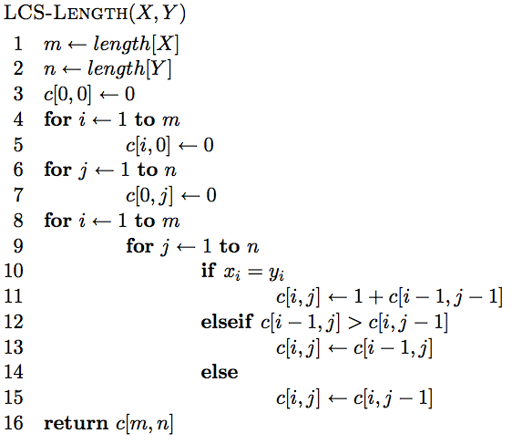
The algorithm

Slide 32
The algorithm
Base case initialization

Slide 33
The algorithm
Fill in the matrix

Slide 34
The algorithm

Slide 35
The algorithm

Slide 36
The algorithm

Slide 37
Keeping track of the solution
Our LCS algorithm only calculated the length of the LCS between X and Y
What if we wanted to know the actual sequence?

Slide 38
j
0 1 2 3 4 5 6
y_{j} B D C A B A
i
0 x_{i}
1 A
2 B
3 C
4 B
5 D
6 A
7 B
0 0 0 0 0 0 0
0 0 0 0 1 1 1
0 1 1 1 1 2 2
0 1 1 2 2 2 2
0 1 1 2 2 ?
0
0
0
LCS(ABCB, BDCAB)

Slide 39
j
0 1 2 3 4 5 6
y_{j} B D C A B A
i
0 x_{i}
1 A
2 B
3 C
4 B
5 D
6 A
7 B
0 0 0 0 0 0 0
0 0 0 0 1 1 1
0 1 1 1 1 2 2
0 1 1 2 2 2 2
0 1 1 2 2 3
0
0
0
LCS(ABCB, BDCAB)

Slide 40
j
0 1 2 3 4 5 6
y_{j} B D C A B A
i
0 x_{i}
1 A
2 B
3 C
4 B
5 D
6 A
7 B
0 0 0 0 0 0 0
0 0 0 0 1 1 1
0 1 1 1 1 2 2
0 1 1 2 2 2 2
0 1 1 2 2 3 ?
0
0
0
LCS(ABCB, BDCABA)

Slide 41
j
0 1 2 3 4 5 6
y_{j} B D C A B A
i
0 x_{i}
1 A
2 B
3 C
4 B
5 D
6 A
7 B
0 0 0 0 0 0 0
0 0 0 0 1 1 1
0 1 1 1 1 2 2
0 1 1 2 2 2 2
0 1 1 2 2 3 3
0
0
0
LCS(ABCB, BDCABA)

Slide 42
j
0 1 2 3 4 5 6
y_{j} B D C A B A
i
0 x_{i}
1 A
2 B
3 C
4 B
5 D
6 A
7 B
0 0 0 0 0 0 0
0 0 0 0 1 1 1
0 1 1 1 1 2 2
0 1 1 2 2 2 2
0 1 1 2 2 3 3
0 1 2 2 2 3 3
0 1 2 2 3 3 4
0 1 2 2 3 4 4
How do we generate the solution from this?

Slide 43
j
0 1 2 3 4 5 6
y_{j} B D C A B A
i
0 x_{i}
1 A
2 B
3 C
4 B
5 D
6 A
7 B
0 0 0 0 0 0 0
0 0 0 0 1 1 1
0 1 1 1 1 2 2
0 1 1 2 2 2 2
0 1 1 2 2 3 3
0 1 2 2 2 3 3
0 1 2 2 3 3 4
0 1 2 2 3 4 4
We can follow the arrows to generate the solution
BCBA

Slide 44
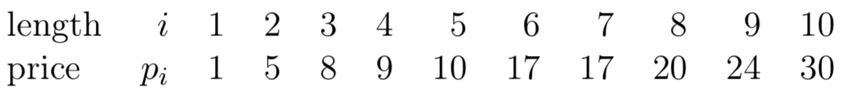
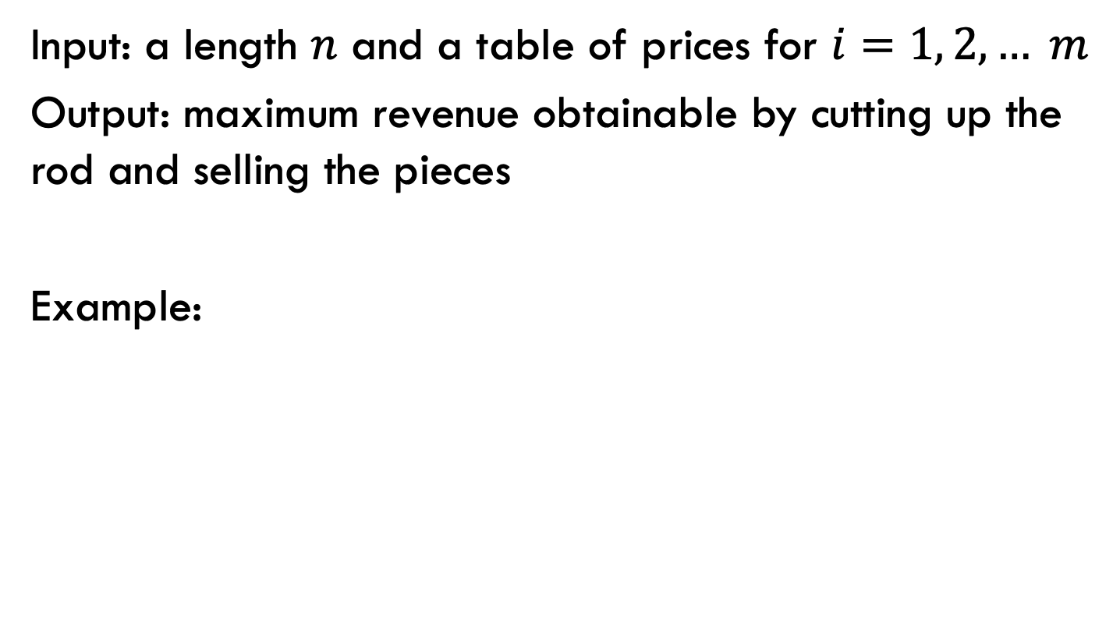
Rod splitting
Input: a length $n$ and a table of prices for $i=1, 2, … m$
Output: maximum revenue obtainable by cutting up the rod and selling the pieces
Example:
3

Slide 45
1a: optimal substructure
Prove: optimal solutions to the problem incorporate optimal solutions to related subproblems
What would a solution look like?

Slide 46
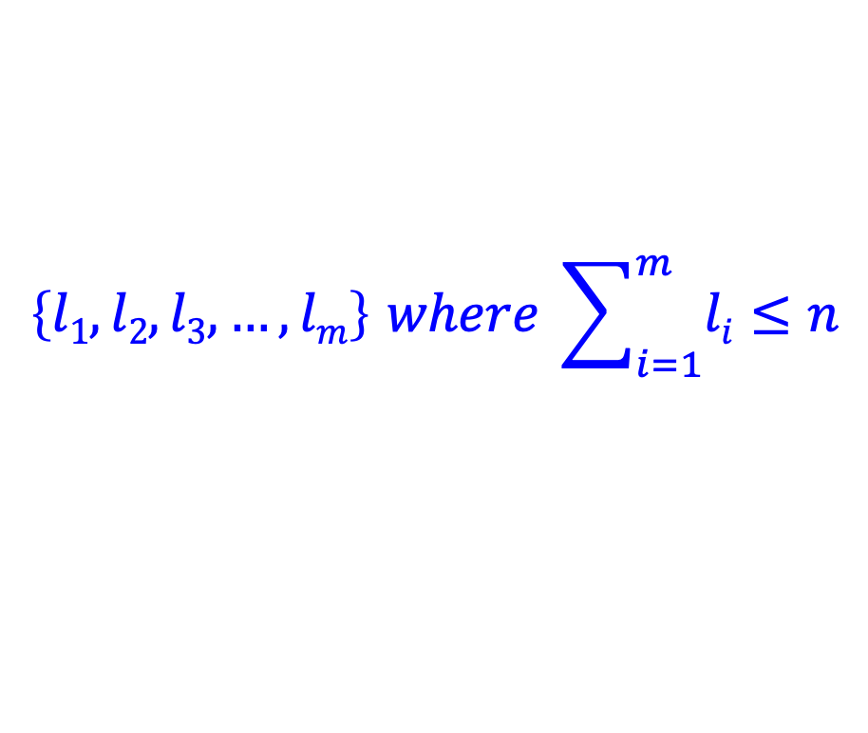
1a: optimal substructure
Prove: optimal solutions to the problem incorporate optimal solutions to related subproblems
3
$$\left\{l1, l2, l3, …, lm\right\} where \sum_{i=1}^{m}{li}≤n$$
What would a subproblem solution look like?

Slide 47
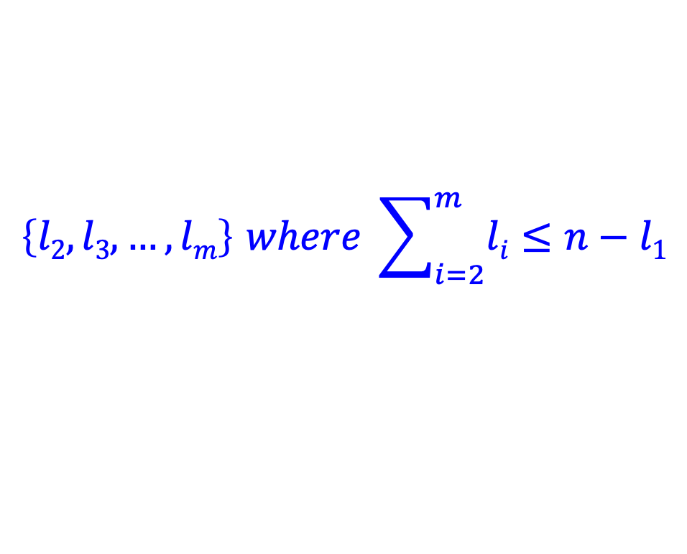
1a: optimal substructure
Prove: optimal solutions to the problem incorporate optimal solutions to related subproblems
$$\left\{l1, l2, l3, …, lm\right\} where \sum_{i=1}^{m}{li}≤n$$
$$\left\{l2, l3, …, lm\right\} where \sum_{i=2}^{m}{li}≤n−l1$$

Slide 48
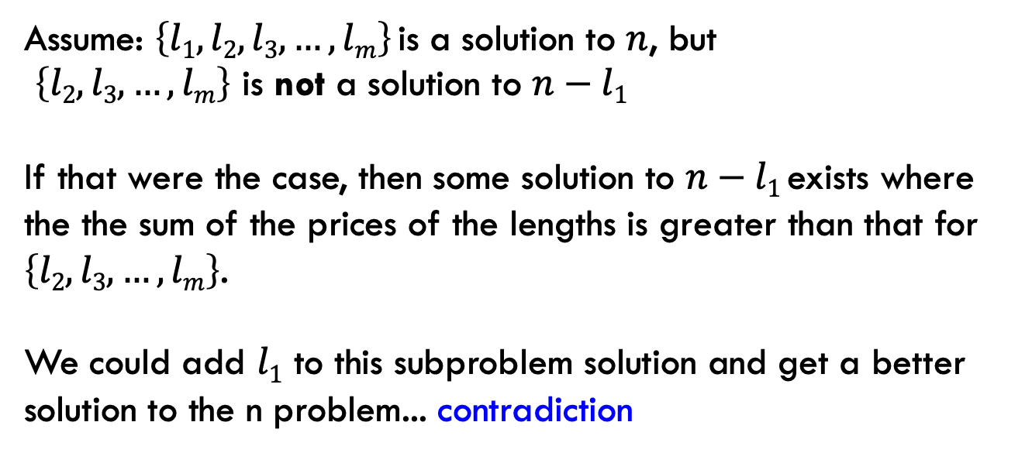
1a: optimal substructure
Prove: optimal solutions to the problem incorporate optimal solutions to related subproblems
Proof by contradiction:
Assume: $\left\{l1, l2, l3, …, lm\right\}$is a solution to $n$, but
$\left\{l2, l3, …, lm\right\}$ is not a solution to $n−l1$
If that were the case, then some solution to $n−l1$exists where the the sum of the prices of the lengths is greater than that for $\left\{l2, l3, …, lm\right\}$.
We could add $l1$ to this subproblem solution and get a better solution to the n problem... contradiction

Slide 49
1b: recursive solution
3
n
What should be the first cut?
What are the options?

Slide 50
1b: recursive solution
3
n
cut 1
price 1
How much is left?

Slide 51
1b: recursive solution
3
n
cut 1
price 1
n-1

Slide 52
1b: recursive solution
3
n
cut 2
price 3
n-2

Slide 53
1b: recursive solution
3
n
Which one should we choose?
…
Pretend like we have a solver (R) that gives us the answer to suproblems.
What would R take as input and return?

Slide 54
1b: recursive solution
3
n
R(x) → price for best set of cuts of length x
(could structure it with the actual cuts, but focusing on just the price is easier for now)
…

Slide 55
1b: recursive solution
3
n
cut 1
price 1
n-1
What’s the best we can do with this cut?

Slide 56
1b: recursive solution
3
n
cut 1
price 1
n-1
1 + R(n-1)

Slide 57
1b: recursive solution
3
n
cut 2
price 3
n-2
What’s the best we can do with this cut?

Slide 58
1b: recursive solution
3
n
cut 2
price 3
n-2
3 + R(n-2)

Slide 59
1b: recursive solution
3
n
What should be the first cut?

Slide 60
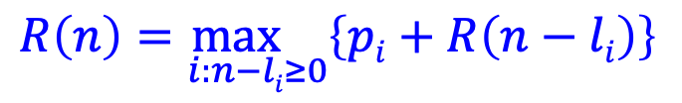
1b: recursive solution
3
n
$$R\left(n\right)=\max_{i:n−li≥0}\left\{pi+R\left(n−li\right)\right\}$$

Slide 61
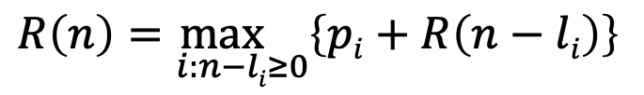
2: DP solution (from the bottom-up)
$$R\left(n\right)=\max_{i:n−li≥0}\left\{pi+R\left(n−li\right)\right\}$$
What are the smallest possible subproblems?
To calculate R(n), what are all the subproblems we need to calculate? This is the “table”.
How should we fill in the table?
Where will the answer be?

Slide 62
2: DP solution (from the bottom-up)
$$R\left(n\right)=\max_{i:n−li≥0}\left\{pi+R\left(n−li\right)\right\}$$
What are the smallest possible subproblems?
R(0) = 0, R(-i) not possible

Slide 63
2: DP solution (from the bottom-up)
$$R\left(n\right)=\max_{i:n−li≥0}\left\{pi+R\left(n−li\right)\right\}$$
To calculate R(n), what are all the subproblems we need to calculate? This is the “table”. R(0)…R(n)
Note: This is filling in a table for all possible integer lengths from 1 to n.

Slide 64
2: DP solution (from the bottom-up)
$$R\left(n\right)=\max_{i:n−li≥0}\left\{pi+R\left(n−li\right)\right\}$$
How should we fill in the table?
R(0) → R(n)
The dependencies are on smaller values

Slide 65
2: DP solution (from the bottom-up)
$$R\left(n\right)=\max_{i:n−li≥0}\left\{pi+R\left(n−li\right)\right\}$$
Where will the answer be?
R(n)

Slide 66
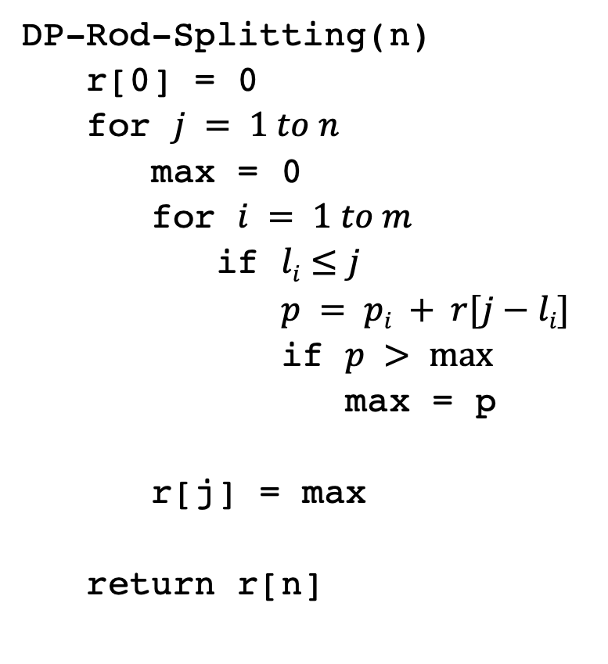
2: DP solution
DP-Rod-Splitting(n)
r[0] = 0
for $j = 1 to n$
max = 0
for $i = 1 to m$
if $li≤j$
$p = pi + r[j−li]$
if $p > max⁡$
max = p
r[j] = max
return r[n]

Slide 67
2: DP solution
DP-Rod-Splitting(n)
r[0] = 0
for $j = 1 to n$
max = 0
for $i = 1 to m$
if $li≤j$
$p = pi + r[j−li]$
if $p > max⁡$
max = p
r[j] = max
return r[n]
Space requirements?
Running time?

Slide 68
2: DP solution
DP-Rod-Splitting(n)
r[0] = 0
for $j = 1 to n$
max = 0
for $i = 1 to m$
if $li≤j$
$p = pi + r[j−li]$
if $p > max⁡$
max = p
r[j] = max
return r[n]
Space requirements: Θ(n)
Running time: Θ(nm)

Slide 69
0-1 Knapsack problem
0-1 Knapsack – A thief robbing a store finds m items worth
v₁, v₂, .., v_{m} dollars and weight
w₁, w₂, …, w_{m} pounds, where v_{i} and w_{i} are integers. The thief can carry at most W pounds in the knapsack. Which items should the thief take if they want to maximize value?
Repetition is allowed, that is you can take multiple copies of any item

Slide 70
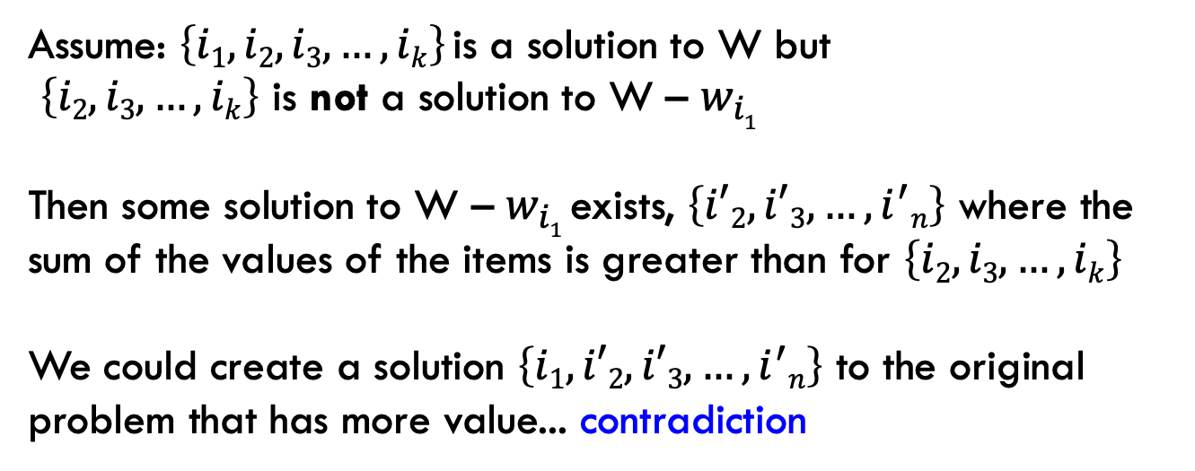
1a: optimal substructure
Prove: optimal solutions to the problem incorporate optimal solutions to related subproblems
Proof by contradiction:
Assume: $\left\{i1, i2,i3, …, ik\right\}$is a solution to W but
$\left\{i2, i3, …, ik\right\}$ is not a solution to W – $w_{i1}$
Then some solution to W – $w_{i1}$exists, $\left\{i′2, i′3, …, i^{′}n\right\}$ where the sum of the values of the items is greater than for $\left\{i2, i3, …, ik\right\}$
We could create a solution $\left\{i1,i′2, i′3, …, i^{′}n\right\}$ to the original problem that has more value... contradiction

Slide 71
1b: recursive solution

Slide 72
2: DP solution (from the bottom-up)
What are the smallest possible subproblems?
K(0) = 0
To calculate K(w), what are all the subproblems we need to calculate? This is the “table”. K(0) … K(W)
How should we fill in the table? K(1) → K(W)
Where will the answer be? K(W)

Slide 73
3: Analysis
What are the smallest possible subproblems? K(0) = 0
To calculate K(w), what are all the subproblems we need to calculate? This is the “table”. K(0) … K(W)
How should we fill in the table? K(0) → K(W)
Where will the answer be? K(W)
Space requirements: Θ(W)
Running time: Θ(Wm)

Slide 74
Memoization
Sometimes it can be a challenge to write the function in a bottom-up fashion
Memoization:
  Write the recursive function top-down
  Alter the function to check if we’ve already calculated the value
  If so, use the pre-calculate value
  If not, do the recursive call(s)

Slide 75
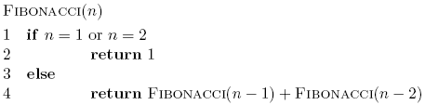
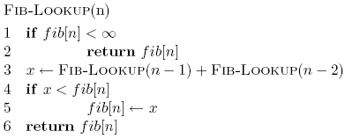
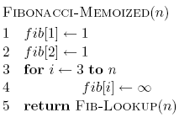
Memoized fibonacci

Slide 76
Memoized fibonacci
Use ∞ to denote uncalculated

Slide 77
Memoized fibonacci
What else could we use besides an array?
Use ∞ to denote uncalculated

Slide 78
Memoized fibonacci
Check if we already calculated the value

Slide 79
Memoized fibonacci
calculate the value

Slide 80
Memoized fibonacci
store the value

Slide 81
Memoization
Pros
  Can be more intuitive to code/understand
  Can be memory savings if you don’t need answers to all subproblems
Cons
  Depending on implementation, larger overhead because of recursion (though often the functions are tail recursive)

