Slide 1
Hashtables
David Kauchak
CS 140 – Spring 2023

Slide 2
Admin
Assignment 6 due Friday
No LCs
Mentor hours for the rest of this week:
Wednesday, 7-9:30pm: Claire and David
Friday, 1-3pm: Jan

Slide 3
Running time of insert and search for open addressing
Average case?
We have to make at least one probe

Slide 4
Running time of insert and search for open addressing
Average case?
What is the probability that the first probe will not be successful (assume uniform hashing function)?
α

Slide 5
Running time of insert and search for open addressing
Average case?
What is the probability that the first two probed slots will not be successful?
~α²
why ‘~’?

Slide 6
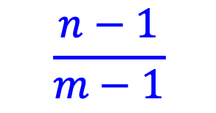
Running time of insert and search for open addressing
Average case?
What is the probability that the first two probed slots will not be successful
~α²
$$\frac{n−1}{m−1}$$
Technically, second probe is:
Notes:
For largish, n and m, this is close to alpha

Slide 7
Running time of insert and search for open addressing
Average case?
What is the probability that the first three probed slots will not be successful?
~α³

Slide 8
Running time of insert and search for open addressing
Average case: expected number of probes
  sum of the probability of making 1 probe, 2 probes, 3 probes, …

Slide 9
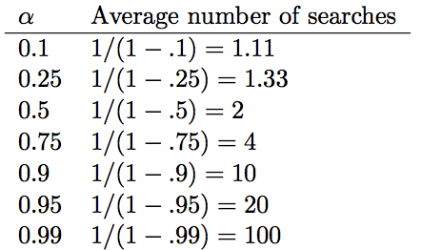
Average number of probes

Slide 10
How big should a hashtable be?
A good rule of thumb is the hashtable should be around half full
What happens when the hashtable gets full?
  Copy: Create a new table and copy the values over
    results in one expensive insert
    simple to implement
  Amortized copy: When a certain ratio is hit, grow the table, but copy the entries over a few at a time with every insert
    no single insert is expensive and can guarantee per insert performance
    more complicated to implement

Slide 11

Checkpoint 1
Induction on trees
$$T\left(n\right)=T\left(\sqrt{n}\right)+c$$

Slide 12
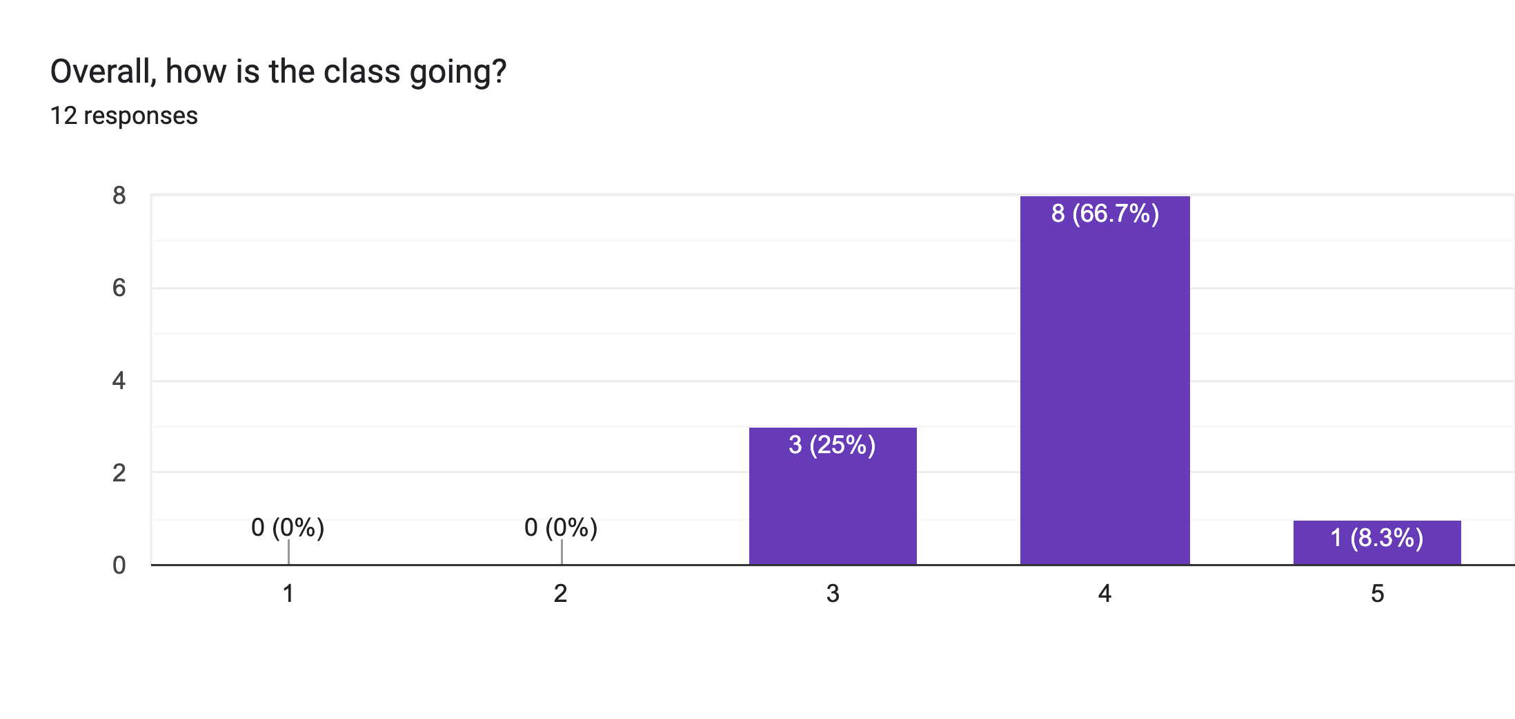
Course feedback

Slide 13
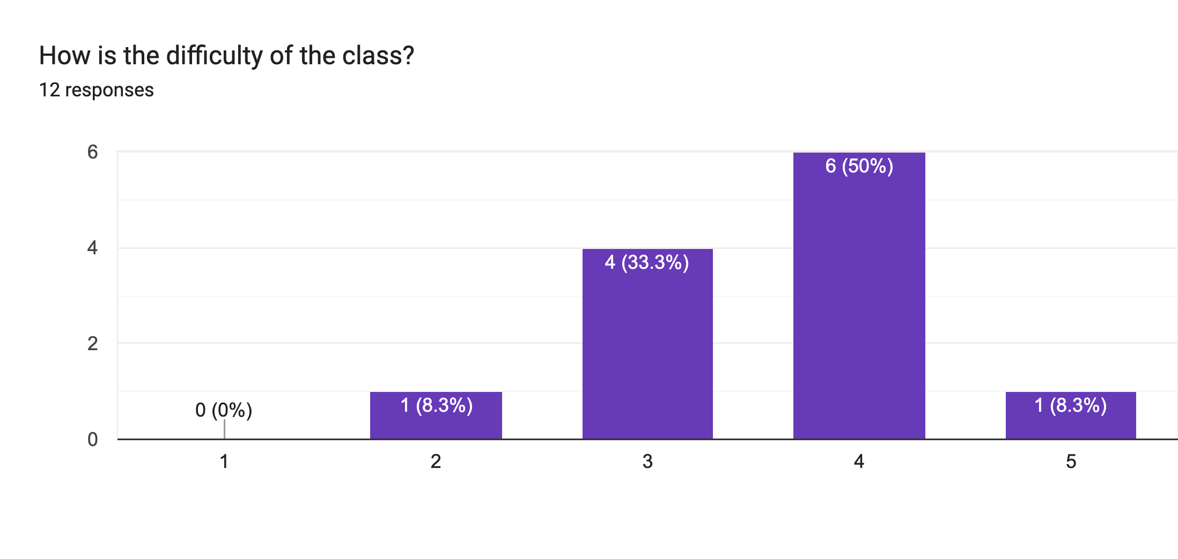
Course feedback

Slide 14
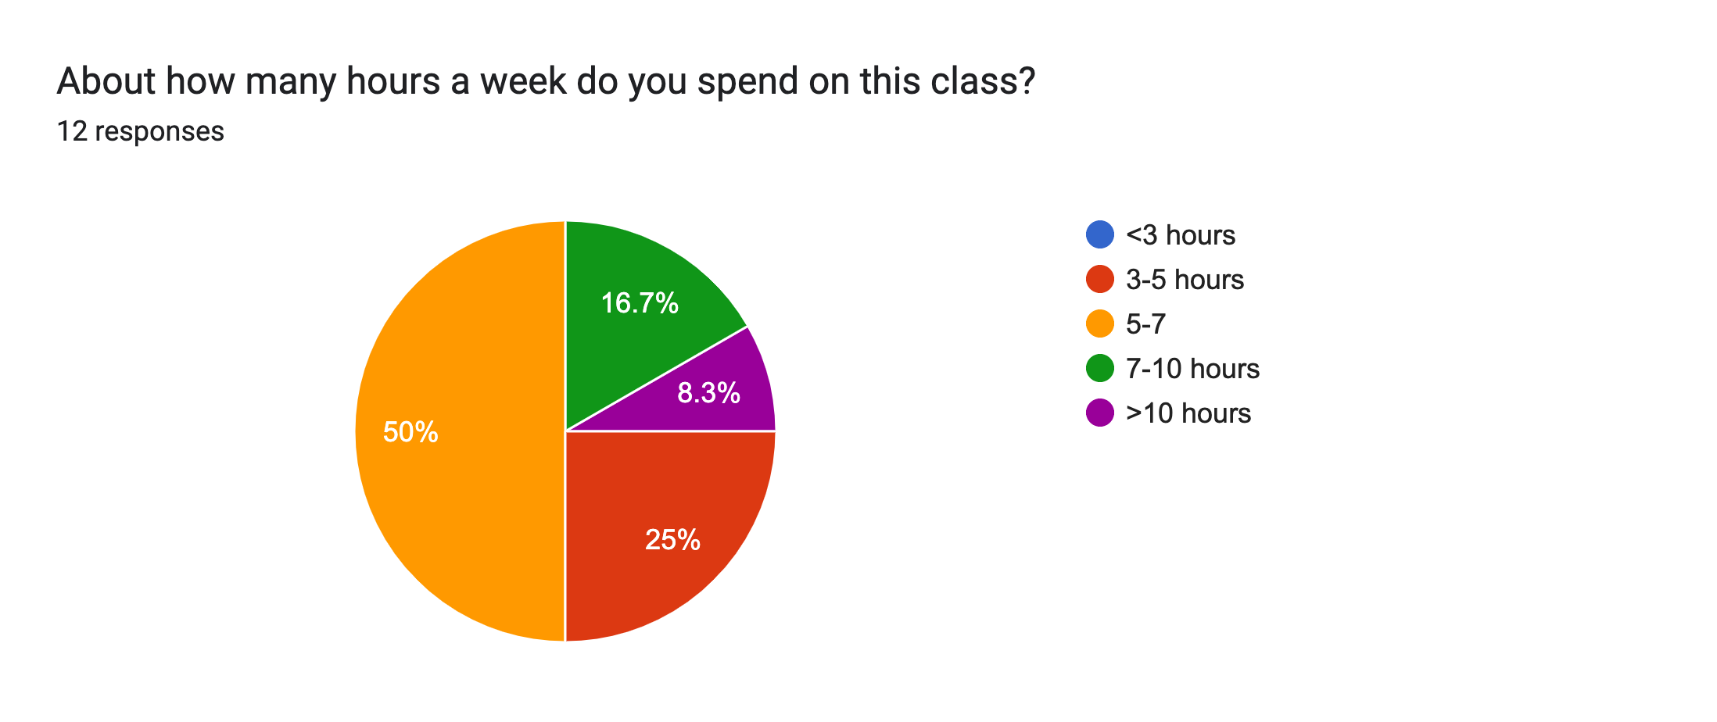
Course feedback

Slide 15
Course feedback
I love proving things and looking at the Math behind the concepts from CS62.
the group assignments
Honestly I just really like the little comics at the start of every homework

Slide 16
Course feedback
lectures are wayyy too fast, barely enough time to process things so it feels pointless to take notes; current course content is comprehensive and makes sense but it feels disorganized, like different content stitched together sort of so…
Having more examples, or going through the slides a bit slower

Slide 17
Course feedback
The homeworks are a lot of work and the mentors are super helpful but someone's even they don't have the solutions and that wastes hours of our time. I think homeworks can have more straight forward problems that show we understand things rather than problems that we always have to scavenge the internet and bug mentors for understandings.

Slide 18
Course feedback
During Class, could we have some more exercises along with the lecture contents?

Slide 19
Class overview
Math/Algorithm Tools
math basics
big-O (omega and theta)
recurrences
amortized analysis
proofs by induction
Algorithm techniques
divide and conquer
greedy
dynamic programming

Slide 20
Class overview
Revisiting data structures
ArrayList: amortized analysis
hashtables: big-O analysis
Redblack trees
binomial heaps
disjoint sets
Graphs/Graph Algorithms:
More details: Dijkstra’s, Bellman-Ford, Prim’s, Kruskal’s
Topological sort for DAGs
Floyd-Warshall, Johnsn’s (all pairs shortest paths)
Network flow

Slide 21
Class overview
NP completeness
Linear programming

Slide 22
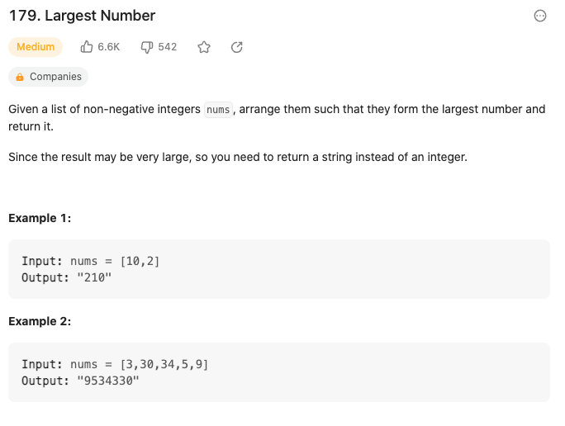
https://leetcode.com/problems/largest-number/

Slide 23
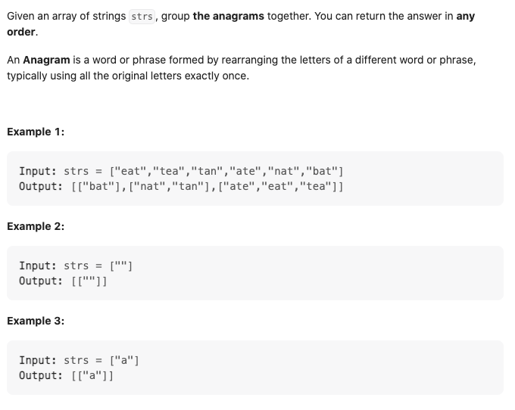
https://leetcode.com/problems/group-anagrams/

