Slide 1
Hashtables
David Kauchak
CS 140 – Spring 2023

Slide 2
Admin
Assignment 4 and 5 back soon

Slide 3
Hashtables
What do you know/remember?

Slide 4
Hashtables
Constant time insertion and search (and deletion in some cases) for a large space of keys
Applications
  Does x belong to S?
  I’ve found them very useful (go by many names, maps, dictionaries, …)
  compilers
  databases
  search engines
  storing and retrieving non-sequential data
  save memory over an array

Slide 5
Hashtables
Constant time insertion and search (and deletion in some cases) for a large space of keys
For this class, we’ll just think of them as a collection of keys
For many applications/implementations, there is a value associated with the key, i.e., key/value pair (though lookup is still exclusively based on the key)

Slide 6
Key/data pair
The key is a numeric representation of a relevant portion of the data
For example:
data
key
integer
number

Slide 7
Key/data pair
The key is a numeric representation of a relevant portion of the data
For example:
key?
data
string
number

Slide 8
Key/data pair
The key is a numeric representation of a relevant portion of the data
For example:
data
key
ascii code
string
number

Slide 9
Key/data pair
The key is a numeric representation of a relevant portion of the data
For example:
key?
data
account information
number

Slide 10
Key/data pair
The key is a numeric representation of a relevant portion of the data
For example:
ascii code of first and last name
key
data
account information
number

Slide 11
Why not just arrays aka direct-address tables?
array must be as large as the universe of keys
universe of keys - U
Array

Slide 12
Why not just arrays?
array must be as large as the universe of keys
universe of keys - U
space of actual keys is often much smaller than the actual keys
actual
keys, n
Array

Slide 13
Why not arrays?
Think of indexing all last names < 10 characters
  Census listing of all last names http://www.census.gov/genealogy/names/dist.all.last
    88,799 last names
  What is the size of our space of keys?
    26¹⁰ = a big number
  Not feasible!
  Even if it were, not space efficient

Slide 14
The load of a table/hashtable
m = number of possible entries in the table
n = number of keys stored in the table
α = n/m is the load factor of the hashtable
What is the load factor of the last example?
  α = 88,799 / 26¹⁰ would be the load factor of last names using direct-addressing
The smaller α, the more wasteful the table
The load also helps us talk about run time

Slide 15
Hash function, h
A hash function is a function that maps the universe of keys to the slots in the hashtable
universe of keys - U
hash function, h: U ➔m
m << |U|

Slide 16
Hash function, h
A hash function is a function that maps the universe of keys to the slots in the hashtable
universe of keys - U
hash function, h: U ➔m
m << |U|

Slide 17
Hash function, h
A hash function is a function that maps the universe of keys to the slots in the hashtable
universe of keys - U
hash function, h: U ➔m
m << |U|

Slide 18
Hash function, h
What can happen if m < |U|?
universe of keys - U
hash function, h: U ➔m
m << |U|

Slide 19
Collisions
If m < |U|, then two keys can map to the same position in the hashtable (pidgeonhole principle)
universe of keys - U
hash function, h
m << |U|

Slide 20
Collisions
A collision occurs when h(x) = h(y), but x ≠ y
A good hash function will minimize the number of collisions
Because the number of hashtable entries is less than the possible keys (i.e. m < |U|) collisions are inevitable!
Collision resolution techniques?

Slide 21
Collision resolution by chaining
Hashtable consists of an array of linked lists
When a collision occurs, the element is added to linked list at that location
If two entries x ≠ y have the same hash value h(x) = h(y), then T(h(x)) will contain a linked list with both values

Slide 22
Insertion
ChainedInsert(x):
entry = h(x)
insert x at the head of T[entry]
ChainedHashInsert( )

Slide 23
Insertion
ChainedInsert(x):
entry = h(x)
insert x at the head of T[entry]
h( )
hash function is a mapping from the key to some value < m

Slide 24
Insertion
ChainedInsert(x):
entry = h(x)
insert x at the head of T[entry]
h( )

Slide 25
Deletion
ChainedDelete(x):
entry = h(x)
delete x at the list at T[entry]
What does that involve?

Slide 26
Deletion
ChainedDelete(x):
entry = h(x)
delete x at the list at T[entry]
Search though the list!

Slide 27
Deletion
ChainedDelete(x):
entry = h(x)
delete x at the list at T[entry]
ChainedHashDelete( )

Slide 28
Deletion
ChainedDelete(x):
entry = h(x)
delete x at the list at T[entry]
h( )

Slide 29
Deletion
ChainedDelete(x):
entry = h(x)
delete x at the list at T[entry]

Slide 30
Deletion
ChainedDelete(x):
entry = h(x)
delete x at the list at T[entry]

Slide 31
Deletion
ChainedDelete(x):
entry = h(x)
delete x at the list at T[entry]

Slide 32
Search
ChainedSearch(x):
entry = h(x)
search for x in list T[entry]
ChainedHashSearch( )

Slide 33
Search
ChainedSearch(x):
entry = h(x)
search for x in list T[entry]
h( )

Slide 34
Search
ChainedSearch(x):
entry = h(x)
search for x in list T[entry]
ChainedHashSearch( )

Slide 35
Search
ChainedSearch(x):
entry = h(x)
search for x in list T[entry]
ChainedHashSearch( )

Slide 36
Search
ChainedSearch(x):
entry = h(x)
search for x in list T[entry]
ChainedHashSearch( )

Slide 37
Running time
ChainedInsert(x):
entry = h(x)
insert x at the head of T[entry]
Θ(1)
ChainedDelete(x):
entry = h(x)
delete x at the list at T[entry]
O(length of the chain)
ChainedSearch(x):
entry = h(x)
search for x in list T[entry]
O(length of the chain)

Slide 38
Length of the chain
Worst case?

Slide 39
Length of the chain
Worst case?
  All elements hash to the same location
  h(k) = 4
  n
…

Slide 40
Length of the chain
Average case:
  Depends on how well the hash function distributes the keys
  What is the best we could hope for a hash function?
    simple uniform hashing: an element is equally likely to end up in any of the m slots
  Under simple uniform hashing what is the average length of a chain in the table?
    n keys over m slots = n / m = α

Slide 41
Average chain length
If you roll a fair m sided die n times, how many times are we likely to see a given value?
For example, 10 sided die:
  1 time
    1/10
  100 times
    100/10 = 10

Slide 42
Search average running time
Two cases:
  Key is not in the table
    must search all entries
    Θ(1 + α)
  Key is in the table
    on average search half of the entries
    O(1 + α)

Slide 43
Hash functions
What makes a good hash function?
  Approximates the assumption of simple uniform hashing
  Deterministic – h(x) should always return the same value
  Low cost – if it is expensive to calculate the hash value (e.g. log n) then we don’t gain anything by using a table
Challenge: we don’t generally know the distribution of the keys
  Frequently data tend to be clustered (e.g. similar strings, run-times, SSNs). A good hash function should spread these out across the table

Slide 44
Hash functions
What are some hash functions you’ve heard of before?

Slide 45
Division method
h(k) = k mod m
m k h(k)
11 25
11 1
11 17
13 133
13 7
13 25

Slide 46
Division method
h(k) = k mod m
m k h(k)
11 25
3
11 1
1
11 17
6
13 133
3
13 7
7
13 25
12

Slide 47
Division method
Don’t use a power of two. Why?
m k bin(k) h(k)
25 11001
8 1 00001
8 17 10001

Slide 48
Division method
Don’t use a power of two. Why?
if h(k) = k mod 2^{p}, the hash function is just the lower p bits of the value
m k bin(k) h(k)
25 11001 1
8 1 00001 1
8 17 10001 1

Slide 49
Division method
Good rule of thumb for m is a prime number not too close to a power of 2
Pros:
  quick to calculate
  easy to understand
Cons:
  keys close to each other will end up close in the hashtable

Slide 50
Multiplication method
Multiply the key by a constant 0 < A < 1 and extract the fractional part of kA, then scale by m to get the index
extracts the fractional portion of kA

Slide 51
Multiplication method
Common choice is for m as a power of 2 and
Why a power of 2?
Book has other heuristics

Slide 52
Multiplication method
m k A
8 15 0.618
8 23 0.618
8 100 0.618
kA h(k)

Slide 53
Multiplication method
m k A
8 15 0.618
8 23 0.618
8 100 0.618
kA h(k)
9.27
floor(0.27*8) = 2
14.214
floor(0.214*8) = 1
61.8
floor(0.8*8) = 6

Slide 54
Other hash functions
http://en.wikipedia.org/wiki/List_of_hash_functions
cyclic redundancy checks (i.e. disks, cds, dvds)
Checksums (i.e. networking, file transfers)
Cryptographic (i.e. MD5, SHA)

Slide 55
Open addressing
Keeping around an array of linked lists can be inefficient and a hassle
Like to keep the hashtable as just an array of elements (no pointers)
How do we deal with collisions?
  compute another slot in the hashtable to examine

Slide 56
Hash functions with open addressing
Hash function must define a probe sequence which is the list of slots to examine when searching or inserting
The hash function takes an additional parameter i which is the number of collisions that have already occurred
The probe sequence must be a permutation of every hashtable entry. Why?
{ h(k,0), h(k,1), h(k,2), …, h(k, m-1) } is a permutation of
{ 0, 1, 2, 3, …, m-1 }
Notes:
If we didn’t do this, we wouldn’t visit all of the entries in the table!

Slide 57
Hash functions with open addressing
Hash function must define a probe sequence which is the list of slots to examine when searching or inserting
The hash function takes an additional parameter i which is the number of collisions that have already occurred
The probe sequence must be a permutation of every hashtable entry. Why?
If not, we wouldn’t explore all the possible location in the table!
Notes:
If we didn’t do this, we wouldn’t visit all of the entries in the table!

Slide 58
Probe sequence
h(k, 0)

Slide 59
Probe sequence
h(k, 1)

Slide 60
Probe sequence
h(k, 2)

Slide 61
Probe sequence
h(k, 3)

Slide 62
Probe sequence
h(k, …)
must visit all locations
…

Slide 63
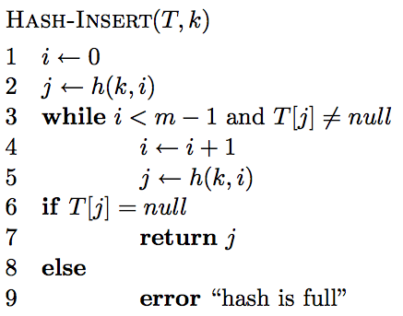
Open addressing: Insert

Slide 64
Open addressing: Insert
get the first hashtable entry to look in

Slide 65
Open addressing: Insert
follow the probe sequence until we find an open entry

Slide 66
Open addressing: Insert
return the open entry

Slide 67
Open addressing: Insert
hashtable can fill up

Slide 68
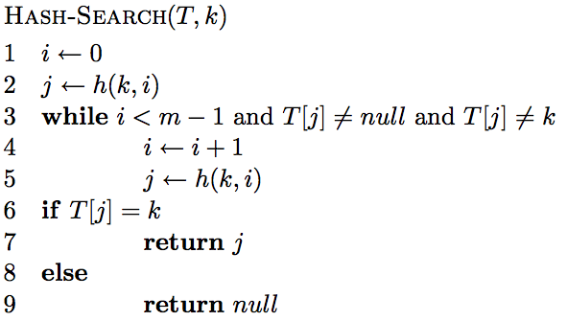
Open addressing: search

Slide 69
Open addressing: search

Slide 70
Open addressing: search
“breaks” the probe sequence

Slide 71
Open addressing: delete
Two options:
  mark node as “deleted” (rather than null)
    modify search procedure to continue looking if a “deleted” node is seen
    modify insert procedure to fill in “deleted” entries
    increases search times
  if a lot of deleting will happen, use chaining

Slide 72
Probing schemes
Linear probing – if a collision occurs, go to the next slot
  h(k,i) = (h(k) + i) mod m
  Does it meet our requirement that it visits every slot?
  for example, m = 7 and h(k) = 4
h(k,0) = 4
h(k,1) = 5
h(k,2) = 6
h(k,3) = 0
h(k,3) = 1

Slide 73
Linear probing: search
h( , 0)

Slide 74
Linear probing: search
h( , 1)

Slide 75
Linear probing: search
h( , 2)

Slide 76
Linear probing: search
h( , 3)

Slide 77
Linear probing: search
h( , 3)

Slide 78
Linear probing
Problem:
  primary clustering – long runs of occupied slots tend to build up and these tend to grow
any value here results in an increase in the cluster
become more and more probable for a value to end up in that range

Slide 79
Quadratic probing
h(k,i) = (h(k) + c₁i + c₂i²) mod m
Rather than a linear sequence, we probe based on a quadratic function
Problems:
  must pick constants and m so that we have a proper probe sequence
  if h(x) = h(y), then h(x,i) = h(y,i) for all i
  secondary clustering

Slide 80
Double hashing
Probe sequence is determined by a second hash function
h(k,i) = (h₁(k) + i(h₂(k))) mod m
Problem:
  h₂(k) must visit all possible positions in the table

Slide 81
Running time of insert and search for open addressing
Depends on the hash function/probe sequence
Worst case?
  O(n) – probe sequence visits every full entry first before finding an empty

Slide 82
Running time of insert and search for open addressing
Average case?
We have to make at least one probe

Slide 83
Running time of insert and search for open addressing
Average case?
What is the probability that the first probe will not be successful (assume uniform hashing function)?
α

Slide 84
Running time of insert and search for open addressing
Average case?
What is the probability that the first two probed slots will not be successful?
~α²
why ‘~’?

Slide 85
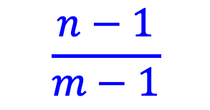
Running time of insert and search for open addressing
Average case?
What is the probability that the first two probed slots will not be successful
~α²
$$\frac{n−1}{m−1}$$
Technically, second probe is:
Notes:
For largish, n and m, this is close to alpha

Slide 86
Running time of insert and search for open addressing
Average case?
What is the probability that the first three probed slots will not be successful?
~α³

Slide 87
Running time of insert and search for open addressing
Average case: expected number of probes
  sum of the probability of making 1 probe, 2 probes, 3 probes, …

Slide 88
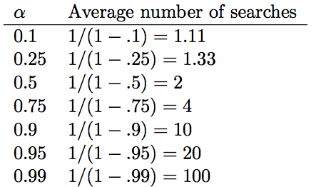
Average number of probes

Slide 89
How big should a hashtable be?
A good rule of thumb is the hashtable should be around half full
What happens when the hashtable gets full?
  Copy: Create a new table and copy the values over
    results in one expensive insert
    simple to implement
  Amortized copy: When a certain ratio is hit, grow the table, but copy the entries over a few at a time with every insert
    no single insert is expensive and can guarantee per insert performance
    more complicated to implement

Slide 90

Checkpoint 1
Induction on trees
$$T\left(n\right)=T\left(\sqrt{n}\right)+c$$

Slide 91
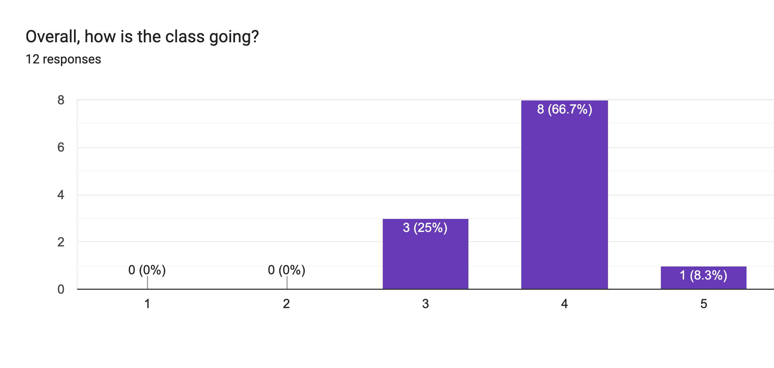
Course feedback

Slide 92
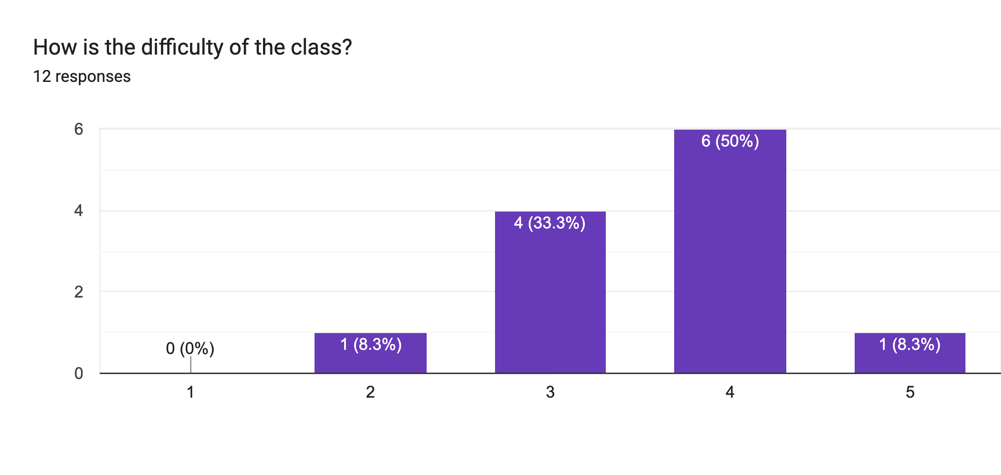
Course feedback

Slide 93
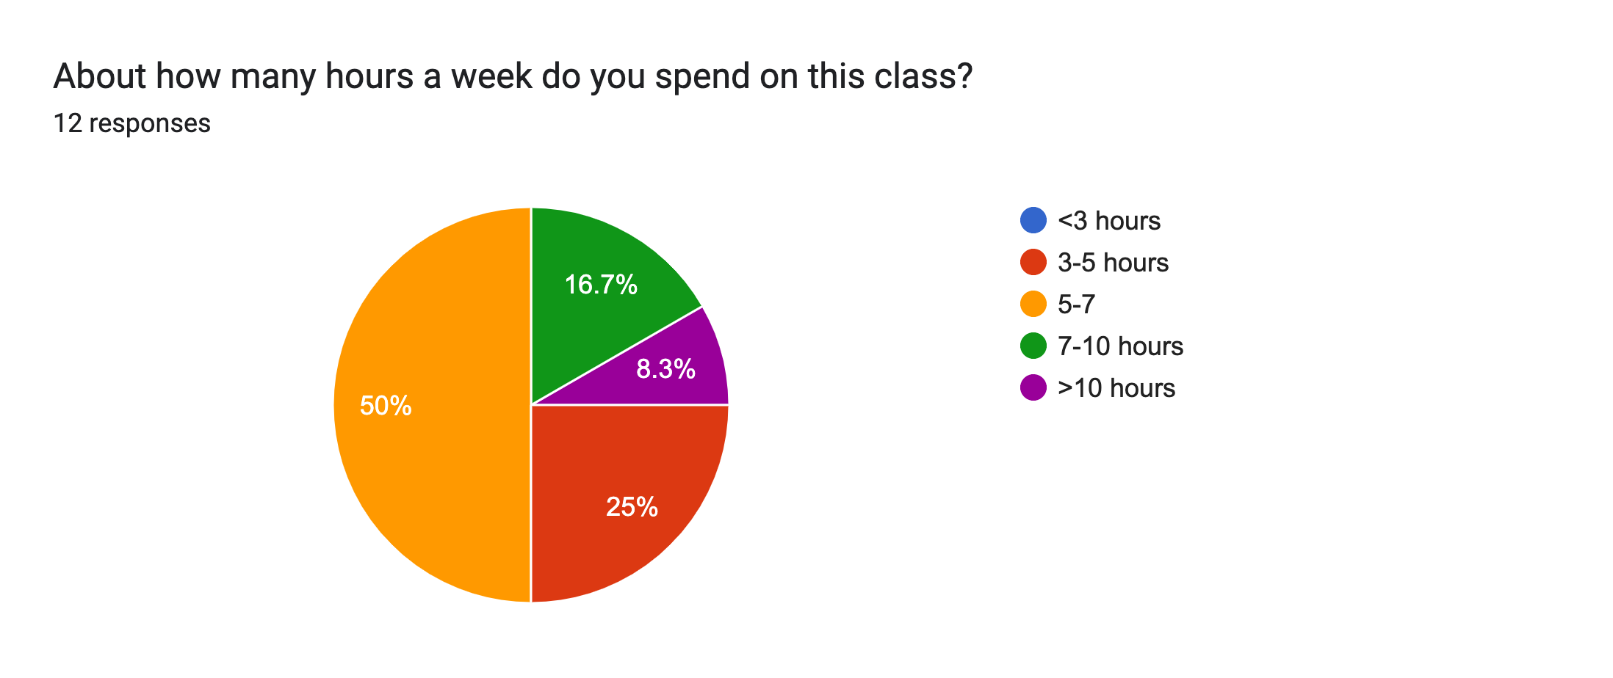
Course feedback

Slide 94
Course feedback
I love proving things and looking at the Math behind the concepts from CS62.
the group assignments
Honestly I just really like the little comics at the start of every homework

Slide 95
Course feedback
lectures are wayyy too fast, barely enough time to process things so it feels pointless to take notes; current course content is comprehensive and makes sense but it feels disorganized, like different content stitched together sort of so…
Having more examples, or going through the slides a bit slower

Slide 96
Course feedback
The homeworks are a lot of work and the mentors are super helpful but someone's even they don't have the solutions and that wastes hours of our time. I think homeworks can have more straight forward problems that show we understand things rather than problems that we always have to scavenge the internet and bug mentors for understandings.

Slide 97
Course feedback
During Class, could we have some more exercises along with the lecture contents?

