Slide 1
Binary search trees
David Kauchak
CS 140 – Spring 2022

Slide 2
Number guessing game
I’m thinking of a number between 1 and n
You are trying to guess the answer
For each guess, I’ll tell you “correct”, “higher” or “lower”
Describe an algorithm that minimizes the number of guesses

Slide 3
Binary Search Trees

Slide 4
Binary Search Trees
BST – A binary tree where a parent’s value is greater than all values in the left subtree and less than or equal to all the values in the right subtree
and the left and right children are also binary search trees
Why not?
Ambiguous about where elements that are equal would reside

Slide 5
Example
12
8
14
5
9
20
Can be implemented with with references or an array

Slide 6
What else can we conclude?
12
The smallest element is the left-most element
The largest element is the right-most element
8
14
5
9
20

Slide 7
Another example: the solo tree
12

Slide 8
Another example: the twig
12
8
5
1

Slide 9
Operations
Search(T,k) – Does value k exist in tree T
Insert(T,k) – Insert value k into tree T
Delete(T,x) – Delete node x from tree T
Minimum(T) – What is the smallest value in the tree?
Maximum(T) – What is the largest value in the tree?
Successor(T,x) – What is the next element in sorted order after x
Predecessor(T,x) – What is the previous element in sorted order of x
Median(T) – return the median of the values in tree T

Slide 10
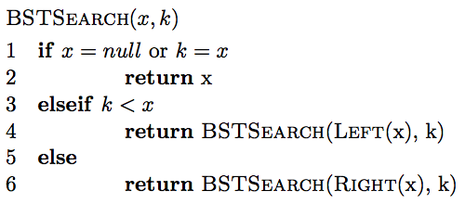
Search
How do we find an element?

Slide 11
Finding an element
Search(T, 9)
12
8
14
5
9
20

Slide 12
Finding an element
Search(T, 9)
12
8
14
5
9
20

Slide 13
Finding an element
Search(T, 9)
12
8
14
5
9
20
9 > 12?

Slide 14
Finding an element
Search(T, 9)
12
8
14
5
9
20

Slide 15
Finding an element
Search(T, 9)
12
8
14
5
9
20

Slide 16
Finding an element
Search(T, 9)
12
8
14
5
9
20

Slide 17
Finding an element
Search(T, 13)
12
8
14
5
9
20

Slide 18
Finding an element
Search(T, 13)
12
8
14
5
9
20

Slide 19
Finding an element
Search(T, 13)
12
8
14
5
9
?
20

Slide 20
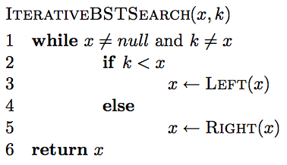
Iterative search

Slide 21
Is BSTSearch correct?

Slide 22
Running time of BSTSearch
Worst case?
  θ(height of the tree)
Average case?
  O(height of the tree)
Best case?
  O(1)

Slide 23
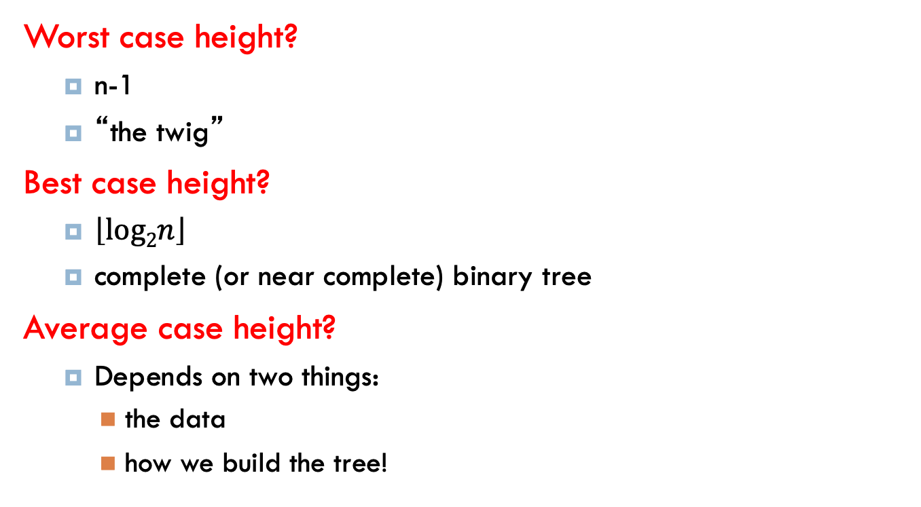
Height of the tree
Worst case height?
  n-1
  “the twig”
Best case height?
  $\left\lfloor log2n\right\rfloor$
  complete (or near complete) binary tree
Average case height?
  Depends on two things:
    the data
    how we build the tree!

Slide 24
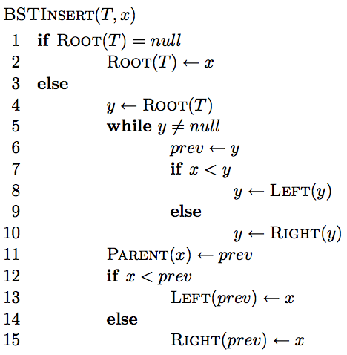
Insertion

Slide 25
Insertion
Similar to search

Slide 26
Insertion
Similar to search
Find the correct location in the tree

Slide 27
Insertion
keeps track of the previous node we visited so when we fall off the tree, we know

Slide 28
Insertion
add node onto the bottom of the tree

Slide 29
Correctness?
maintain BST property

Slide 30
Correctness
What happens if it is a duplicate?

Slide 31
Inserting duplicate
Insert(T, 14)
12
8
14
5
9
20

Slide 32
Inserting duplicate
Insert(T, 14)
12
8
14
5
9
20
14

Slide 33
Running time
O(height of the tree)

Slide 34
Running time
O(height of the tree)
Why not
Θ(height of the tree)?

Slide 35
Running time
Insert(T, 15)
12
8
5
1

Slide 36
Height of the tree
Worst case: “the twig” – When will this happen?
Notes:
sorted or inversely sorted data (and there are other cases as well)

Slide 37
Height of the tree
Best case: “complete” – When will this happen?

Slide 38
Height of the tree
Average case for random data?
Randomly inserting data into a BST generates a tree on average that is O(log n)

Slide 39
Visiting all nodes
In sorted order
12
8
14
5
9
20

Slide 40
Visiting all nodes
In sorted order
5
12
8
14
5
9
20

Slide 41
Visiting all nodes
In sorted order
5, 8
12
8
14
5
9
20

Slide 42
Visiting all nodes
In sorted order
5, 8, 9
12
8
14
5
9
20

Slide 43
Visiting all nodes
In sorted order
5, 8, 9, 12
12
8
14
5
9
20

Slide 44
Visiting all nodes
What’s happening?
5, 8, 9, 12
12
8
14
5
9
20

Slide 45
Visiting all nodes
In sorted order
5, 8, 9, 12, 14
12
8
14
5
9
20

Slide 46
Visiting all nodes
In sorted order
5, 8, 9, 12, 14, 20
12
8
14
5
9
20

Slide 47
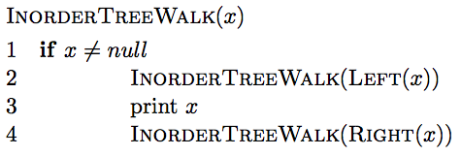
Visiting all nodes in order

Slide 48
Visiting all nodes in order
any operation

Slide 49
Is it correct?
Does it print out all of the nodes in sorted order?

Slide 50
Running time?
Recurrence relation:
  j nodes in the left subtree
  n – j – 1 in the right subtree
Or
  How much work is done for each call?
  How many calls?
  Θ(n)

Slide 51
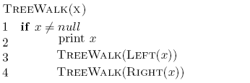
What about?

Slide 52
Preorder traversal
12, 8, 5, 9, 14, 20
Tree copying: insert in to new tree in preorder
prefix notation: (2+3)*4 -> * + 2 3 4
How is this useful?
12
8
14
5
9
20

Slide 53
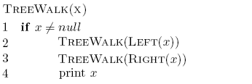
What about?

Slide 54
Postorder traversal
5, 9, 8, 20, 14, 12
postfix notation: (2+3)*4 -> 4 3 2 + *
?
How is this useful?
12
8
14
5
9
20

Slide 55
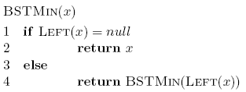

Min/Max
12
8
14
5
9
20

Slide 56
Running time of min/max?
O(height of the tree)

Slide 57
Successor and predecessor
Predecessor(12)?
9
12
8
14
5
9
13
20

Slide 58
Successor and predecessor
Predecessor in general?
largest node of all those smaller than this node
rightmost element of the left subtree
12
8
14
5
9
13
20

Slide 59
Successor
Successor(12)?
13
12
8
14
5
9
13
20

Slide 60
Successor
Successor in general?
smallest node of all those larger than this node
leftmost element of the right subtree
12
8
14
5
9
13
20

Slide 61
Successor
What if the node doesn’t have a right subtree?
smallest node of all those larger than this node
leftmost element of the right subtree
12
8
14
5
9
13
20

Slide 62
Successor
What if the node doesn’t have a right subtree?
node is the largest
the successor is the node that has x as a predecessor
12
8
14
5
9
13
20

Slide 63
Successor
successor is the node that has x as a predecessor
12
8
14
5
9
13
20

Slide 64
Successor
successor is the node that has x as a predecessor
12
8
14
5
9
13
20

Slide 65
Successor
successor is the node that has x as a predecessor
12
8
14
5
9
13
20

Slide 66
Successor
keep going up until we’re no longer a right child
successor is the node that has x as a predecessor
12
8
14
5
9
13
20

Slide 67
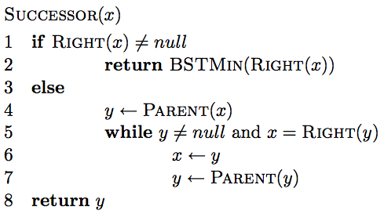
Successor

Slide 68
Successor
if we have a right subtree, return the smallest of the right subtree

Slide 69
Successor
find the node that x is the predecessor of
keep going up until we’re no longer a right child

Slide 70
Successor running time
O(height of the tree)

Slide 71
Deletion
12
8
14
5
9
13
20
Three cases!

Slide 72
Deletion: case 1
No children
Just delete the node
12
8
14
5
9
13
20
17

Slide 73
Deletion: case 1
No children
Just delete the node
12
8
14
5
13
20
17

Slide 74
Deletion: case 2
One child
Splice out the node
12
8
14
5
13
20
17

Slide 75
Deletion: case 2
One child
Splice out the node
12
5
14
13
20
17

Slide 76
Deletion: case 3
Two children
Replace x with it’s successor
12
5
14
13
20
17

Slide 77
Deletion: case 3
Two children
Replace x with it’s successor
12
5
17
13
20

Slide 78
Deletion: case 3
Two children
Will we always have a successor?
Why successor?
  Larger than the left subtree
  Less than or equal to right subtree

Slide 79
Height of the tree
Most of the operations take time
O(height of the tree)
We said trees built from random data have height O(log n), which is asymptotically tight
Two problems:
  We can’t always insure random data
  What happens when we delete nodes and insert others after building a tree?

Slide 80
Balanced trees
Make sure that the trees remain balanced!
  Red-black trees
  AVL trees
  2-3-4 trees
  …
B-trees

Slide 81
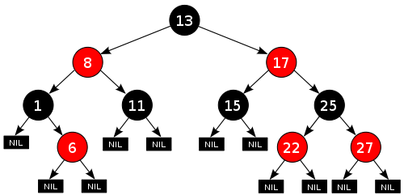
Red-black trees: BST (plus some)
every node is either red or black
root is black
leaves (NIL) are black
if a node is red, both children are black
for every node, all paths from the node to descendant leaves contain the same number of black nodes.
https://en.wikipedia.org/wiki/Red–black_tree

Slide 82
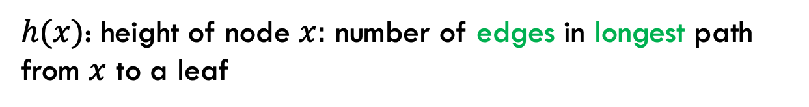
Red-black trees: BST (plus some)
every node is either red or black
root is black
leaves (NIL) are black
if a node is red, both children are black
for every node, all paths from the node to descendant leaves contain the same number of black nodes.
$h(x)$: height of node $x:$ number of edges in longest path from $x$ to a leaf

Slide 83

Red-black trees: BST (plus some)
$h(x)$: height of node $x:$ number of edges in longest path from $x$ to a leaf
What is the height of the root node?

Slide 84
Red-black trees: BST (plus some)
$h(x)$: height of node $x:$ number of edges in longest path from $x$ to a leaf
4

Slide 85
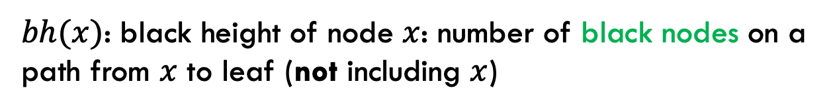
Red-black trees: BST (plus some)
every node is either red or black
root is black
leaves (NIL) are black
if a node is red, both children are black
for every node, all paths from the node to descendant leaves contain the same number of black nodes.
$bh(x)$: black height of node $x$: number of black nodes on a path from $x$ to leaf (not including $x$)
Why don’t we say ”path with the most…”?

Slide 86
Red-black trees: BST (plus some)
every node is either red or black
root is black
leaves (NIL) are black
if a node is red, both children are black
for every node, all paths from the node to descendant leaves contain the same number of black nodes.
$bh(x)$: black height of node $x$: number of black nodes on a path from $x$ to leaf (not including $x$)
Why don’t we say ”path with the most…”?

Slide 87
Red-black trees: BST (plus some)
$bh(x)$: black height of node $x$: number of black nodes on a path from $x$ to leaf (not including $x$)
What is the black height of the root node?

Slide 88
Red-black trees: BST (plus some)
$bh(x)$: black height of node $x$: number of black nodes on a path from $x$ to leaf (not including $x$)
2

Slide 89
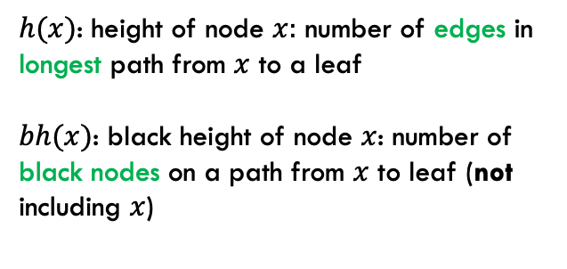
Bounding the height
every node is either red or black
root is black
leaves (NIL) are black
if a node is red, both children are black
for every node, all paths from the node to descendant leaves contain the same number of black nodes.
$h(x)$: height of node $x:$ number of edges in longest path from $x$ to a leaf
$bh(x)$: black height of node $x$: number of black nodes on a path from $x$ to leaf (not including $x$)
Claim 1: For every node $x$, $bh\left(x\right)≥h(x)/2$
Proof?

Slide 90
Bounding the height
every node is either red or black
root is black
leaves (NIL) are black
if a node is red, both children are black
for every node, all paths from the node to descendant leaves contain the same number of black nodes.
$h(x)$: height of node $x:$ number of edges in longest path from $x$ to a leaf
$bh(x)$: black height of node $x$: number of black nodes on a path from $x$ to leaf (not including $x$)
Claim 1: For every node $x$, $bh\left(x\right)≥h(x)/2$
Worst case: nodes alternate red/black
root is black
leaf is black
In terms of h(x): How many black nodes are there on this path?

Slide 91

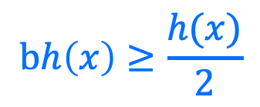
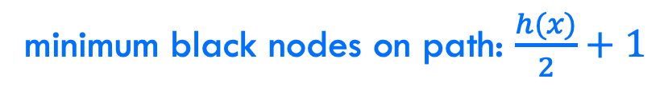
Bounding the height
every node is either red or black
root is black
leaves (NIL) are black
if a node is red, both children are black
for every node, all paths from the node to descendant leaves contain the same number of black nodes.
$h(x)$: height of node $x:$ number of edges in longest path from $x$ to a leaf
$bh(x)$: black height of node $x$: number of black nodes on a path from $x$ to leaf (not including $x$)
Claim 1: For every node $x$, $bh\left(x\right)≥h(x)/2$
minimum black nodes on path: $\frac{h(x)}{2}+1$
$$bh\left(x\right)≥\frac{h(x)}{2}$$
$bh$ does NOT include x, i.e., the root in this case

Slide 92

Bounding the height
Claim 2: The subtree rooted at any node $x$ contains at least $2^{bh(x)}−1$ internal (non-leaf) nodes
Proof?

Slide 93
Bounding the height
Claim 2: The subtree rooted at any node $x$ contains at least $2^{bh(x)}−1$ internal (non-leaf) nodes
Base case:

Slide 94
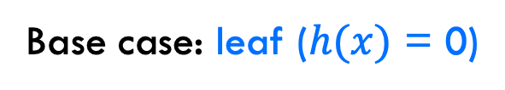


Bounding the height
Claim 2: The subtree rooted at any node $x$ contains at least $2^{bh(x)}−1$ internal (non-leaf) nodes
Base case: leaf ($h(x)$ = 0)
$$bh\left(x\right)= 0$$
$$2^{0}−1=0$$

Slide 95

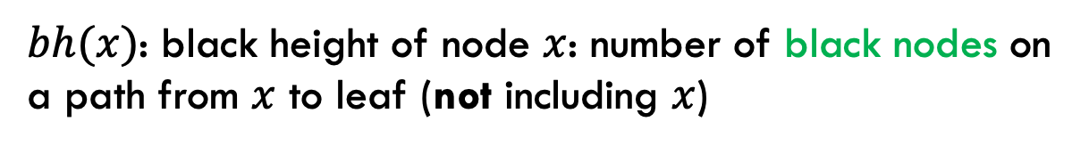
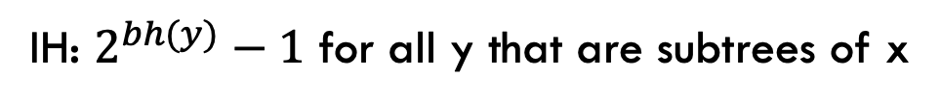

Bounding the height
Claim 2: The subtree rooted at any node $x$ contains at least $2^{bh(x)}−1$ internal (non-leaf) nodes
Inductive case: $h(x)$ > 0
IH: $2^{bh(y)}−1$ for all y that are subtrees of x
What is $bh(child(x))$ wrt $bh(x)$?
$bh(x)$: black height of node $x$: number of black nodes on a path from $x$ to leaf (not including $x$)

Slide 96
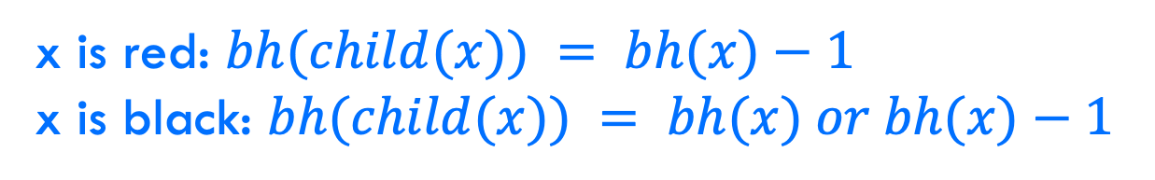
Bounding the height
Claim 2: The subtree rooted at any node $x$ contains at least $2^{bh(x)}−1$ internal (non-leaf) nodes
Inductive case: $h(x)$ > 0
IH: $2^{bh(y)}−1$ for all y that are subtrees of x
x is red: $bh(child(x)) = bh(x)−1$
x is black: $bh(child(x)) = bh(x) or bh(x)−1$
$bh(x)$: black height of node $x$: number of black nodes on a path from $x$ to leaf (not including $x$)

Slide 97
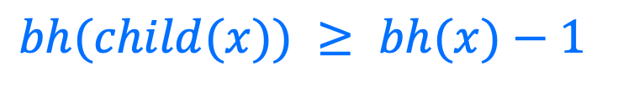
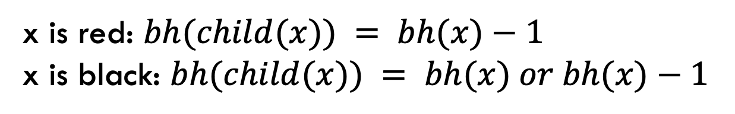
Bounding the height
Claim 2: The subtree rooted at any node $x$ contains at least $2^{bh(x)}−1$ internal (non-leaf) nodes
Inductive case: $h(x)$ > 0
IH: $2^{bh(y)}−1$ for all y that are subtrees of x
x is red: $bh(child(x)) = bh(x)−1$
x is black: $bh(child(x)) = bh(x) or bh(x)−1$
$bh(child(x)) ≥ bh(x)−1$

Slide 98


Bounding the height
Claim 2: The subtree rooted at any node $x$ contains at least $2^{bh(x)}−1$ internal (non-leaf) nodes
Inductive case: $h(x)$ > 0
IH: $2^{bh(y)}−1$ for all y that are subtrees of x
$bh(child(x)) ≥ bh(x)−1$
$$x$$
How many (internal nodes are in this tree (at least)?

Slide 99



Bounding the height
Claim 2: The subtree rooted at any node $x$ contains at least $2^{bh(x)}−1$ internal (non-leaf) nodes
Inductive case: $h(x)$ > 0
IH: $2^{bh(y)}−1$ for all y that are subtrees of x
$bh(child(x)) ≥ bh(x)−1$
$$x$$
$$1$$
$$2^{bh\left(x\right)−1}−1$$
$$2^{bh\left(x\right)−1}−1$$

Slide 100

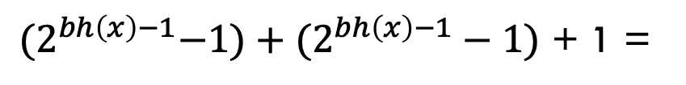
Bounding the height
Claim 2: The subtree rooted at any node $x$ contains at least $2^{bh(x)}−1$ internal (non-leaf) nodes
Inductive case: $h(x)$ > 0
IH: $2^{bh(y)}−1$ for all y that are subtrees of x
$bh(child(x)) ≥ bh(x)−1$
${(2}^{bh\left(x\right)−1}−1)+(2^{bh\left(x\right)−1}−1)$ + 1 =
$$2^{bh\left(x\right)}−1$$

Slide 101
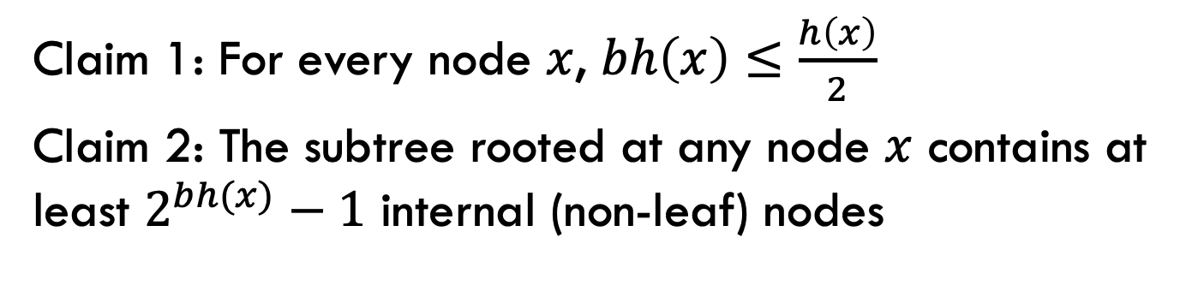
Bounding the height (almost there!)
Claim 1: For every node $x$, $bh\left(x\right)≤\frac{h\left(x\right)}{2}$
Claim 2: The subtree rooted at any node $x$ contains at least $2^{bh(x)}−1$ internal (non-leaf) nodes
How does this help us?

Slide 102

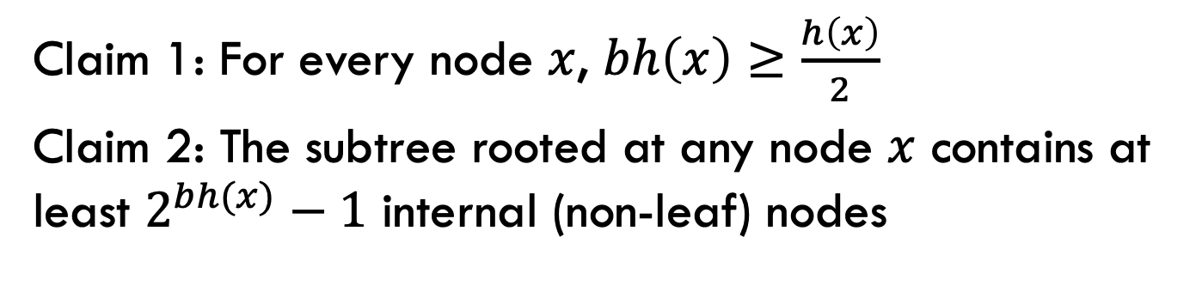



Bounding the height
Claim 1: For every node $x$, $bh\left(x\right)≥\frac{h\left(x\right)}{2}$
Claim 2: The subtree rooted at any node $x$ contains at least $2^{bh(x)}−1$ internal (non-leaf) nodes
${n ≥2}^{bh(x)}−1$
Claim 2
Claim 1
${n ≥2}^{h(x)/2}−1$
math
$${n+1 ≥2}^{h(x)/2}$$
math
$$h\left(x\right) ≤2log⁡(n+1)$$
What does this mean?

Slide 103
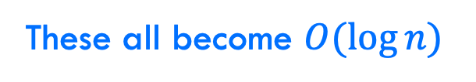
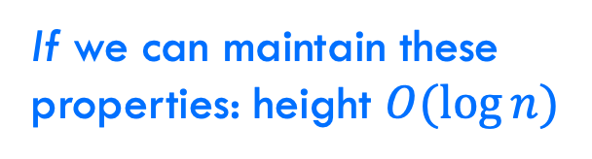
Bounding the height
every node is either red or black
root is black
leaves (NIL) are black
if a node is red, both children are black
for every node, all paths from the node to descendant leaves contain the same number of black nodes.
If we can maintain these properties: height $O(log⁡n)$
Search
Insert
Delete
Maximum
These all become $O(\log{n})$

Slide 104
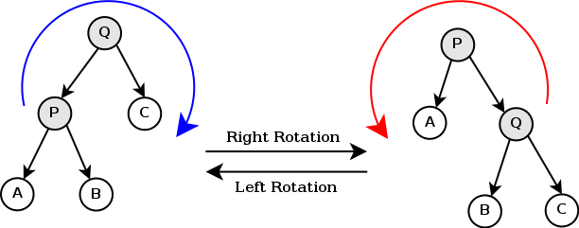
Can it be done?
Can we maintain the red-black tree properties without making insertion and deletion more expensive?
https://en.wikipedia.org/wiki/Tree_rotation#/media/File:Tree_rotation.png

Slide 105
A quick example
https://www.youtube.com/watch?v=vDHFF4wjWYU

