Slide 1
More Recurrences
David Kauchak
cs140
Fall 2022

Slide 2
Administrative
Assignment 2

Slide 3
Recurrence
A function that is defined with respect to itself on smaller inputs

Slide 4
The challenge
Recurrences are often easy to define because they mimic the structure of the program
But… they do not directly express the computational cost, i.e. n, n², …
We want to remove self-recurrence and find a more understandable form for the function

Slide 5
Three approaches
Substitution method: when you have a good guess of the solution, prove that it’s correct
Recursion-tree method: If you don’t have a good guess, the recursion tree can help. Then solve with substitution method.
Master method: Provides solutions for recurrences of the form:

Slide 6
Substitution method
Guess the form of the solution
Then prove it’s correct by induction
Halves the input then constant amount of work
Similar to binary search:
Guess: O(log₂ n)

Slide 7
Assume T(k) = O(log₂ k) for all k < n
Show that T(n) = O(log₂ n)
From our assumption, T(n/2) = O(log₂ n/2):
From the definition of big-O: T(n/2) ≤ c log₂(n/2)
How do we now prove T(n) = O(log n)?

Slide 8
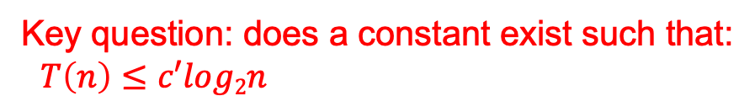
To prove that T(n) = O(log₂ n) identify the appropriate constants:
i.e. some constant c’ such that T(n) ≤ c’ log₂ n
from our inductive hypothesis
residual
Key question: does a constant exist such that:
$T\left(n\right)≤c′log2n$

Slide 9
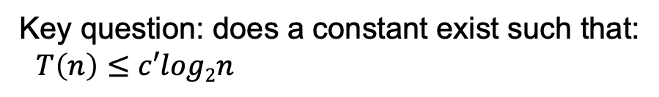

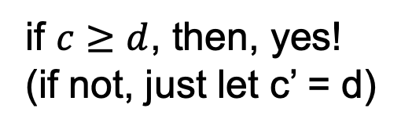
To prove that T(n) = O(log₂ n) identify the appropriate constants:
i.e. some constant c’ such that T(n) ≤ c’ log₂ n
Key question: does a constant exist such that:
$T\left(n\right)≤c′log2n$
$$T\left(n\right)≤clog2n−c+d$$
if $c≥d$, then, yes!
(if not, just let c’ = d)

Slide 10
Guess the solution?
  At each iteration, does a linear amount of work (i.e. iterate over the data) and reduces the size by one at each step
  O(n²)
Assume T(k) = O(k²) for all k < n
  again, this implies that T(n-1) ≤ c(n-1)²
Show that T(n) = O(n²), i.e. T(n) ≤ c’n²

Slide 11
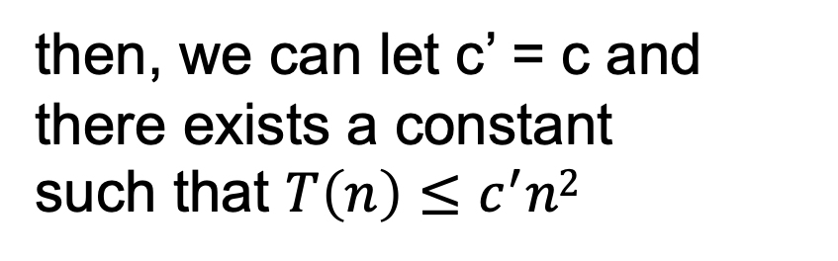
from our inductive hypothesis
residual
if
then, we can let c’ = c and there exists a constant
such that $T\left(n\right)≤c^{′}n2$

Slide 12
from our inductive hypothesis
residual
which holds for any c ≥1 for n ≥1

Slide 13
Guess the solution?
  Recurses into 2 sub-problems that are half the size and performs some operation on all the elements
  O(n log n)
What if we guess wrong, e.g. O(n²)?
Assume T(k) = O(k²) for all k < n
  again, this implies that T(n/2) ≤ c(n/2)²
Show that T(n) = O(n²)

Slide 14
from our inductive hypothesis
residual
if
overkill?

Slide 15
What if we guess wrong, e.g. O(n)?
Assume T(k) = O(k) for all k < n
  again, this implies that T(n/2) ≤ c(n/2)
Show that T(n) = O(n)
factor of n so we can just roll it in?

Slide 16
What if we guess wrong, e.g. O(n)?
Assume T(k) = O(k) for all k < n
  again, this implies that T(n/2) ≤ c(n/2)
Show that T(n) = O(n)
Must prove the exact form!
cn+n ≤ cn ??
factor of n so we can just roll it in?

Slide 17
Prove T(n) = O(n log₂ n)
Assume T(k) = O(k log₂ k) for all k < n
  again, this implies that T(k) = ck log₂k
Show that T(n) = O(n log₂ n)
residual
if cn ≥ n, c > 1

Slide 18
Changing variables
Guesses?
We can do a variable change: let m = log₂ n
(or n = 2^{m})
Now, let S(m)=T(2^{m})

Slide 19
Changing variables
Guess?
substituting m=log n

Slide 20
Recursion Tree
Guessing the answer can be difficult
The recursion tree approach
  Draw out the cost of the tree at each level of recursion
  Sum up the cost of the levels of the tree
    Find the cost of each level with respect to the depth
    Figure out the depth of the tree
    Figure out (or bound) the number of leaves
  Verify your answer using the substitution method

Slide 21
cost
cn²
cn²
T(n/4 )
T(n/4 )
T(n/4 )

Slide 22
cost
cn²
cn²
3/16cn²

Slide 23
cost
cn²
cn²
3/16cn²
(3/16)²cn²
What is the cost at each level?

Slide 24
What is the depth of the tree?
At each level, the size of the data is divided by 4

Slide 25
cn²
How many leaves are there?

Slide 26
How many leaves?
How many leaves are there in a complete ternary tree of depth d?

Slide 27
Total cost
let x = 3/16
?

Slide 28
Total cost
Assignment 1!

Slide 29
Verify solution using substitution
Assume T(k) = O(k²) for all k < n
Show that T(n) = O(n²)
Given that T(n/4) = O((n/4)²), then
T(n/4) ≤ c(n/4)²

Slide 30
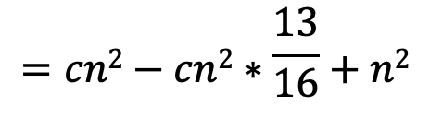
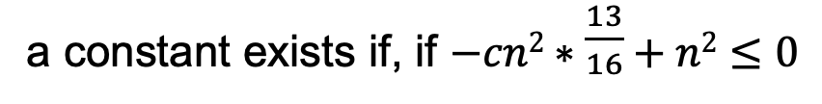
To prove that Show that T(n) = O(n²) we need to identify the appropriate constants:
i.e. some constant c such that T(n) ≤ cn²
$$=cn2−cn2∗\frac{13}{16}+n2$$
residual
a constant exists if, if $−cn2∗\frac{13}{16}+n2≤0$

Slide 31
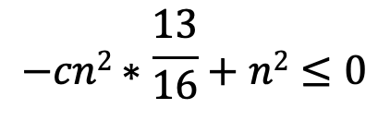
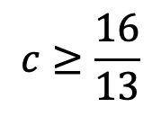
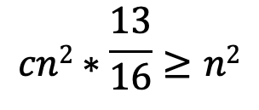
To prove that Show that T(n) = O(n²) we need to identify the appropriate constants:
i.e. some constant c such that T(n) ≤ cn²
$$−cn2∗\frac{13}{16}+n2≤0$$
$$cn2∗\frac{13}{16}≥n2$$
$$c≥\frac{16}{13}$$

Slide 32
Master Method
Provides solutions to the recurrences of the form:

Slide 33
a =
b =
f(n) =
16
4
n
Case 1:
Θ(n²)

Slide 34
a =
b =
f(n) =
1
2
2^{n}
Case 3?

Slide 35
Let c = 1/2
T(n) = Θ(2^{n})

Slide 36
a =
b =
f(n) =
2
2
n
Case 2:
Θ(n log n)

Slide 37
a =
b =
f(n) =
16
4
n!
Case 3?

Slide 38
Let c = 1/2
T(n) = Θ(n!)
therefore,

Slide 39
a =
b =
f(n) =
2
logn
Case 1:
Θ( )

Slide 40
a =
b =
f(n) =
4
2
n
Case 1:
Θ(n²)

Slide 41
Recurrences

Slide 42
Why does the master method work?
a
a
a
a

Slide 43
What is the depth of the tree?
At each level, the size of the data is divided by b

Slide 44
How many leaves?
How many leaves are there in a complete
a-ary tree of depth d?

Slide 45
Total cost
Case 1: cost is dominated by the cost of the leaves

Slide 46
Total cost
Case 2: cost is evenly distributed across tree
As we saw with mergesort, log n levels to the tree and at each level f(n) work

Slide 47
Total cost
Case 3: cost is dominated by the cost of the root
a

Slide 48
Other forms of the master method

