Slide 1
Recurrences
David Kauchak
cs140
Fall 2022

Slide 2
Administrative
Mentor hours and office hours posted
Assignment 1
Assignment 2 out today (can start after this class)

Slide 3
Divide and Conquer
Divide: Break the problem into smaller sub-problems
Conquer: Solve the sub-problems. Generally, this involves waiting for the problem to be small enough that it is trivial to solve (i.e. 1 or 2 items)
Combine: Given the results of the solved sub-problems, combine them to generate a solution for the complete problem

Slide 4
Divide and Conquer: some thoughts
Often, the sub-problem is the same as the original problem
Dividing the problem in half frequently does the job
May have to get creative about how the data is split
Splitting tends to generate run times with log n in them

Slide 5
Divide and conquer
One approach:
Pretend like you have a working version of your function, but it only works on smaller sub-problems
If you split up the current problem in some way (e.g. in half) and solved those sub-problems, how could you then get the solution to the larger problem?

Slide 6
Divide and Conquer: Sorting
How should we split the data?
What are the sub-problems we need to solve?
How do we combine the results from these sub-problems?

Slide 7
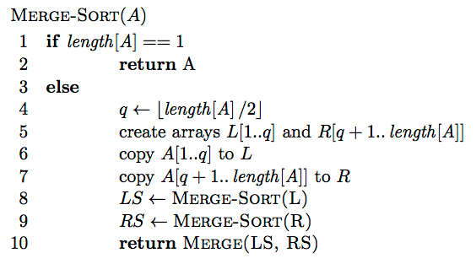
MergeSort

Slide 8
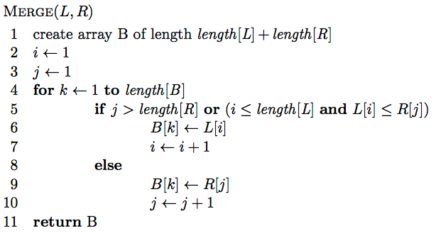
MergeSort: Merge
Assuming L and R are sorted already, merge
the two to create a single sorted array

Slide 9
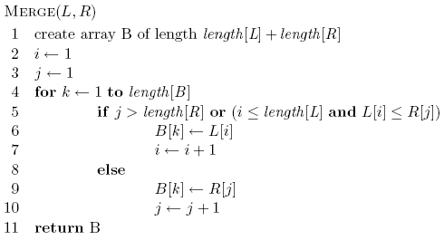
Merge
L: 1 3 5 8
R: 2 4 6 7

Slide 10
Merge
L: 1 3 5 8
R: 2 4 6 7
B:

Slide 11
Merge
i
j
L: 1 3 5 8
R: 2 4 6 7
B:

Slide 12
Merge
i
j
L: 1 3 5 8
R: 2 4 6 7
B:

Slide 13
Merge
i
j
L: 1 3 5 8
R: 2 4 6 7
B: 1

Slide 14
Merge
i
j
L: 1 3 5 8
R: 2 4 6 7
B: 1

Slide 15
Merge
i
j
L: 1 3 5 8
R: 2 4 6 7
B: 1 2

Slide 16
Merge
i
j
L: 1 3 5 8
R: 2 4 6 7
B: 1 2

Slide 17
Merge
i
j
L: 1 3 5 8
R: 2 4 6 7
B: 1 2 3

Slide 18
Merge
i
j
L: 1 3 5 8
R: 2 4 6 7
B: 1 2 3

Slide 19
Merge
i
j
L: 1 3 5 8
R: 2 4 6 7
B: 1 2 3 4

Slide 20
Merge
i
j
L: 1 3 5 8
R: 2 4 6 7
B: 1 2 3 4

Slide 21
Merge
i
j
L: 1 3 5 8
R: 2 4 6 7
B: 1 2 3 4 5

Slide 22
Merge
i
j
L: 1 3 5 8
R: 2 4 6 7
B: 1 2 3 4 5

Slide 23
Merge
i
j
L: 1 3 5 8
R: 2 4 6 7
B: 1 2 3 4 5 6

Slide 24
Merge
i
j
L: 1 3 5 8
R: 2 4 6 7
B: 1 2 3 4 5 6

Slide 25
Merge
i
j
L: 1 3 5 8
R: 2 4 6 7
B: 1 2 3 4 5 6 7

Slide 26
Merge
i
j
L: 1 3 5 8
R: 2 4 6 7
B: 1 2 3 4 5 6 7

Slide 27
Merge
i
j
L: 1 3 5 8
R: 2 4 6 7
B: 1 2 3 4 5 6 7 8

Slide 28
Merge
Does the algorithm terminate?

Slide 29
Merge
Is it correct?
Loop invariant: At the end of each iteration of the for loop of lines 4-10 the subarray B[1..k] contains the smallest k elements from L and R in sorted order.

Slide 30
Merge
Is it correct?
Loop invariant: At the beginning of the for loop of lines 4-10 the first k-1 elements of B are the smallest k-1 elements from L and R in sorted order.

Slide 31
Merge
Running time?

Slide 32
Merge
Running time? Θ(n) - linear

Slide 33
MergeSort
Running time?

Slide 34
Merge-Sort
Running time?
D(n): cost of splitting (dividing) the data
C(n): cost of merging/combining the data

Slide 35
Merge-Sort
Running time?
D(n): cost of splitting (dividing) the data - linear Θ(n)
C(n): cost of merging/combining the data – linear Θ(n)

Slide 36
Merge-Sort
Running time?
Which is?

Slide 37
Merge-Sort
cn
T(n/2)
T(n/2)

Slide 38
Merge-Sort
cn
cn/2
cn/2
T(n/4)
T(n/4)
T(n/4)
T(n/4)

Slide 39
Merge-Sort
cn
cn/2
cn/2
cn/4
cn/4
cn/4
cn/4
T(n/8)
T(n/8)
T(n/8)
T(n/8)
T(n/8)
T(n/8)
T(n/8)
T(n/8)

Slide 40
Merge-Sort
cn
cn/2
cn/2
cn/4
cn/4
cn/4
cn/4
cn/8
cn/8
cn/8
cn/8
cn/8
cn/8
cn/8
cn/8
…
c c c c c … c c c c c c

Slide 41
Merge-Sort
cn
cn
cn/2
cn/2
cn
cn/4
cn/4
cn/4
cn/4
cn
cn/8
cn/8
cn/8
cn/8
cn/8
cn/8
cn/8
cn/8
cn
…
c c c c c … c c c c c c
cn

Slide 42
Merge-Sort
cn
cn
cn/2
cn/2
cn
cn/4
cn/4
cn/4
cn/4
cn
cn/8
cn/8
cn/8
cn/8
cn/8
cn/8
cn/8
cn/8
cn
…
c c c c c … c c c c c c
cn
Depth?

Slide 43
Merge-Sort
We can calculate the depth, by determining when the recursion gets to down to a small problem size, e.g. 1
At each level, we divide by 2

Slide 44
Merge-Sort
Running time?
  Each level costs cn
  log n levels
cn log n = Θ(n log n )

Slide 45
Recurrence
A function that is defined with respect to itself on smaller inputs

Slide 46
Why are we interested in recurrences?
Computational cost of divide and conquer algorithms
  a subproblems of size n/b
  D(n) the cost of dividing the data
  C(n) the cost of recombining the subproblem solutions
In general, the runtimes of most recursive algorithms can be expressed as recurrences

Slide 47
The challenge
Recurrences are often easy to define because they mimic the structure of the program
But… they do not directly express the computational cost, i.e. n, n², …
We want to remove self-recurrence and find a more understandable form for the function

Slide 48
Three approaches
Substitution method: when you have a good guess of the solution, prove that it’s correct
Recursion-tree method: If you don’t have a good guess, the recursion tree can help. Then solve with substitution method.
Master method: Provides solutions for recurrences of the form:

Slide 49
Substitution method
Guess the form of the solution
Then prove it’s correct by induction
Halves the input then constant amount of work
Guesses?

Slide 50
Substitution method
Guess the form of the solution
Then prove it’s correct by induction
Halves the input then constant amount of work
Similar to binary search:
Guess: O(log₂ n)

Slide 51
Proof?
Ideas?

Slide 52
Proof?
Proof by induction!
Assume it’s true for smaller T(k), i.e. k < n
prove that it’s then true for current T(n)

Slide 53
Assume T(k) = O(log₂ k) for all k < n
Show that T(n) = O(log₂ n)
From our assumption, T(n/2) = O(log₂ n):
From the definition of big-O: T(n/2) ≤ c log₂(n/2)
How do we now prove T(n) = O(log n)?

Slide 54
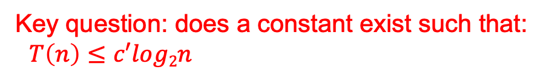
To prove that T(n) = O(log₂ n) identify the appropriate constants:
i.e. some constant c’ such that T(n) ≤ c’ log₂ n
from our inductive hypothesis
residual
Key question: does a constant exist such that:
$T\left(n\right)≤c′log2n$

Slide 55
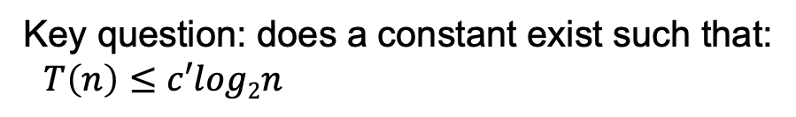

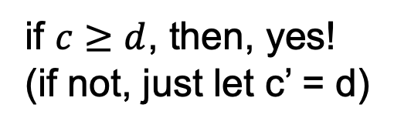
To prove that T(n) = O(log₂ n) identify the appropriate constants:
i.e. some constant c₂ such that T(n) ≤ c₂ log₂ n
Key question: does a constant exist such that:
$T\left(n\right)≤c′log2n$
$$T\left(n\right)≤clog2n−c+d$$
if $c≥d$, then, yes!
(if not, just let c’ = d)

Slide 56
Base case?
For an inductive proof we need to show two things:
  Assuming it’s true for k < n show it’s true for n
  Show that it holds for some base case
What is the base case in our situation?

Slide 57
Guess the solution?
  At each iteration, does a linear amount of work (i.e. iterate over the data) and reduces the size by one at each step
  O(n²)
Assume T(k) = O(k²) for all k < n
  again, this implies that T(n-1) ≤ c(n-1)²
Show that T(n) = O(n²), i.e. T(n) ≤ c’n²

Slide 58
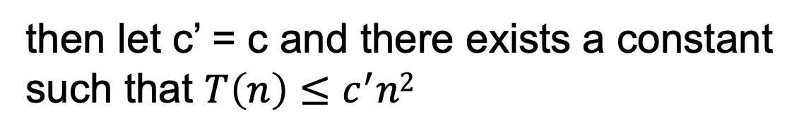
from our inductive hypothesis
residual
if
then let c’ = c and there exists a constant
such that $T\left(n\right)≤c^{′}n2$

Slide 59
from our inductive hypothesis
residual
which holds for any c ≥1 for n ≥1

