Slide 1
minimum spanning trees
David Kauchak
CS 140 – Fall 2020

Slide 2
Admin
Assignment
Assignment 4.1graded
Mentor hours this week
Checkpoint

Slide 3
Minimum spanning trees
What are they?
What do you remember about them?
What algorithms do you remember?

Slide 4
Minimum spanning trees
What is the lowest weight set of edges that connects all vertices of an undirected graph with positive weights
Input: An undirected, positive weight graph, G=(V,E)
Output: A tree T=(V,E’) where E’ ⊆ E that minimizes

Slide 5
MST example
1
A
C
E
3
4
4
4
2
5
B
D
F
4
6
1
A
C
E
4
4
2
5
B
D
F

Slide 6
MSTs
Can an MST have a cycle?
1
A
C
E
4
4
2
5
B
D
F
4

Slide 7
MSTs
Can an MST have a cycle?
1
A
C
E
4
4
2
5
B
D
F

Slide 8
Applications?
Connectivity
  Networks (e.g. communications)
  Circuit design/wiring
hub/spoke models (e.g. flights, transportation)
Traveling salesman problem?
Notes:
MST is a lower bound on TSP. 2 * MST is one approximate solution to the TSP problem.

Slide 9
Algorithm ideas?
1
A
C
E
3
4
4
4
2
5
B
D
F
4
6
1
A
C
E
4
4
2
5
B
D
F

Slide 10
Cuts
A cut is a partitioning of the vertices into two sets S and V-S
An edge “crosses” the cut if it connects a vertex u∈V and v∈V-S
1
A
C
E
3
4
4
4
2
5
B
D
F
4
6

Slide 11
Minimum cut property
Given a partition S, let edge e be the minimum cost edge that crosses the partition. Every minimum spanning tree contains edge e.
Prove this!
1
A
C
E
3
4
4
4
2
5
B
D
F
4
6

Slide 12
Minimum cut property
Given a partition S, let edge e be the minimum cost edge that crosses the partition. Every minimum spanning tree contains edge e.
S
V-S
e
e’
Consider an MST with edge e’ that is not the minimum edge

Slide 13
Minimum cut property
Given a partition S, let edge e be the minimum cost edge that crosses the partition. Every minimum spanning tree contains edge e.
S
V-S
e
e’
Using e instead of e’, still connects the graph, but produces a tree with smaller weights

Slide 14
Minimum cut property
If the minimum cost edge that crosses the partition is not unique, then some minimum spanning tree contains edge e.
1
A
C
E
3
4
4
4
2
5
B
D
F
4
6

Slide 15
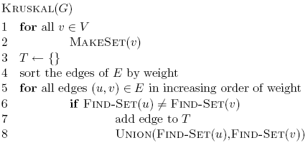
Kruskal’s algorithm
Given a partition S, let edge e be the minimum cost edge that crosses the partition. Every minimum spanning tree contains edge e.

Slide 16
Kruskal’s algorithm
Add smallest edge that connects two sets not already connected
1
A
C
E
3
4
5
4
4
2
MST
B
D
F
4
6
A
C
E
G
B
D
F

Slide 17
Kruskal’s algorithm
Add smallest edge that connects two sets not already connected
1
A
C
E
3
4
5
4
4
2
MST
B
D
F
4
6
1
A
C
E
G
B
D
F

Slide 18
Kruskal’s algorithm
Add smallest edge that connects two sets not already connected
1
A
C
E
3
4
5
4
4
2
MST
B
D
F
4
6
1
A
C
E
G
2
B
D
F

Slide 19
Kruskal’s algorithm
Add smallest edge that connects two sets not already connected
1
A
C
E
3
4
5
4
4
2
MST
B
D
F
4
6
1
A
C
E
G
4
2
B
D
F

Slide 20
Kruskal’s algorithm
Add smallest edge that connects two sets not already connected
1
A
C
E
3
4
4
4
2
5
MST
B
D
F
4
6
1
A
C
E
G
4
4
2
B
D
F

Slide 21
Kruskal’s algorithm
Add smallest edge that connects two sets not already connected
1
A
C
E
3
4
4
4
2
5
MST
B
D
F
4
6
1
A
C
E
G
4
4
2
5
B
D
F

Slide 22
Correctness of Kruskal’s
Never adds an edge that connects already connected vertices
Always adds lowest cost edge to connect two sets. By min cut property, that edge must be part of the MST

Slide 23
Running time of Kruskal’s

Slide 24
Running time of Kruskal’s
|V| calls to MakeSet
O(|E| log |E|)
2 |E| calls to FindSet
|V| calls to Union

Slide 25
Running time of Kruskal’s
Disjoint set data structure
O(|E| log |E|) +
MakeSet
FindSet
|E| calls
Union
|V| calls
Total
Linked lists

Slide 26
Disjoint set
A
B
C
D

Slide 27
Disjoint set: union
A
B
C
D

Slide 28
Disjoint set: union
B
A
C
D

Slide 29
Disjoint set: union
B
D
A
C

Slide 30
Disjoint set: union
D
C
B
A
Running time?

Slide 31
Disjoint set: union
D
C
B
A
O(1)

Slide 32
Disjoint set: find-set
B
D
A
C
Search each linked list

Slide 33
Disjoint set: find-set
B
D
A
C
Running time?

Slide 34
Disjoint set: find-set
B
D
A
C
O(n) -- n = number of things in set

Slide 35
Running time of Kruskal’s
Disjoint set data structure
O(|E| log |E|) +
MakeSet
FindSet
|E| calls
Union
|V| calls
Total
Linked lists
|V|
O(|V| |E|)
|V|
O(|V||E| + |E| log |E|)
O(|V| |E|)
Linked lists +
heuristics
|V|
O(|E| log |V|)
|V|
O(|E| log |V|+ |E| log |E|)
O(|E| log |E| )

Slide 36
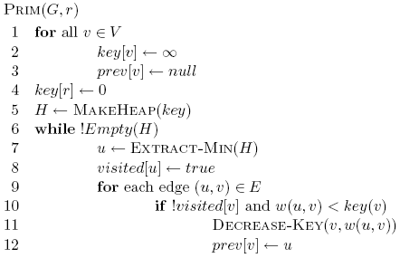
Prim’s algorithm

Slide 37
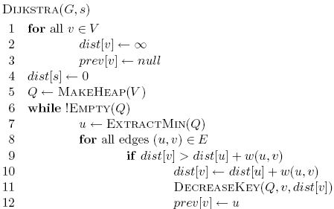
Prim’s algorithm

Slide 38
Prim’s algorithm

Slide 39
Prim’s algorithm
Start at some root node and build out the MST by adding the lowest weighted edge at the frontier

Slide 40
Prim’s
1
A
C
E
3
4
5
MST
4
4
2
B
D
F
4
6
A
C
E
B
D
F

Slide 41
Prim’s
1
A
C
E
3
4
5
MST
4
4
2
∞
∞
∞
B
D
F
4
6
A
C
E
B
D
F
∞
∞
0

Slide 42
Prim’s
1
A
C
E
3
4
5
MST
4
4
2
∞
4
5
B
D
F
4
6
A
C
E
B
D
F
∞
6
0

Slide 43
Prim’s
1
A
C
E
3
4
5
MST
4
4
2
∞
4
5
B
D
F
4
6
A
C
E
B
D
F
∞
6
0

Slide 44
Prim’s
1
A
C
E
3
4
5
MST
4
4
2
1
4
5
B
D
F
4
6
A
C
E
B
D
F
4
2
0

Slide 45
Prim’s
1
A
C
E
3
4
5
MST
4
4
2
1
4
5
B
D
F
4
6
A
C
E
B
D
F
4
2
0

Slide 46
Prim’s
1
A
C
E
3
4
5
MST
4
4
2
1
4
5
B
D
F
4
6
A
C
E
B
D
F
4
2
0

Slide 47
Prim’s
1
A
C
E
3
4
5
MST
4
4
2
1
4
5
B
D
F
4
6
A
C
E
B
D
F
4
2
0

Slide 48
Prim’s
1
A
C
E
3
4
5
MST
4
4
2
1
4
5
B
D
F
4
6
A
C
E
B
D
F
4
2
0

Slide 49
Prim’s
1
A
C
E
3
4
5
MST
4
4
2
1
4
5
B
D
F
4
6
A
C
E
B
D
F
4
2
0

Slide 50
Prim’s
1
A
C
E
3
4
5
MST
4
4
2
1
4
5
B
D
F
4
6
A
C
E
B
D
F
4
2
0

Slide 51
Prim’s
1
A
C
E
3
4
5
MST
4
4
2
1
4
5
B
D
F
4
6
A
C
E
B
D
F
4
2
0

Slide 52
Correctness of Prim’s?
Can we use the min-cut property?
  Given a partion S, let edge e be the minimum cost edge that crosses the partition. Every minimum spanning tree contains edge e.
Let S be the set of vertices visited so far
The only time we add a new edge is if it’s the lowest weight edge from S to V-S

Slide 53
Running time of Prim’s

Slide 54
Running time of Prim’s
Θ(|V|)
1 call to MakeHeap
|V| calls to Extract-Min
|E| calls to Decrease-Key

Slide 55
Running time of Prim’s
1 MakeHeap
|V| ExtractMin
|E| DecreaseKey
Total
Array
θ(|V|)
O(|V|²)
O(|E|)
O(|V|²)
Bin heap
θ(|V|)
O(|V| log |V|)
O(|E| log |V|)
O((|V|+|E|) log |V|)
O(|E| log |V|)
Fib heap
θ(|V|)
O(|V| log |V|)
O(|E|)
O(|V| log |V| + |E|)
Kruskal’s: O(|E| log |E| )

