Slide 1
Greedy algorithms
David Kauchak
CS 140 – Fall 2022

Slide 2
Admin
Assignment 7
Learning communities: may attend any group going forward
Grading update
  5 graded
  4.1 soon!
  Checkpoint revisions graded

Slide 3
Checkpoint 2
2 pages of notes
From hashtables (9/2) through dynamic programming (10/13)
Practice problems available in group assignment 7

Slide 4
A problem
Input: a number k
Output: {n_{p}, n_{n}, n_{d}, n_{q}}, where n_{p}+5n_{n}+10n_{d}+25n_{q}=k and n_{p}+n_{n}+n_{d}+n_{q} is minimized
What is this problem?
How would you state it in English?

Slide 5
Making change!
Input: a number k
Output: {n_{p}, n_{n}, n_{d}, n_{q}}, where n_{p}+5n_{n}+10n_{d}+25n_{q}=k and n_{p}+n_{n}+n_{d}+n_{q} is minimized
Provide (U.S.) coins that sum up to k such that we minimize the number of coins

Slide 6
Making change!
Input: a number k
Output: {n_{p}, n_{n}, n_{d}, n_{q}}, where n_{p}+5n_{n}+10n_{d}+25n_{q}=k and n_{p}+n_{n}+n_{d}+n_{q} is minimized
Algorithm to solve it?

Slide 7
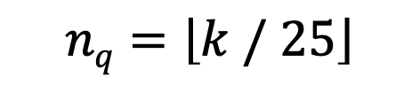
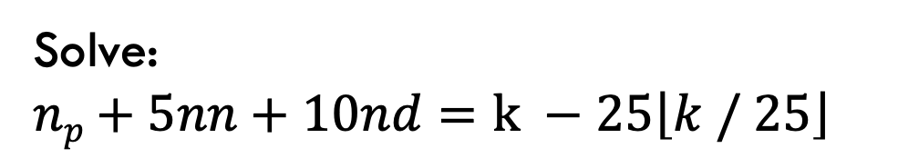
Making change!
Input: a number k
Output: {n_{p}, n_{n}, n_{d}, n_{q}}, where n_{p}+5n_{n}+10n_{d}+25n_{q}=k and n_{p}+n_{n}+n_{d}+n_{q} is minimized
$$nq=\left\lfloor k / 25\right\rfloor$$
pick as many quarters as we can
Solve:
$np+5nn+10nd=$ $k −25\left\lfloor k / 25\right\rfloor$
recurse

Slide 8
Algorithms vs heuristics
What is the difference between an algorithm and a heuristic?
Algorithm: a set of steps for arriving at the correct solution
Heuristic: a set of steps that will arrive at some solution

Slide 9
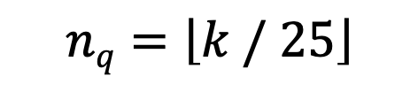
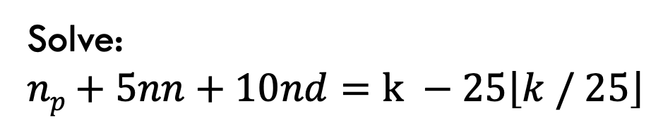
Making change!
$$nq=\left\lfloor k / 25\right\rfloor$$
pick as many quarters as we can
Solve:
$np+5nn+10nd=$ $k −25\left\lfloor k / 25\right\rfloor$
recurse
Algorithm or heuristic?
Need to prove its correct!

Slide 10
Greedy algorithms
What is a greedy algorithm?
Algorithm that makes a local decision with the goal of creating a globally optimal solution
Method for solving problems where optimal solutions can be defined in terms of optimal solutions to sub-problems
What does this mean? Where have we seen this before?

Slide 11
Greedy vs. divide and conquer
Divide and conquer
To solve the general problem:
Break into sum number of sub problems, solve:
then possibly do a little work

Slide 12
Divide and conquer
Divide and conquer
To solve the general problem:
The solution to the general problem is solved with respect to solutions to sub-problems!

Slide 13
Dynamic programming
Dynamic programming
To solve the general problem:
…
The solution to the general problem is solved with respect to solutions to sub-problems that overlap!

Slide 14
Greedy vs. divide and conquer
Greedy
To solve the general problem:
Pick a locally optimal solution and repeat

Slide 15
Greedy vs. divide and conquer
Greedy
To solve the general problem:
The solution to the general problem is solved with respect to solutions to sub-problems!
Slightly different than divide and conquer

Slide 16
Proving greedy algorithms correct
One approach, prove:
Optimal substructure: The optimal solution contains within it the optimal solution to subproblems
Greedy choice property: The greedy choice is contained within some optimal solution

Slide 17
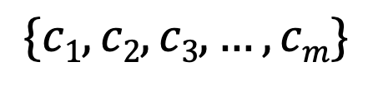
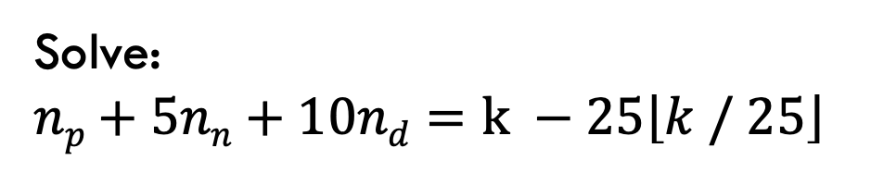
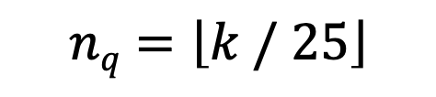
Making change!
$$nq=\left\lfloor k / 25\right\rfloor$$
pick as many quarters as we can
Solve:
$np+5nn+10nd=$ $k −25\left\lfloor k / 25\right\rfloor$
recurse
$$\{c1, c2, c3, …, cm\}$$
solution: individual coins selected

Slide 18
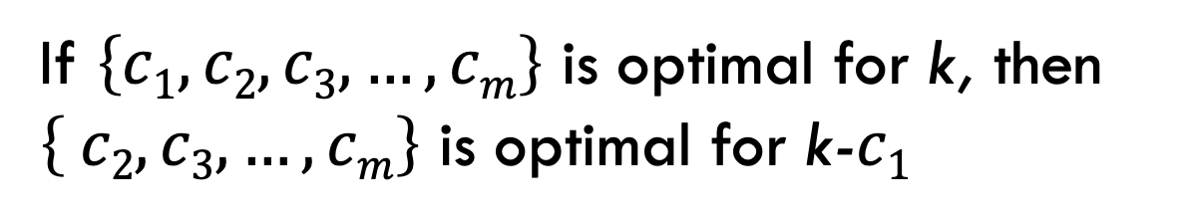
Optimal substructure
If $\left\{c1, c2, c3, …, cm\right\}$ is optimal for k, then $\left\{ c2, c3, …, cm\right\}$ is optimal for k-$c1$
We can combine a greedy choice with the optimal solution for the remaining problem and get a solution to the general problem

Slide 19
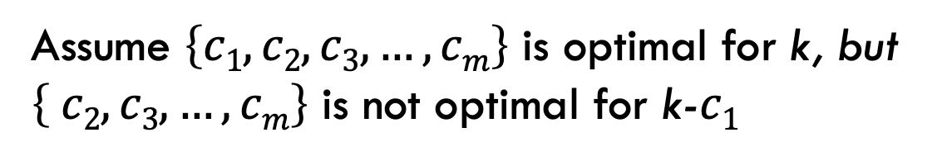
Optimal substructure
Proof by contradiction:
Assume $\left\{c1, c2, c3, …, cm\right\}$ is optimal for k, but $\left\{ c2, c3, …, cm\right\}$ is not optimal for k-$c1$
What does that imply?

Slide 20
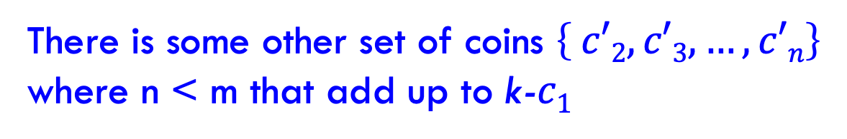
Optimal substructure
Proof by contradiction:
Assume $\left\{c1, c2, c3, …, cm\right\}$ is optimal for k, but $\left\{ c2, c3, …, cm\right\}$ is not optimal for k-$c1$
There is some other set of coins $\left\{ c′2, c′3, …, c′n\right\}$ where n < m that add up to k-$c1$
Any problem contradiction?

Slide 21
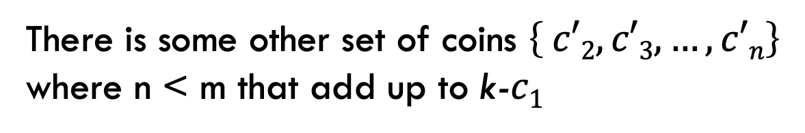
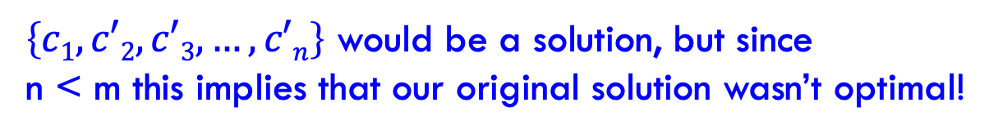
Optimal substructure
Proof by contradiction:
Assume $\left\{c1, c2, c3, …, cm\right\}$ is optimal for k, but $\left\{ c2, c3, …, cm\right\}$ is not optimal for k-$c1$
There is some other set of coins $\left\{ c′2, c′3, …, c′n\right\}$ where n < m that add up to k-$c1$
$\left\{c1, c′2, c′3, …, c′n\right\}$ would be a solution, but since
n < m this implies that our original solution wasn’t optimal!

Slide 22
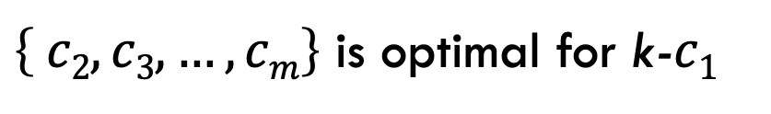
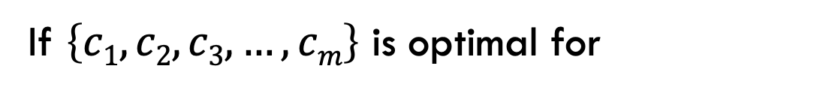
Optimal substructure
If $\left\{c1, c2, c3, …, cm\right\}$ is optimal for
$\left\{ c2, c3, …, cm\right\}$ is optimal for k-$c1$
We can make greedy decisions

Slide 23
Greedy choice property
Greedy choice property: The greedy choice is contained within some optimal solution
The greedy choice results in an optimal solution

Slide 24
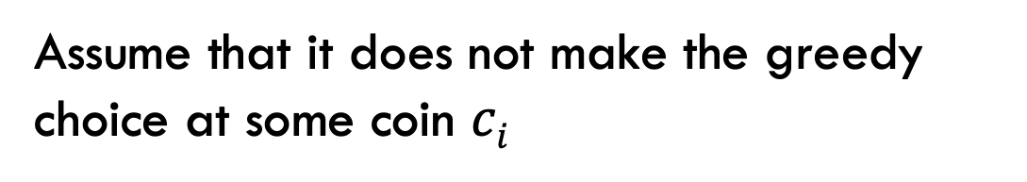
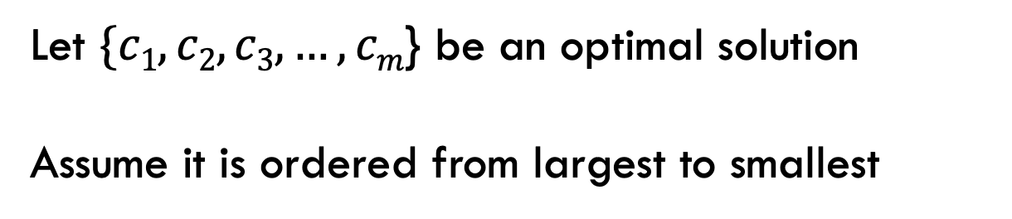
Greedy choice property
Proof by contradiction:
Let $\{c1, c2, c3, …, cm$} be an optimal solution
Assume it is ordered from largest to smallest
Assume that it does not make the greedy choice at some coin $ci$
Any problem contradiction?

Slide 25
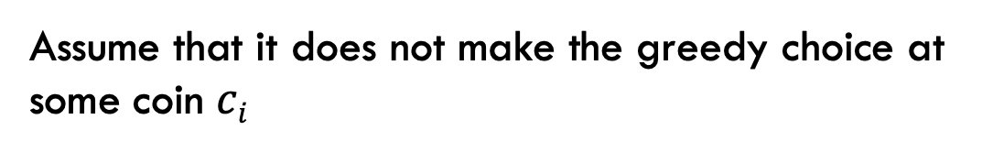
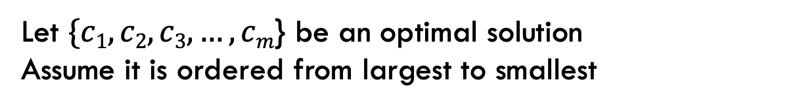
Greedy choice property
Proof by contradiction:
Let $\{c1, c2, c3, …, cm$} be an optimal solution
Assume it is ordered from largest to smallest
Assume that it does not make the greedy choice at some coin $ci$
g_{i} > c_{i}. We need at least one more lower denomination coin because g_{i} can be made up of c_{i} and one or more of the other denominations
but that would mean that the solution is longer than the greedy!

Slide 26
Interval scheduling
Given n activities A = [a₁,a₂, .., a_{n}] where each activity has start time s_{i} and a finish time f_{i}. Schedule as many as possible of these activities such that they don’t conflict.

Slide 27
Interval scheduling
Given n activities A = [a₁,a₂, .., a_{n}] where each activity has start time s_{i} and a finish time f_{i}. Schedule as many as possible of these activities such that they don’t conflict.
Which activities conflict?

Slide 28
Interval scheduling
Given n activities A = [a₁,a₂, .., a_{n}] where each activity has start time s_{i} and a finish time f_{i}. Schedule as many as possible of these activities such that they don’t conflict.
Which activities conflict?

Slide 29
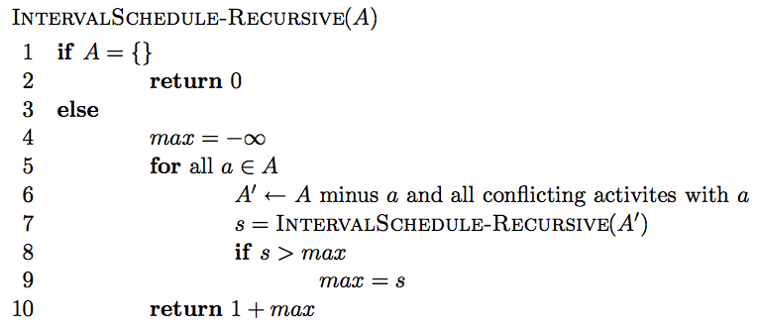
Simple recursive solution
Enumerate all possible solutions and find which schedules the most activities

Slide 30
Simple recursive solution
Is it correct?
  max{all possible solutions}
Running time?
  O(n!)

Slide 31
Can we do better?
Dynamic programming
  O(n²)
Greedy solution – Is there a way to repeatedly make local decisions?
  Key: we’d still like to end up with the optimal solution

Slide 32
Overview of a greedy approach
Greedily pick an activity to schedule
Add that activity to the answer
Remove that activity and all conflicting activities. Call this A’.
Repeat on A’ until A’ is empty

Slide 33
Greedy options
Select the activity that starts the earliest, i.e.
argmin{s₁, s₂, s₃, …, s_{n}}?

Slide 34
Greedy options
Select the activity that starts the earliest, i.e. argmin{s₁, s₂, s₃, …, s_{n}}?
non-optimal

Slide 35
Greedy options
Select the shortest activity, i.e.
argmin{f₁-s₁, f₂-s₂, f₃-s₃, …, f_{n}-s_{n}}

Slide 36
Greedy options
Select the shortest activity, i.e.
argmin{f₁-s₁, f₂-s₂, f₃-s₃, …, f_{n}-s_{n}}
non-optimal

Slide 37
Greedy options
Select the activity with the smallest number of conflicts

Slide 38
Greedy options
Select the activity with the smallest number of conflicts

Slide 39
Greedy options
Select the activity with the smallest number of conflicts

Slide 40
Greedy options
Select the activity that ends the earliest, i.e. argmin{f₁, f₂, f₃, …, f_{n}}?

Slide 41
Greedy options
Select the activity that ends the earliest, i.e. argmin{f₁, f₂, f₃, …, f_{n}}?
remove the conflicts

Slide 42
Greedy options
Select the activity that ends the earliest, i.e. argmin{f₁, f₂, f₃, …, f_{n}}?

Slide 43
Greedy options
Select the activity that ends the earliest, i.e. argmin{f₁, f₂, f₃, …, f_{n}}?

Slide 44
Greedy options
Select the activity that ends the earliest, i.e. argmin{f₁, f₂, f₃, …, f_{n}}?
remove the conflicts

Slide 45
Greedy options
Select the activity that ends the earliest, i.e. argmin{f₁, f₂, f₃, …, f_{n}}?

Slide 46
Greedy options
Select the activity that ends the earliest, i.e. argmin{f₁, f₂, f₃, …, f_{n}}?

Slide 47
Greedy options
Select the activity that ends the earliest, i.e. argmin{f₁, f₂, f₃, …, f_{n}}?

Slide 48
Greedy options
Select the activity that ends the earliest, i.e. argmin{f₁, f₂, f₃, …, f_{n}}?

Slide 49
Greedy options
Select the activity that ends the earliest, i.e. argmin{f₁, f₂, f₃, …, f_{n}}?
Multiple optimal solutions

Slide 50
Greedy options
Select the activity that ends the earliest, i.e. argmin{f₁, f₂, f₃, …, f_{n}}?

Slide 51
Greedy options
Select the activity that ends the earliest, i.e. argmin{f₁, f₂, f₃, …, f_{n}}?

Slide 52
Efficient greedy algorithm
Once you’ve identified a reasonable greedy heuristic:
  Prove that it always gives the correct answer
  Develop an efficient solution

Slide 53
Is our greedy approach correct?
“Stays ahead” argument:
show that no matter what other solution someone provides you, the solution provided by your algorithm always “stays ahead”, in that no other choice could do better

Slide 54
Is our greedy approach correct?
“Stays ahead” argument
Let r₁, r₂, r₃, …, r_{k} be the solution found by our approach
Let o₁, o₂, o₃, …, o_{k} be another optimal solution
Show our approach “stays ahead” of any other solution
…
r₁
r₂
r₃
r_{k}
…
o₁
o₂
o₃
o_{k}

Slide 55
Stays ahead
…
r₁
r₂
r₃
r_{k}
…
o₁
o₂
o₃
o_{k}
Compare first activities of each solution
what do we know?

Slide 56
Stays ahead
…
r₁
r₂
r₃
r_{k}
…
o₁
o₂
o₃
o_{k}
finish(r₁) ≤ finish(o₁)
what does this imply?

Slide 57
Stays ahead
…
r₂
r₃
r_{k}
…
o₂
o₃
o_{k}
We have at least as much time as any other solution to schedule the remaining 2…k tasks

Slide 58
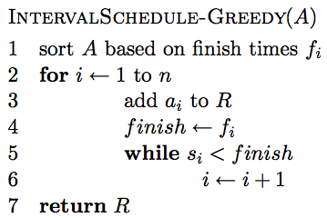
An efficient solution

Slide 59
Running time?
Θ(n log n)
Θ(n)
Better than:
O(n!)
O(n²)
Overall: Θ(n log n)

Slide 60
Scheduling all intervals
Given n activities, we need to schedule all activities. Goal: minimize the number of resources required.

Slide 61
Greedy approach?
The best we could ever do is the maximum number of conflicts for any time period

Slide 62
Calculating max conflicts efficiently

Slide 63
Calculating max conflicts efficiently
3

Slide 64
Calculating max conflicts efficiently
1

Slide 65
Calculating max conflicts efficiently
3

Slide 66
Calculating max conflicts efficiently
1

Slide 67
Calculating max conflicts efficiently
…

Slide 68
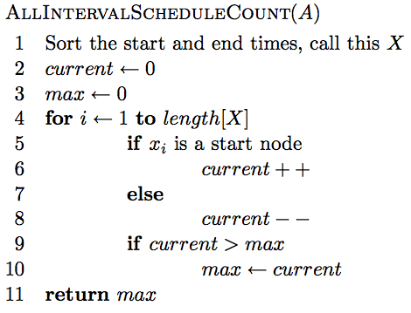
Calculating max conflicts

Slide 69
Correctness?
We can do no better then the max number of conflicts. This exactly counts the max number of conflicts.

Slide 70
Runtime?
O(2n log 2n + n) = O(n log n)

Slide 71
Knapsack problems:
Greedy or not?
0-1 Knapsack – A thief robbing a store finds n items worth v₁, v₂, .., v_{n} dollars and weight w₁, w₂, …, w_{n} pounds, where v_{i} and w_{i} are integers. The thief can carry at most W pounds in the knapsack. Which items should the thief take if he wants to maximize value.
Fractional knapsack problem – Same as above, but the thief happens to be at the bulk section of the store and can carry fractional portions of the items. For example, the thief could take 20% of item i for a weight of 0.2w_{i} and a value of 0.2v_{i}.

