Slide 1
Dynamic programming:
More fun!
David Kauchak
CS 140 – Fall 2022

Slide 2
Admin
Assignment 6
Mentor hours this week

Slide 3
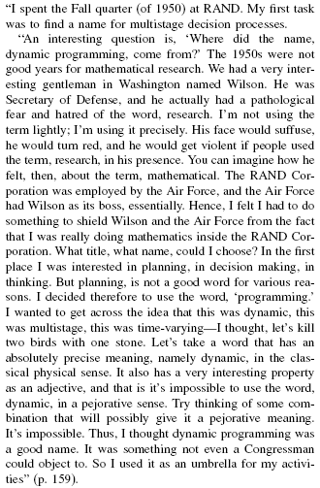
Where did “dynamic programming” come from?
Richard Bellman On the Birth of Dynamic Programming
Stuart Dreyfus
http://www.eng.tau.ac.il/~ami/cd/or50/1526-5463-2002-50-01-0048.pdf

Slide 4
Dynamic programming
Method for solving problems where optimal solutions can be defined in terms of optimal solutions to subproblems
AND
the subproblems are overlapping

Slide 5
Dynamic programming: steps
1a) optimal substructure: optimal solutions to the problem incorporate optimal solutions to related subproblems
  convince yourself that there is optimal substructure
1b) recursive definition: use this to recursively define the value of an optimal solution
2) DP solution: describe the dynamic programming table:
  size, initial values, order in which it’s filled in, location of solution
3) Analysis: analyze space requirements, running time

Slide 6
LCS problem
Given two sequences X and Y, a common subsequence is a subsequence that occurs in both X and Y
Given two sequences X = x₁, x₂, …, x_{n} and
Y = y₁, y₂, …, y_{n}
What is the longest common subsequence?

Slide 7
2: DP solution
What types of subproblem solutions do we need to store?
LCS(X_{1…j}, Y_{1…k})

Slide 8
j
0 1 2 3 4 5 6
y_{j} B D C A B A
i
0 x_{i}
1 A
2 B
3 C
4 B
5 D
6 A
7 B
0 0 0 0 0 0 0
0
0
0
0
0
0
0
How should we fill in the table?

Slide 9
j
0 1 2 3 4 5 6
y_{j} B D C A B A
i
0 x_{i}
1 A
2 B
3 C
4 B
5 D
6 A
7 B
0 0 0 0 0 0 0
0
0
0 ?
0
0
0
0
To fill in an entry, we may need to look:
up one
left one
diagonal up and left
Just need to make sure these exist

Slide 10
j
0 1 2 3 4 5 6
y_{j} B D C A B A
i
0 x_{i}
1 A
2 B
3 C
4 B
5 D
6 A
7 B
0 0 0 0 0 0 0
0 ?
0
0
0
0
0
0
LCS(A, B)

Slide 11
j
0 1 2 3 4 5 6
y_{j} B D C A B A
i
0 x_{i}
1 A
2 B
3 C
4 B
5 D
6 A
7 B
0 0 0 0 0 0 0
0 0
0
0
0
0
0
0

Slide 12
j
0 1 2 3 4 5 6
y_{j} B D C A B A
i
0 x_{i}
1 A
2 B
3 C
4 B
5 D
6 A
7 B
0 0 0 0 0 0 0
0 0 0 0 ?
0
0
0
0
0
0
LCS(A, BDCA)

Slide 13
j
0 1 2 3 4 5 6
y_{j} B D C A B A
i
0 x_{i}
1 A
2 B
3 C
4 B
5 D
6 A
7 B
0 0 0 0 0 0 0
0 0 0 0 1
0
0
0
0
0
0
LCS(A, BDCA)

Slide 14
j
0 1 2 3 4 5 6
y_{j} B D C A B A
i
0 x_{i}
1 A
2 B
3 C
4 B
5 D
6 A
7 B
0 0 0 0 0 0 0
0 0 0 0 1 1 1
0 1 1 1 1 2 2
0 1 1 2 2 2 2
0 1 1 2 2 ?
0
0
0
LCS(ABCB, BDCAB)

Slide 15
j
0 1 2 3 4 5 6
y_{j} B D C A B A
i
0 x_{i}
1 A
2 B
3 C
4 B
5 D
6 A
7 B
0 0 0 0 0 0 0
0 0 0 0 1 1 1
0 1 1 1 1 2 2
0 1 1 2 2 2 2
0 1 1 2 2 3
0
0
0
LCS(ABCB, BDCAB)

Slide 16
j
0 1 2 3 4 5 6
y_{j} B D C A B A
i
0 x_{i}
1 A
2 B
3 C
4 B
5 D
6 A
7 B
0 0 0 0 0 0 0
0 0 0 0 1 1 1
0 1 1 1 1 2 2
0 1 1 2 2 2 2
0 1 1 2 2 3 3
0 1 2 2 2 3 3
0 1 2 2 3 3 4
0 1 2 2 3 4 4
Where’s the final answer?

Slide 17
j
0 1 2 3 4 5 6
y_{j} B D C A B A
i
Space requirements?
Running time?
0 x_{i}
1 A
2 B
3 C
4 B
5 D
6 A
7 B
0 0 0 0 0 0 0
0 0 0 0 1 1 1
0 1 1 1 1 2 2
0 1 1 2 2 2 2
0 1 1 2 2 3 3
0 1 2 2 2 3 3
0 1 2 2 3 3 4
0 1 2 2 3 4 4

Slide 18
j
0 1 2 3 4 5 6
y_{j} B D C A B A
i
Space requirements: Θ(nm)
Running time: Θ(nm)
0 x_{i}
1 A
2 B
3 C
4 B
5 D
6 A
7 B
0 0 0 0 0 0 0
0 0 0 0 1 1 1
0 1 1 1 1 2 2
0 1 1 2 2 2 2
0 1 1 2 2 3 3
0 1 2 2 2 3 3
0 1 2 2 3 3 4
0 1 2 2 3 4 4

Slide 19
Keeping track of the solution
Our LCS algorithm only calculated the length of the LCS between X and Y
What if we wanted to know the actual sequence?

Slide 20
j
0 1 2 3 4 5 6
y_{j} B D C A B A
i
0 x_{i}
1 A
2 B
3 C
4 B
5 D
6 A
7 B
0 0 0 0 0 0 0
0 0 0 0 1 1 1
0 1 1 1 1 2 2
0 1 1 2 2 2 2
0 1 1 2 2 ?
0
0
0
LCS(ABCB, BDCAB)

Slide 21
j
0 1 2 3 4 5 6
y_{j} B D C A B A
i
0 x_{i}
1 A
2 B
3 C
4 B
5 D
6 A
7 B
0 0 0 0 0 0 0
0 0 0 0 1 1 1
0 1 1 1 1 2 2
0 1 1 2 2 2 2
0 1 1 2 2 3
0
0
0
LCS(ABCB, BDCAB)

Slide 22
j
0 1 2 3 4 5 6
y_{j} B D C A B A
i
0 x_{i}
1 A
2 B
3 C
4 B
5 D
6 A
7 B
0 0 0 0 0 0 0
0 0 0 0 1 1 1
0 1 1 1 1 2 2
0 1 1 2 2 2 2
0 1 1 2 2 3 ?
0
0
0
LCS(ABCB, BDCABA)

Slide 23
j
0 1 2 3 4 5 6
y_{j} B D C A B A
i
0 x_{i}
1 A
2 B
3 C
4 B
5 D
6 A
7 B
0 0 0 0 0 0 0
0 0 0 0 1 1 1
0 1 1 1 1 2 2
0 1 1 2 2 2 2
0 1 1 2 2 3 3
0
0
0
LCS(ABCB, BDCABA)

Slide 24
j
0 1 2 3 4 5 6
y_{j} B D C A B A
i
0 x_{i}
1 A
2 B
3 C
4 B
5 D
6 A
7 B
0 0 0 0 0 0 0
0 0 0 0 1 1 1
0 1 1 1 1 2 2
0 1 1 2 2 2 2
0 1 1 2 2 3 3
0 1 2 2 2 3 3
0 1 2 2 3 3 4
0 1 2 2 3 4 4
How do we generate the solution from this?

Slide 25
j
0 1 2 3 4 5 6
y_{j} B D C A B A
i
0 x_{i}
1 A
2 B
3 C
4 B
5 D
6 A
7 B
0 0 0 0 0 0 0
0 0 0 0 1 1 1
0 1 1 1 1 2 2
0 1 1 2 2 2 2
0 1 1 2 2 3 3
0 1 2 2 2 3 3
0 1 2 2 3 3 4
0 1 2 2 3 4 4
We can follow the arrows to generate the solution
BCBA

Slide 26
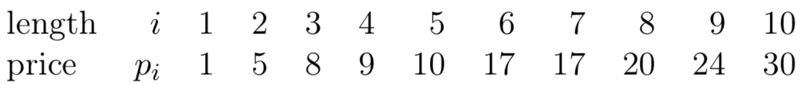
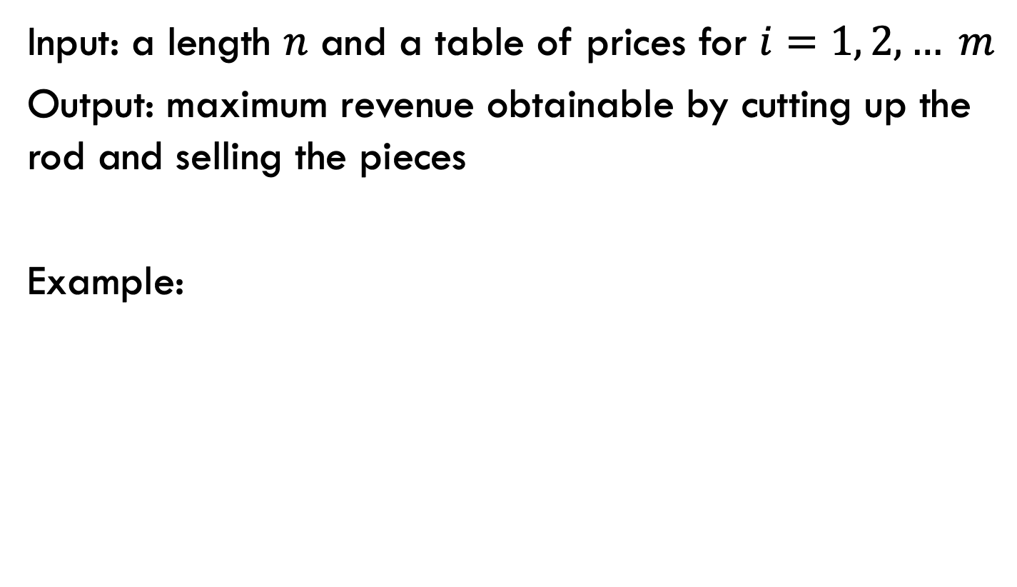
Rod splitting
Input: a length $n$ and a table of prices for $i=1, 2, … m$
Output: maximum revenue obtainable by cutting up the rod and selling the pieces
Example:

Slide 27
1a: optimal substructure
Prove: optimal solutions to the problem incorporate optimal solutions to related subproblems
What would a solution look like?

Slide 28
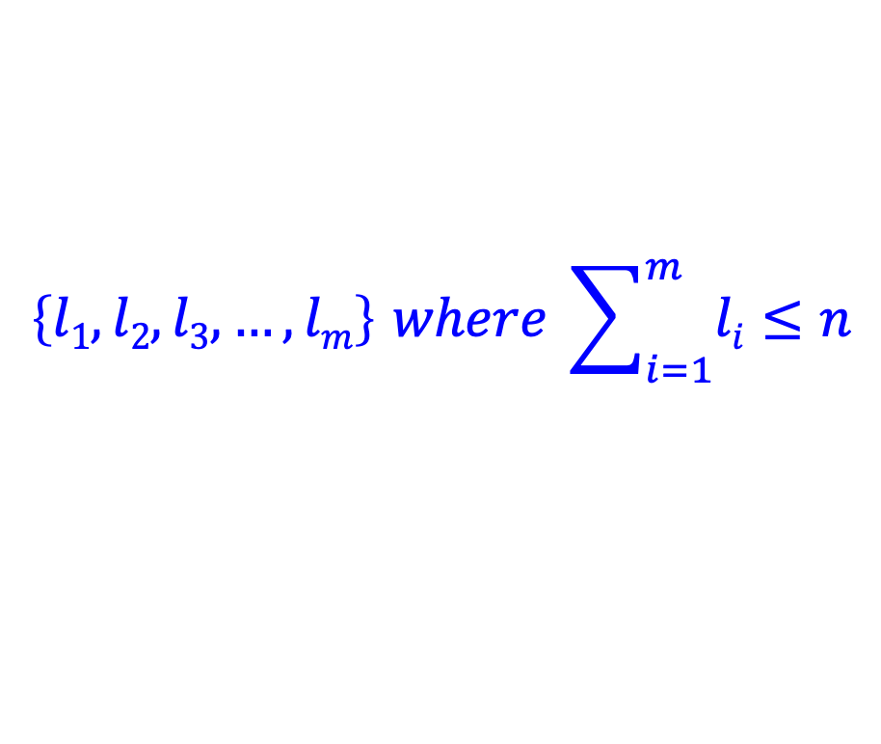
1a: optimal substructure
Prove: optimal solutions to the problem incorporate optimal solutions to related subproblems
$$\left\{l1, l2, l3, …, lm\right\} where \sum_{i=1}^{m}{li}≤n$$
What would a subproblem solution look like?

Slide 29
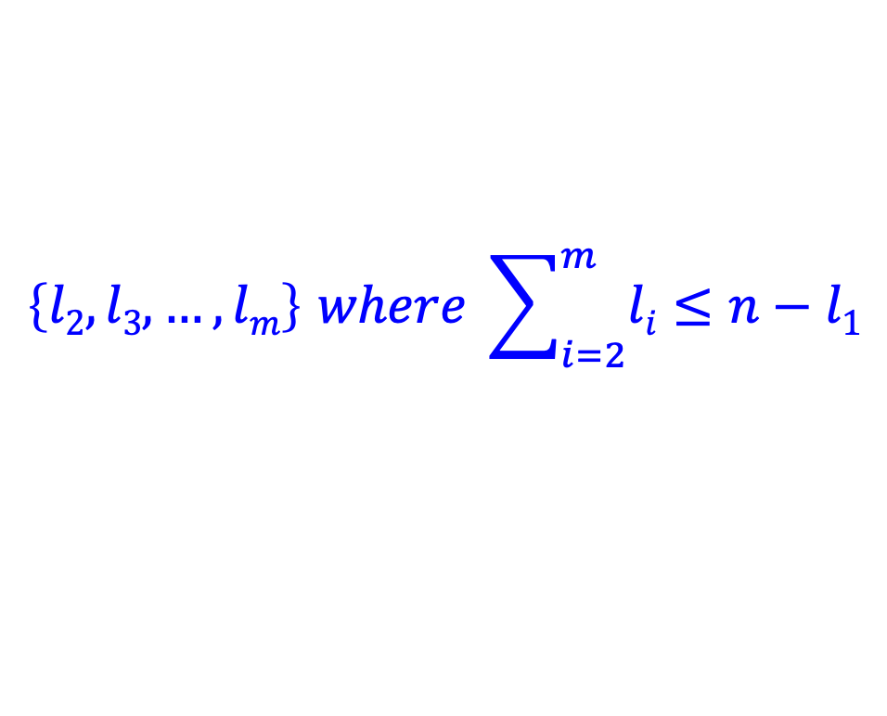
1a: optimal substructure
Prove: optimal solutions to the problem incorporate optimal solutions to related subproblems
$$\left\{l1, l2, l3, …, lm\right\} where \sum_{i=1}^{m}{li}≤n$$
$$\left\{l2, l3, …, lm\right\} where \sum_{i=2}^{m}{li}≤n−l1$$

Slide 30
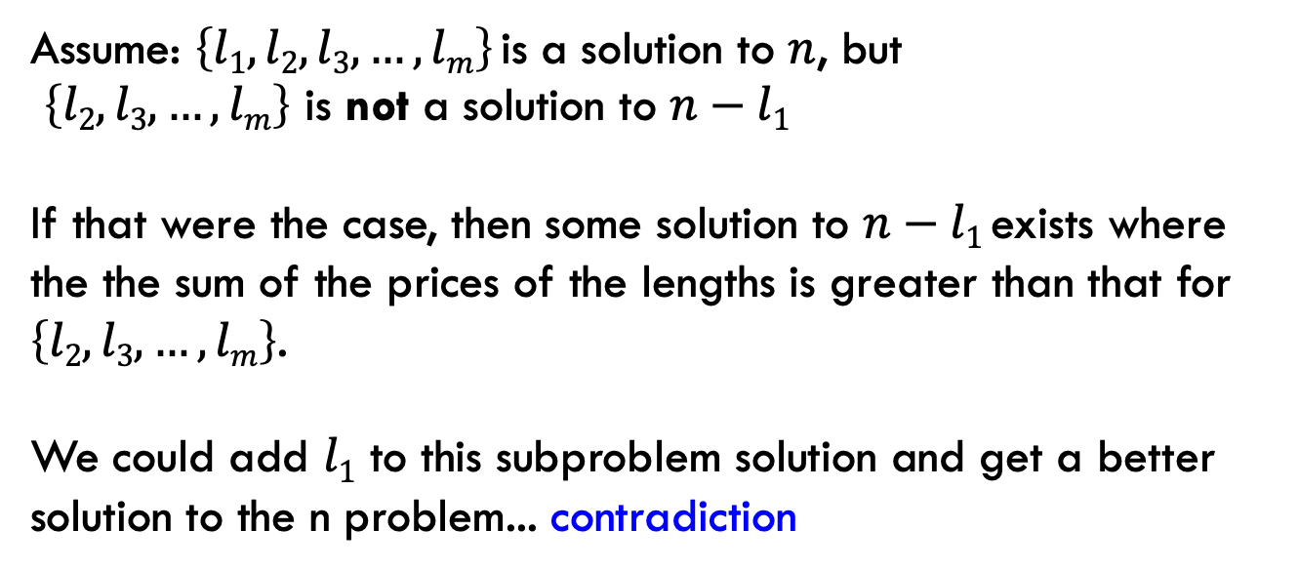
1a: optimal substructure
Prove: optimal solutions to the problem incorporate optimal solutions to related subproblems
Proof by contradiction:
Assume: $\left\{l1, l2, l3, …, lm\right\}$is a solution to $n$, but
$\left\{l2, l3, …, lm\right\}$ is not a solution to $n−l1$
If that were the case, then some solution to $n−l1$exists where the the sum of the prices of the lengths is greater than that for $\left\{l2, l3, …, lm\right\}$.
We could add $l1$ to this subproblem solution and get a better solution to the n problem... contradiction

Slide 31
1b: recursive solution
n
What should be the first cut?
What are the options?

Slide 32
1b: recursive solution
n
cut 1
price 1
How much is left?

Slide 33
1b: recursive solution
n
cut 1
price 1
n-1

Slide 34
1b: recursive solution
n
cut 2
price 5
n-2

Slide 35
1b: recursive solution
n
Which one should we choose?
…
Pretend like we have a solver (R) that gives us the answer to suproblems.
What would R take as input and return?

Slide 36
1b: recursive solution
n
R(x) → price for best set of cuts of length x
(could structure it with the actual cuts, but focusing on just the price is easier for now)
…

Slide 37
1b: recursive solution
n
cut 1
price 1
n-1
What’s the best we can do with this cut?

Slide 38
1b: recursive solution
n
cut 1
price 1
n-1
1 + R(n-1)

Slide 39
1b: recursive solution
n
cut 2
price 5
n-2
What’s the best we can do with this cut?

Slide 40
1b: recursive solution
n
cut 2
price 5
n-2
5 + R(n-2)

Slide 41
1b: recursive solution
n
What should be the first cut?

Slide 42
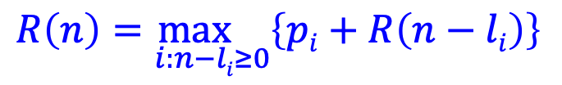
1b: recursive solution
n
$$R\left(n\right)=\max_{i:n−li≥0}\left\{pi+R\left(n−li\right)\right\}$$

Slide 43
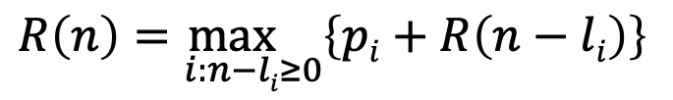
2: DP solution (from the bottom-up)
$$R\left(n\right)=\max_{i:n−li≥0}\left\{pi+R\left(n−li\right)\right\}$$
What are the smallest possible subproblems?
To calculate R(n), what are all the subproblems we need to calculate? This is the “table”.
How should we fill in the table?
Where will the answer be?

Slide 44
2: DP solution (from the bottom-up)
$$R\left(n\right)=\max_{i:n−li≥0}\left\{pi+R\left(n−li\right)\right\}$$
What are the smallest possible subproblems?
R(0) = 0, R(-i) not possible

Slide 45
2: DP solution (from the bottom-up)
$$R\left(n\right)=\max_{i:n−li≥0}\left\{pi+R\left(n−li\right)\right\}$$
To calculate R(n), what are all the subproblems we need to calculate? This is the “table”. R(0)…R(n)
Note: This is filling in a table for all possible integer lengths from 1 to n.

Slide 46
2: DP solution (from the bottom-up)
$$R\left(n\right)=\max_{i:n−li≥0}\left\{pi+R\left(n−li\right)\right\}$$
How should we fill in the table?
R(0) → R(n)
The dependencies are on smaller values

Slide 47
2: DP solution (from the bottom-up)
$$R\left(n\right)=\max_{i:n−li≥0}\left\{pi+R\left(n−li\right)\right\}$$
Where will the answer be?
R(n)

Slide 48
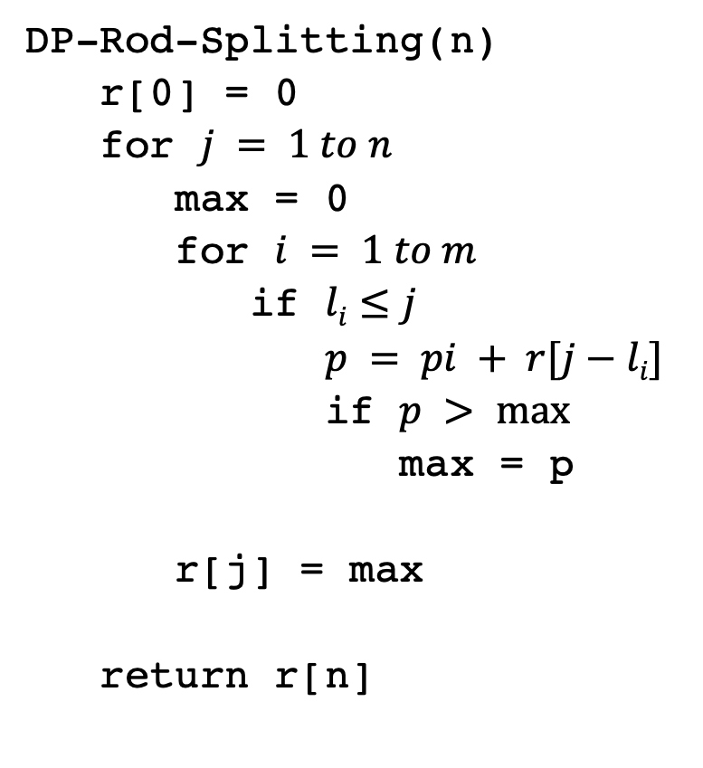
2: DP solution
DP-Rod-Splitting(n)
r[0] = 0
for $j = 1 to n$
max = 0
for $i = 1 to m$
if $li≤j$
$p = pi + r[j−li]$
if $p > max⁡$
max = p
r[j] = max
return r[n]

Slide 49
3: Analysis
DP-Rod-Splitting(n)
r[0] = 0
for $j = 1 to n$
max = 0
for $i = 1 to m$
if $li≤j$
$p = pi + r[j−li]$
if $p > max⁡$
max = p
r[j] = max
return r[n]
Space requirements?
Running time?

Slide 50
3: Analysis
DP-Rod-Splitting(n)
r[0] = 0
for $j = 1 to n$
max = 0
for $i = 1 to m$
if $li≤j$
$p = pi + r[j−li]$
if $p > max⁡$
max = p
r[j] = max
return r[n]
Space requirements: Θ(n)
Running time: Θ(nm)

Slide 51
0-1 Knapsack problem
0-1 Knapsack – A thief robbing a store finds m items worth
v₁, v₂, .., v_{m} dollars and weight
w₁, w₂, …, w_{m} pounds, where v_{i} and w_{i} are integers. The thief can carry at most W pounds in the knapsack. Which items should the thief take if they want to maximize value?
Repetition is allowed, that is you can take multiple copies of any item

Slide 52
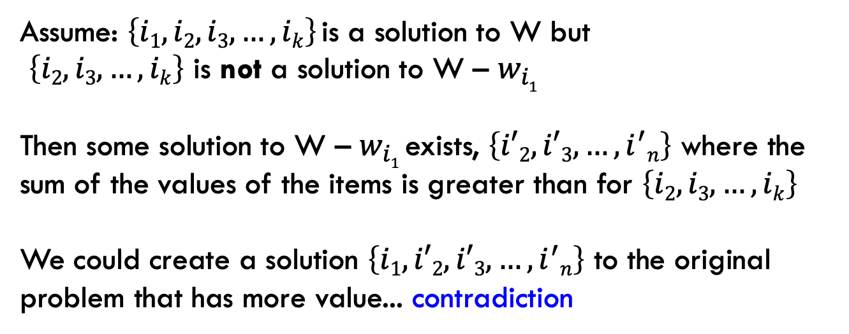
1a: optimal substructure
Prove: optimal solutions to the problem incorporate optimal solutions to related subproblems
Proof by contradiction:
Assume: $\left\{i1, i2,i3, …, ik\right\}$is a solution to W but
$\left\{i2, i3, …, ik\right\}$ is not a solution to W – $w_{i1}$
Then some solution to W – $w_{i1}$exists, $\left\{i′2, i′3, …, i^{′}n\right\}$ where the sum of the values of the items is greater than for $\left\{i2, i3, …, ik\right\}$
We could create a solution $\left\{i1,i′2, i′3, …, i^{′}n\right\}$ to the original problem that has more value... contradiction

Slide 53
1b: recursive solution

Slide 54
2: DP solution (from the bottom-up)
What are the smallest possible subproblems?
K(0) = 0
To calculate K(w), what are all the subproblems we need to calculate? This is the “table”. K(0) … K(W)
How should we fill in the table? K(1) → K(W)
Where will the answer be? K(W)

Slide 55
3: Analysis
What are the smallest possible subproblems? K(0) = 0
To calculate K(w), what are all the subproblems we need to calculate? This is the “table”. K(0) … K(W)
How should we fill in the table? K(0) → K(W)
Where will the answer be? K(W)
Space requirements: Θ(W)
Running time: Θ(Wm)

Slide 56
Memoization
Sometimes it can be a challenge to write the function in a bottom-up fashion
Memoization:
  Write the recursive function top-down
  Alter the function to check if we’ve already calculated the value
  If so, use the pre-calculate value
  If not, do the recursive call(s)

Slide 57
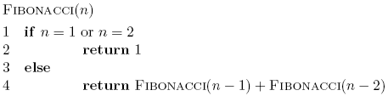
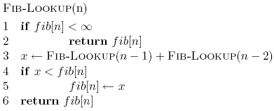
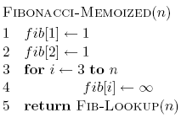
Memoized fibonacci

Slide 58
Memoized fibonacci
Use ∞ to denote uncalculated

Slide 59
Memoized fibonacci
What else could we use besides an array?
Use ∞ to denote uncalculated

Slide 60
Memoized fibonacci
Check if we already calculated the value

Slide 61
Memoized fibonacci
calculate the value

Slide 62
Memoized fibonacci
store the value

Slide 63
Memoization
Pros
  Can be more intuitive to code/understand
  Can be memory savings if you don’t need answers to all subproblems
Cons
  Depending on implementation, larger overhead because of recursion (though often the functions are tail recursive)

