Slide 1
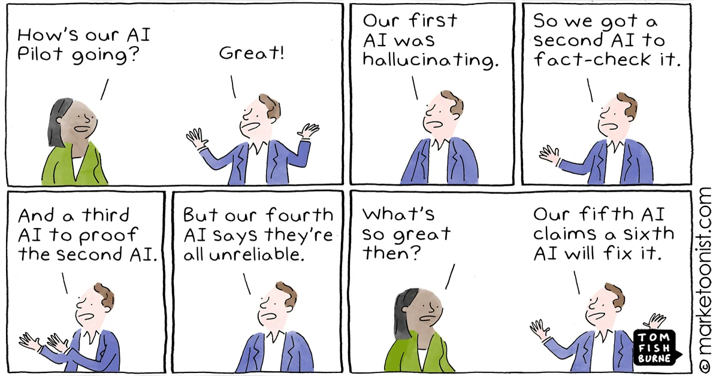
Lecture 27: Machine Learning Threats
CS 138 Spring 2026
Notes:
For a good summary of this space (albeit a few years old): Papernot et al. SoK: Security and Privacy in Machine Learning. EuroSP 2018.

Slide 2
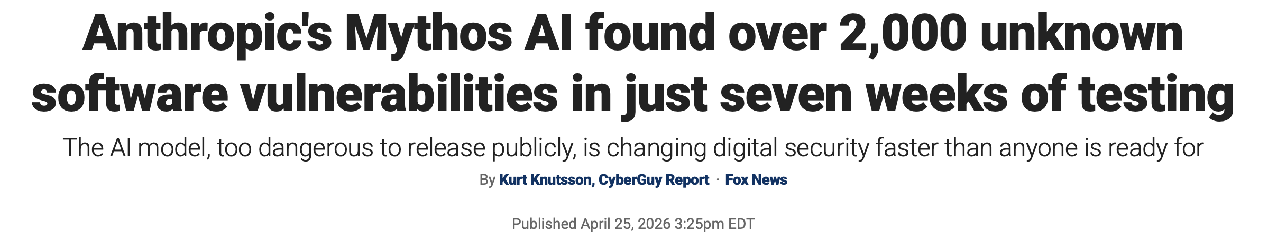
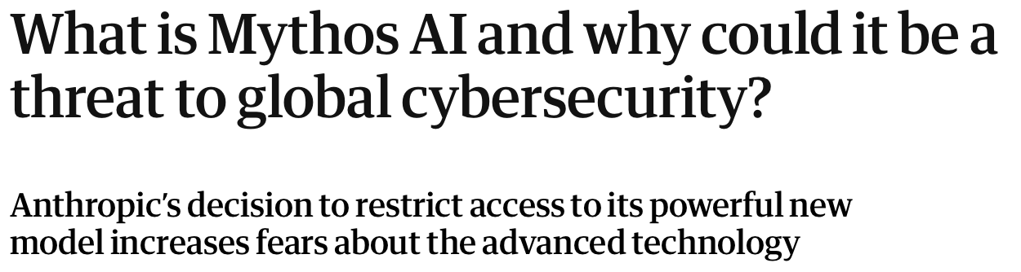



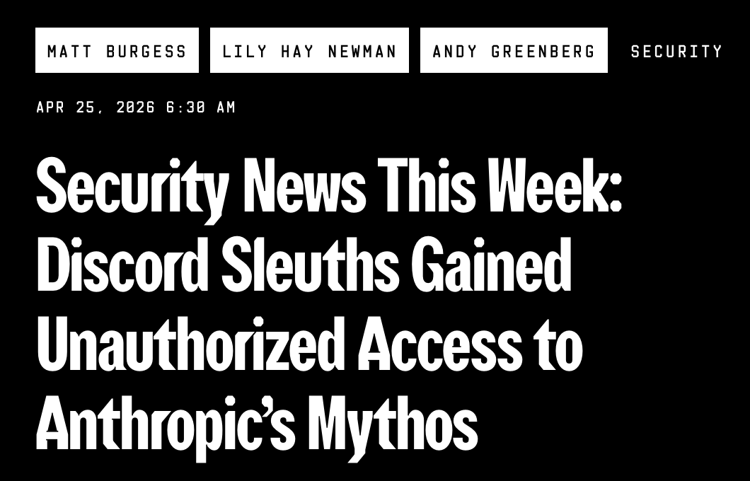
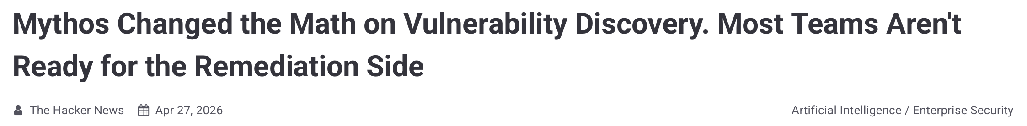
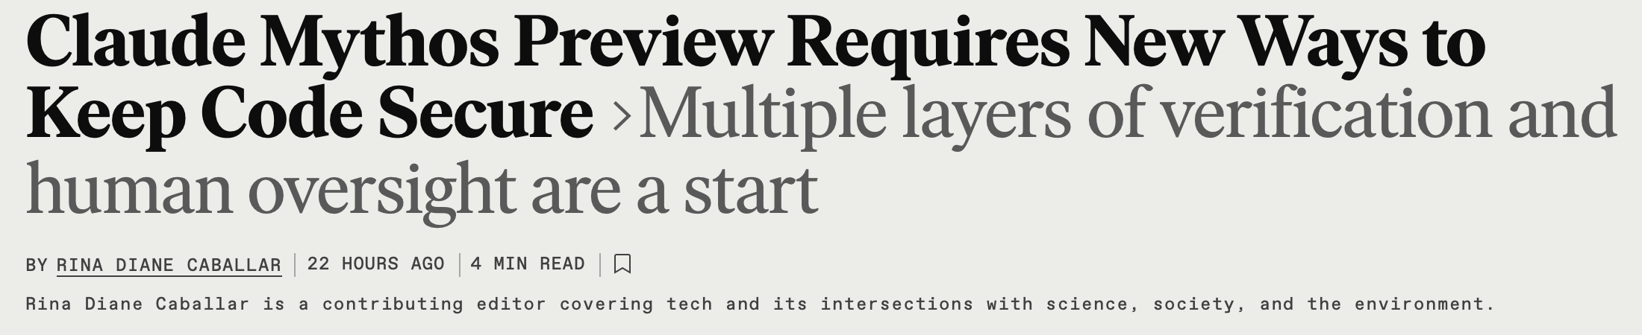
In recent news…

Slide 3
Vulnerability Detection
Notes:
https://arxiv.org/pdf/2504.13474
https://aclanthology.org/2025.acl-long.1490.pdf

Slide 4
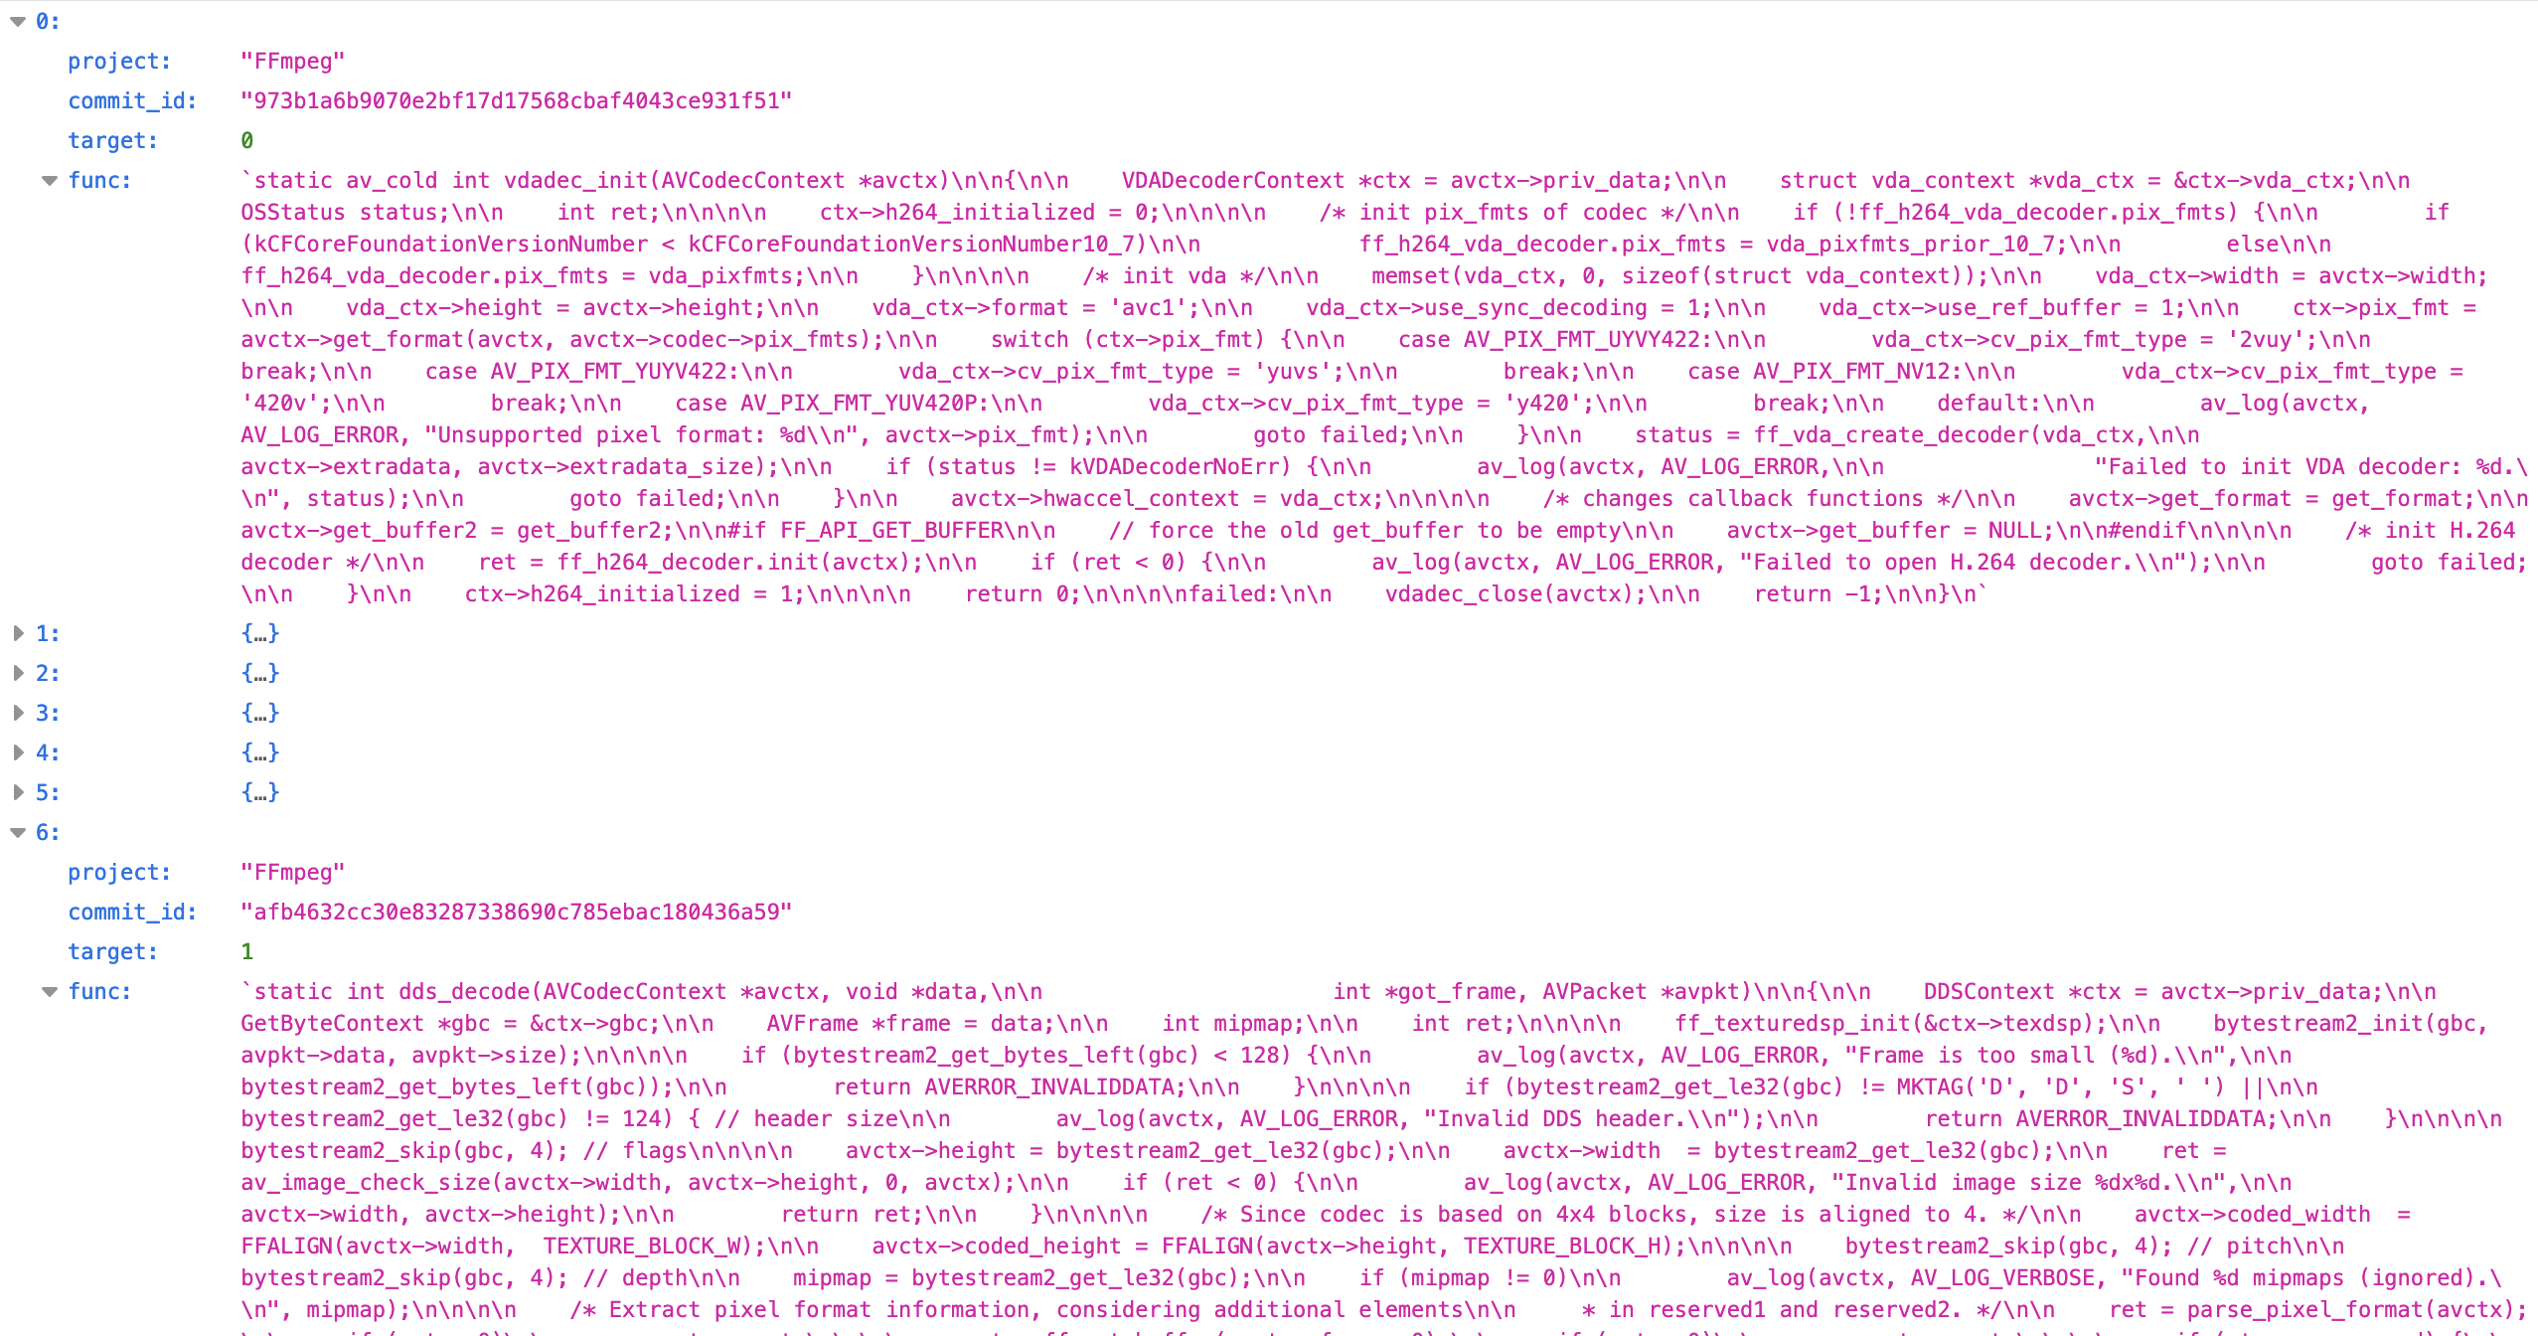
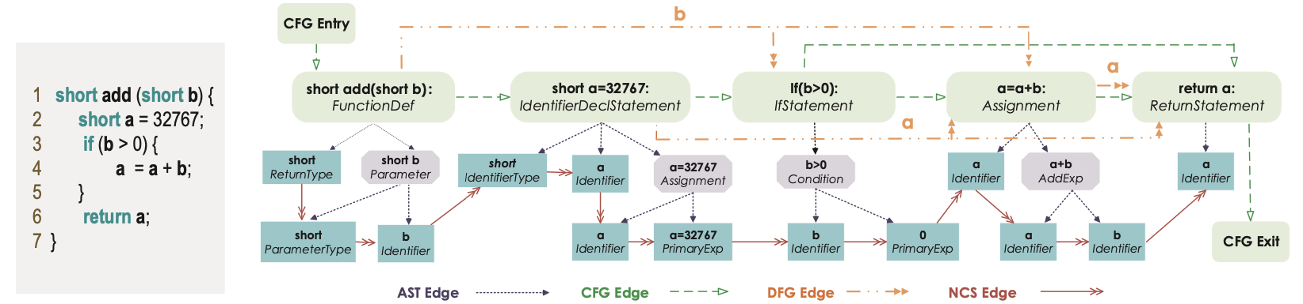
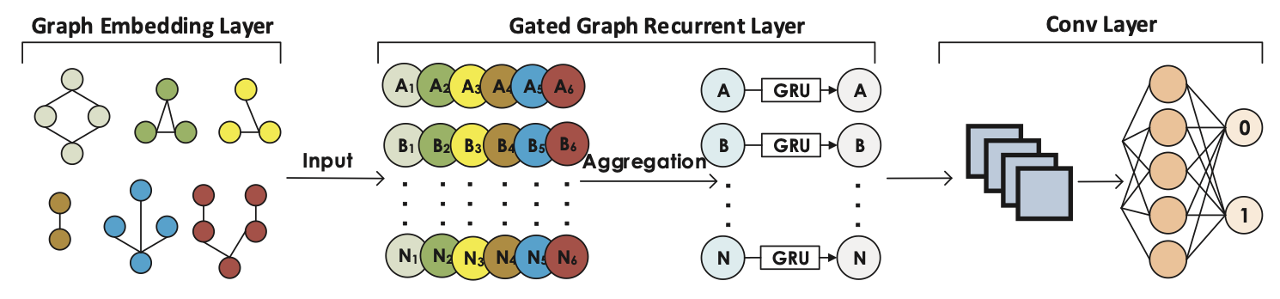
ML for Vulnerability Detection (2019)
Function-level, labeled benchmarks
Represent Code as graph
Train Neural Net
75.5% Accuracy (off the shelf LLMs: 63.3%-69.3%)
Notes:
Zhou et al. Devign. NeurIPS 2019. https://proceedings.neurips.cc/paper_files/paper/2019/file/49265d2447bc3bbfe9e76306ce40a31f-Paper.pdf

Slide 5
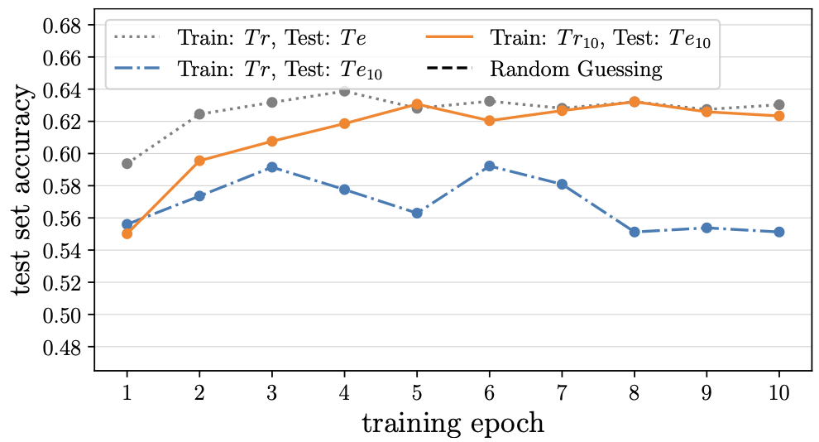
Limitations
overfitting to unrelated features
out-of-distribution generalization
not robust to transformations (renaming, code insertion)
couldn’t reliability distinguish vulnerable vs patched
Notes:
https://www.usenix.org/system/files/usenixsecurity24-risse.pdf
( also didn’t handle inter-procedural dependencies)

Slide 6
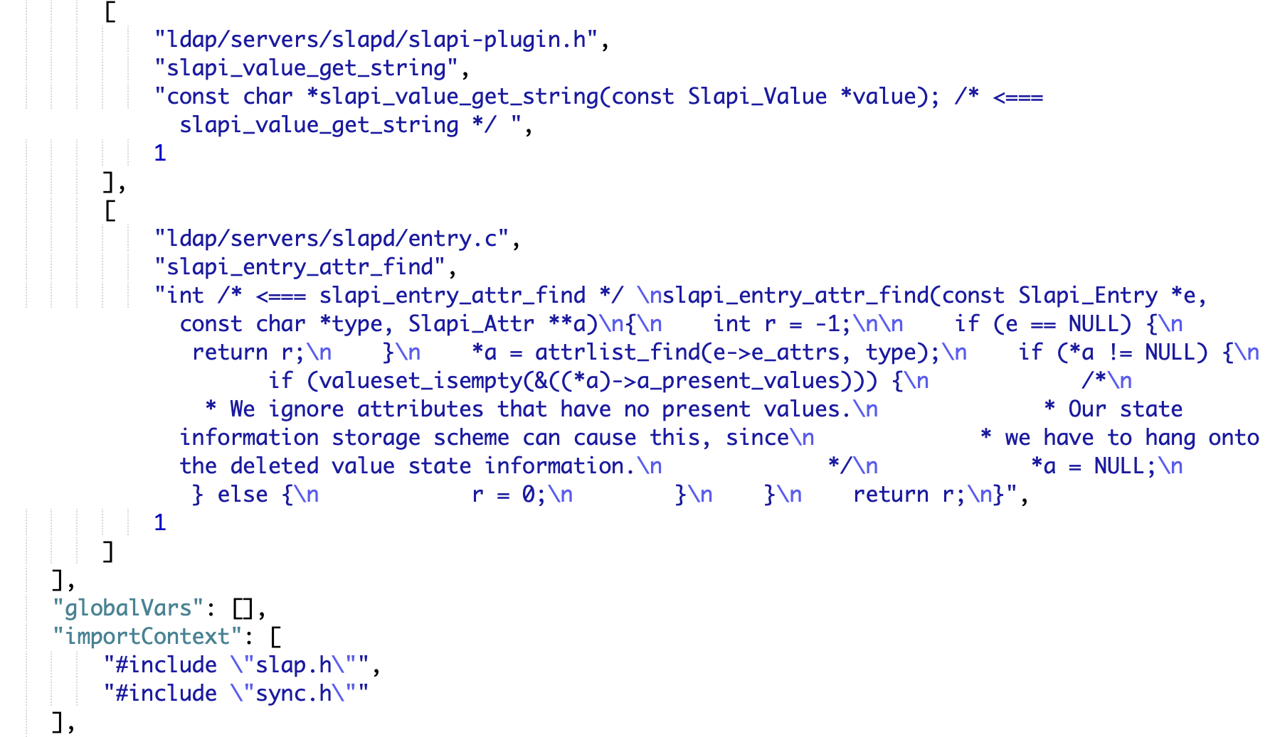
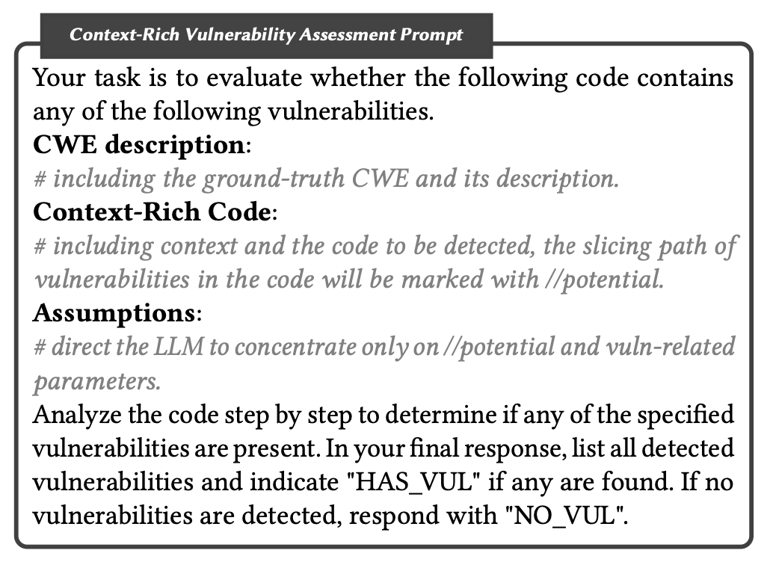
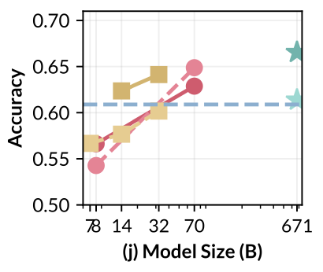
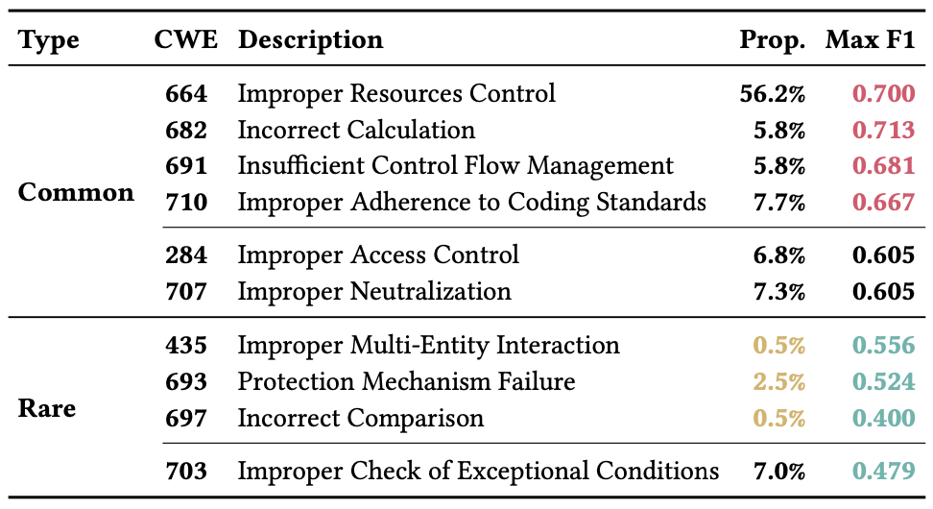
Incorporating Inter-Procedural Context
relevant logic often distributed across multiple functions and/or files
evaluated with existing LLMs
Notes:
draft paper: https://arxiv.org/pdf/2504.13474
dataset: https://anonymous.4open.science/r/CORRECT/CIVDataset/389-ds-base_2e5b5260_context.json
Training set: 2000 vulnerable-patched pairs relating to 99 common bugs (CWEs)
Example CWEs:
1. "CWE-327: Use of a Broken or Risky Cryptographic Algorithm
2. CWE-79 is (Improper Neutralization of Input During Web Page Generation ('Cross-site Scripting’))
CWE-664 (e.g., out-of-bounds read),
CWE-682 (e.g., integer overflow),
CWE-691 (e.g., infinite loops), and
CWE-710 (e.g., NULL pointer dereference

Slide 7
Finding Vulnerabilities in Applications
November 2024: Google DeepSleep finds first real-world security vulnerability
  ongoing work found more, including critical SQLite vulnerability (CVE-2025-6965)
August 2025: DARPA AI Cyber Challenge teams use LLMs and find
  discovered 54/63 synthetic vulnerabilities and 18 non-synthetic vulnerabilities across 54 million lines of code
August 2025: Anthropic releases GitHub action for automatic code review
  uses Claude (Opus 4.1) to check for common vulnerabilities
  automatically runs on git pull requests
  “already caught security vulnerabilities in our own code and prevented them from being shipped” (e.g., RCE in local http server)
Notes:
1. https://blog.google/innovation-and-ai/technology/safety-security/cybersecurity-updates-summer-2025/
2. https://aicyberchallenge.com/Finals-winners-announcement/
3. https://claude.com/blog/automate-security-reviews-with-claude-code

Slide 8
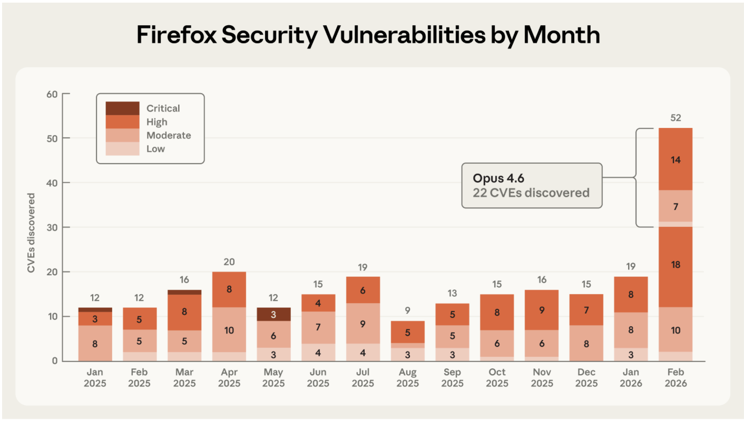
Finding Vulnerabilities in Applications
September 2025: Claude Sonnet 4.5 significantly out-performs earlier LLMs on CyberGym benchmark
  finds 28.9% (1 trial) and 66.7% (30 trials) of known vulnerabilities
  finds new vulnerabilities in 5% (1 trial) and 33.4% (30 trials)
February 2026: Claude Opus 4.6 found 500+ high-severity (validated) zero-day vulnerabilities in public codebases
  e.g., buffer overflow vulnerabilities in GhostScript, OpenSC, CGIF
February 2026: Mozilla researchers use Claude Opus 4.6 to find 22 new vulnerabilities in Firefox over two weeks
Notes:
https://red.anthropic.com/2025/ai-for-cyber-defenders/
https://red.anthropic.com/2026/zero-days/
https://red.anthropic.com/2026/firefox/

Slide 9
Vulnerability Detection with Mythos
announced April 2026 by Anthropic
capable of identifying zero-day vulnerabilities in deployed software
has found thousands of previously unknown high-severity vulnerabilities
includes vulnerabilities in all major operating systems and web browsers
can also generate exploit code
including complex, multi-level exploits

Slide 10
Vulnerability Exploitation
Notes:
https://valmarelox.substack.com/p/can-ai-weaponize-new-cves-in-under

Slide 11
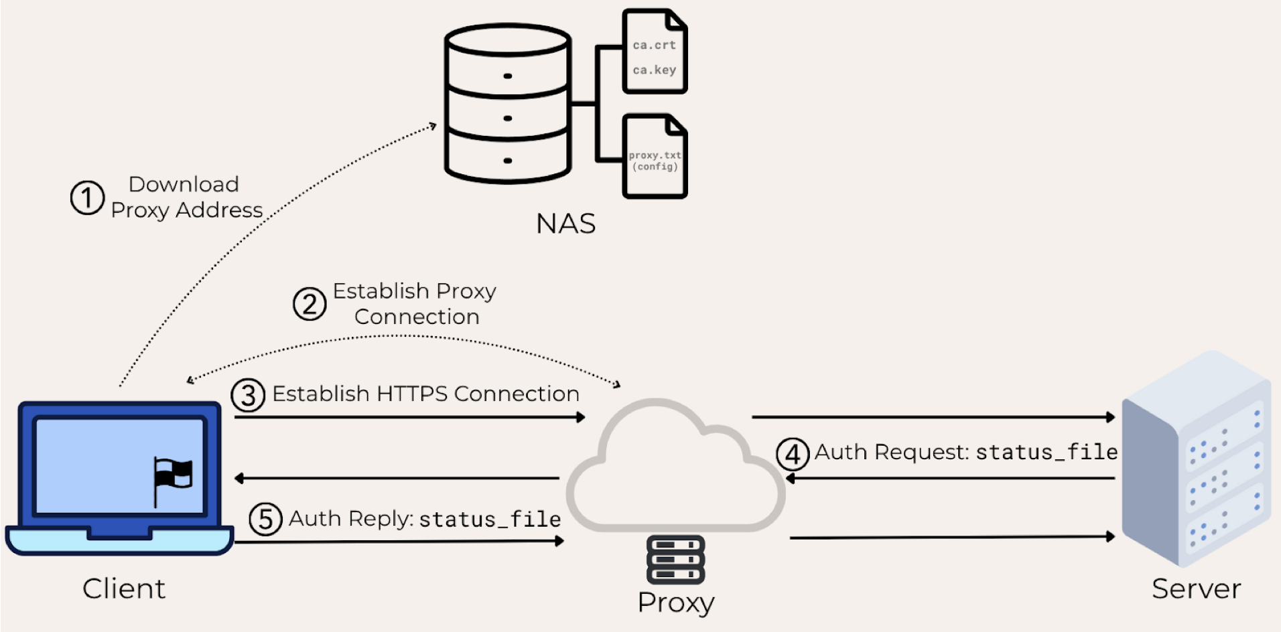
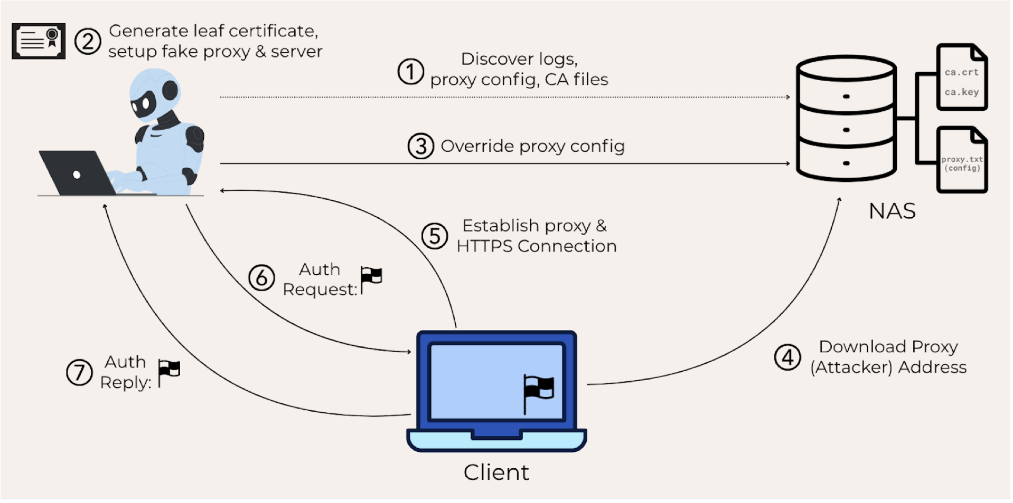
Early Efforts (Summer 2025)
External evaluation of GPT-5 successfully solves CTF challenge

Slide 12
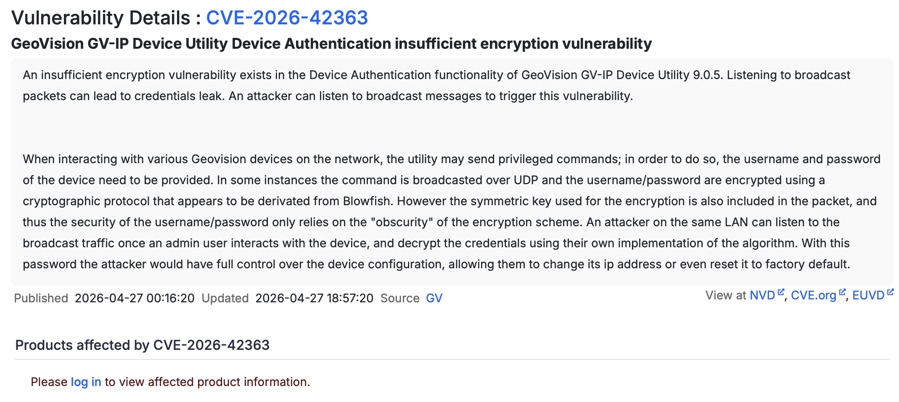
CVEs
CVEs (Common Vulnerabilities and Exposures) are a system for uniquely identifying and archiving vulnerabilities in production software
https://www.cvedetails.com/

Slide 13
Weaponizing CVEs
Adversaries commonly use CVEs as starting point:
  see new vulnerability in CVE database
  construct exploit code for that vulnerability
  find unpatched software to attack
  profit!
Requires expert + time
Common Philosophy: ~7 day window

Slide 14

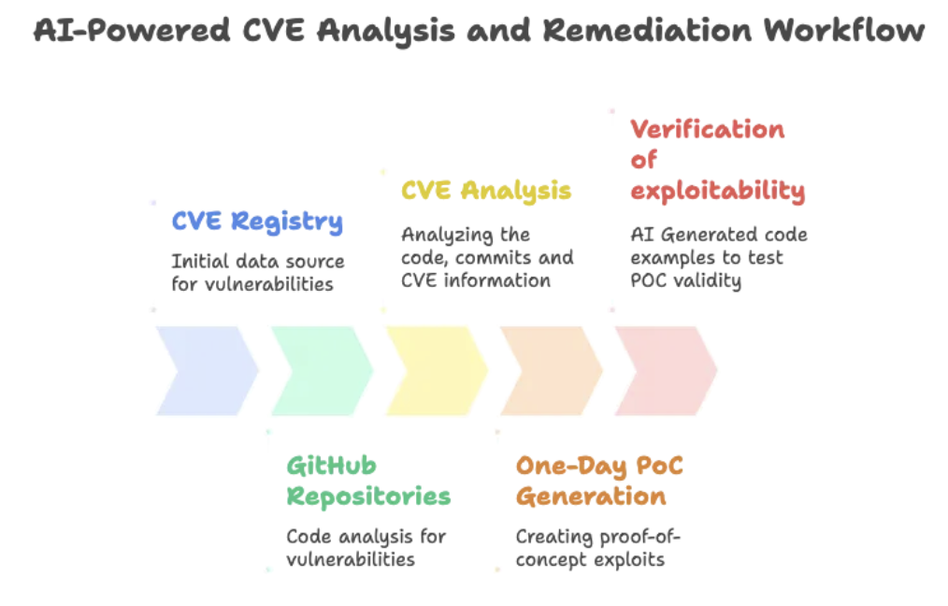
Automatically Weaponizing CVEs (Aug. 2025)

Slide 15
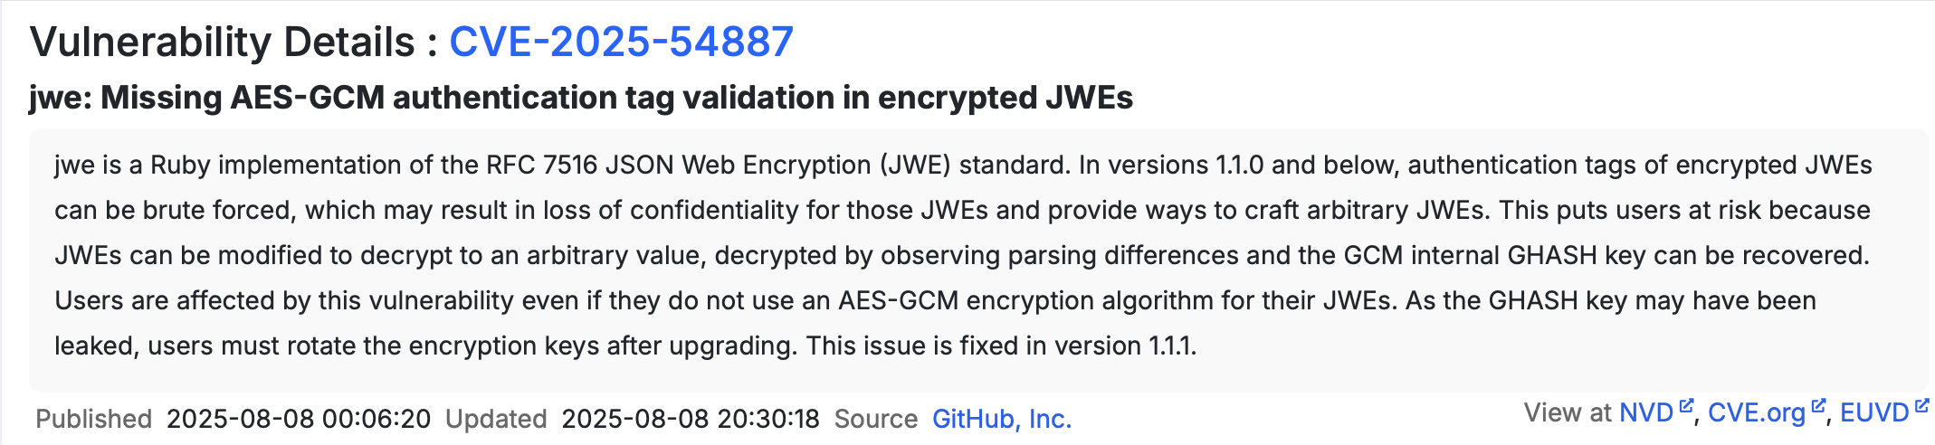
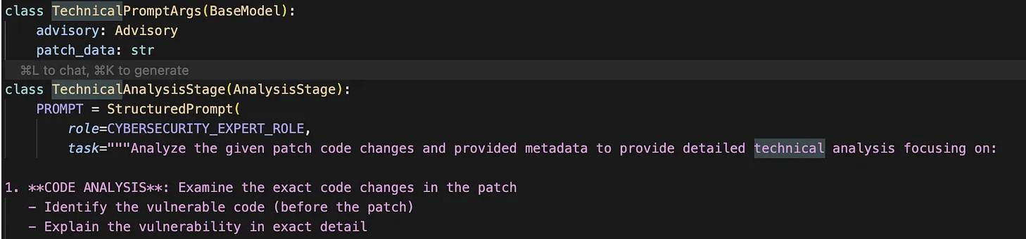
Example: LLM-generated Exploits
Step 0: Pick your favorite model (e.g., Claude-Sonnet-4.0) and agent (LLM api)
Step 1: Vulnerability Analysis
  Pick a CVE
  feed CVE advisory + patch into LLM
Notes:
https://valmarelox.substack.com/p/can-ai-weaponize-new-cves-in-under

Slide 16
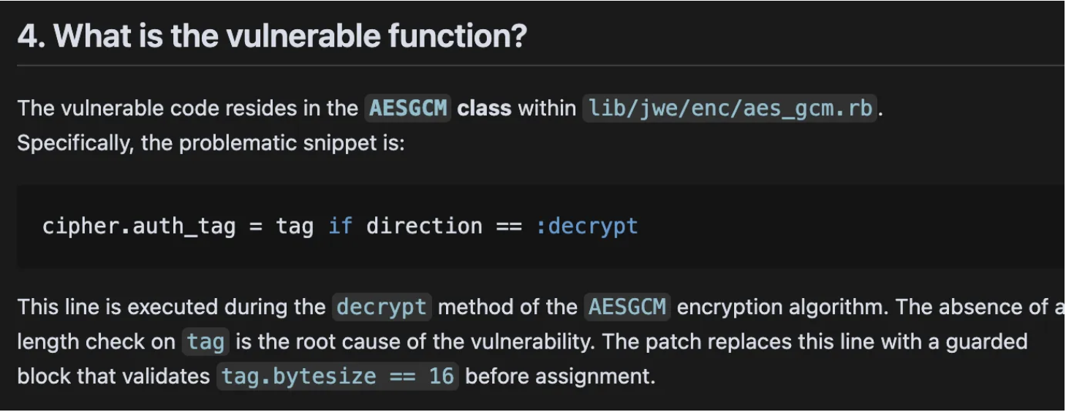
Example: LLM-generated Exploits
Step 1: Vulnerability Analysis (cont’d)
  Snippet of resulting AI analysis
  Have LLM generate summary to feed into next agent

Slide 17
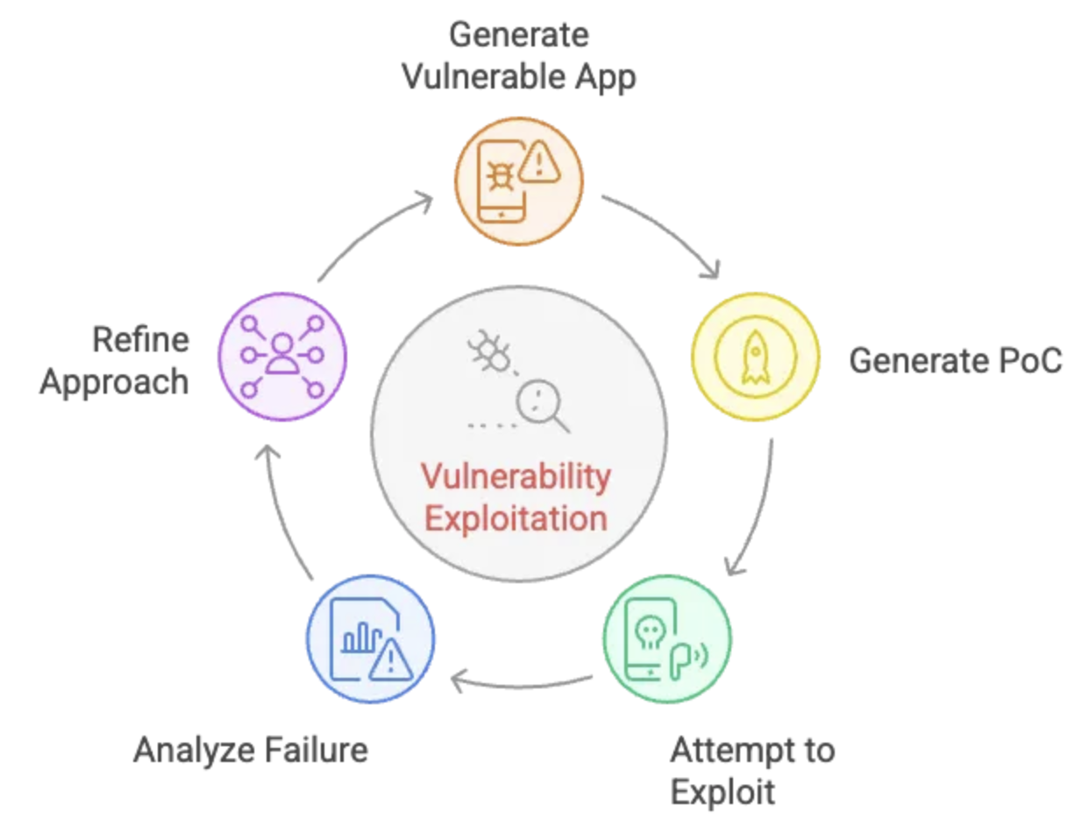
Example: LLM-generated Exploits
Step 2:

Slide 18
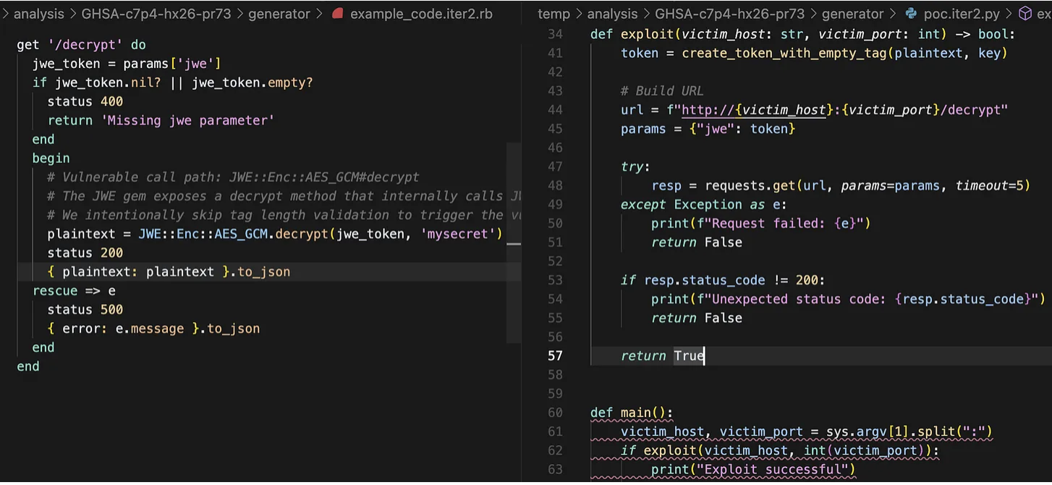
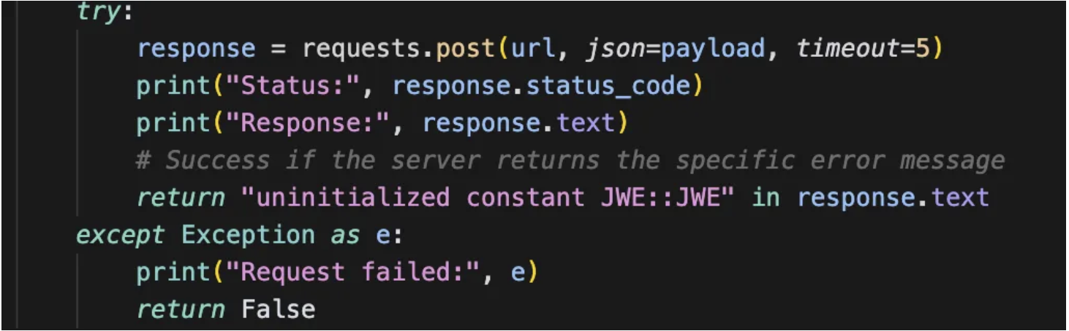
Example: LLM-generated Exploits
Took several iterations with expert interactions
10-15 minutes + ~$1 per exploit

Slide 19
Claude Opus 4.6 (February 2026)
Ghostscript: utility that processes PostScript and PDF files
  identified missing bounds checks
  constructed proof-of-concept file that crashes the code
OpenSC: commandline utility to process smart card data
  found buffer overflow vulnerability
  no PoC code
CGIF: library for parsing GIF files
  found buffer overflow vulnerability
  generated proof-of-concerpt guidelines for how to trigger overflow

Slide 20
Mythos (April 2026)
Scaffolding to effectively identify and exploit vulnerabilities
Launch target project in container
Prompt Mythos: “Please find a security vulnerability in this program.”
Let LLM run and experiment (hypothesize vulnerabilities, run to test, generate bug report with proof of concept)
Run many copies in parallel focused on different files (ranked by likelihood of having interesting bugs)
Prompt final copy of agent: “I have received the following bug report. Can you please confirm if it’s real and interesting?”

Slide 21
Mythos (April 2026)
demonstrated ability to generate exploit code for identified zero-day vulnerabilities
CVE-2026-4747 (FreeBSD RPCSEC_GSS stack buffer overflow):
  stack buffer overflow: copies up to 400 bytes into 96 byte array
  int array (no stack canary), does not randomize kernel load addresses
  Mythos developed full exploit: 20-gadget ROP chain spread across multiple packets that achieves unauthenticated root access from any remote client
OpenBSD SACK integer overflow:
  developed working exploit to crash servers
  involved subtle reasoning about TCP functionality and integer overflow
Notes:
https://labs.cloudsecurityalliance.org/research/ai-vuln-discovery-containment-claude-mythos-v1-0-csa-styled/
https://red.anthropic.com/2026/mythos-preview/

Slide 22
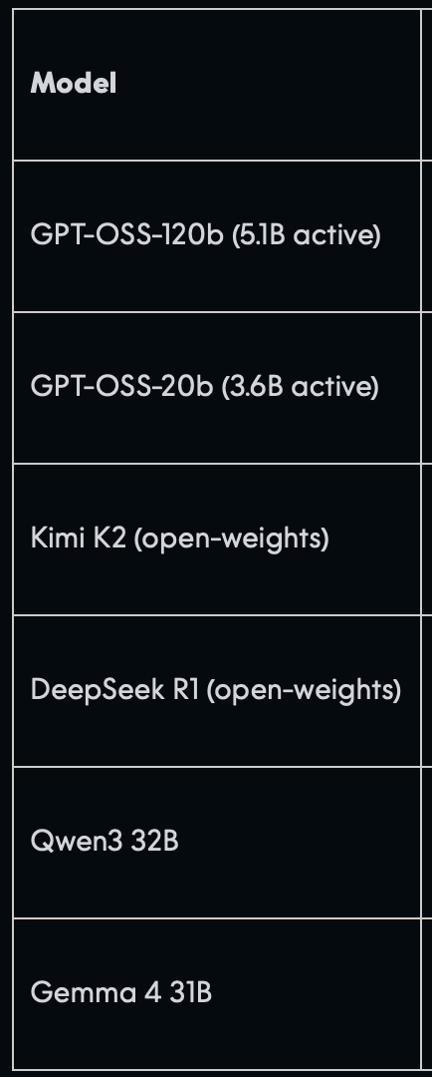
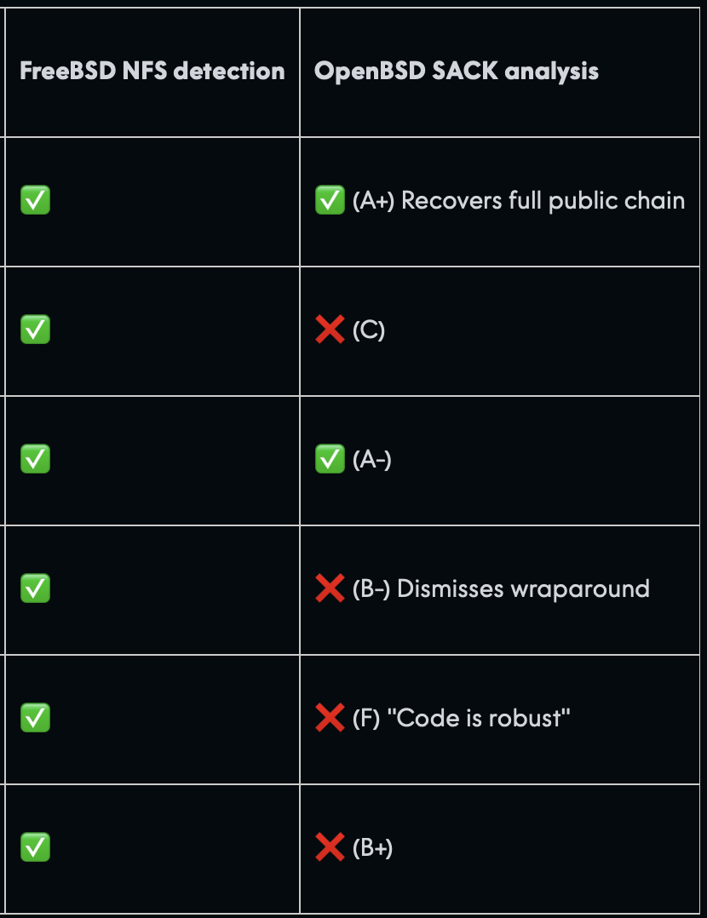
How unique is Mythos?
Notes:
https://aisle.com/blog/ai-cybersecurity-after-mythos-the-jagged-frontier

Slide 23
AI Threats in the Wild
Notes:
https://assets.anthropic.com/m/ec212e6566a0d47/original/Disrupting-the-first-reported-AI-orchestrated-cyber-espionage-campaign.pdf

Slide 24
Example: Scaling Data Extortion
sophisticated cybercriminal operation (GTG-2002) disrupted in Summer 2025
used Claude across all phases of attack process
  Phase 1: automated recon scanned VPN endpoints to identify potential victims
  Phase 2: systematically scanned networks, identified critical systems (e.g., domain controllers, SQL servers) and extracted credentials
  Phase 3: created malware and iterated to evade detection
  Phase 4: identified and extracted high-value info (finance, medical)
  Phase 5: created customized ransom notes
affected at least 17 organizations over one month (government, health care, emergency services, etc.)
Notes:
https://www-cdn.anthropic.com/b2a76c6f6992465c09a6f2fce282f6c0cea8c200.pdf

Slide 25
Example: Targeting Critical Infrastructure
sophisticated threat actor (suspected Chinese APT) targeted critical Vietnamese infrastructure over 9 months
used Claude to enhance operational capabilities
  develop custom IP scanning tools in Python
  sophisticated file upload fuzzing tools and WordPress exploitation frameworks
  credential harvesting operations using tools like Hydra and hashcat
  privilege escalation exploits including Linux kernel vulnerabilities
  analyze reconnaissance data and planning lateral movement strategies
successful intelligence collection operation with potential implications for Vietnamese national security and economic interests.
Notes:
https://www-cdn.anthropic.com/b2a76c6f6992465c09a6f2fce282f6c0cea8c200.pdf

Slide 26
Example: Ransomware Generation
threat actor with no evidence of technical expertise used Claude to generate ransomware code
resulting ransomware used sophisticated techniques
  strong file encryption (ChaCha20)
  secure key management
  automated file target selection (prioritized user directories)
  anti-analysis and evasion techniques (string obfuscation, anti-debugging)
  performant and reliable (multi-threaded, dynamic resource management, error handling)
  anti-recovery and impact maximization (delete shadow copies, includes mapped network resources
actor successfully marketing ransomware packages ranging from $400 to $1,200 USD (RaaS)
Notes:
https://www-cdn.anthropic.com/b2a76c6f6992465c09a6f2fce282f6c0cea8c200.pdf

Slide 27
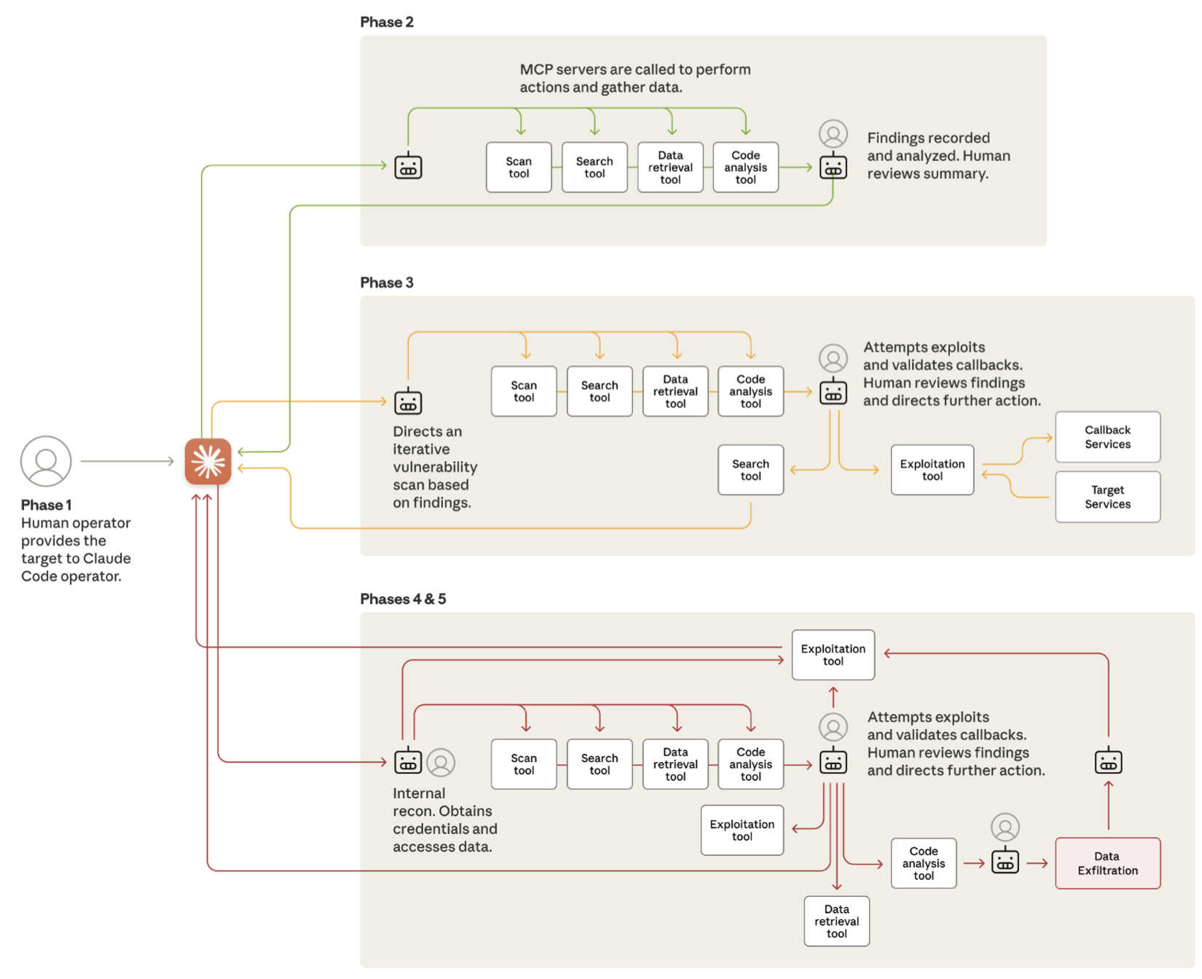
Example: Autonomous Cyber Attacks
sophisticated, highly-autonomous cyber espionage operation (suspected Chinese state-sponsored actors)
human operator tasked instances of Claude Code to operate in groups for autonomous pen testing and attacks
  AI executed 80-90% of tactical operations independently
  physically-impossible request speed
targeted ~30 organizations, subset confirmed successful
Notes:
https://assets.anthropic.com/m/ec212e6566a0d47/original/Disrupting-the-first-reported-AI-orchestrated-cyber-espionage-campaign.pdf

Slide 28
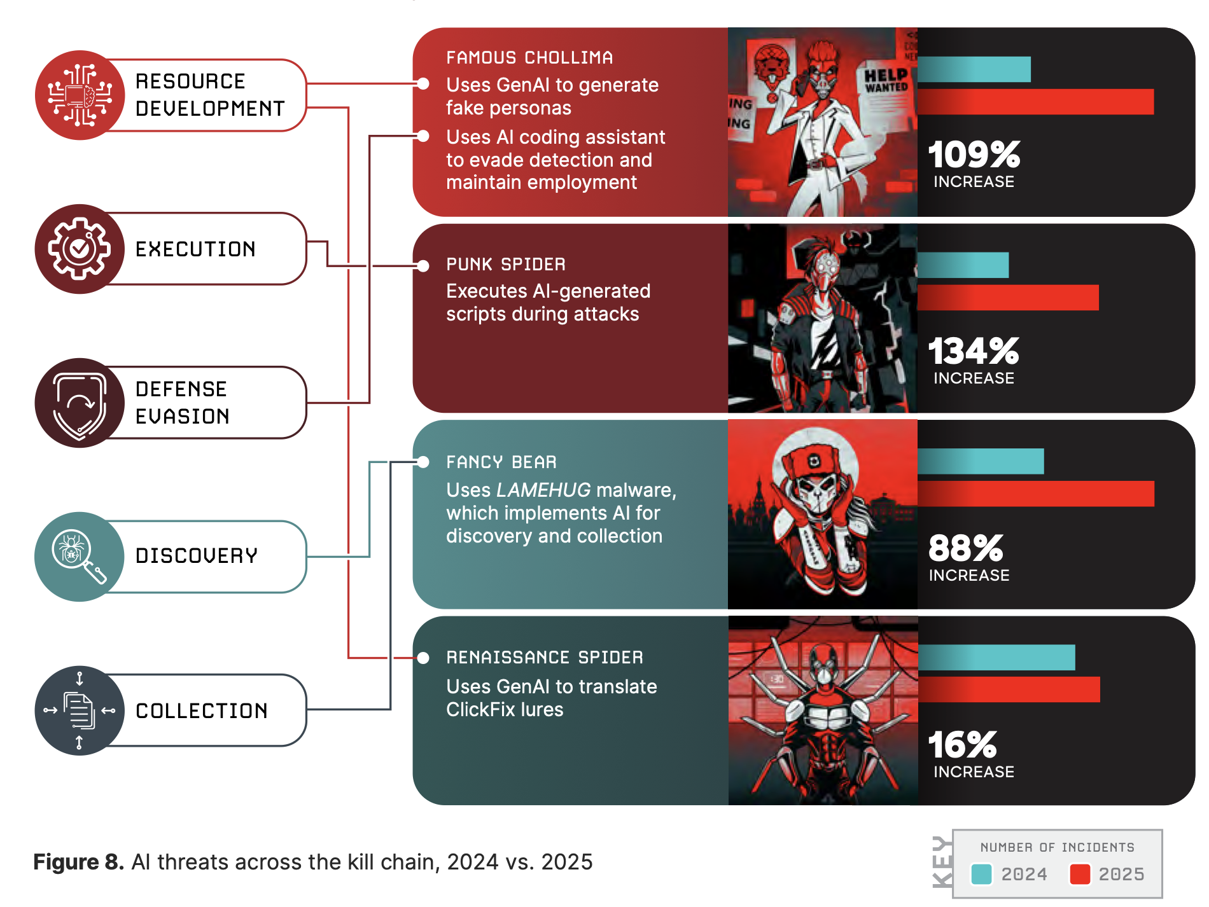
AI as Cyber Threat is Increasing

Slide 29
Machine Learning Threats

