Slide 1
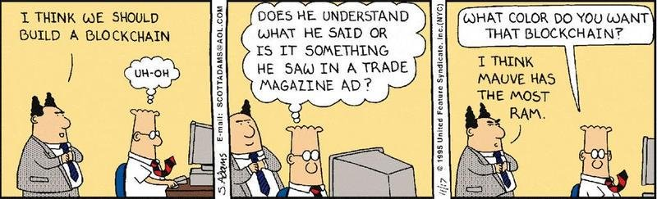
Lecture 23: Blockchains
CS 138 Spring 2026
Notes:
Based on slides by Ethan Cecchetti from CS 5430 (Cornell University, Spring 2018)

Slide 2



Blockchain: A public tamper-proof log
Publicly visible
Publicly writable
Unmodifiable
Event 1
Event 2
Event 3
✔
Useful for an audit log!
✔

Slide 3


Preventing Tampering
VS
Notes:
Model: lots of people trying to agree on a log

Slide 4
Traditional Consensus
Members Vote
Event 1?
✔
“Byzantine fault-tolerant
(BFT) consensus”
Tolerates < 1/3 faulty
Must know who
everyone is!
✔
✔
X
✔

Slide 5

Sybil Attacks
What if anyone can join?
Event 1?
✔
✔
✔
X
X
✔
X
X
X

Slide 6
Defending against Sybil
Need a scarce resource
  BFT consensus uses identity – you only get one
  What else can we use?
    Money (Proof of Stake)
    Computational power (Proof of Work)

Slide 7
Computation as a scarce resource: Proof of Work

Slide 8
Proof of Work: The basics
Find x such that Hash(x) < N
  This could take a while…
What about replays?
  Add a random value r
  Look for Hash(r || x) < N
x₁
x₂
x_{k}
…
Hash
y₁
> N
y₂
> N
…
y_{k}
< N

Slide 9
Proof of Work: Building a log
Make the random value useful
  Use a message digest!
  d = Digest(m)
  Find x such that Hash(d || x) < N
x₁
x₂
x_{k}
…
Hash
y₁
> N
y₂
> N
…
y_{k}
< N

Slide 10
Proof of Work: Building a log
To add a message, generate a proof of work with that message
Connect each message to previous
Hash < N
Hash < N
Hash < N
0
d₁
x₁
h₁
d₂
x₂
h₂
d₃
x₃
Msg 1
Msg 2
Msg 3

Slide 11
Proof of Work: Coming to consensus
What can go wrong?
Forks
d₃
x₃
d₄
x₄
d₁
x₁
d₂
x₂
d'₃
x'₃
Take the heaviest fork
(one with the most work)

Slide 12
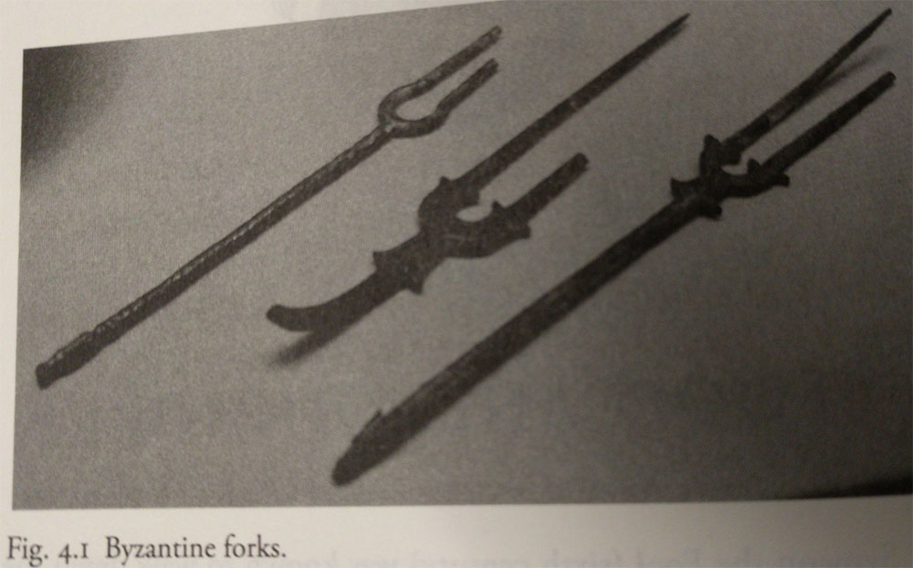
Nakamoto Consensus
If majority of computation is honest,
honest parties will agree (eventually)
Log is tamper-proof
  It would require redoing all of the work to tamper

Slide 13
Blockchains for Audit
Individual accountability
  Everything is visible. Everyone is accountable.
Event reconstruction
  All of the events are there. Easy to reconstruct.
Real-time intelligence
  Miners can verify everything as it goes on the log.
before!

Slide 14
Not just a log!
Authoritative record
Instead of logging events elsewhere, the blockchain can record the definition of events (e.g. transactions)
Online validation can prevent illegal events from ever happening!

Slide 15
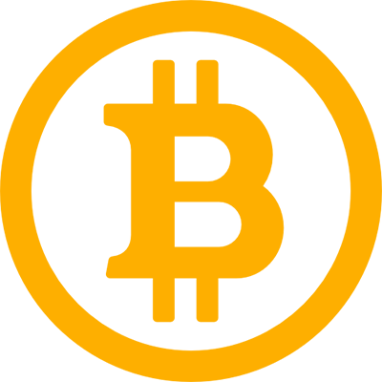
What restrictions make sense?
Transaction Processing System
Each block has a limited number of transactions (1 MB)
Transactions cannot create money
  Except coinbase transaction to reward miner
Coins can only be spent once (spending creates new unspent coins)
To spend a coin conditions must be met (e.g., owner authorizes)
Bitcoin

Slide 16
Blockchains and Confidentiality

Slide 17
What do we do with private data?
Cannot put it on the blockchain – everything is public
Only publish commitments
d₁
x₁
d₂
x₂
C₁
C₂
Secret M₁
Secret M₂
Commit(M₁)
Commit(M₂)

Slide 18


Commitment Schemes
A commitment scheme Com is a protocol such that:
Hiding: receiver does not learn anything about x from Com(x)
Binding: sender cannot produce alternative x' such that Com(x) = x'
I owe you $100
~EB
I owe you $5
~EB

Slide 19

Pedersen Commitments
let n be some prime number and let g, h be numbers in the range 1 < g, h < n
$Commit(m)$:
  Pick a random $r←[1, n−1]$
  $c=g^{m}⋅h^{r}$

Slide 20

Hash-based Commitments
$Commit(m)$:
  $r←{\left\{0,1\right\}}^{n}$
  $c=H(m|\left|r\right)$

Slide 21

What do we do with private data?
Cannot put it on the blockchain – everything is public
Only publish commitments
  Still tamper-proof ✔
  No longer able to see actions
    Cannot reconstruct events X
    Cannot perform online validation X
☹

Slide 22
Doing better with private data
Verify data validity without leaking secrets
Ongoing research with two main tools
Heavy-duty cryptographic constructs
  Complex zero-knowledge proofs
Trusted hardware
  Places trust in hardware instead of crypto or a large group

Slide 23
Zero-Knowledge Proof
A zero-knowledge proof is a protocol that satisfies:
  Completeness: if the statement is true, a verifier will be convinced of this fact.
  Soundness: if the statement is false, no cheating prover can convince an honest verifier that it is true (except with some small probability).
  Zero-knowledge: if the statement is true, no verifier learns anything other than the fact that the statement is true.

Slide 24
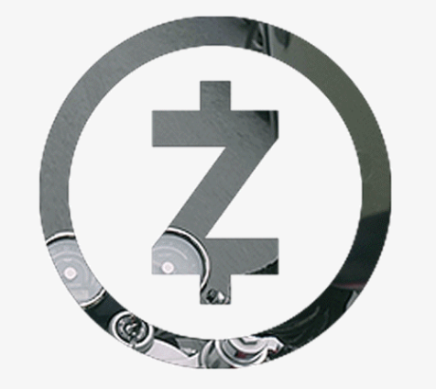

Cryptographic Example
ZKP gives strong publicly verifiable integrity guarantees
  Sender authorized transaction
  Sender had money to send
  Transaction value was not negative
  Transaction was processed correctly
Can (provably) furnish transaction details to external auditor

Slide 25
Trusted Hardware
Special machine instructions
  Isolate process from the surrounding system
  Can remotely attest that they’re running specific code
    Uses (literally) hard-wired keys in the CPU
Trustworthy code can operate on secret data and attest to correctness
Examples:
  Intel Software Guard eXtensions (SGX)
  ARM TrustZone

Slide 26
Exercise
Working with you project group, consider how you might incorporate auditing into you project.
  what events to audit
  what information to audit for each event
  how you will format the log entries
  what you will do with your audit log

Slide 27
Blockchains

