Slide 1
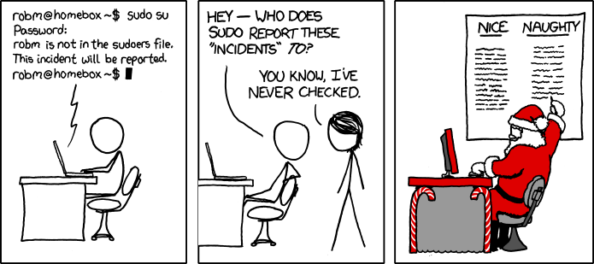
Lecture 22: Audit
CS 138 Spring 2026

Slide 2


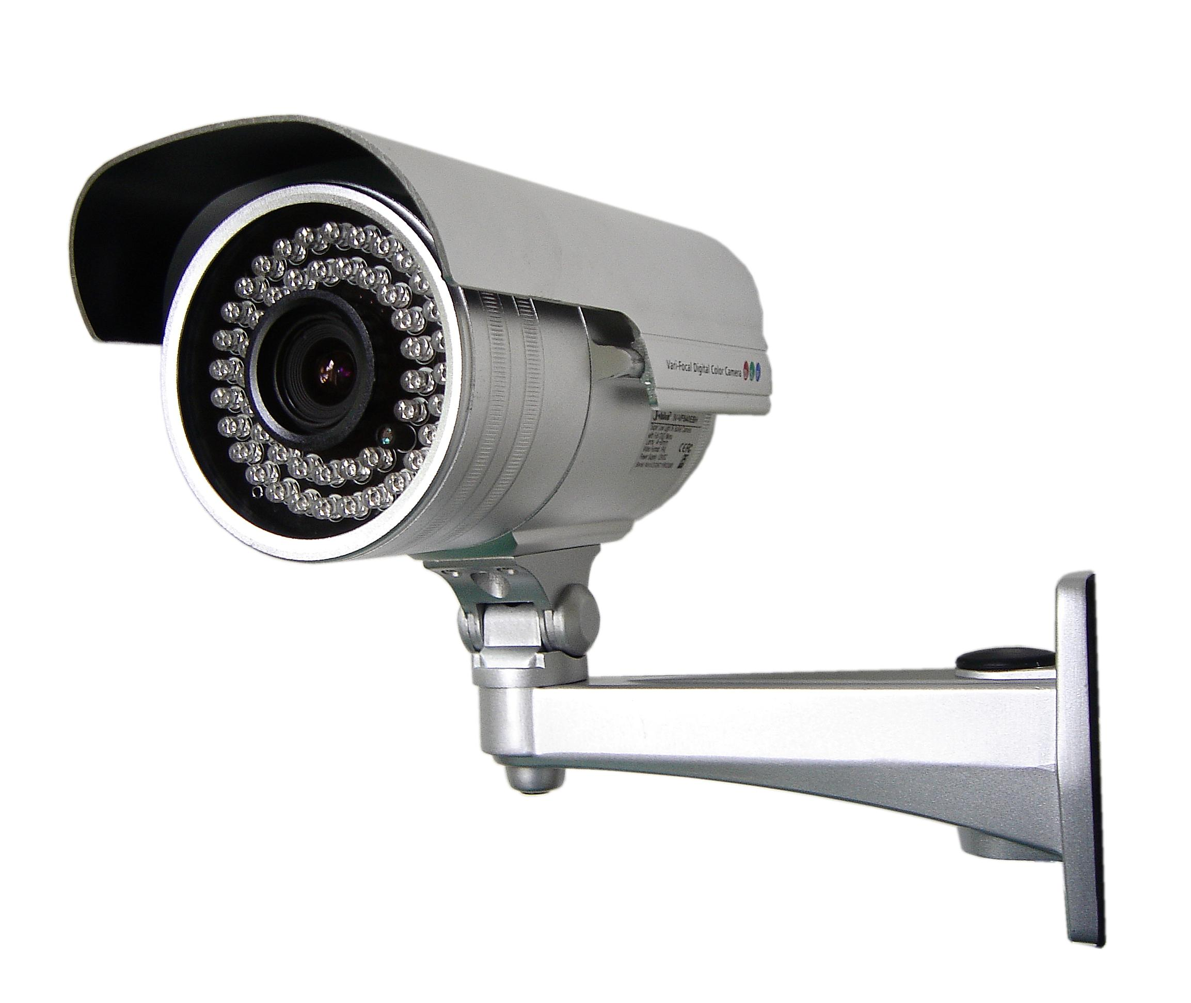
Classes of Countermeasures
Authentication: mechanisms that bind principals to actions
Authorization: mechanisms that govern whether actions are permitted
Audit: mechanisms that record and review actions

Slide 3
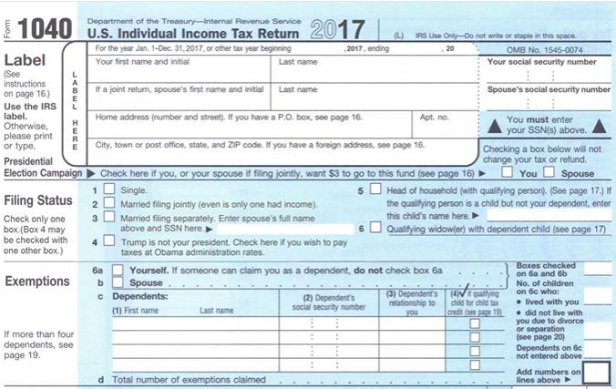
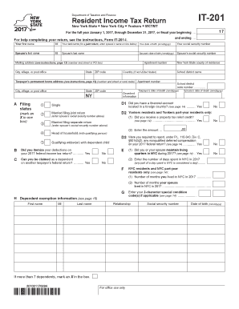
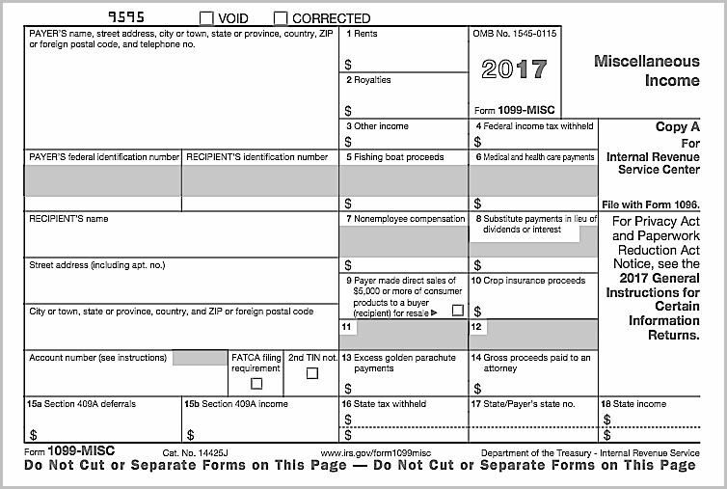
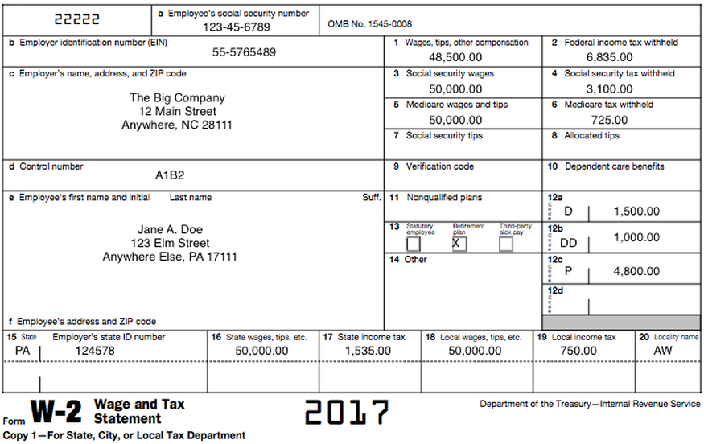
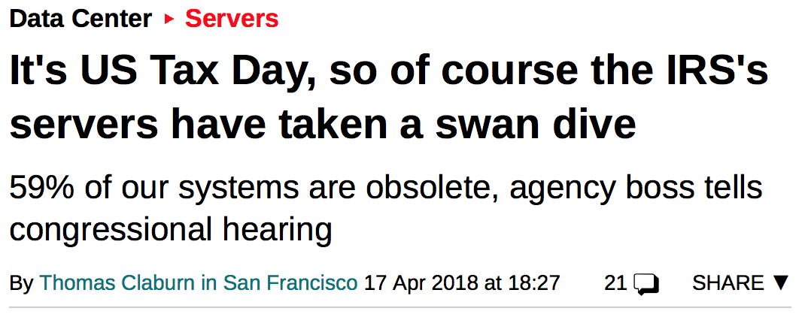
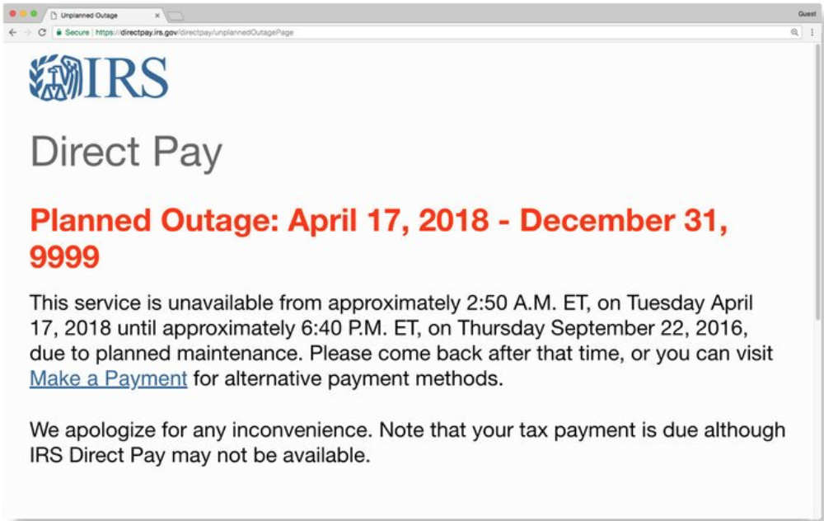

Uses of audit
Deterrence through accountability: deter misbehavior
Detection and recovery: determine what happened and how to recover
Problem monitoring: real-time intelligence
Notes:
Deterrence through accountability: santa, panopticon, chilling effect

Slide 4
Audit tasks
Recording:
  what to log
  what not to log
  how to log
    locally
    remotely
  how to protect the log
Reviewing:
  automated analysis
  manual exploration

Slide 5
What to Log

Slide 6
What to log?
Example: US State Department pilot program (1980s)
Requirements:
  log every transaction related to protected electronic documents
  system administrator reviews log daily to search for malicious behavior
Experiment:
  test system for 5 users, 10 minutes
  audit log was a stack of paper over a foot high
  real system would have been 1000s of users working 24/7
Lessons learned:
  logging and review of everything by a human is impractical
  need to reduce information logged: log reduction
  need automated review

Slide 7
States vs. events
States: data, what the system is
  backup, or more
  survive power failures, crashes, attacks
  what state? memory, disk, network, ...
  consistent snapshot of distributed system is hard
Events: actions, how the system came to be
  login, access to protected resource, elevation and attenuation of privileges, ...
  our focus
  which events?

Slide 8
Recall: Security requirements
Functional requirement: something system should do
  e.g., allow people to cash checks
Security goal: something system should/shouldn't do
  e.g., prevent loss of revenue through bad checks
Security requirement: constraint on functional requirement to achieve goal
  e.g., check must be drawn on bank where being cashed, or person cashing must be customer at that bank and deposit in their account

Slide 9
Events to log
Any event that involves a security requirement
  Fact that requirement was checked
  Whether it was met or not
  The information that led to that decision
Typically involves the gold standard...
  whether a principal was authenticated, or
  whether an action was authorized

Slide 10
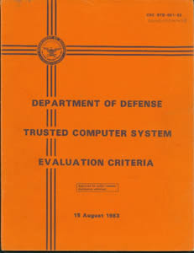
Orange Book logging
For minimal C2 level certification:
Events to log:
  Use of identification and authentication mechanisms
  Introduction of objects into a user's address space (e.g., file open, program initiation)
  Deletion of objects
  Actions taken by computer operators and system administrators and/or system security officers
Notes:
"Orange Book" (DoD Trusted Computer System Evaluation Criteria)
Used approx. 1985-2000 for US government systems
http://csrc.nist.gov/publications/history/dod85.pdf
D: meets no higher requirements
C1: DAC & authentication (but maybe not at the level of individual users), TCB with integrity verification, security testing, documentation of security features/testing/design
C2: improved DAC (at the level of single users, failsafe defaults, limits on propagation), audit (of specified security relevant events and details of those events)
- IBM mainframes and Windows NT got this certification
B: MAC
A: Verified

Slide 11
Orange Book logging
For minimal C2 level certification:
What to log:
  Date and time of the event
  User
  Type of event
  Success or failure of the event
  For identification/authentication events: origin of request
  For events involving objects: name of the object

Slide 12
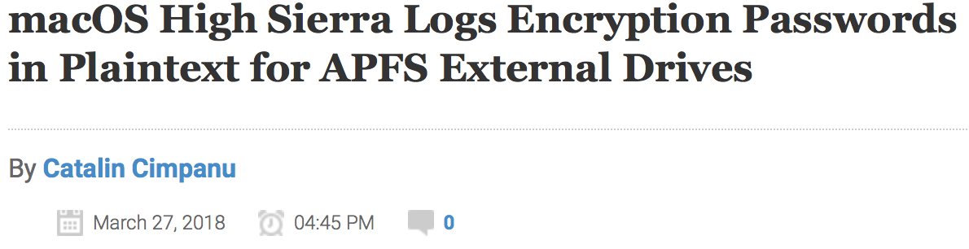
What not to log
Some information might be too sensitive for log files:
  cryptographic keys, passwords
  the details of company's shiny new product
  the GPS coordinates of undercover secret agents
Possibilities:
  log it anyway, protect the log
  sanitize log
Notes:
Bug: whenever a user creates a new APFS volume and chooses an encryption password, the Disk Utility.app will log the encryption password in the unified OS log. Issue confirmed to affect to affect only macOS 10.13 and 10.13.1

Slide 13
Sanitization
Protect confidential information in log
by deleting
by modifying
  e.g., replace with user names with pseudonyms, keep separate protected map between names and pseudonyms

Slide 14
Sanitization
Before writing to log:
  Pro: protects users from system administrators; maybe surveillance warranted only with probable cause
  Con: have to decide in advance, as part of system design, what information to keep vs. discard
After writing to log:
  Con: confidentiality of log must be (more) protected
  Pro: can decide afterwards what information to discard, perhaps even redact logs and send to 3rd party for analysis

Slide 15
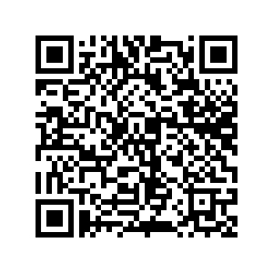
Exercise
Imagine that you are designing the log for a system. What events would you log? What information would you include for each log entry?
Possible systems:
  Gradescope
  Instagram
  the 5C SSO
  a banking app/site

Slide 16
How to Log

Slide 17
Say what you mean
Main principle: Every log entry should say what it means
Interpretation of log entry should depend only upon content of log entry
Hence reviewer can recover meaning without needing to assume or supply any context
Notes:
Writing down a straightforward English sentence describing the meaning of each log entry is good practice

Slide 18
Log file format
Keeping log files in standard format enables...
  Reuse of tools for log analysis
  Correlation across logs from multiple applications
Standard formats:
  Common Log Format (used by web servers)
  syslog (used by Unix)
    originated with sendmail
    became a de facto standard
    then standardized by IETF: RFC 5424
    examples: take a look in your local /var/log directory
Notes:
sendmail: general purpose send email facility released 1983

Slide 19
Common Log Format
client IP
client id
user id
timestamp
127.0.0.1 user-identifier eleanor [10/Oct/2000:13:55:36 -0700] "GET /apache_pb.gif HTTP/1.0" 200 2326
HTTP request
response code
response len

Slide 20
syslog example message
timestamp
hostname
appliction
process id
Apr 8 00:48:29 ariel kernel[0]:
AppleThunderboltNHIType2::prePCIWake - power up complete - took 1624 us
message
Notes:
Violates syslog RFC standard in various ways: timestamp omits information, hostname isn't fully qualified

Slide 21
syslog message format
facility: category
  kernel, mail, security, printer, clock, ...
severity
  emergency, alert, critical, error, warning, notice, informational, debug
timestamp
hostname
application name
process id
  no standard meaning; sometime co-opted by application to provide identifier that groups related messages (e.g. a transaction)
message type
  also no standard meaning; just a string that can be used for (e.g.) filtering
message
  can be structured as key-value pairs, or unstructured

Slide 22
Log space
What happens if log size grows too large?
Halt system
Overwrite previous entries
Stop logging

Slide 23
Reviewing the log

Slide 24
Manual review
Enable administrators to explore logs and look for {states, events}
Issues:
  Designers might not have anticipated the right {states, events} to record
  Visualization, query, expressivity (HCI/DB issues)
  Correlation amongst multiple logs

Slide 25
Interfaces
Flat text
Hypertext
DBMS
Visualization tools
Notes:
http://seclab.cs.ucdavis.edu/projects/awb/vabhg/demos/rdist/root.html
Discuss SUID attack example

Slide 26
Techniques
Temporal replay: animate what happened when
Slice: display minimal set of log events that affect a given object
Notes:
Idea comes from program slicing: debugging technique that reveals program statements that led to current value of variable
Discuss example systems: splunk, logz.io, etc
https://www.keycdn.com/blog/log-analysis-tools/
https://youtu.be/OD1_I9IDvBs?t=213

Slide 27
Automated review and response
Review: detect suspicious behavior that looks like an attack, or detect violations of explicit policy
  Custom-built systems
  Classic AI techniques like training neural nets, expert systems, etc.
  Modern applications of machine learning
Response: report, take action

Slide 28
Exercise
Imagine that you have designing the log for a system. How should this log be used? What tools/visualizations/guidelines would you provide to make the best use of this log?
Possible systems:
  Gradescope
  Instagram
  the 5C SSO
  a banking app/site

Slide 29
Audit

