Slide 1
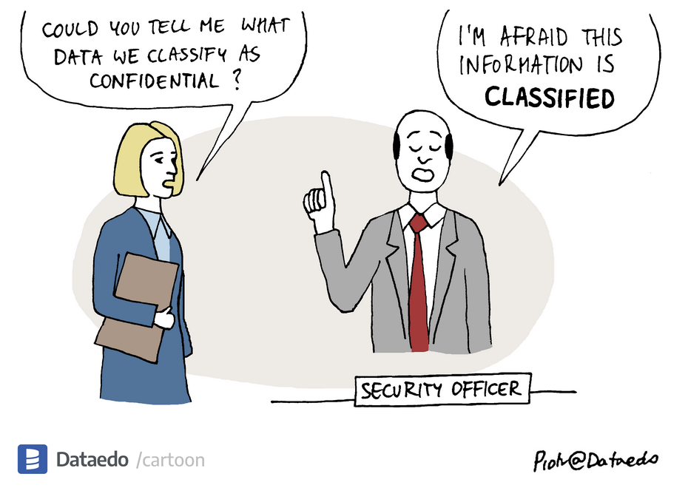
Lecture 18: Mandatory Access Control
CS 138 Spring 2026

Slide 2
Review: Access control
Subject: principal to which execution can be attributed
Object: data or resource
Operation: performed by subject on object
Right: entitlement to perform operation

Slide 3
Review: DAC
Discretionary access control (DAC)
Philosophy: users have the discretion to specify policy themselves
Commonly, information belongs to the owner of object
Model: access control relation
Set of triples (subj,obj,rights)
Sometimes described as access control "matrix"
Implementations:
Access control lists (ACLs): each object associated with list of (subject, rights)
Capability lists: each subject associated with list of (object, rights)

Slide 4
MAC
Mandatory access control (MAC)
philosophy: central authority mandates policy
information belongs to the authority, not to the individual users
not Message Authentication Code (applied crypto), nor Media Access Control (networking)

Slide 5
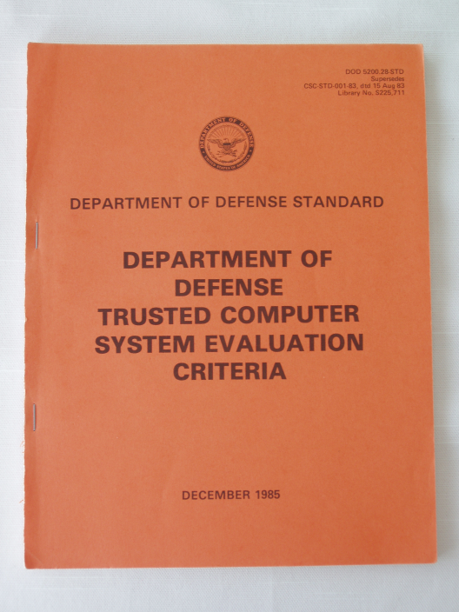
Multi-Level Security
A mechanism for monitoring access control in a system where both principals and objects have security labels drawn from a hierarchy of labels
Commonly associated with military systems
Influenced "Orange Book" (DoD Trusted Computer System Evaluation Criteria)
A) Verified Protection
B) Mandatory Protection
C) Discretionary Protection
D) Minimal Protection
Notes:
Initially issued 1983

Slide 6

Sensitivity
Concern is confidentiality of information
Documents classified according to sensitivity: risk associated with release of information
In US:
Top Secret
Secret
Confidential
Unclassified
Notes:
If there are levels above Top Secret, they must themselves be classified...

Slide 7
Compartments
Documents classified according to compartment(s): categories of information (in fact, aka category)
cryptography
nuclear
biological
reconnaissance
Need to Know Principle: access should be granted only when necessary to perform assigned duties (instance of Least Privilege)
{crypto, nuclear}: must need to know about both to access
{}: no particular compartments

Slide 8
Labels
Label: pair of sensitivity level and set of compartments, e.g.,
(Top Secret, {crypto, nuclear})
(Unclassified, {})
Document is labeled aka classified
Perhaps each paragraph labeled
Label of document is most restrictive label for any paragraph
Users are labeled according to their clearance
Users trustworthy by virtue of vetting process for security clearance
Out of scope (e.g.): user who views Top Secret information and calls the Washington Post
Labels are imposed by organization
Notation: let L(X) be the label of entity X

Slide 9
Restrictiveness of labels
Notation: L1 ⊑ L2
means L1 is less (or equally) restrictive than L2
Definition:
Let L1 = (S1, C1) and L2 = (S2, C2)
L1 ⊑ L2 iff S1 ≤ S2 and C1 ⊆ C2
Where ≤ is order on sensitivity: Unclassified ≤ Confidential ≤ Secret ≤ Top Secret
e.g.
(Unclassified,{}) ⊑ (Top Secret, {})
(Top Secret, {crypto}) ⊑ (Top Secret, {crypto,nuclear})

Slide 10
Label partial order
Secret, {nuc, crypto}
Secret, {nuc}
Conf, {nuc,crypto}
Secret, {crypto}
Conf, {nuc}
Secret, {}
Conf, {crypto}
Conf, {}
Notes:
Hasse diagram

Slide 11
Label partial order
Sec, {nuc,crypto}
Secret, {nuc}
Conf, {nuc,crypto}
Secret, {crypto}
Conf, {nuc}
Secret, {}
Conf, {crypto}
Incomparable
Conf, {}

Slide 12
Label partial order
Sec, {nuc,crypto}
Incomparable
Secret, {nuc}
Conf, {nuc,crypto}
Secret, {crypto}
Conf, {nuc}
Secret, {}
Conf, {crypto}
Conf, {}

Slide 13
Exercise 1: Label Partial Order
For each pair of labels, determine whether L1 ⊑ L2, L2 ⊑ L1, or neither
L1= (Conf, {}), L2 = (Secret, {crypto})
L1 = (Conf, {nuc}), L2 = (Secret, {crypto})
L1 = (Secret, {nuc,crypto}), L2= (Conf, {crypto}

Slide 14
Access control with MLS
When may a subject read an object?
Threat: subject attempts to read information for which it is not cleared
e.g., subject with clearance Unclassified attempts to read Top Secret information
Notes:
group discussion

Slide 15
Access control with MLS
When may a subject read an object?
S may read O iff L(O) ⊑ L(S)
object's classification must be below (or equal to) subject's clearance
"no read up" _

Slide 16
Exercise 2: Reading with MLS
Scenario:
Alice has clearance (Secret, {nuclear, Europe})
DocA with classification (Confidential, {nuclear})
DocB with classification (Secret, {Europe, US})
DocC with classification (Top Secret, {nuclear, Europe})
Which documents may Alice read?
Recall: S may read O iff L(O) ⊑ L(S)
DocA: (Confidential, {nuclear}) ⊑ (Secret, {nuclear, Europe})
DocB: (Secret, {Europe, US}) ⋢ (Secret, {nuclear, Europe})
DocC: (Top Secret, {nuclear, Europe}) ⋢ (Secret, {nuclear, Europe})

Slide 17
Access control with MLS
When may a subject read an object?
S may read O iff L(O) ⊑ L(S)
object's classification must be below (or equal to) subject's clearance
"no read up" _
When may a subject write an object?
Threat: subject attempts to leak information by writing into a lower-security object
e.g., subject with clearance Top Secret reads Top Secret information then writes it into an Unclassified file
Notes:
group discussion

Slide 18
Access control with MLS
When may a subject read an object?
S may read O iff L(O) ⊑ L(S)
object's classification must be below (or equal to) subject's clearance
"no read up" _
When may a subject write an object?
S may write O iff L(S) ⊑ L(O)
object's classification must be above (or equal to) subject's clearance
"no write down"

Slide 19
Exercise 3: Writing with MLS
Scenario:
Alice has clearance (Secret, {nuclear, Europe})
DocA with classification (Confidential, {nuclear})
DocB with classification (Secret, {Europe, US})
DocC with classification (Top Secret, {nuclear, Europe})
Which documents may Alice write?
Recall: S may write O iff L(S) ⊑ L(O)
DocA: (Secret, {nuclear, Europe}) ⋢ (Confidential, {nuclear})
DocB: (Secret, {nuclear, Europe}) ⋢ (Secret, {Europe, US})
DocC: (Secret, {nuclear, Europe}) ⊑ (Top Secret, {nuclear, Europe})
Notes:
Exercize

Slide 20
Reading and writing with MLS
Scenario:
Principal P with clearance (Secret, {nuclear, Europe})
DocA with classification (Confidential, {nuclear})
DocB with classification (Secret, {Europe, US})
DocC with classification (Top Secret, {nuclear, Europe})
Summary:
DocA: P may read but not write
DocB: P may neither read nor write
DocC: P may write but not read

Slide 21
Perplexities of writing with MLS
Blind write: subject may not read higher-security object yet may write it
Useful for logging
Some implementations prohibit writing up as well as writing down
User who wants to write lower-security object may not
Attenuation of privilege: login at a lower security level than clearance
Nice (annoying?) application of Least Privilege
Declassification violates "no write down"
Encryption or billing procedure produces (e.g.) Unclassified output from Secret information
Traditional solution is trusted subjects who are not constrained by access control rules

Slide 22
Formalizing MLS
[Bell and LaPadula 1973]
Formal mathematical model of MLS plus access control matrix
Proof that information cannot leak to subjects not cleared for it
"No read up": simple security property
"No write down": *-property
"The influence of [BLP] permeates all policy modeling in computer security" –Matt Bishop
Influenced Orange Book
Led to research field "foundations of computer security”

Slide 23
Exercise
A fictitious microprocessor company called Mintel, Inc., is implementing a MLS model for its computer systems. The security officer of Mintel proposes the following labels:
Users:
Alice is the CEO of Mintel. L(Alice) = (Top Secret, {NewCPU,HR})
Bob is a manager in the HR office. L(Bob) = (Secret, {HR})
Cindy is a working on a new CPU product. L(Cindy) = (Secret, {NewCPU})
Dave is a receptionist in the main lobby. L(Dave) = (Unclassified, {})
Objects:
payroll.xlsx Salaray spreadsheet. L(payroll.xlsx) = (Confidential, {HR})
strategy.pptx Briefing on new CPU. L(strategy.pptx) = (TopSecret, {NewCPU})
index.php Homepage of Mintel's website. L(index.php) = (Unclassified, {})
Assuming each user logs in with their full clearance, which files can each user read? Which files can each user write?

Slide 24
Integrity
BLP is about confidentiality
Adapted to integrity by Biba [1977]: same rules, different lattice
Instead of Unclassified and Secret, labels could be Untrusted and Trusted
L1 ⊑ L2 means “L1 may flow to L2 without breaking confidentiality”
BLP: low secrecy sources may flow to high secrecy sinks
Hence Unclassified ⊑ Secret, but not v.v.
Biba: low integrity sources may not flow to high integrity sinks
Hence Trusted ⊑ Untrusted, but not v.v.
High vs. low is “flipped” (lattices are duals)

Slide 25
Biba model
S may read O iff L(O) ⊑ L(S)
E.g., Trusted subject cannot read Untrusted object
But Untrusted subject may read Trusted object
S may write O iff L(S) ⊑ L(O)
E.g., Trusted subject may write Untrusted object
But Untrusted subject may not write Trusted object

Slide 26
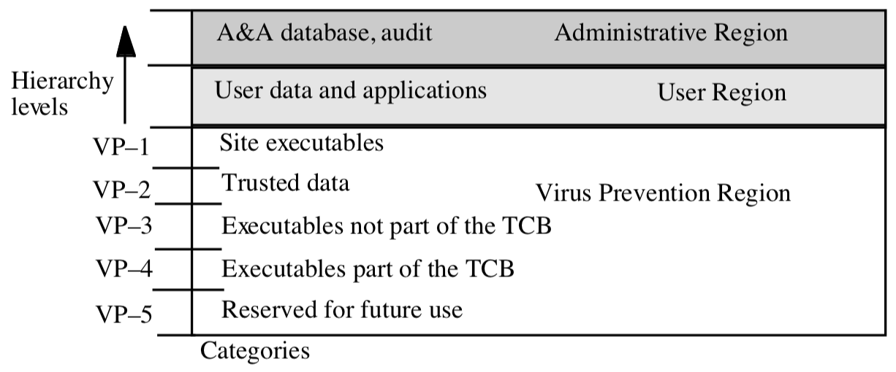
MLS in OSs
DG/UX
Discontinued Unix OS, release 1985
Three regions: Virus Protection ⊑ User Region ⊑ Administrative Region
Notes:
DG/UX = Data General (company)/Unix, Data General later bough by EMC which then merged with Dell
User Region: users are cleared here
Virus Protection: executables that implement the system
Can't be written by users (no write down)
Can be executed (okay to read down)
Administrative Region: authorization & authentication database (assigns labels), audit logs
Can't be read by users (no read up)
Can't be changed by users (no blind writes)

Slide 27
MLS in OSs
DG/UX
Discontinued Unix OS, release 1985
Three regions: Virus Protection ⊑ User Region ⊑ Administrative Region
MLS confidentiality: read down, no read up
Extra integrity: no write down, no write up
for shared directories (e.g., /tmp), introduced multi-level directories with one hidden subdirectory for each level

Slide 28

MLS in OSs
SELinux
Kernel security module, dates back to NSA c. 2000, merged with Linux kernel mainline in 2.6
Goal: separate security policy from security decisions
Supports mandatory access controls in reference policy. When MLS is enabled:
Each principal (user or process) is assigned a context (username, role, domain, (sensitivity))
Each object (file, port, hardware) is assigned a context
SELinux enforces MLS

Slide 29
MLS in OSs
TrustedBSD [2000]
Similar goals to SELinux: separate policy from security mechanism, implements MLS
ported parts of SELinux to FreeBSD
Many components eventually folded into FreeBSD
Most interfaces supported on Macs since OSX 10.5
Notes:
The source for the TrustedBSD/OSX discussion is the PhD dissertation of Robert Watson, New Approaches to Operating System Security Extensibility, http://www.cl.cam.ac.uk/techreports/UCAM-CL-TR-818.html.

Slide 30
Beyond Multi-level Security…
Mandatory access control comes in many different forms:
Multi-level security (confidentiality, military)
Biba model (integrity, military)
Role-based access control (hybrid, organization)
Clark-Wilson (integrity, business)
Brewer-Nash (hybrid, consulting firm)

Slide 31
Mandatory Access Control

