Slide 1
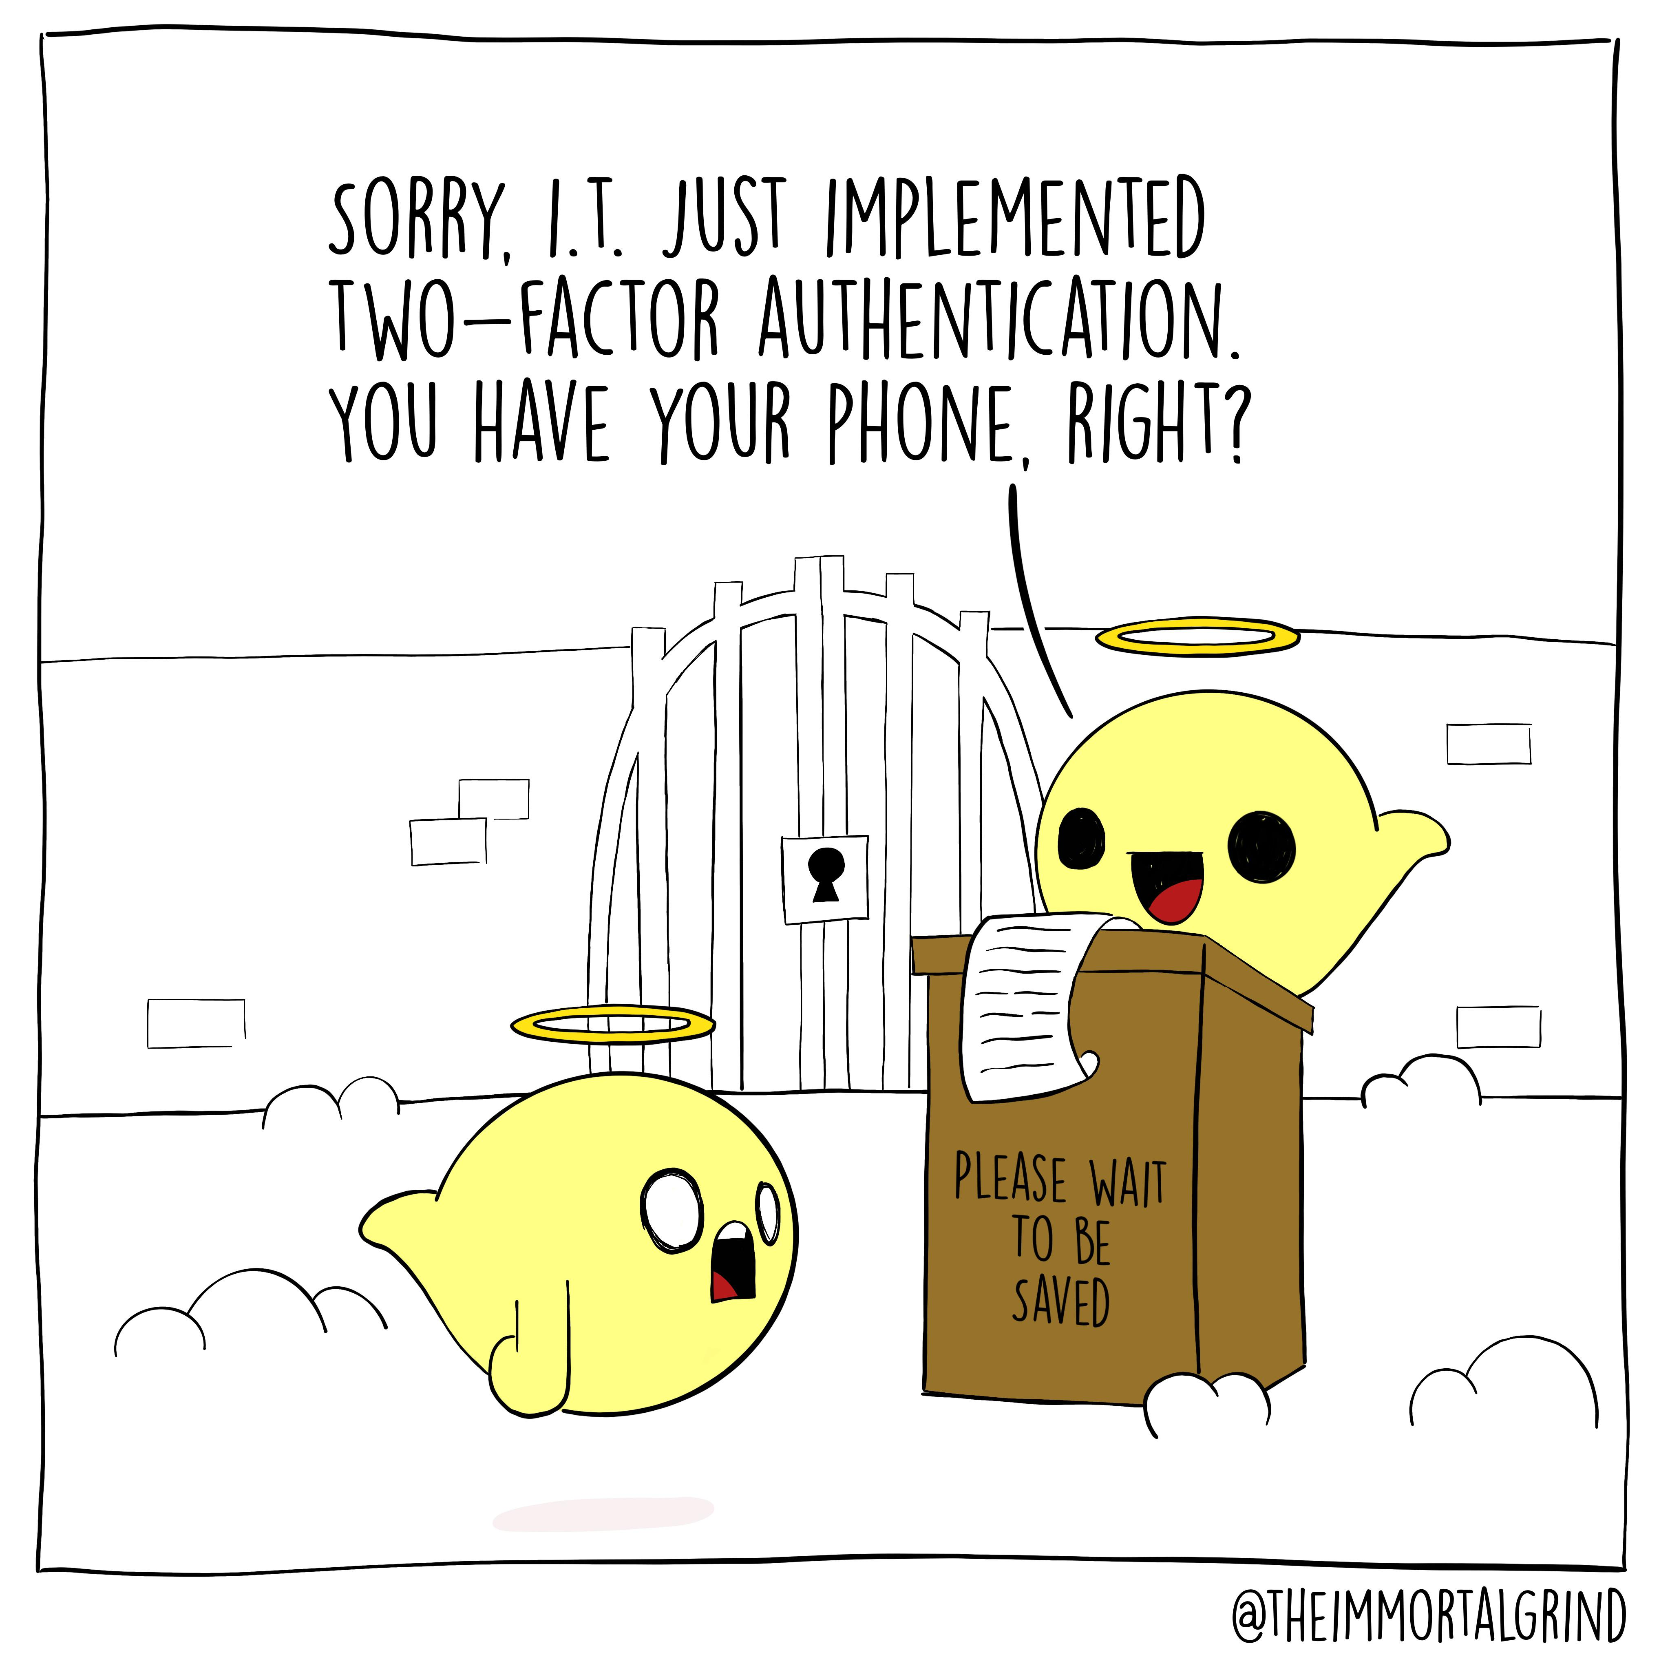
Lecture 15: Tokens
CS 138 Spring 2026

Slide 2
Review: Authentication of humans
Something you are
  fingerprint, retinal scan, hand silhouette, a pulse
Something you know
  password, passphrase, PIN, answers to security questions
Something you have
  physical key, ticket, {ATM, prox, credit} card, token

Slide 3
Authentication Tokens
What hardware authentication tokens and/or phone apps have you used in real life?

Slide 4
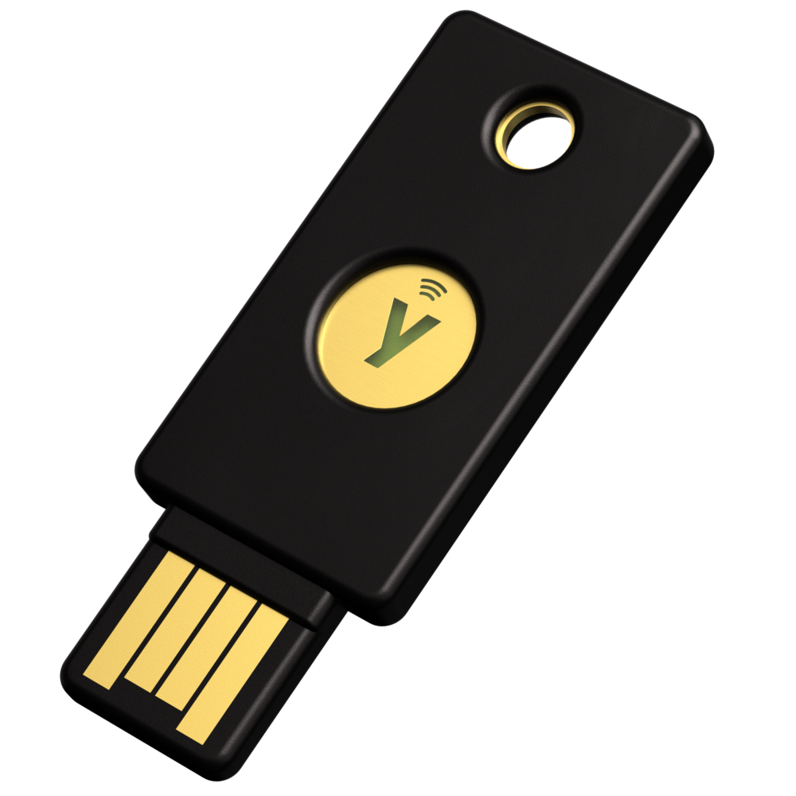
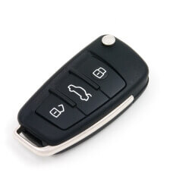
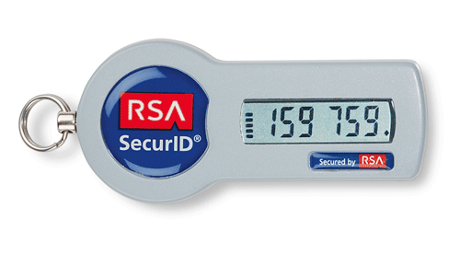
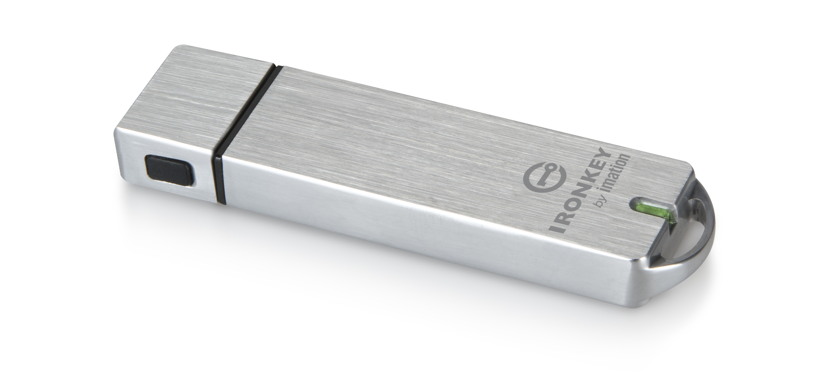


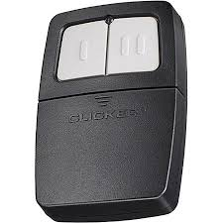
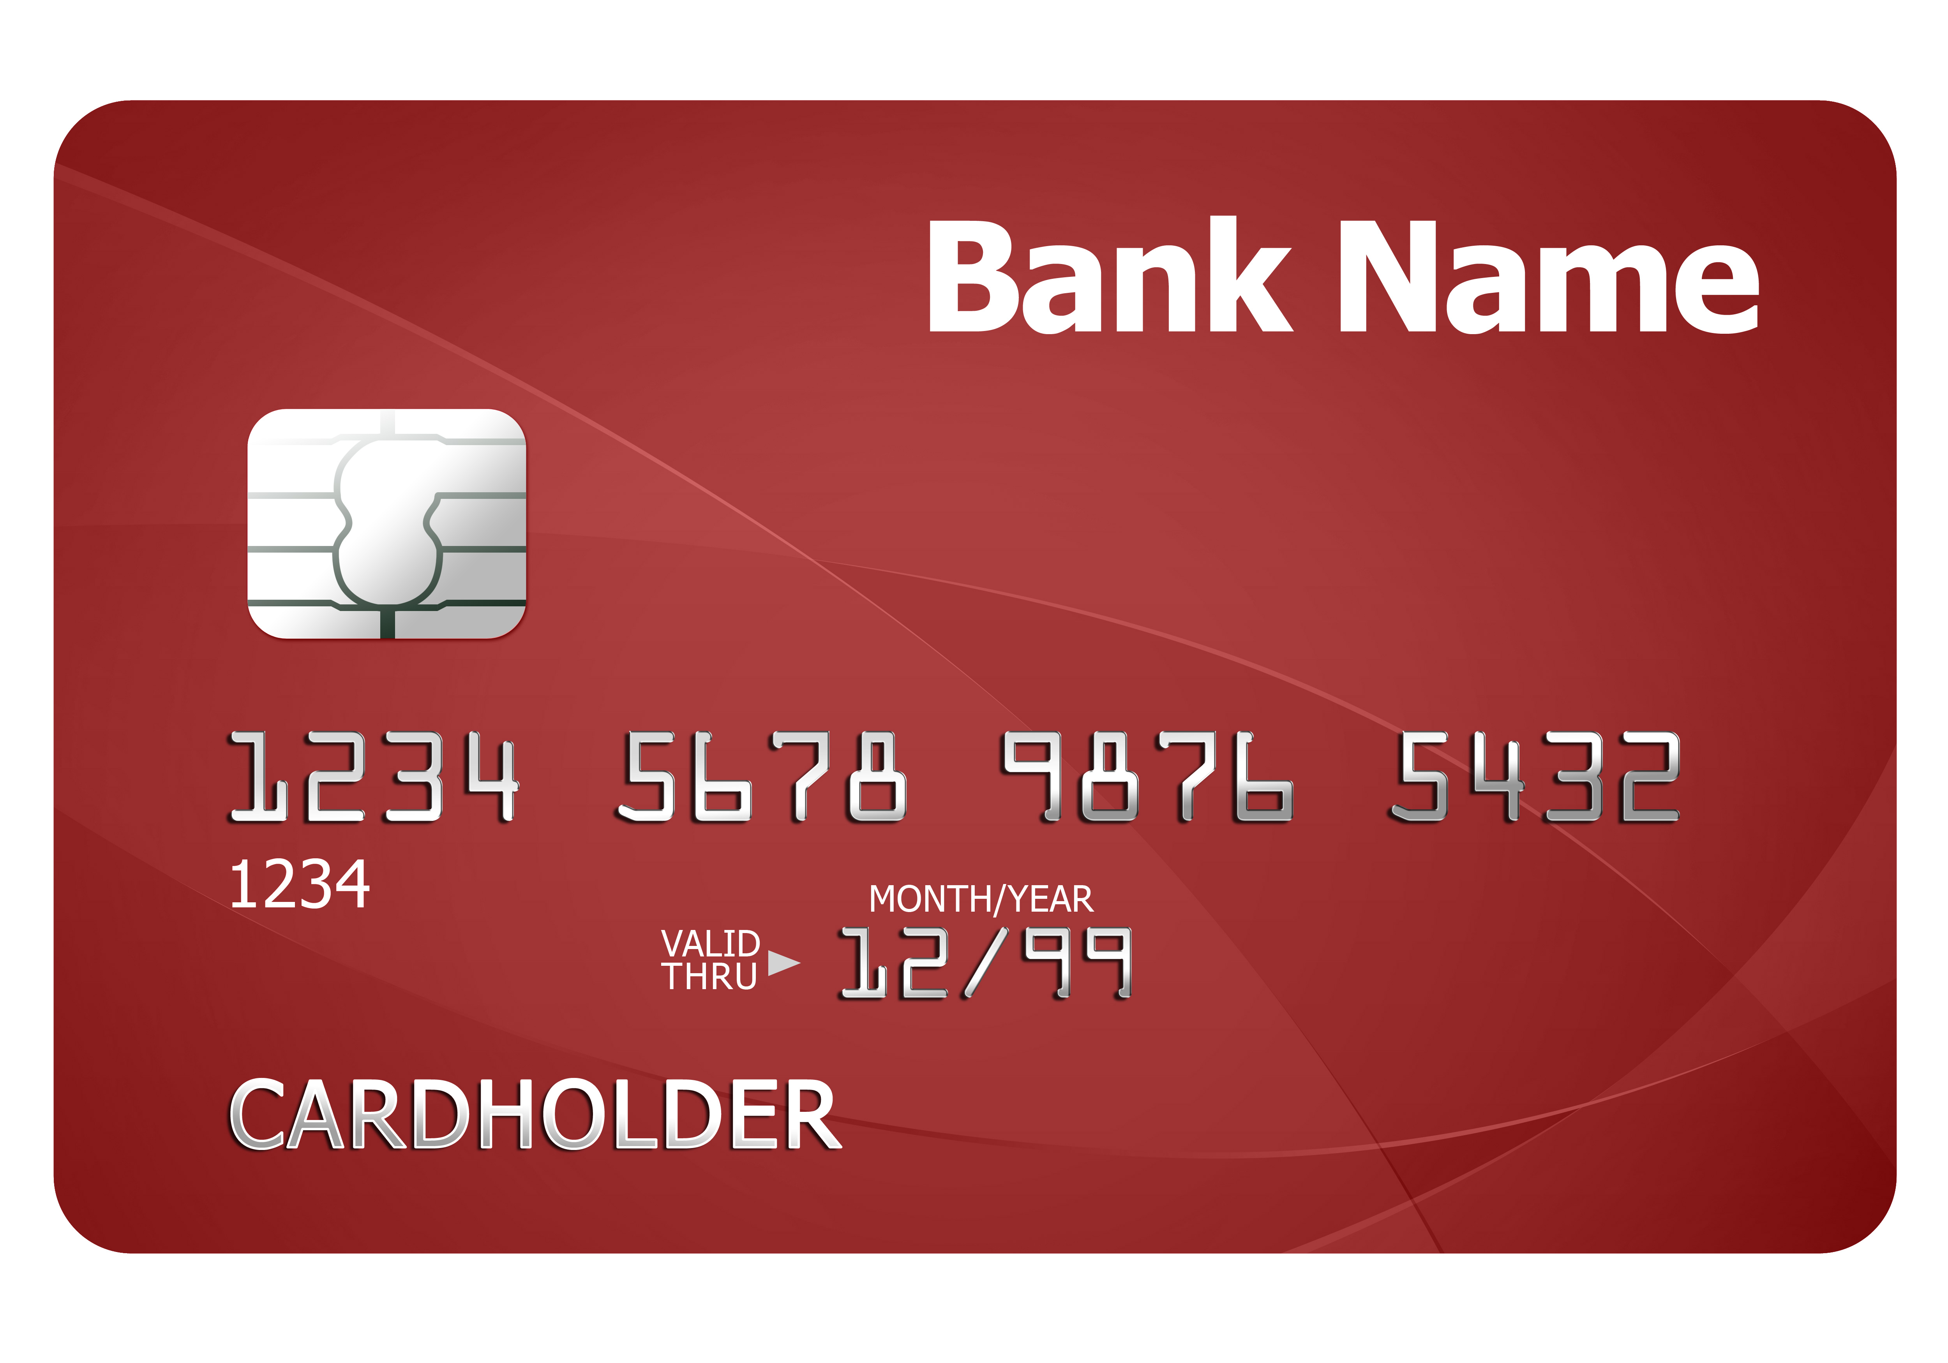
Authentication tokens
Notes:
Usability: users don't have to remember secrets, (often) easy to carry, efficient, infrequent errors
Deployability: (typically) low cost, but need to be physically distributed
Security: tokens store a value, this value can be longer/more random than value stored by human (ie, password),
some tokens can also do crypto -> typically more security

Slide 5
Threat Model: Eavesdropper
Adversary can read read and replay messages
Adversary cannot change messages during protocol execution (not full Dolev-Yao)

Slide 6

Fixed codes (Keyless Entry)
Token stores a secret value id_T (e.g., key, id, password)
Reader stores list of authorized ids
To enter: T->B: id_T
Attack: replay: thief sits in car nearby, records serial number, programs another token with same number, steals car
Attack: brute force: serial numbers were 16 bits, devices could search through that space in under an hour for a single car (and in a whole parking lot, could unlock some car in under a minute)
Attack: insider: serial numbers typically show up on many forms related to car, so mechanic, DMV, dealer's business office, etc. must be trusted
Notes:
relate to traditional rfid (note: rfid epc usually 96 or 128 bits, so eliminate 2/3 attacks)
replay concerns + privacy concerns
2018 Honda Civic vulnerable to this attack: https://cve.mitre.org/cgi-bin/cvename.cgi?name=CVE-2022-27254

Slide 7

Fixed codes (RFIDs)
Token stores a secret value id_T (e.g., key, id, password)
Reader stores list of authorized ids
To enter: T->B: id_T
Attack: replay: thief sits nearby, records serial number, programs another token with same number, authenticates
Attack: privacy: adversary tracks token usage across system and learns user attributes and/or behaviors

Slide 8
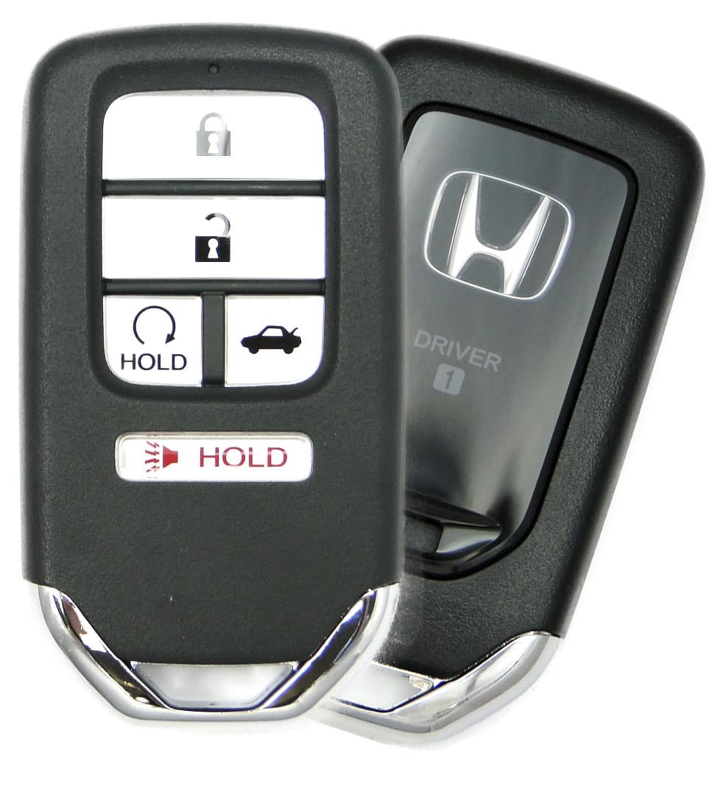
“Rolling” codes
Token stores: id_T, sk_T, n
Lock stores info for all authorized ids
To enter: Token->Lock: id_T, Hash(id_T, n, sk_T)
Both Token and Lock increment n after each authentication
Problem: desynchronization of nonce
Notes:
serial number T
shared key k, which is H(rk, T) for some root key
nonce N, which is a sequence counter

Slide 9
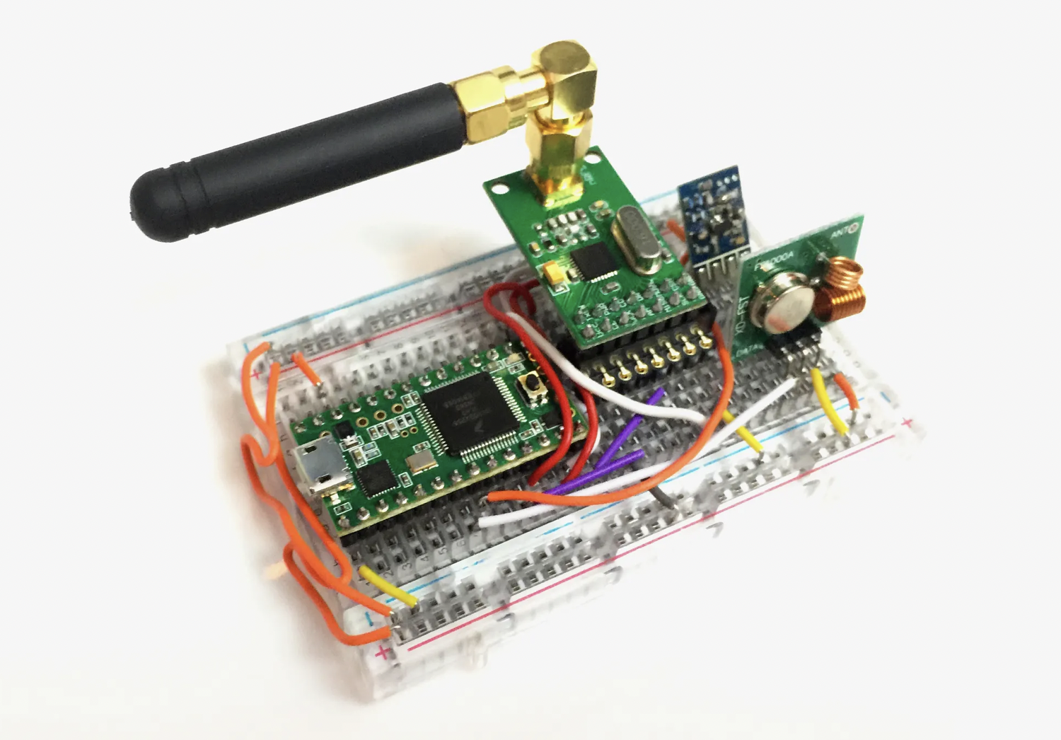
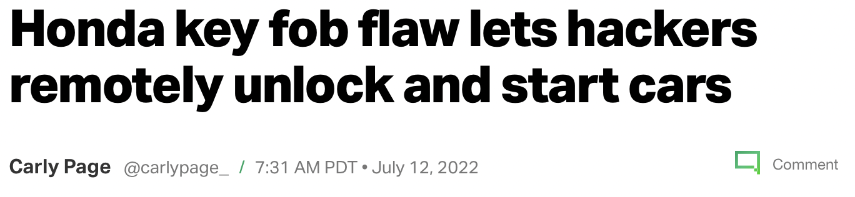
Hacking Rolling Codes
Notes:
brute force (2015): https://www.wired.com/2015/08/hackers-tiny-device-unlocks-cars-opens-garages/
repeater attacks: extend range of keys when near front of house
block-and-forward MITM attack: block first try, block second and forward first
bugs (2022): lock and unlock resets rolling keys, so replay attacks can work

Slide 10
One-Time Passwords
OTP may be deemed valid only once (the first time)
Adversary cannot predict future OTPs, even with complete knowledge of what passwords have already been used
Notes:
rules out replay attacks, MITM attacks still possible

Slide 11


Challenge-based OTPs
Token stores: id_T, sk_T
Lock stores info for all authorized ids
To enter:
  Token->Lock: I want to authenticate
  Lock->Token: n (new, randomly chosen number)
  Token->Lock: id_T, Hash(id_T, n, sk_T)
Notes:
EPC Gen2v2 RFID Cards

Slide 12
Exercise 2: Digital Signatures
Assume: B stores a MAC key for each token and T stores k_T
1. U->B: U,T
2. B: choose rand r
3. B->T: r
4. T: t=MAC(r; k_T)
5. T->B: id_T, t
6. B: U is auth as uid if t=MAC(r; k_T)
Assume: B stores a verification key for each token and T stores signing key k_T
1. U->B: U,T
2. B: choose rand r
3. B->T: r
4. T: s=Sign(r; k_T)
5. T->B: id_T, s
6. B: U is auth as uid if Ver(r; s; K_T)
Notes:
Token T needs to store key(s), can't hash and salt them because plaintext is needed; could use some kind of tamper-proof secure co-processor, or encrypt with key never stored on disk (if that’s possible)

Slide 13
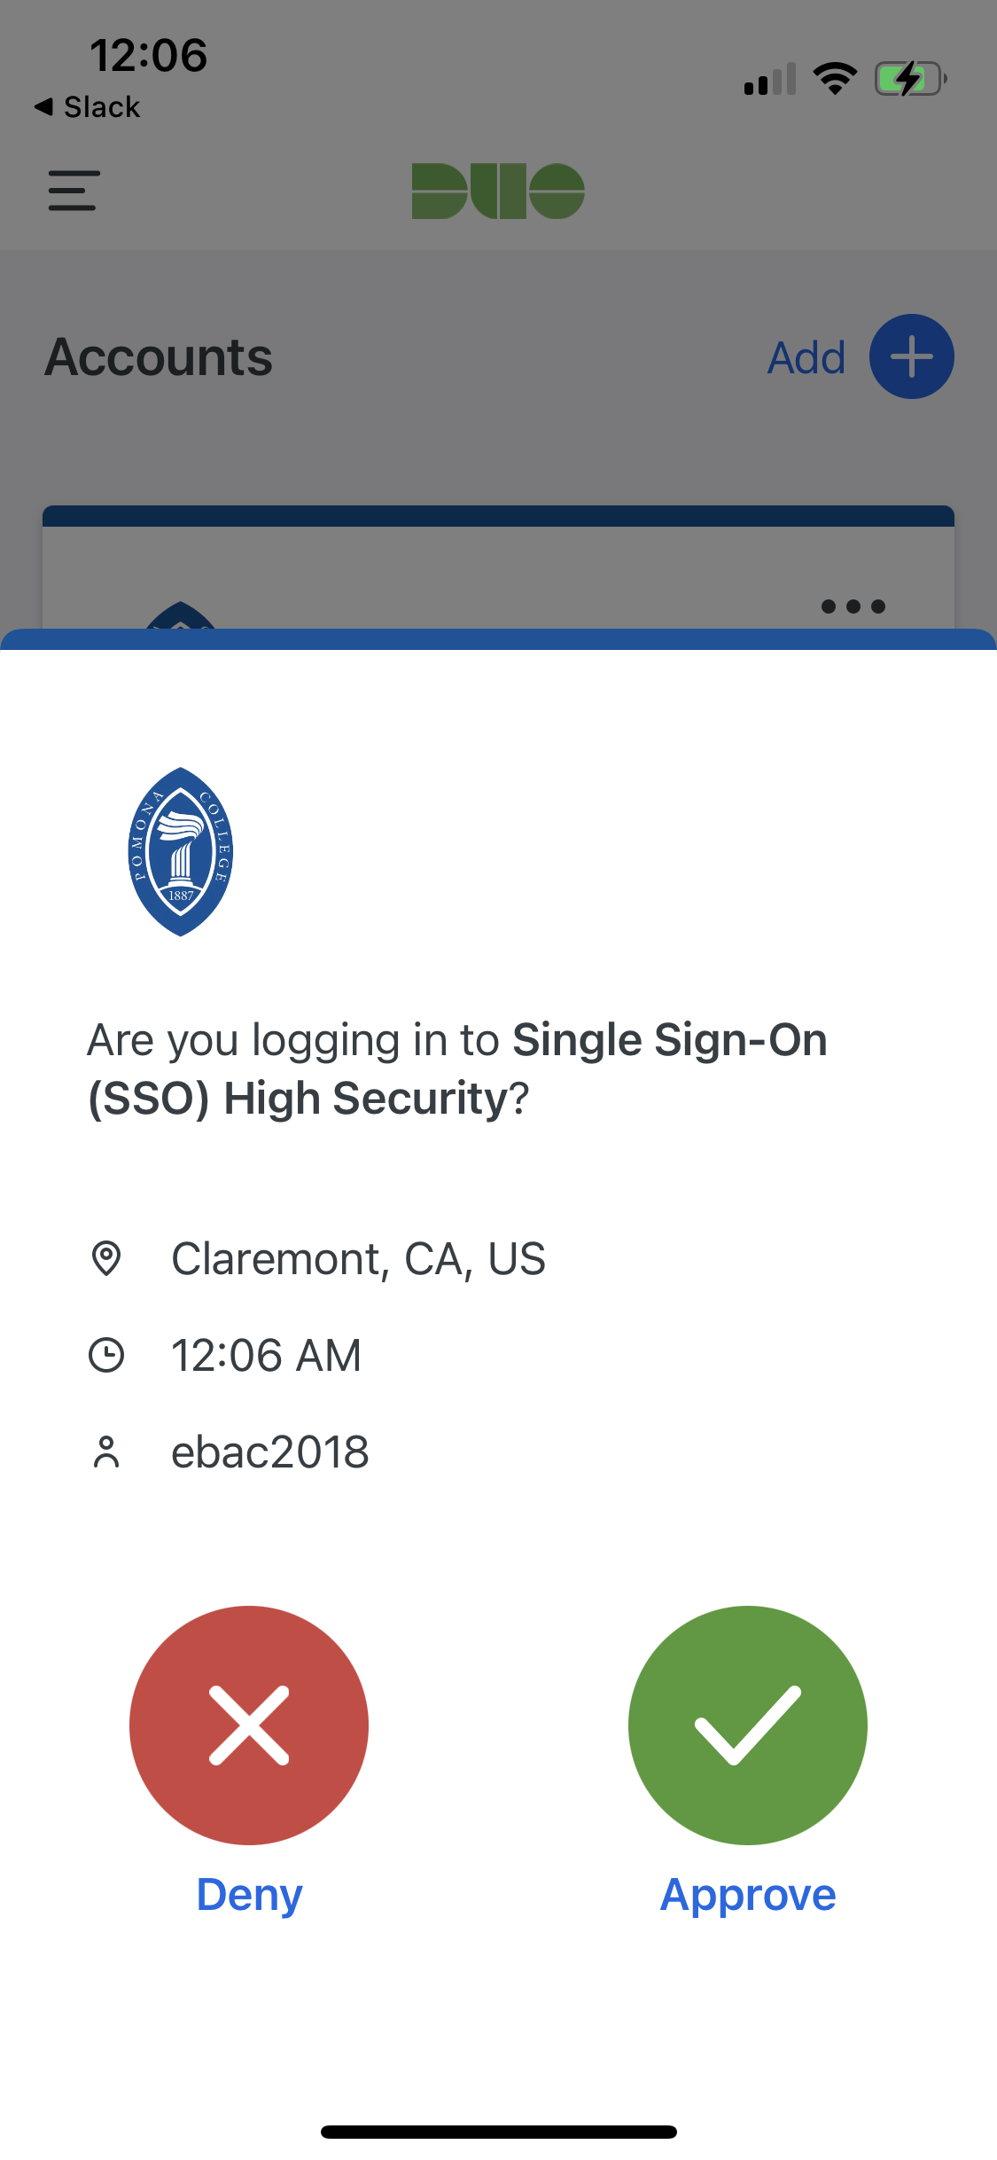

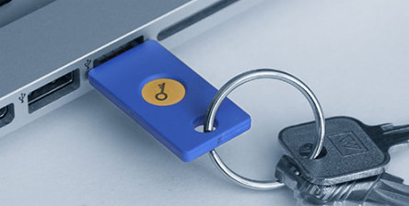
Signature-based OTPs
Token stores: id_T, sk_T
Lock stores ids, public keys for all authorized ids
To enter:
  User->Lock: I want to authenticate
  Lock->Token: auth_details (time, location, IP, etc)
  Token->User: auth_details
  (if yes) Token->Lock: id_T, Sign(auth_details, sk_T)
Notes:
U2F created by Yubico and Google, open standard deployed in 2015
supported in Chrome, Firefox, Opera
derives app-specific ECC keypair using hardware secret, hashing
https://developers.yubico.com/U2F/Protocol_details/
also mobile app
also passkeys!!

Slide 14
Time-based One-Time Password
Token stores: id_T, sk_T
Lock stores info for all authorized ids
To enter: Token->Lock: id_T, Hash(id_T, time, sk_T)

Slide 15
Exercise: Clock Synchronization
Assume that timestamps have a granularity of 1 second
Assume that T and S last synchronized their clocks 24 hours ago (at noon the previous day)
Assume that the network latency is 1-10 seconds
Assume that the clock drift between the two clocks is at most .01 seconds per second
If S receives a message at noon, what is the maximum and minimum timestamp it should accept?
tS = 11:59:50
tS = 11:59:59
tS = 12:00:00
tT = [11:45:27, 12:14:13]
tT = [11:54:27, 12:23:13]
Notes:
86400 in 24 hours * .01 = 14 minutes 24 seconds
86390*.01 = 863.9 s = 14 mins 23.9 s
86399*.01 = 863.99 s = 14 mins 23.99 s

Slide 16
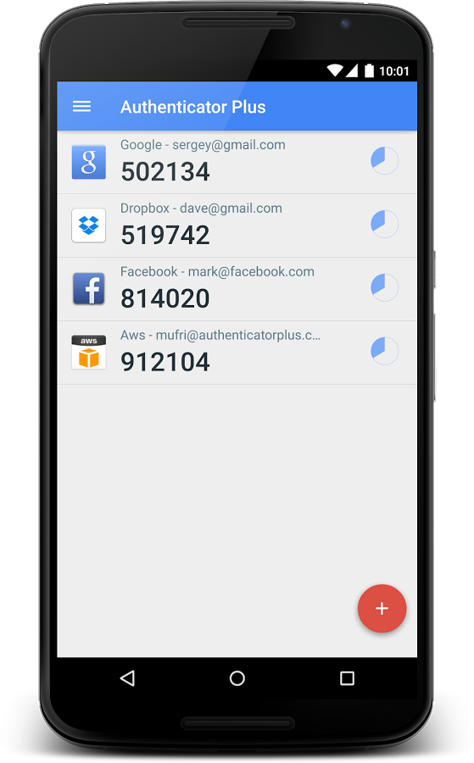
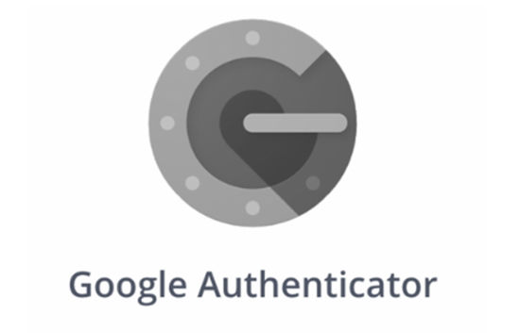
Time-based One-Time Password
Token stores: id_T, sk_T
Lock stores info for all authorized ids
To enter: Token->Lock: id_T, Hash(id_T, time, sk_T)
30-60 second valid window

Slide 17
Remote Authentication
(Usually) No communication from server to token
Usability considerations render challenge-response impractical

Slide 18
Hypothetical protocol
Assume: S stores a set of tuples (id_T, uid, kT, pin), and T stores kT
1. U->L: I want to authenticate as uid to S
2. L and S: establish secure channel
3. L->U: Enter PIN and code on my keyboard
4. T->U: code = MAC(time@T, id_T; kT)
5. U->L: pin, code
6. L: compute h = H(pin, code)
7. L->S: uid, h
8. S: lookup (pin, id_T, kT) for uid;
id_Hu is authenticated
if h=H(pin, MAC(time@S, id_T; kT))
Engineering challenge: clock synchronization
Notes:
Pratical issues: clock drift, message delivery delay

Slide 19
Exercise 3: Clock Synchronization
Assume that timestamps have a granularity of 1 second
Assume that T and S last synchronized their clocks 24 hours ago (at noon the previous day)
Assume that the network latency is 1-10 seconds
Assume that the clock drift between the two clocks is at most .01 seconds per second
If S receives a message at noon, what is the maximum and minimum timestamp it should accept?
tS = 11:59:50
tS = 11:59:59
tS = 12:00:00
tT = [11:45:27, 12:14:13]
tT = [11:54:27, 12:23:13]
Notes:
86400 in 24 hours * .01 = 14 minutes 24 seconds
86390*.01 = 863.9 s = 14 mins 23.9 s
86399*.01 = 863.99 s = 14 mins 23.99 s

Slide 20
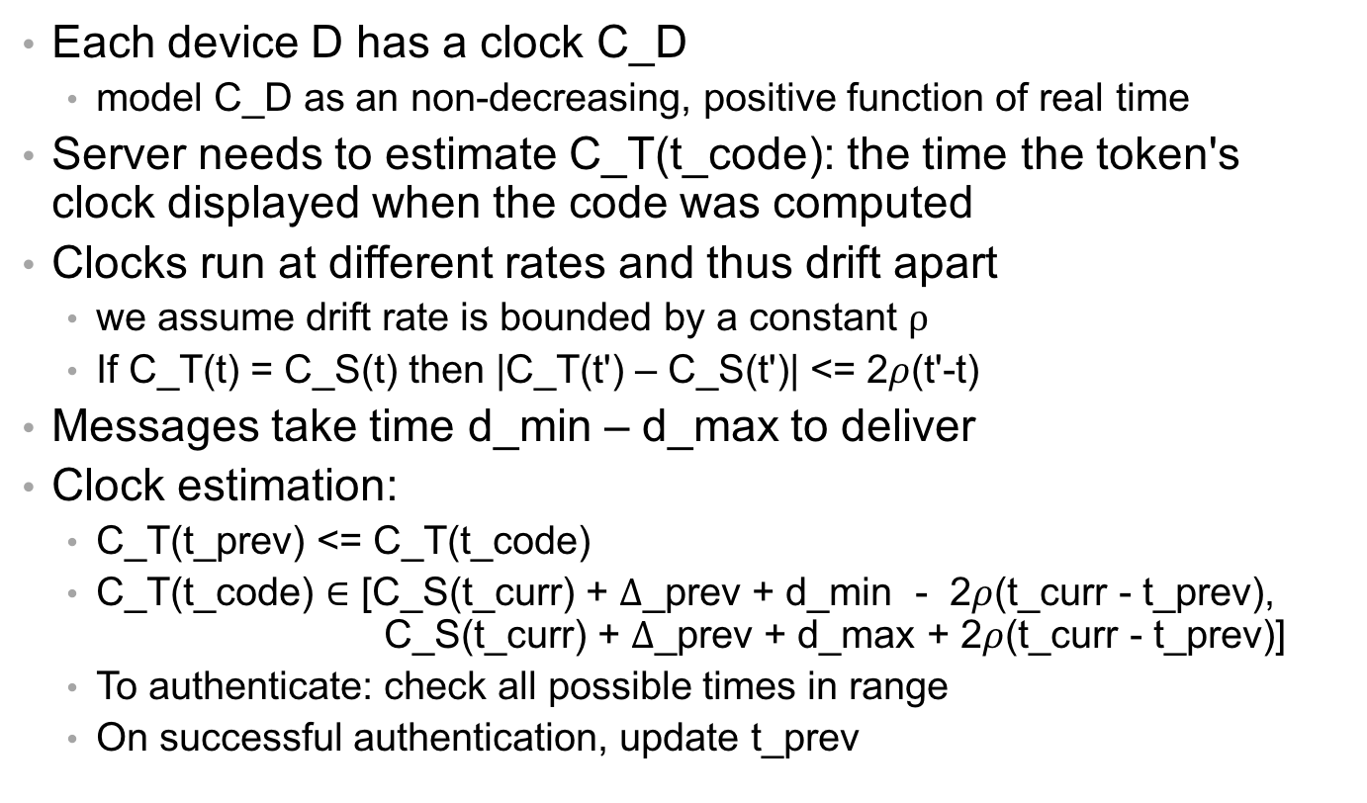
Estimating clock value
Each device D has a clock C_D
  model C_D as an non-decreasing, positive function of real time
Server needs to estimate C_T(t_code): the time the token's clock displayed when the code was computed
Clocks run at different rates and thus drift apart
  we assume drift rate is bounded by a constant $ρ$
  If C_T(t) = C_S(t) then |C_T(t') – C_S(t')| <= 2$ρ$(t'-t)
Messages take time d_min – d_max to deliver
Clock estimation:
  C_T(t_prev) <= C_T(t_code)
  C_T(t_code) $∈$ [C_S(t_curr) + $Δ$_prev + d_min - 2$ρ$(t_curr - t_prev), C_S(t_curr) + $Δ$_prev + d_max + 2$ρ$(t_curr - t_prev)]
  To authenticate: check all possible times in range
  On successful authentication, update t_prev
Notes:
clock granularity tradeoffs
For clocks found in digital electronics, drift rate \rhoe will be on the order of 10^−6 seconds per second.

Slide 21


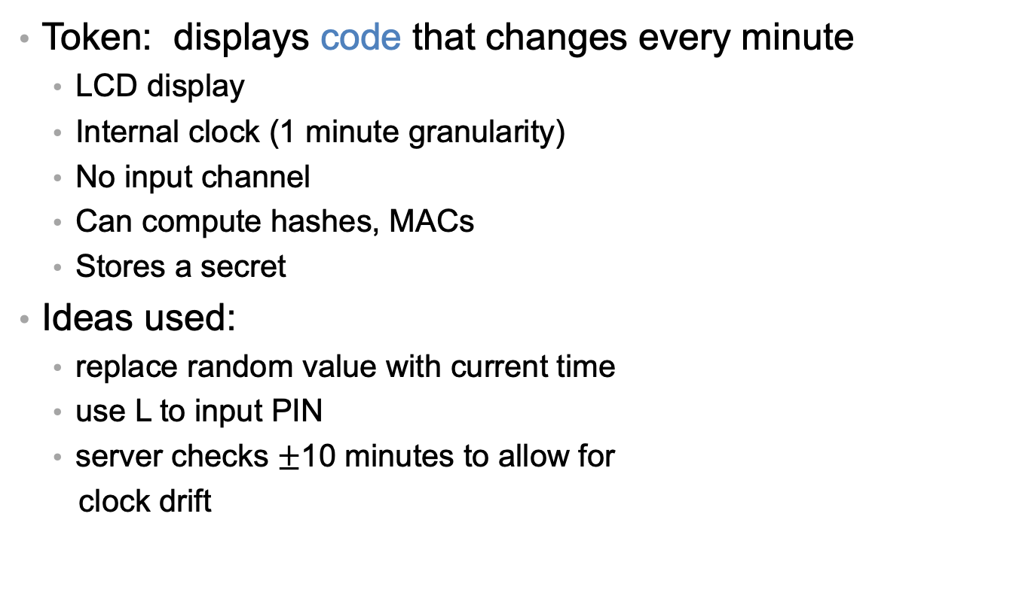
SecurID
Token: displays code that changes every minute
  LCD display
  Internal clock (1 minute granularity)
  No input channel
  Can compute hashes, MACs
  Stores a secret
Ideas used:
  replace random value with current time
  use L to input PIN
  server checks $±$10 minutes to allow for
  clock drift
Notes:
built to be tamper-resistant, so an attacker who steals a SecurID token is unlikely to be able to physically open it and learn the secret it stores.
unique 128 bit secret installed at the factory
battery powered, with the expectation that the entire token will be replaced every 3 years.

Slide 22
Hash chains
Let H^{i}(x) be i iterations of H applied to x
  H⁰(x) = x
  H¹(x) = H(x)
  H²(x) = H(H(x)
  …
  H^{i+1}(x) = H(H^{i}(x))
Hash chain: H¹(x), H²(x), H³(x), ..., H^{n}(x)

Slide 23
OTPs from hash chains
Given a randomly chosen, large, secret seed s...
Bad idea: generate a sequence of OTPs as a hash chain: H¹(s), H²(s), ..., H^{n}(s)
  Suppose untrusted public machine learns H^{i}(s)
  From then on can compute next OTP H^{i+1}(s) by applying H, because hashes are easy to compute in forward direction
  But hashes are hard to invert...
Good idea [Lamport 1981]: generate a sequence of OTPs as a reverse hash chain: H^{n}(s), ..., H¹(s)
  Suppose untrusted public machine learns H^{i}(s)
  Next password is H^{i-1}(s)
  Computing that is hard!

Slide 24
Exercise: Reverse Hash Chains
How could we use a reverse Hash Chain to authenticate users with tokens?

Slide 25
Solution 1
Assume: S stores a set of tuples (uid, n_u, s_u)
1. U->L->S: uid
2. S: lookup (n_u, s_u) for uid;
let n = n_u;
let otp = H^{n}(s_u);
decrement stored n_u
3. S->L->U: n
4. U: p = H^{n}(s_u)
5. U->L->S: p
6. S: uid is authenticated if p = otp
Problem: S has to compute a lot of hashes if authentication is frequent

Slide 26
Solution 2
S stores last: last successful OTP for id_Hu, where last = H^{n+1}(s)
S receives next: next attempted OTP, where if all is well next = H^{n}(s)
S checks its correctness with a single hash:
  H(next) = H(H^{n}(s)) = H^{n+1}(s) = last
And if correct S updates last successful OTP: last := next
Next problem: what if Hu and S don't agree on what password should be used next? i.e., become desynchronized
network drops a message
attacker does some online guessing (impersonating Hu) or spoofing (impersonating S)

Slide 27
Solution 3
Hu and S independently store index of last used password from their own perspective, call them m_Hu and m_S
  Neither is willing to reuse old passwords (i.e., higher indexes)
  But both are willing to skip ahead to newer passwords (i.e., lower indexes)
To authenticate:
  S requests index m_S
  Hu computes min(m_S, m_Hu), sends that along with OTP for it
  S and Hu adjust their stored index
Next problem: running out of passwords: have to bother sysadmin periodically

Slide 28
Solution 4
Compute OTP as H^{n}(pass,salt)
Whenever Hu wants to generate new set of OTPs:
  find a local machine Hu trusts (could be offline, phone, ...)
  request new salt from S
  enter pass
  generate as many new OTPs as Hu likes by running hash forward
  let S know how many were generated and what the last one was

Slide 29
S/KEY
[RFC 1760]:
Instantiation of that protocol for particular hash algorithms and sizes
But same idea works for newer hashes and larger sizes

Slide 30
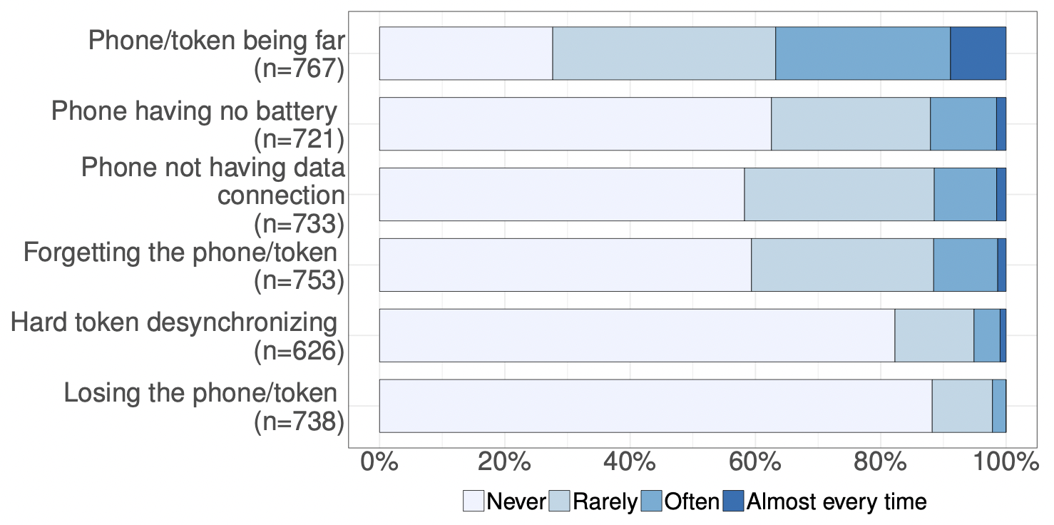
Usablility Problems with Tokens
Notes:
Survey 2

Slide 31
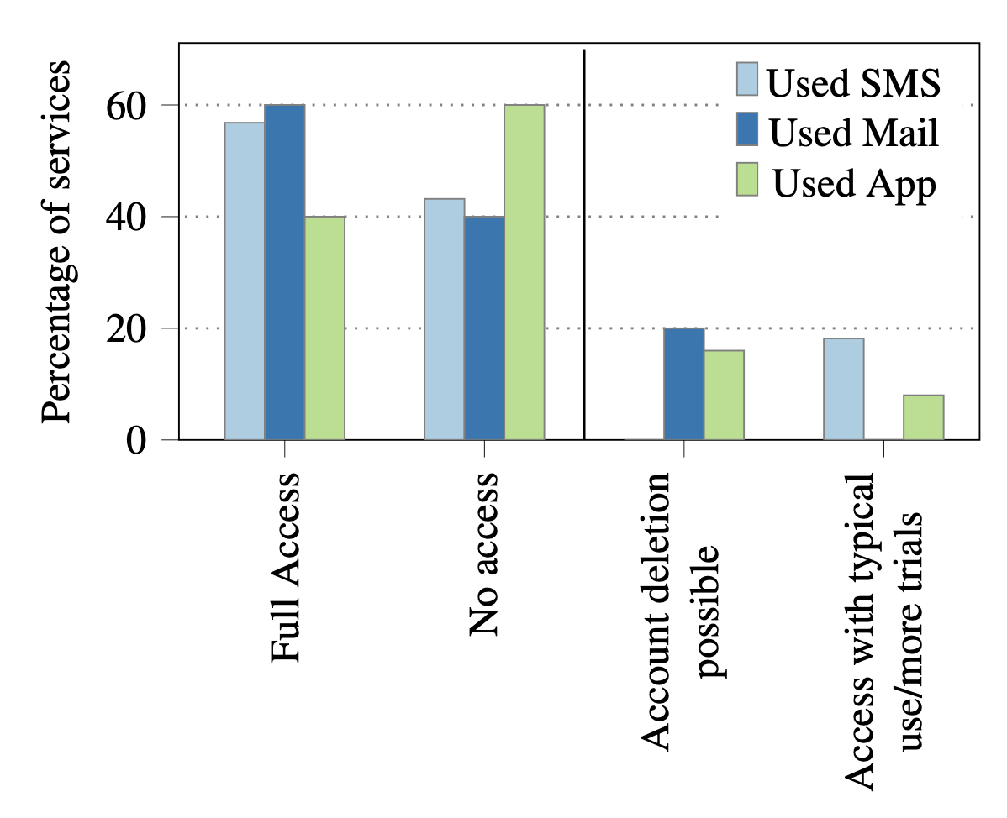
Recovering from token loss
Recovered 41/78
  maybe 9 more if real
Ways to recover:
  personal info
  ID document
  basic account info
  extended account info
  email access
Some had wait period (1-30 days)
Website interfaces often unhelpful

Slide 32
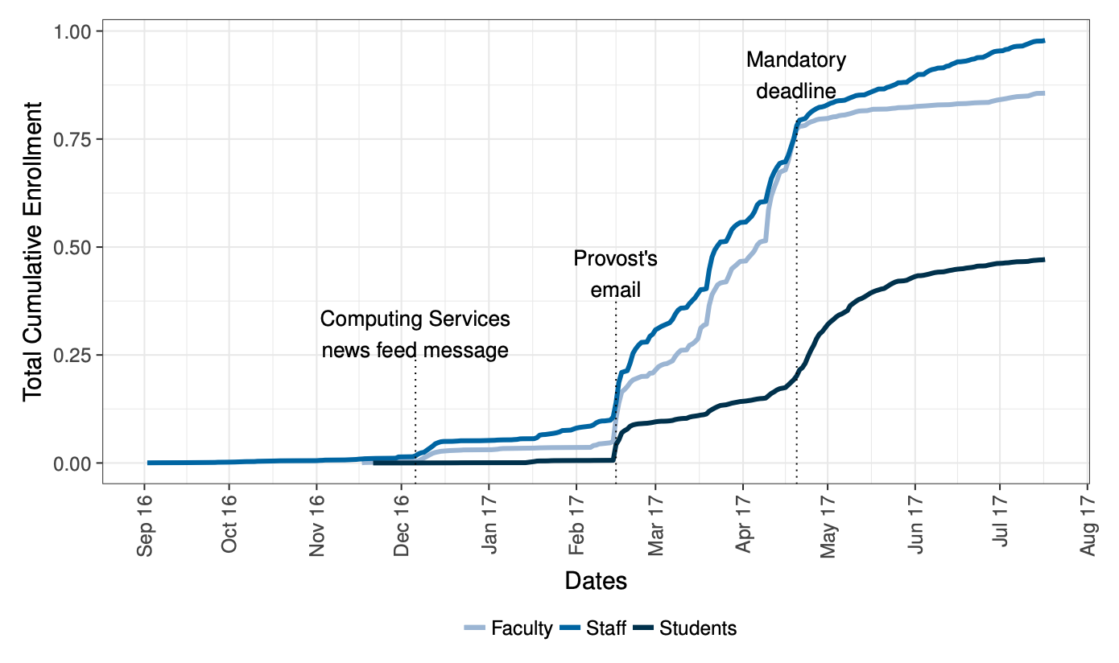
Mandatory Use drives Adoption
Notes:
Survey 1

Slide 33
Token-based Authentication

