Slide 1
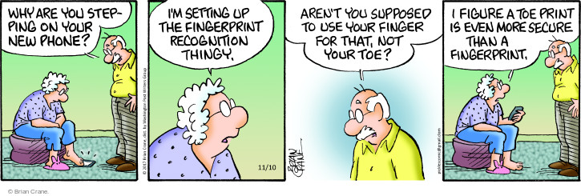
Lecture 13: Biometrics
CS 138 Spring 2026

Slide 2

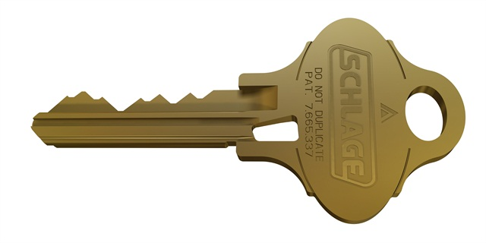
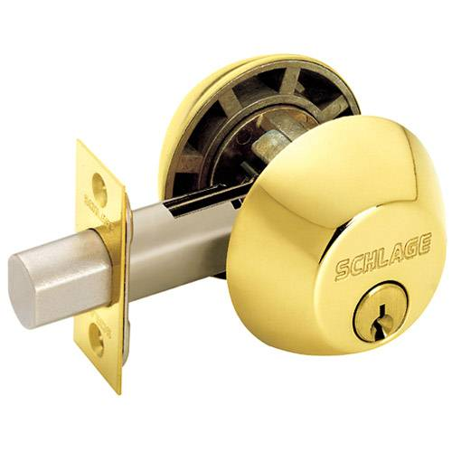
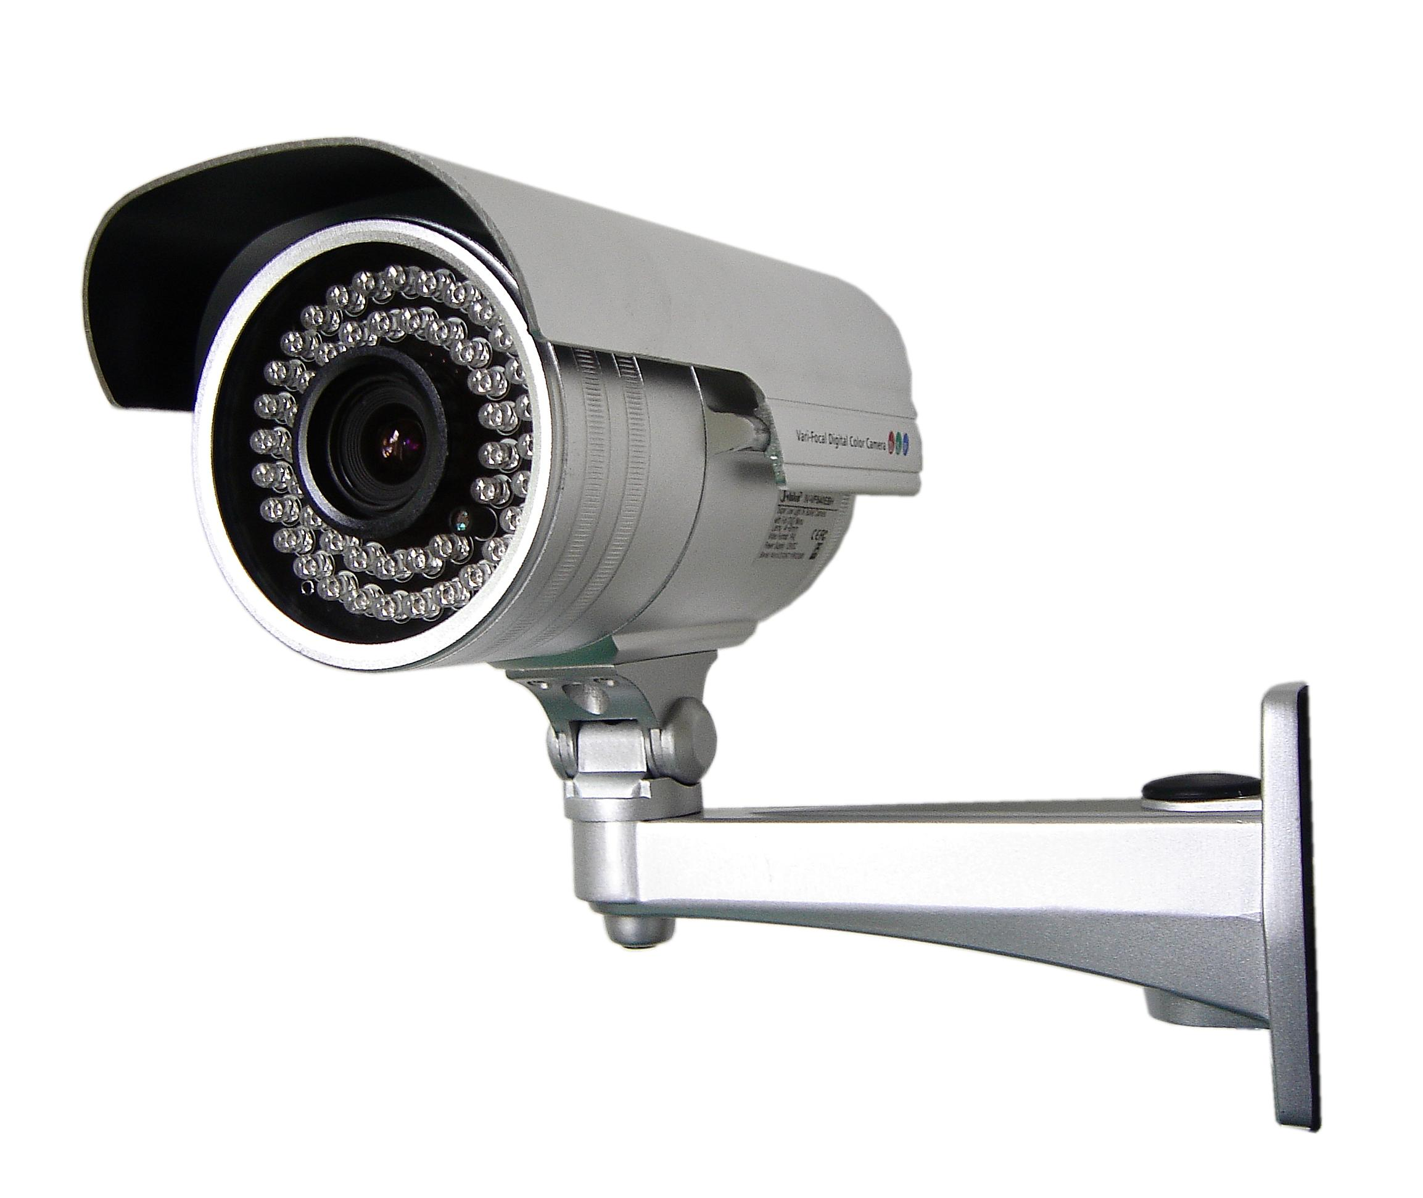
Review: Classes of Security Mechanisms
thentication: mechanisms that bind
principals to actions
thorization: mechanisms that govern
whether actions are permitted
dit: mechanisms that record and
review actions
Notes:
Authentication: passwords, digital signatures, EV certificates in browsers
Authorization: file permissions, firewalls, mobile app permissions, social media visibility settings
Audit: log files, log browsers, intrusion detection systems

Slide 3
Identity
Notes:
Question: what different ways have you experienced in which you had to authenticate yourself?

Slide 4
Personal identity
Major philosophical problem
People are not identical to themselves over time, but their identity persists throughout changes
cf. Ship of Theseus
Intrinsic identity: continuation of consciousness
Extrinsic identity: relationship to everything else
Control: individual's, others', no one's?
Notes:
Ship of Theseus [Plutarch,1st century] Is it still the same ship after every board has been replaced? What if the original boards were gathered and used to build the same model ship? Would it be identical?
Discussion: how do you identify people?
You control your clothing choices, others control the ID numbers assigned to you, no one controls your age.

Slide 5
Digital identity
Digital identity: data that describes a person and its relationship to others
set of attributes
data could be incorrect, outdated, incomplete
not the person itself; not a personal identity
A person could have many digital identities, some overlapping, some contradictory
Notes:
fictional people, dead people, virtual people (AIs?)

Slide 6
Aspects of digital identity
Name
NetID
Email address
URL
IP address
Citizenship
Political party
...

Slide 7
Identity
Attribute: property of a principal
name is "Cecil Sagehen", birthdate is 11/29/1913
Identity: set of attributes
each principal may have many identities of use in different scenarios (student, taxpayer, athlete)
Identifier: an attribute that is unique within a population
Verifier: an attribute that is hard to produce hence can be used as a basis for authentication

Slide 8
Enrollment
Enrollment: establishing identity with a system
Create an account
Get an ID card, visa
Register a machine on a network
Get a signing key from a provider
System might (not) verify claimed attributes during enrollment
Websites rarely do
Governments often do

Slide 9
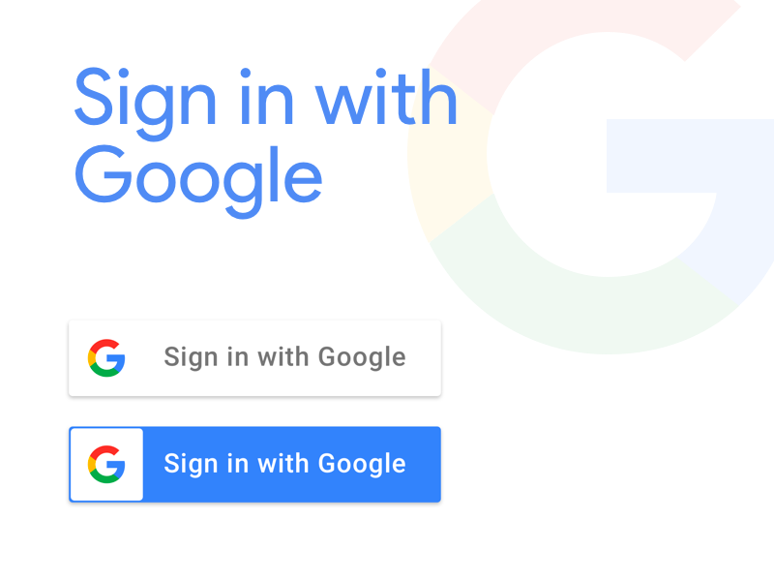

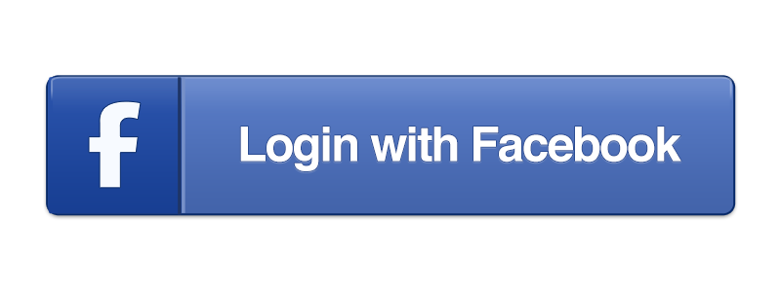
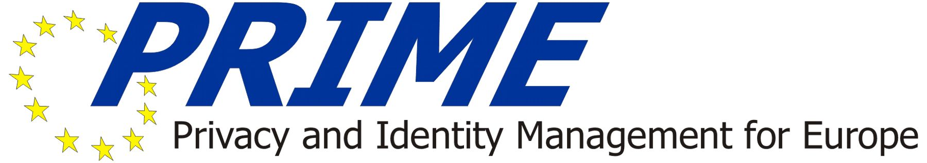
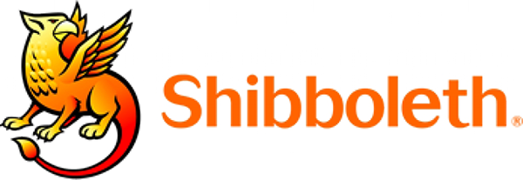
Identity Management Systems

Slide 10
Human Authentication
Notes:
Question: what different ways have you experienced in which you had to authenticate yourself?

Slide 11
Exercise: Human Authentication
Come up with a list of ways you have authenticated yourself to a machine.

Slide 12
Authentication of humans
Something you are
biometrics (e.g., fingerprints)
Something you know
secret information (e.g., a password)
Something you have
possession of a physical device (e.g., a particular phone)
Notes:
Categories: [IBM, TR G520-2169, 1970]
Discussion: different possible examples
Note: bring in border cases (e.g., A sheet of passwords, each valid only once, could be "know" or "have." A finger could be "have" or "are.")

Slide 13
Exercise: Classifying Authentication
Come up with a list of ways you have authenticated yourself to a machine. For each, classify it as something you are, something you know, or something you have
Something you are
Something you know
Something you have
Notes:
Examples: - Something you are: fingerprint, retinal scan, facial scan
- Something you know: password, passphrase, PIN, answers to security questions
- Something you have: phone, token, physical key, ticket, {ATM, prox, credit} card
border cases (e.g., A sheet of passwords, each valid only once, could be "know" or "have." A finger could be "have" or "are.")

Slide 14
Multi-factor Authentication
Two-factor authentication: authenticate based on two independent methods
ATM card plus PIN
password plus registered mobile phone
Multi-factor authentication: two or more independent methods
Best to combine separate categories, not reuse categories
non-example: requiring two passwords from a single human: arguably not independent
non-example: requiring single password from each of two humans: authenticates two humans then makes authorization decision

Slide 15
Something you Are

Slide 16
Biometric
Biometric: measurement of biological and behavioral attributes (something you are)
biological attributes can be confounded by behavior
biology and behavior is non-constant: variation from one measurement to the next
Notes:
Fingerprint is most common; not great for error rates but serves as a good deterrant.
Iris is by far the best for error rates (even zero FAR) and for measurement, so long as individuals are willing to get close to the camera

Slide 17
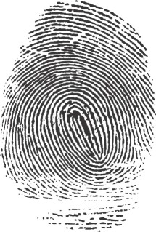
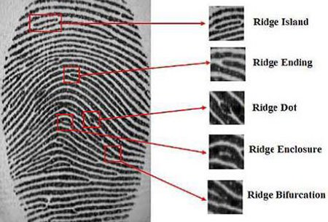
Example: Fingerprint
Example use: California social services
prevent applicants for welfare from defrauding state by receiving assistance under multiple identities
Fingerprint stored as bitmap and as minutae
When user authenticates, computer compares minutiae
If they match, human additionally reviews bitmap images (about 15 out of 10000 authentications have minutiae match even though fingerprints do not)
Notes:
Used as identifiers since 19th century

Slide 18
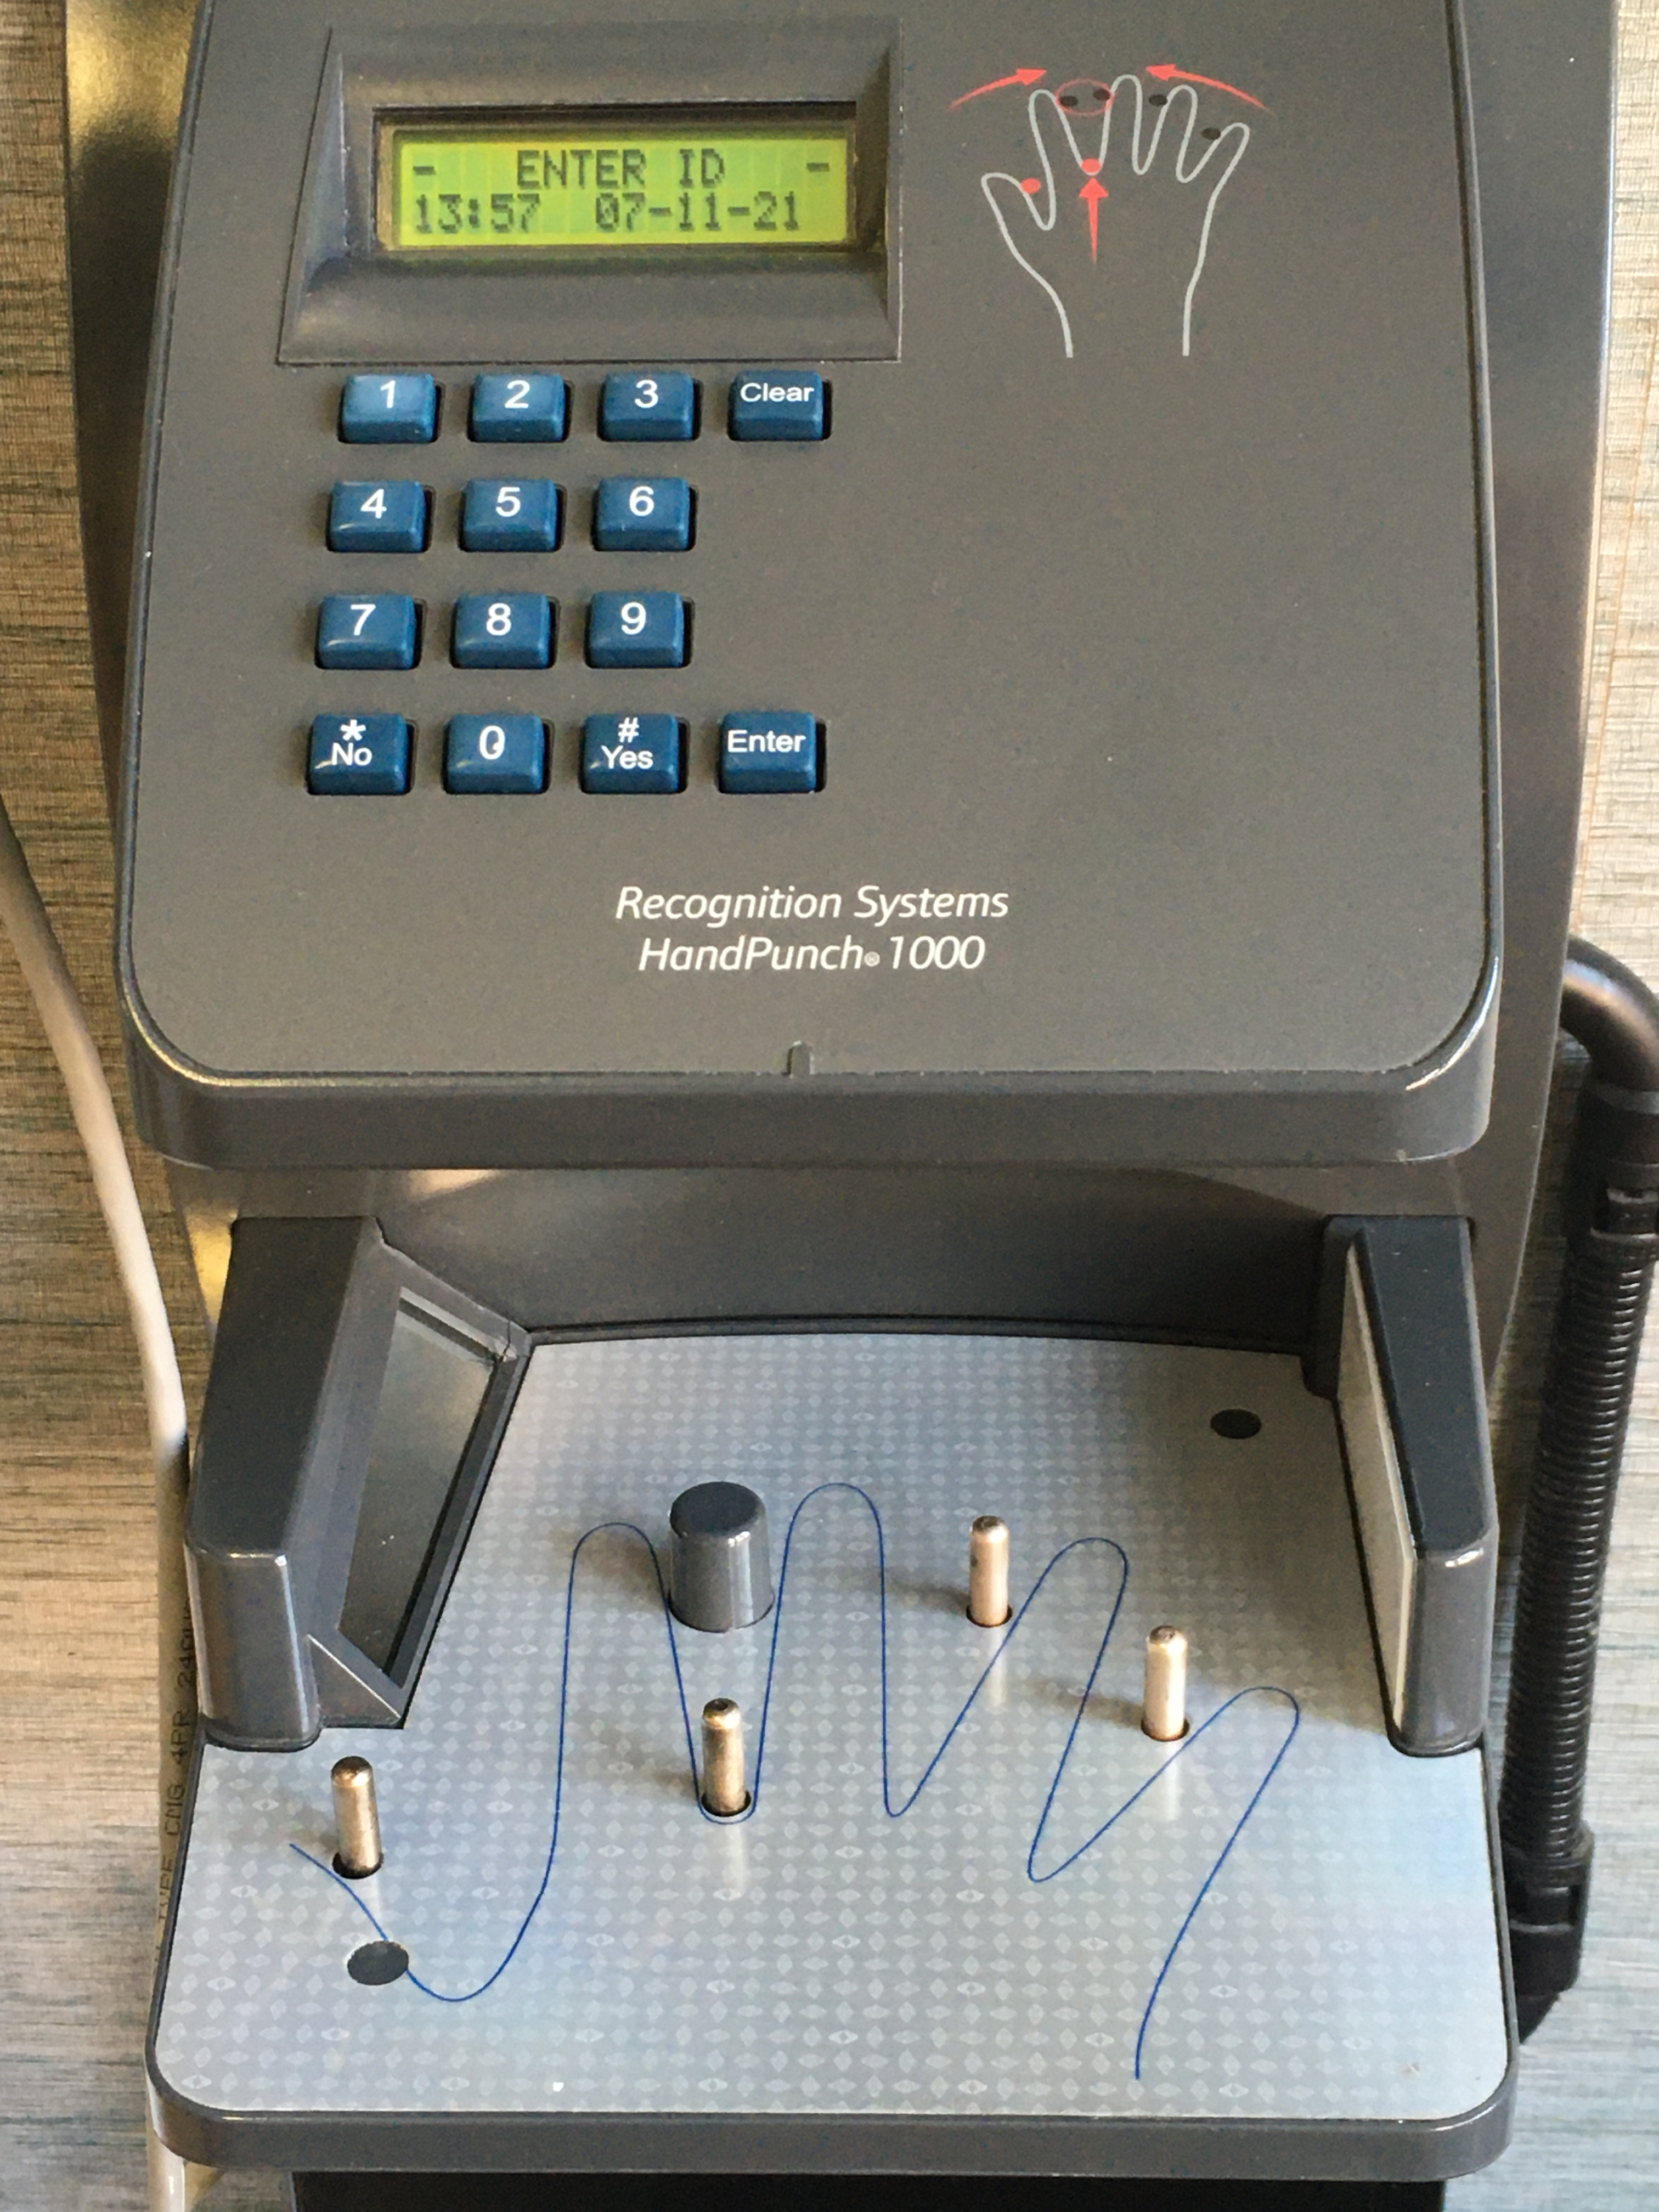
Example: Hand geometry
Used in 2012 Olympic Games, Disney World, nuclear facilities, data centers, ...
Camera images palm (and side) of hand (no texture information)
Images reduced to (e.g.) 31000 points then 90 measurements then 9 bytes of data
Final data not directly related to any source measurements
Data stored as a template for later comparison
When user authenticates, another set of images taken
If data are close enough to stored template, user deemed authenticated
Can adjust threshold per-user, in case some users are difficult to authenticate
Each time user is authenticated, template is updated to account for change over time
Notes:
longest biometric in use in modern computing systems (1980s)
Disney parks: used in conjunction with passes

Slide 19
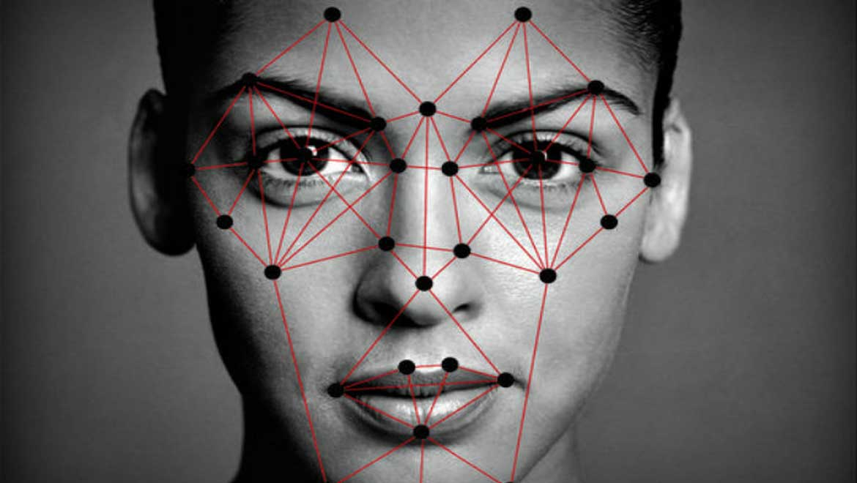
Example: Facial recognition
Used in border control, TSA, iPhone, image tagging
Operates on 2D image or depth map
Modern systems use ML classifiers to identify matches
Most systems perform poorly on profiles, low-res images
Most systems perform less well on women and minorities

Slide 20
Other Biometrics
Notes:
Discussion: what biometrics have people seen/heard of in the real world?
Example: Aadhaar (Indian universal ID, uses photograph, fingerprints, iris scans)
fingerprint, iris, retina, face, voice, handwriting, hand shape, hand veins, hand print, (DNA?)

Slide 21
Biometric attributes as verifiers
Advantages:
Can't lose or forget a biometric
Can be convenient (e.g., facial scan vs. PIN on iPhone)
Disadvantages:
Physical process with errors (and potentially changes over time)
Updating identities after disclosure is hard (new fingerprints? new face?)
So enrolling a biometric identifier places permanent trust in receiver, even if they go bankrupt, retroactively change privacy policies, get taken over by new administration, ...
Impossible to be application specific (your hand geometry is the same regardless of what system you use)
Fear of negative implications for privacy...

Slide 22
Evaluating Biometrics
Notes:
Discussion: what might we want to consider?

Slide 23
Biometric attributes as verifiers
Biometric | Easy to Measure
Face | Easy
Voice | Easy
Palm vein | Easy
Fingerprint | Medium
Iris | Medium
DNA | Hard
Requirements:
Identifier
Easy to measure
Accurate
Small variation over time and measurement
Difficult to spoof
Acceptable to users
Usable
Socially acceptable
Notes:
Discussion: what do we want to look for in a biometric identifier?

Slide 24
Accuracy
False accept: authenticate a principal with wrong identity
False reject: fail to authenticate a principal under right identity
Tunable trade off of sensitivity between which error is more likely
False acceptance rate (FAR): percentage of attempts in which imposters are authenticated (with wrong identity)
False reject rate (FRR): percentage of attempts in which legitimate users are denied authentication
Notes:
Hypothesis testing:
null hypothesis: human being authenticated has claimed identity
false reject = type I error
false accept = type II error

Slide 25
Sensitivity
Receiver operating characteristics (ROC) curve: graph of FRR vs. FAR (or perhaps 1-FAR, perhaps nonlinear axes)
γ = sensitivity
Notes:
ROC comes from radar operation in WW2: turn up gain on radar too high and enemy is lost in clutter; too low, can't see at all.
UK banks in 1996 set a goal of FAR=1% and FRR=.01% for biometrics.
Strictly speaking, some people would say ROC is (1-FAR) vs FRR and detection error tradeoff (DET) curve is FAR vs FRR on axes scaled by standard normal deviates or just logarithmically [Wikipedia!]
Graph source: http://www.csee.wvu.edu/~natalias/biom426/performance_fall09.pdf

Slide 26
ROC comparison
Two matchers (A=solid; B=dashed)
At point C, matchers have same FAR and FRR
To the left of C, matcher A has lower FRR for same FAR
To the right, matcher B has lower FRR for same FAR
Notes:
Graph source: http://www.csee.wvu.edu/~natalias/biom426/performance_fall09.pdf

Slide 27
ROC comparison
Crossover error rate (CER): value on ROC at which FAR=FRR (aka equal error rate, ERR)
Many other statistics for comparison possible
Anytime a graph is reduced to a single number, we lose information
What matters most for biometrics is the use case/threat model

Slide 28
Exercise: Use Cases
What are examples of use-cases where it is more important to minimize false positives?
What are examples of use-cases where it is more important to minimize false negatives?
Notes:
Note: connect back to threat model
Activity:
Construct a new, plausible scenario in which false accepts would be far more problematic than false rejects.
Construct a new, plausible scenario in which false rejects would be far more problematic than false accepts.
e.g., military base vs hotel lobby

Slide 29
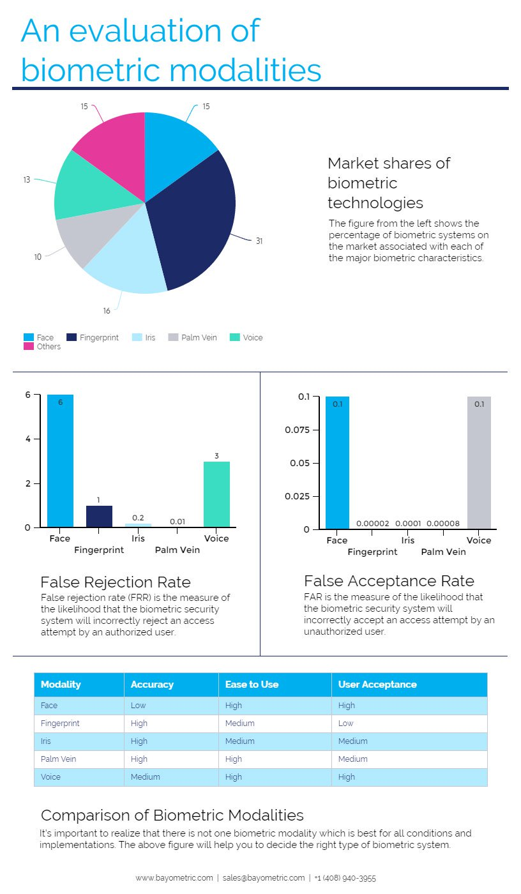
Comparing Biometric Accuracy
Biometric | Accuracy
Face | Low
Voice | Medium
Fingerprint | High
Iris | High
Palm vein | High
Notes:
Table source (2006): http://biometrics.pbworks.com/w/page/14811349/Advantages%20and%20disadvantages%20of%20technologies
Table source (2018) https://www.bayometric.com/biometrics-face-finger-iris-palm-voice/
Graph source(2018): https://www.bayometric.com/biometrics-face-finger-iris-palm-voice/

Slide 30
Disparate Impact
Classifier | All
MSFT | 93.7
Face++ | 90.0
IBM | 87.9
F | M
89.3 | 97.4
78.7 | 99.3
79.7 | 94.4
Dark | Light
87.1 | 99.3
83.5 | 95.3
77.6 | 96.8
DF | DM | LF | LM
79.2 | 94.0 | 98.3 | 100
65.5 | 99.3 | 90.2 | 99.2
65.3 | 88.0 | 92.9 | 99.7
Notes:
Buolamwini and Gebru. Gender Shades. FAccT 2018.

Slide 31
Spoofing
Active adversary fools sensor with artificial object
Solution:
better sensors
better biometrics
multi-factor authentication

Slide 32
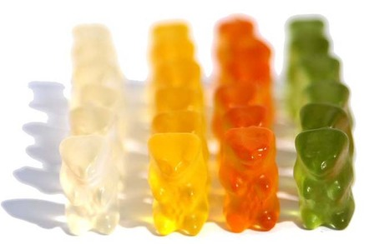
Gummy Bear Attack
Notes:
First demonstrated by Tsutomu Matsumoto in 2002, effective against modern fingerprint readers (e.g., iPhone)
https://www.theregister.co.uk/2002/05/16/gummi_bears_defeat_fingerprint_sensors/
https://www.youtube.com/watch?v=2u4ZLGsw1zo
https://www.youtube.com/watch?v=bvRK7XDvTOk

Slide 33
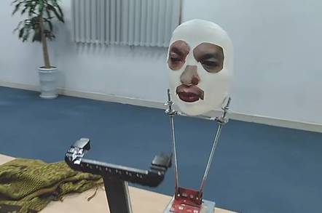
Face ID Attack
Notes:
In November 2017, Bkav Corporation, an tech security company, demonstrated how to bypass the face recognition system on the iPhone X with a $150 3D printed mask.
http://www.bkav.com/FaceID
https://www.youtube.com/watch?v=i4YQRLQVixM

Slide 34
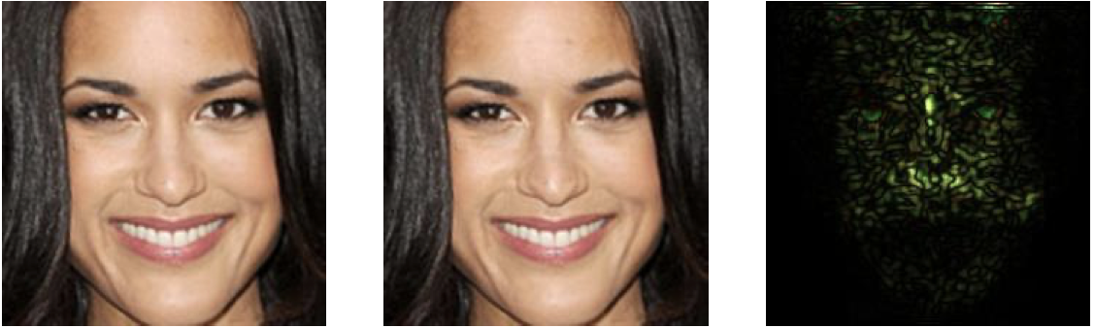
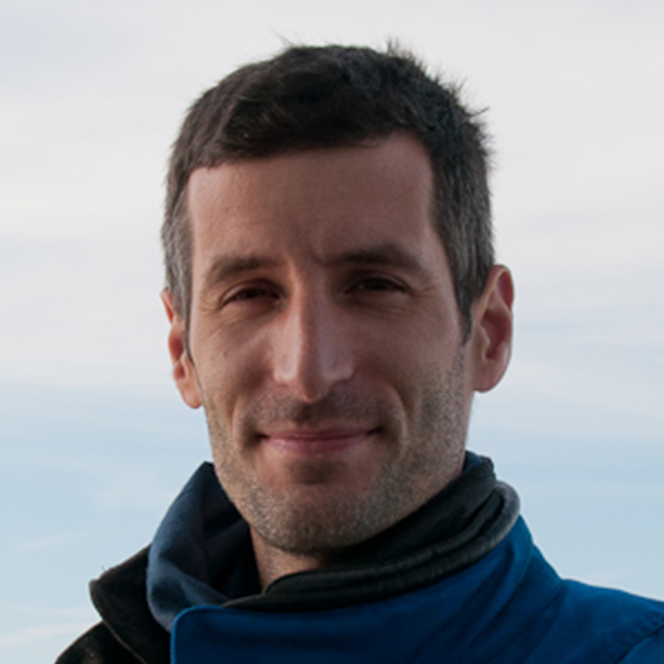
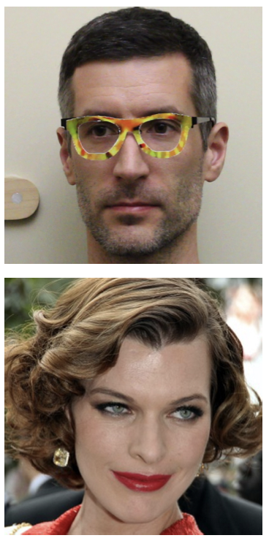
Adversarial Examples
Notes:
Sharif et al. Accessorize to a Crime: Real and Stealthy Attacks on State-of-the-Art Face Recognition. CCS 2016.

Slide 35
Exercise: Evaluating Biometrics
Consider the use of voice authentication as a biometric. With voice authentication, the human is asked to say a specific passphrase and their response compared to a recorded voice print by a machine learning system.
What are potential advantages of this biometric?
What are potential disadvantages of this biometric?
Would you recommend this biometric for unlocking phones?
Would you recommend this biometric for authenticating with a bank?

Slide 36
Privacy concerns
Humans might have concerns about measurements (have photo taken, parts of body scanned)
Humans might not want to disclose attributes during enrollment (SSN, political party)
Humans might not want action bound to their identity (buying medication)
Humans might not want their actions linked to other actions, exposing them to inference about what they thought were unrelated activities.
Notes:
India uses biometric based identity cards (Aadhaar); data includes photos, fingerprints, iris scans. In january 2018, journalists reported they were able to access records for 500 rupees ($8.75); unclear if access was being sold by hackers or insiders.

Slide 37
Privacy and biometrics
Biometrics can violate intrinsic privacy by requiring submission to bodily contact or measurement
Fear of germs
Religious prohibitions
Biometrics can violate informational privacy
Biometric identifiers might effectively become a standard, universal identifier, enabling linking

Slide 38
Principles for privacy
When building authentication systems...
Seek consent: get permission to authenticate and store identity
Select minimal identity: use the smallest possible set of attributes
Limit storage: don't save information about identity or authentication without need, and delete when no longer needed
Avoid linking: don't reuse identifiers across systems

Slide 39
Biometrics

