Slide 1
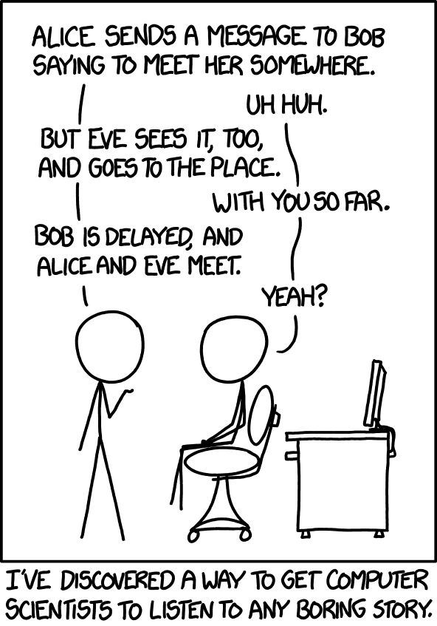
Lecture 11: Authentication Protocols (cont'd)
CS 138 Spring 2026

Slide 2
Review: Authentication
Threat: attacker who controls the network
  Dolev-Yao model: attacker can read, modify, delete messages
Vulnerability: communication channel between sender and receiver can be controlled by other principals
Harm: attacker can pretend to be someone else (violating security goals)
Countermeasure: authentication protocols

Slide 3


Review: Authentication Protocols
An authentication protocol allows a principal receiving a message to verify the identity of the principal that sent that message
It's sunny in New York
I prefer rain

Slide 4

Secure Authentication Protocols
Multiple Keys
Included Identity
B->T: B, r
  T->B: A, r
  B->T: B, Enc(r; k_BA)
T->B: A, Enc(r; k_BA)
B->T: B, r
  T->B: A, r
  B->T: B, Enc(B, r; k)
T->B: A, Enc(B, r; k)

Slide 5








Assumptions
Assume Alice and Bob have a shared secret key k
Assume that symmetric-key crypto works
Assume there is a trusted Key Distribution Center (KDC) and that all principals have a shared key with the KDC
Key Distribution Center
(KDC)
$$k_{A}$$
$$k_{B}$$
$$k_{C}$$
$$k_{Z}$$
…

Slide 6
Goals
Alice should be convinced that she is talking to Bob
Bob should be convinced that he is talking to Alice
Alice and Bob should acquire a shared key that they can use to securely communicate
Notes:
mediated key exchange or mediated authentication

Slide 7
Protocol 1
A -> KDC: A, B
KDC -> A: A, B, Enc(k; k_A)
KDC -> B: A, B, Enc(k; k_B)
Notes:
Engineering issue: Alice doesn't know whether Bob has received k

Slide 8
Protocol 2
A -> KDC: A, B
KDC -> A: A, B, Enc(k; k_A), Enc(k; k_B)
A -> B: A, B, Enc(k; k_B)

Slide 9
Threat Model
Dolev-Yao attacker
  controls the network, can read, modify, create packets
A replay attack occurs when an adversary repeats fragments of a previous protocol run
A reflection attack occurs when an adversary sends messages from an ongoing protocol back to the originator
A man-in-the-middle attack occurs when an adversary secretly relays (and potentially changes) communications between two principals who believe they are communicating directly with eachother
Notes:
replay: harm = force principals to use old (potentially compromised) key
MITM: harm = force principals to use key (or keys) known to adversary

Slide 10
Exercise 1: Replay Attacks
Is this protocol vulnerable to a replay attack?
A -> KDC: A, B
KDC -> A: A, B, Enc(k; k_A), Enc(k; k_B)
A -> B: A, B, Enc(k; k_B)
  A -> T: A, B
  T -> A: A, B, Enc(k; k_A), Enc(k; k_B)
  A -> B: A, B, Enc(k; k_B)

Slide 11
Protocol 3
A -> KDC: A, B, r
KDC -> A: A, B, Enc(k,r;k_A), Enc(k;k_B)
A -> B: A, B, Enc(k; k_B)
Is this protocol vulnerable to a replay attack?
Notes:
Attack: replay on message 3

Slide 12
MITM Attack
A -> T: A, B, r
  T -> KDC: A, T, r
  KDC -> T: A, T, Enc(k, r; k_A), Enc(k; k_T)
  T -> KDC: T, B, r
  KDC -> T: T, B, Enc(k2, r; k_T), Enc(k2; k_B)
T -> A: A, B, Enc(k, r; k_A), Enc(k2; k_B)
A -> B: A, B, Enc(k2; k_B)

Slide 13
Protocol 4
A -> KDC: A, B, r
KDC -> A: A, B, Enc(k, r, Enc(k; k_B); k_A)
A -> B: A, B, Enc(k; k_B)
Notes:
Motivation: shouldn’t be able to separate B's message from A's message

Slide 14
Attack on Protocol 4
T
A -> KDC: A, B, r
KDC -> A: A, B, Enc(k, r, Enc(k; k_B);k_A)
A -> B: A, B, Enc(k; k_B)
T
T
T
T
T
T
Notes:
Bob is convinced that Trudy is really Alice

Slide 15
Protocol 5
A -> KDC: A, B, r
KDC -> A: A, B, Enc(k,r,Enc(A,B,k; k_B);k_A)
A -> B: A, B, Enc(A,B,k; k_B)

Slide 16
Attack on Protocol 5
A -> T: A, B, r
  T -> KDC: A, T, r
  KDC -> T: A, T, Enc(k, r, Enc(A,T,k; k_T);k_A)
T -> A: A, B, Enc(k, r, Enc(A,T,k; k_T);k_A)
A -> T: A, B, Enc(A,T,k; k_T)
Notes:
Alice is convinced that Trudy is really Bob

Slide 17
Protocol 6
A -> KDC: A, B, r
KDC -> A: Enc(A,B,k,r,Enc(A,B,k; k_B);k_A)
A -> B: A, B, Enc(A,B,k; k_B)
Notes:
Still haven’t solved the replay problem with Step 3 (in which case Alice and Bob might have different keys)

Slide 18
Protocol 7: Needham-Schroeder
A -> KDC: A, B, r
KDC -> A: Enc(A,B,k,r,Enc(A,B,k; k_B);k_A)
A -> B: A, B, Enc(A,B,k; k_B)
B -> A: A, B, Enc(r2; k)
A -> B: A, B, Enc(r2+1; k)

Slide 19
Exercise 2: MITM Attacks
Consider the following variant of Needham-Schroeder. Is this protocol vulnerable to a MITM attack?
A -> KDC: A, B, r
KDC -> A: Enc(A,B,r;k_A),Enc(r,k; k_A)
KDC -> B: Enc(A,B,r;k_B),Enc(r,k; k_B)
B -> A: A, B, Enc(r2; k)
A -> B: A, B, Enc(r2+1; k)

Slide 20
Exercise 2: MITM Attacks
Consider the following variant of Needham-Schroeder. Is this protocol vulnerable to a MITM attack?
A -> T: A, B, r
  T -> KDC: A, B, r
  KDC -> T: Enc(A,B,r;k_A), Enc(r,k;k_A)
  KDC -> T: Enc(A,B,r;k_B), Enc(r,k;k_B)
  T -> KDC: A, T, r
  KDC -> T: Enc(A,T,r;k_A), Enc(r,k2;k_A)
  KDC -> T: Enc(A,T,r;k_T), Enc(r,k2;k_T)
  T -> KDC: T, B, r
  KDC -> T: Enc(T,B,r;k_T), Enc(r,k3;k_T)
  KDC -> T: Enc(T,B,r;k_B), Enc(r,k3;k_B)
T -> A: Enc(A,B,r;k_A),Enc(r,k2; k_A)
T -> B: Enc(A,B,r;k_B),Enc(r,k3; k_B)
B -> T: A, B, Enc(r2; k3)
T -> B: A, B, Enc(r2+1; k3)
  T -> A: A, B, Enc(r2; k2)
  A -> T: A, B, Enc(r2+1; k2)

Slide 21
Protocol 7: Needham-Schroeder
A -> KDC: A, B, r
KDC -> A: Enc(A,B,k,r,Enc(A,B,k; k_B);k_A)
A -> B: A, B, Enc(A,B,k; k_B)
B -> A: A, B, Enc(r2; k)
A -> B: A, B, Enc(r2+1; k)
Notes:
Problem: If T has saved old message 3 and compromises that key, can replay and authenticate as A

Slide 22
Solution #1: More random numbers
A -> B: A, B
B -> A: A, B, r3
A -> KDC: A, B, r, r3
KDC -> A: Enc(A,B,k,r,Enc(A,B,k,r3; k_B);k_A)
A -> B: A, B, Enc(A,B,k,r3; k_B)
B -> A: A, B, Enc(r2; k)
A -> B: A, B, Enc(r2+1; k)

Slide 23
Solution #2: Timestamps
A -> KDC: A, B, r,
KDC -> A: Enc(A,B,k,r,Enc(A,B,k,t; k_B);k_A)
A -> B: A, B, Enc(A,B,k,t; k_B)
B -> A: A, B, Enc(r2; k)
A -> B: A, B, Enc(r2+1; k)

Slide 24
Solution #3: Otway-Rees
A -> B: n, A, B, Enc(r1,n,A,B;k_A)
B -> KDC: n, A, B, Enc(r1,n,A,B;k_A),
Enc(r2,n,A,B;k_B)
KDC -> B: n, Enc(r1,k;k_A),
Enc(r2,k;k_B)
B -> A: n, Enc(r1,k;k_A)

Slide 25
Type Attack
A -> B: n, A, B, Enc(r1,n,A,B;k_A)
B -> KDC: n, A, B, Enc(r1,n,A,B;k_A),
Enc(r2,n,A,B;k_B)
T -> B: n, Enc(r1,n,A,B;k_A),
Enc(r2,n,A,B;k_B)
B -> A: n, Enc(r1,n,A,B;k_A)

Slide 26
Exercise 3: Type Attacks
Consider the following variant of Otway-Rees
A -> B: n, A, B, Enc(r1,n,A,B;k_A)
B -> KDC: n, A, B, Enc(r1,n,A,B;k_A),
Enc(r2,n,A,B;k_B)
KDC -> B: n, Enc(r1+1,k;k_A),
Enc(r2+1, k;k_B)
B -> A: n, Enc(r1+1,k;k_A)
Would this protocol be vulnerable to a type attack?
Notes:
No, this actually works

Slide 27



Authentication in Practice

Slide 28
Authentication Protocols

