Slide 1
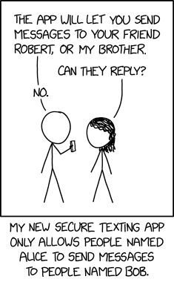
Lecture 10: Authentication Protocols
CS 138 Spring 2026

Slide 2

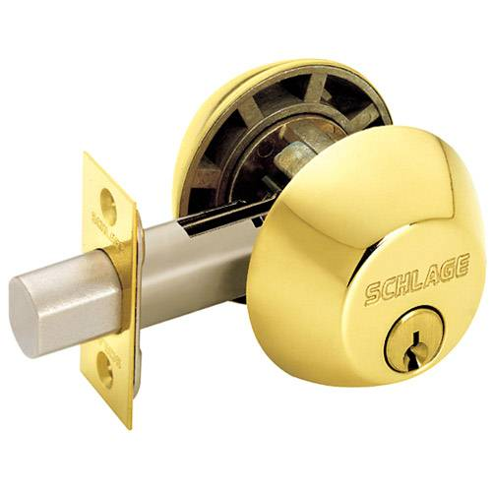
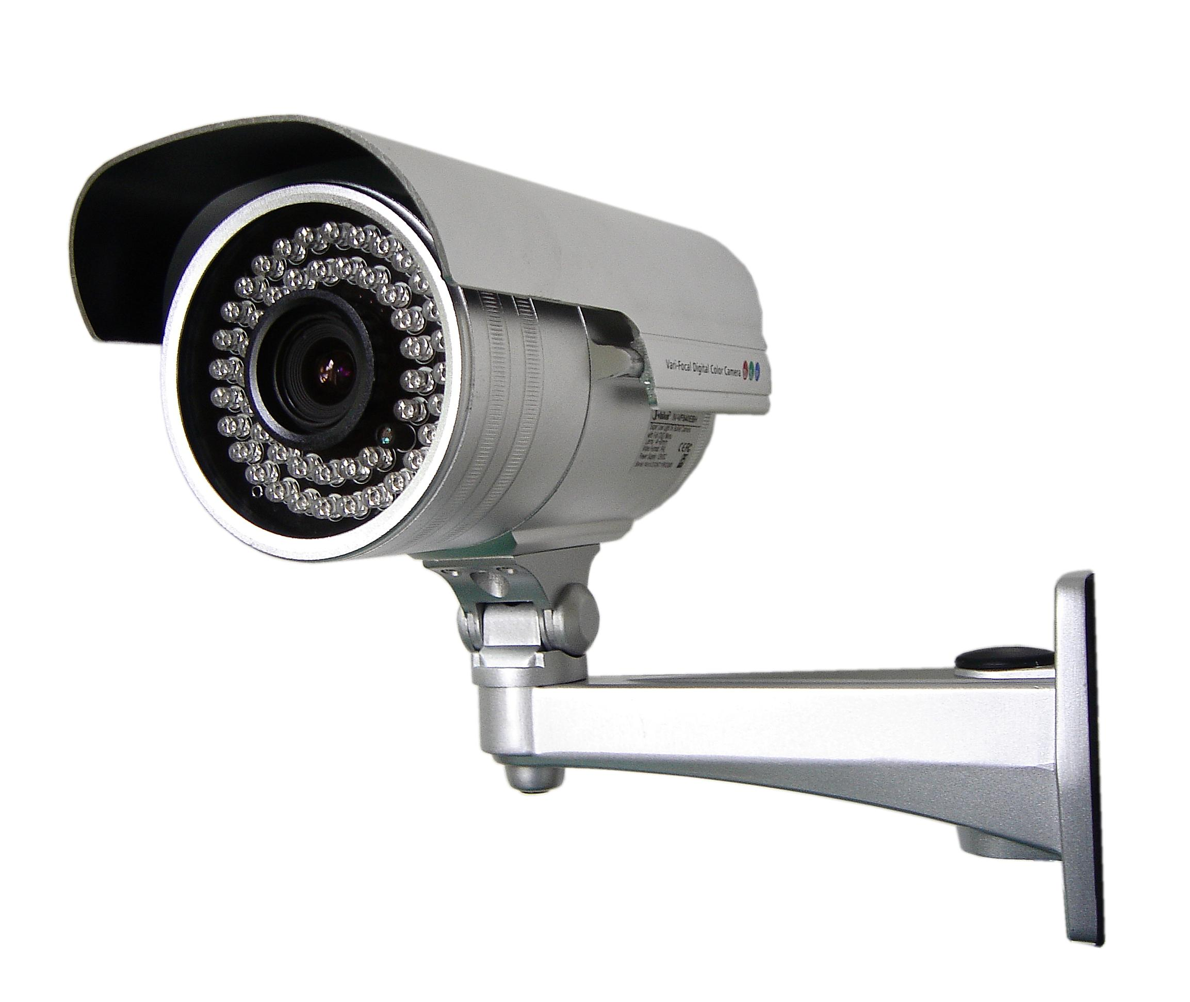
Aspects of Security
Authentication: mechanisms that bind principals to actions
Authorization: mechanisms that govern whether actions are permitted
Audit: mechanisms that record and review actions
Notes:
Warning: people often confuse authorization and authentication!
Examples:
Authorization: file permissions, firewalls, visibility restrictions in FB
Authentication: passwords, digital signatures, EV certificates in browsers
Audit: log files, log browsers, intrusion detection systems

Slide 3

Aspects of Security
Authentication: mechanisms that bind principals to actions
Authorization: mechanisms that govern whether actions are permitted
Audit: mechanisms that record and review actions
... Gold Standard [Lampson 2000]

Slide 4
Classes of Principals
Authentication: mechanisms that bind principals to actions
Authenticating Machines
Authenticating Programs
Authenticating Humans

Slide 5
Authentication
Threat: attacker who controls the network
Dolev-Yao model: attacker can read, modify, delete messages
Vulnerability: communication channel between sender and receiver can be controlled by other principals
Harm: attacker can pretend to have attributes they don't actually have (violating security goals)
Countermeasure: authentication protocols

Slide 6


Authentication Protocols
An authentication protocol allows a principal receiving a message to verify the identity of the principal that sent that message
It's sunny in New York
I prefer rain

Slide 7
Assumptions
Assume Alice and Bob have a shared secret key k
Assume that symmetric-key crypto works

Slide 8
Protocol 1
B -> A: B
A -> B: A, k

Slide 9
Defining Authentication
A strong authentication protocol demonstrates knowledge of the secret without revealing the secret itself

Slide 10
Protocol 2
B -> A: B
A -> B: A, H(k)

Slide 11
Threat Model
Dolev-Yao attacker
controls the network, can read, modify, create packets
A replay attack occurs when an adversary repeats (fragments of) a previous protocol run
B -> A: B
A -> B: A, H(k)
B -> T: B
T -> B: A, H(k)
Notes:
Note: these definitions are interwoven with a sequence of authentication protocols

Slide 12
Exercise: Replay Attacks
Consider the following authentication protocol. Either demonstrate a replay attack against it or make an informal argument as to why it is secure against replay attacks.
B -> A: B
A -> B: A, Enc(A^{B}; k)
B -> T: B
T -> B: A, Enc(A^{B}; k)

Slide 13

Protocol 3
Idea: require Alice to authenticate with a different message every time
B -> A: B, r
A -> B: A, Enc(r;k)
B -> T: B, r2
T -> B: A, Enc(r; k)

Slide 14
Threat Model
Dolev-Yao attacker
controls the network, can read, modify, create packets
A reflection attack occurs when an adversary sends messages from an ongoing protocol back to the originator
B -> T: B, r
T -> B: A, r
B -> T: B, Enc(r;k)
T -> B: A, Enc(r;k)

Slide 15
Exercise: Reflection Attacks
Consider the following authentication protocol. Is this protocol vulnerable to a replay attack? Is this protocol vulnerable to a reflection attack? In each case, exhibit an attack or explain why it is not possible
B -> A: B, r
A -> B: A, Enc(A*B+r; k)

Slide 16
Exercise: Reflection Attacks
Replay Attacks
Reflection Attacks
B->A: B, r
A->B: A, Enc(A*B+r;k)
B->T: B, r2
T->B: A, Enc(A*B+r;k)
B->T: B, r
T->B: A, r
B->T: B, Enc(B*A+r;k)
T->B: A,Enc(B*A+r;k)

Slide 17
Protocol 4: Multiple Keys
Idea: have two different keys k_AB and k_BA for authenticating in the different directions
B -> A: B, r
A -> B: A, Enc(r;k_AB)

Slide 18
Protocol 5: Included Identity
Idea: include the identity of the sender in the encrypted ciphertext
B -> A: B, r
A -> B: A, Enc(A, r; k)

Slide 19
Foiling Reflection Attacks
Multiple Keys
Included Identity
B->T: B, r
T->B: A, r
B->T: B, Enc(r;k_BA)
T->B: A, Enc(r;k_BA)
B->T: B, r
T->B: A, r
B->T: B, Enc(B, r; k)
T->B: A, Enc(B, r; k)

Slide 20
Exercise: Authentication Protocols
Consider the following authentication protocols. For each: Is it vulnerable to a replay attack? Is this protocol vulnerable to a reflection attack? In each case, exhibit an attack or explain why it is not possible
Protocol 1:
B -> A: B, r
A -> B: A, Enc(A^B; k) // xor
Protocol 2:
B -> A: B, r
A -> B: A, Enc(A^B + r; k) // xor
Protocol 3:
B -> A: B, r
A -> B: A, Enc(A^{B} + r; k) // exponentiation

Slide 21
Threat Model
Dolev-Yao attacker
controls the network, can read, modify, create packets
A man-in-the-middle attack occurs when an adversary secretly relays (and potentially changes) communications between two principals who believe they are communicating directly with eachother
B -> T: B, r
T -> A: B, r
A -> T: A, Enc(A, r; k)
T -> B: A, Enc(A, r;k)
Notes:
Note: these definitions are interwoven with a sequence of authentication protocols

Slide 22
Authentication
Threat: attacker who controls the network
Dolev-Yao model: attacker can read, modify, delete messages
Vulnerability: communication channel between sender and receiver can be controlled by other principals
Harm: attacker can pretend to have attributes they don't actually have (violating security goals)
Countermeasure: authentication protocols

Slide 23
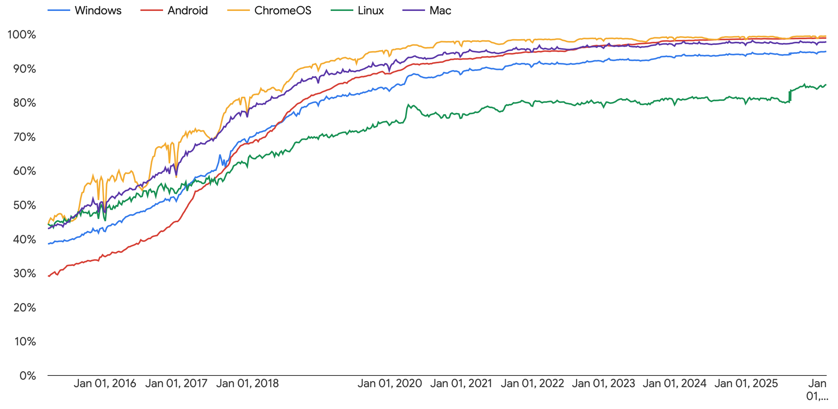
Solution: Encrypt Everything
Notes:
https://transparencyreport.google.com/https/overview?hl=en

Slide 24
Authentication Protocols

