Slide 1
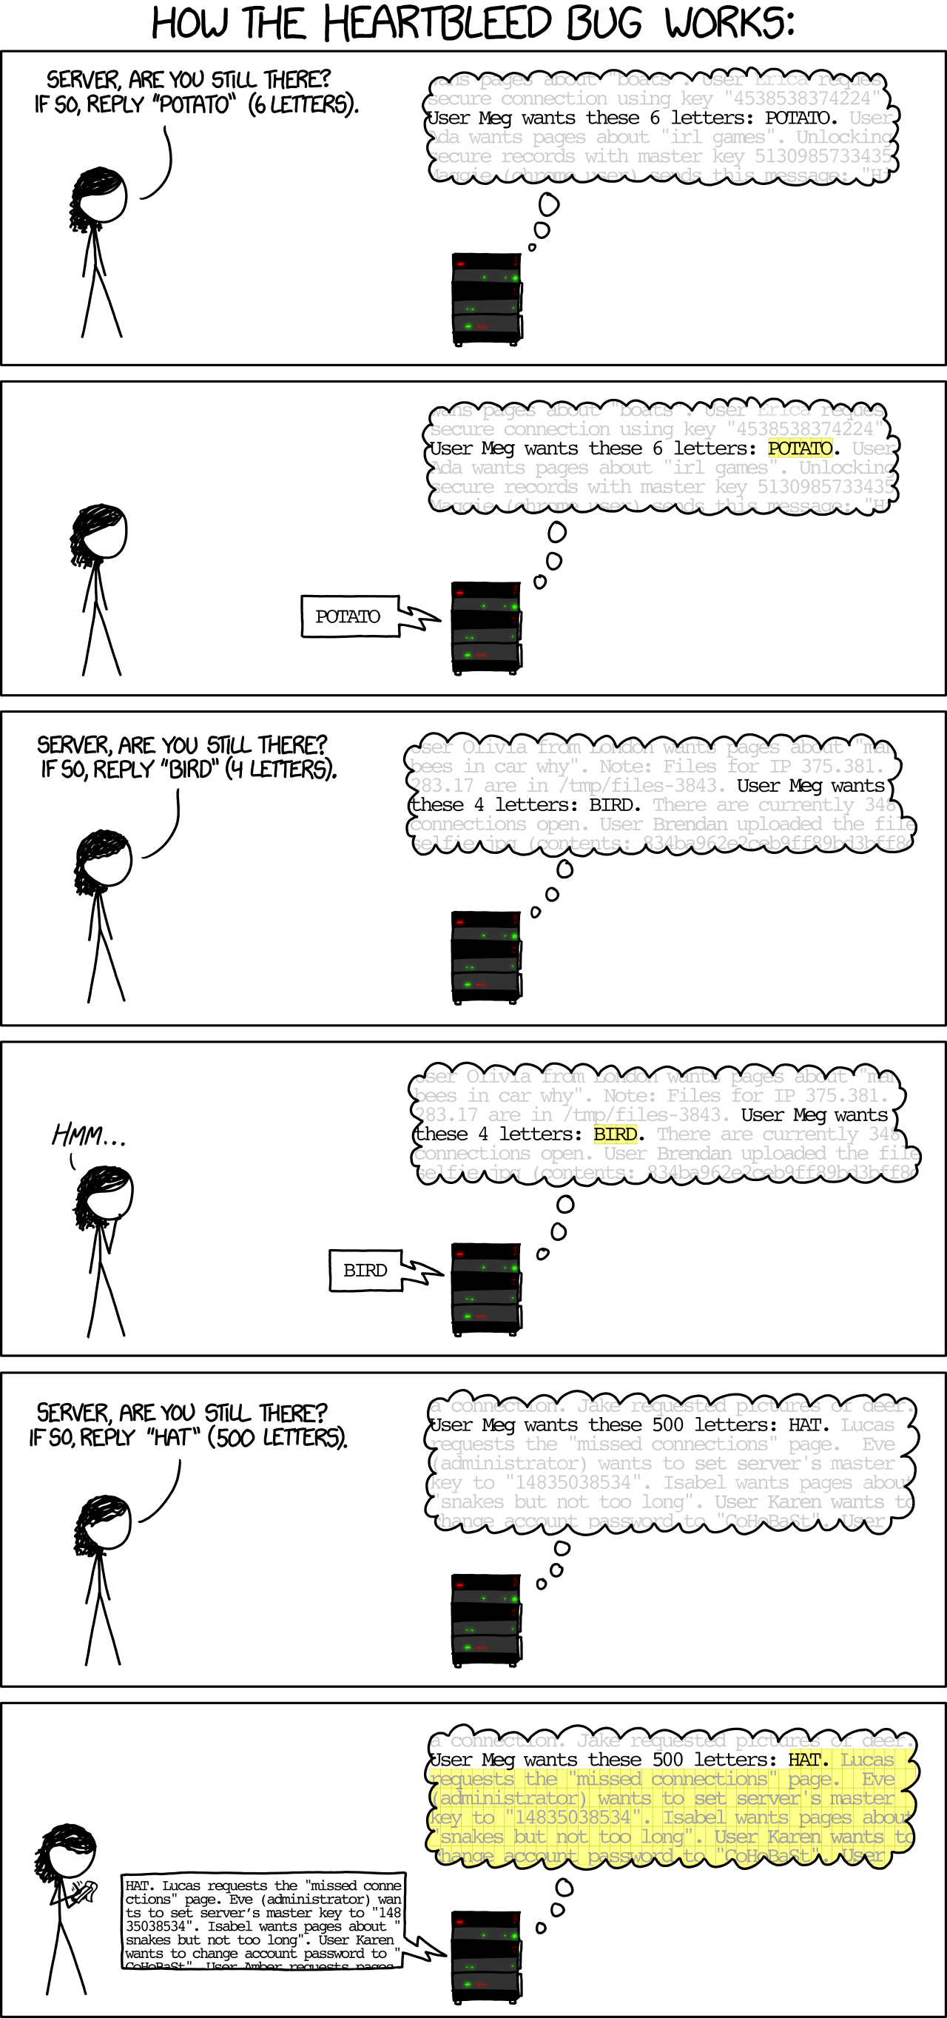
Lecture 9: Secure Channels
CS 138 Spring 2026

Slide 2
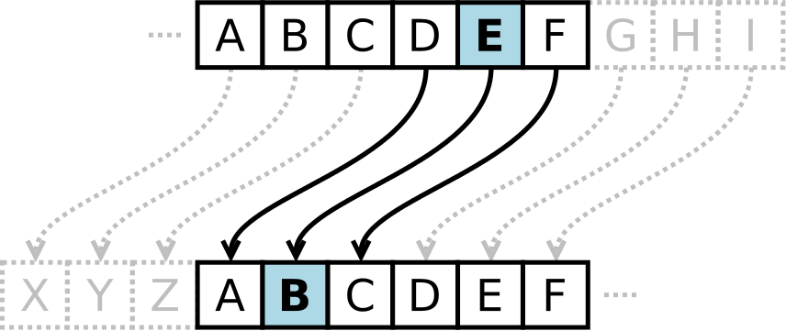
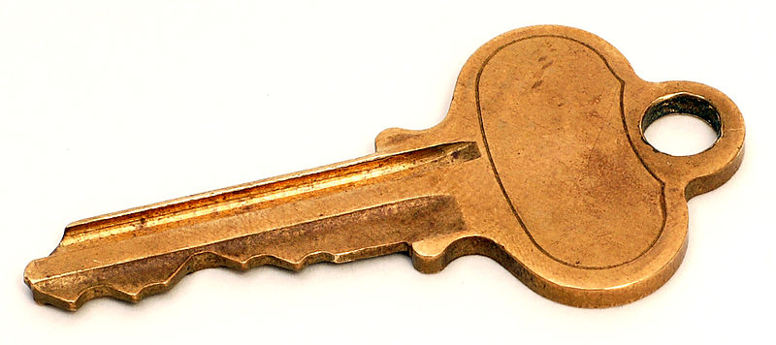

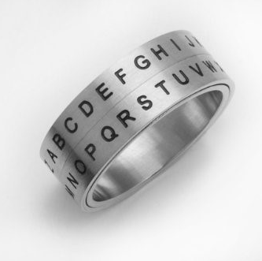

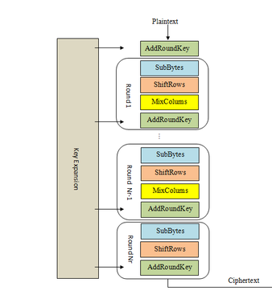
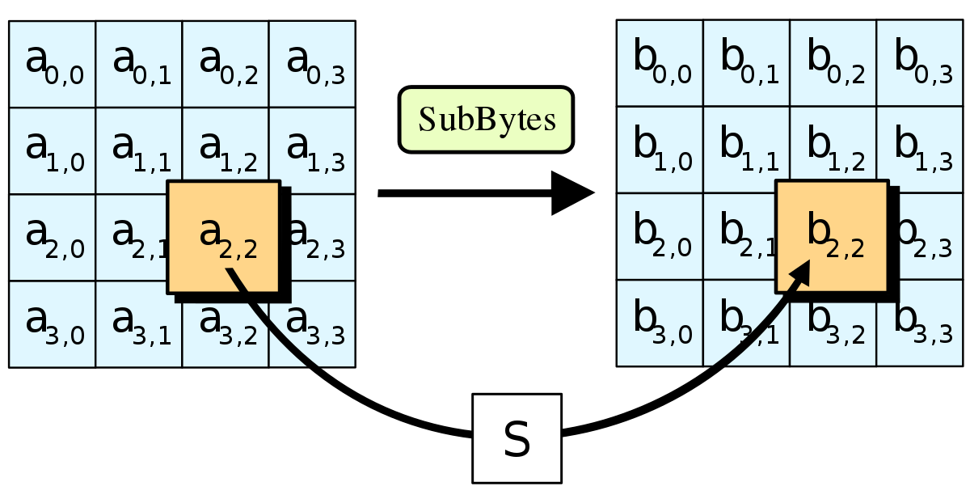
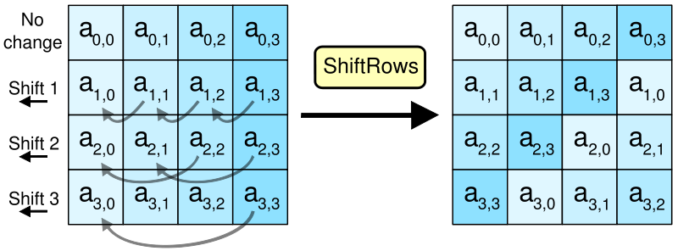

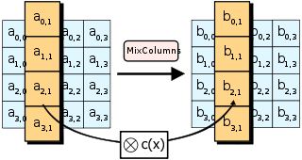

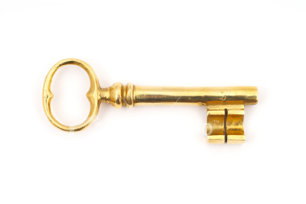
Crypto Thus Far…
Sign

Slide 3
Today: Secure Channels
Threat: attacker who controls the network
Dolev-Yao model: attacker can read, modify, delete messages
Vulnerability: communication channel between sender and receiver can be controlled by other principals
Harm: conversation can be learned (violating confidentiality) or changed (violating integrity) by attacker
Countermeasure: all the crypto…

Slide 4


Today: Secure Channels

Slide 5
Today: Secure Channels
Requirements:
Channel must provide both confidentiality and integrity
A and B must agree on session key(s)
A and B must agree on cipher suite (crypto protocols, encryption mode, key lengths)
Must detecting missing messages & repeated messages
Must maintain connection (and be able to end it)

Slide 6
Authenticated encryption
Traditionally: MAC-then-encrypt
Now: block cipher modes designed to provide confidentiality and integrity (e.g., GCM)

Slide 7
Today: Secure Channels
Requirements:
Channel must provide both confidentiality and integrity
A and B must agree on session key(s)
A and B must agree on cipher suite (crypto protocols, encryption mode, key lengths)
Must detecting missing messages & repeated messages
Must maintain connection (and be able to end it)

Slide 8
Agreeing on a session key
Hybrid Encryption (RSA)
Diffie-Hellman
A -> B: g, p, g^a mod p
B -> A: g^b mod p
B: k_s := (g^a)^b mod p
A: k_s := (g^b)^a mod p
DH, ECDH
Notes:
Liger cub: cross between lion and tiger
ECDH has smaller keys and faster performance for same security

Slide 9
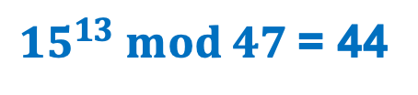
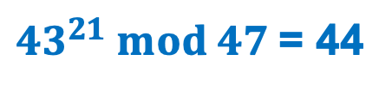
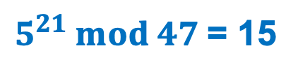
Exercise 1: DH Key Agreement
Assume that Alice chooses a=13 and sends Bob the message (5, 47, 43)
Assume that Bob then chooses b=21
What message will Bob send to Alice?
What secret key will be generated by Bob?
What secret key will be generated by Alice?
$5^{21} mod 47$= 15
$43^{21} mod 47$= 44
${15}^{13} mod 47$= 44

Slide 10
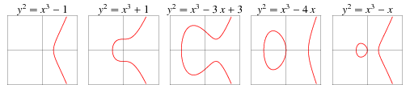
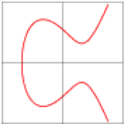
Elliptic Curves
$y^{2}=x^{3}+ax+b$
B
A
A+B
Notes:
y^2 = x^3 + ax+b

Slide 11
Key reuse
Principle: every key in system should have unique purpose
generate a fresh session key for every connection (ephemeral)
Have one key: k_s, Need 4 keys:
How to get many out of one: use a cryptographic hash function H to derive keys...
kea = H(k, "Enc Alice to Bob")
keb = H(k, "Enc Bob to Alice")
kma = H(k, "MAC Alice to Bob")
kmb = H(k, "MAC Bob to Alice")
Notes:
How to solve that last problem? Use it to seed PRNG and use that PRNG as input to Gen.

Slide 12
Today: Secure Channels
Requirements:
Channel must provide both confidentiality and integrity
A and B must agree on session key(s)
A and B must agree on cipher suite (crypto protocols, encryption mode, key lengths)
Must detecting missing messages & repeated messages
Must maintain connection (and be able to end it)

Slide 13
Secure Socket Layer (SSL)
SSL 2.0 (1995): designed by Netscape, contains a number of security flaws, prohibited since 2011
SSL 3.0 (1996): complete re-design, all accepted cipher suites now have known vulnerabilities, prohibited since 2015
TLS 1.0 (1999): contains known vulnerabilities, suggested migration by June 2018
TLS 1.1 (2006): update with significant changes in how IVs/padding are handled to prevent known attacks
TLS 1.2 (2008): update with modern cipher suites
TLS 1.3 (2018): drops insecure features and introduces additional cipher suites
Notes:
TLS = Transport Layer Security

Slide 14
SSL/TLS Handshake
Version, cipher suites, rClient
ClientHello
Version, cipher suite, rServer,
certificate
ServerHello
ServerKeyExchange
(optional)
ClientKeyExchange
Enc_pks(ms_p)
Compute master secret
Compute master secret
ChangeCipherSpec
ChangeCipherSpec

Slide 15
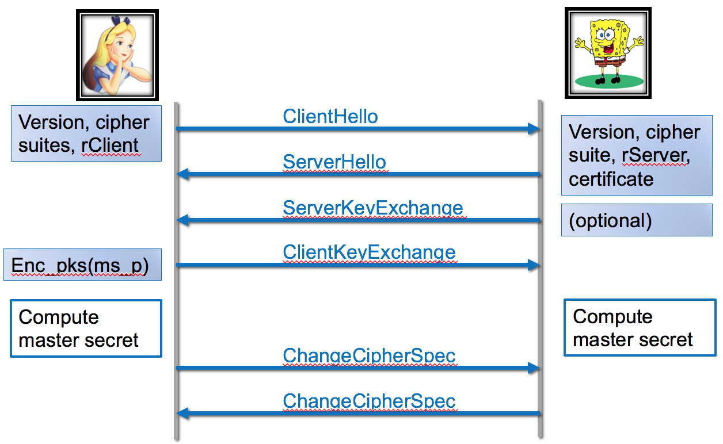
Exercise 2: TLS Handshake
What messages would be exchanged in the initial three-way handshake if the principals elected to use DH instead of hybrid encryption to agree on a message?
TLS1.3, […,DHE,…], rc
DHE, rs
rc, rs, p, g, g^B, sign(rc, rs, p, g, g^B;skB)
g^A

Slide 16
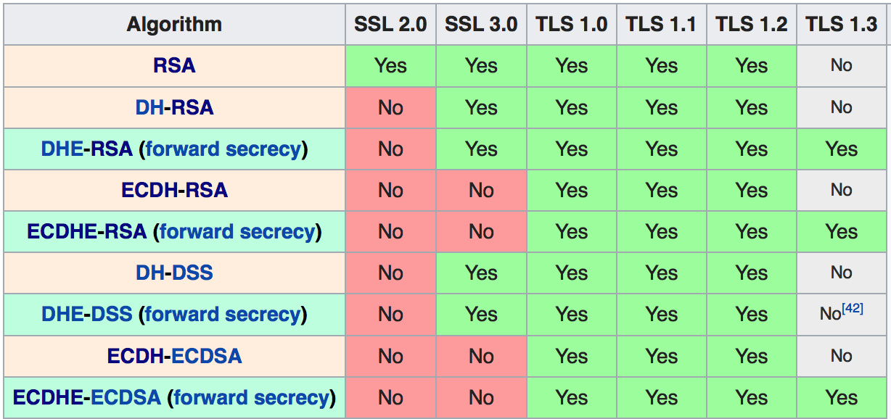
Supported Cipher Suites

Slide 17
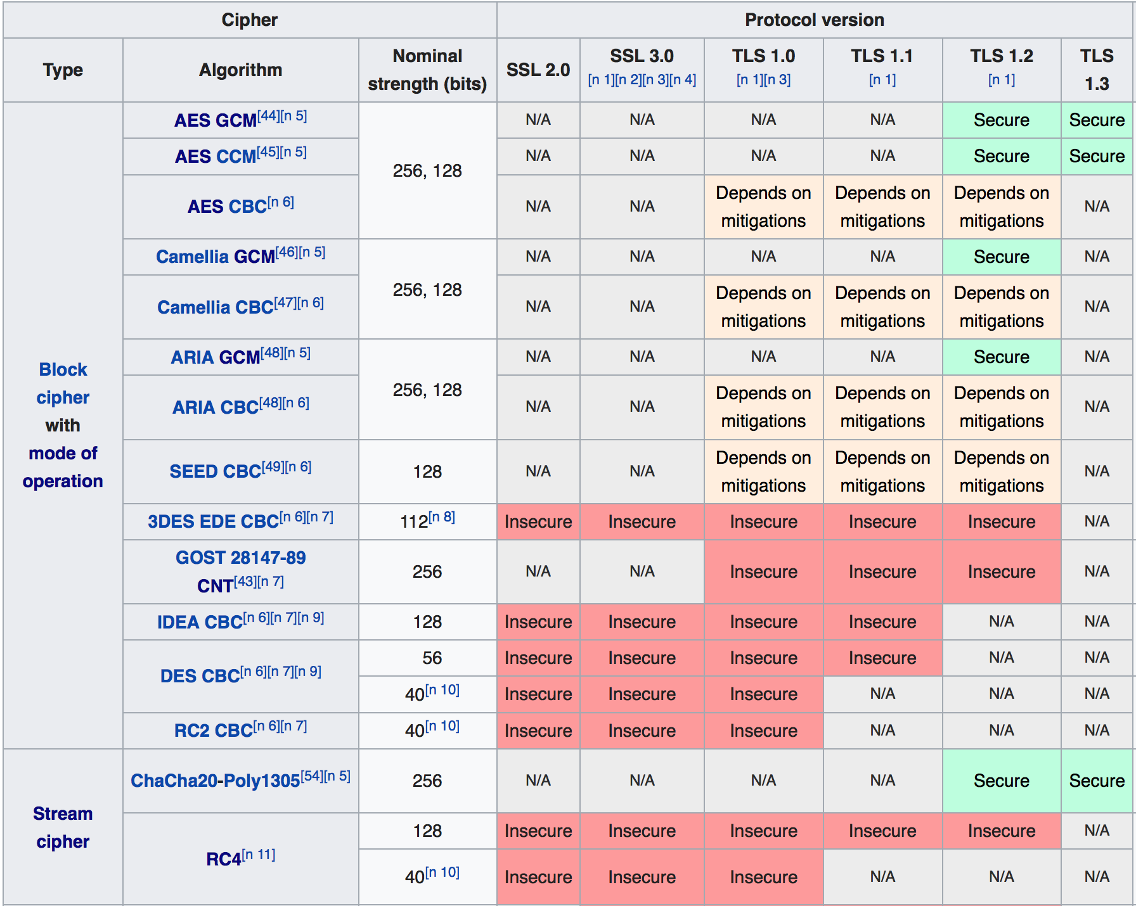
Notes:
Check what you have supported: https://browserleaks.com/tls

Slide 18


Attacks on Cipher Negotiation
POODLE (2014)
NOMORE (2015)
SLOTH (2016)
DROWN (2016)
ROBOT (2017)
Notes:
Padding Oracle On Downgraded Legacy Encryption (POODLE) https://blog.qualys.com/product-tech/2014/12/08/poodle-bites-tls
NOMORE
https://www.usenix.org/conference/usenixsecurity15/technical-sessions/presentation/vanhoef
Security Losses from Obsolute and Truncated Transcript Hashes (SLOTH)
https://www.mitls.org/downloads/transcript-collisions.pdf
Decrypting RSA with Obsolete and Weakened eNcryption (DROWN)
https://drownattack.com
Return of Beichenbacker's Oracle Threat (ROBOT)
https://robotattack.org

Slide 19
Today: Secure Channels
Requirements:
Channel must provide both confidentiality and integrity
A and B must agree on session key(s)
A and B must agree on cipher suite (crypto protocols, encryption mode, key lengths)
Must detecting missing messages & repeated messages
Must maintain connection (and be able to end it)

Slide 20
Message numbers
Every message that Alice sends is numbered
1, 2, 3, ...
numbers increase monotonically
never reuse a number
Bob keeps state to remember last message number he received
Bob accepts only increasing message numbers
And ditto all the above, for Bob sending to Alice
so each principal keeps two independent counters: messages sent, messages received
Notes:
Aka sequence numbers

Slide 21
Message numbers
What if Bob detects a gap? e.g. 1, 2, 5
Maybe Mallory deleted messages 3 and 4 from network
Maybe Mallory detectably changed 3 and 4, causing Bob to discard them
In either case, channel is under active attack
Absent availability goals, time to PANIC: abort protocol, produce appropriate information for later auditing, shut down channel
What if network non-maliciously dropped messages or will deliver them later?
Let's assume underlying transport protocol guarantees that won't happen (e.g. TCP)

Slide 22
Message numbers
Message number usually implemented as a fixed-size unsigned integer, e.g., 32 or 48 or 64 bits
What if that int overflows and wraps back around to 0?
Message number must be unique within conversation to prevent Mallory from replaying old conversation
So conversation must stop at that point
Can start a new conversation with a new session key
Notes:
Note: in SSL, sequence number is implicit (included in MAC)

Slide 23
Today: Secure Channels
Requirements:
Channel must provide both confidentiality and integrity
A and B must agree on session key(s)
A and B must agree on cipher suite (crypto protocols, encryption mode, key lengths)
Must detecting missing messages & repeated messages
Must maintain connection (and be able to end it)

Slide 24
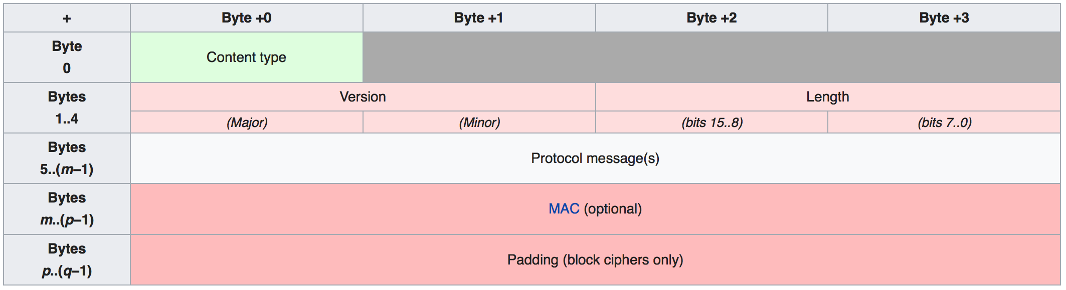
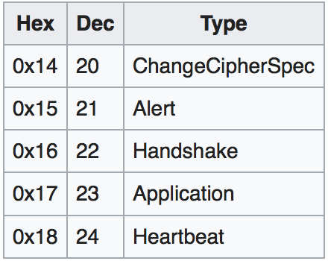
TLS record

Slide 25

Heartbleed
Notes:
Heartbleed was a vulnerability in the OpenSSL resulting from a missing bounds check (a buffer overread vulnerability) in its implementation of the TLS heartbeat extension; it was discovered in April 2014. Transport Layer Security (TLS) is the standard protocol for creating secure, encrypted communication channels. The TLS heartbeat extension is designed to keep the connection alive, avoiding the overhead of negotiating a new connection; it works by having one end of the connection send an arbitrary message which the other end echoes back, proving that the connection is OK. The heartbeat message, according to the RFC, has the following structure:\begin{verbatim} struct { HeartbeatMessageType type; uint16 payload_length; opaque payload[HeartbeatMessage.payload_length]; opaque padding[padding_length]; } HeartbeatMessage;\end{verbatim}Unfortunately, OpenSSL's implementation did not check the claimed {\verb payload_length } against the actual length of the TLS record sent. If the claimed length (which could be up to 64KB) exceeded the length of the actual payload (which could be just one byte), the ``echo'' message returned by the server would send back a copy of the one byte message as well as the next 64KB-1 bytes of memory. Because this memory often contains sensitive values, this approach allowed an attacker to access servers' private keys as well as users' session cookies and passwords. At the time it was disclosed, 17\% of secure web servers on the Internet were believed to be vulnerable. Experts estimate that as of January 2017, as many as 200,000 services remain vulnerable.

Slide 26
Heartbeat

Slide 27
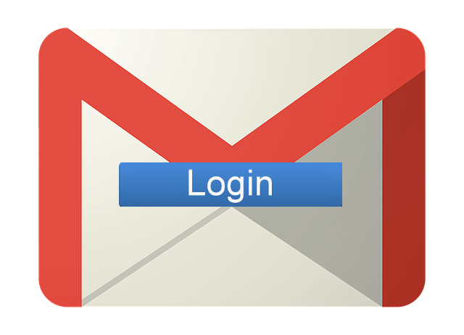
Truncation Attack
Notes:
A TLS (logout) truncation attack blocks a victim's account logout requests so that the user unknowingly remains logged into a web service. When the request to sign out is sent, the attacker injects an unencrypted TCP FIN message (no more data from sender) to close the connection. The server therefore doesn't receive the logout request and is unaware of the abnormal termination.^{[251]}
Published in July 2013, the attack causes web services such as Gmail and Hotmail to display a page that informs the user that they have successfully signed-out, while ensuring that the user's browser maintains authorization with the service, allowing an attacker with subsequent access to the browser to access and take over control of the user's logged-in account. The attack does not rely on installing malware on the victim's computer; attackers need only place themselves between the victim and the web server (e.g., by setting up a rogue wireless hotspot).This vulnerability also requires access to the victim's computer. Another possibility is when using FTP the data connection can have a false FIN in the data stream, and if the protocol rules for exchanging close_notify alerts is not adhered to a file can be truncated.

Slide 28
Today: Secure Channels
Requirements:
Channel must provide both confidentiality and integrity
A and B must agree on session key(s)
A and B must agree on cipher suite (crypto protocols, encryption mode, key lengths)
Must detecting missing messages & repeated messages
Must maintain connection (and be able to end it)

Slide 29
Secure Channels

