Slide 1
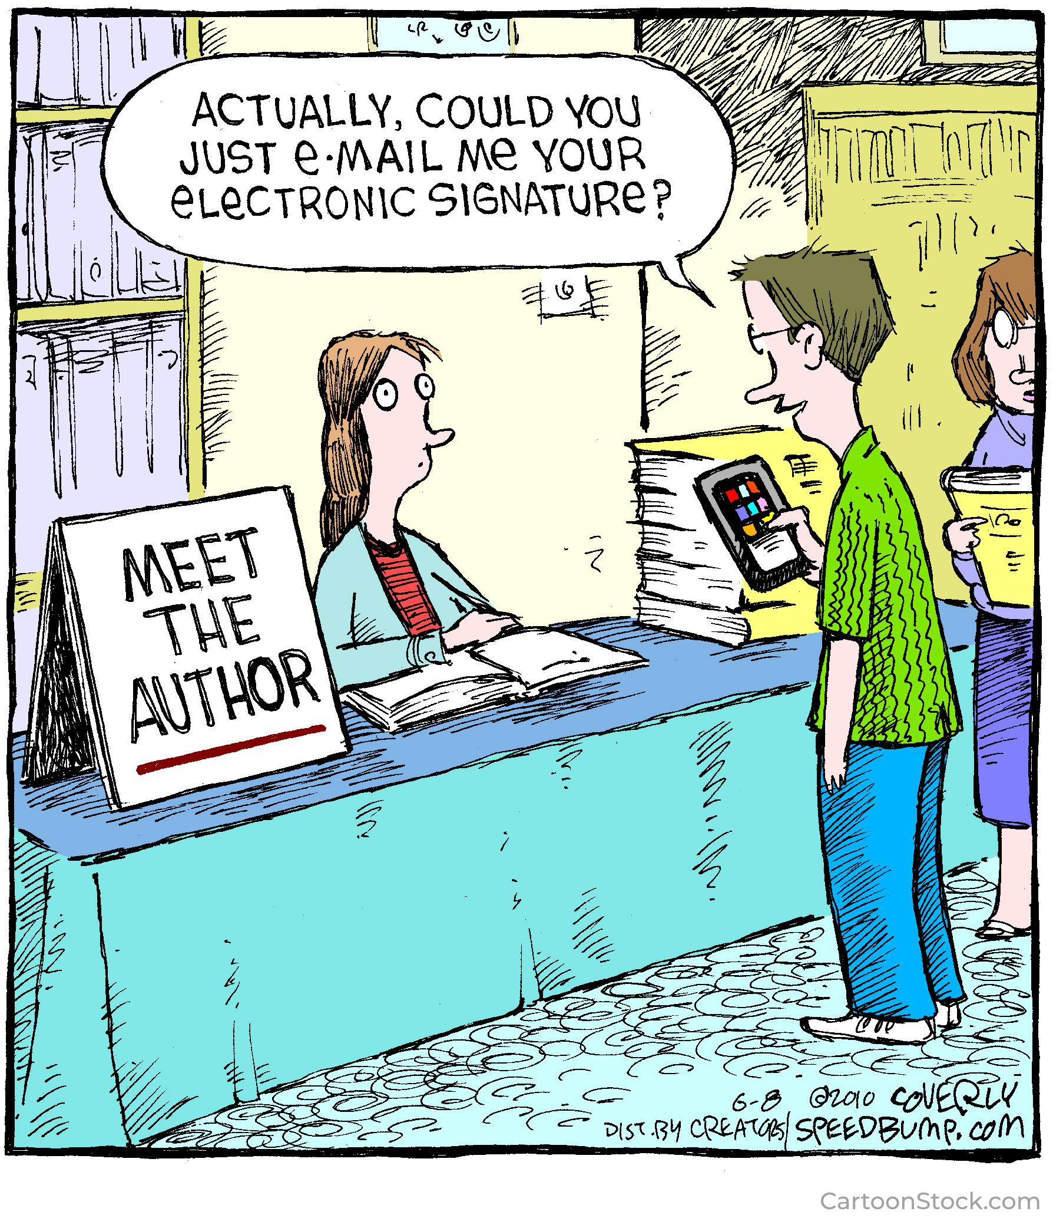
Crypto for Integrity
CS 138 Spring 2026

Slide 2
Protection of integrity
Threat: attacker who controls the network
Dolev-Yao model: attacker can read, modify, delete messages
Vulnerability: communication channel between sender and receiver can be controlled by other principals
Harm: information contained in messages can be changed by attacker (violating integrity)
Countermeasure: more crypto

Slide 3
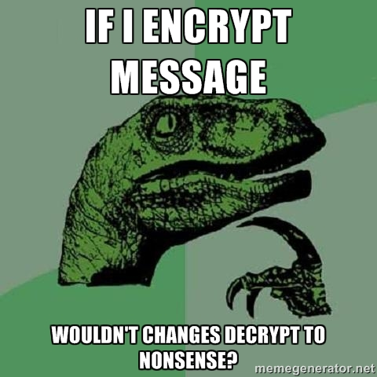
Encryption and integrity

Slide 4
Encryption and integrity
NO!
Plaintext block might be random number, and recipient has no way to detect change in random number
Attacker might substitute ciphertext from another execution of same protocol (replay)
Adversary can modify encrypted plaintext in predictable ways (malleability)get integrity solely from encryption

Slide 5
Malleable Ciphertexts
AES-CBC
Adversary can truncate blocks from end of message
AES-CTR
Flipping bits of plaintext flips bits of ciphertext
RSA
Adversary can multiply message

Slide 6
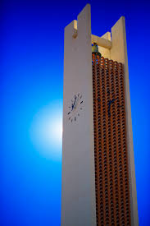
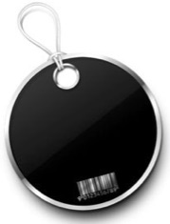

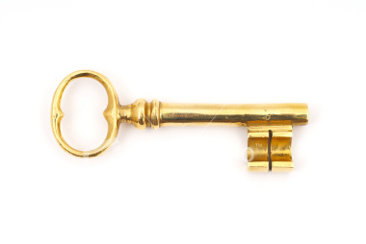

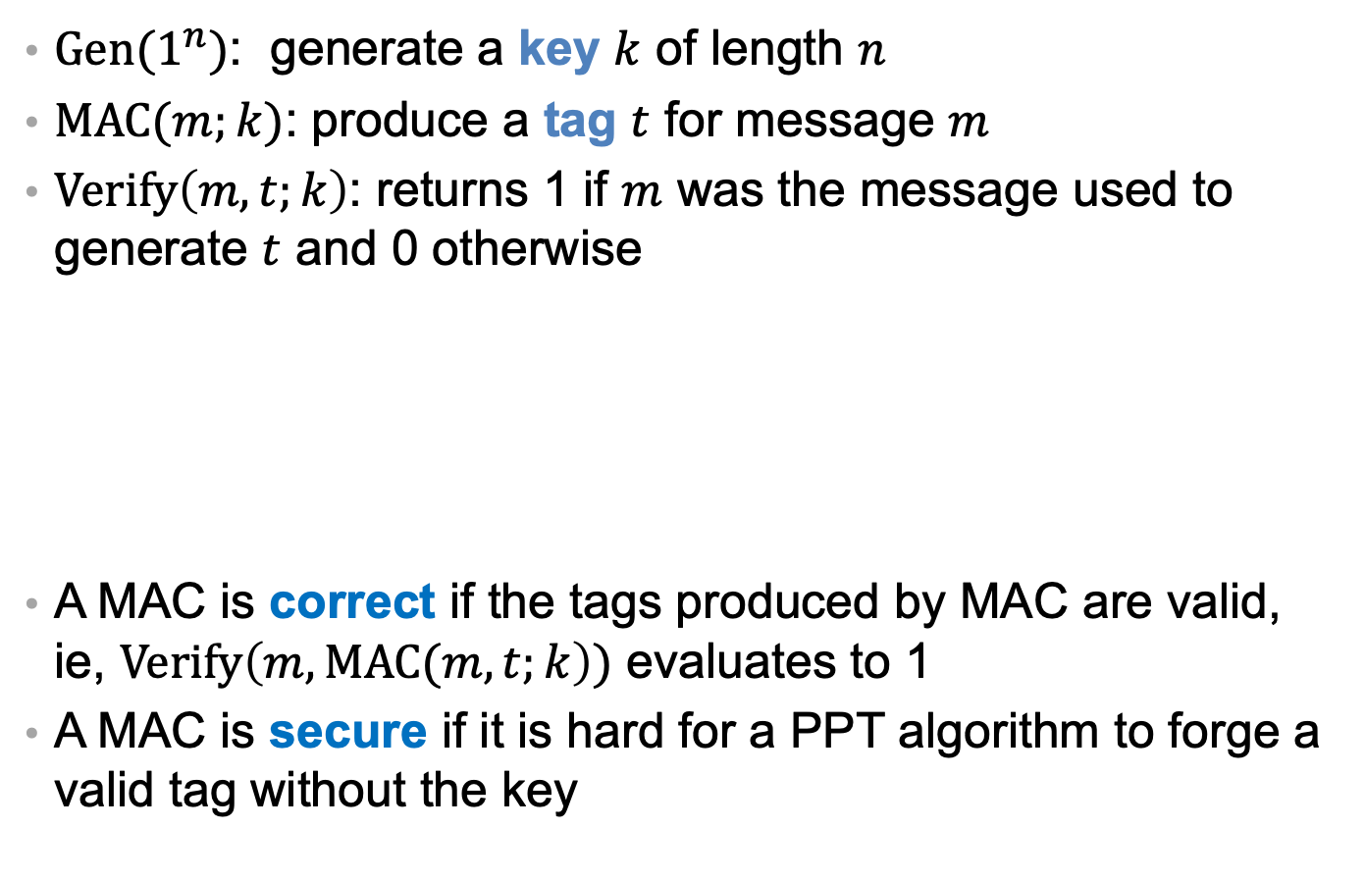
MAC algorithms
$Gen(1^{n})$: generate a key $k$ of length $n$
$MAC(m;k)$: produce a tag $t$ for message $m$
$Verify\left(m, t;k\right)$: returns 1 if $m$ was the message used to generate $t$ and 0 otherwise
A MAC is correct if the tags produced by MAC are valid, ie, $Verify\left(m, MAC(m,t;k\right))$ evaluates to 1
A MAC is secure if it is hard for a PPT algorithm to forge a valid tag without the key
MAC
MAC

Slide 7
Real-world MACs
CBC-MAC
Parameterized on a block cipher
Core idea: encrypt message with block cipher in CBC mode, use very last ciphertext block as the tag
HMAC
Parameterized on a hash function
Core idea: hash message together with key
Your everyday hash function isn't good enough...

Slide 8
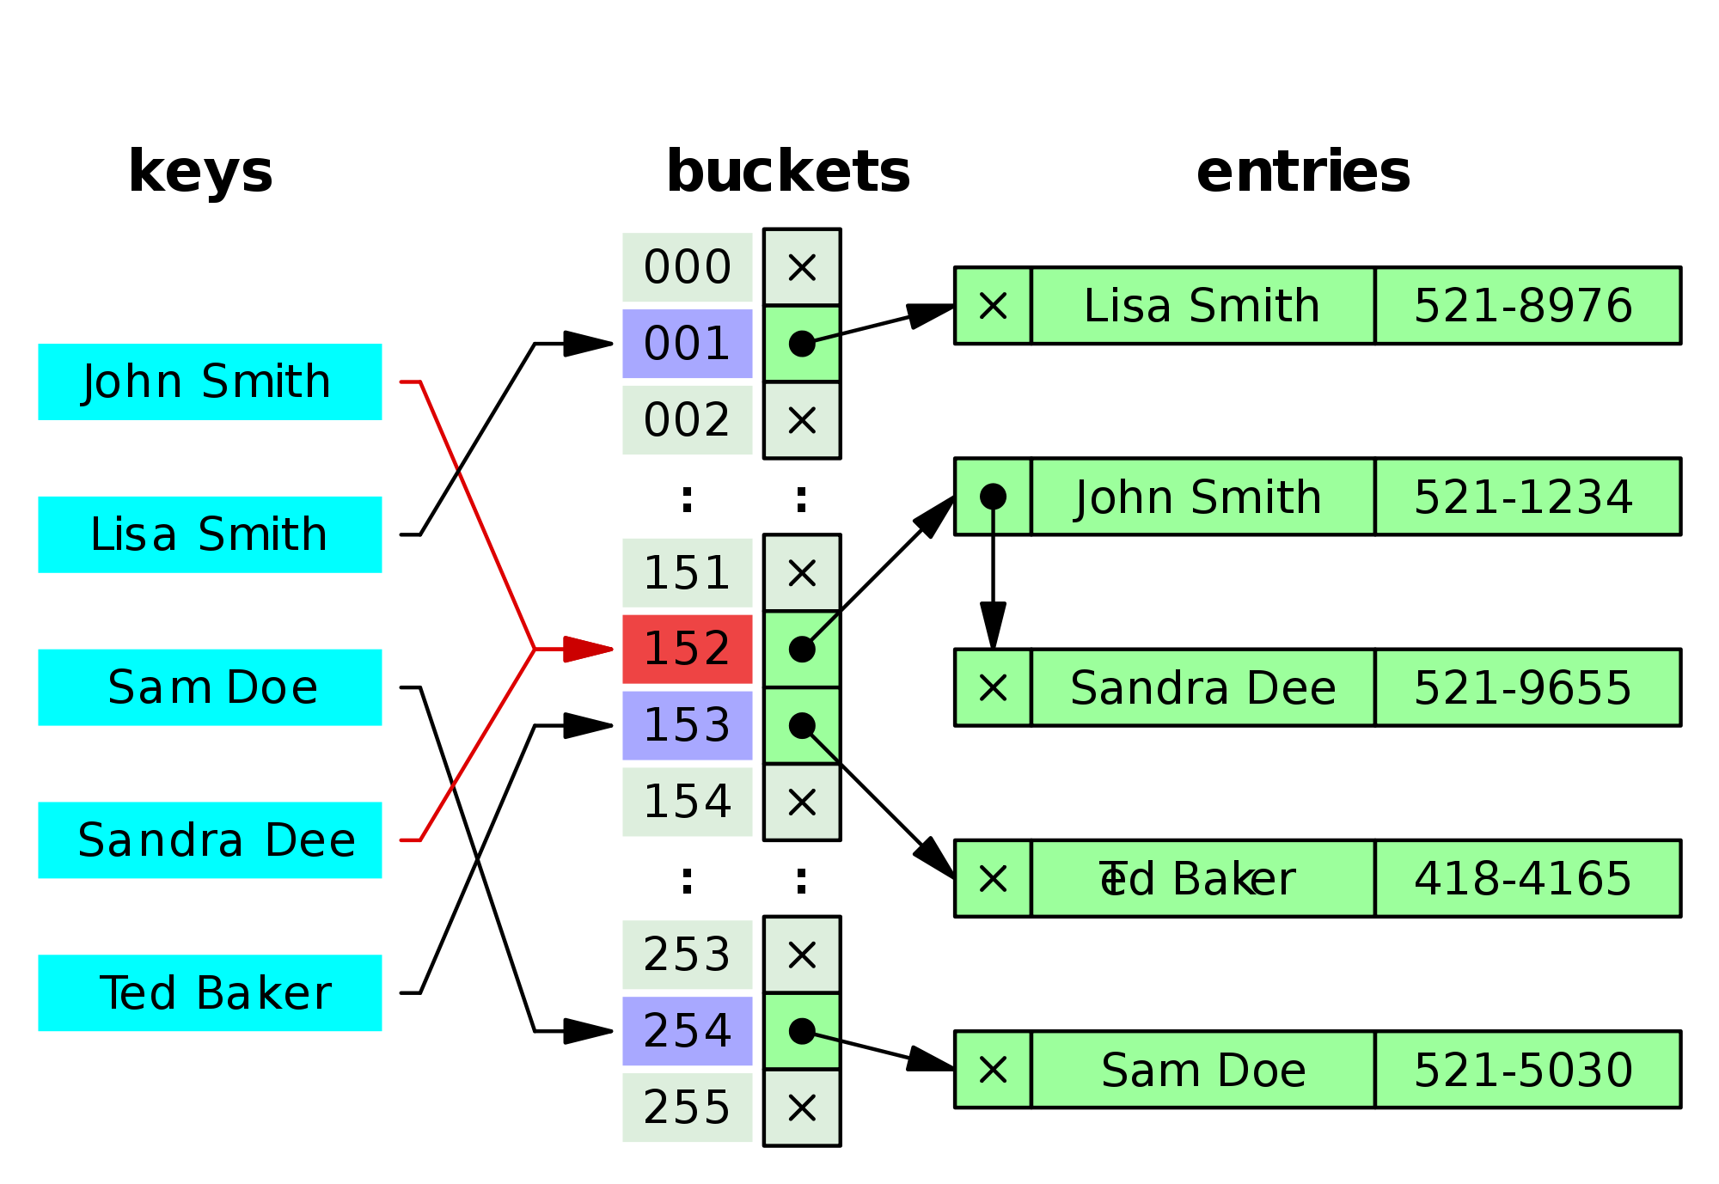
Hash functions
Input: arbitrary size bit string
Output: fixed size bit string
compression: size of the output is smaller than the input
diffusion: minimize collisions (and clustering)

Slide 9
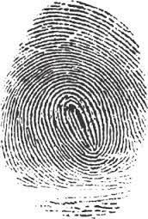
Cryptographic hash functions
Stronger requirements than (plain old) hash functions
Goal: hash is compact representation of original like a fingerprint
Hard to find 2 people with same fingerprint
Whether you get to pick pairs of people, or whether you start with one person and find another
...collision-resistant
Given person easy to get fingerprint
Given fingerprint hard to find person
...one-way

Slide 10
Exercise: MACs
Consider a hash function f that breaks a value into 4-byte blocks and returns the xor of these blocks. Would this function make a good HMAC? Why or why not?
compression
diffusion
collision-resistant
one-way

Slide 11
Historical hash functions
MD5: Ron Rivest (1991)
128 bit output
Collision resistance broken 2004-8
Can now find collisions in seconds
Don't use it
SHA-1: NSA (1995)
160 bit output
Theoretical attacks that reduce strength to less than 80 bits
As of 2017, “practical attack” on PDFs: https://shattered.io/
Don't use it

Slide 12
Real world hash functions
SHA-2: NSA (2001)
Family of algorithms with output sizes {224, 256, 385, 512}
In principle, could one day be vulnerable to similar attacks as SHA-1
SHA-3: public competition (won in 2012, standardized by NIST in 2015)
Same output sizes as SHA-2
Plus a variable-length output option called SHAKE

Slide 13

Encrypt and MAC
m
0. k_E = Gen_E(len)
k_M = Gen_M(len)
1. A: c = Enc(m; k_E)
t = MAC(m; k_M)
2. A -> B: c, t
3. B: m' = Dec(c; k_E)
t' = MAC(m'; k_M)
if t = t'
then output m'
else abort
c
t

Slide 14
Encrypt and MAC
Pro: can compute Enc and MAC in parallel
Con: MAC must protect confidentiality
Notes:
man ssh_config CIPHERS and MACS

Slide 15
Encrypt then MAC
m
1. A: c = Enc(m; k_E)
t = MAC(c; k_M)
2. A -> B: c, t
3. B: t' = MAC(c; k_M)
if t = t'
then output Dec(c; k_E)
else abort
c
t

Slide 16
Encrypt then MAC
Pro: provably most secure of three options [Bellare & Namprepre 2001]
Pro: don't have to decrypt if MAC fails
resist DoS
Example, ssh (Secure Shell) protocol used this
default encryption is chacha20
default MAC is umac, recommends HMAC-SHA2-512 or 256
Example: IPsec (Internet Protocol Security)
recommends AES-CBC for encryption and HMAC-SHA2-384 for MAC, among others
or AES-GCM
Notes:
man ssh_config CIPHERS and MACS https://media.defense.gov/2021/Sep/16/2002855928/-1/-1/0/CONFIGURING_IPSEC_VIRTUAL_PRIVATE_NETWORKS_2020_07_01_FINAL_RELEASE.PDF

Slide 17
MAC then encrypt
m
1. A: t = MAC(m; k_M)
c = Enc(m,t; k_E)
2. A -> B: c
3. B: m',t' = Dec(c; k_E)
if t' = MAC(m'; k_M)
then output m'
else abort
c

Slide 18
MAC then encrypt
Pro: provably next most secure
and just as secure as Encrypt-then-MAC for strong enough MAC schemes
HMAC and CBC-MAC are strong enough
Example: SSL (Secure Sockets Layer)
Many options for encryption, e.g. CHACHA20, AES-256
For MAC, standard is HMAC with many options for hash, e.g. SHA-256, SHA-384
Notes:
https://developers.cloudflare.com/ssl/reference/cipher-suites/recommendations/

Slide 19
Aside: Key reuse
Never use same key for both encryption and MAC schemes
Principle: every key in system should have unique purpose

Slide 20
Authenticated encryption
Newer block cipher modes designed to provide confidentiality and integrity
OCB: Offset Codebook Mode
CCM: Counter with CBC-MAC Mode
GCM: Galois Counter Mode
Notes:
The GF(2¹²⁸) field used is defined by the polynomial x^128+x^7+x^2+x+1

Slide 21
















Galois Counter Mode
$$P_{1}$$
…
Plaintext
$$P_{2}$$
$$P_{n}$$
IV
01
IV
02
IV
03
IV
n+1
Enc
Enc
Enc
Enc
$$P_{1}$$
$$⊕$$
$$P_{2}$$
$$⊕$$
…
$$P_{n}$$
$$⊕$$
$$C_{1}$$
$$C_{2}$$
$$C_{n}$$
$$⊕$$
$$⊕$$
$$⊕$$
Mult_{H}
Mult_{H}
Mult_{H}
Mult_{H}
$$Mult_{H}\left(x\right)=x^{128}+x^{7}+x^{2}+1$$
len(A)
len(C)
$$⊕$$
Data
Mult_{H}
$$⊕$$
IV
Data
$$C_{1}$$
$$C_{2}$$
…
$$C_{n}$$
Auth Tag
Notes:
Data = Authenticated (but not encrypted) data (e.g., message headers)
Mult_H is multiplication in a Galois field

Slide 22
Digital Signatures

Slide 23
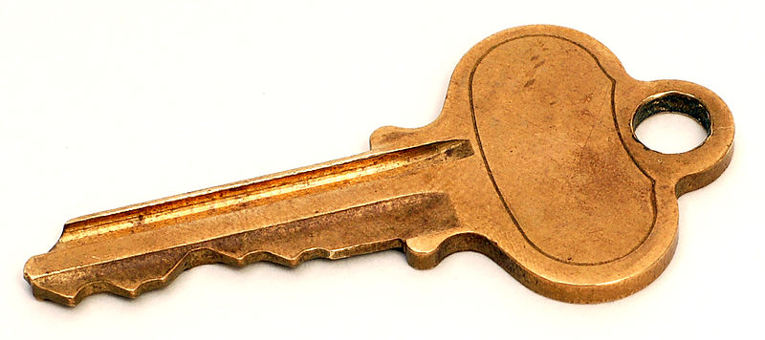

Recall: Key pairs
Instead of sharing a key between pairs of principals...
...every principal has a pair of keys
public key: published for the world to see
private key: kept secret and never shared

Slide 24
Key pair terminology
 | Encryption | Digital Signatures
Public key | Encryption key | Verification key
Private key | Decryption key | Signing key

Slide 25

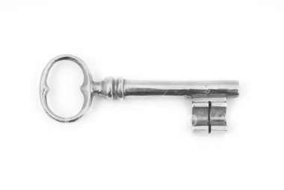
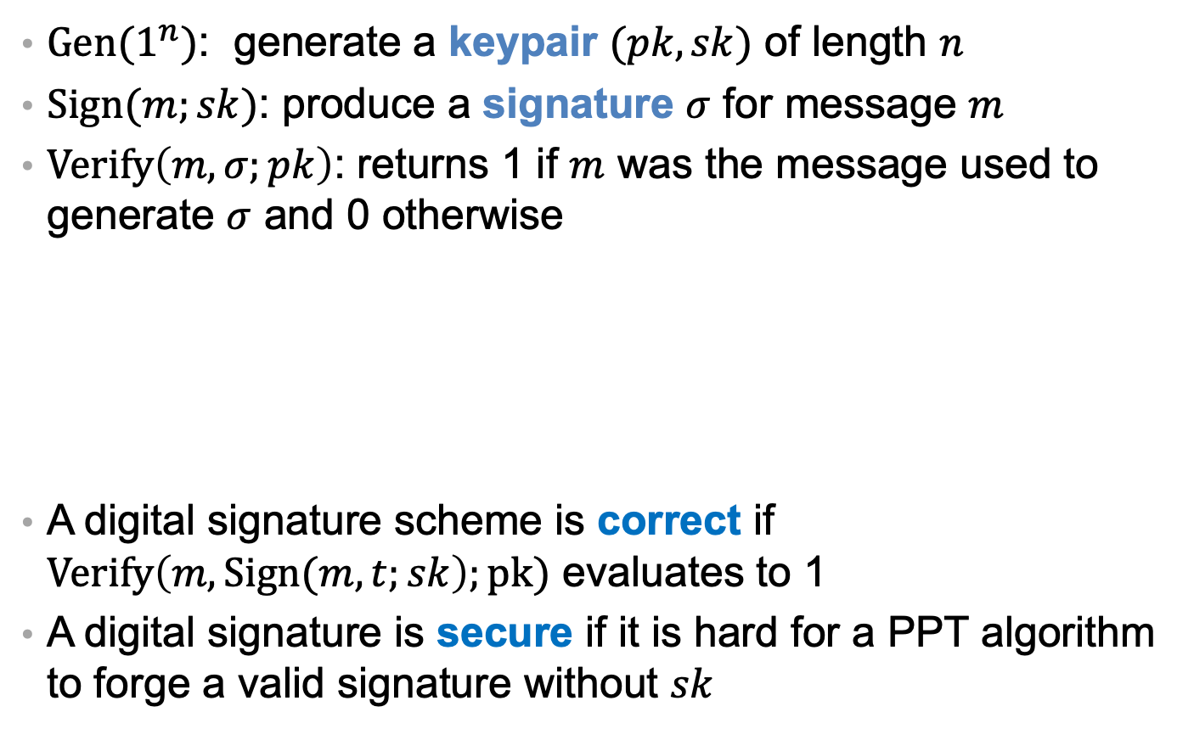
Digital Signatures
$Gen(1^{n})$: generate a keypair $(pk,sk)$ of length $n$
$Sign(m;sk)$: produce a signature $σ$ for message $m$
$Verify\left(m, σ;pk\right)$: returns 1 if $m$ was the message used to generate $σ$ and 0 otherwise
A digital signature scheme is correct if $Verify\left(m, Sign(m,t;sk\right);pk)$ evaluates to 1
A digital signature is secure if it is hard for a PPT algorithm to forge a valid signature without $sk$
MAC
MAC

Slide 26
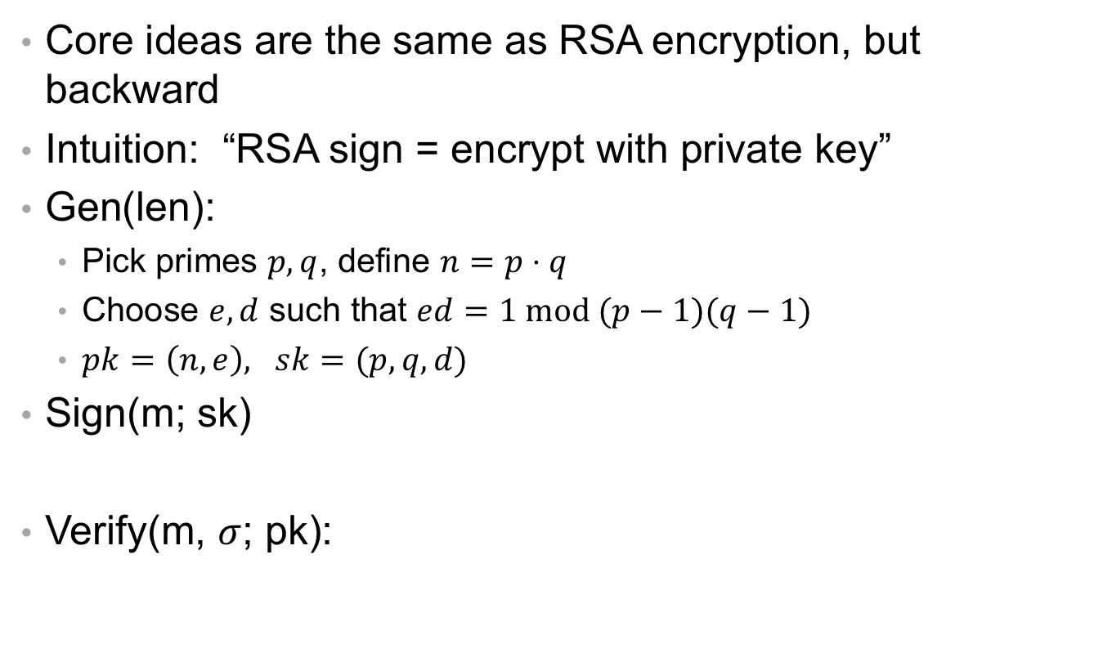
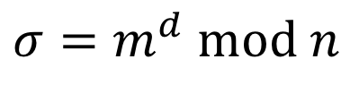
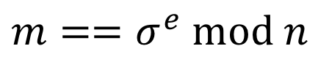
RSA
Core ideas are the same as RSA encryption, but backward
Intuition: “RSA sign = encrypt with private key”
Gen(len):
Pick primes $p,q$, define $n=p⋅q$
Choose $e,d$ such that $ed=1 mod (p−1)(q−1)$
$pk=\left(n, e\right), sk=(p,q, d)$
Sign(m; sk)
Verify(m, $σ$; pk):
$$σ=m^{d} mod n$$
$$m==σ^{e} mod n$$
Notes:
The DSA patent credits Kravitz; NIST is who introduced it.

Slide 27





Exercise: Forging Signatures
Assume that an adversary convinces Alice to sign two messages $m_{1}$ and $m_{2}$ with the same key, producing signatures $σ_{1}$ and $σ_{2}$. How could this adversary forge a signed message with the value $m_{1}m_{2}$?
$$Sign\left(m_{1}m_{2}\right)={\left(m_{1}m_{2}\right)}^{d} mod n$$
$$=m_{1}^{d}m_{2}^{d} mod n$$
$$={(m}_{1}^{d} mod n)(m_{2}^{d} mod n) mod n$$
$$=σ_{1}σ_{2} mod n$$

Slide 28
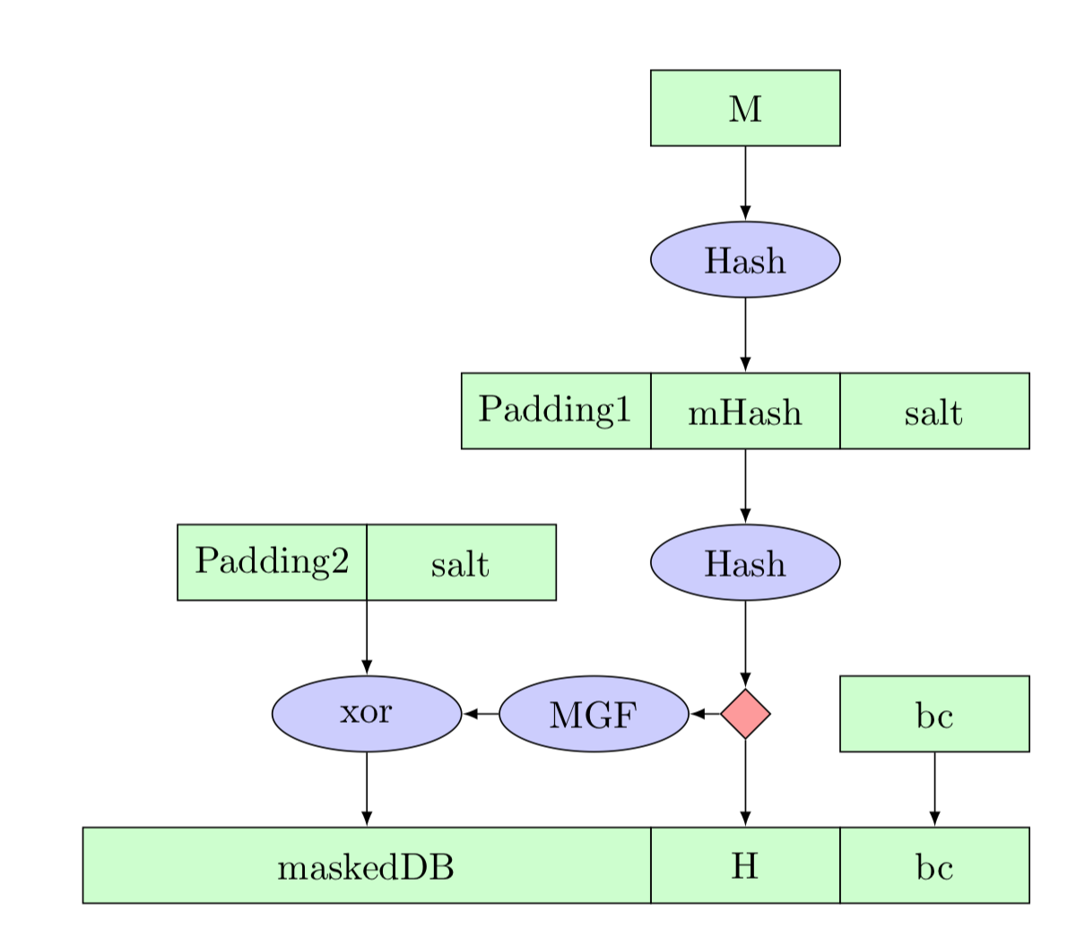
RSA
Core ideas are the same as RSA encryption
Intuition: “RSA sign = encrypt with private key”
Truth (in real world, outside of textbooks):
there's a core RSA function R that works with either pk or sk
RSA encrypt = do some prep work on m then call R with pk
RSA sign = do different prep work on m then call R with sk
Prep work: recall “textbook RSA is insecure”
(For encryption: OAEP)
For signatures: PSS (probabilistic signature scheme)
Also need to handle long messages…
Notes:
MGF = “mask generation function” (basically hash w/ fixed bitlength output)
bc is fix byte 0xbc
padding is all zeros
salt is unique and random each time

Slide 29
Signatures with hashing
1. A: s = Sign(H(m); k_A)
2. A -> B: m, s
3. B: accept if Ver(H(m); s; K_A)
Notes:
So common a practice that I won't bother to write the hashing from now on

Slide 30
DSA
DSA: Digital Signature Algorithm [Kravitz 1991]
Standardized by NIST and made available royalty-free in 1991/1993
Used for decades without any serious attacks
Closely related to Elgamal encryption
Usual implemented with elliptic curve (ECDSA, Ed25519)
Notes:
The DSA patent credits Kravitz; NIST is who introduced it.

Slide 31
Blind signatures
[Chaum 1983]
Purpose: signer doesn’t know what they are signing
Two additional algorithms: Blind and Unblind
Unblind(Sign(Blind(m); k)) = Sign(m; k)
Uses: e-cash, e-voting

Slide 32
Group signatures
[Chaum and van Heyst 1991]
Purpose: one member of group signs anonymously on behalf of group
Introduces a group manager who controls membership
Two new protocols: Join and Revoke, to manage membership
One new algorithm: Open, which manager can run to reveal who signed a message

Slide 33
Crypto for Integrity

