Slide 1
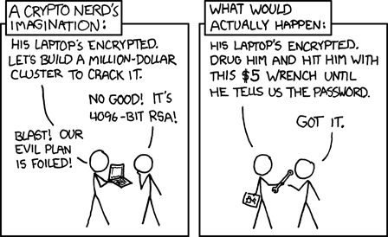
Lecture 7: Public-Key Encryption
CS 138 Spring 2026
Notes:
Liger cub: cross between lion and tiger
Asymmetric encryption uses big integers, not byte arrays
in theory could use block modes like with symmetric encryption in practice, that's too inefficient...
big integer operations are slow, say, 1 to 3 orders of magnitude slower than block ciphers

Slide 2
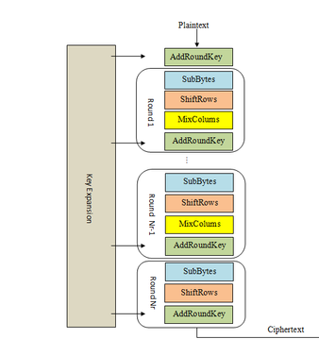
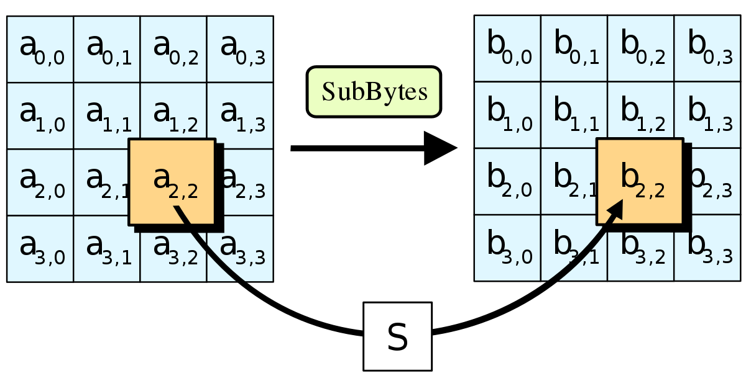
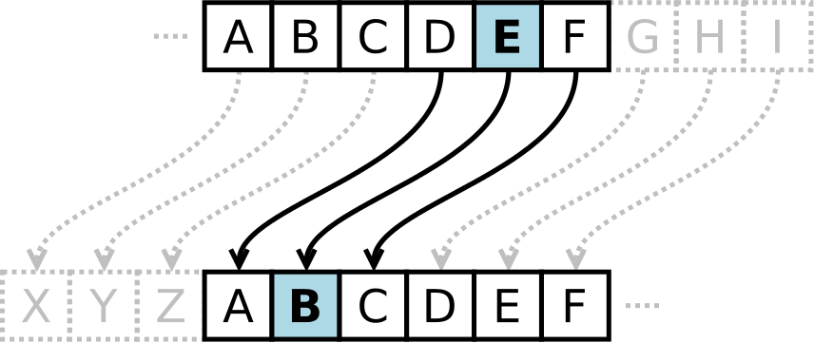
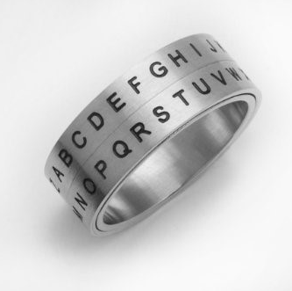
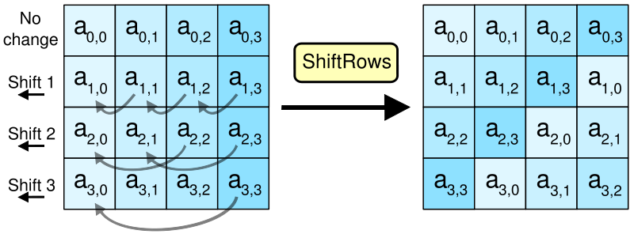
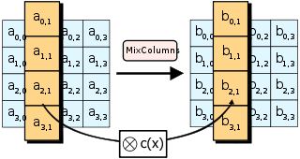
Crypto Thus Far…
Notes:
The problem: too many keys (n^2), no good transportation mechanism

Slide 3
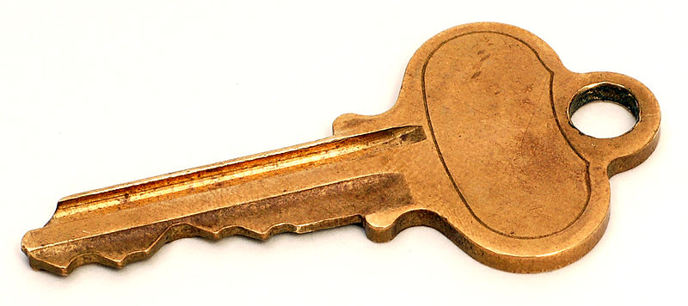

Key pairs
Instead of sharing a key between pairs of principals...
...every principal has a pair of keys
  public key: published for the world to see
  private key: kept secret and never shared

Slide 4
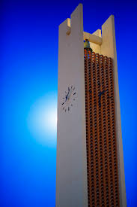
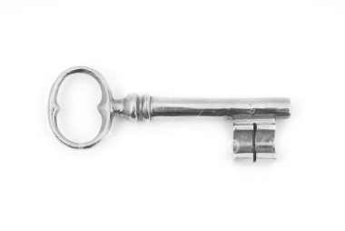



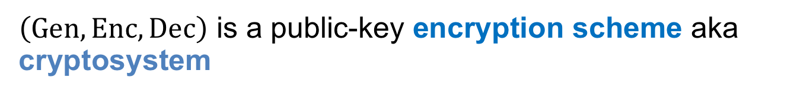
(Public-Key) Encryption algorithms
$Gen(1^{n})$: generate a keypair (pk, sk) of length n
$Enc(m;pk)$: encrypt message under public key pk
$Dec\left(c;sk\right)$: decrypt ciphertext c with secret key sk
Enc
Dec
$\left(Gen, Enc, Dec\right)$ is a public-key encryption scheme aka cryptosystem

Slide 5
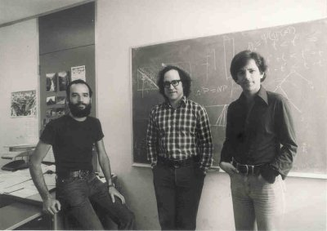
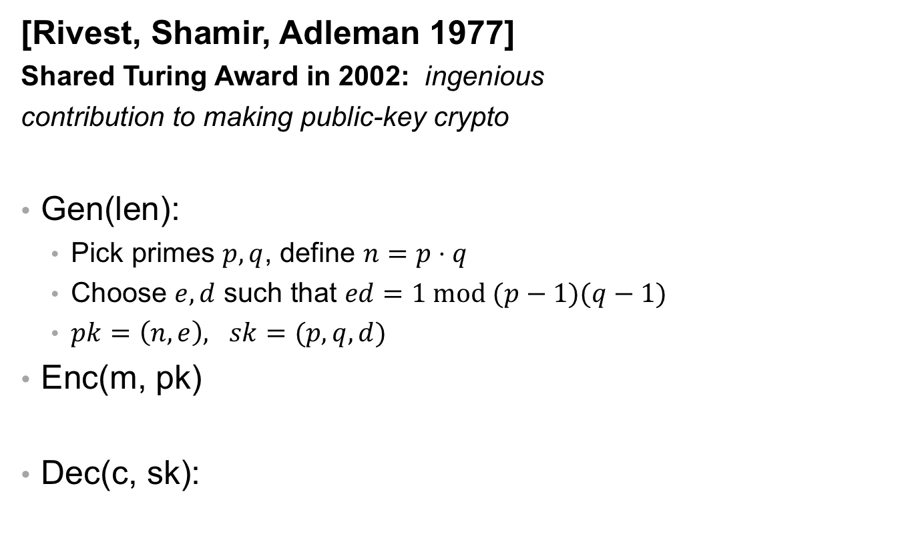


RSA
[Rivest, Shamir, Adleman 1977]
Shared Turing Award in 2002: ingenious
contribution to making public-key crypto
Gen(len):
  Pick primes $p,q$, define $n=p⋅q$
  Choose $e,d$ such that $ed=1 mod (p−1)(q−1)$
  $pk=\left(n, e\right), sk=(p,q, d)$
Enc(m, pk)
Dec(c, sk):
$$c=m^{e} mod n$$
$$m=c^{d} mod n$$
Notes:
size of modulus bounds size of keys and methods: usually 2048 bit (note: much bigger than AES keys!!!)
recommendations for strength summarized at https://www.keylength.com/en/
factoring n would break RSA (assumed to be hard) Largest challenge broken so far is 768-bit modulus [2010]
Shor's algorithm factors in polynomial time on a quantum computer: largest factorization so far is of the number 56153 (i.e., 16 bits); motivates work on post-quantum cryptography

Slide 6

Exercise 1: RSA
Let $pk=\left(n,e\right)= (21, 5)$ and $sk=\left(p, q, d\right)=(3, 7, 5)$
Observe that $ed=5⋅5=25=1 mod 12$
Compute $c= Enc(17;pk)$
Compute $Dec(c;sk)$
$$c= Enc\left(17;\left(21, 5\right)\right)={17}^{5} mod 21=1419857 mod 21=5$$
$$Dec\left(c;sk\right)= Dec\left(5;\left(3,7,5\right)\right)=5^{5} mod 21=3125 mod 21= 17$$

Slide 7


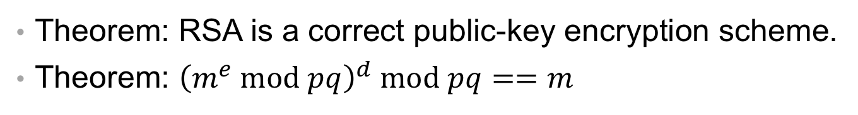











RSA
Theorem: RSA is a correct public-key encryption scheme.
Theorem: ${\left(m^{e} mod pq\right)}^{d} mod pq==m$
$${Dec\left(Enc\left(m;pk\right);sk\right)= \left(m^{e} mod pq\right)}^{d} mod pq$$
$${= \left(m^{e}\right)}^{d} mod pq$$
$$={ m}^{ed} mod pq$$
$$=m mod pq$$
$$m^{ed} mod p=m^{1+k(p−1)(q−1)} mod p$$
$$m^{ed} mod q=m^{1+k(p−1)(q−1)} mod q$$
$$={ m^{1}⋅(m}^{p−1}) ^{k(q−1)} mod p$$
$$={ m^{1}⋅(m}^{q−1}) ^{k(p−1)} mod q$$
$$={ m⋅(m}^{p−1} mod p) ^{k(q−1)} mod p$$
$$={ m⋅(m}^{q−1} mod p) ^{k(p−1)} mod q$$
$$=m⋅\left(1\right) ^{k\left(q−1\right)} mod p$$
$$=m⋅\left(1\right) ^{k\left(p−1\right)} mod q$$
$$=m mod p$$
$$=m mod q$$
Notes:
8. Fermat's Little Theorem (Pierre de Fermat asserted, 1640, proof by Gottfried Leibniz, 1683, published by Leonhard Euler, 1736)
- note: technically this assumes that m is not a multiple of p or q, but if it is, both sides are 0
11. Chinese Remainder Theorem (Sun-tzu, 3rd century AD)

Slide 8
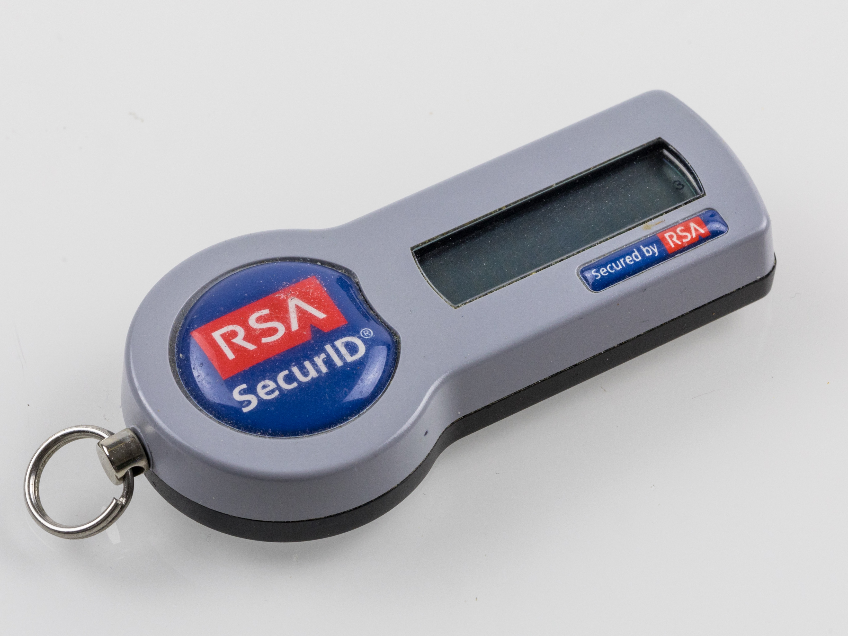
RSA
Theorem: RSA is a secure public-key encryption scheme.
Theorem: If factoring is hard, then RSA is a secure public-key encryption scheme.
SEEMS LEGIT

Slide 9

Problems with Textbook RSA
Insecure keys: There are known efficient attacks for some choices of e, d, p, q
pq is too small: $n=pq$ can be factored
small values of e: if you send the same message with multiple keys, plaintext message can be recovered
small values of e: if $m^{e}<n$ can compute log efficiently
small values of d: Boneh-Durfee attack for $d<n^{0.292}$
p or q is shared with other key: can compute gcd to factor
p similar to q: $n=pq$ can be efficiently factored
p or q are bad primes: $n=pq$ can be efficiently factored
gcd(e, lcm(p-1,q-1)) > 1:
make sure n is 2048 bits
e = 65537
use high-quality randomness
use a good library, don't implement RSA yourself!
Notes:
https://www.sjoerdlangkemper.nl/2019/06/19/attacking-rsa/

Slide 10
Problems with Textbook RSA
Insecure keys: There are known efficient attacks for some choices of e, d, p, q
Deterministic: given same plaintext and key, always produces the same ciphertext

Slide 11
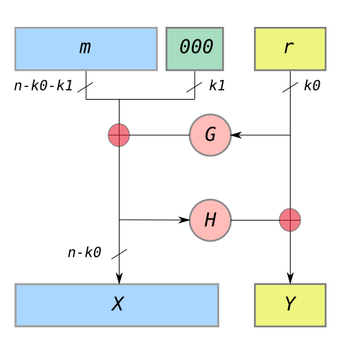
Solution 1: Padding
PKCS#1 v1.5: 0x00 0x02 [non-zero bytes] 0x00 [message]
  Vulnerable to a padding oracle attack!
OAEP (Optimal Asymmetric Encryption Padding)
  Security proof (with assumptions)

Slide 12
Exercise 2: OAEP
Define a function in C to compute m given values X and Y, bitlengths k0 and k1, and hash functions G and H
extract_m(X, Y){
r = H(X)^Y;
m' = X^G(r);
m = m' >> k1;
return m;
}

Slide 13
Problems with Textbook RSA
Insecure keys: There are known efficient attacks for some choices of e, d, p, q
Deterministic: given same plaintext and key, always produces the same ciphertext
Big numbers: if m > n, can't compute do math mod n

Slide 14

Solution 2: Hybrid encryption
Assume:
  Symmetric encryption scheme (Gen_SE, Enc_SE, Dec_SE)
  Public-key encryption scheme (Gen_PKE, Enc_PKE, Dec_PKE)
Use public-key encryption to establish a shared session key
  Avoids quadratic problem, assuming existence of phonebook
  Avoids problem of key distribution
Use symmetric encryption to exchange long plaintext encrypted under session key
  Gain efficiency of block cipher and mode
Notes:
Liger cub: cross between lion and tiger
Asymmetric encryption uses big integers, not byte arrays
in theory could use block modes like with symmetric encryption in practice, that's too inefficient...
big integer operations are slow, say, 1 to 3 orders of magnitude slower than block ciphers

Slide 15


Protocol to exchange encrypted message
m
0. B: (pk_B, sk_B) = Gen_PKE(len_PKE)
publish (B, pk_B)
1. A: k_s = Gen_SE(len_SE)
c1 = Enc_PKE(k_s; pk_B)
c2 = Enc_SE(m; k_s)
2. A -> B: c1, c2
3. B: k_s = Dec_PKE(c1; sk_B)
m = Dec_SE(c2; k_s)

Slide 16
Session keys
If key compromised, only those messages encrypted under it are disclosed
Used for a brief period then discarded
  cryptoperiod: length of time for which key is valid
  in this case, for a single (long) message
  not intended for reuse in future messages
only intended for unidirectional usage:
    A->B, not B->A
Notes:
Why only one way? A chose the key, not B

Slide 17
Problems with Textbook RSA
Insecure keys: There are known efficient attacks for some choices of e, d, p, q
Deterministic: given same plaintext and key, always produces the same ciphertext
Big numbers: if m > n, can't compute do math mod n
Side channel attacks: interfaces can leak information about secret key

Slide 18
Square-and-Multiply
int modular_exp(x, n, p){
res = 1;
while (n > 0) {
if (n % 2 == 1){
res = res * x % p;
}
x = x^2 % p;
n >> 1;
}
return res;
}

Slide 19

Exercise 3: Square-and Multiply
Compute $3^{5} mod 21$ using square and multiply
int modular_exp(x, n, p){
res = 1;
while (n > 0) {
if (n % 2 == 1){
res = res * x % p;
}
x = x^2 % p;
n >> 1;
}
return res;
}
res = 1 x = 3 n = 5
res = 3 x = 9 n = 2
res = 3 x = 18 n = 1
res = 12 x = 9 n = 0

Slide 20
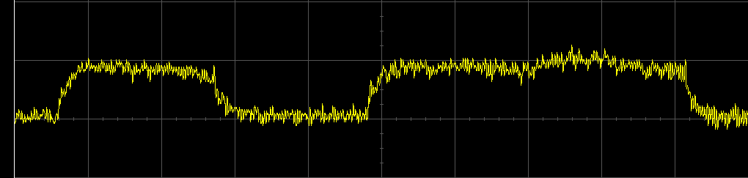
Side Channels
Power
Timing
EM Radiation
Acoustics

Slide 21
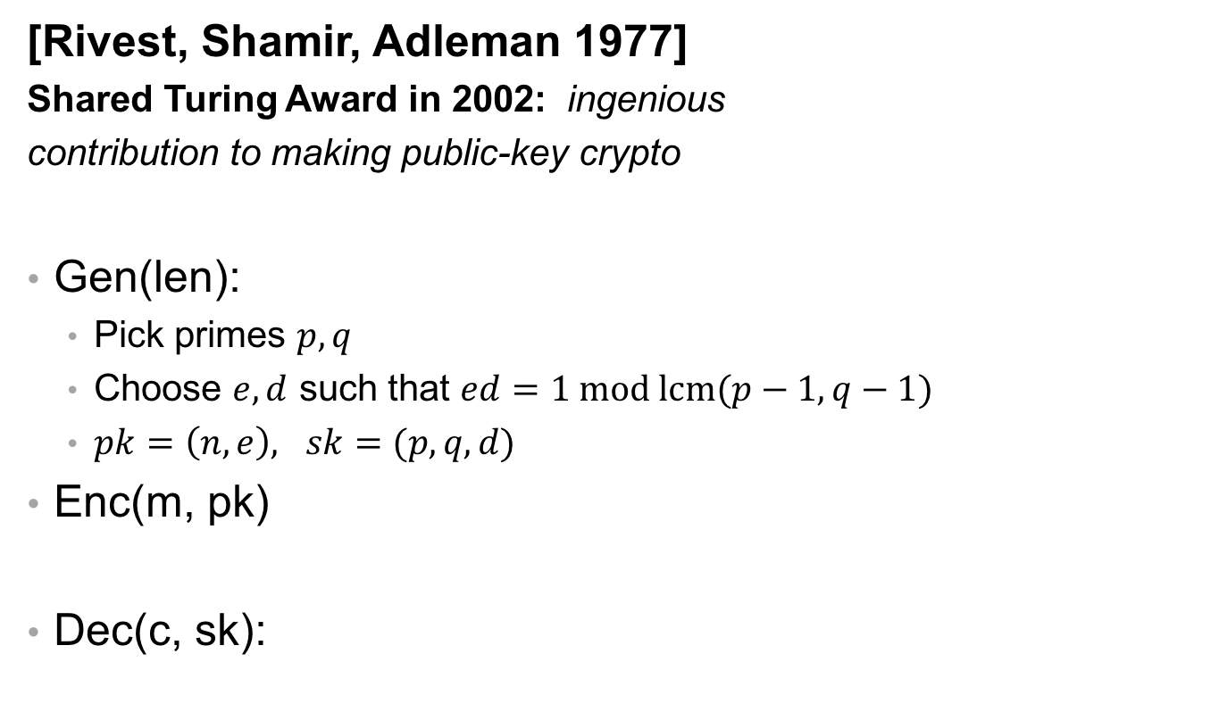
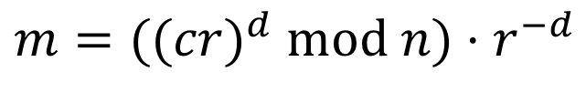
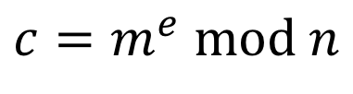
Solution 3: Blinded RSA
[Rivest, Shamir, Adleman 1977]
Shared Turing Award in 2002: ingenious
contribution to making public-key crypto
Gen(len):
  Pick primes $p,q$
  Choose $e,d$ such that $ed=1 mod lcm(p−1, q−1)$
  $pk=\left(n, e\right), sk=(p,q, d)$
Enc(m, pk)
Dec(c, sk):
$$c=m^{e} mod n$$
$$m={((cr)}^{d} mod n)⋅r^{−d}$$
Notes:
size of modulus bounds size of keys and methods: usually 2048 bit (note: much bigger than AES keys!!!)
recommendations for strength summarized at https://www.keylength.com/en/
factoring n would break RSA (assumed to be hard) Largest challenge broken so far is 768-bit modulus [2010]
Shor's algorithm factors in polynomial time on a quantum computer: largest factorization so far is of the number 56153 (i.e., 16 bits); motivates work on post-quantum cryptography

Slide 22
Problems with Textbook RSA
Insecure keys: There are known efficient attacks for some choices of e, d, p, q
Deterministic: given same plaintext and key, always produces the same ciphertext
Big numbers: if m > n, can't compute do math mod n
Side channel attacks: interfaces can leak information about secret key
Key Management: secure storage and authentication

Slide 23
Solution 4: Key Management
Store private keys offline
Store private keys in protected files
PKI infrastructure to authenticate public keys
Use another solution
  PBE: Memorize the keys (sort of)
  DH: Generate shared keys on the fly

Slide 24
Password-Based Encryption
PBKDF2: Password-based key derivation function [RFC 8018]
Output: derived key k
Input:
  Password p
  Salt s
  Iteration count c
  Key length len
  Pseudorandom function (PRF): "looks random" to an adversary that doesn't know an input called the seed (commony instantiated with an HMAC)

Slide 25
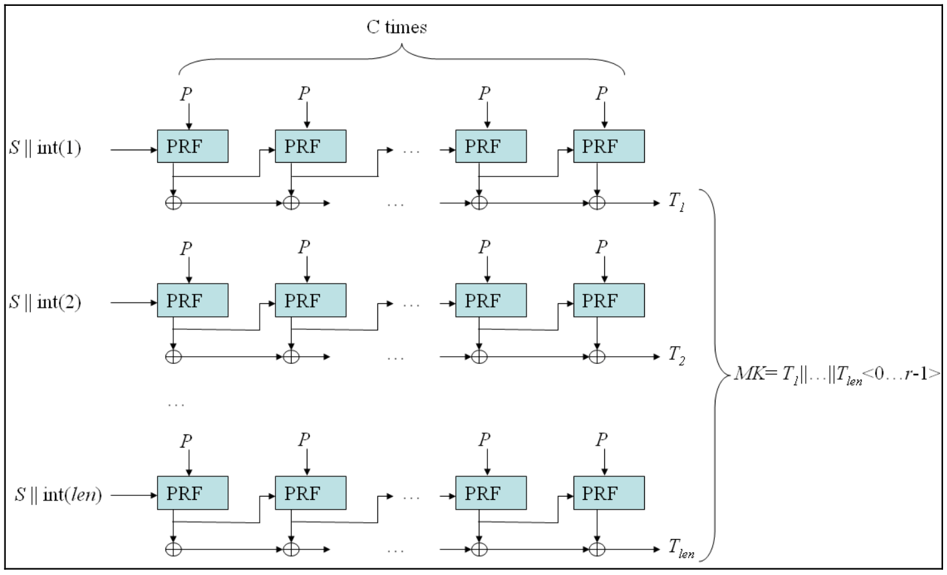
PBKDF2
Algorithm:
F(p, s, i, c) = U(1) XOR ... XOR U(c)
  U(1) = PRF(s, i; p)
  U(j) = PRF(U(j-1); p)
  F is in essence a salted iterated hash...
k = F(p, s, 1, c) || F(p, s, 2, c) || ... || F(p, s, n, c)
  enough copies to reach keylen
  || denotes bit concatenation
Notes:
Could use to store passwords
F(p,s,c,1) is essentially what we agreed to store for salted and iterated-hash protected passwords
But easier to attack speed than scrypt/bcrypt
Note: Argon2 also key derivation, but less standard

Slide 26
Problems with Textbook RSA
Insecure keys: There are known efficient attacks for some choices of e, d, p, q
Deterministic: given same plaintext and key, always produces the same ciphertext
Big numbers: if m > n, can't compute do math mod n
Side channel attacks: interfaces can leak information about secret key
Key Management: key storage and authentication
Quantum Computers: provably breakable with different hardware

Slide 27
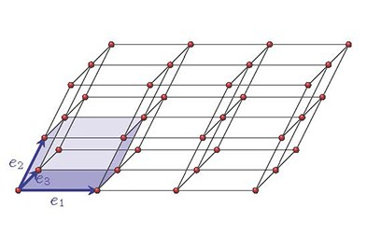
Solution 5: Post-Quantum Cryptography

Slide 28
Public Key Encryption

