Slide 1
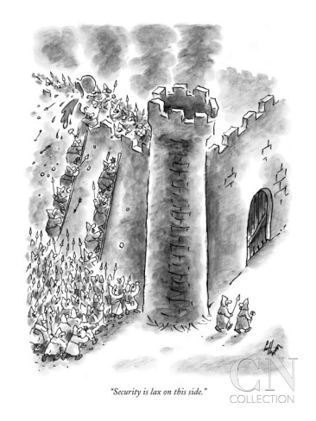
Lecture 4: Principles of Security
CS 138 Spring 2026

Slide 2
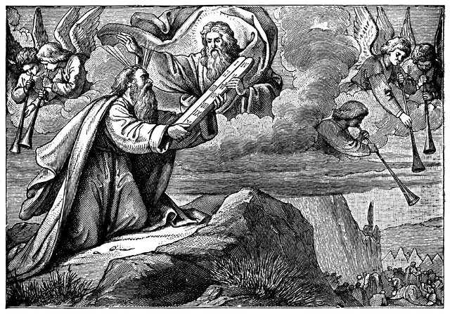


Assurance
Security = does what it should + nothing more
This should be accompanied by an assurance argument, which is some compelling basis to believe the system is secure.
The set of system components that you have to trust in order for your security goals to be satisfied is called the Trusted Computing Base (TCB)
Axiomatic Trust
Analytic Trust
Synthetic Trust

Slide 3
Principles of Prevention
[Saltzer and Schroeder, The Protection of Information in Computer Systems, 1975]
Economy of Mechanism
Complete Mediation
Least Privilege
Separation of Privilege
Failsafe Defaults
Defense in Depth
Open Design
Psychological Acceptability
Notes:
Danger of seeming too abstract

Slide 4
Principle: Economy of Mechanism
Prefer mechanisms that are simpler and smaller
Easier to construct, understand, analyze
Hence less likely to have unknown vulnerabilities
TCB should be small
Notes:
prefer synthetic
prefer separation of policy from mechanism

Slide 5
Assumptions
Attacker cannot replace/modify mechanism
Web
Browser (Client)
Enter
Username
&
Password
Web
Server
SELECT *
FROM Users
WHERE user='me' AND pwd='1234'
DB
What if user = “ ' or 1=1 -- ”
Notes:
config files/pwd files, CFG example – Integrity of mechanism
filevault example - https://www.theregister.com/2016/12/16/apple_left_filevault_open/

Slide 6
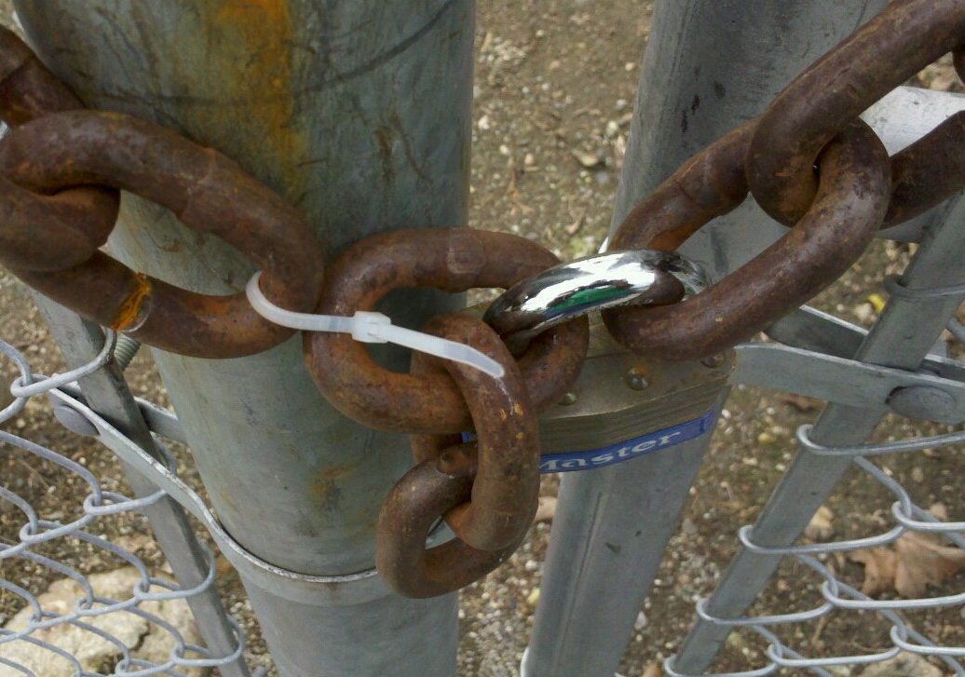
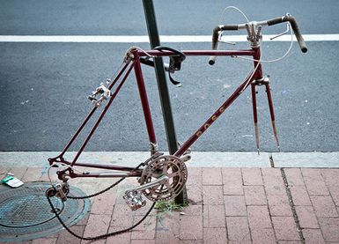
Assumptions
Attacker cannot replace/modify mechanism
Attacker cannot circumvent mechanism
Notes:
config files/pwd files, CFG example – Integrity of mechanism
filevault example - https://www.theregister.com/2016/12/16/apple_left_filevault_open/

Slide 7
Enforcement Mechanisms
Attacker
Vulnerability
Execute Instructions
An enforcement mechanism must either
prevent the execution of those instructions or
eliminate or mitigate the effects of those instructions
Possible approaches to enforcement:
Isolation
Monitoring

Slide 8
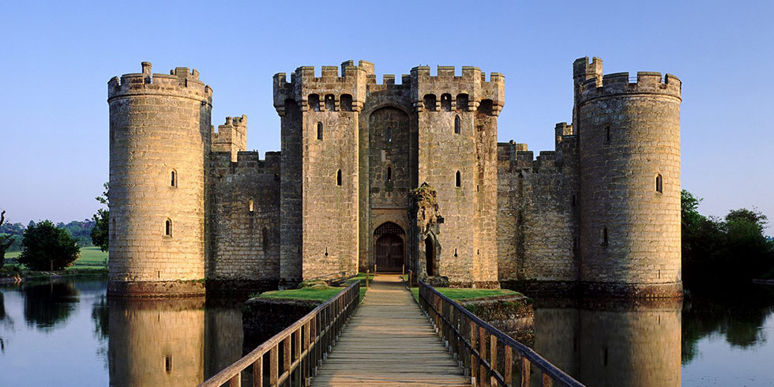
Isolation
Key idea: prevent or restrict the ability of one principal to influence execution by another
Notes:
if we restrict ability of attackers to communicate with their targets, then we block attacks because (by definition) they need influence execution to execute the attack

Slide 9
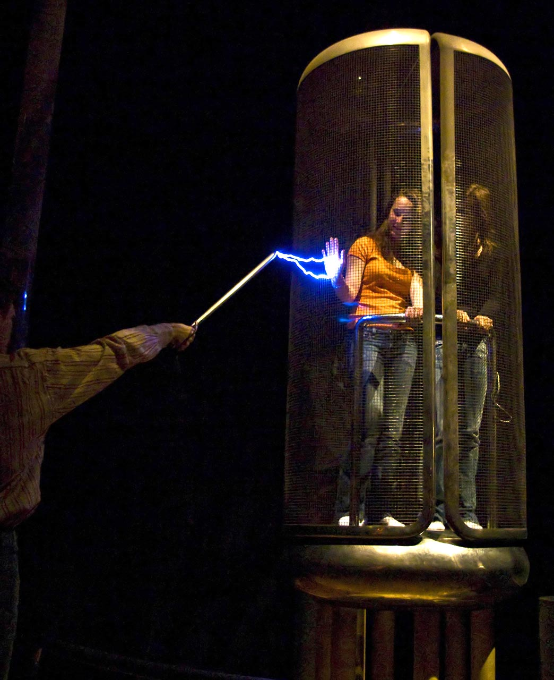
Isolation: Physical Isolation
A Faraday cage is an enclosure made of conductive material or mesh
The external electrical field causes electric charges to be distributed in a way that cancels out the field's effect on the interior
This effectively blocks any sort of electromagnetic radiation
US gov/military use rooms inside Faraday cages, called SCIFs, to hold classified meetings
Notes:
SCIF = sensitive compartmented information facility

Slide 10
Isolation: Virtual Machines
A virtual machine behaves as if it were an isolated computer despite other execution on the underlying hardware
A hypervisor implements virtual machines that have the same instruction set as the underlying hardware
OS
OS
OS
OS
OS
Hypervisor
OS
Hardware

Slide 11
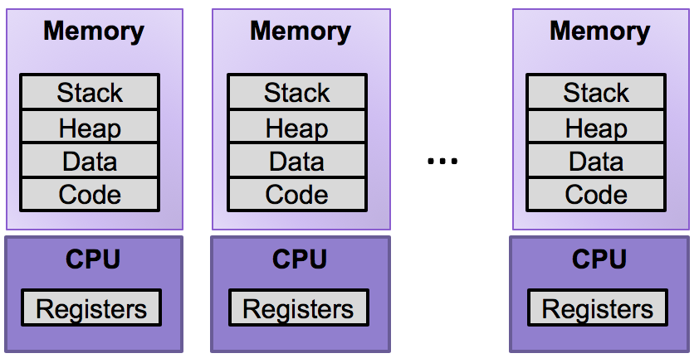
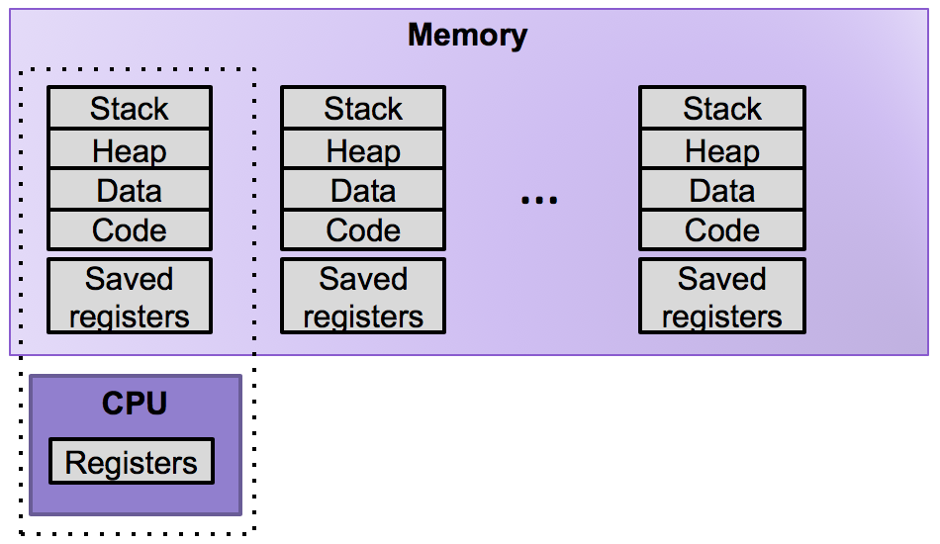
Isolation: Processes
The OS kernel multiplexes the actual processor and creates a set of processes
Each process executes in its own isolated address space
Kernel-supported instructions provide access to system services and shared resources
Illusion
Reality

Slide 12

Isolation: Sandboxes
A sandbox runs an application in a restricted environment
Example: in Chrome, the entire HTML rendering and JavaScript execution is sandboxed (cannot access files or windows outside the current job, cannot read/write to clipboard)
Notes:
chromium.googlesource.com/chromium/src/+/master/docs/design/sandbox.md

Slide 13
Partial Isolation: Firewalls
Idea: just enough isolation to block communications used for attacks
A firewall interrupts the connection from some group of computers to some network
It is configured to pass only certain messages (e.g., those to specific ports or from particular sources)

Slide 14
Partial Isolation: Code Signing
Only code that is digitally signed by a trusted principal is allowed to execute
Example: Microsoft Authenticode protects against web pages containing malicious executable content by only allowing downloaded content to be executed if it was produced by Microsoft or a Microsoft-approved software provider

Slide 15

Monitoring
Key idea: monitor a set of interfaces and halt malicious execution before any damage is done
a security policy that describes acceptable sequences of operations
a reference monitor that receives control whenever operations are requested
a means by which the reference monitor can block further execution that does not comply with the policy
Code
Code

Slide 16
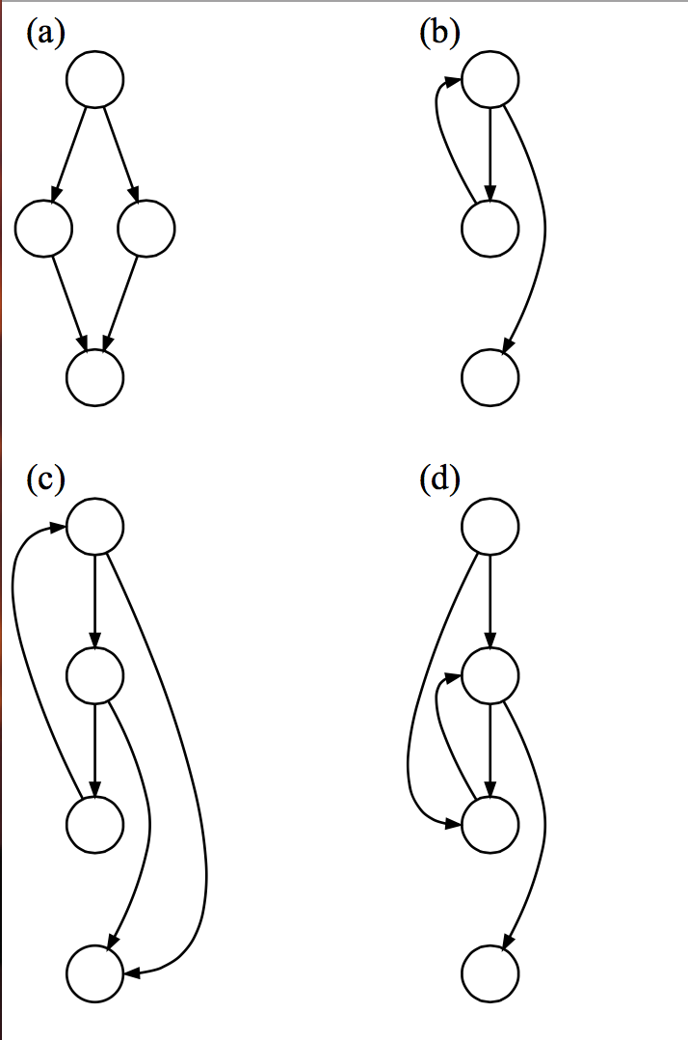
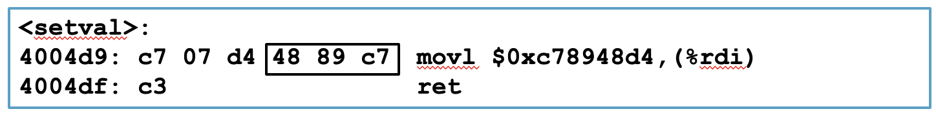
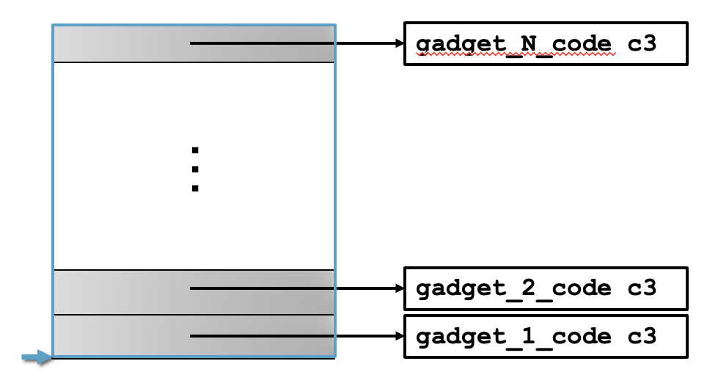
Monitoring: Control Flow Integrity

Slide 17
Monitoring: Control Flow Integrity
Code
Code

Slide 18
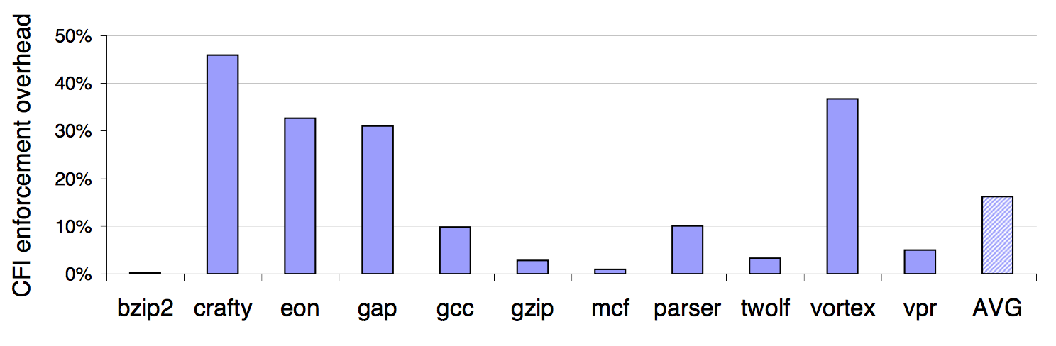
Monitoring: CFI Overhead

Slide 19
Monitoring: Control Flow Guard
Approximate CFI implementation introduced in Windows 8.1
Jump is valid if it beginning of function
Granularity: 8 bytes
Check implemented as bitmap
Code
Code

Slide 20


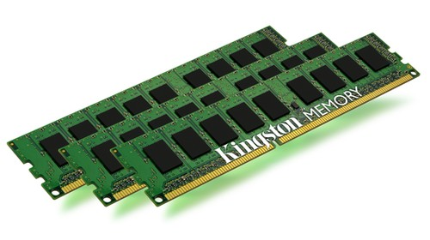
Monitoring: Address Translation
Stack
NULL page or
access not allowed
SegFault
page#
offset
vaddr
MMU
Heap
page table
Invalid page
Data
v | Frame | Access
1 | 47 | R,W
0 | NULL | R,W
0 | 13 | R,W
1 | 42 | R,X
Page Fault
Code
paddr =
Frame[page#]
offset
…
Data
Notes:
Define MMU

Slide 21
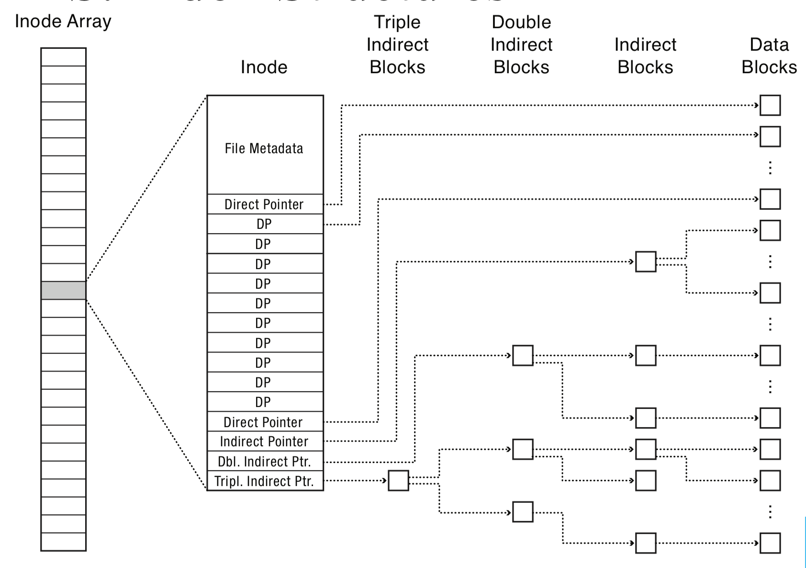
Monitoring: File Access Control
inode for each file stores permission bits (r, w, x)
Operating system enforces access control when file is is opened
Error if principal is not authorized

Slide 22
Principle: Complete Mediation
Every operation requested by a principal must be intercepted and determined to be acceptable according to the security policy
Component that does the interception and determination is the reference monitor
Restricts caching of information, including previous decisions

Slide 23
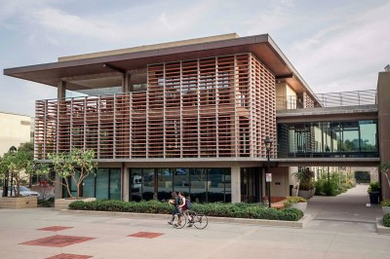
Exercise 1: Complete Mediation
Consider the security mechanisms
deployed in your dorm.
These systems are designed to
prevent access by unauthorized
people.
To what extent do those security features enforce Complete Mediation?

Slide 24
Principle: Least Privilege
Principals should be given the minimum privileges necessary to accomplish their task
Limits the damage that can result from accident or malice
Cf. "need to know"
Notes:
Examples:
Valet key
Normal users can't write to most system files, but root can
Web server can read files only from certain directories, not others

Slide 25
Exercise 2: Least Privilege
Consider the security mechanisms
deployed on campus.
These systems are designed to
prevent access by unauthorized
people.
To what extent do those security features enforce Least Privilege?

Slide 26
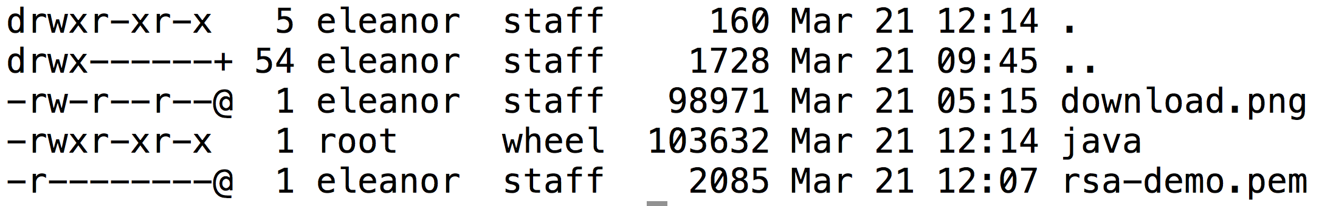
Principle: Separation of Privilege
Different operations should require different privileges
Disseminate privileges for an operation amongst multiple principals (Separation of Duty)
Notes:
Examples:
r,w,x are separate privileges on Unix file systems
Examples:
Company checks that must be counter-signed by two officers
Missile launch systems that require two keys

Slide 27

Principle: Failsafe Defaults
Base decisions on the presence of privilege, not the absence of prohibition
The default answer is "no"
Say "yes" only when there is an explicit reason to do so
Principals who discover they don't have access will complain
Attackers who discover they do have access won't complain!

Slide 28
Principle: Defense in Depth
Prefer a set of complementary mechanisms over a single mechanism
Complementary:
Independent: attack that compromises one mechanism is unlikely to compromise others
Overlapping: attacks must compromise multiple mechanisms to succeed
Notes:
Examples:
Your bank might use both a password and a hardware token to authenticate customers.
Your apartment building might have multiple door locks and an electronic security system.
Your university IT department might use firewalls and virus scanners to prevent spread of malware.

Slide 29


Slide 30
Exercise 3: Defense in Depth
Consider the security mechanisms
deployed on campus.
These systems are designed to
prevent access by unauthorized
people.
To what extent do those security features satisfy the overlapping requirement of Defense in Depth?
How could the security features be modified to add defense in depth if it does not already exist?

Slide 31

Principle: Open Design
Security shouldn't depend upon the secrecy of design or implementation
/* efdtt.c Author: Charles M. Hannum <root@ihack.net> */
#define m(i)(x[i]^s[i+84])<<
unsigned char x[5],y,s[2048];main(n){for(read(0,x,5);read(0,s,n=2048);write(1,s
,n))if(s[y=s[13]%8+20]/16%4==1){int i=m(1)17^256+m(0)8,k=m(2)0,j=m(4)17^m(3)9^k
*2-k%8^8,a=0,c=26;for(s[y]-=16;--c;j*=2)a=a*2^i&1,i=i/2^j&1<<24;for(j=127;++j<n
;c=c>y)c+=y=i^i/8^i>>4^i>>12,i=i>>8^y<<17,a^=a>>14,y=a^a*8^a<<6,a=a>>8^y<<9,k=s
[j],k="7Wo~'G_\216"[k&7]+2^"cr3sfw6v;*k+>/n."[k>>4]*2^k*257/8,s[j]=k^(k&k*2&34)
*6^c+~y;}}
Notes:
DVDs were protected by the Content Scrambling System (CSS), a proprietary encryption scheme meant to protect DVDs from copying. Details of the algorithm were kept secret and revealed only to licensees (who paid money, signed contracts, hence could be held legally responsible). But in 1999 a group in Norway reverse engineered the algorithm. The code here is shortest known C decryption algorithm for it. These days Blu Ray is protected by AES, an openly designed algorithm.

Slide 32
Principle: Open Design
Security shouldn't depend upon the secrecy of design or implementation
Arguments for open design:
Secrets eventually come out: reverse engineering is possible, employees move around
Making details public increases chance of identifying and repairing vulnerabilities

Slide 33
Principle: Open Design
Security shouldn't depend upon the secrecy of design or implementation
Arguments against open design:
Secrecy supports Defense in Depth by making it harder to find vulnerabilities
Lack of hard evidence that Linus' Law really holds ("given enough all eyeballs, all bugs are shallow")
After identification, some vulnerabilities cannot quickly or easily be repaired
Notes:
"Maybe the eyeballs aren't looking"

Slide 34
Exercise 4: Defense in Depth
Consider the security mechanisms
deployed on campus.
To what extent do these defenses
implement open design?

Slide 35
Countermeasures
A defense that protects against attacks by neutralizing either the threat or vulnerability involved
Strategy:
Prevent: block attack or close vulnerability
Deter: make attack harder
Deflect: make other targets more attractive
Mitigate: make harm less severe
Detect: as it happens or after the fact
Recover: undo harm
Prevention
Risk Management
Deterrence through Accountability
Notes:
Prevention is most of what we do here
But it's not a 100% achievable goal
We don't have the technical means.
Formal verification still doesn't scale well enough
Exhaustive testing isn't feasible
We largely don't know how to defend against unknown attacks
We can't control people adequately (they make mistakes, ...)
Risk management seems sensible and more achievable.
Focus on paying as little as possible for as much security as possible
Buy insurance for any residual risk
But it requires making rational investments, which requires quantitative calculations; we don't have the numbers
How to value C? I? A?
How to reason about low-probability events? (Humans are bad—overestimate Pr of unlikely+bad events they haven't experienced)
Actuarial models can't be constructed; not enough data about attacks, cost to recover, probability of them, etc.
No one wants to release this data for themselves; undermines trust in them!
Metrics for cybersecurity just don't exist
Accountability treats security through the lens of crime.
Must be able to perform forensics, identify perpetrators, prosecute. Each is problematic.
Forensics are difficult for the same reasons prevention is, though there is a body of art/science one can learn
Attributing actions of machines to actions of humans is complicated and demands a tradeoff between confidentiality/privacy and that attribution. Policy makers tend to underestimate that tradeoff.
Prosecution requires cooperation across jurisdictions, possibly international with very different local laws.

Slide 36
Principles of Security

