Slide 1
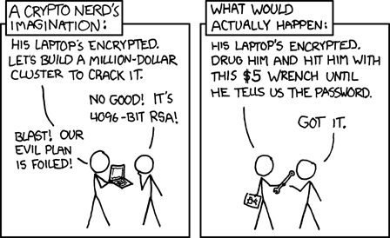
Lecture 3: Assurance
CS 138 Spring 2026
Notes:
Last time: lots of vulnerabilities. So how to we build secure systems?

Slide 2
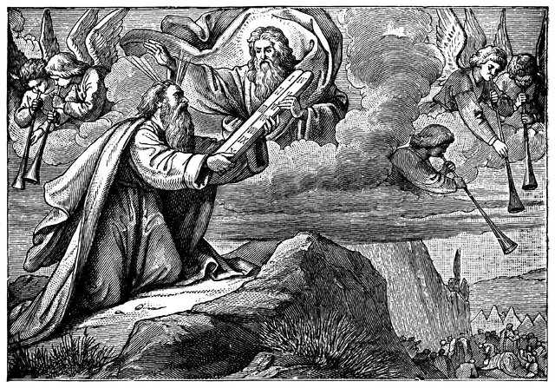

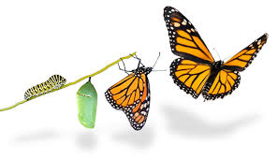
Bases for Trust
Axiomatic Trust
Analytic Trust
Synthetic Trust
Axiomatic Trust: Trust derived from beliefs that we accept on faith. We might trust some hardware or software, for example, because it is built or sold by a given company. We are putting our faith in the company's reputation.
Analytic Trust: Trust derived from testing and/or reasoning to justify conclusions about what a component or system will and/or will not do. Trust in an artifact is justified by trust in some method of analysis.
Synthetic Trust: Trust derived from modification of the system. Trust in the whole derives from how components are combined. Examples: OS isolation, reference monitors, firewalls reputation.

Slide 3
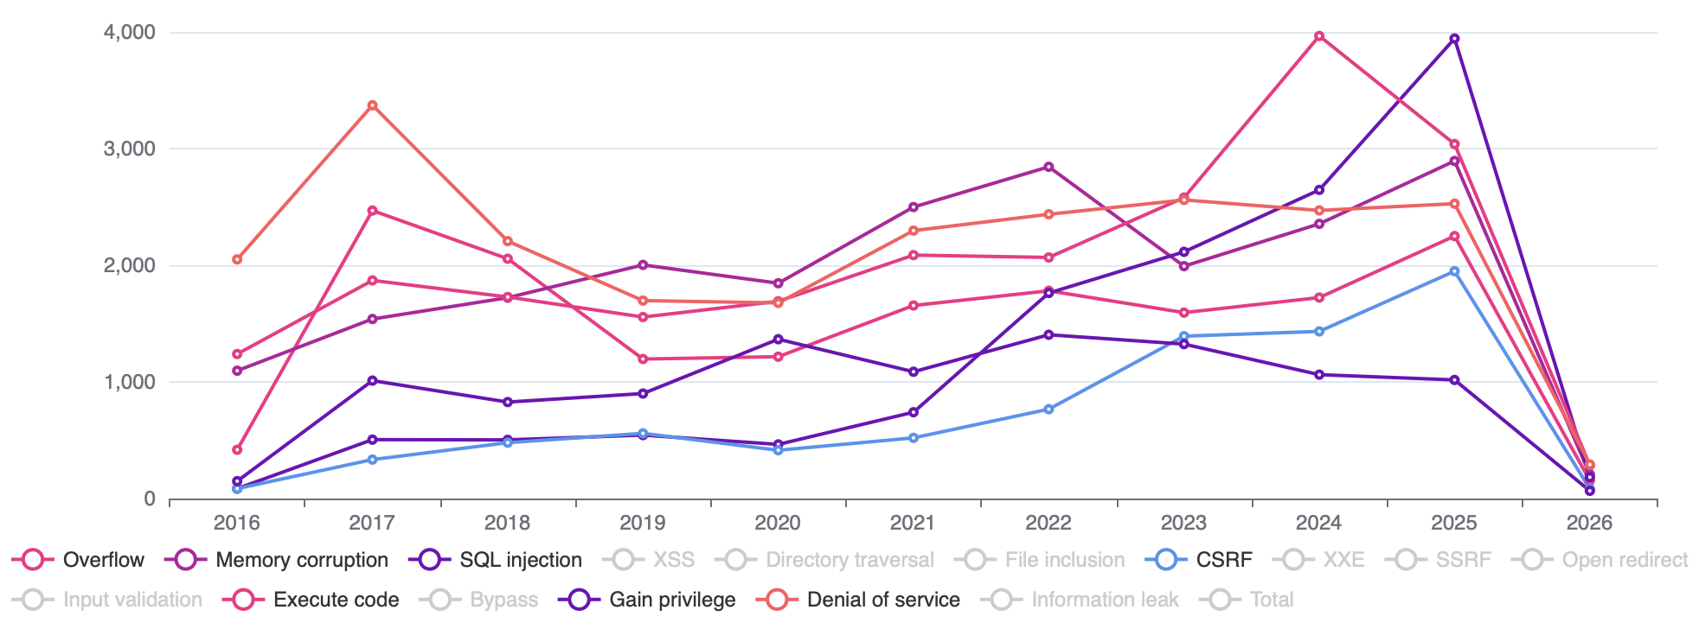
Vulnerabilities by Year
Notes:
https://www.cvedetails.com/vulnerabilities-by-types.php

Slide 4
Bases for Trust
Axiomatic Trust
Analytic Trust
Synthetic Trust
Axiomatic Trust: Trust derived from beliefs that we accept on faith. We might trust some hardware or software, for example, because it is built or sold by a given company. We are putting our faith in the company's reputation.
Analytic Trust: Trust derived from testing and/or reasoning to justify conclusions about what a component or system will and/or will not do. Trust in an artifact is justified by trust in some method of analysis.
Synthetic Trust: Trust derived from modification of the system. Trust in the whole derives from how components are combined. Examples: OS isolation, reference monitors, firewalls reputation.

Slide 5
Testing
Goal is to expose existence of faults, so that they can be fixed
  Unit testing: isolated components
  Integration testing: combined components
  System testing: functionality, performance, acceptance
When do you stop testing?
  Bad answer: when you run out of time
  Bad answer: what all tests pass
  Better answer: when methodology is complete (code coverage, paths, boundary cases, etc.)

Slide 6
Penetration testing
Experts attempt to attack
  Internal vs. external
  Overt vs. covert
Typical vulnerabilities exploited:
  Passwords (cracking)
  Buffer overflows
  Bad input validation
  Race conditions / TOCTOU
  Filesystem misconfiguration
  Kernel flaws

Slide 7
Fuzz testing
Generate random inputs and feed them to programs:
  Crash? hang? terminate normally?
Of ~90 utilities in '89, crashed about 25-33% in various Unixes
  Results have been repeated for Windows, Mac OSX
  Results keep getting worse in GUIs but better on command line
Since then, "fuzzing" has become a standard practice for security testing
How to generate random inputs:
  Use grammar to generate inputs
  Or randomly mutate good inputs in small ways
    especially for testing of network protocols
Notes:
[Barton Miller, 1989, 2000, 2006]
Literally was a dark and stormy night: noise on telephone line was inserting random character into shell session, causing Unix utilities to crash

Slide 8
Type Checking
public class Main {
public static void main(String[] args) {
String s = 5;
System.out.println(s);
}
}
$ javac Main.java
Main.java:3: error: incompatible types: int cannot be converted to String
String s = 5;
^
1 error

Slide 9
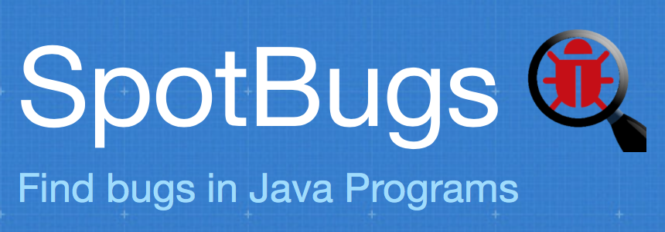
SpotBugs
Looks for patterns in code that are likely faults and that are likely to cause failures
Categorizes and prioritizes bugs for presentation to developer

Slide 10
Formal Verification
prove program is correct with respect to some formal specification
Examples: seL4, CompCert
Problems: correctness of specification, scale

Slide 11
Bases for Trust
Axiomatic Trust
Analytic Trust
Synthetic Trust
Axiomatic Trust: Trust derived from beliefs that we accept on faith. We might trust some hardware or software, for example, because it is built or sold by a given company. We are putting our faith in the company's reputation.
Analytic Trust: Trust derived from testing and/or reasoning to justify conclusions about what a component or system will and/or will not do. Trust in an artifact is justified by trust in some method of analysis.
Synthetic Trust: Trust derived from modification of the system. Trust in the whole derives from how components are combined. Examples: OS isolation, reference monitors, firewalls.

Slide 12
Engineering Countermeasures
Attacks
are perpetrated by
threats
that inflict
harm
by exploiting
vulnerabilities
which are controlled by
countermeasures.

Slide 13
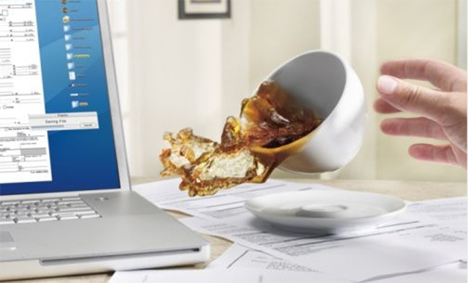
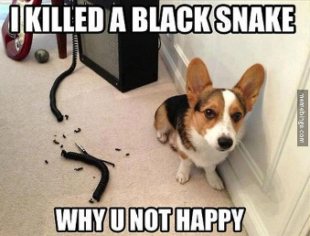
Threats
A principal that has potential to cause harm to assets
Adversary or attacker: a human threat, motivated and capable
Sometimes humans aren't malicious: accidents happen
Sometimes non-humans cause harm: floods, earthquakes, power outage, hardware failure

Slide 14
Threat Models
Identify threats of concern to system
  Especially malicious, human threats
  What kinds of attackers will system resist?
  What are their motivations, resources, and capabilities?
Best if analysis is specific to system and its functionality
Non threats?
  Trusted hardware
  Trusted environment (e.g., physically secured machine room reachable only by trustworthy system operators)

Slide 15
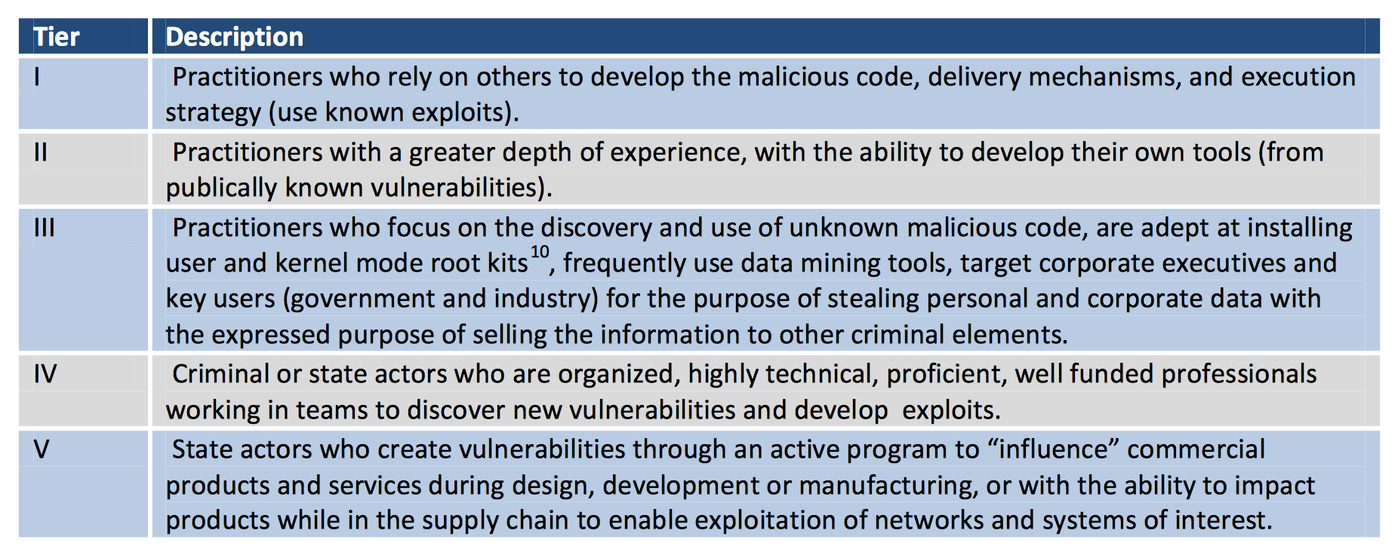
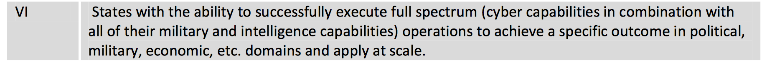
Threats (DSB)

Slide 16
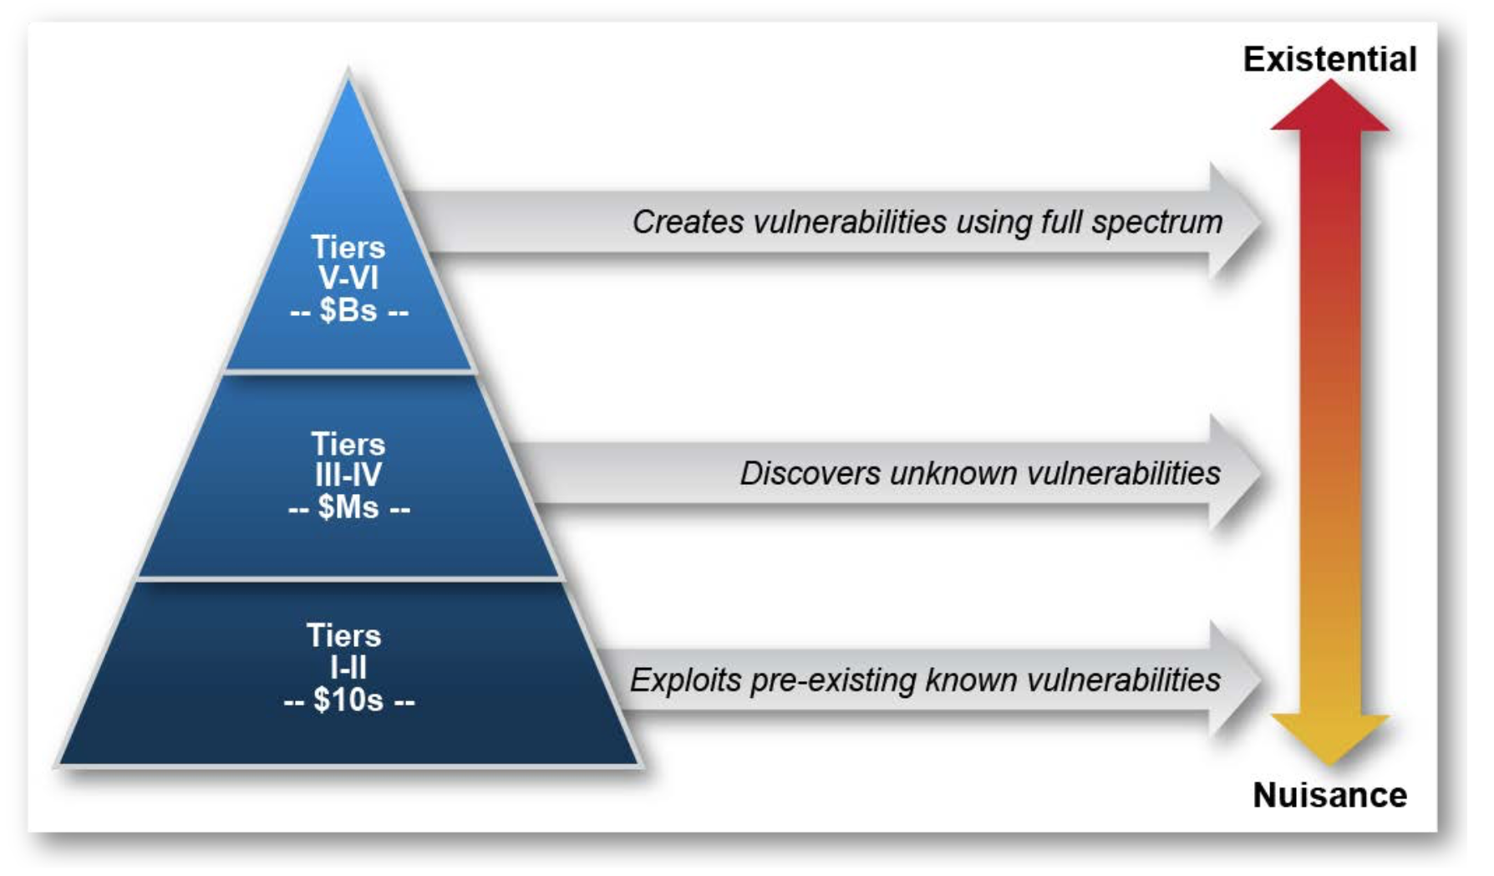
Threats (DSB)

Slide 17
Exercise 1: DSB Threat Model
For each of the following systems, how would you classify the threats that are likely to perpetrate attacks against that system using the DSB threat model?
  A game app
  A social network
  A classified government database

Slide 18
Threats (Motives)
Harm
Gain

Slide 19
Threats (Motives)
Inquisitive people, unintentional blunders
Hackers driven by technical challenges
Disgruntled employees or customers seeking revenge
Criminals interested in personal financial gain, stealing services, or industrial espionage
Organized crime with the intent of hiding something or financial gain
Organized terrorist groups attempting to influence policy by isolated attacks
Foreign espionage agents seeking to exploit information for economic, political, or military purposes
Tactical countermeasures intended to disrupt specific weapons or command structures
Multifaceted tactical information warfare applied in a broad orchestrated manner to disrupt major military missions
Large organized groups or nation states intent on overthrowing a government

Slide 20
Exercise 2: Motives Threat Model
For each of the following systems, how would you classify the threats that are likely to perpetrate attacks against that system according to their motives?
  A game app
  A social network
  A classified government database

Slide 21
Threats (Goals)
Type | Description | Counter
Spoofing | Accessing and using another user’s credentials, such as username and password. | Authentication
Tampering | Changing or modifying persistent data, such as records in a database, or alterating of data in transit over an network, such as the Internet. | Integrity
Repudiation | Performing prohibited operations in a system that lacks the ability to trace the operations. | Audit
Information disclosure | Reading a file that one was not granted access to, or reading data in transit. | Confidentiality
Denial of service | Denying access to valid users, such as making a web server temporarily unavailable or unusable. | Availability
Elevation of privilege | Gaining privileged access to resources in order to gain unauthorized access to information or to compromise a system. | Authorization
Notes:
https://owasp.org/www-community/Threat_Modeling_Process

Slide 22
Exercise 3: Goals Threat Model
Consider your favorite social network. What is one concrete example of a goal an adversary attacking that network might have for each of the following categories:
  Spoofing
  Tampering
  Repudiation
  Information disclosure
  Denial of Service
  Elevation of Privilege

Slide 23
Threats (Capabilities)
Physical access

Slide 24
Cold-boot attack
https://youtu.be/E6gzVVjW4yY

Slide 25
Threats (Capabilities)
Physical access
Software access
  disk access
  memory access
  privilege levels

Slide 26

CL0P Data Breach
Notes:
https://www.cisa.gov/news-events/cybersecurity-advisories/aa23-158a
https://cybernews.com/security/clop-publish-all-moveit-victim-ransom-data-clearweb/
https://www.theregister.com/2023/11/20/moveit_victim_77m_medical/

Slide 27

Heartbleed

Slide 28
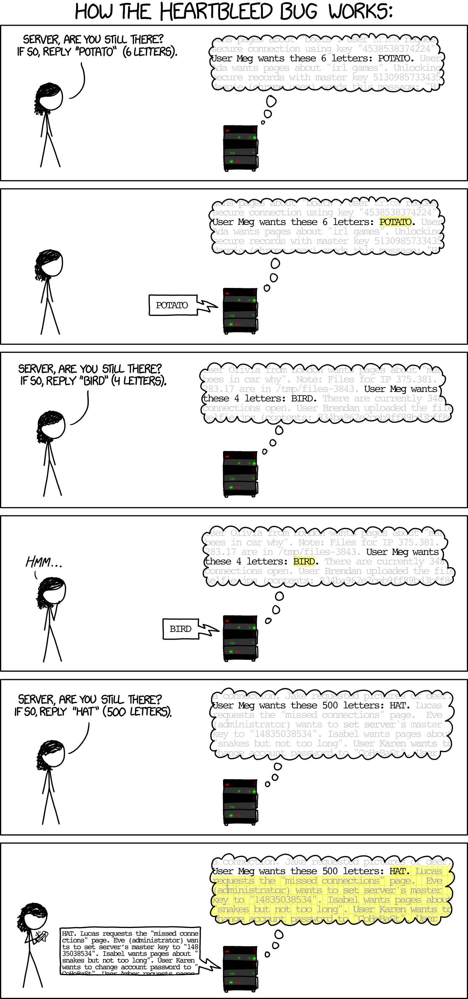
Heartbleed

Slide 29
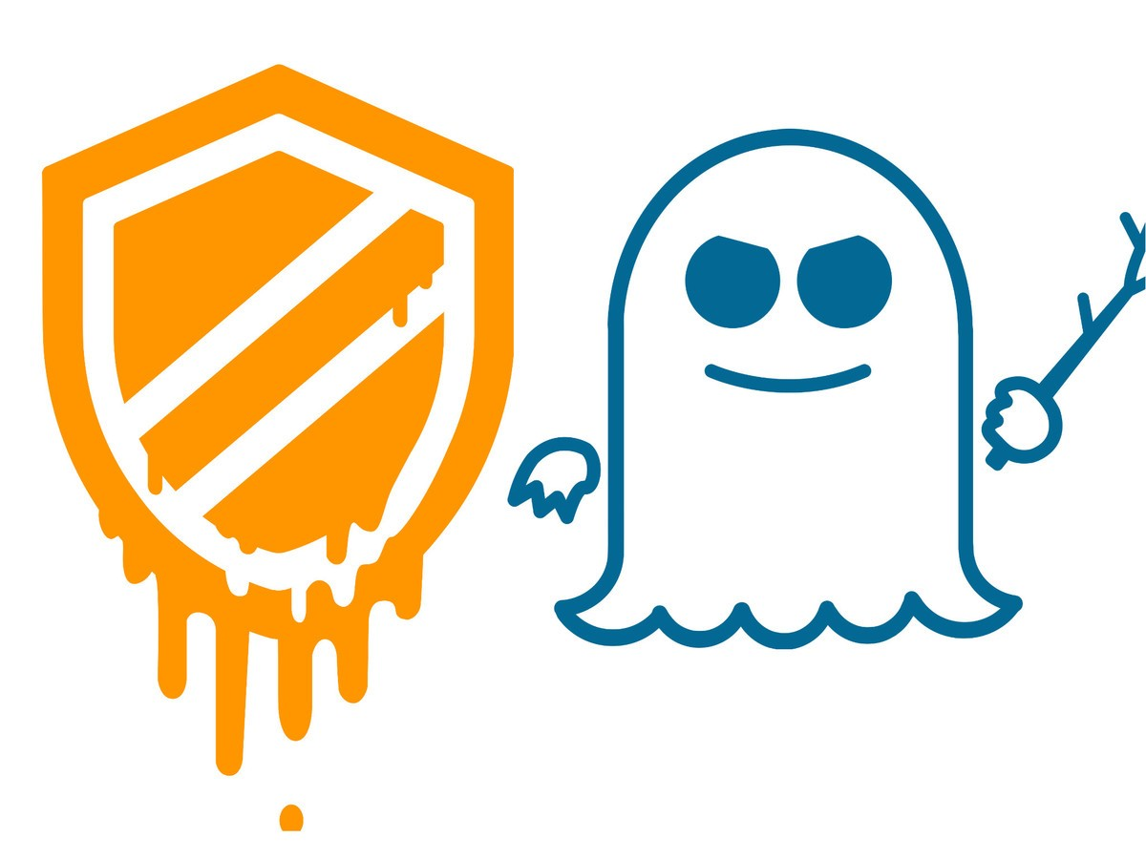

Slide 30
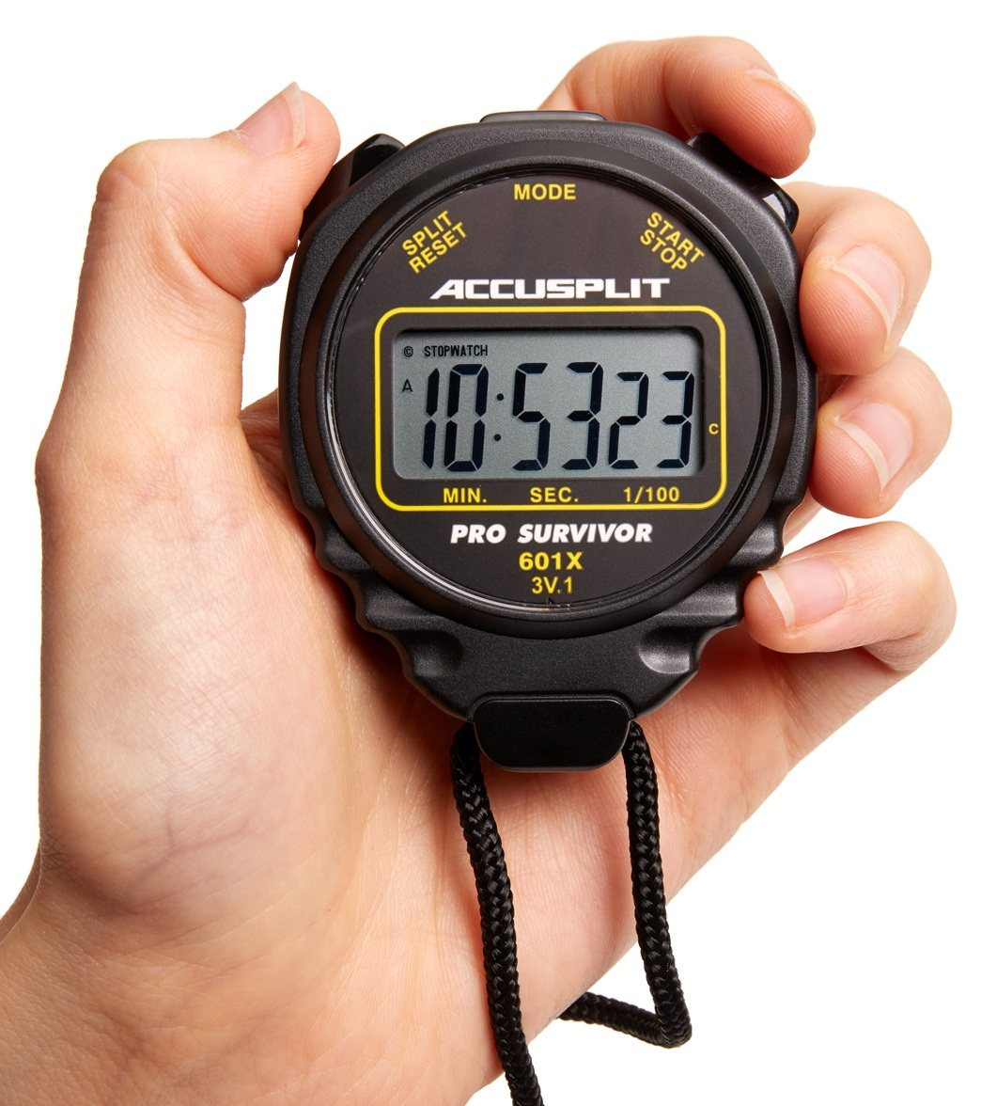
Speculative Execution
int i1, i2;
boolean b1,b2;
boolean[] a1,a2;
if (i1 < a1.length()) {
boolean bval= a1[i1];
if(bval){i2= 1;} else{i2= 0;}
if(i2 < a2.length()){
b2 = a2[i2];
}
}
Notes:
If arr1->length is uncached, the processor can speculatively load data from arr1->data[untrusted_offset_from_caller]. This is an out-of-bounds read. That should not matter because the processor will effectively roll back the execution state when the branch has executed

Slide 31
Threats (Capabilities)
Physical access
Software access
  disk access
  memory access
  privilege levels
Network access

Slide 32
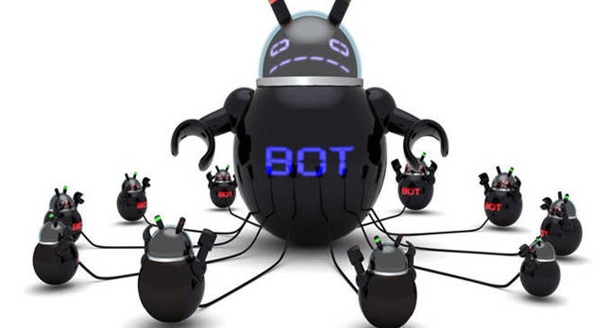
Dyn DDoS
Notes:
https://www.theguardian.com/technology/2016/oct/26/ddos-attack-dyn-mirai-botnet

Slide 33

DDoS as Geopolitical Tactic
Notes:
https://therecord.media/monobank-ukraine-ddos

Slide 34
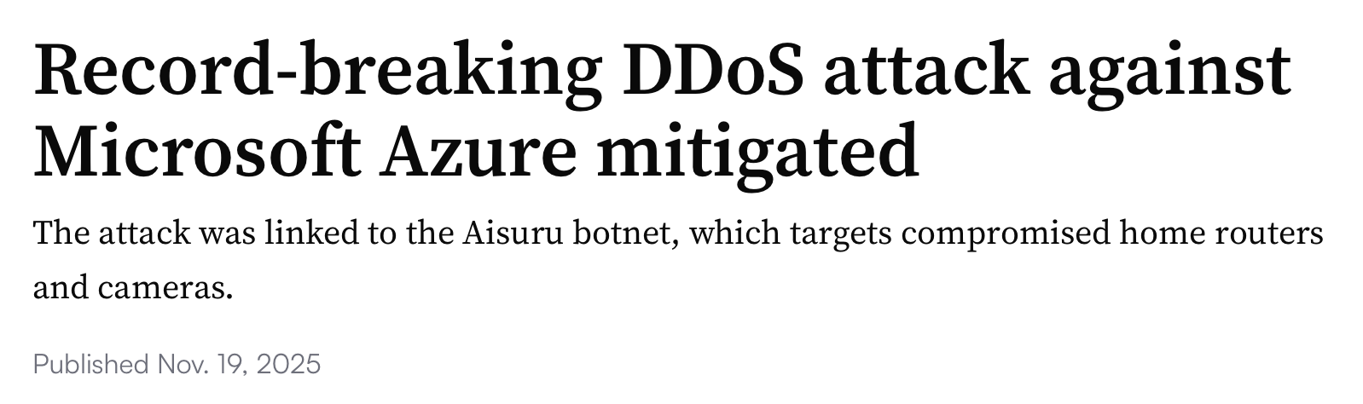
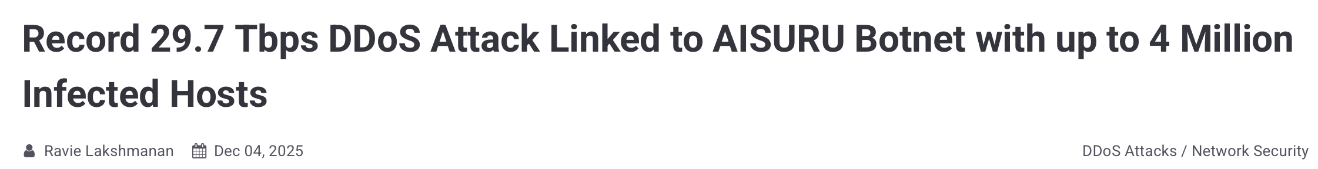
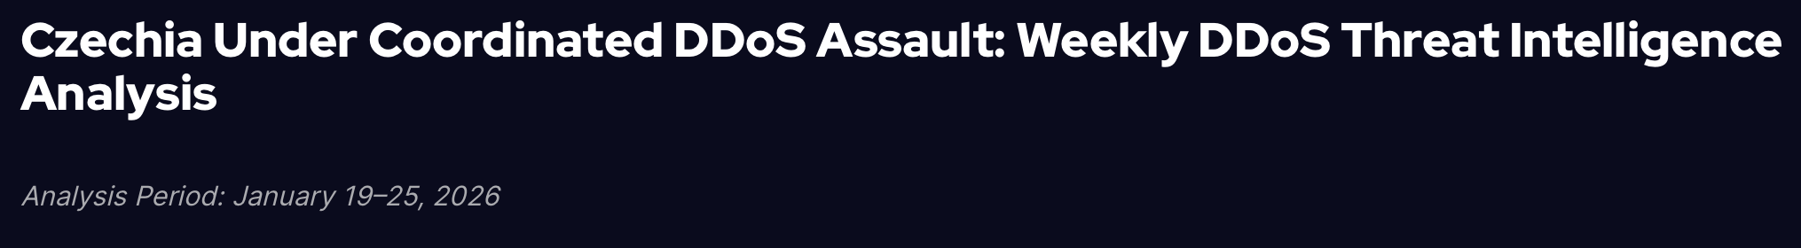
Recent DDoS Attacks
Notes:
https://thehackernews.com/2025/12/record-297-tbps-ddos-attack-linked-to.html
https://www.ampcuscyber.com/shadowopsintel/aisuru-botnet-ddos-attacks-record/
https://socradar.io/blog/ddos-threat-intelligence-czechia-26-jan26/

Slide 35
Threats (Capabilities)
Physical access
Software access
  disk access
  memory access
  privilege levels
Network access
User access

Slide 36




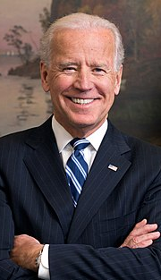
Phishing
Notes:
https://teampassword.com/blog/what-happened-during-the-twitter-spear-phishing-attack

Slide 37
Formal Models of Capabilities
PPT
Dolev-Yao

Slide 38

Example
Threat model: The adversary desires to prevent baby deliveries. The adversary has access to radio equipment that transmits and receives on the same frequencies that providence uses for communication with a stork. The adversary also controls weapons systems that can destroy a stork in flight.

Slide 39
Exercise 4: Capability Threat Model
For each of the following systems, how would you classify the threats that are likely to perpetrate attacks against that system according to their access?
  A game app
  A social network
  A classified government database

Slide 40
Threat Models

