Slide 1
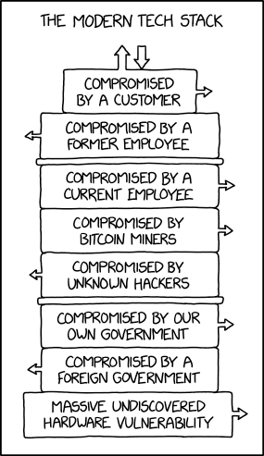
Lecture 2: Vulnerabilities
CS 138 Spring 2026

Slide 2
Announcements
Office Hours: Mondays 7-9pm + Tuesdays 2-4
We have a slack channel: #cs138-2026sp
First assignment due tomorrow

Slide 3
The Big Picture
Attacks
are perpetrated by
threats
that inflict
harm
by exploiting
vulnerabilities
which are controlled by
countermeasures.

Slide 4
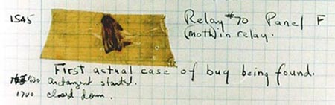
Bugs
"bug": suggests something just wandered in
[IEEE 729]
Fault: result of human error in software system
  E.g., implementation doesn't match design, or design doesn't match requirements
  Might never appear to end user
Failure: violation of requirement
  Something goes wrong for end user
Human error
Fault
Failure
Notes:
First bug found by Grace Hopper
https://www.schneier.com/blog/archives/2008/05/random_number_b.html

Slide 5

Vulnerability
An unintended aspect of a system (design, implementation, or configuration) that can cause the system to do something it shouldn't, or fail to do something it should
E.g., buffer overflows, code injection, cross-site scripting, missing authentication or access control, misconfiguration
National databases: CVE, NVD
Ignoring vulnerabilities is risky
  Too often: "no one would/could ever exploit that"
  Weakest link phenomenon
Assumptions are vulnerabilities

Slide 6
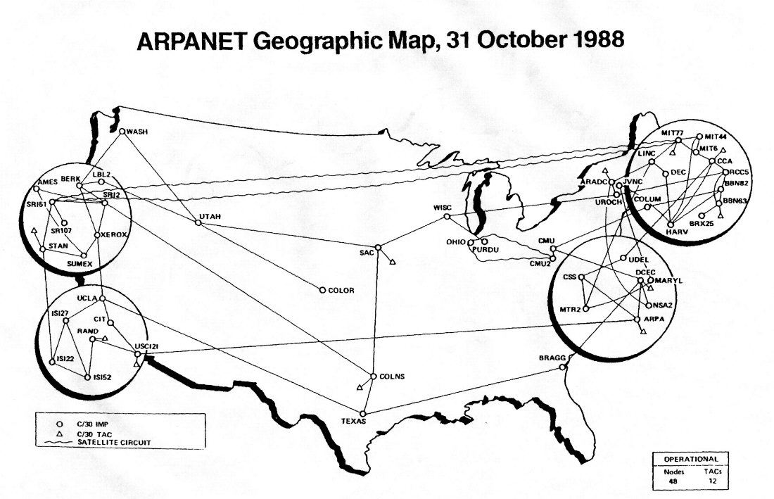

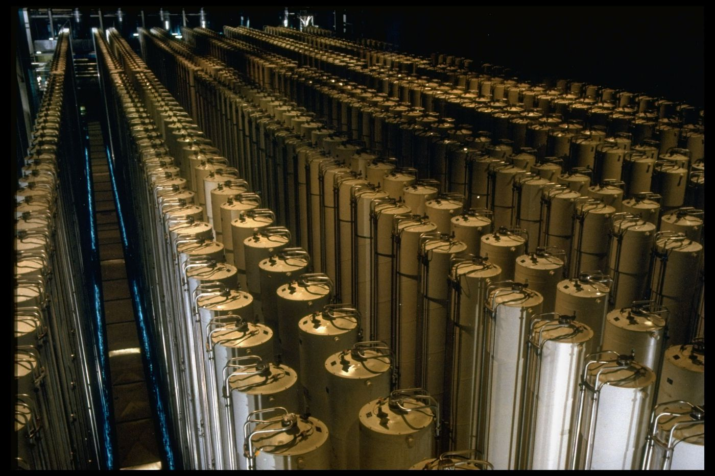

Buffer Overflow
Notes:
Morris Worm (November 2, 1988), $100,000-$10mil, bugs in finger and sendmail
Stuxnet (discovered 2010): bug in functions that process files to display icons when USB connected to PC
Heartbleed (2014): bug in openssl library hearbeat
WhatsApp (2019)

Slide 7
Review: Stack Frames
0x7FFFFFFF
Stack
Each function called gets a stack frame
Passing data:
  calling procedure P uses registers (and stack) to provide parameters to Q.
  Q uses register %rax for return value
Passing control:
  call <proc>
    Pushes return address (current %rip) onto stack
    Sets %rip to first instruction of proc
  ret
    Pops return address from stack and places it in %rip
Local storage:
  allocate space on the stack by decrementing stack pointer, deallocate by incrementing
saved registers
local variables
P's Stack Frame
Arguments 7..n
return address
saved registers
local variables
Q's Stack Frame
Arguments 7..n
return address
%rsp
Heap
Text
%rip
Code
0x00000000

Slide 8
Review: Stack Smashing
Idea: fill the buffer with bytes that will be interpreted as code
Overwrite the return address with address of the beginning of the buffer
Stack Frame
for call_echo
/* Echo Line */
void echo()
{
char buf[4];
gets(buf);
puts(buf);
}
7f
ff
ff
ff
00
00
00
00
Return Address
(8 bytes)
saved
%rip
Return Address
(8 bytes)
ff
ff
ea
40
00
40
06
f6
33
32
31
30
20 bytes unused
Stack Frame
for echo
39
38
37
36
echo:
subq $18, %rsp
movq %rsp, %rdi
call gets
call puts
addq $18, %rsp
ret
35
34
33
32
31
30
39
38
37
36
35
34
33
32
31
30
%rsp
[3]
[2]
[1]
[0]
buf
Notes:
Note: works on linux
Demo: crash, jump

Slide 9
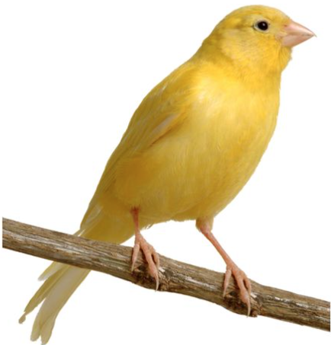
Stack Canaries
0x7FFFFFFF
Stack
Idea
  Place special value (“canary”) on stack just beyond buffer
  Check for corruption before exiting function
GCC Implementation
  -fstack-protector
  Now the default (disabled earlier)
…
local variables
Arguments 7..n
return address
saved registers
local variables
Arguments 7..n
return address
0x00000000

Slide 10
Stack Canaries
authenticate:
pushq %rbx
subq $16, %rsp
movq %rdi, %rbx
movq %fs:40, %rax
movq %rax, 8(%rsp)
xorl %eax, %eax
movq %rsp, %rdi
call gets
movq %rsp, %rsi
movq %rbx, %rdi
call strcmp
testl %eax, %eax
sete %al
movq 8(%rsp), %rdx
xorq %fs:40, %rdx
je .L2
call __stack_chk_fail
.L2:
movzbl %al, %eax
addq $16, %rsp
popq %rbx
ret
Stack Frame
for call_echo
00
00
00
00
Return Address
(8 bytes)
saved
%rip
Return Address
(8 bytes)
00
40
06
f6
Stack Frame
for echo
canary
34
00
32
31
30
20 bytes unused
Stack Frame
for echo
39
38
37
36
35
34
33
32
31
30
39
38
37
36
35
34
33
32
31
30
buf
%rsp
[3]
[2]
[1]
[0]
Notes:
Discussion: what would make a good canary value?

Slide 11
Exercise 1: Stack Canaries
Which of the following would make a good stack canary?
  A secret, constant value
  The current process ID
  A fixed sequence of common terminators (\0, EOF, etc.)
  A random number chosen each time the program is run

Slide 12
Review: Tracking Free Blocks
Method 1: Implicit list using length—links all blocks
Method 2: Explicit list among the free blocks using pointers
Method 3: Segregated free list
  Different free lists for different size classes
Method 4: Blocks sorted by size
  Can use a balanced tree (e.g. Red-Black tree) with pointers within each free block, and the length used as a key
5
4
6
2
5
4
6
2
Notes:
Small group discussion: what data structure would you use?

Slide 13
Review: Block Format
Allocated Blocks
Free Blocks
Footer
Size
1
Footer
Size
0
Payload and
padding
Padding
a = 1: Allocated block
Size: Total block size
Payload: Application data
a = 0: Free block
Size: Total block size
next_free_ptr
prev_free_ptr
Header
Size
1
Header
Size
0

Slide 14
Heap Smashing
Size
1
Payload and
Padding
Size
1
Size
0
Size
1
padding
padding
ret_addr
exploit code
fake_next_free
Array
fake_prev_free
Size
1

Slide 15
Exercise 2: Heap Smashing
What would happen when the block after this one gets freed? (Assume that the coalesced block needs to be moved into a new linked list.)
604060
Size
0
604058
exploit code
604050
406002
604048
7fffffffea90
nop; nop; nop;
604040
7fffffffea88
addq $16, %rip
604038
7fffffffea80
604038
604030
7fffffffea80
604028
Size
1
604020

Slide 16
Double Free
free(ptr)
free(ptr)
p = malloc(n)
// write to block
// free block after target
Size
0
Size
0
Size
0
Size
1
0
Size
0
Padding
Padding
Padding
Padding
padding
ret_addr
exploit code
next_free_ptr
next_free_ptr
next_free_ptr
next_free_ptr
fake_next_free
prev_free_ptr
prev_free_ptr
prev_free_ptr
prev_free_ptr
fake_prev_free
Size
0
Size
0
Size
0
Size
0
1

Slide 17

Data Execution Prevention (DEP)
W $⊕$ X

Slide 18

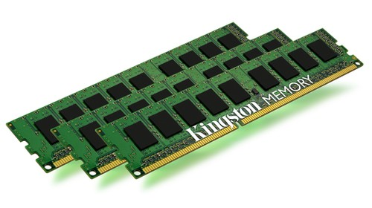
Review: NX bit
Stack
NULL page or
access not allowed
SegFault
page#
offset
vaddr
MMU
Heap
page table
Invalid page
Data
v | Frame | Access
1 | 47 | X
0 | NULL | X
0 | 13 | X
1 | 42 | NX
Page Fault
Code
paddr =
Frame[page#]
offset
…
Data
Notes:
Define MMU

Slide 19
Code Reuse Attacks
Key idea: execute instructions that already exist
Defeats memory tagging defenses
Examples:
  return to a library function (e.g., return-into-libc)
  return to some other instruction (return-oriented programming)

Slide 20
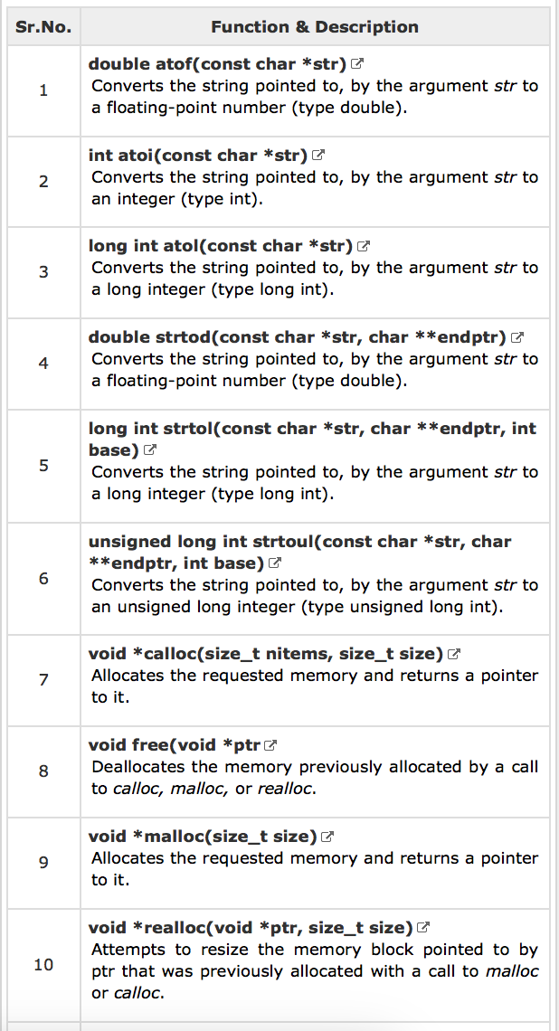
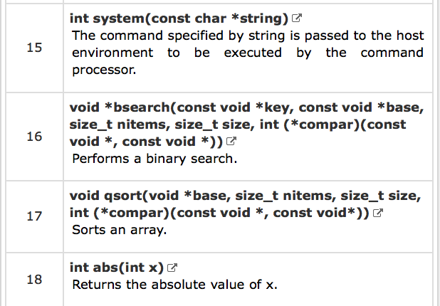
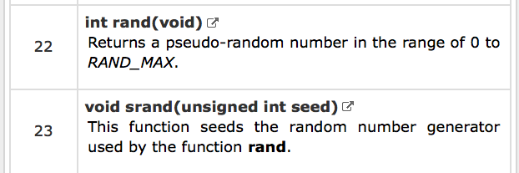
Return-into-libc

Slide 21
ASCII Armoring
Make sure all system library addresses contain a null byte (0x00).
Can be done by placing this code in the first 0x01010101 bytes of memory
Notes:
With ASCII armoring, all the system libraries (e.g. libc) addresses contain a NULL byte(0x00). This is commonly done by placing them in the first 0x01010101 bytes of memory (a few pages more than 16 MB, dubbed the "ASCII armor region"), as every address up to (but not including) this value contains at least one NULL byte. This makes it impossible to emplace code containing those addresses using string manipulation functions such as strcpy(). However, this technique does not work if the attacker has a way to overflow NULL bytes into the stack. If the program is too large to fit in the first 16 MiB, protection may be incomplete.[

Slide 22
Review: Properties of x86 Assembly
Intel Instruction Set Architecture (ISA)
Introduced 1978, still supported
As of 2020, most common architecture on servers, PCs, and laptops
variable length instructions
not word aligned
dense instruction set

Slide 23
Gadgets
void setval(unsigned *p) {
*p = 3347663060u;
}
<setval>:
4004d9: c7 07 d4 48 89 c7 movl $0xc78948d4,(%rdi)
4004df: c3 ret
gadget address: 0x4004dc
encodes: movq %rax, %rdi
ret
executes: %rdi <- %rax
Notes:
https://defuse.ca/online-x86-assembler.htm

Slide 24
Example Gadgets
Load Constant
Load from memory
48 89 C0 C3
movq (%rax), %rax
ret
0xbad00001
5a c3
pop %rdx
ret
58 c3
pop %rax
ret
0xbad00002

Slide 25
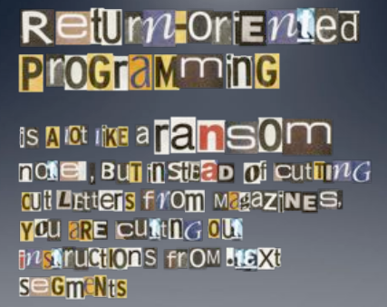
Return-oriented Programming
Notes:
Image By: Dino Dai Zovi

Slide 26
Return-oriented Programming
gadget_N_code c3
…
gadget_2_code c3
gadget_1_code c3
Final ret in each gadget sets pc (%rip) to
beginning of next gadget code

Slide 27
Return-Oriented Shellcode
%rip | %rdi | %rsi | %rax | %rdx
%rip | %rdi | %rsi | %rax | %rdx
4004b9 | 3b3b3b | ea70 | 3b | 0
%rip | %rdi | %rsi | %rax | %rdx
400666 | 3b3b3b | ea78 | 0 | 0
%rip | %rdi | %rsi | %rax | %rdx
400663 | 3b3b3b | ea78 | 0
%rip | %rdi | %rsi | %rax | %rdx
400660 | 3b3b3b | ea78 | 0
%rip | %rdi | %rsi | %rax | %rdx
40090b
%rip | %rdi | %rsi | %rax | %rdx
4004b8 | 3b3b3b | ea78 | 3b | 0
%rip | %rdi | %rsi | %rax | %rdx
400420 |  |  | 0
%rip | %rdi | %rsi | %rax | %rdx
40090e |  |  | 0
%rip | %rdi | %rsi | %rax | %rdx
4002a6 | 3b3b3b | ea78 | 3b | 0
%rip | %rdi | %rsi | %rax | %rdx
4002a3 | 3b3b3b | ea78 | 0 | 0
%rip | %rdi | %rsi | %rax | %rdx
400421 | 3b3b3b |  | 0
%rip | %rdi | %rsi | %rax | %rdx
400421 | 3b3b3b | ea78 | 0
%rip | %rdi | %rsi | %rax | %rdx
4004b9 | ea80 | ea70 | 3b | 0
"\bin\sh\0"
%rip | %rdi | %rsi | %rax | %rdx
40042a | ea80 | ea70 | 3b | 0
7fffffffea80
0
7fffffffea78
0x1122334455667788
7fffffffea70
0x7fffffffea80
7fffffffea68
0x40042a
0F 05 C3
7fffffffea60
0x7fffffffea80
5E 5F C3
syscall
ret
7fffffffea58
0x7fffffffea70
0x4004b8
pop %rsi
pop %rdi
ret
7fffffffea50
0x4002a3
40 00 F8 C3
7fffffffea48
7fffffffea40
0x400660
48 89 06 48 89 c2 C3
add %dil, %al
ret
7fffffffea38
0x7fffffffea78
mov %rax, (%rsi)
mov %rax, %rdx
ret
7fffffffea30
0x3b3b3b3b3b3b3b3b
7fffffffea28
0x400420
5F 5E C3
0x40090b
48 31 C0 C3
pop %rdi
pop %rsi
ret
7fffffffea20
xor %rax, %rax
ret
Notes:
Note: syscall: number of syscall actually passed in register %rax.
System call index: http://blog.rchapman.org/posts/Linux_System_Call_Table_for_x86_64/

Slide 28
Exercise 3: ROP
What are the values in the registers when the function at address 0x401a82 starts executing?
%rip | %rdi | %rsi | %rax | %rdx
401a5c |  |  | ..97ff | ..ea58
%rip | %rdi | %rsi | %rax | %rdx
401bb0 |  |  | ..97ff | ..ea58
%rip | %rdi | %rsi | %rax | %rdx
401a5b |  |  | ..97ff
%rip | %rdi | %rsi | %rax | %rdx
4002a3 |  |  | 2f | ..ea58
%rip | %rdi | %rsi | %rax | %rdx
4019e6 |  |  | ..97ff
%rip | %rdi | %rsi | %rax | %rdx
4019e5
%rip | %rdi | %rsi | %rax | %rdx
%rip | %rdi | %rsi | %rax | %rdx
401a82 | 2f |  | 2f | ..ea58
%rip | %rdi | %rsi | %rax | %rdx
401bb3 |  |  | 2f | ..ea58
%rip | %rdi | %rsi | %rax | %rdx
4002a3 | 2f |  | 2f | ..ea58
%rip | %rdi | %rsi | %rax | %rdx
7fffffffea58
0x59b997d0
7fffffffea50
0x401a82
48 89 C7 C3
7fffffffea48
0x4002a3
mov %rax, %rdi
ret
7fffffffea40
0x401bb0
48 2B 02 C3
7fffffffea38
0x7fffffffea58
sub (%rdx), %rax
ret
7fffffffea30
0x401a5b
5A C3
7fffffffea28
0x59b997ff
pop %rdx
ret
7fffffffea20
0x4019e5
58 C3
pop %rax
ret

Slide 29

Address Space Layout Randomization

Slide 30
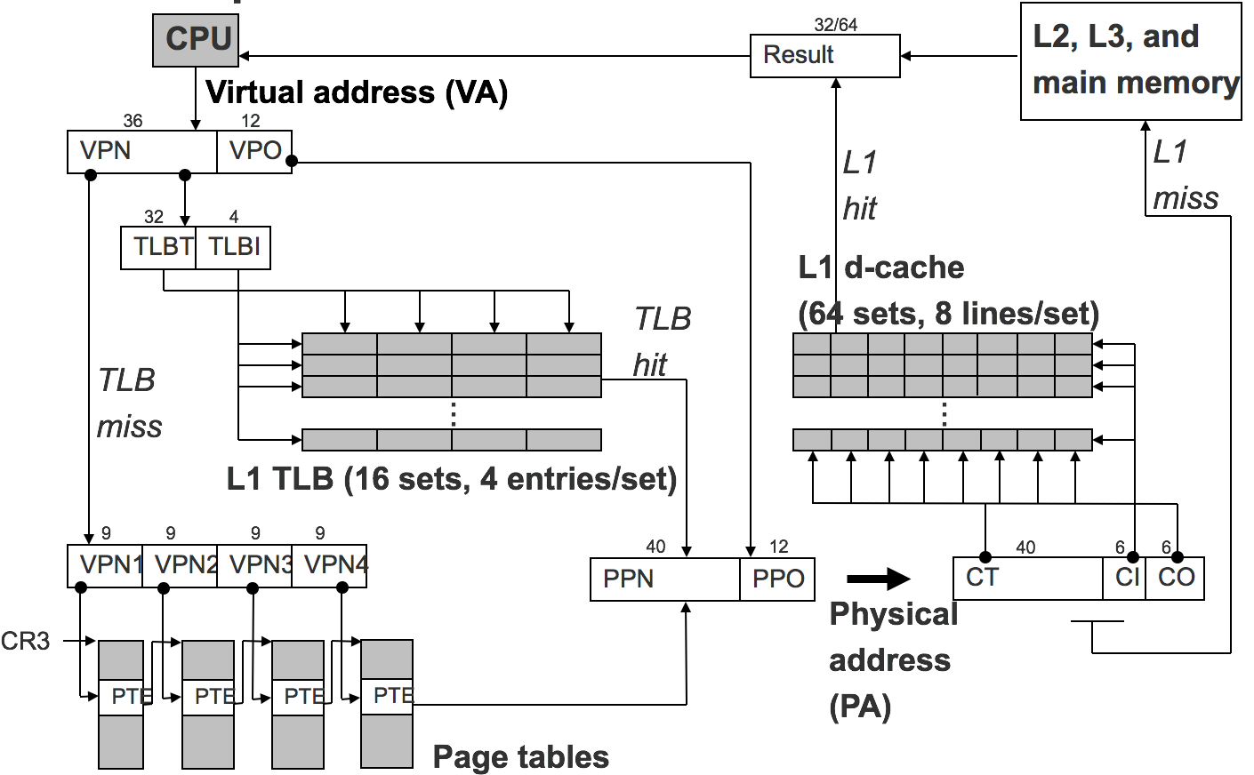
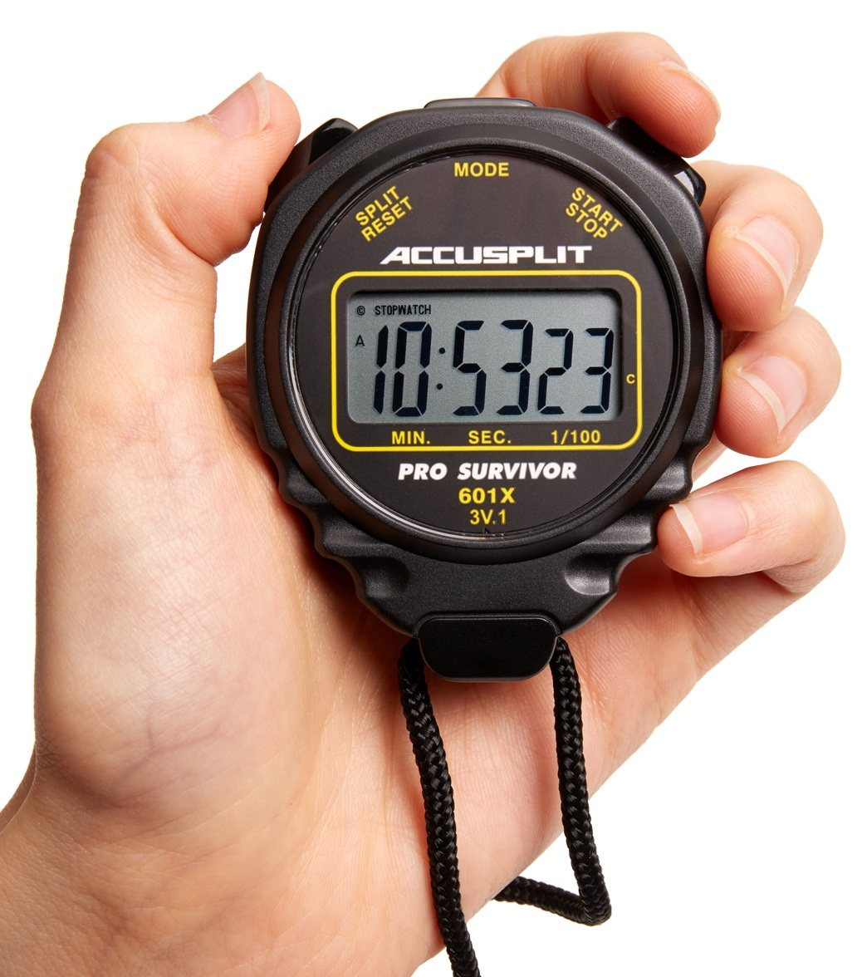
Memory Disclosure Vulnerabilities
ASLR ⊕ Cache

Slide 31
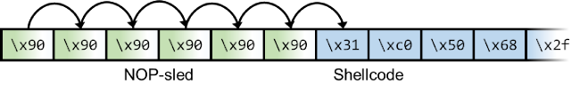
JIT Spraying

Slide 32


Gadget Elimination

Slide 33
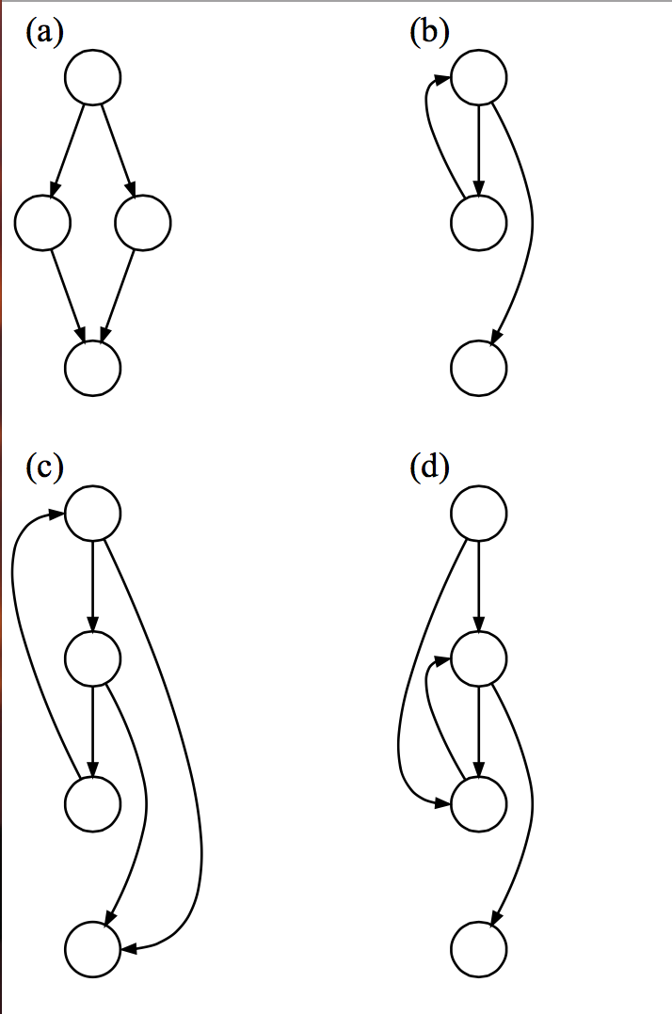
Control Flow Integrity

Slide 34

CFI = Insert Monitors
Code
Code

Slide 35
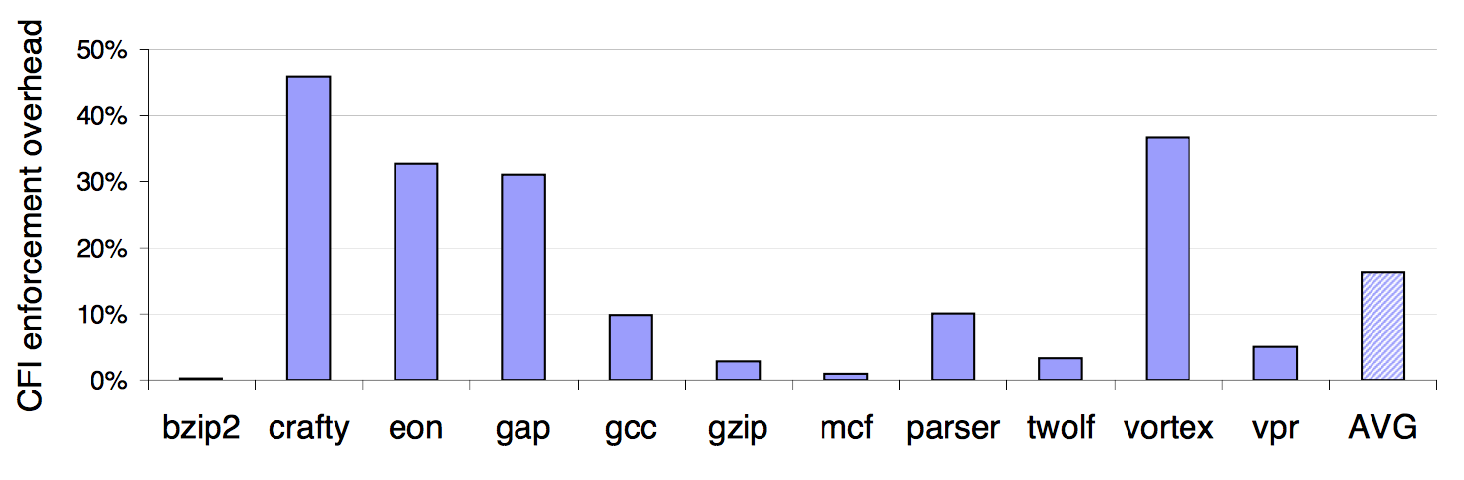
CFI Overhead

Slide 36
Control Flow Guard
Approximate CFI implementation in Windows 8.1, 10+
Jump is valid if its beginning of function
  Granularity: 8 bytes
Check implemented as bitmap
Code
Code

Slide 37
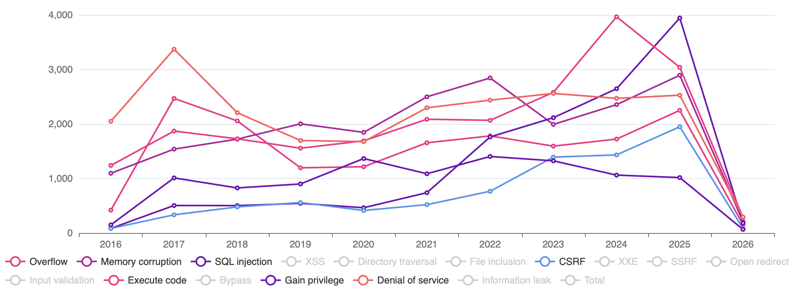
Vulnerabilities by Year
Notes:
https://www.cvedetails.com/vulnerabilities-by-types.php

Slide 38
Vulnerabilities

