Slide 1
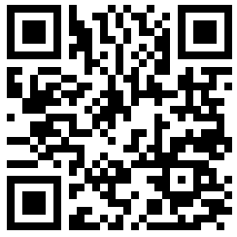
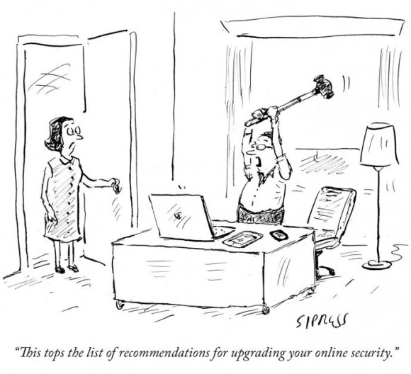
Lecture 1: Introduction to Security
http://www.cs.pomona.edu/classes/cs138/
CS 138 Spring 2026

Slide 2
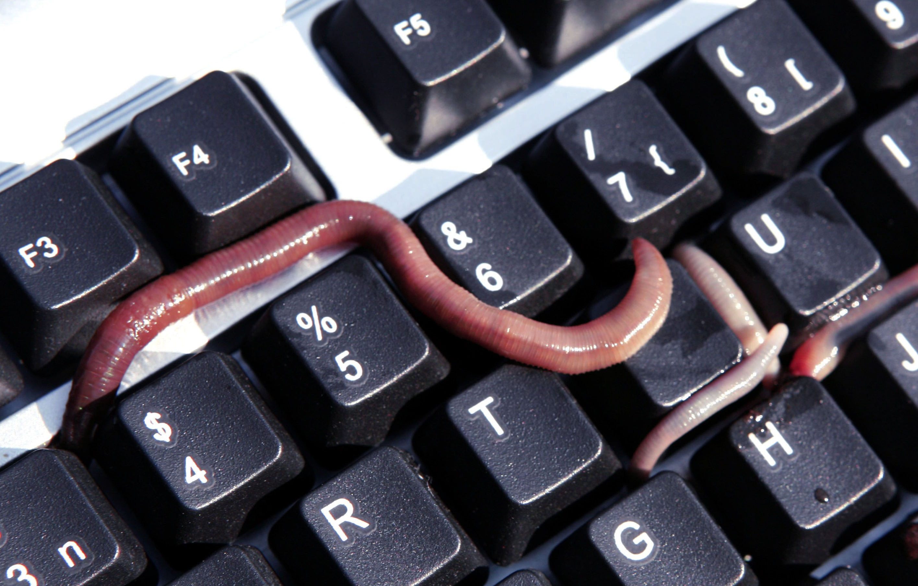
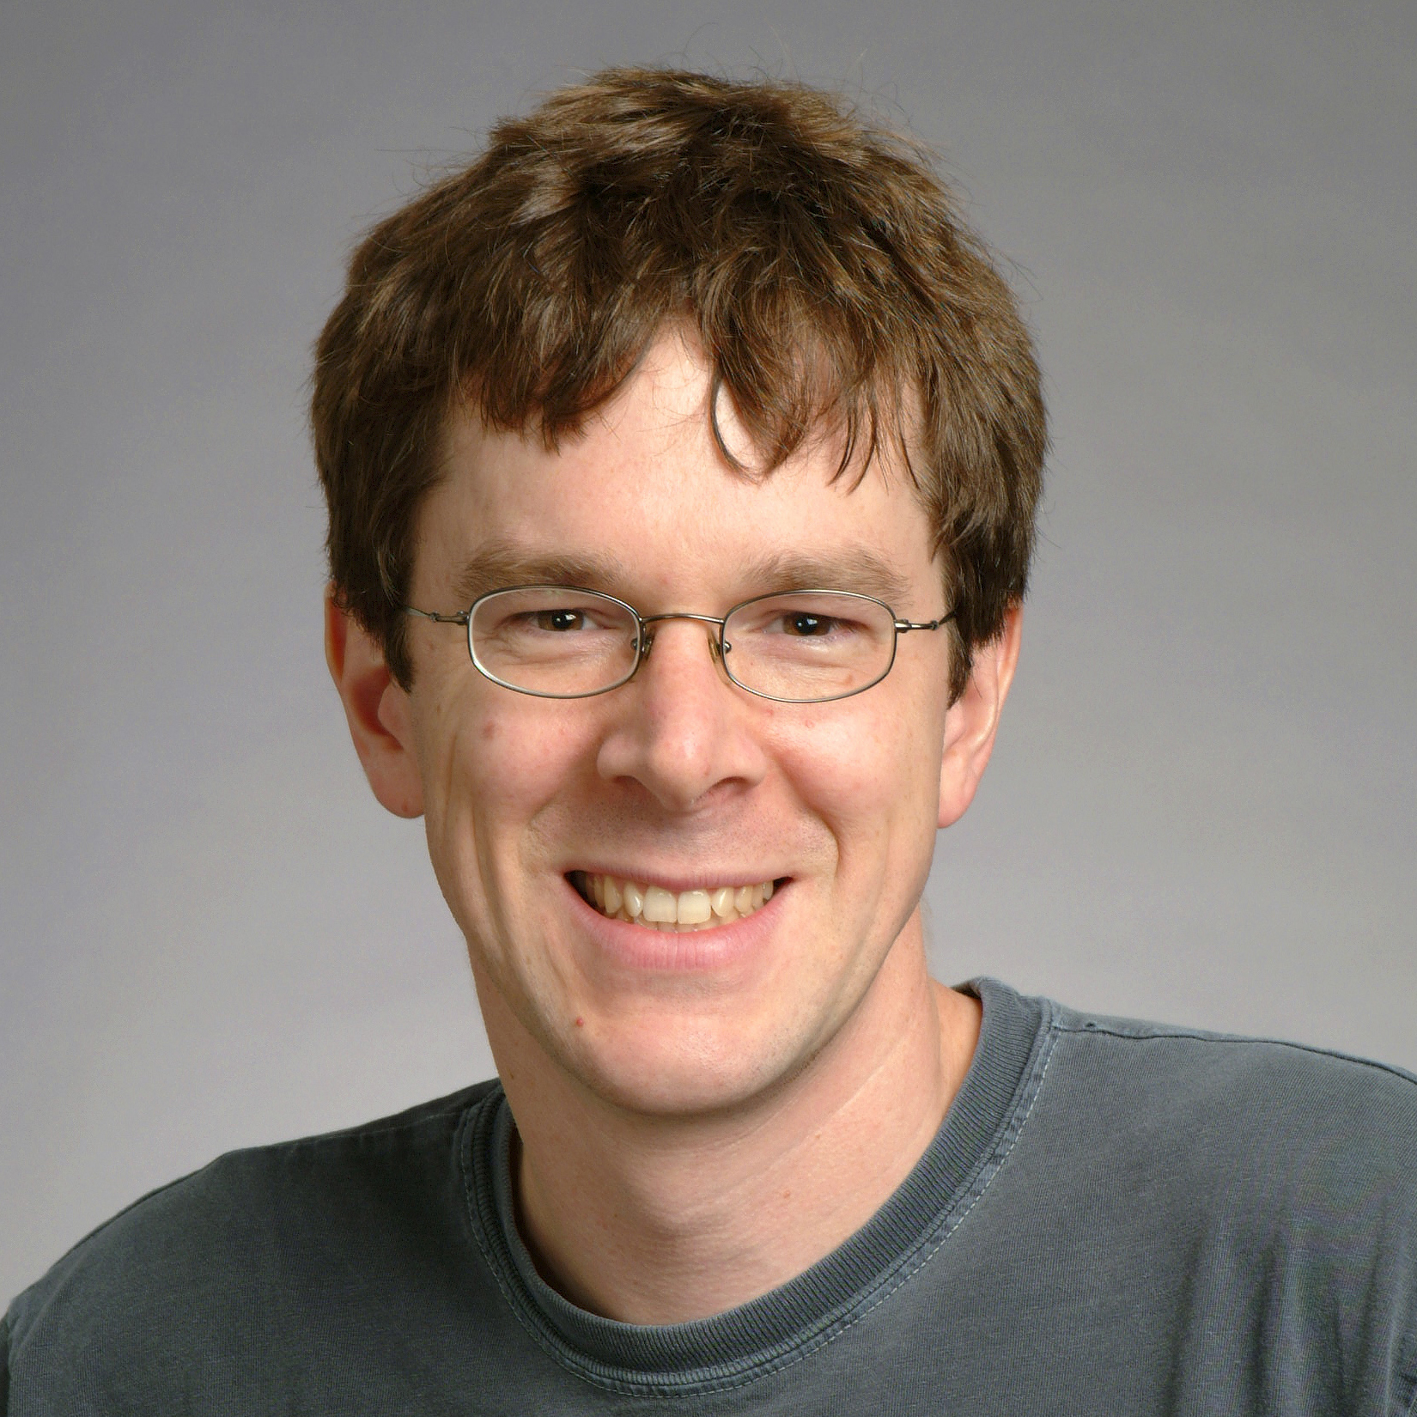
static report_breakin(arg1, arg2) /* 0x2494 */
{
int s;
struct sockaddr_in sin;
char msg;
if (7 != random() % 15)
return;
bzero(&sin, sizeof(sin));
sin.sin_family = AF_INET;
sin.sin_port = REPORT_PORT;
sin.sin_addr.s_addr = inet_addr(XS("128.32.137.13"));
November 2, 1988
Notes:
Robert Tappan Morris, Jr. released the "great worm." (His dad, Bob Morris, was chief scientist at NSA's National Computer Security Center.) This was the first worm; the first malware to get media attention; and the first conviction under the Computer Fraud and Abuse Act. Morris was 23 years old, and a first year grad student at Cornell. (He released the worm from MIT, though.) He later claimed the worm's purpose was to measure size of Internet, but the immediate effect was denial of service (DoS). The Internet "came apart" as hosts were overloaded by invisible processes. System admins had to disconnect from the network to isolate their systems from infection. The US GAO later estimated the cost of recovery was somewhere in $100k to $10m. Morris was tried in US District Court. His sentence: 3 years probation, 400 hours community service, and a $13k fine. In 1999, he received a PhD from Harvard. And now he's a professor at MIT.

Slide 3
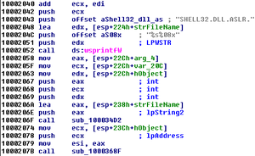
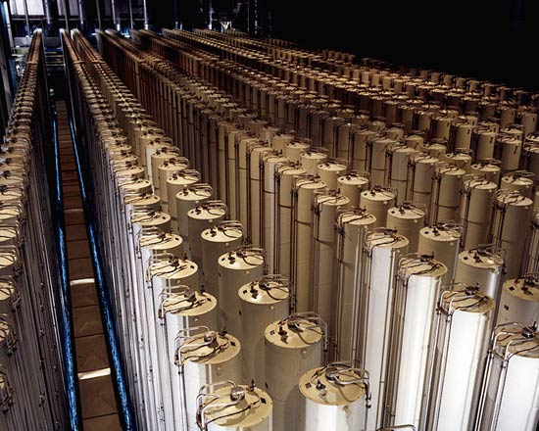
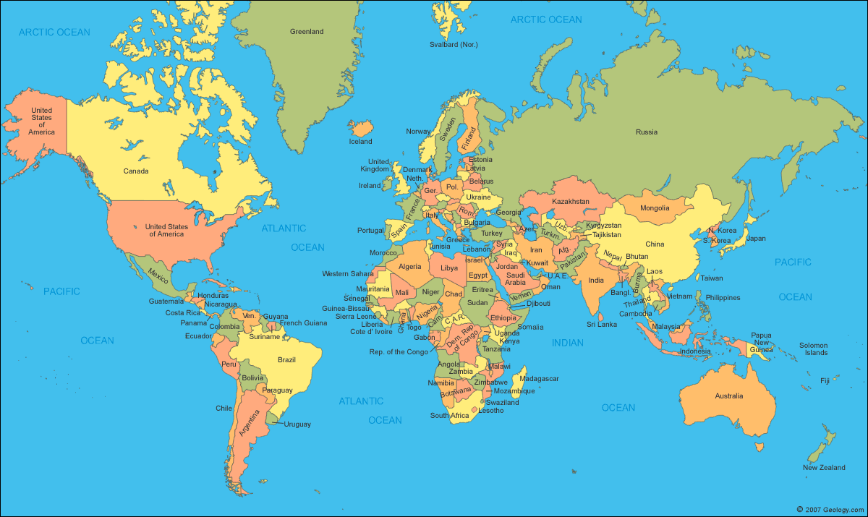
June 1, 2012
?
Notes:
The New York Times reports that the US and Israel created Stuxnet, the first (publicly known) cyberweapon. Its provenance was initially unknown. The weapon first infects Windows systems, then subsequently infects an industrial control device, causing it to vary the frequency of its motor and do physical harm. But, the weapon hides that frequency change from the device's monitoring system, so that the harm won't be noticed until it's too late. The purpose of the weapon seemed to be destruction of centrifuges in Iranian uranium enrichment facilities.

Slide 4




January 21, 2026
Notes:
Windows: https://socprime.com/blog/latest-threats/cve-2025-47981-windows-vulnerability/
zlib: https://cyberpress.org/critical-zlib-vulnerability/
Gemini: https://www.darkreading.com/cloud-security/google-gemini-flaw-calendar-invites-attack-vector
Anthropic: https://cyata.ai/blog/cyata-research-breaking-anthropics-official-mcp-server/Anthropic/Claude: https://www.theregister.com/2026/01/15/anthropics_claude_bug_cowork/
(Also Claude: https://www.trendmicro.com/en_us/research/25/f/why-a-classic-mcp-server-vulnerability-can-undermine-your-entire-ai-agent.html)

Slide 5
INTERESTING
Today
HARD
FUN
IMPORTANT
Notes:
Today, security is
hard: we don't (fully) know how to accomplish it,
interesting: involves lots of cool ideas, and
important: society depends on computers, hence their security.
That's what makes this such a fun field of study

Slide 6
Defining security
Security = does what it should + nothing more
Notes:
A computer system is secure when it
- does what it should
- and nothing more.
A security policy stipulates what should and should not be done.

Slide 7
Functional Requirements
Security = does what it should + nothing more
"As a user I can action so that purpose"
e.g., As a professor, I can create a new assignment by specifying its name, number of possible points, and due date.
e.g., As a student, I can upload a file as a solution to an assignment.
e.g., As a professor, I can assign grades to student solutions.
Should be testable: a 3rd party could determine whether requirement is met
These user stories reveal system assets
Functional requirements should specify what not how

Slide 8
Security Goals
Security = does what it should + nothing more
"The system shall prevent/detect action on/to/with asset."
e.g., "The system shall prevent students from accessing assignments that are not theirs"
e.g., "The system shall prevent grades from being changed by anyone but the professor"
Poor goals:
"the system shall use encryption to prevent reading of messages"
"the system shall use authentication to verify user identities"
"the system shall resist attacks"
If a system enforces a goal, it is called a security property
Security goals should specify what not how

Slide 9
C I A
Confidentiality
Integrity
Availability

Slide 10
Confidentiality Properties
Protection of assets from unauthorized disclosure
i.e., which principals are allowed to learn what
Examples:
Keep contents of a file from being read (access control: more later)
Keep information secret (information flow: more later)
value of variable secret
behavior of system
information about individual
Notes:
Examples of iflow:
pub :=0; if (sec=1) { pub := 1; }
system load goes up when processing secret information
power consumed when processing secret information (DPA)
Database linking: Gender, DOB, ZIP uniquely identify about 99% of people in Cambridge, MA

Slide 11
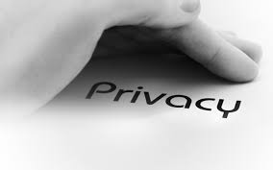
Privacy
Privacy concerns information about individuals (people, organizations, etc.)
Often construed as legal right
Privacy is not a synonym for confidentiality or for secrecy

Slide 12
Integrity Properties
Protection of assets from unauthorized modification
i.e., what changes are allowed to system and its environment, including inputs and outputs
Examples:
Output is correct according to (mathematical) specification
No exceptions thrown
Only certain principals may write to a file (access control)
Data are not corrupted or tainted by downloaded programs (information flow)

Slide 13
Availability Properties
Protection of assets from loss of use
i.e., what has to happen when/where
Examples:
Operating system accepts inputs periodically
Program produces output by specified time
Requests are processed fairly (order, priority, etc.)
Denial of service (DoS) attacks compromise availability

Slide 14
Exercise: Label each property as C/I/A
Students can always log into their accounts
The grade for an assignment is available only to the student who submitted that assignment.
The professor can see all submitted assignments and grades.
If your course grade changed, then the professor made that change.
If your course grade changed, you see the updated grade.
Requests to the grading server are processed in the order they were received.

Slide 15
Aspects of security
Confidentiality: protection of assets from unauthorized disclosure
Integrity: protection of assets from unauthorized modification
Availability: protection of assets from loss of use
Notes:
This course will mostly focus on C and I, not A

Slide 16
Ex 1
Attack: John copies Mary's homework
What is a security goal this attack would violate?
Which aspect of security does that policy address?
Notes:
Even if there aren't right answers, some are better than others---simpler, more clear cut, easier to argue, etc.

Slide 17
Ex 2
Attack: Paul causes Linda's system to freeze
Goal?
Aspect?

Slide 18
Exercise: Security Goals

Slide 19

Stork Baby Delivery
The stork baby delivery system allows an autonomous aircraft (a stork) to deliver a payload (a baby) to a geographic location prespecified by some higher authority (providence). Prior to take-off, providence programs a stork with the geographic location describing where the baby should be delivered. Throughout the mission, the stork transmits back to providence a video of the landscape (labeled with geographic location coordinates) that the stork flies over. While a stork is in flight, providence may issue commands to that stork and change the location for the delivery, alter the path being followed to that location, or abort the mission.
Threat model: The adversary desires to prevent baby deliveries. The adversary has access to radio equipment that transmits and receives on the same frequencies that providence uses for communication with a stork. The adversary also controls weapons systems that can destroy a stork in flight.

Slide 20
The Bigger Picture
Attacks are perpetrated by threats that inflict harm by exploiting vulnerabilities which are controlled by countermeasures.

Slide 21
Logistics

Slide 22
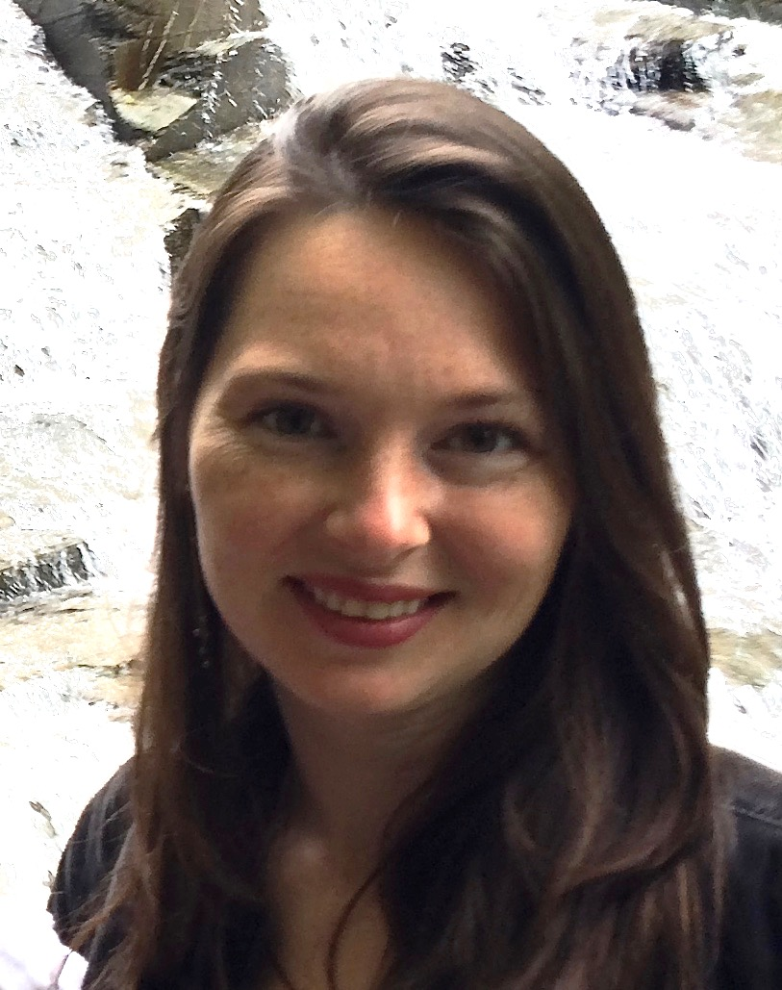
Course Logistics
Prof. Eleanor Birrell
Edmunds 221
Research in security and privacy
Lectures:
MW 1:15-2:30pm in Edmunds 101
Office Hours:
TBD (probably Mondays and Tuesdays)

Slide 23
Course Work
6 assignments (40%)
Mix of theory assignments and programming assignments
Course project (50%)
Design and build a secure system
Done in groups of 3-4
Participation (10%)
All coursework will be due Tuesdays at 11:59pm PT

Slide 24
Course website
http://www.cs.pomona.edu/classes/cs138
ding)
All information is on the course website
Various reading materials: slides, notes, links to online readings, pointers to textbook chapters
Optional? Yes. But...
the more of these you read, the more you will get out of the course
assignments are often inspired by this material
Lectures are the ground truth for material we cover

Slide 25
Introduction to Security

