Slide 1
Lecture 20: Synchronization
CS 105 Spring 2026

Slide 2
Review: Alternate View of a Process
Process = thread + other state
Thread (main thread)
Other data
brk
Stack
Heap
rsp
Data
Code
Thread context:
Data registers
Stack pointer (rsp)
Condition codes
Program counter (rip)
0
Kernel context:
VM structures
File table
brk pointer

Slide 3
Review: Multi-threading
Multiple threads can be associated with a process
  Each thread has its own logical control flow
  Each thread has its own stack for local variables
  Each thread has its own thread id (TID)
  Each thread shares the same code, data, and kernel context
Thread 1 (main thread)
Thread 2 (peer thread)
Shared data
brk
Heap
Stack 1
Stack 2
rsp
rsp
Data
Thread 1 context:
Data registers
Stack pointer
Condition codes
Program counter
Thread 2 context:
Data registers
Stack pointer
Condition codes
Program counter
Code
0
Kernel context:
VM structures
File table
brk pointer

Slide 4
Problems with Locks
Locks are slow
  threads that fail to acquire a lock on the first attempt must "spin", which wastes CPU cycles
  threads get scheduled and de-scheduled while the lock is still locked
Using locks correctly is hard
  hard to ensure all race conditions are eliminated
  easy to introduce synchronization bugs (deadlock, livelock)

Slide 5
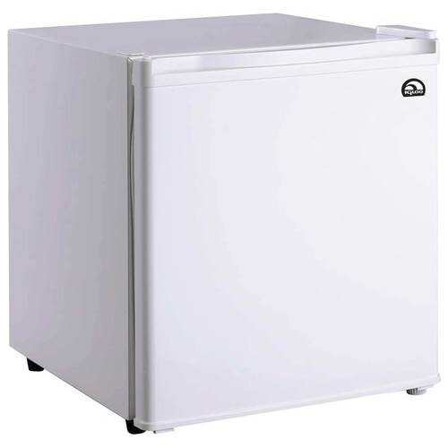
Review: Solution 1: Leave a note
You and your roommate share a refrigerator. Being good roommates, you both try to make sure that the refrigerator is always stocked with milk.
Algorithm 2:
if (milk == 0) { // no milk
if (note == 0) { // no note
note = 1; // leave note
milk++; // buy milk
note = 0; // remove note
}
}
Safety violation: you've introduced a Heisenbug!

Slide 6
Solution 2: Leave note before check note
You and your roommate share a refrigerator. Being good roommates, you both try to make sure that the refrigerator is always stocked with milk.
Algorithm 3:
note1 = 1
if (note2 == 0) { // no note from
roommate
if (milk == 0) {// no milk
milk++; // buy milk
}
}
note1 = 0
Liveness violation: No one buys milk

Slide 7
Solution 3: Keep checking for note
You and your roommate share a refrigerator. Being good roommates, you both try to make sure that the refrigerator is always stocked with milk.
Algorithm 4:
note1 = 1
while (note2 == 1) { // wait until
; // no note
}
if (milk == 0) { // no milk
milk++; // buy milk
}
note1 = 0
Liveness violation: You've introduced deadlock

Slide 8
Solution 4: Take turns
You and your roommate share a refrigerator. Being good roommates, you both try to make sure that the refrigerator is always stocked with milk.
Algorithm 5:
note1 = 1
turn = 2
while (note2 == 1 and turn == 2){
;
}
if (milk == 0) { // no milk
milk++; // buy milk
}
note1 = 0
(probably) correct, but complicated and inefficient
Notes:
Note: this solution might fail if the compiler or hardware reorders instruction
Properties we need: (1) if no contention, proceed, (2) if contention, wait until no one is in critical section, then one proceed

Slide 9
Locks
A lock (aka a mutex) is a synchronization primitive that provides mutual exclusion. When one thread holds a lock, no other thread can hold it.
  a lock can be in one of two states: locked or unlocked
  a lock is initially unlocked
  function acquire(&lock) waits until the lock is unlocked, then atomically sets it to locked
  function release(&lock) sets the lock to unlocked

Slide 10
Atomic Operations
Solution: hardware primitives to support synchronization
A machine instruction that (atomically!) reads and updates
Example: xchg src, dest
  one instruction
  semantics: TEMP ← DEST; DEST ← SRC; SRC ← TEMP;

Slide 11
Spinlocks
acquire:
mov $1, eax ; Set EAX to 1
xchg eax, (rdi) ; Atomically swap EAX w/ lock val
test eax, eax ; check if EAX is 0 (lock unlocked)
jnz acquire ; if was locked, loop
ret ; lock has been acquired, return
release:
mov $0, eax ; Set EAX to 0
xchg eax, (rdi) ; Atomically swap EAX w/ lock val
ret ; lock has been released, return

Slide 12
Solution 5: use a lock
You and your roommate share a refrigerator. Being good roommates, you both try to make sure that the refrigerator is always stocked with milk.
Algorithm 6:
acquire(&lock)
if (milk == 0) { // no milk
milk++; // buy milk
}
release(&lock)
Correct!

Slide 13
Programming with Locks
C (pthreads)
Python (threading)
Defines lock type pthread_mutex_t
functions to create/destroy locks:
  int pthread_mutex_init(&lock, attr);
  int pthread_mutex_destroy(&lock);
functions to acquire/release lock:
  int pthread_mutex_lock(&lock);
  int pthread_mutex_unlock(&lock);
Defines class Lock
constructor to create locks:
  Lock()
  destroyed by garbage collector
functions to aquire/release lock:
  lock.acquire()
  lock.release()

Slide 14
Blocking Lock (aka mutex)
Initial state of lock is 0 ("available")
acquire(&lock)
  while value == 1, block (suspend thread)
  when value == 0, set value to 1
release(&lock)
  set value to 0
  resume a thread waiting on lock (if any)
acquire(&lock){
while(lock == 1){
;
}
lock = 1
}
release(&lock){
lock = 0
}
Notes:
This is just a binary semaphore

Slide 15
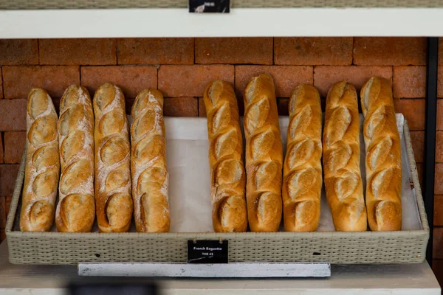
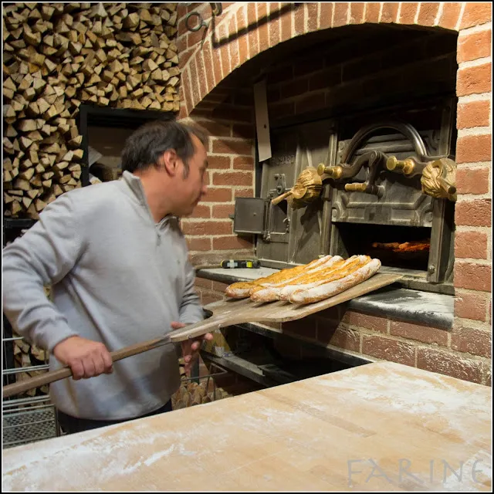

Example: Bounded Buffers
finite capacity (e.g. 20 loaves)
implemented as a queue
How do you implement a bounded buffer (0 <= count <= n)?
How do you synchronize concurrent access to a bounded buffer?
Threads A: produce loaves of bread and put them in the queue
Threads B: consume loaves by taking them off the queue

Slide 16
Example: Bounded Buffers
0 1 2 3 4 5 (n = 6)
b
3
2
2
4
1
Values wrap around!!
rear
front
Exercise: What can go wrong?
typedef struct {
int* b; // ptr to buffer containing the queue
int n; // length of array (max # slots)
int count; // number of elements in array
int front; // index of first element, 0 <= front < n
int rear; // (index of last elem)+1 % n, 0 <= rear < n
} bbuf_t
void put(bbuf_t* ptr, int val){
ptr->b[ptr->rear]= val;
ptr->rear= ((ptr->rear)+1)%(ptr->n);
ptr->count++;
}
void init(bbuf_t* ptr, int n){
ptr->b = malloc(n*sizeof(int));
ptr->n = n;
ptr->count = 0;
ptr->front = 0;
ptr->rear = 0;
}
int get(bbuf_t* ptr){
int val= ptr->b[ptr->front];
ptr->front= ((ptr->front)+1)%(ptr->n);
ptr->count--;
return val;
}
Notes:
Discussion: what can go wrong (3 problems)
Fix code w/ semaphores
Initialization: how many available?

Slide 17

Example: Bounded Buffers
0 1 2 3 4 5 (n = 6)
b
3
2
4
1
void put(bbuf_t* ptr, int val){
ptr->b[ptr->rear]= val;
ptr->rear= ((ptr->rear)+1)%(ptr->n);
ptr->count++;
}
acquire(&(ptr->lock))
while(ptr->count==ptr->n){
}
typedef struct {
int* b;
int n;
int count;
int front;
int rear;
} bbuf_t
rear
front
release(&lock)
acquire(&lock)
pthread_mutex_t lock;
release(&(ptr->lock))
int get(bbuf_t* ptr){
int val= ptr->b[ptr->front];
ptr->front= ((ptr->front)+1)%(ptr->n);
ptr->count--;
return val;
}
void init(bbuf_t* ptr, int n){
ptr->b = malloc(n*sizeof(int));
ptr->n = n;
ptr->count = 0;
ptr->front = 0;
ptr->rear = 0;
}
acquire(&(ptr->lock))
while(ptr->count==0){
release(&lock)
acquire(&lock)
}
init(&(ptr->lock));
release(&(ptr->lock))
Notes:
Discussion: what can go wrong (3 problems)
Fix code w/ semaphores
Initialization: how many available?

Slide 18
Condition Variables
A condition variable cv is a stateless synchronization primitive that is used in combination with locks (mutexes)
  condition variables allow threads to efficiently wait for a change to the shared state protected by the lock
  a condition variable is comprised of a waitlist
Interface:
  wait(CV* cv, Lock* lock): Atomically releases the lock, suspends execution of the calling thread, and places that thread on cv's waitlist; after the thread is awoken, it re-acquires the lock before wait returns
  signal(CV* cv): takes one thread off of cv's waitlist and marks it as eligible to run. (No-op if waitlist is empty.)

Slide 19
Example: Bounded Buffers
0 1 2 3 4 5 (n = 6)
b
3
2
4
1
void put(bbuf_t* ptr, int val){
ptr->b[ptr->rear]= val;
ptr->rear= ((ptr->rear)+1)%(ptr->n);
ptr->count++;
}
acquire(&(ptr->lock))
while(ptr->count == ptr->n)
wait(&(ptr->bread_bought), &(ptr->lock));
if(ptr->count == ptr->n)
wait(&bread_bought, &(ptr->lock));
typedef struct {
int* b;
int n;
int count;
int front;
int rear;
} bbuf_t
rear
front
signal(&(ptr->bread_added))
pthread_mutex_t lock;
release(&(ptr->lock))
CV bread_bought;
CV bread_added;
int get(bbuf_t* ptr){
int val= ptr->b[ptr->front];
ptr->front= ((ptr->front)+1)%(ptr->n);
ptr->count--;
return val;
}
void init(bbuf_t* ptr, int n){
ptr->b = malloc(n*sizeof(int));
ptr->n = n;
ptr->count = 0;
ptr->front = 0;
ptr->rear = 0;
}
acquire(&(ptr->lock))
while(ptr->count == 0)
wait(&(ptr->bread_added), &(ptr->lock));
if(ptr->count == 0)
wait(&bread_added, &(ptr->lock));
init(&(ptr->lock));
signal(&(ptr->bread_bought))
init(&(ptr->bread_bought));
release(&(ptr->lock))
init(&(ptr->bread_added));
Notes:
Discussion: what can go wrong (3 problems)
Fix code w/ semaphores
Initialization: how many available?

Slide 20
Using Condition Variables
Declare a lock. Each shared value needs a lock to enforce mutually exclusive access to the shared value.
Add code to acquire and release the lock. All code that accesses the shared value must hold the lock.
Identify each place something could go wrong if the next line is executed under the wrong circumstances
    Declare a condition variable that corresponds to when it is safe to proceed with the function.
    Add a wait for that condition to ensure the critical line is only executed under the right conditions.
    Add a signal when the condition becomes true.
Add loops around your waits. Even though a condition was true when signal was called, it might not still be true when a thread resumes execution.

Slide 21
Exercise: Synchronization Barrier
With data parallel programming, a computation proceeds in parallel, with each thread operating on a different section of the data. Once all threads have completed, they can safely use each others results.
int done_count = 0;
int done_count = 0;
Lock lock;
CV all_done;
/* Thread routine */
void* thread(void* args)
{
parallel_computation(args)
done_count++;
use_results();
}
/* Thread routine */
void* thread(void* args)
{
parallel_computation(args)
done_count++;
use_results();
}
acquire(&lock);
release(&lock);
while(done_count < n){
wait(&all_done, &lock);
}
What can go wrong?
signal(&all_done);
Use locks and condition variables to synchronize this code.

Slide 22
Condition Variables
A condition variable cv is a stateless synchronization primitive that is used in combination with locks (mutexes)
  condition variables allow threads to efficiently wait for a change to the shared state protected by the lock
  a condition variable is comprised of a waitlist
Interface:
  wait(CV * cv, Lock * lock): Atomically releases the lock, suspends execution of the calling thread, and places that thread on cv's waitlist; after the thread is awoken, it re-acquires the lock before wait returns
  signal(CV * cv): takes one thread off of cv's waitlist and marks it as eligible to run. (No-op if waitlist is empty.)
  broadcast(CV * cv): takes all threads off cv's waitlist and marks them as eligible to run. (No-op if waitlist is empty.)

Slide 23
Exercise: Readers/Writers
Consider a collection of concurrent threads that have access to a shared object
Some threads are readers, some threads are writers
  a unlimited number of readers can access the object at same time
  a writer must have exclusive access to the object
int num_readers = 0;
int num_writers = 0;
Lock lock;
CV readable;
CV writeable;
int num_readers = 0;
int num_writers = 0;
void writer(void* shared, int val){
num_writers=1;
write(shared, val);
num_writers=0;
}
int reader(void* shared){
num_readers++;
int x = read(shared);
num_readers--;
return x
}
void writer(void* shared, int val){
num_writers=1;
write(shared, val);
num_writers=0;
}
int reader(void* shared){
num_readers++;
int x = read(shared);
num_readers--;
return x
}
acquire(&lock);
release(&lock);
acquire(&lock);
release(&lock);
while(num_writers > 0)
wait(readable, &lock);
acquire(&lock);
release(&lock);
while(num_readers > 0)
wait(writeable, &lock);
if(num_readers == 0)
signal(writeable);
broadcast(readable);
signal(writeable);

Slide 24
Programming with CVs
C
Python
Initialization:
pthread_mutex_t lock =
PTHREAD_MUTEX_INITIALIZER;
pthread_cond_t cv =
PTHREAD_COND_INITIALIZER;
Lock acquire/release:
pthread_mutex_lock(&lock);
pthread_mutex_unlock(&lock);
CV operations:
  pthread_cond_wait(&cv, &lock);
  pthread_cond_signal(&cv);
  pthread_cond_broadcast(&cv);
Initialization:
  lock = Lock()
cv = Condition(lock)
Lock acquire/release:
  lock.acquire()
  lock.release()
V
  cv.wait()
  cv.notify()
  cv.notify_all()

