Slide 1
Lecture 21: Threads and Concurrency
CS 105 Spring 2026

Slide 2


Slide 3

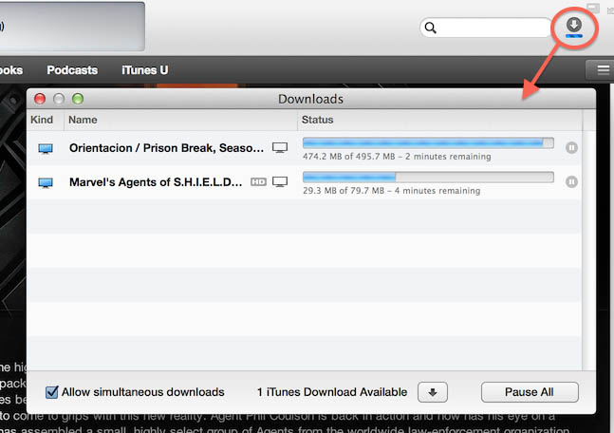
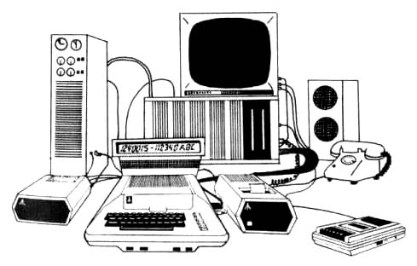
Why Concurrent Programs?
Program Structure: expressing logically
concurrent programs
Responsiveness: shifting work to run
in the background
Responsiveness: managing I/O devices
Performance: exploiting multiprocessors
Notes:
Text Editors - When you are typing in an editor, spell-checking, formatting of text and saving the text are done concurrently by multiple threads. The same applies for Word processors also.

Slide 4
Traditional View of a Process
Process = process context + (virtual) memory state
Process Control Block
Virtual Memory
Program context:
Data registers
Stack pointer (rsp)
Condition codes
Program counter (rip)
Stack
rsp
brk
Heap
Kernel context:
VM structures
File table
brk pointer
Data
rip
Code
0

Slide 5
Alternate View of a Process
Process = thread + other state
Thread (main thread)
Other data
brk
Stack
Heap
rsp
Data
Code
Thread context:
Data registers
Stack pointer (rsp)
Condition codes
Program counter (rip)
0
Kernel context:
VM structures
File table
brk pointer

Slide 6
A Process With Multiple Threads
Multiple threads can be associated with a process
  Each thread has its own logical control flow
  Each thread has its own stack for local variables
  Each thread has its own thread id (TID)
  Each thread shares the same code, data, and kernel context
Thread 1 (main thread)
Thread 2 (peer thread)
Shared data
brk
Heap
Stack 1
Stack 2
rsp
rsp
Data
Thread 1 context:
Data registers
Stack pointer
Condition codes
Program counter
Thread 2 context:
Data registers
Stack pointer
Condition codes
Program counter
Code
0
Kernel context:
VM structures
File table
brk pointer

Slide 7
Threads Memory Model
Conceptual model:
  Multiple threads run within the context of a single process
  Each thread has its own separate thread context
    Thread ID, stack, stack pointer, PC, condition codes, and GP registers
  All threads share the remaining process context
    Code, data, heap, and shared library segments of the process virtual address space
    Open files and installed handlers
Operationally, this model is not strictly enforced:
  Register values are truly separate and protected, but…
  Any thread can read and write the stack of any other thread
The mismatch between the conceptual and operation model
is a source of confusion and errors

Slide 8
Threads vs. Processes
How threads and processes are similar
  Each has its own logical control flow
  Each can run concurrently with others (possibly on different cores)
  Each is scheduled and context switched
How threads and processes are different
  Threads share all code and data (except local stacks)
    Processes (typically) do not
  Threads are somewhat less expensive than processes
    Thread control (creating and reaping) is half as expensive as process control
      ~20K cycles to create and reap a process
      ~10K cycles (or less) to create and reap a thread
    Thread context switches are less expensive (e.g., don't flush TLB)

Slide 9
Logical View of Threads
Threads associated with process form a pool of peers
  Unlike processes which form a tree hierarchy
Process hierarchy
Threads associated with process foo
P0
T2
T4
T1
P1
shared code, data
and kernel context
sh
sh
sh
T5
T3
foo
bar

Slide 10
Posix Threads Interface
C (Pthreads)
Python (threading)
Creating and reaping threads
  pthread_create()
  pthread_join()
Determining your thread ID
  pthread_self()
Terminating threads
  pthread_cancel()
  pthread_exit()
  exit() [terminates all threads]
  RET [terminates current thread]
Creating and reaping threads
  Thread()
  thread.join()
Determining your thread ID
  thread.get_ident()
Terminating threads
  thread.exit()
  RET [terminates current thread]

Slide 11
The Pthreads "hello, world" Program
/*
* hello.c - Pthreads "hello, world" program
*/
#include "csapp.h"
void* thread(void* vargp);
int main(){
pthread_t tid;
pthread_create(&tid, NULL, hello, NULL);
pthread_join(tid, NULL);
exit(0);
}
Thread attributes
(usually NULL)
Thread ID
Thread routine
Thread arguments
(void* p)
Return value
(void** p)
void* hello(void* vargp){ /* thread routine */
printf("Hello, world!\n");
return NULL;
}

Slide 12
Example: Sharing with Threads
char** ptr; /* global var */
int main(){
pthread_t tid;
char* msgs[2] = {"Hello from foo",
"Hello from bar"};
ptr = msgs;
for (int i = 0; i < 2; i++){
pthread_create(&tid, NULL,
fun, (void*) i);
}
pthread_exit(NULL);
}
void* fun(void* vargp){
long myid = (long) vargp;
static int cnt = 0;
printf("[%d]: %s (cnt=%d)\n",
myid, ptr[myid], ++cnt);
return NULL;
}
fun threads reference main thread’s stack indirectly through global ptr variable

Slide 13
Mapping Variable Instances to Memory
Global variables
  Def: Variable declared outside of a function
  Virtual memory contains exactly one instance of any global variable
Local variables
  Def: Variable declared inside function
  Each thread stack contains one instance of each local variable
Local static variables
  Def: Variable declared inside function with the static attribute
  Virtual memory contains exactly one instance of any local static variable.
without static attribute

Slide 14
Mapping Variable Instances to Memory
int* int_ptr; /* global var */
int main(){
pthread_t tid;
int* array[2] = {1,2}
int_ptr = array;
for (int i = 0; i < 2; i++)
pthread_create(&tid, NULL,
thread, (void *)i);
pthread_exit(NULL);
}
Global var: 1 instance (ptr [data])
Local vars: 1 instance (i.m, msgs.m)
Local var: 2 instances (
myid.p0 [peer thread 0’s stack],
myid.p1 [peer thread 1’s stack]
)
Local static var: 1 instance (cnt [data])
void *thread(void *vargp){
long myid = (long)vargp;
static int cnt = 0;
printf("[%d]: %s (cnt=%d)\n",
myid, ptr[myid], ++cnt);
return NULL;
}

Slide 15
Threads Memory Model
Conceptual model:
  Multiple threads run within the context of a single process
  Each thread has its own separate thread context
    Thread ID, stack, stack pointer, PC, condition codes, and GP registers
  All threads share the remaining process context
    Code, data, heap, and shared library segments of the process virtual address space
    Open files and installed handlers
Operationally, this model is not strictly enforced:
  Register values are truly separate and protected, but…
  Any thread can read and write the stack of any other thread
The mismatch between the conceptual and operation model
is a source of confusion and errors

Slide 16
Exercise 1: Shared Variables
char** ptr; /* global var */
int main(){
pthread_t tid;
char* msgs[2] = {"Hello from foo",
"Hello from bar"};
ptr = msgs;
for (int i = 0; i < 2; i++){
pthread_create(&tid, NULL,
fun, (void *)i);
pthread_exit(NULL);
}
Which variables are shared (aka can be accessed by more than one thread)?
  ptr
  cnt
  i
  msgs
  myid
void* fun(void* vargp){
long myid = (long) vargp;
static int cnt = 0;
printf("[%d]: %s (cnt=%d)\n",
myid, ptr[myid], ++cnt);
return NULL;
}
Notes:
A variable x is shared iff multiple threads reference at least one instance of x.

Slide 17
Exercise 1: Shared Variables
Which variables are shared?
  A variable x is shared iff multiple threads reference at least one instance of x.
ptr, cnt, and msgs are shared
i and myid are not shared
Variable Referenced by Referenced by Referenced by
instance main thread? peer thread 0? peer thread 1?
ptr
cnt
i.main
msgs.main
myid.fun0
myid.fun1
yes
yes
yes
no
yes
yes
yes
no
no
yes
yes
yes
no
yes
no
no
no
yes

Slide 18
Why not Concurrent Programs?
/* Global shared variable */
volatile long cnt = 0; /* Counter */
int main(int argc, char** argv){
long niters;
pthread_t tid1, tid2;
niters = atoi(argv[1]);
pthread_create(&tid1, NULL,
count_func, &niters);
pthread_create(&tid2, NULL,
count_func, &niters);
pthread_join(tid1, NULL);
pthread_join(tid2, NULL);
/* Check result */
if (cnt != (2 * niters))
printf("BOOM! cnt=%ld\n", cnt);
else
printf("OK cnt=%ld\n", cnt);
exit(0);
}
/* Thread routine */
void* count_func(void* vargp){
long i, niters;
niters = *((long*) vargp);
for (i = 0; i < niters; i++){
cnt++;
}
return NULL;
}
linux> ./badcnt 10000
OK cnt=20000
linux> ./badcnt 10000
BOOM! cnt=13051
linux>

Slide 19
Assembly Code for Counter Loop
C code for counter loop in thread i
for (i = 0; i < niters; i++){
cnt++;
}
movq (%rdi), %rcx
testq %rcx,%rcx
jle .L2
movl $0, %eax
.L3:
movq cnt(%rip),%rdx
addq $1, %rdx
movq %rdx, cnt(%rip)
addq $1, %rax
cmpq %rcx, %rax
jne .L3
.L2:
H_{i} : Head
L_{i} : Load cnt
U_{i} : Update cnt
S_{i} : Store cnt
T_{i} : Tail

Slide 20
Race conditions
A race condition is a timing-dependent error involving shared state
  whether the error occurs depends on thread schedule
program execution/schedule can be non-deterministic
compilers and processors can re-order instructions

Slide 21
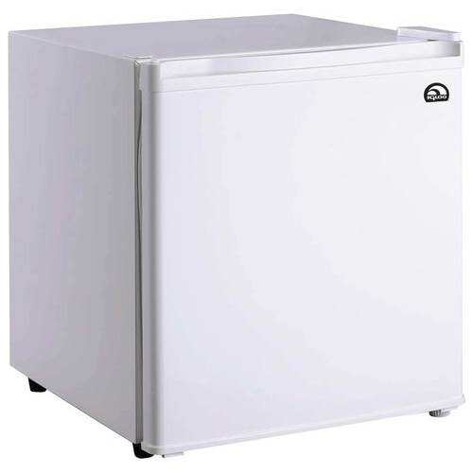
A concrete example…
You and your roommate share a refrigerator. Being good roommates, you both try to make sure that the refrigerator is always stocked with milk.
Liveness: if you are out of milk, someone buys milk
Safety: you never have more than one quart of milk
Algorithm 1:
Look in fridge.
If out of milk:
go to store,
buy milk,
go home
put milk in fridge
Algorithm 1:
if (milk == 0) { // no milk
milk++; // buy milk
}

Slide 22
A problematic schedule
You
Your Roommate
3:00 Look in fridge; out of milk
3:05 Leave for store
3:10 Arrive at store
3:15 Buy milk
3:20 Arrive home; put milk in fridge
3:10 Look in fridge; out of milk
3:15 Leave for store
3:20 Arrive at store
3:25 Buy milk
3:30 Arrive home; put milk in fridge
Safety violation:
You have too much milk and it spoils

Slide 23
Solution 1: Leave a note
You and your roommate share a refrigerator. Being good roommates, you both try to make sure that the refrigerator is always stocked with milk.
Algorithm 2:
if (milk == 0) { // no milk
if (note == 0) { // no note
note = 1; // leave note
milk++; // buy milk
note = 0; // remove note
}
}
Safety violation: you've introduced a Heisenbug!

Slide 24
Solution 2: Leave note before check note
You and your roommate share a refrigerator. Being good roommates, you both try to make sure that the refrigerator is always stocked with milk.
Algorithm 3:
note1 = 1
if (note2 == 0) { // no note from
roommate
if (milk == 0) {// no milk
milk++; // buy milk
}
}
note1 = 0
Liveness violation: No one buys milk

Slide 25
Solution 3: Keep checking for note
You and your roommate share a refrigerator. Being good roommates, you both try to make sure that the refrigerator is always stocked with milk.
Algorithm 4:
note1 = 1
while (note2 == 1) { // wait until
; // no note
}
if (milk == 0) { // no milk
milk++; // buy milk
}
note1 = 0
Liveness violation: You've introduced deadlock

Slide 26
Solution 4: Take turns
You and your roommate share a refrigerator. Being good roommates, you both try to make sure that the refrigerator is always stocked with milk.
Algorithm 5:
note1 = 1
turn = 2
while (note2 == 1 and turn == 2){
;
}
if (milk == 0) { // no milk
milk++; // buy milk
}
note1 = 0
(probably) correct, but complicated and inefficient
Notes:
Note: this solution might fail if the compiler or hardware reorders instruction
Properties we need: (1) if no contention, proceed, (2) if contention, wait until no one is in critical section, then one proceed

Slide 27
Locks
A lock (aka a mutex) is a synchronization primitive that provides mutual exclusion. When one thread holds a lock, no other thread can hold it.
  a lock can be in one of two states: locked or unlocked
  a lock is initially unlocked
  function acquire(&lock) waits until the lock is unlocked, then atomically sets it to locked
  function release(&lock) sets the lock to unlocked

Slide 28
Atomic Operations
Solution: hardware primitives to support synchronization
A machine instruction that (atomically!) reads and updates
Example: xchg src, dest
  one instruction
  semantics: TEMP ← DEST; DEST ← SRC; SRC ← TEMP;

Slide 29
Spinlocks
acquire:
mov $1, eax ; Set EAX to 1
xchg eax, (rdi) ; Atomically swap EAX w/ lock val
test eax, eax ; check if EAX is 0 (lock unlocked)
jnz acquire ; if was locked, loop
ret ; lock has been acquired, return
release:
mov $0, eax ; Set EAX to 0
xchg eax, (rdi) ; Atomically swap EAX w/ lock val
ret ; lock has been released, return

Slide 30
Solution 5: use a lock
You and your roommate share a refrigerator. Being good roommates, you both try to make sure that the refrigerator is always stocked with milk.
Algorithm 6:
acquire(&lock)
if (milk == 0) { // no milk
milk++; // buy milk
}
release(&lock)
Correct!

Slide 31
Programming with Locks
C (pthreads)
Python (threading)
Defines lock type pthread_mutex_t
functions to create/destroy locks:
  int pthread_mutex_init(&lock, attr);
  int pthread_mutex_destroy(&lock);
functions to acquire/release lock:
  int pthread_mutex_lock(&lock);
  int pthread_mutex_unlock(&lock);
Defines class Lock
constructor to create locks:
  Lock()
  destroyed by garbage collector
functions to aquire/release lock:
  lock.acquire()
  lock.release()

Slide 32
Exercise 2: Locks
/* Global shared variable */
volatile long cnt = 0; /* Counter */
int main(int argc, char** argv){
long niters;
pthread_t tid1, tid2;
niters = atoi(argv[1]);
pthread_create(&tid1, NULL,
count_func, &niters);
pthread_create(&tid2, NULL,
count_func, &niters);
pthread_join(tid1, NULL);
pthread_join(tid2, NULL);
/* Check result */
if (cnt != (2 * niters))
printf("BOOM! cnt=%ld\n", cnt);
else
printf("OK cnt=%ld\n", cnt);
exit(0);
}
/* Thread routine */
void* count_func(void* vargp){
long i, niters;
niters = *((long*) vargp);
for (i = 0; i < niters; i++){
cnt++;
}
return NULL;
}
TODO: Modify this example to guarantee correctness

Slide 33
Problems with Locks
Locks are slow
  threads that fail to acquire a lock on the first attempt must "spin", which wastes CPU cycles
  threads get scheduled and de-scheduled while the lock is still locked
Using locks correctly is hard
  hard to ensure all race conditions are eliminated
  easy to introduce synchronization bugs (deadlock, livelock)

Slide 34
Better Synchronization Primitives
Semaphores
  stateful synchronization primitive
Condition variables
  event-based synchronization primitive

