Slide 1
Lecture 15: Dynamic Memory
CS 105 Spring 2026

Slide 2
Memory
0x7FFFFFFFFFFF
Stack
byte addressable array made up of four logical segments
attempt to access uninitialized address results in exception (segfault)
stack provides local storage for procedures
  "top" of the stack stored in register %rsp
heap is an area of memory maintained by a dynamic memory allocator
  operating system maintains variable brk that points to the top of heap
  program can dynamically allocate/deallocate heap memory
data stores global variables
code stores program instructions
%rsp
brk
Heap
Data
%rip
Code
0x000000000000

Slide 3
Dynamic Memory Allocation
Dynamic memory allocator
  Manages the heap
    organizes the heap as a collection of (variable-size) blocks, each of which is either allocated or free
    allocates and deallocates memory
    may ask OS for additional heap space using system call sbrk()
  Part of the process’s runtime system
    Linked into program
Example dynamic memory allocators
  malloc and free in C
  new and delete in C++
  object creation & garbage collection in Java
  object creation & garbage collection in Python
explicit allocators
implicit allocators

Slide 4
Allocation Example using malloc
#include <stdio.h>
#include <stdlib.h>
void foo(int n) {
/* Allocate a block of n ints */
int* p = (int*) malloc(n * sizeof(int));
if (p == NULL) {
perror("malloc");
exit(0);
}
/* Initialize allocated block */
for (int i=0; i<n; i++){
p[i] = i;
}
/* Return allocated block to the heap */
free(p);
}

Slide 5
Allocation Example
p4
p1
p2
p3
Assume each diagram block depicts 4 bytes
p1 = malloc(16)
p2 = malloc(20)
p3 = malloc(24)
free(p2)
p4 = malloc(8)

Slide 6
Allocator Requirements
Must handle arbitrary request sequences:
  cannot control number, size, or order of requests
  (but we'll assume that each free request corresponds to an allocated block)
Must respond immediately:
  no reordering or buffering requests
Must not modify allocated blocks:
  can only allocate from free memory on the heap
  cannot modify or move blocks once they are allocated
Must align blocks:
  8-byte (x86) or 16-byte (x86-64) alignment on Linux
  Ensures that allocated blocks can hold any type of data
Must only use the heap:
  any data structures used by the allocator must be stored in the heap

Slide 7
First Example: A Simple Allocator
void* malloc (size_t size) {
return sbrk(align(size));
}
void free (void* ptr) {
// do nothing
}
Advantages
Simple
Blazing fast
Disadvantages
Memory is never recycled
Wastes a lot of space

Slide 8
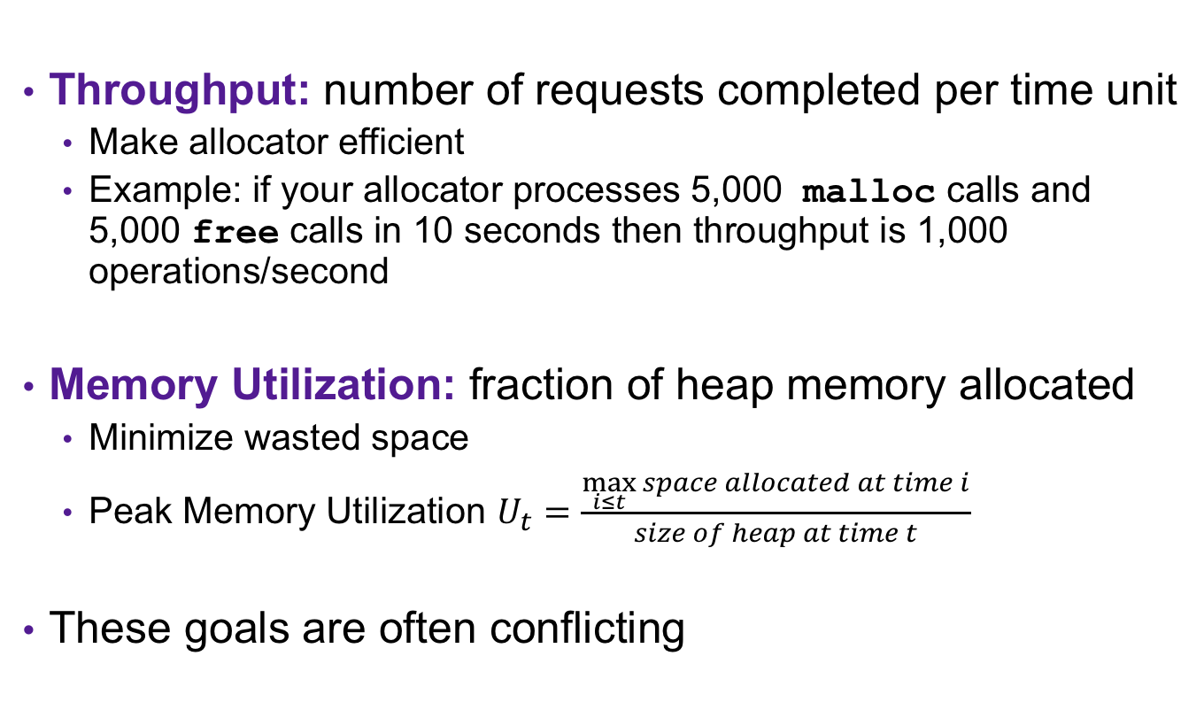
Allocator Goals
Throughput: number of requests completed per time unit
  Make allocator efficient
  Example: if your allocator processes 5,000 malloc calls and 5,000 free calls in 10 seconds then throughput is 1,000 operations/second
Memory Utilization: fraction of heap memory allocated
  Minimize wasted space
  Peak Memory Utilization $U_{t}=\frac{\max_{i≤t}{space allocated at time i}}{size of heap at time t}$
These goals are often conflicting

Slide 9









Exercise: Memory Utilization
Recall that Peak Memory Utilization $U_{t}=\frac{\max_{i≤t}{space allocated at time i}}{size of heap at time t}$
What is the Peak Memory Utilization at time $t=2$?
What is the Peak Memory Utilization at time $t=5$?
$$t=0$$
$$t=1$$
$$t=2$$
$$t=3$$
$$t=4$$
$$t=5$$
$$3/4$$
$$5/8$$

Slide 10
Utilization Blocker: External Fragmentation
Occurs when there is enough aggregate heap memory, but no single free block is large enough
Depends on the pattern of future requests
  Thus, difficult to measure
p1
p2
p3
p1 = malloc(16)
p2 = malloc(20)
p3 = malloc(24)
free(p2)
p4 = malloc(24)

Slide 11
Utilization Blocker: Internal Fragmentation
For a given block, internal fragmentation occurs if payload is smaller than block size
Caused by
  Overhead of maintaining heap data structures
  Padding for alignment purposes
  Explicit policy decisions
  (for example, returning a big block to satisfy a small request)
Depends only on the pattern of previous requests
  Thus, easy to measure
Block
Internal
fragmentation
Payload
Internal
fragmentation

Slide 12
Challenges
Goal: maximize throughput and peak memory utilization
Implementation challenges:
  How do we know how much memory to free given just a pointer?
  How do we keep track of the free blocks?
  How do we pick a block to use for allocation?
  What do we do with the extra space when allocating a structure that is smaller than the free block it is placed in?
  How do we reinsert a freed block?

Slide 13
Knowing How Much to Free
Standard method
  Keep the length of a block in the word preceding the block.
    This word is often called the header field or header
  Requires an extra (4 byte) header for every allocated block
p0
p0 = malloc(16)
20
header = block size
payload
free(p0)

Slide 14
Challenges
Goal: maximize throughput and peak memory utilization
Implementation Challenges:
  How do we know how much memory to free given just a pointer?
  How do we keep track of the free blocks?
  How do we pick a block to use for allocation?
  What do we do with the extra space when allocating a structure that is smaller than the free block it is placed in?
  How do we reinsert a freed block?

Slide 15
Keeping Track of Free Blocks
Method 1: Implicit list using length—links all blocks
20
16
24
8

Slide 16
Method 1: Implicit List
For each block we need both size and allocation status
  Could store this information in two ints: wasteful!
Standard trick
  If blocks are aligned, some low-order address bits are always 0
  Instead of storing an always-0 bit, use it as an allocated/free flag
  When reading size word, must mask out this bit
Optional
padding
Format of
allocated and
free blocks
Payload
Payload: application data
(allocated blocks only)
Addresses
Size: total block size (incl header + padding)
a = 1: Allocated block
a = 0: Free block
Size
a
Header
(4 bytes)

Slide 17
Keeping Track of Free Blocks
Method 1: Implicit list using length—links all blocks
20
17
24
9
Allocated blocks: shaded
Free blocks: unshaded
Headers: labeled with size in bytes/allocated bit

Slide 18
Exercise: Block Headers
Determine the block sizes and header values that would result from the following sequence of malloc requests. Assume that the allocator uses an implicit list implementation with the block format just described and maintains 8-byte alignment.
Request | Block size (decimal) | Block header (hex)
malloc(1)
malloc(5)
malloc(12)
Optional
padding
Request | Block size (decimal) | Block header (hex)
malloc(1)
malloc(5)
malloc(12)
8
0x00000009
Payload
16
0x00000011
16
0x00000011
Header
(4 bytes)
Size
a

Slide 19
Keeping Track of Free Blocks
Method 1: Implicit list using length—links all blocks
Method 2: Explicit list among the free blocks using pointers
Method 3: Segregated free list
  Different free lists for different size classes
Method 4: Blocks sorted by size
  Can use a balanced tree (e.g. Red-Black tree) with pointers within each free block, and the length used as a key
20
17
24
9
13
20
17
24
9
13
Notes:
Small group discussion: what data structure would you use?

Slide 20
Challenges
Goal: maximize throughput and peak memory utilization
Implementation Challenges:
  How do we know how much memory to free given just a pointer?
  How do we keep track of the free blocks?
  How do we pick a block to use for allocation?
  What do we do with the extra space when allocating a structure that is smaller than the free block it is placed in?
  How do we reinsert a freed block?

Slide 21
Implicit List: Finding a Free Block
  First fit. Search list from beginning, choose first free block that fits:
  Can take linear time in total number of blocks (allocated and free)
  In practice it can cause “splinters” at beginning of list
Next fit. Like first fit, but search list starting where previous search finished:
  Should often be faster than first fit: avoids re-scanning unhelpful blocks
  Some research suggests that fragmentation is worse
Best fit. Search the list, choose the best free block: fits, with fewest bytes left over:
  Keeps fragments small—usually improves memory utilization
  Will typically run slower than first fit
p = start;
while ((p < end) && \\ not passed end
((*p & 1) || \\ already allocated
(*p <= len))) \\ too small
p = p + (*p & -2); \\ goto next block (word addressed)

Slide 22
Challenges
Goal: maximize throughput and peak memory utilization
Implementation Challenges:
  How do we know how much memory to free given just a pointer?
  How do we keep track of the free blocks?
  How do we pick a block to use for allocation?
  What do we do with the extra space when allocating a structure that is smaller than the free block it is placed in?
  How do we reinsert a freed block?

Slide 23
Implicit List: Allocating in Free Block
Allocating in a free block: splitting
  Since allocated space might be smaller than free space, we might want to split the block
16
17
24
9
p
addblock(p, 4)
16
17
17
8
9
void addblock(ptr p, int len) {
int newsize = ((len + 1) >> 1) << 1; // round up to even
int oldsize = *p & -2; // mask out low bit
*p = newsize | 1; // set new length
if (newsize < oldsize)
*(p+newsize) = oldsize - newsize; // set length in remaining
} // part of block

Slide 24
Summary of Key Allocator Policies
Free-block storage policy:
  Implicit lists, with boundary tags (nice and simple)
  Explicit lists, exclude free blocks (faster, but more overhead)
  Segregated lists (different lists for different sized blocks)
  Fancy data structures (red-black trees, for example)
Placement policy:
  First-fit (simple, but lower throughput and higher fragmentation)
  Next-fit (higher throughput, higher fragmentation)
  Best-fit (lower throughput, lower fragmentation
  segregated free lists approximate a best fit placement policy without having to search entire free list
Splitting policy:
  When do we go ahead and split free blocks?
  How much internal fragmentation are we willing to tolerate?

Slide 25
Challenges
Goal: maximize throughput and peak memory utilization
Implementation Challenges:
  How do we know how much memory to free given just a pointer?
  How do we keep track of the free blocks?
  How do we pick a block to use for allocation?
  What do we do with the extra space when allocating a structure that is smaller than the free block it is placed in?
  How do we reinsert a freed block?

Slide 26
Implicit List: Freeing a Block
Simplest implementation:
  Need only clear the “allocated” flag
    void free_block(ptr p) { *p = *p & -2 }
  But can lead to “false fragmentation”
16
17
17
8
9
free(p)
p
16
17
16
8
9
malloc(20)
Oops!
  There is enough free space, but the allocator won’t be able to find it

Slide 27
Implicit List: Coalescing
Join (coalesce) with next/previous blocks, if they are free
  Coalescing with next block
16
17
17
8
9
logically
gone
free(p)
p
16
17
24
8
9
  But how do we coalesce with previous block?

Slide 28
Implicit List: Bidirectional Coalescing
Boundary tags [Knuth73]
  Replicate size/allocated word at “bottom” (end) of free blocks
  Allows us to traverse the “list” backwards, but requires extra space
  Important and general technique!
16
16
17
17
24
24
17
17
Boundary tag
(footer)
Size
a
a = 1: Allocated block
a = 0: Free block
Size: Total block size
Payload: Application data
(allocated blocks only)
Format of
allocated and
free blocks
Payload and
padding
Header
Size
a

Slide 29
Constant-Time Coalescing
Case 1: Prev and next block allocated
Case 2: Prev block free, next block allocated
n3
1
n3
1
n3
1
n3
1
n3
1
n3
1
n3
1
n3
1
n2
1
n2
0
n2
1
n1+n2
0
p
p
n2
1
n2
0
n2
1
n2
1
n1
1
n1
1
n1
0
n1
0
n1
1
n1
1
n1
0
n1+n2
0
Case 2: Prev block allocated, next block free
Case 4: Prev and next block free
n3
0
n2+n3
0
n3
0
n1+n2+n3
0
n3
0
n3
0
n3
0
n3
0
n2
1
n2
1
n2
1
n2
1
p
p
n2
1
n2+n3
0
n2
1
n2
1
n1
1
n1
1
n1
0
n1
0
n1
1
n1
1
n1
0
n1+n2+n3
0

Slide 30
Exercise: Coalescing
Assume the current heap is shown below. What would be the state of the heap after the function free(0x118)is executed?
0x00000018
0x0000000c
0x128
0x00000047
following block (free)
0x124
0x0000000c
0x120
0x0000000d
0x11c
0xc0ffee24
current block (allocated)
0x118
0x00000018
0x0000000d
0x114
0x00000011
0x110
0x5ca1ab1e
0x10c
previous block (allocated)
0x0000000d
0x108
0x00000011
0x104
0x0000000d
0x100

Slide 31
Summary of Key Allocator Policies
Free-block storage policy:
  Implicit lists, with boundary tags (nice and simple)
  Explicit lists, exclude free blocks (faster, but more overhead)
  Segregated lists (different lists for different sized blocks)
  Fancy data structures (red-black trees, for example)
Placement policy:
  First-fit (simple, but lower throughput and higher fragmentation)
  Next-fit (higher throughput, higher fragmentation)
  Best-fit (lower throughput, lower fragmentation
  segregated free lists approximate a best fit placement policy without having to search entire free list
Splitting policy:
  When do we go ahead and split free blocks?
  How much internal fragmentation are we willing to tolerate?
Coalescing policy:
  No coalescing (bad choice)
  Immediate coalescing: coalesce each time free is called
  Deferred coalescing: coalesce on allocate or after fixed time

