Slide 1
Lecture 4: Floats
CS 105 Spring 2026

Slide 2
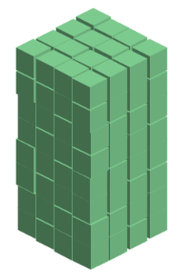
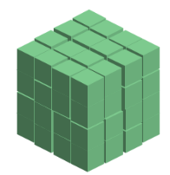
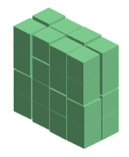





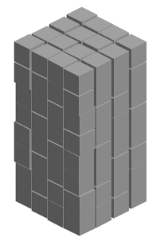
Review: Representing Integers
unsigned:
signed (two's complement aka normal integers):
128 (2⁷) | 64 (2⁶) | 32 (2⁵) | 16 (2⁴) | 8 (2³) | 4 (2²) | 2 (2¹) | 1 (2⁰)
-128 (2⁷) | 64 (2⁶) | 32 (2⁵) | 16 (2⁴) | 8 (2³) | 4 (2²) | 2 (2¹) | 1 (2⁰)

Slide 3
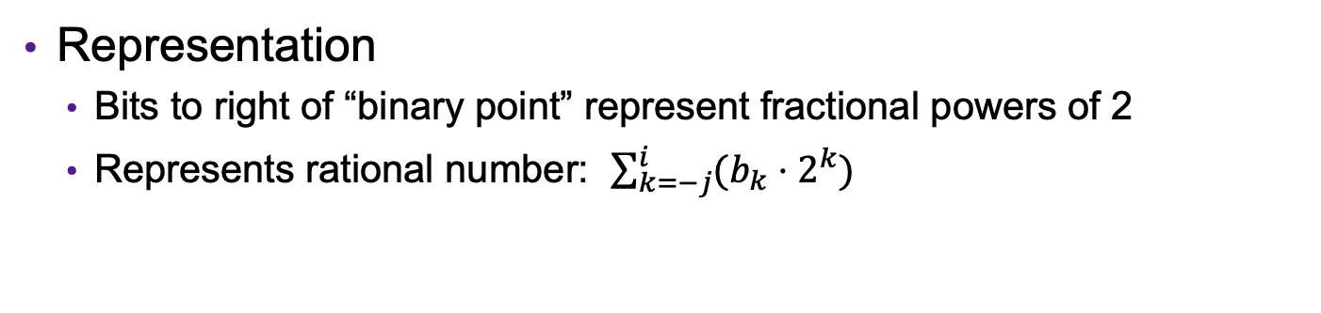
Fractional binary numbers
2^{i}
2^{i-1}
4
2
1
• • •
bi | bi-1 | ••• | b2 | b1 | b0 | b-1 | b-2 | b-3 | ••• | b-j
1/2
1/4
1/8
2^{-j}
• • •
Representation
  Bits to right of “binary point” represent fractional powers of 2
  Represents rational number: $\sum_{k=−j}^{i}{(b_{k}⋅2^{k})}$

Slide 4
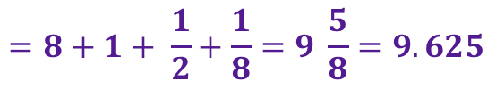
Example: Fractional Binary Numbers
What is 1001.101₂?
What is the binary representation of 13 9/16?
$$=8+1+ \frac{1}{2}+\frac{1}{8}=9 \frac{5}{8}=9.625$$
1101.
1001
Notes:
101.112
010.1112
001.01112

Slide 5
Exercise 1: Fractional Binary Numbers
Translate the following fractional numbers to their binary representation
  5 3/4
  2 7/8
  1 7/16
Translate the following fractional binary numbers to their decimal representation
  .011
  .11
  1.1
101.11
10.111
1.0111
.375
.75
1.5
Notes:
Divide by 2 by shifting right (unsigned)
Multiply by 2 by shifting left
Numbers of form 0.111111…2 are just below 1.0
1/2 + 1/4 + 1/8 + … + 1/2^{i} + … ➙ 1.0

Slide 6
Representable Numbers
Limitation #1
  Can only exactly represent numbers of the form x/2^{k}
  Other rational numbers have repeating bit representations
  Value Representation
    1/3 0.0101010101[01]…2
    1/5 0.001100110011[0011]…2
    1/10 0.0001100110011[0011]…2
Limitation #2
  Just one setting of binary point within the w bits
  Limited range of numbers (very small values? very large?)

Slide 7





Floating Point Representation
Numerical Form: ${\left(−1\right)}^{s}⋅M⋅2^{E}$
  Sign bit $s$ determines whether number is negative or positive
  Significand $M$ normally a (binary) fractional value in range [1.0,2.0)
  Exponent $E$ weights value by power of two
Examples:
  1.0
  -1.25
  64
  -.625
1.0
$${\left(−1\right)}^{0}⋅1.0⋅2^{0}$$
s = 0, M = 1.0, E = 0
-1.01
$${\left(−1\right)}^{1}⋅1.01⋅2^{0}$$
s = 1, M = 1.01, E = 0
1000000
$${\left(−1\right)}^{0}⋅1.0⋅2^{6}$$
s = 0, M = 1.0, E = 6
-0.101
$${\left(−1\right)}^{0}⋅1.01⋅2^{−1}$$
s = 0, M = 1.01, E = -1
Notes:
Define values s, M, E for each

Slide 8

Exercise 2: Floating Point Numbers
For each of the following numbers, specify a bit s, binary fractional number M in [1.0,2.0) and a binary number E such that the number is equal to ${\left(−1\right)}^{s}⋅M⋅2^{E}$
  5 3/4
  2 7/8
  -1 1/2
  -3/4
101.11
s = 0, M = 1.0111, E = 2
10.111
s = 0, M = 1.0111, E = 1
-1.1
s = 1, M = 1.1, E = 0
-0.11
s = 1, M = 1.1, E = -1
Notes:
Define values s, M, E for each
Divide by 2 by shifting right (unsigned)
Multiply by 2 by shifting left
Numbers of form 0.111111…2 are just below 1.0
1/2 + 1/4 + 1/8 + … + 1/2^{i} + … ➙ 1.0

Slide 9
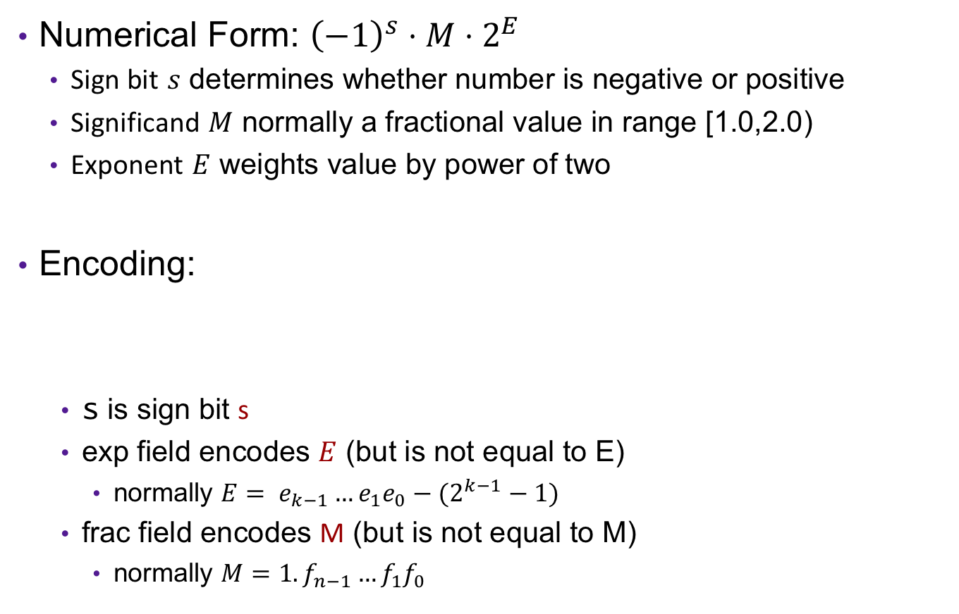
Floating Point Representation
Numerical Form: ${\left(−1\right)}^{s}⋅M⋅2^{E}$
  Sign bit $s$ determines whether number is negative or positive
  Significand $M$ normally a fractional value in range [1.0,2.0)
  Exponent $E$ weights value by power of two
Encoding:
  s is sign bit s
  exp field encodes $E$ (but is not equal to E)
    normally $E= e_{k−1}…e_{1}e_{0}−(2^{k−1}−1)$
  frac field encodes M (but is not equal to M)
    normally $M=1.f_{n−1}…f_{1}f_{0}$
$$s$$ | $$\exp{=e_{k−1}…e_{1}e_{0}}$$ | $$frac=f_{n−1}…f_{1}f_{0}$$
Float (32 bits):
k = 8, n = 23
bias = 127
Double (64 bits)
k=11, n = 52
bias = 1023
bias
Notes:
Normalize demo: 1.0 hex->interpretation on board, then 1.25, then demo exponent changes with bigger and smaller values

Slide 10

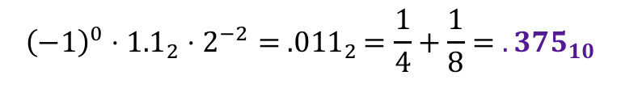
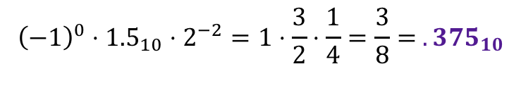
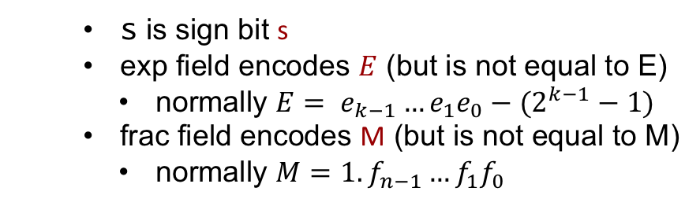
Example: Floats
What fractional number is represented by the bytes 0x3ec00000? Assume big-endian order.
$$s$$ | $$\exp{=e_{k−1}…e_{1}e_{0}}$$ | $$frac=f_{n−1}…f_{1}f_{0}$$
  s is sign bit s
  exp field encodes $E$ (but is not equal to E)
    normally $E= e_{k−1}…e_{1}e_{0}−(2^{k−1}−1)$
  frac field encodes M (but is not equal to M)
    normally $M=1.f_{n−1}…f_{1}f_{0}$
Float (32 bits):
k = 8, n = 23
bias = 127
$${\left(−1\right)}^{s}⋅M⋅2^{E}$$
0011 1110 1100 0000 0000 0000 0000 0000
s=0
exp=125
frac = 10000000000000000000000₂
s=0
E = -2
M = 1.10000000000000000000000₂ = 1.5₁₀
$${\left(−1\right)}^{0}⋅{1.5}_{10}⋅2^{−2}=1⋅\frac{3}{2}⋅\frac{1}{4}=\frac{3}{8}= {.375}_{10}$$
$${\left(−1\right)}^{0}⋅{1.1}_{2}⋅2^{−2}= {.011}_{2}=\frac{1}{4}+\frac{1}{8}= {.375}_{10}$$
Notes:
.375

Slide 11
Exercise 3: Floats
What fractional number is represented by the bytes 0xc23c0000? Assume big-endian order.
$$s$$ | $$\exp{=e_{k−1}…e_{1}e_{0}}$$ | $$frac=f_{n−1}…f_{1}f_{0}$$
  s is sign bit s
  exp field encodes $E$ (but is not equal to E)
    normally $E= e_{k−1}…e_{1}e_{0}−(2^{k−1}−1)$
  frac field encodes M (but is not equal to M)
    normally $M=1.f_{n−1}…f_{1}f_{0}$
Float (32 bits):
k = 8, n = 23
bias = 127
$${\left(−1\right)}^{s}⋅M⋅2^{E}$$

Slide 12
Limitation so far…
s | exp | frac
1 | 8-bits | 23-bits
How do we represent zero?
Notes:
.375

Slide 13
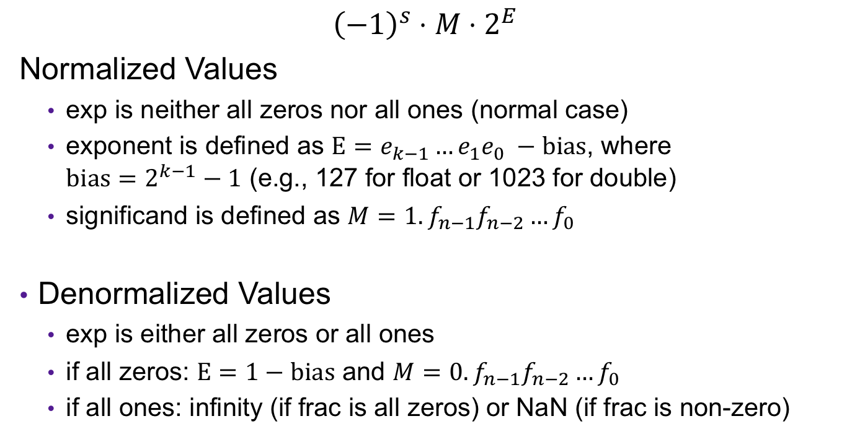
Normalized and Denormalized
s | exp | frac
$${\left(−1\right)}^{s}⋅M⋅2^{E}$$
Normalized Values
  exp is neither all zeros nor all ones (normal case)
  exponent is defined as $E=e_{k−1}…e_{1}e_{0} −bias$, where $bias=2^{k−1}−1$ (e.g., 127 for float or 1023 for double)
  significand is defined as $M=1.f_{n−1}f_{n−2}…f_{0}$
Denormalized Values
  exp is either all zeros or all ones
  if all zeros: $E=1−bias$ and $M=0.f_{n−1}f_{n−2}…f_{0}$
  if all ones: infinity (if frac is all zeros) or NaN (if frac is non-zero)

Slide 14
Visualization: Floating Point Encodings
−∞
+∞
−Normalized
−Denorm
+Denorm
+Normalized
NaN
NaN
−0
+0

Slide 15
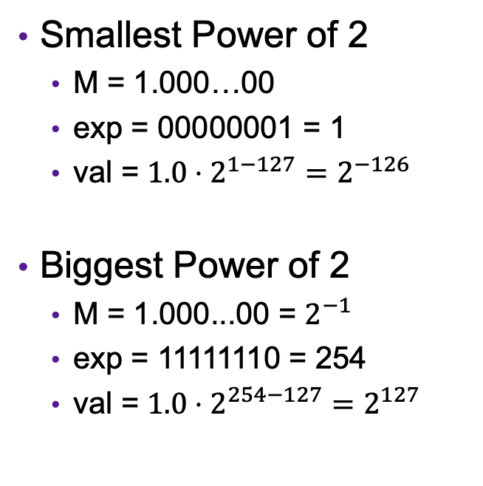
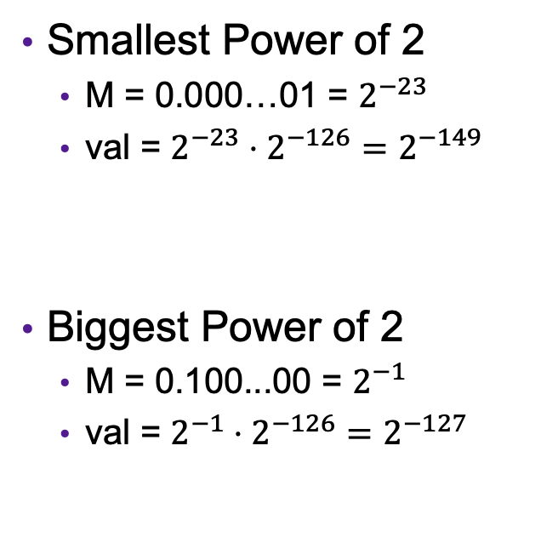
Limits of Floats
Denormalized Floats
Normalized Floats
Smallest Power of 2
  M = 0.000…01 = $2^{−23}$
  val = $2^{−23}⋅2^{−126}=2^{−149}$
Biggest Power of 2
  M = 0.100...00 = $2^{−1}$
  val = $2^{−1}⋅2^{−126}=2^{−127}$
Smallest Power of 2
  M = 1.000…00
  exp = 00000001 = 1
  val = $1.0⋅2^{1−127}=2^{−126}$
Biggest Power of 2
  M = 1.000...00 = $2^{−1}$
  exp = 11111110 = 254
  val = $1.0⋅2^{254−127}=2^{127}$

Slide 16
Example: Limits of Floats
s | exp | frac
1 | 8-bits | 23-bits
There are big gaps between representable numbers (when exponent is big)
0111 1111 0111 1111 1111 1111 1111 1111
s=0
E = 127
M = 1.11111111111111111111111₂
$${x=1.11111111111111111111111}_{2}⋅2^{127}$$
$${y=1.11111111111111111111110}_{2}⋅2^{127}$$
$x−y={0.00000000000000000000001}_{2}⋅2^{127}=1⋅2^{−23}⋅2^{127}=2^{104}$

Slide 17
Correctness
Example 1: Is (x + y) + z = x + (y + z)?
  Ints: Yes!
  Floats:
    (2^30 + -2^30) + 3.14 ➙ 3.14
    2^30 + (-2^30 + 3.14) ➙ 0.0

Slide 18
Floating Point Operations
All of the bitwise and logical operations still work
Float arithmetic operations done by separate hardware unit (FPU)

Slide 19
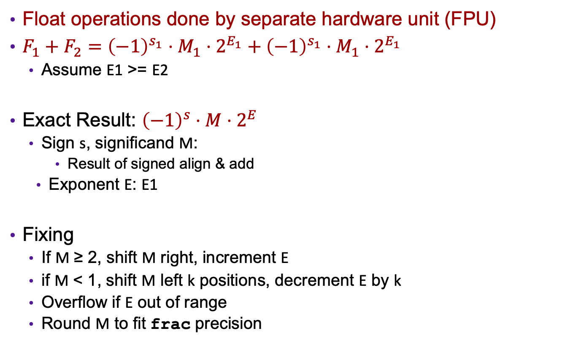
Floating Point Addition
Float operations done by separate hardware unit (FPU)
$F_{1}+F_{2}={\left(−1\right)}^{s_{1}}⋅M_{1}⋅2^{E_{1}}+{\left(−1\right)}^{s_{1}}⋅M_{1}⋅2^{E_{1}}$
  Assume E1 >= E2
Exact Result: ${\left(−1\right)}^{s}⋅M⋅2^{E}$
  Sign s, significand M:
    Result of signed align & add
  Exponent E: E1
Fixing
  If M ≥ 2, shift M right, increment E
  if M < 1, shift M left k positions, decrement E by k
  Overflow if E out of range
  Round M to fit frac precision
Get binary points lined up
E1–E2
(–1)^{s1} M1
+
(–1)^{s2} M2
(–1)^{s} M

Slide 20
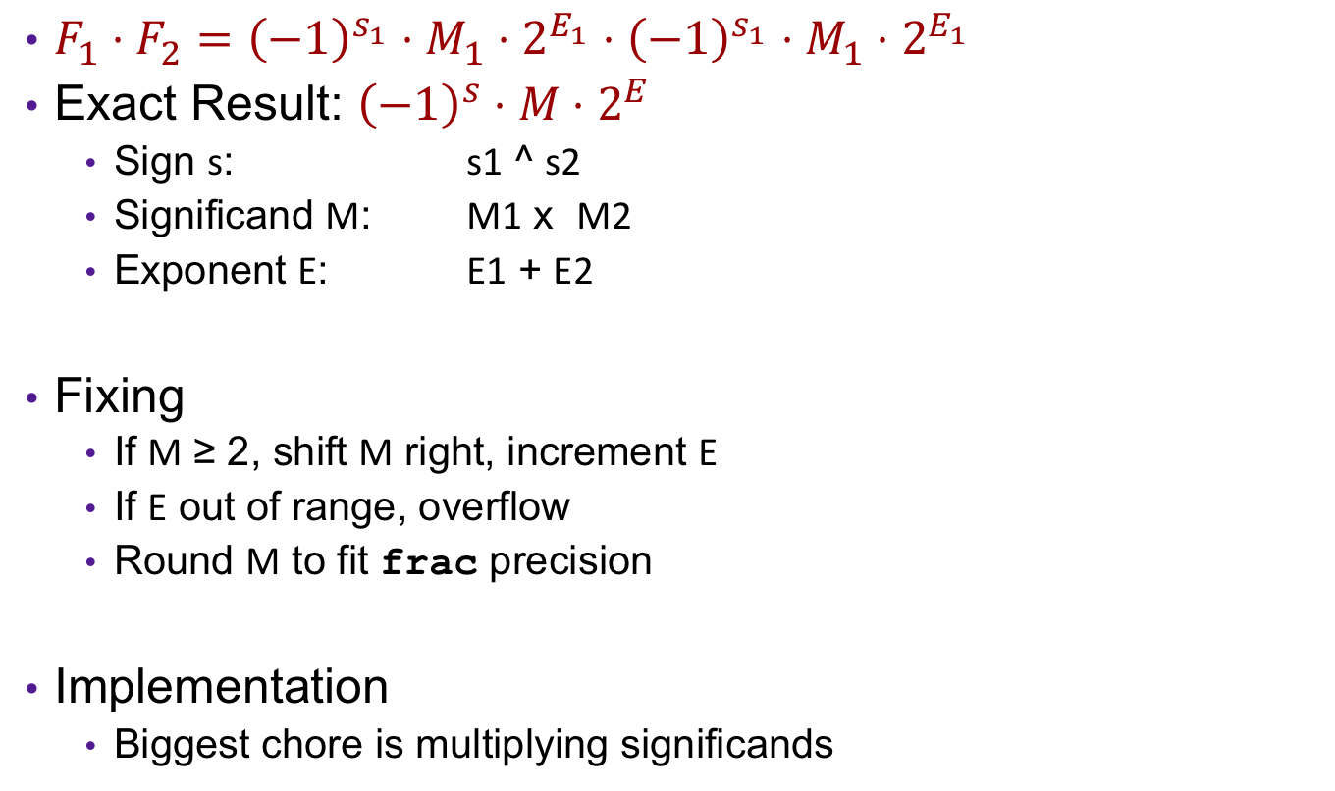
Floating Point Multiplication
$F_{1}⋅F_{2}={\left(−1\right)}^{s_{1}}⋅M_{1}⋅2^{E_{1}}⋅{\left(−1\right)}^{s_{1}}⋅M_{1}⋅2^{E_{1}}$
Exact Result: ${\left(−1\right)}^{s}⋅M⋅2^{E}$
  Sign s: s1 ^ s2
  Significand M: M1 x M2
  Exponent E: E1 + E2
Fixing
  If M ≥ 2, shift M right, increment E
  If E out of range, overflow
  Round M to fit frac precision
Implementation
  Biggest chore is multiplying significands

Slide 21
Floating Point in C
C Guarantees Two Levels
  float single precision (32 bits)
  double double precision (64 bits)
Conversions/Casting
  Casting between int, float, and double changes bit representation
  double/float → int
    Truncates fractional part
    Like rounding toward zero
    Not defined when out of range or NaN: Generally sets to TMin
  int → double
    Exact conversion,
  int → float
    Will round
This is what most languages
call floats!

Slide 22
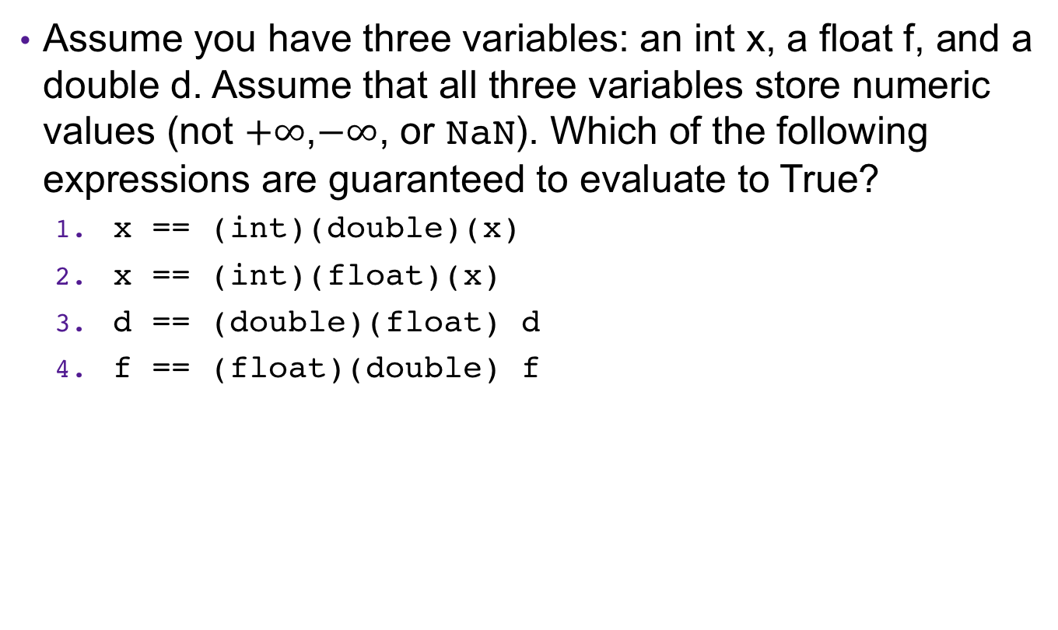
Example: Casting with Floats
Assume you have three variables: an int x, a float f, and a double d. Assume that all three variables store numeric values (not $+∞$,$−∞$, or NaN). Which of the following expressions are guaranteed to evaluate to True?
  x == (int)(double)(x)
  x == (int)(float)(x)
  d == (double)(float) d
  f == (float)(double) f

Slide 23
Example: Casting with Floats
Assume you have three variables: an int x, a float f, and a double d. Assume that all three variables store numeric values (not $+∞$,$−∞$, or NaN). Which of the following expressions are guaranteed to evaluate to True?
  x == (int)(double)(x)
  x == (int)(float)(x)
  d == (double)(float) d
  f == (float)(double) f
True
False
False
True

