Slide 1
Lecture 3: Representing Signed Integers
CS 105 Spring 2026

Slide 2
Course Announcements
Assignment 1 is graded
Assignment 2 is due tomorrow
We have a course slack channel! #cs105-2026sp

Slide 3
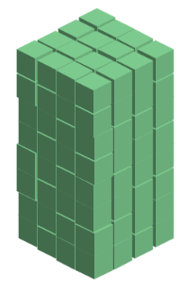
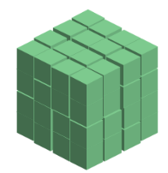
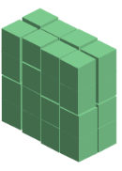





Review: Binary Numbers
128 (2⁷) | 64 (2⁶) | 32 (2⁵) | 16 (2⁴) | 8 (2³) | 4 (2²) | 2 (2¹) | 1 (2⁰)
0 | 0 | 0 | 0 | 0 | 1 | 0 | 1
0 | 0 | 1 | 0 | 1 | 1 | 1 | 1
1 | 1 | 1 | 1 | 1 | 1 | 1 | 1

Slide 4

Representing Signed Integers
Option 1: sign-magnitude
  One bit for sign; interpret rest as magnitude
  $Signed\left(x\right)={{\left(−1\right)}^{x_{w−1}}}_{ }⋅\sum_{i=0}^{w−2}{x_{i}⋅2^{i}}$
+/- | 64 (2⁶) | 32 (2⁵) | 16 (2⁴) | 8 (2³) | 4 (2²) | 2 (2¹) | 1 (2⁰)
-
0 | 0 | 0 | 0 | 0 | 1 | 0 | 1
1 | 0 | 0 | 0 | 0 | 1 | 0 | 1
1 | 1 | 1 | 1 | 1 | 1 | 1 | 1
Notes:
Issues: two zeros, arithmetic is different for pos vs neg (and weird around zero), e.g, try 5+1 vs -5+1 vs. -5 + 6

Slide 5
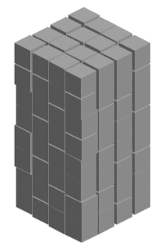

Representing Signed Integers
Option 2: excess-K
  Choose a positive K in the middle of the unsigned range
  $Signed\left(x\right)=\sum_{i=0}^{w−1}{x_{i}⋅2^{i} }−2^{w−1}$
128 (2⁷) | 64 (2⁶) | 32 (2⁵) | 16 (2⁴) | 8 (2³) | 4 (2²) | 2 (2¹) | 1 (2⁰) | -128
0 | 0 | 0 | 0 | 0 | 1 | 0 | 1
1 | 0 | 0 | 0 | 0 | 1 | 0 | 1
1 | 1 | 1 | 1 | 1 | 1 | 1 | 1
Notes:
issue: zero no longer zero -> multiplication is weird

Slide 6

Representing Signed Integers
Option 3: two’s complement
  Like unsigned, except the high-order contribution is negative
  $Signed\left(x\right)=−x_{w−1}⋅2^{w−1}+\sum_{i=0}^{w−2}{x_{i}⋅2^{i}}$
-128 (-2⁷) | 64 (2⁶) | 32 (2⁵) | 16 (2⁴) | 8 (2³) | 4 (2²) | 2 (2¹) | 1 (2⁰)
0 | 0 | 0 | 0 | 0 | 1 | 0 | 1
1 | 0 | 0 | 0 | 0 | 1 | 0 | 1
1 | 1 | 1 | 1 | 1 | 1 | 1 | 1

Slide 7
Important Signed Integers
 | 8 | 16 | 32 | 64
TMax | 0x7F | 0x7FFF | 0x7FFFFFFF | 0x7FFFFFFFFFFFFFFF
TMin | 0x80 | 0x8000 | 0x80000000 | 0x8000000000000000
0 | 0x00 | 0x0000 | 0x00000000 | 0x0000000000000000
-1 | 0xFF | 0xFFFF | 0xFFFFFFFF | 0xFFFFFFFFFFFFFFFF

Slide 8
Two’s Complement Signed Integers
“Signed” does not mean “negative”
High order bit is the sign bit
  To negate, complement all the bits and add 1
Arithmetic is the same as unsigned—same circuitry
(Error conditions and comparisons are different)
Notes:
-1 is all 1’s
Sign extension

Slide 9
Example: Three-bit integers
Base-10 | unsigned | signed
7 | 111
6 | 110
5 | 101
4 | 100
3 | 011 | 011
2 | 010 | 010
1 | 001 | 001
0 | 000 | 000
-1 |  | 111
-2 |  | 110
-3 |  | 101
-4 |  | 100
For signed ints:
  high-order bit is 0 for pos values, 1 for neg
  000…0 is 0
  111…1 is -1
  same representation as unsigned for numbers that can be represented with both
  ~x+1 == -1*x

Slide 10
Exercise 1: (Signed) Binary Numbers
Consider the following one-byte binary values. What is the (signed) integer interpretation of these values?
  01101001
  10010111
  01000010
  10111110
What is the one-byte binary representation of the following integers?
  47
  -47
105
-105
66
-66
00101111
11010001
-x == -x+1-1 == -1-x+1 == 111…1-x+1 = ~x+1

Slide 11
Integers in C
C Data Type | Size (bytes)
unsigned char | 1
unsigned short | 2
unsigned int | 4
unsigned long | 8
C Data Type | Size (bytes)
char | 1
short | 2
int | 4
long | 8
Notes:
Note: unsigned demo

Slide 12
Casting between Numeric Types
Casting from shorter to longer types preserves the value
Casting from longer to shorter types drops the high-order bits
Casting between signed/unsigned types preserves the bits (it just changes the interpretation)
Implicit casting occurs in assignments and parameter lists. In mixed expressions, signed values are implicitly cast to unsigned
    Source of many errors!
Notes:
Note: casting part of signed demo

Slide 13
Exercise 2: Casting
Assume you have a machine with 6-bit integers/3-bit shorts
Assume variables: int x = -17; short sy = -3;
Complete the following table
Expression | Decimal | Binary
x | -17
sy | -3
(unsigned int) x
(int) sy
(short) x

Slide 14
When to Use Unsigned
Rarely
When doing multi-precision arithmetic, or when you need an extra bit of range … but be careful!
int example(){
int a[5] = {1,2,3,4,5};
for (unsigned int i = len-2; i >= 0; i--){
a[i] += a[i+1];
}
return a[i]
}

Slide 15
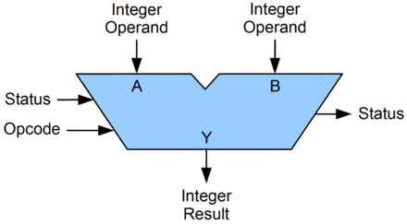
Arithmetic Logic Unit (ALU)
circuit that performs bitwise operations and arithmetic on integer binary types

Slide 16
Bitwise vs Logical Operations in C
Bitwise Operators &, |, ~, ^
  View arguments as bit vectors
  operations applied bit-wise in parallel
Logical Operators &&, ||, !
  View 0 as “False”
  View anything nonzero as “True”
  Always return 0 or 1
  Early termination
Shift operators <<, >>
  Left shift fills with zeros
  For signed integers, right shift is arithmetic (fills with high-order bit)

Slide 17
Exercise 3: Bitwise vs Logical Operations
What is the binary representation of each of the following expressions? Assume signed char data type (one byte).
  ~(-30)
  -30 & 22
  -30 && 22
  22 << 1
  22 >> 1
  -30 >> 1
= ~(11100010) = 00011101 = 29
= 11100010 & 00010110 = 00000010 = 2
= 11100010 && 00010110 = 00000001 = 1
= 00010110 << 1 = 00101100 = 44
= 00010110 >> 1 = 00001011 = 11
= 11100010 >> 1 = 11110001 = -15

Slide 18
Addition Example
Compute 5 + -3 assuming all ints are stored as four-bit signed values
1
1
0 1 0 1
+ 1 1 0 1
0
0
1
0
= 2 (Base-10)
Exactly the same as unsigned numbers!
… but with different error cases

Slide 19
Addition/Subtraction with Overflow
Compute 5 + 6 assuming all ints are stored as four-bit signed values
1
0 1 0 1
+ 0 1 1 0
1
0
1
1
= -5 (Base-10)

Slide 20



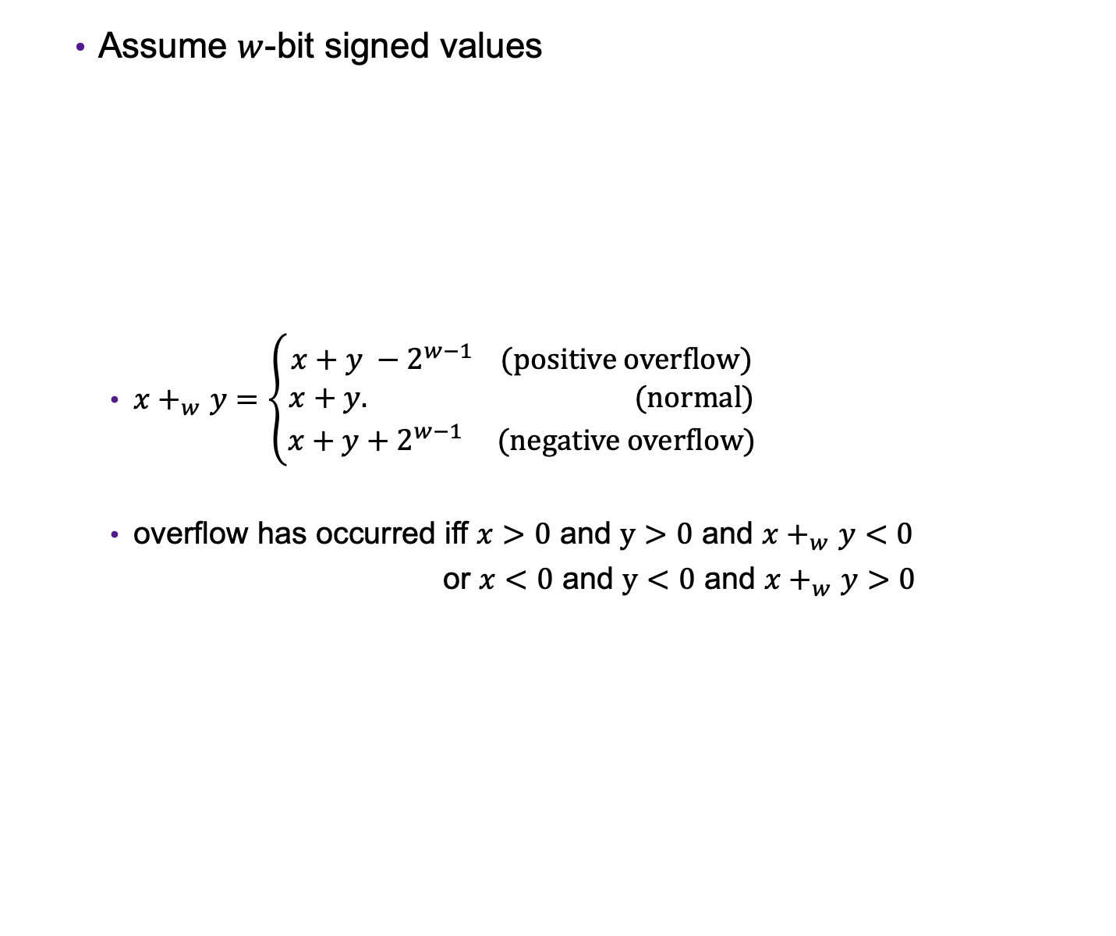



Error Cases
Assume $w$-bit signed values
  $x+_{w}^{}y=\left\{\begin{aligned}x+y −2^{w−1} (positive overflow) \\ x+y. (normal) \\ x+y+2^{w−1} (negative overflow)\end{aligned}\right.$
  overflow has occurred iff $x>0$ and $y>0$ and $x+_{w}^{}y<0$
  or $x<0$ and $y<0$ and $x+_{w}^{}y>0$
$${−2⋅2}^{w−1}$$
$${−2}^{w−1}$$
$$0$$
$$2^{w−1}−1$$
$${2⋅(2}^{w−1}−1)$$
[ ]
representable values
[ ]
Possible values of $x+y$

Slide 21
Exercise 4: Binary Addition
Given the following 5-bit signed values, compute their sum and indicate whether or not an overflow occurred
x | y | x+y | overflow?
00010 | 00101
01100 | 00100
10100 | 10001
x+y | overflow?
00101
no
10000
yes
00101
yes

Slide 22
Multiplication Example
Compute 3 x 2 assuming all ints are stored as four-bit signed values
0 0 1 1
x 0 0 1 0
0 0 0 0
0 0 1 1 0
+ _
0 1 1 0
= 6 (Base-10)
Exactly like unsigned multiplication!
… except with different error cases

Slide 23
Multiplication Example
Compute 5 x 2 assuming all ints are stored as four-bit signed values
0 1 0 1
x 0 0 1 0
0 0 0 0
0 1 0 1 0
+ _
1 0 1 0
= -6 (Base-10)

Slide 24






Error Cases
Assume $w$-bit unsigned values
$x∗_{w}^{t}y=U2T(\left(x⋅y\right) mod 2^{w})$
$${−2}^{2(w−1)}$$
$${−2}^{w−1}$$
$$0$$
$$2^{w−1}−1$$
$${ 2}^{2(w−1)}$$
[ ]
representable values
[ )
Possible values of $x∗y$

Slide 25
Exercise 5: Binary Multiplication
Given the following 3-bit signed values, compute their product and indicate whether or not an overflow occurred
x | y | x*y | overflow?
100 | 101
010 | 011
111 | 010
x*y | overflow?
100
yes
110
yes
110
no

